Slide 1
Public health council
February 9, 2022
Please standby – the meeting will begin shortly
Today’s presentation is available on the mass.gov/dph website under “Upcoming Events” by clicking on the January 12th Public Health Council listing

Slide 2
PUBLIC HEALTH COUNCIL meeting
FEBRUARY 9, 2022
Margret R. Cooke, Commissioner

Slide 3
DPH Personnel Updates
Dr. Estevan Garcia, Chief Medical Officer
Jennifer Barrelle, Deputy Commissioner
Yves Singletary, Senior Advisor to the Commissioner

Slide 4
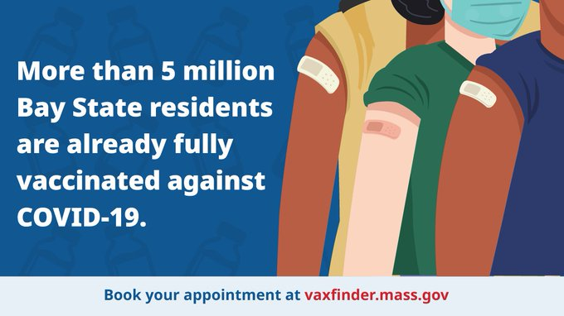
COVID-19 Updates

Slide 5
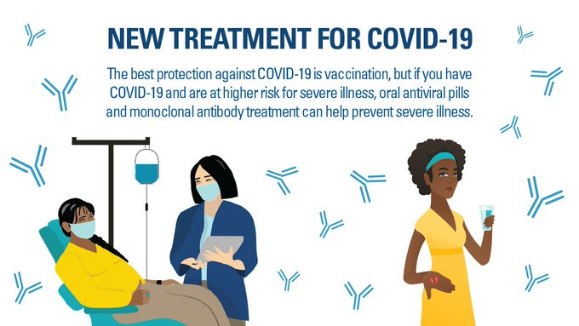
New Therapeutics
www.mass.gov/covidtreatments

Slide 6
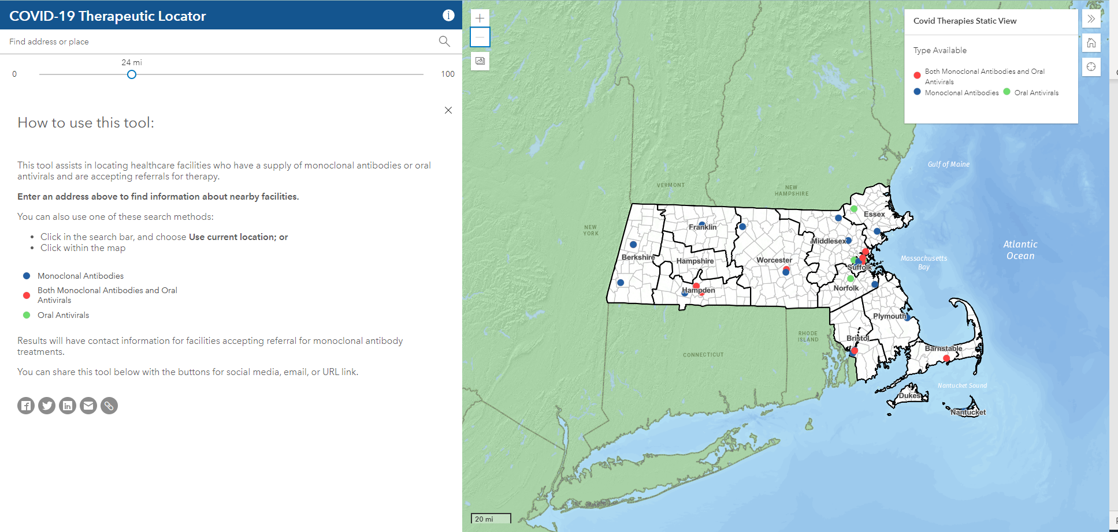
New Therapeutics
www.mass.gov/covidtreatments

Slide 7
PUBLIC HEALTH COUNCIL meeting
FEBRUARY 9, 2022
Margret R. Cooke, Commissioner

Slide 8
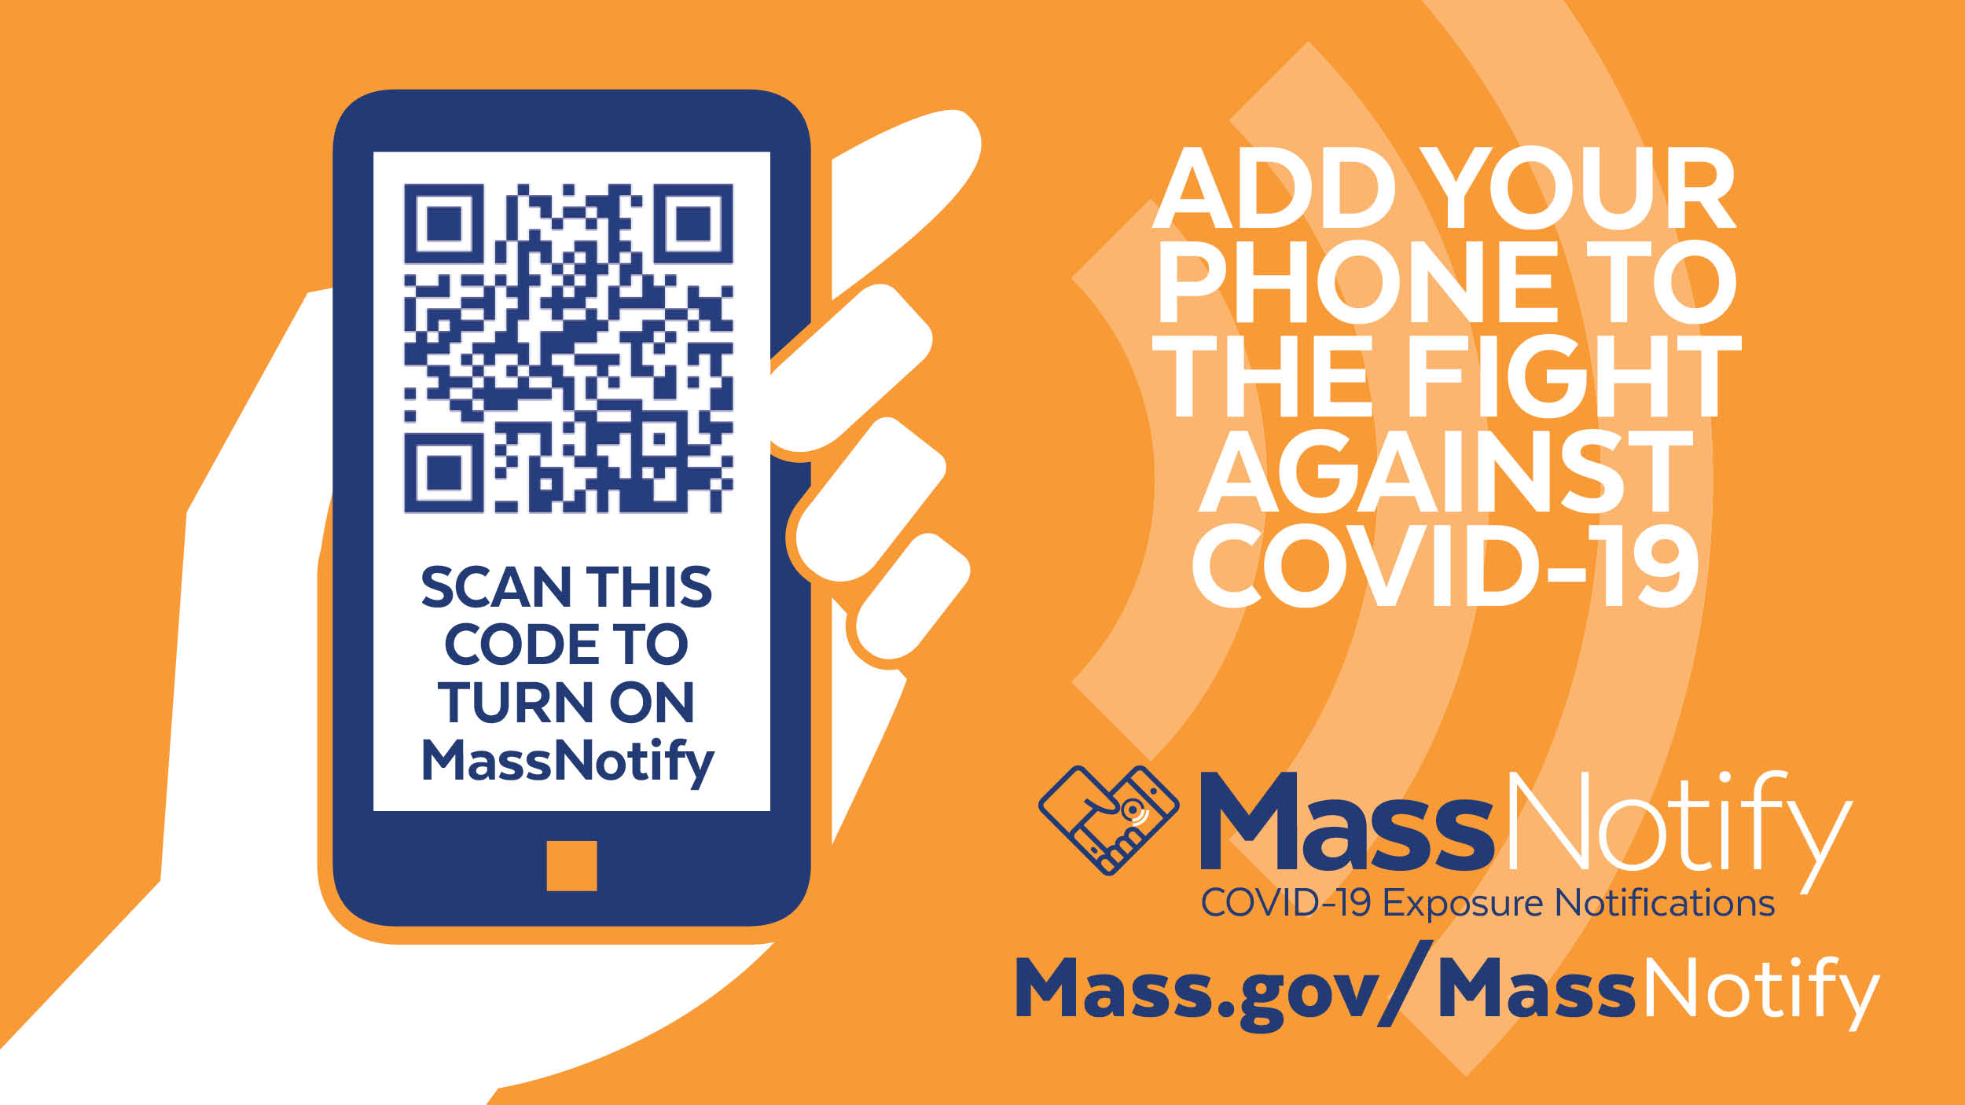
New Tools

Slide 9
A Public Health Thank You

Slide 10
Connect with DPH
@MassDPH
Massachusetts Department of Public Health
www.mass.gov/dph

Slide 11
PUBLIC HEALTH COUNCIL meeting
FEBRUARY 9, 2022
Margret R. Cooke, Commissioner

Slide 12
Determination of Need:
Request by Wellman Healthcare Group, Inc. for a substantial capital expenditure

Slide 13
Determination of Need:
Request by PAM Cubed, LLC for a transfer of ownership

Slide 14
COVID-19
Community Impact Survey(CCIS)
Preliminary Analysis Results as of
February 8, 2022 Presented by Allison Guarino MPH, Co-authors: Elizabeth Beatriz, PhD, Justine Egan, MPH, Beatriz Pazos Vautin, MPH
Massachusetts Department of Public Health

Slide 15
CCIS TEAM MEMBERS
CCIS Project Leads
W.W. Sanouri Ursprung, Lauren Cardoso, Beth Beatriz, Glory Song, Caroline Stack, Kathleen Fitzsimmons, Emily Sparer-Fine, Ta-wei Lin, Lisa Potratz, Heather Nelson, Amy Flynn, Lisa Arsenault, Abby Atkins
CCIS Steering Committee
Lauren Cardoso, W.W. Sanouri Ursprung, Beth Beatriz, Abbie Averbach, Ruth Blodgett, Ben Wood, Sabrina Selk,
Jessica del Rosario Nicole Daley, Lisa Potratz
CCIS Analytic Team, Data to Action Team, Data Dissemination Team, Communications Team
Allison Guarino, Andrea Mooney, Angela Laramie, Ann Marie Matteucci, Anna Agan, Arielle Coq, Barry Callis,
Beatriz Pazos Vautin, Ben Wood, Brittany Brown, Chelsea Orefice, Dana Bernson, David Hu, Dawn Fukuda,
Ekta Saksena, Elise Pechter, Emily White, Fareesa Hasan, Frank Gyan, Glennon Beresin, Hanna Shephard,
Hannah Walters, Hermik Babkhanlou-Chase, James Laing, Jena Pennock, Jennica Allen, Jennifer Halstrom,
Justine Egan, Kathleen Grattan, Kim Etingoff, Kirby Lecy, Lamar Polk, Lauren Fogarty, Lauren Larochelle,
Mahsa Yazdy, Marianne Mabida, Matthew Tumpney, Megan Hatch, Megan Young, Melody Kingsley, Michelle Reid, Miriam Scrivener, Nassira Nicola, Nicole Daniels, Nicole Roos, Rebecca Berger, Rebecca Han, Robert Leibowitz, Susan Manning, Thomas Brigham, Timothy St. Laurent, Vera Mouradian, Victoria Nielsen, Ziming Xuan,
Elizabeth Showalter, Priyokti Rana, Mayowa Sanusi, Emily Lawson, Alana LeBrón

Slide 16
CCIS COMMUNITY PARTNERS
Many groups that were critical in the success of this effort and gave important input on the development and deployment of the survey:
Academic Public Health Volunteer Corps and their work with local boards of health and on social media
Mass in Motion programs, including Springfield, Malden, and Chelsea
Cambodian Mutual Assistance
The Mashpee Wampanoag Tribe
The Immigrants’ Assistance Center, Inc
Families for Justice as Healing
City of Lawrence Mayor’s Health Task Force
The 84 Coalitions, including the Lawrence/Methuen Coalition
Boys and Girls Clubs, including those in Fitchburg and Leominster and the Metro South area
Chinatown Neighborhood Association
Father Bill’s
UTEC
MassCOSH
Stavros Center for Independent Living
Greater Springfield Senior Services
Center for Living and Working
DEAF, Inc.
Massachusetts Commission for the Deaf and Hard of Hearing
Viability, Inc.

Slide 17
OVERVIEW
Purpose and Approach of the Covid-19 Community Impact Survey (CCIS)
Preliminary Findings
Youth Safety and Healthcare Access
Appendix

Slide 18
RESULTS TOPICS TO DATE
SOCIAL DETERMINANTS OF HEALTH
MITIGATING INDIVIDUAL RISK OF INFECTION
ACCESS TO
TESTING​
ACCESS TO HEALTHCARE​
MENTAL HEALTH
EMPLOYMENT
SUBSTANCE USE
DISCRIMINATION: & RACE SPOTLIGHTS
PARENTS & FAMILIES
YOUTH SPOTLIGHT
SOGI POPULATION SPOTLIGHTS
INTIMATE PARTNER VIOLENCE
HOUSING STABILITY
RURAL COMMUNITIES SPOTLIGHT
PERSONS WITH DISABILITIES SPOTLIGHT
CAREGIVERS SPOTLIGHT
NEW: YOUTH SAFETY & HEALTHCARE ACCESS
DISCRIMINATION: & RACE SPOTLIGHTS

Slide 19
FRAMING MATTERS
During the pandemic, many youth experienced multiple changes at once: youth were taken out of school and adapted to schooling online; young people were isolated from their friends, peers, and trusted adults outside of their families; youth access to healthcare declined; and young people took on surrogate parenting roles to support their families. Many youth also experienced discrimination during the pandemic and endured heightened racial trauma associated with the protests that took place in the summer of 2020.
While major decisions around the COVID-19 pandemic have been made by adults, the pandemic and other current events have significantly affected youth health, especially mental health. Youth voice should be taken into consideration by decision-makers.

Slide 20
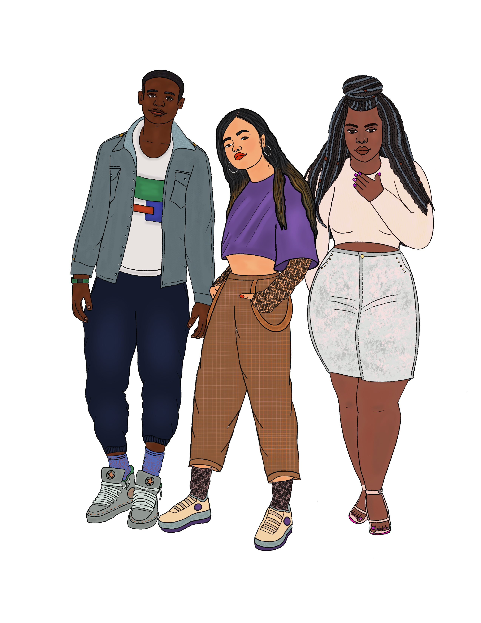
YOUTH CCIS RESPONDENTS PROFILE
The CCIS worked intentionally to reach diverse youth populations by partnering with community-based organizations serving youth in MA, as well as communities most impacted by COVID-19
3,052 youth ages 14-24 took the survey
32% speak a language other than English at home
46% under 18 years old
54% 18 and over
21% youth with disabilities
39% working youth
Artwork by Farah Jeune

Slide 21
YOUTH SAFETY

Slide 22
YOUTH & SAFETY DURING COVID-19
While 65% of youth feel very safe in their neighborhoods in terms of crime or violence, certain groups of youth are less likely to report feeling safe.
Youth with cognitive disabilities are 20% less likely to feel very safe in their neighborhoods compared to youth without cognitive disabilities
Youth in urban communities are 27% less likely to feel very safe in their neighborhoods compared to youth in rural communities
LGBTQ+ youth are between 13-21% less likely to feel very safe in their neighborhoods compared to straight youth
Youth of color are between 17-32% less likely to report feeling safe compared to White NH/NL youth
NOTE: The number of respondents = 2,376. Effective sample size = 2,316.

Slide 23
YOUTH EXPERIENCE WITH VIOLENCE DURING COVID-19
Household violence: You or someone you live with was hurt or threatened by someone in your household during the first 6-8 months after the COVID-19 pandemic began in March 2020
Intimate partner violence (IPV): Someone you were dating or married to controlled or coerced you through monitoring your phone, stopping you from doing things you wanted to do, other coercion, or physically hurt you during the first 6-8 months of the pandemic
Any violence: includes IPV and/or household violence during the first 6-8 months of the pandemic
Data notes: 1) All percentages are weighted to the statewide age and race/ethnicity distribution of those 14-24 years; 6) The number of respondents = 1,998. Effective sample size = 1,997.

Slide 24
YOUTH EXPERIENCE WITH HOUSEHOLD VIOLENCE DURING COVID-19
Youth with disabilities, transgender youth, and gay/lesbian youth were between 2-3 times as likely to experience household violence during COVID-19 compared to youth overall.
Young parents were 3 times as likely to experience IPV compared to youth who were not parents. Youth with disabilities, Black NH/NL youth, and bi/pansexual youth were 2 times as likely to experience IPV during COVID-19 compared to other youth.
Overall, 3% of youth reported household violence during the pandemic.
Youth who were more likely to report household violence included:
Youth with cognitive disabilities
Transgender youth
Gay/lesbian youth
Bi/pansexual youth
Overall, 5% of youth reported IPV during the pandemic.
Youth who were more likely to report IPV included:
Young parents
Youth with disabilities
Black NH/NL youth
Bi/pansexual youth
Data notes: 1)”Non-binary” includes respondents identifying as non-binary, genderqueer, not exclusively male or female; 2)“nH/nL”=non-Hispanic/non-Latinx; 3)“American Indian/Alaskan Native” includes Hispanic/Latinx; 4)* denotes rate is significantly different (p<0.05) compared to the reference group; 5) All percentages are weighted to the statewide age and race/ethnicity distribution of those 14-24 years; 6) The number of respondents = 2,364. Effective sample size = 2,308 for the data on the left. The number of respondents = 1,998. Effective sample size = 1,997 for the data on the right.

Slide 25
YOUTH MENTAL HEALTH AND VIOLENCE
Youth experiencing violence were 3 times as likely to report persistent poor mental health and 1.6 times as likely to report 3 or more PTSD reactions during the pandemic compared to youth who did not experience violence.
Persistent poor mental health is defined as reporting feeling so sad or hopeless for two weeks or more in a row during the past 12 months that you stopped doing some usual activities.
PTSD reactions include:
Having nightmares or thinking about COVID-19 when you did not want to
Trying not to think about it or going out of your way to avoid situations that reminded you of it
Being constantly on guard, watchful, or easily startled
Feeling numb or detached from people, activities, or your surroundings
Feeling guilty or unable to stop blaming yourself or others for it or any problems it may have caused
Data notes: 1) All percentages are weighted to the statewide age and race/ethnicity distribution of those 14-24 years; 2) Differences in mental health were statistically significant (p<0.05). 3) The number of respondents = 1,896. Effective sample size = 1,898.

Slide 26
YOUTH ACCESS TO HEALTH CARE

Slide 27
IMPACT ON YOUTH ACCESS TO CARE
In many ways, youth were able to get access to health care during the pandemic
46% of all youth were able to see a provider in- person during COVID-19
36% of all youth were able to see a provider by phone or video during COVID-19
NOTE: The number of respondents reporting about access to health care = 2914. Effective sample size = 2889.

Slide 28
IMPACT ON YOUTH ACCESS TO CARE
However, youth had concerns about getting medical care during COVID-19
57% of youth who were unable to get care during COVID-19 were seeking routine check ups
Almost 1/3 of youth who were unable to get health care (29%) were worried about getting COVID if they sought out medical care
16% of youth had other responsibilities, like taking are of siblings, that prevented them from seeking medical care during the pandemic
NOTE: The number of respondents reporting unable to get health care = 298. Effective sample size = 322.

Slide 29
IMPACT ON YOUTH ACCESS TO CARE
Youth had concerns about getting sexual and reproductive health care during COVID-19
23% of youth who could not see a provider during the pandemic wanted to see a sexual and reproductive health provider
This is almost 2x as high for queer youth- 41% of queer youth could not see a sexual and reproductive health provider but wanted to during the pandemic
NOTE: The number of respondents reporting unable to get health care = 298. Effective sample size = 322.

Slide 30
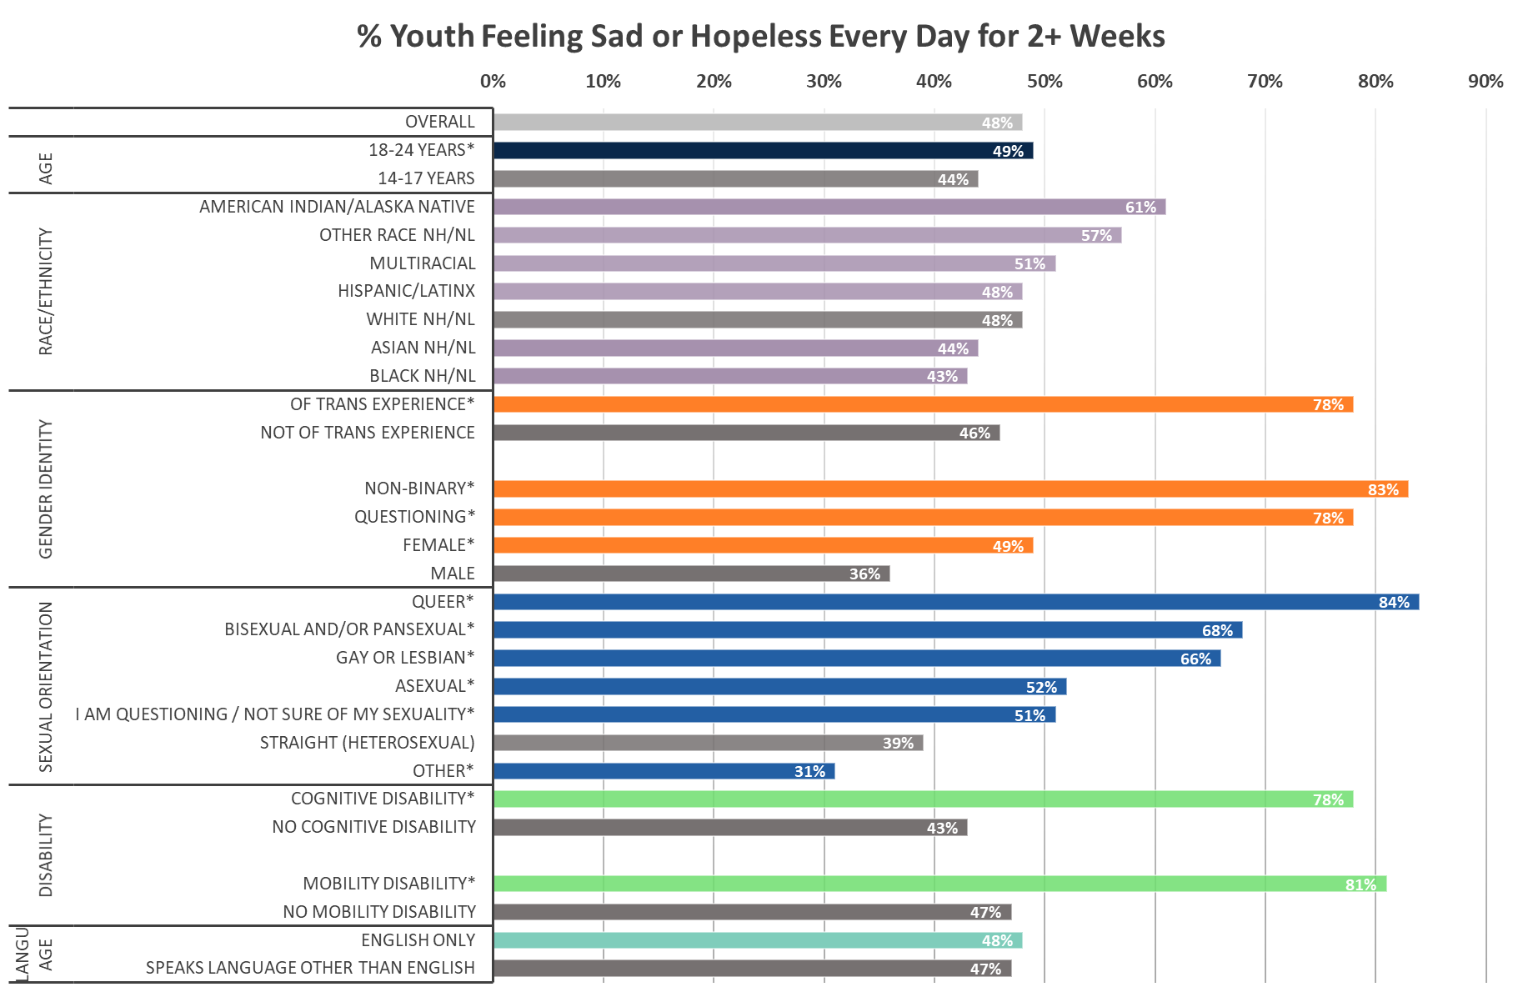
IMPACT ON YOUTH MENTAL HEALTH
As seen before, youth mental health was greatly impacted during COVID-19
LGBTQ+ youth and youth with disabilities are experiencing the greatest inequities when it comes to persistent mental health concerns during the pandemic
NOTE: * denotes statistically significant findings (p<0.05). The number of respondents responding to questions related to their mental health= 2483. Effective sample size = 2428.

Slide 31
IMPACT ON YOUTH ACCESS TO CARE
Youth had concerns about getting mental health care during COVID-19
48% of all youth reported poor mental health during the pandemic
37% of youth who were unable to get health care, wanted to see a doctor or counselor to get help dealing with stress, depression, nervousness, or anxiety, including:
67%* of youth of transgender experience
54% of non-binary youth
42% of Black nH/nL youth
41% of Hispanic/Latinx youth
NOTE: * denotes statistically significant findings (p<0.05). The number of respondents responding to questions related to their mental health= 2483. Effective sample size = 2428. The number of respondents reporting unable to get health care = 298. Effective sample size = 322.

Slide 32
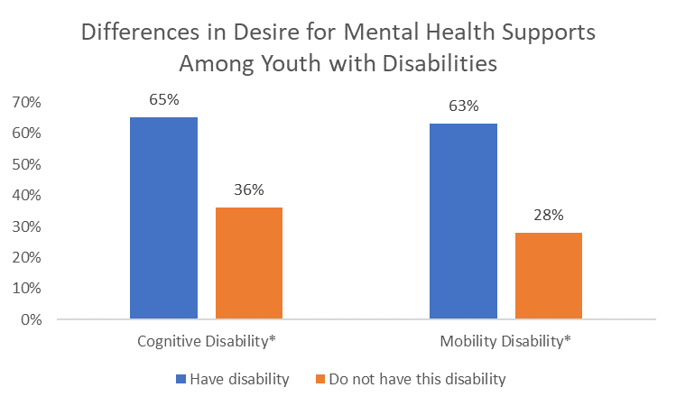
IMPACT ON YOUTH ACCESS TO CARE
Youth with disabilities had concerns about getting mental health care during COVID-19
Youth with cognitive disabilities were 1.8x as likely to want to have accessed mental health care during the pandemic and not been able to get it, compared to youth without cognitive disabilities
Youth with mobility disabilities were 2.3x as likely to want to have accessed mental health care during the pandemic and not been able to get it, compared to youth without mobility disabilities
NOTE: : * denotes statistically significant findings (p<0.05). The number of respondents reporting unable to get health care = 298. Effective sample size = 322.

Slide 33
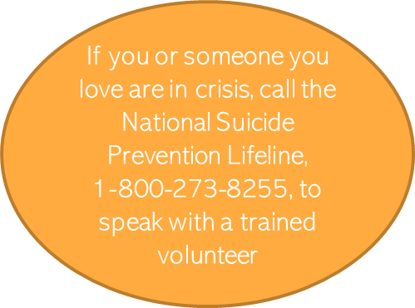
IMPACT ON YOUTH ACCESS TO CARE
Youth had concerns about getting mental health care during COVID-19
Among youth who wanted mental health resources but could not access them during COVID-19, 19%* of them reported wanting suicide and crisis resources.
While we would expect some youth who want access to mental health support would be in crisis, this highlights the critical need of increased mental health care for young people.
NOTE: Percentages statistically significant (p<0.05). The number of respondents reporting wanting mental health resources and unable to get them = 108. Effective sample size = 115.

Slide 34
PROTECTIVE FACTORS FOR YOUTH

Slide 35
YOUTH RELATIONSHIPS DURING COVID-19
Most youth report they have someone outside of their home they could contact about a problem. Having a trusted adult to talk to is a protective factor for youth.
65% of youth said there was an adult they could talk to outside of their home during COVID-19
75% of MA youth reported having an adult or teacher at school they can talk to about a problem prior to the pandemic (MA YRBS, 2017)
Data notes: 1) All percentages are weighted to the statewide age and race/ethnicity distribution of those 14-24 years; 2) Differences in mental health were statistically significant (p<0.05). 3) The number of respondents = 2,419. Effective sample size = 2,353.

Slide 36
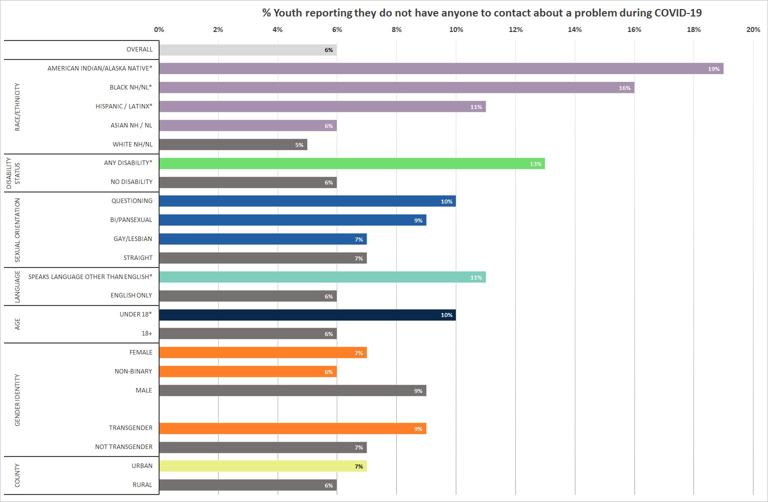
YOUTH RELATIONSHIPS DURING COVID-19
American Indian/Alaska Native youth, Black youth, and Hispanic/Latinx youth are 3 times as likely as White youth and youth with disabilities are 2 times as likely as youth without disabilities to report not having a person to talk to outside of their home.
Overall, 6% of youth reported that they did not have someone outside of their home to talk to about a problem during the pandemic.
Youth who were less likely to have a trusted person outside of their home were:
Youth of color
Youth with disabilities
Youth who speak a language other than English
Youth under the age of 18
Data notes: 1)”Non-binary” includes respondents identifying as non-binary, genderqueer, not exclusively male or female; 2)“nH/nL”=non-Hispanic/non-Latinx; 3)“American Indian/Alaskan Native” includes Hispanic/Latinx; 4)* denotes rate is significantly different (p<0.05) compared to the reference group; 5) All percentages are weighted to the statewide age and race/ethnicity distribution of those 14-24 years; 6) The number of respondents = 1,896. Effective sample size = 1,898.

Slide 37
YOUTH MENTAL HEALTH & RELATIONSHIPS
Youth who do not have someone to contact outside of their home about a problem are more likely to report persistent poor mental health and concern about emotional support.
Persistent poor mental health is defined as reporting feeling so sad or hopeless for two weeks or more in a row during the past 12 months that you stopped doing some usual activities.
PTSD reactions include:
Having nightmares or thinking about COVID-19 when you did not want to
Trying not to think about it or going out of your way to avoid situations that reminded you of it
Being constantly on guard, watchful, or easily startled
Feeling numb or detached from people, activities, or your surroundings
Feeling guilty or unable to stop blaming yourself or others for it or any problems it may have caused
Data notes: 1) All percentages are weighted to the statewide age and race/ethnicity distribution of those 14-24 years; 2) Differences in mental health were statistically significant (p<0.05). 3) The number of respondents = 1,896. Effective sample size = 1,898.

Slide 38
KEY TAKEAWAYS: YOUTH
Youth of color were more likely than White NH/NL youth to experience safety concerns, such as discrimination during the pandemic and not feeling safe from violence in their neighborhoods.
Youth with disabilities and LGBTQ+ youth were more likely than other groups of youth to report experiencing any type of violence, including household and intimate partner violence
While many youth were able to access health care, many groups of youth were unable to get access to care, particularly those who wanted mental health care and support (37% of youth)
Youth mental health is impacted by these health and safety concerns – youth experiencing violence were more likely to report persistent poor mental health
Increasing access to health care and healthy relationships outside the home could mitigate some mental health concerns
Having someone to talk to about a problem outside of the home was associated with less reported persistent poor mental health, but the groups that reported not having someone to talk to were also the groups that experienced more discrimination, violence, and difficulty accessing healthcare

Slide 39
KEY TAKEAWAYS: YOUTH
These findings underscore the need for continued commitment to youth-serving programs that are trauma-informed, reduce barriers for youth, promote protective factors and center youth who are facing multiple challenges, such as LGBTQ youth, youth of color and youth with mental health challenges.
Examples of these programs and initiatives at MDPH include:
They also underscore the importance of a spectrum of approaches to meet the complex needs of youth (e.g. promoting access to the National Suicide Prevention Hotline,1-800-273-8255, while also preventing violence against youth and promoting youth strengths and supports).
Safe Spaces for LGBTQ Youth
School-based health center program
Suicide prevention program
Sexual and reproductive health program
Interagency School-based Telebehavioral Health program
Healthy relationships grant
Adolescent Sexuality Education(ASE) program
Office of Youth and Young Adult Services
Massachusetts Pregnant and Parenting Teen Initiative

Slide 40
APPENDIX

Slide 41
YOUTH SAMPLE
 | Population | Sample Size
Sexual Orientation | Asexual | 71
Race/Ethnicity | Bisexual and/or Pansexual | 445
 | Gay or Lesbian | 175
 | Straight (Heterosexual) | 2023
 | Queer | 81
 | Questioning | 137
 | Other; Don’t understand; prefer not answer | 101
Transgender | Of transgender experience | 103
 | Not of transgender exp. | 2816
 | Population | Sample Size
Disability | Deaf/hard of hearing | 24
Race/Ethnicity | Blind/ vision impairment | 44
 | Cognitive disability | 414
 | Mobility disability | 40
 | Self-care/independent living disability | 133
Working/ employed youth | Yes | 1190
 | No | 1318
Young parents | Yes | 148
 | No | 2904
 | Population | Sample Size
 | Total | 3052
Race/ Ethnicity | American Indian/Alaska Native | 63
 | Asian, nH/nL | 278
 | Black, nH/nL | 221
 | Hispanic/Latinx | 675
 | Multiracial, nH/nL | 104
 | Other, nH/nL | 44
 | White, nH/nL | 1608
Age | <18 | 1400
 | 18+ | 1652
Geography | Rural | 203
 | Urban | 2785
Gender Identity | Male only | 789
 | Female only | 2059
 | Non-binary | 128
 | Questioning | 31
 | Other | 36
Note: May not sum to total due to missing data for some questions.
Includes respondents under the age of 25 (both from youth survey and young parents who took the adult survey)
Language | English only | 2056
 | Speaks lang other than Eng. | 991

Slide 42
Next Meeting:
March 9, 2022

