Slide 1
DPH COVID-19 Health Equity Advisory Group: Recommendations, Data Release & DPH Response
Public Health Council Meeting
07/08/20

Slide 2
Table of Contents
Description of the Health Equity Advisory Group
Health Equity Advisory Group Recommendations and DPH Next Step Examples
COVID-19 Health Equity Data Highlight
Appendices
DPH Health Equity Framework
Full Health Equity Advisory Group Recommendations
Full COVID-19 Health Equity Data (updated July 1st)
COVID-19 Community Impact Survey Details

Slide 3
COVID-19 HEALTH EQUITY ADVISORY GROUP

Slide 4
DPH COVID-19 Health Equity Advisory Group
The Commissioner convened the Health Equity Advisory Group to advise DPH on the needs of communities and populations disproportionately impacted by the COVID-19 pandemic.
The 26 Health Equity Advisory Group members represent a cross-sector of community leaders and health and racial equity experts.
The group met twice weekly throughout the month of May. The group organized its effort into four subcommittees chosen by the members to create a set of recommendations.
Group members provided reading materials and feedback in between meetings as well.

Slide 5
DPH COVID-19 Health Equity Advisory Group
Members selected four areas to address:
    Data and Metrics
    COVID-19 Mitigation
    Community Engagement and Support
    Social Determinants of Health
Each subcommittee was led by volunteer co-chairs who were members of the advisory group. Logistical support and note-taking was provided by DPH staff.
In total the group met 8 times, 5 times as a full group and 3 times in the subgroups.

Slide 6
DPH COVID-19 Health Equity Advisory Group
The primary function of the advisory group was to generate a series of recommendations for the Commissioner of the Massachusetts Department of Public Health on how the COVID-19 pandemic response could be informed by a health equity lens to ensure equitable access to resources and services, and prevent inequities and disproportionate negative outcomes.

Slide 7
Members of DPH COVID-19 Health Equity Advisory Group
Monica Bharel, MD, MPH, Commissioner, Massachusetts Department of Public Health (CHAIR)
Dolores Acevedo-Garcia, Ph.D., Director, Institute for Child, Youth and Family Policy, Heller School for Social Policy and Management, Brandeis University
Madeline Aviles-Hernandez, Psy.D., Director of Outpatient and Recovery Services, Gandara Center
Mary Bassett, MD, MPH, Director, FXB Center for Health and Human Rights, Harvard University; FXB Professor of the Practice of Health and Human Rights, Harvard School of Public Health
Bithiah Carter, President and CEO, New England Blacks in Philanthropy
Elisa Choi, MD, FACP, FIDSA, Governor, American College of Physicians, Massachusetts Chapter
Yvette Cozier, DSc, Assistant Dean for Diversity and Inclusion, BUSPH
Michael Curry, Deputy CEO and General Council, Mass League of Community Health Centers
Denise De Las Nueces, MD, MPH, Medical Director, Boston Health Care for the Homeless Program’s Barbara McInnis House
Deb Enos, Independent Consultant, Governor’s Black Advisory Commission Chair
Isabel Gonzalez-Webster, Director, Worcester Interfaith
Raquel Halsey, Executive Director, North American Indian Center of Boston
Rev. Dr. Conley Hughes, Sr. Pastor, Concord Baptist Church of Boston
Helena DaSilva Hughes, Executive Director, Immigrants Assistance Center

Slide 8
Members of DPH COVID-19 Health Equity Advisory Group, continued
Claude A. Jacob, Chief Public Health Officer, Cambridge Public Health Department
Thea James, MD, Vice President of Mission and Associate Chief Medical Officer, Emergency Medicine, Boston Medical Center
Collin Killick, Executive Director, Disability Policy Consortium
Jennifer Kimball, Principal Planner, Berkshire Public Health Alliance / Berkshire Planning Commission
Alden Landry, MD, MPH, Emergency Medicine, physician, BIDMC; Director of Health Equity Education, Harvard Medical School
Jennifer Lee, Chair, Massachusetts Statewide Independent Living Council
Juan Lopera, Vice President of Business Diversity, Tufts Health Plan
Eva Millona, Executive Director, MIRA
Vanessa Otero, Director, Urban Education Initiative, Smith College
Claire Pierre, MD, Chief Medical Officer, Harbor Health Services, Inc, Internal Medicine Physician, Board Certified in Clinical Informatics
Maria Belen Power, Associate Executive Director, GreenRoots, Inc. (Chelsea)
Tanisha Sullivan, Esq., President, NAACP Boston Branch​
Simone Wildes, MD, Infectious Disease, South Shore Health; Chair, Committee on Diversity in Medicine and Vice-Chair, Committee on Public Health, Mass Medical Society

Slide 9
COVID-19 HEALTH EQUITY ADVISORY GROUP Recommendations

Slide 10
Principles Underlying Recommendations
As part of the development of these recommendations, the Health Equity Advisory Group Social Determinants of Health Subcommittee developed the following principles:
Acknowledging the fundamental role of racism, xenophobia and lack of economic opportunity as causes of inequitable outcomes;
acknowledging the role of root causes even if addressing a more immediate and urgent need; at a minimum, ensuring that immediate mitigations are implemented in a way that does not perpetuate inequities and does more than provide a service that alone does not work to change the condition leading to the inequity;
identifying actions that can have measurable impact and/or where we can demonstrate what success looks like;
these actions are intended to challenge existing systems that are not working.

Slide 11
How Social Determinants Interact
Education
Economic Mobility
Health
Healthy Food Access
Stable Housing

Slide 12
Social Determinants of Health Subcommittee
 | Recommendations
Housing Stability | Implement policies that increases housing stability
Economic Mobility | Develop pathways to financial freedom to prevent further disparities and that support economic mobility

Slide 13
SDOH Recommendation: Economic Mobility Example
Recommendation: Develop pathways to financial freedom to prevent further disparities and that support economic mobility
Root Cause Identified: Economic opportunity
Population(s) Impacted: Communities of color as primary focus
Details:
COVID-19 has shined a spotlight on systems that disadvantage communities of color and limit ability to participate fully in the economy. Implementation of a comprehensive economic package that includes but is not limited to relief for small businesses owned by persons of color will strive to change the wealth gap and support economic mobility.

Slide 14
SDOH Recommendation: DPH Potential Action
Economic Mobility | While recognizing that this recommendation extends beyond DPH, DPH will engage in conversations to address the connection between public health and inequitable economic practices and systems.

Slide 15
Community Engagement & Support Subcommittee
 | Recommendations
Multilingual Messaging | Prioritize investment in multilingual outreach to communities most critically impacted by COVID-19 regarding testing, protection at home and workplace, and how to access state assistance programs and resources available
Engaging the Community | Plan and implement strategy for the active engagement and representation of existing anchor organizations in the communities in decision-making processes related to COVID-19 response and recovery Develop pathways for foreign-trained medical professionals to practice
Partnership | Develop and expand public and private partnerships with community health centers, local governments, other state agencies, quasi-state agencies (e.g. MBTA) and philanthropic organizations

Slide 16
Community Engagement and Support Recommendation: Multilingual Messaging Example
Recommendation: Prioritize investment in multilingual outreach to communities most critically impacted by COVID-19 regarding testing, protection at home and workplace, and how to access state assistance programs and resources available
Root Cause Identified: Systemic inequities; lack of accessible + culturally tailored information
Population(s) Impacted:
“Priority communities” defined as: race, class, and language, those that have historically received the least resources, racially and ethnically, low income, ability, immigration status, insurance status, history of incarceration
Details:
Make informational materials on accessing COVID-19 testing and care, Pandemic Unemployment Assistance, and the eviction moratorium available in at minimum the following languages Portuguese, Chinese, Haitian Creole

Slide 17
Community Engagement & Support: DPH Potential Action
Multilingual Messaging | Increase materials & web platforms available in multiple languages and simplified English; Deliver messages through trusted members of the respective community

Slide 18
COVID-19 Mitigation Subcommittee
 | Recommendations
Access to PPE | Ensure equitable distribution of personal protective equipment (PPE) to essential workers, residents in professions most at-risk, and communities with high rates of infection
Housing Stability | Understand housing instability in response to needs raised by COVID-19
Culturally Appropriate Workforce | Create strategic guidance to intentionally recruit diverse, culturally intelligent workforce, including for contact tracing, tracking cases, and other workforce needs
Access to Care | Work to ensure all populations have equitable access to culturally appropriate and needed therapies, vaccines, trials, and other necessary medical care Develop pathways for foreign-trained medical professionals to practice
System Coordination | Create coordinated effort across healthcare providers and other relevant stakeholders to streamline efforts regarding mitigation and surge
Community Safety | Monitor enforcement of COVID-19 guidance to avoid over-policing in disenfranchised communities and increasing inequities

Slide 19
COVID-19 Mitigation: Community Safety Example
Recommendation: Monitor enforcement of guidance to avoid over-policing in disenfranchised communities and increasing inequities
Root Cause Identified: Systemic racial and other inequities
Population(s) Impacted:
People of Color (race/ethnicity)
Sexual orientation and gender identity
People who have a disability
People who primarily speak languages other than English and those with varying levels of literacy
Details:
Establish and communicate state guidelines regarding equitable enforcement.
Monitor communities using city and zip-code level data; consider how guidance is being enforced.

Slide 20
COVID-19 Mitigation: DPH Potential Action
Community Safety | Explore training regarding implementation of public health guidance for required face masks where social distancing is not possible and intersection with law enforcement

Slide 21
Data and Metrics Subcommittee
 | Recommendations
Public Health COVID-19 Indicators | Report indicators disaggregated across vulnerable and marginalized populations to ensure resource distribution is equitable and culturally/ linguistically appropriate
‘Safer at Home’ advisory | Track ability to work from home across vulnerable and marginalized populations to ensure resources ($, PPE, testing, etc.) are geared towards these populations
Caring for Children | Track childcare providers re-opening by diverse ownership to ensure equal opportunity for minority-owned businesses and increased support to meet safety protocols Track access to childcare across vulnerable and marginalized populations to ensure equitable childcare access for workers required to return
Transit | Track ridership in “hot spot” transit areas to ensure vulnerable and marginalized communities are not subject to increased exposure due to crowded transit
Reopening Massachusetts Plan Details: https://www.mass.gov/info-details/reopening-massachusetts

Slide 22
Data and Metrics: Public Health COVID-19 Indicators Example
Recommendation: Track and report on the 6 COVID19 indicators disaggregated across vulnerable populations to ensure equitable and culturally/linguistically appropriate resource distribution
Root Cause Identified: Segregation and disinvestment in marginalized communities, inequities in access to resources among marginalized populations
Population(s) Impacted: Communities of color, immigrants, people with disabilities
Details:
Demographic and geographic data at a granular level (vulnerable populations and hot spots/gateway city data by zip code), disability status, institutional settings (prisons, group homes)
      E.g. include data for Native/indigenous populations on reports

Slide 23
Data and Metrics: DPH Potential Actions
Public Health COVID-19 Indicators | Improve data collection Disaggregate existing data Conduct COVID-19 Community Impact Survey: applicable across all recommendations for data/metrics

Slide 24
COVID-19 Health Equity Data Highlights: Updated July 1, 2020
Population denominators for rate calculations provided by UMass Donahue Inst. based on Strate S, et al. Small Area Population Estimates for 2011 through 2020, published March 2020 (original report published Oct 2016)
24

Slide 25
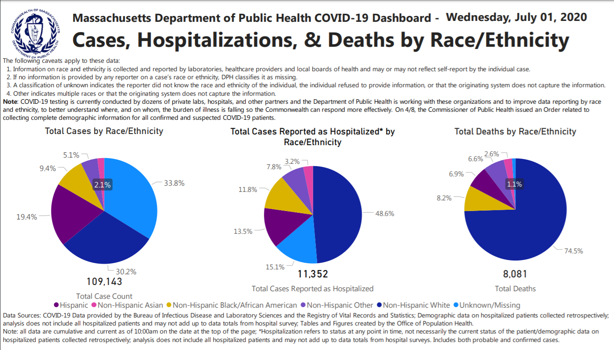
https://www.mass.gov/info-details/covid-19-response-reporting#covid-19-daily-dashboard-

Slide 26
Following the Executive Order on April 8th, race/ethnicity data reporting has improved for cases, deaths, and hospitalizations

Slide 27
The Rate of Positive Cases is Highest for Black and Hispanic Residents
Black non-Hispanics represent 7.2% of the MA population but double that proportion of cases at 14.2% of cases
Hispanics represent 12.2% of the MA population but more than twice that proportion of cases at 29.3% of cases
The highest rates of positive cases are among Black non-Hispanics and Hispanics which are more than 3x higher than the rate for White non-Hispanics
Data as of 07/01/2020
Population denominators for rate calculations provided by UMass Donahue Inst. based on Strate S, et al. Small Area Population Estimates for 2011 through 2020, published March 2020 (original report published Oct 2016)

Slide 28
Cities with the Highest Rates of COVID-19 are Primarily Communities of Color
The ten communities with the highest rates of COVID-19 are shown below. The overall rate in MA of COVID-19 Cases is 1,490.8 per 100,000 people as of 06/30/2020. Almost all of these communities have high (>50%) percentage of residents who are people of color (shaded blue)
MA State Average Rate
Town | Chelsea | Brockton | Lawrence | Everett | Lynn | Revere | Randolph | Worcester | Danvers | Lowell
Case Count | 2994 | 4225 | 3553 | 1765 | 3635 | 1782 | 950 | 5227 | 737 | 2895
Percent of Residents who are People of Color | 80% | 68% | 87% | 61% | 66% | 52% | 75% | 51% | 7.6% | 55%
Population denominators for rate calculations provided by UMass Donahue Inst. based on Strate S, et al. Small Area Population Estimates for 2011 through 2020, published March 2020 (original report published Oct 2016)
State and Town-level COVID-19 data from 06/30

Slide 29
The Rate of Hospitalizations is Highest for Black and Hispanic Residents
White non-Hispanics represent 71.5% of the population but only 57.2% of the hospitalizations, whereas the percentages of Black Non-Hispanic and Hispanics who are hospitalized are greater than their proportions in the population.
The rate of hospitalizations for Black non-Hispanics and Hispanics is 2.4x and 1.6x higher (respectively) than for White non-Hispanics.
Data as of 07/01/2020
Population denominators for rate calculations provided by UMass Donahue Inst. based on Strate S, et al. Small Area Population Estimates for 2011 through 2020, published March 2020 (original report published Oct 2016)

Slide 30
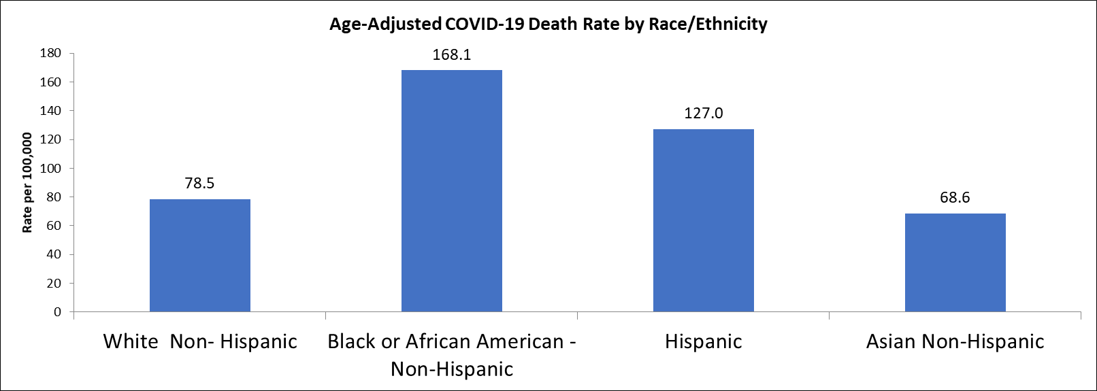
Age-Adjusted Death Rates by Race/Ethnicity Reveal Inequities
The age-adjusted death rate is highest for Black residents, at 168.1 deaths/100,000
Age-adjusted death rates are recommended for comparisons among race groups given differences in the underlying age distribution of the MA population by race, and differences in COVID-19 death trends by age
Data as of 06/30/2020
Population denominators for rate calculations provided by UMass Donahue Inst. based on Strate S, et al. Small Area Population Estimates for 2011 through 2020, published March 2020 (original report published Oct 2016)
Rates are per 100,000 population. Age-adjusted to the 2000 US standard population. See weights used at: https://www.cdc.gov/nchs/data/statnt/statnt20.pdf
Count and Rate (per 100,000) of Reported Deaths among COVID-19 Confirmed and Probable Cases by Race and Ethnicity and Age Group in MA (N= 8054). Data are current as of 6/30/2020 and are subject to change.

Slide 31
Thank You!
Questions?

Slide 32
appendices
32

Slide 33
a. DPH health equity framework
33

Slide 34
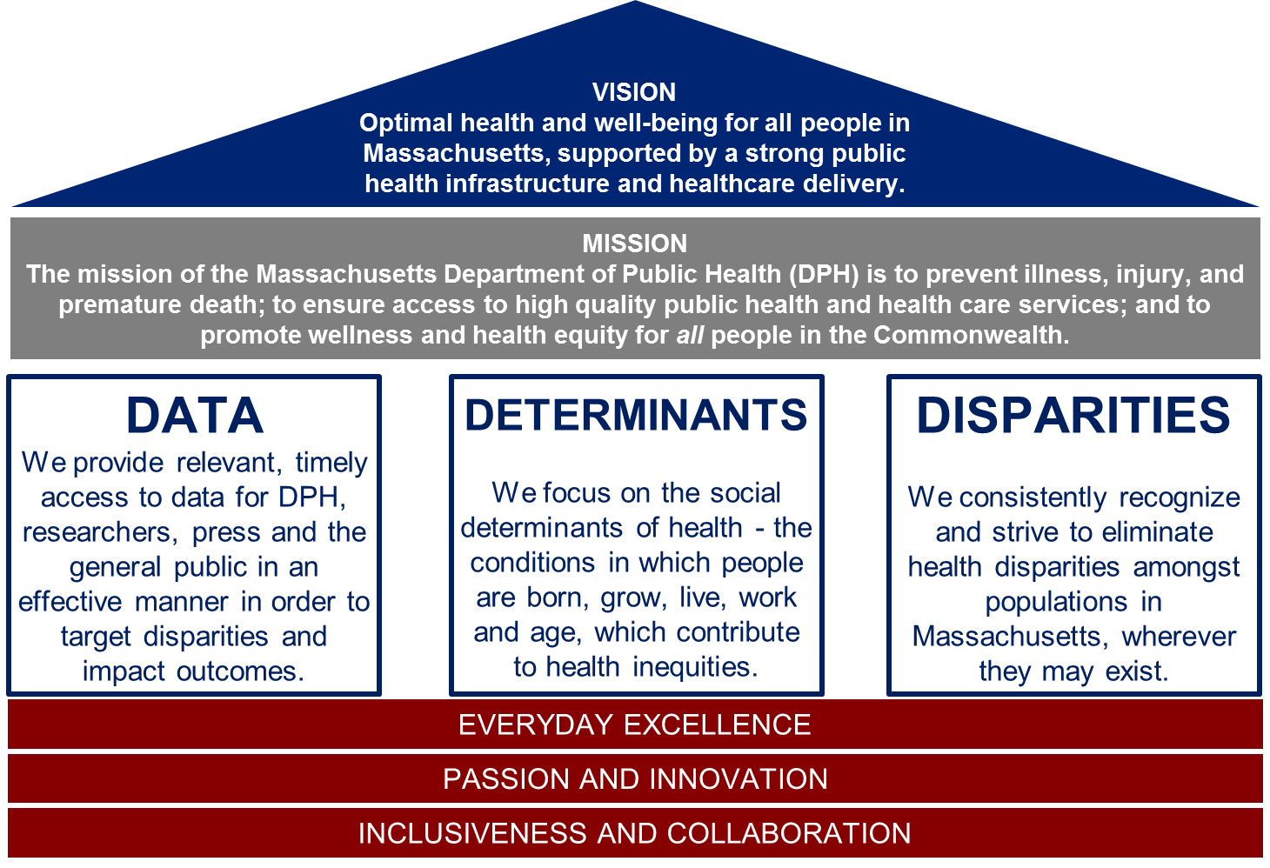

Slide 35
Office of Health Equity
Mission:
Leverage public and private partnerships to collect, use and disseminate high quality data and documentation and inform and influence policies, programs, practices, prevention strategies and resource allocation that address inequities in the social determinants of health. The Office of Health Equity was established at DPH in the 1980s and was expanded in 2018 through an Interagency Services Agreement from the Executive Office of Health & Human Services.
DPH Office of Population Health
Office of Data Management and Outcomes Assessment
Office of Health Equity
Special Analytic Projects
Registry of Vital Records and Statistics

Slide 36
A working framework for DPH’s equity activities
Strategic Vision
DPH “House” and Mission as principles guiding the road to eliminating health inequities
Culture
Racial Equity trainings, Diversity Council, Racial Equity Initiatives in Bureaus (e.g. Racial Equity Leadership Team)
Data Infrastructure
Public Health Data Warehouse, Population Health Information Tool, Refining and Defining Population Data Standards
Capacity Building
Data Day, Epi Conference, Equity Labs and Reframes, DPH policies & practices (e.g. procurement and hiring)

Slide 37
Definition of Terms
What is health equality?
Everyone is given the same health intervention without consideration of underlying needs.
What are health disparities?
Disparities are significant differences in health outcomes between populations.
What are health inequities?
Inequities are the unjust distribution of resources and power between populations which manifests in disparities.
What is health equity?
Everyone has what they need to attain their highest level of health.

Slide 38
What Makes Us Healthy?
SOURCE: ADAPTED FROM R TARLOV, A. (1999). PUBLIC POLICY FRAMEWORKS FOR IMPROVING POPULATION HEALTH. ANNALS OF THE NEW YORK ACADEMY OF SCIENCES. 896. 281-93.

Slide 39
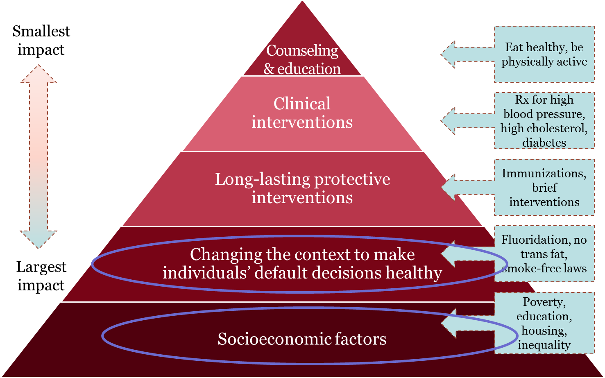
CDC Health Impact Pyramid

Slide 40
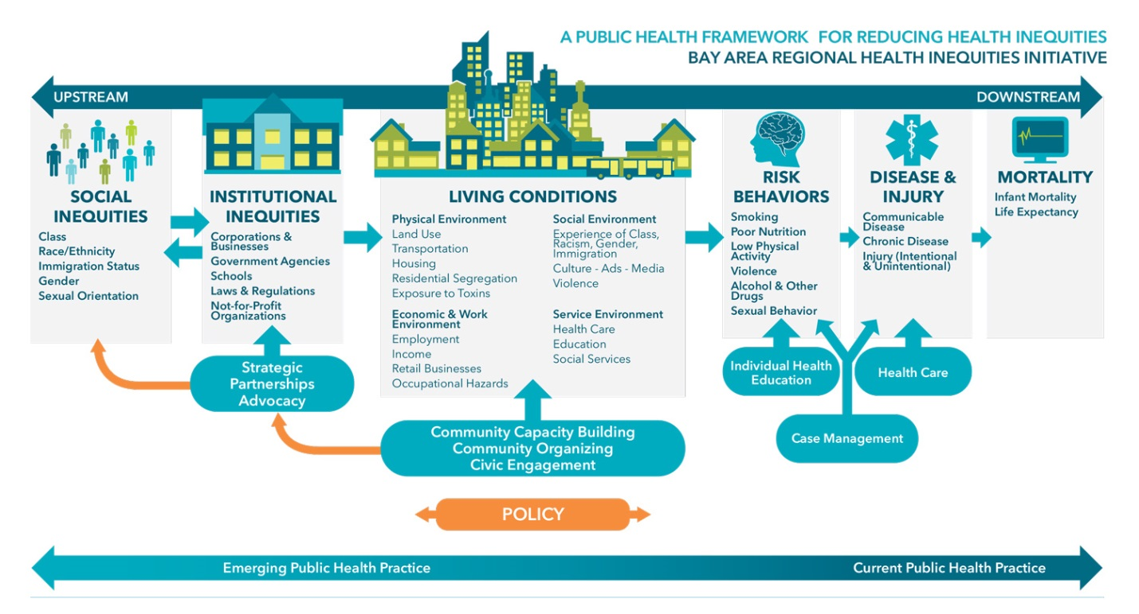
Poor conditions prevent people from practicing healthy behaviors and achieving good health.

Slide 41
B. Full COVID-19 Health Equity Advisory Group Recommendations

Slide 42
Principles Underlying Recommendations
As part of the development of these recommendations, the Health Equity Advisory Group Social Determinants of Health Subcommittee developed the following principles:
Acknowledging the fundamental role of racism, xenophobia and lack of economic opportunity as causes of inequitable outcomes;
acknowledging the role of root causes even if addressing a more immediate and urgent need; at a minimum, ensuring that immediate mitigations are implemented in a way that does not perpetuate inequities and does more than provide a service that alone does not work to change the condition leading to the inequity;
identifying actions that can have measurable impact and/or where we can demonstrate what success looks like;
these actions are intended to challenge existing systems that are not working.

Slide 43
Model of How Social Determinants Interact
Education
Economic Mobility
Health
Healthy Food Access
Stable Housing

Slide 44
Social Determinants of Health Subcommittee
 | Recommendations
Housing Stability | Implement policies that increases housing stability
Economic Mobility | Develop pathways to financial freedom to prevent further disparities and that support economic mobility

Slide 45
SDOH Recommendation 1: Implement policies that increases housing stability
Details: Moratorium on evictions and foreclosures to include a financial relief package help pay rents and mortgages
Root Cause Identified: Redlining, lending practices and segregation have limited communities of color ability to own homes
Population(s) Impacted: Communities of color as primary focus

Slide 46
SDOH Recommendation 2: Develop pathways to financial freedom to prevent further disparities and that support economic mobility
Details: COVID-19 has shined a spotlight on systems that disadvantage communities of color and limit ability to participate fully in the economy. Implementation of a comprehensive economic package that includes but is not limited to relief for small businesses owned by persons of color will strive to change the wealth gap and support economic mobility.
Root Cause Identified: Lack of economic opportunity
Population(s) Impacted: Communities of color as primary focus

Slide 47
Social Determinants of Health
 | DPH Potential Actions
Housing Stability | Describe and disseminate model of housing as a social determinant of health and the prevention of homelessness and housing instability as critical for addressing health equity Improve housing data in public health data systems
Economic Mobility | Engage in conversations to address the connection between public health and inequitable economic practices and systems Work with community groups to encourage hiring of diverse individuals. Outreach to young adults and other groups where appropriate and set up potential career pathways (e.g. in healthcare, nonprofits)

Slide 48
Community Engagement & Support Subcommittee
 | Recommendations
Multilingual Messaging | Prioritize investment in multilingual outreach to communities most critically impacted by COVID-19 regarding testing, protection at home and workplace, and how to access state assistance programs and resources available
Engaging the Community | Plan and implement strategy for the active engagement and representation of existing anchor organizations in the communities in decision-making processes related to COVID-19 response and recovery Develop pathways for foreign-trained medical professionals to practice
Partnership | Develop and expand public and private partnerships with community health centers, local governments, other state agencies, quasi-state agencies (e.g. MBTA) and philanthropic organizations

Slide 49
Community Engagement Recommendation 1: Prioritize investment in multilingual outreach to communities most critically impacted by COVID-19 regarding testing, protection at home and workplace, and how to access state assistance programs and resources available
Details:
Deliver explicit message at the highest level – ensuring people that they should feel safe getting services and health care (especially immigrants, domestic violence victims)
Provide more information and instruction about how to isolate in closer quarters such as an apartments, where a lot of individuals in are living together
Make informational materials on accessing COVID-19 testing and care, Pandemic Unemployment Assistance, and the eviction moratorium available in at minimum the following languages Portuguese, Chinese, Haitian Creole
Create portal for unemployment benefits in the at minimum the following languages, Portuguese, Chinese, Haitian Creole
Create portal for SNAP benefits in the at minimum the following languages, Portuguese, Chinese, Haitian Creole
Create portal for RAFT (application for housing) benefits in the at minimum the following languages, Portuguese, Chinese, Haitian Creole

Slide 50
Community Engagement Recommendation 1 (cont.): Prioritize investment in multilingual outreach to communities most critically impacted by COVID-19 regarding testing, protection at home and workplace, and how to access state assistance programs and resources available,
Details, continued:
Create portal for MassHealth benefits in the at minimum the following languages, Portuguese, Chinese, Haitian Creole
Recruit members of priority communities to be health outreach workers, to support with the development and dissemination of culturally informed resources
Employ foreign-trained medical professionals to deploy statewide campaigns (ex: educational videos that can be shared on social media platforms)
Root Cause Identified: Systemic inequities; lack of accessible + culturally tailored information
Population(s) Impacted: “Priority communities” defined as: race, class, and language, those that have historically received the least resources, racially and ethnically, low income, ability, immigration status, insurance status, history of incarceration

Slide 51
Community Engagement Recommendation 2: Plan and implement strategy for the active engagement and representation of existing anchor organizations in the communities in decision-making processes related to COVID-19 response and recovery
Details:
Invest in the capacity of existing partner organizations
Allow enough time to engage stakeholders
Put those with lived experience at the center of this process
Root Cause Identified: Systemic inequities; lack of accessible + culturally tailored information
Population(s) Impacted: “Priority communities” defined as: race, class, and language, those that have historically received the least resources, racially and ethnically, low income, ability, immigration status, insurance status, history of incarceration

Slide 52
Community Engagement Recommendation 2: Develop pathways for foreign-trained medical professionals to practice
Details:
Conduct an inventory of the number of foreign trained medical professionals unable to practice in MA
Assess current licensing requirements and models (ex. CHW) to develop plan to increase Foreign-trained medical professionals ability to practice
Root Cause Identified: Systemic inequities; lack of accessible + culturally tailored information
Population(s) Impacted: “Priority communities” defined as: race, class, and language, those that have historically received the least resources, racially and ethnically, low income, ability, immigration status, insurance status, history of incarceration

Slide 53
Community Engagement & Support
 | DPH Potential Actions
Messaging | Increase materials & web platforms available in multiple languages and simplified English Deliver messages through trusted members of the respective community
Engaging the Community | Develop and disseminate department-wide community engagement guidance Invest in the capacity of existing partner organizations Allow enough time to engage stakeholders Put those with lived experience at the center of this process
Partnership | Work with partners to create local community mitigation teams (e.g., clergy, business owners, community-based organizations, youth leaders) to develop strategies for effective community engagement, education, and distribution of PPE Encourage all municipalities to develop these teams Provide guidance on the best ways to empower the teams

Slide 54
COVID-19 Mitigation Subcommittee
 | Recommendations
Access to PPE | Ensure equitable distribution of personal protective equipment (PPE) to essential workers, residents in professions most at-risk, and communities with high rates of infection
Housing Stability | Understand housing instability in response to needs raised by COVID-19
Culturally Appropriate Workforce | Create strategic guidance to intentionally recruit diverse, culturally intelligent workforce, including for contact tracing, tracking cases, and other workforce needs
Access to Care | Work to ensure all populations have equitable access to culturally appropriate and needed therapies, vaccines, trials, and other necessary medical care Develop pathways for foreign-trained medical professionals to practice
System Coordination | Create coordinated effort across healthcare providers and other relevant stakeholders to streamline efforts regarding mitigation and surge
Community Safety | Monitor enforcement of COVID-19 guidance to avoid over-policing in disenfranchised communities and increasing inequities

Slide 55
Mitigation Recommendation 1: Ensure equitable distribution of personal protective equipment (PPE) to essential workers, residents in professions most at-risk, and communities with high rates of infection
Details: Increase distribution of PPE (medical grade surgical masks) Create and communicate standards and regulatory guidance for equitable access to quality PPE, including its use and reuse Tasks: Identify existing guidance on PPE and testing (beyond federal guidance) and consider universal protocol that could be used across the state and is appropriate for all ages Create local community mitigation teams (e.g., clergy, business owners, community-based organizations, youth leaders, etc.) aimed at developing strategies for effective community engagement, education, and distribution of PPE. Encourage all municipalities (cities and towns) to develop these teams. Provide guidance on the best ways to empower the teams. Making sure essential workers, who are not in healthcare, also have access to PPE Consider public-private partnerships, including philanthropy and MBTA Work with efforts already happening at community level

Slide 56
Mitigation Recommendation 1 (cont.): Ensure equitable distribution of personal protective equipment to essential workers, residents in professions most at-risk, and communities with high rates of infection
Tasks, continued: Develop domestic supply chains for 3 to 6 to 12 months out (swabs, gowns, masks, face shields, etc.), and identify the target number needed to meet broader access targets. Consider how to intentionally engage communities re: guidance on PPE and testing Use mobile units that provide access to care and relevant materials, focusing on hot spots Utilize community health centers for mass distribution of masks, especially to vulnerable populations Pursue federal reimbursement in Stimulus #4 for mitigation activities taken by states in response to COVID-19 that includes acquisition of PPE. Audit the state’s response over the past three months generally to determine strengths and weaknesses of the response, but particularly look at where unequal access to PPE may have exacerbated the spread in certain communities. Allow the findings to inform the strategy going forward.

Slide 57
Mitigation Recommendation 1 (cont.): Ensure equitable distribution of personal protective equipment to essential workers, residents in professions most at-risk, and communities with high rates of infection
Tasks, continued: Identify a school reopening strategy (possibly September 2020) that includes PPE needs with prioritization for communities with higher rates of chronic illnesses that make their families more at-risk from COVID-19 Root Cause Identified: Systemic racial and other inequities in housing, economic status, employment, reliance on public transportation, as well as barriers to accessing health care and protective measures. Population(s) Impacted: Healthcare workers (includes care attendants and CHWs) and essential workers; Individuals who live or work in congregate settings, homeless shelters, people with disabilities, communities of color, immigrant communities with intentional focus on the undocumented, Department of Corrections and County Jails (those who live and work in corrections facilities) with monitoring

Slide 58
Mitigation Recommendation 2: Understand housing instability in response to needs raised by COVID-19 and implement policies that increase housing stability
Details:
Moratorium on evictions and foreclosures to include a financial relief package help pay rents and mortgages
Establish a broader effort to create temporary housing using college dormitories and hotels for those in isolation or those who feel unsafe to return home and
Assist individuals in finding or staying in safe, affordable housing.
Tasks:
Secure interim housing options for those needing to isolate, with a focus on available college dormitories and hotel rooms/suites
  Develop implementation and management plan in collaboration with colleges and hotels (monitor and manage inventory of available housing)
  Provide family care support during time of temporary isolation (child and elder care, explore option of utilizing low risk family and friends)
  Incorporate, to the extent feasible, cultural considerations in location and core elements of temporary housing (e.g. food choices)

Slide 59
Mitigation Recommendation 2 (cont.): Understand housing instability in response to needs raised by COVID-19 and implement policies that increase housing stability
Tasks, continued:
Expand the state’s three mobile housing subsidies: MRVP, AHVP, and the DMH Rental Subsidy. This will help ensure experiencing economic disruption can find safe, affordable places to live.
Ensure emergency housing options are available to all regardless of immigration status
Root Cause Identified: Redlining, lending practices and segregation have limited communities of color ability to own homes
Population(s) Impacted: Communities of color as primary focus; Essential workers with positive COVID-19 test results (health care and other essential workers); Essential workers in dense living arrangements with concerns of family exposure; Other individuals (non-essential workers) who are members of priority populations; Immigrant communities with intentional focus on the undocumented; People who are homeless; Those who have been decarcerated

Slide 60
Mitigation Recommendation 3: Create strategic guidance to intentionally recruit diverse, culturally intelligent workforce, including for contact tracing, tracking cases, and other workforce needs
Details: Work with community groups to hire diverse individuals and outreach to young adults and set up potential career pathway Recruit culturally competent and aware workers (CHW model), reflecting the community Pursue federal reimbursement in Stimulus #4 and advocate for tracing funds Advocate to ensure COVID-19-related workforce reflects the communities being served and demonstrate ongoing commitment to build core of community workers Root Cause Identified: Systemic racial and other inequities in economic status and employment Population(s) Impacted: People of Color (race/ethnicity), sexual orientation and gender identity, people with disabilities, people with limited English proficiency and those with low literacy, immigrant communities with focus on undocumented, low-income, young adults

Slide 61
Mitigation Recommendation 4: Work to ensure all populations have equitable access to needed therapies, vaccines, trials, and other necessary medical care
Details: Create guidance regarding equitable distribution of necessary medical care Update the crisis standards of care as they relate to the allocation of resources Partner with community health centers and local government to disseminate materials Tasks: Establish and communicate state guidelines to individual providers (either when licenses are renewed or voluntary) regarding equitable distribution of needed therapies, vaccines, trials, antibody testing, and other necessary medical care. Build equity into resource planning to ensure adequate supply and prioritize identified populations Collect data from providers on equitable distribution of resources to target populations Allocate resources based on immediate lives saved- do not allocate resources based on presumed quality of life Update the crisis standards of care as they relate to the allocation of resources, including treatments and vaccinations, and remove the consideration of 5-year survival.

Slide 62
Mitigation Recommendation 4 (cont.): Work to ensure all populations have equitable access to needed therapies, vaccines, trials, and other necessary medical care
Tasks, continued: Partner with community health centers and local government to disseminate materials, while partnering with other providers (who need to prioritize access to priority populations) such as labs, pharmaceutical industry, independent living facilities, the recovery community, and the disability community in distribution efforts Educate that everyone deserves equal access to treatments to all stakeholders Include diverse stakeholders at every conversation point around access and allocation Increase available resources to avoid scarcity Root Cause Identified: Resources allocated in inequitable manner; discrimination/racism in healthcare and history of trauma/distrust related to unethical testing practices. Population(s) Impacted: People of Color (race/ethnicity), sexual orientation and gender identity, people with disabilities, people with limited English proficiency and those with low literacy, immigrant communities with focus on undocumented, low-income, individuals who are incarcerated

Slide 63
Mitigation Recommendation 5: Create coordinated effort across healthcare providers and other relevant stakeholders to streamline efforts regarding mitigation and surge
Details: Increase COVID-19 mitigation and surge inclusion and collaboration across all relevant providers – such as hospitals, health centers, congregate arrangements, social services, and others – through partnership, regulations, and guidance, alongside ongoing engagement of representatives of marginalized communities Tasks: Ensure that representatives of marginalized communities are fully represented in any and all efforts to allocate scarce medical resources during the pandemic. Expand outreach to representatives of marginalized communities, and incorporate them into existing bodies (e.g. Crisis Standards of Care committee, Reopening Advisory Boards) rather than creating separate subsidiary groups for them. Ensure all relevant providers are regularly inspected for compliance with infection control procedures. Impose tightened regulations on non-compliant facilities and relocate COVID-negative residents of non-compliant facilities to safe community settings when possible. Develop and publish classification system to identify settings of highest concern

Slide 64
Mitigation Recommendation 5 (cont.): Create coordinated effort across healthcare providers and other relevant stakeholders to streamline efforts regarding mitigation and surge
Tasks, continued: Ensure that all congregate settings, including nursing homes, group homes, adult foster care, and mental health facilities, are treated as healthcare providers for purpose of communication and PPE priority. Establish standing congregate settings stakeholder group that can partner with the state to set policy and share information. Establish tighter oversight of transfers between community settings and hospitals. Ensure no COVID-positive individuals are discharged into community settings unless there are clear and adequate plans to provide on-site treatment and isolate them completely from COVID-negative residents. Look for patterns of admission/discharge between community settings and hospitals and formalize communication relationships.

Slide 65
Mitigation Recommendation 5 (cont.): Create coordinated effort across healthcare providers and other relevant stakeholders to streamline efforts regarding mitigation and surge
Details, continued: For patients enrolled in MassHealth Managed Care plans, ensure that care coordinators are involved in all emergency care decision-making regarding that patient. Engage managed care plans and providers in holistic planning for needs of COVID patients with underlying conditions. Root Cause Identified: Existing siloes Population(s) Impacted: People of Color (race/ethnicity); Sexual orientation and gender identity; Individuals who have a disability, especially ID/DD, respiratory disorders, autoimmune disorders, deaf people, people with mental health diagnoses, people who use durable medical equipment; People who primarily speak languages other than English and those with varying levels of literacy

Slide 66
Mitigation Recommendation 6: Monitor enforcement of guidance to avoid over-policing in disenfranchised communities and increasing inequities
Details: Establish and communicate state guidelines regarding equitable enforcement to ensure that communities of color aren’t disproportionately targeted for enforcement activities. Monitor communities using city and zip-code level data; consider how guidance is being enforced. Root Cause Identified: Systemic racial and other inequities Population(s) Impacted: People of Color (race/ethnicity); Sexual orientation and gender identity; People who have a disability; People who primarily speak languages other than English and those with varying levels of literacy

Slide 67
 | COVID-19 Mitigation: DPH Potential Actions
Access to PPE | Support implementation of MA COVID-19 testing plan Engage with Occupational Health to provide guidance to employees and employers on safe work spaces
Housing Stability | Bring public health perspective to administration efforts to build state supports for low-income people (e.g. increasing MVRP subsidies) and mobilizing for increased access
Culturally Appropriate Workforce | Provide best practices to CTC regarding additional hires and additional training to improve cultural intelligence Explore CHWs for contract tracing roles Disseminate guidance on steps for foreign-trained medical professionals to practice in MA
Access to Care | Develop guidance for relevant stakeholders regarding access and inclusion of underserved groups to available services (trials, vaccines, needed medical care, etc.) Determine best practices from other states and countries regarding equitable access Leverage efforts on chronic disease management, health insurance status, and continuity of care to identify and address impacts of not seeking care due to COVID-19
System Coordination | Work with MassHealth & ACOs to support access to care with social supports Work with community partners to address care coordination gaps and needs
Community Safety | Explore training regarding implementation of public health guidance for required face masks where social distancing is not possible and intersection with law enforcement
2. COVID-19 Mitigation: DPH Next Steps

Slide 68
Data and Metrics Subcommittee
 | Recommendations
Public Health COVID-19 Indicators | Report indicators disaggregated across vulnerable and marginalized populations to ensure resource distribution is equitable and culturally/ linguistically appropriate
‘Safer at Home’ advisory | Track ability to work from home across vulnerable and marginalized populations to ensure resources ($, PPE, testing, etc.) are geared towards these populations
Caring for Children | Track childcare providers re-opening by diverse ownership to ensure equal opportunity for minority-owned businesses and increased support to meet safety protocols Track access to childcare across vulnerable and marginalized populations to ensure equitable childcare access for workers required to return
Transit | Track ridership in “hot spot” transit areas to ensure vulnerable and marginalized communities are not subject to increased exposure due to crowded transit
Reopening Massachusetts Plan Details: https://www.mass.gov/info-details/reopening-massachusetts

Slide 69
Data Recommendation 1: Track and report COVID19 indicators disaggregated across vulnerable populations to ensure equitable and culturally/linguistically appropriate resource distribution
Details:
Demographic and geographic data at a granular level (vulnerable populations and hot spots/gateway city data by zip code), disability status, institutional settings (prisons, group homes) e.g. include data for Native/indigenous populations on reports
Include denominators by neighborhood when tracking disaggregated testing data
Incorporate SDOH into health equity framing. Avoid stigma stereotypes and "blaming" by framing disparities data in the systemic inequities that are causing them.
Root Cause Identified: Segregation and disinvestment in marginalized communities, inequities in access to resources among marginalized populations
Population(s) Impacted: Racial/Ethnic groups (AAPI, Black, Indigenous, and Latinx); immigrants, women, elders, low-income and people with disabilities

Slide 70
Data Recommendation 2: Track ability to work from home across vulnerable populations to ensure resources (funds, PPE, testing, etc.) are geared towards vulnerable populations
Details:
Working with specific industries or employers to supplement as state data may be limited
Assess the feasibility of data recommendations, i.e. does the infrastructure already exist to collect this information, or can they be improved?
Be mindful of the limitations of other data sources, e.g. public schools' challenges collecting Native Alaskan/American Indian/Native Hawaiian student data
Root Cause Identified: Lower-paying/hourly wage jobs are often held by people of color both US and foreign born, and women; these jobs are typically harder to do from home or have no telework options
Population(s) Impacted: Women and Communities of color, immigrants, and low income

Slide 71
Data Recommendation 3: Track access to and ownership of childcare services across vulnerable populations and geography to ensure equitable childcare access for workers required to return to work and support minority-owned childcare services in hot spots
Details:
Certain businesses/industries less likely to work from home presenting higher risk for workers. Those same jobs required to return are less likely to be able to afford and more likely to need childcare
Populations that are likely to have access to PPE, may exist in areas/serve populations with higher case rates
Track childcare providers' ownership and ability to afford cost of PPE and safety standards
Root Cause Identified: Segregation and disinvestment in marginalized communities, inequities in access to resources among marginalized populations
Population(s) Impacted: Communities of color, immigrants, low income population

Slide 72
Data Recommendation 4: Track ridership in “hot spot” transit areas to ensure minority communities are not subject to increased exposure due to crowded transit
Details:
Riders that use public transit to commute to/from “hot spot” (areas with high incidence of COVID-19) likely to have increased exposure
Surveillance data needed for hot spot residents/workers
Need to track indicators of risk mitigation for riders as well
Consider State plan to allocate resources MBTA riders at hot spot areas, e.g. provide free masks/PPE at transit stops in these areas
Root Cause Identified: Segregation and disinvestment in marginalized communities, inequities in access to resources among marginalized populations
Population(s) Impacted: Communities of color, immigrants, low income population

Slide 73
Data and Metrics
 | DPH Potential Actions
Public Health COVID-19 Indicators | Working on internal data resources to disaggregate data: Linking data across datasets Using algorithms to impute data Providing mapping overlays with social determinants Disaggregating existing data and improve data collection Conduct a COVID-19 Community Impact Survey-- applicable across all recommendations for data/metrics Work with state agencies to look across recommendations and existing data (e.g. EHS Interagency Health Equity Working Group)
‘Safer at Home’ advisory | Add items related to the re-opening plan into the DPH COVID-19 Health Equity Survey, and share back this information with sister agencies and other stakeholders to inform future data collection efforts.
Caring for Children
Transit

Slide 74
COVID-19 Health Equity Data Highlights: Updated July 1, 2020
Population denominators for rate calculations provided by UMass Donahue Inst. based on Strate S, et al. Small Area Population Estimates for 2011 through 2020, published March 2020 (original report published Oct 2016)
74

Slide 75
https://www.mass.gov/info-details/covid-19-response-reporting#covid-19-daily-dashboard-

Slide 76
Following the Executive Order on April 8th, race/ethnicity data reporting has improved for cases, deaths, and hospitalizations

Slide 77
The Rate of Positive Cases is Highest for Black and Hispanic Residents
Black non-Hispanics represent 7.2% of the MA population but double that proportion of cases at 14.2% of cases
Hispanics represent 12.2% of the MA population but more than twice that proportion of cases at 29.3% of cases
The highest rates of positive cases are among Black non-Hispanics and Hispanics which are more than 3x higher than the rate for White non-Hispanics
Data as of 07/01/2020
Population denominators for rate calculations provided by UMass Donahue Inst. based on Strate S, et al. Small Area Population Estimates for 2011 through 2020, published March 2020 (original report published Oct 2016)

Slide 78
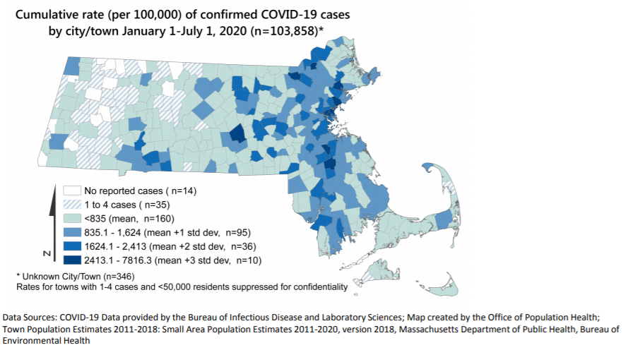
The Communities with Highest Case Rates are Primarily in High Density Population Areas
The ten communities with the highest cumulative rates of COVID-19 cases per 100,000 residents were: Chelsea, Brockton, Lawrence, Everett, Lynn, Revere, Randolph, Worcester, Danvers, and Lowell.

Slide 79
Cities with the Highest Rates of COVID-19 are Primarily Communities of Color
The ten communities with the highest rates of COVID-19 are shown below. The overall rate in MA of COVID-19 Cases is 1,490.8 per 100,000 people as of 06/30/2020. Almost all of these communities have high (>50%) percentage of residents who are people of color (shaded blue)
MA State Average Rate
Town | Chelsea | Brockton | Lawrence | Everett | Lynn | Revere | Randolph | Worcester | Danvers | Lowell
Case Count | 2994 | 4225 | 3553 | 1765 | 3635 | 1782 | 950 | 5227 | 737 | 2895
Percent of Residents who are People of Color | 80% | 68% | 87% | 61% | 66% | 52% | 75% | 51% | 7.6% | 55%
Population denominators for rate calculations provided by UMass Donahue Inst. based on Strate S, et al. Small Area Population Estimates for 2011 through 2020, published March 2020 (original report published Oct 2016)
State and Town-level COVID-19 data from 06/30

Slide 80
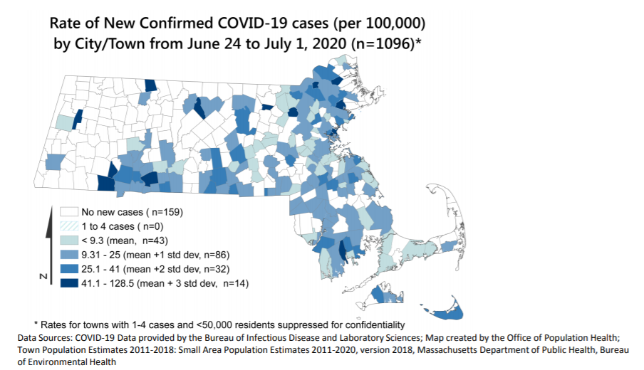
Communities with New Cases include those with High Cumulative Case Rates
From June 24th to July 1st cities/towns with high cumulative case rates reported above state average rate of new cases, these include Chelsea, Danvers, Lawrence, and Revere.
New communities with high weekly new case rates compared to the average new case rate are Ayer, Hampden, Haverhill, Middleton, New Bedford and Springfield.

Slide 81
The Rate of Hospitalizations is Highest for Black and Hispanic Residents
White non-Hispanics represent 71.5% of the population but only 57.2% of the hospitalizations, whereas the percentages of Black Non-Hispanic and Hispanics who are hospitalized are greater than their proportions in the population.
The rate of hospitalizations for Black non-Hispanics and Hispanics is 2.4x and 1.6x higher (respectively) than for White non-Hispanics.
Data as of 07/01/2020
Population denominators for rate calculations provided by UMass Donahue Inst. based on Strate S, et al. Small Area Population Estimates for 2011 through 2020, published March 2020 (original report published Oct 2016)

Slide 82
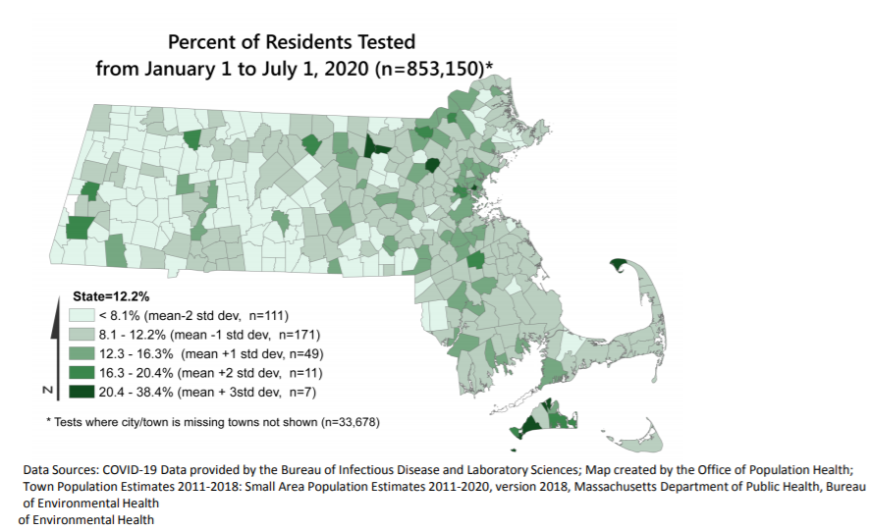
Testing Rates are High in Communities with Highest Case Rates
The overall testing rate in MA is 12,246 per 100,000 residents. Sixty-four cities/towns with the high case rates also have testing rates above the state average, including Chelsea.
Nine towns have high testing rates, but are not among the highest case rate communities: Aquinnah, Ayer, Bedford, Chilmark, Edgartown, Gardner, Provincetown, Shirley, and Tisbury

Slide 83
Age-Specific Death Rates by Race/Ethnicity Reveal Inequities
Age-specific death rates reveal that Hispanic, Black Non-Hispanic and Other Non-Hispanic residents have higher rates of death in every age group compared to White and Asian Non-Hispanic. This is most pronounced for age groups under 70. (Caveat: Some of the smaller counts can be unstable.)
 | White Non-Hispanic |  | Hispanic |  | Black Non-Hispanic |  | Asian Non-Hispanic |  | Other² Non-Hispanic |  | Unknown
Age Group | Count | Rate | Count | Rate | Count | Rate | Count | Rate | Count | Rate | Count
0-19 years | 0 | 0 | 0 | 0 | 0 | 0 | 0 | 0 | 0 | 0 | 0
20-29 years | 3 | 0.45 | 7 | 4.28 | <5 |  | <5 |  | <5 |  | 0
30-39 years | 11 | 1.83 | 11 | 8.35 | * |  | 0 | 0.00 | <5 |  | <5
40-49 years | 28 | 4.72 | 26 | 24.80 | 21 | 32.93 | <5 |  | <5 |  | <5
50-59 years | 136 | 17.77 | 65 | 82.49 | 46 | 73.95 | 11 | 21.77 | 22 | 236.21 | 7
60-69 years | 508 | 73.25 | 96 | 209.19 | 139 | 318.82 | 24 | 68.13 | 62 | 957.61 | 11
70-79 years | 1278 | 308.20 | 134 | 603.47 | 169 | 797.29 | 51 | 281.65 | 109 | 3379.20 | 28
80+ years | 4025 | 1557.78 | 223 | 2200.79 | 279 | 2486.54 | 124 | 1315.66 | 339 | 22010.91 | 39
1Data are current as of 6/30/2020 and are subject to change. 2Other includes individuals that identify as Native Hawaiian/Pacific Islander, American Indian/Alaskan Native, Multi-Race, and Other. *Case counts are suppressed to prevent back calculations. For populations <50,000 case counts, <5 cases are reported as such or are suppressed for confidentiality purposes. Rates are not calculated for suppressed counts. Population denominators for rate calculations provided by UMass Donahue Inst. based on Strate S, et al. Small Area Population Estimates for 2011 through 2020, published March 2020 (original report published Oct 2016)
Data as of 06/30/2020
Rates are per 100,000 population. Age-adjusted to the 2000 US standard population. See weights used at: https://www.cdc.gov/nchs/data/statnt/statnt20.pdf
Count and Rate (per 100,000) of Reported Deaths among COVID-19 Confirmed and Probable Cases by Race and Ethnicity and Age Group in MA¹ (N=8054)

Slide 84
Age-Adjusted Death Rates by Race/Ethnicity Reveal Inequities
The age-adjusted death rate is highest for Black residents, at 168.1 deaths/100,000
Age-adjusted death rates are recommended for comparisons among race groups given differences in the underlying age distribution of the MA population by race, and differences in COVID-19 death trends by age
Data as of 06/30/2020
Population denominators for rate calculations provided by UMass Donahue Inst. based on Strate S, et al. Small Area Population Estimates for 2011 through 2020, published March 2020 (original report published Oct 2016)
Rates are per 100,000 population. Age-adjusted to the 2000 US standard population. See weights used at: https://www.cdc.gov/nchs/data/statnt/statnt20.pdf
Count and Rate (per 100,000) of Reported Deaths among COVID-19 Confirmed and Probable Cases by Race and Ethnicity and Age Group in MA (N= 8054). Data are current as of 6/30/2020 and are subject to change.

Slide 85
D. COVID-19 Community Impact Survey

Slide 86
COVID-19 Community Impact Survey
This is a survey of needs, knowledge and issues related to COVID-19 based on a large, tailored convenient sample that will:
  Collect detailed demographic information
  Support short and long term action
  Will be translated into multiple languages
  Include a strong community engagement strategy.
Aim of survey is to get actionable information from communities and populations disproportionately impacted by COVID-19

Slide 87
COVID-19 Community Impact Survey
Purpose: To better understand the needs of residents of the Commonwealth arising from the COVID-19 crisis and the mitigation efforts, in order to help address those needs now and plan for longer-term support.
Section 1: Awareness and Perceptions of COVID-19
Section 2: Experiences of COVID-19
Section 3: Comorbid Conditions/Risk Factors for COVID-19
Section 4: Impact of COVID-19 on Basic Needs (includes tech questions)
Section 5: Impact of COVID-19 on Mental Health
Section 6: Impact of COVID-19 on Family
Section 7: Impact of COVID-19 on Substance Abuse
Section 8: Impact of COVID-19 on Education
Section 9: Impact of COVID-19 on Employment/Income
Section 10: Impact of COVID-19 on Safety/Violence
Section 11: Protective Factors
Section 12: Demographics

Slide 88
Community Impact Survey: Priority Populations
Priority populations identified for the adult survey:
Young parents (youth age 24 or less with children)
People who are currently using substances
People who are incarcerated or have a history of incarceration
People who are experiencing homelessness or housing instability
Pregnant and postpartum women
People of color, including:
  Foreign born people
  People with limited English proficiency
People with disabilities
LGBTQ+ people
Geographic: Representation across the state (with oversampling of hotspots)
People who are essential workers
People who are recently unemployed
Elders

Slide 89
Community Impact Survey: Priority Populations
Priority populations identified for the youth survey (age 14-24):
Young people who are incarcerated or have a history of incarceration
Young people who are experiencing homelessness or housing instability
Young people of color, including:
  Foreign born young people
  Young people with limited English proficiency
Young people with disabilities
LGBTQ+ young people
Out of school youth
Geographic: Representation across the state (with oversampling of hotspots)
Young people who are essential workers

