Slide 1
Public health council
January 12, 2022
Please standby – the meeting will begin shortly
Today’s presentation is available on the mass.gov/dph website under “Upcoming Events” by clicking on the January 12th Public Health Council listing

Slide 2
PUBLIC HEALTH COUNCIL meeting
JANUARY 12, 2022
Margret R. Cooke, Acting Commissioner

Slide 3
COVID-19 Update
Omicron
Preserving healthcare resources
New CDC guidance on isolation and quarantine

Slide 4
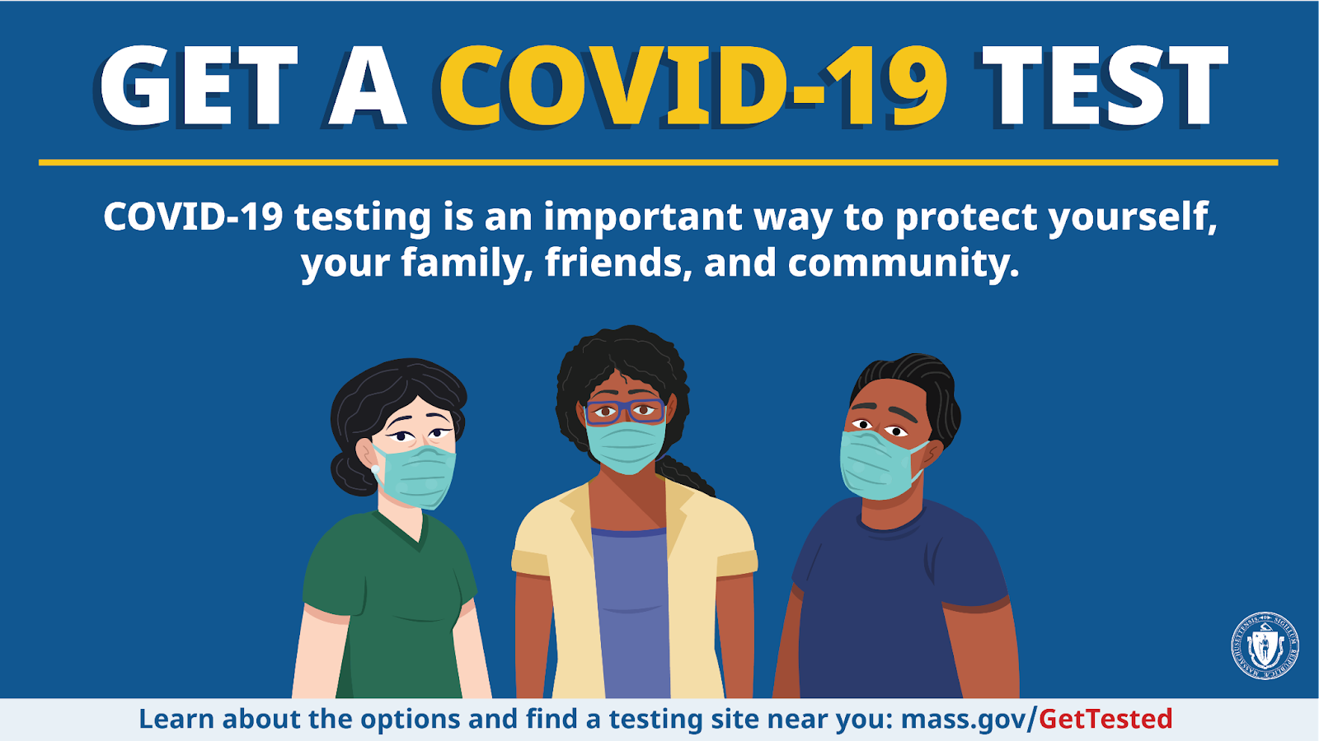
Tests

Slide 5
COVID-19 Vaccination

Slide 6
Boosters

Slide 7
PUBLIC HEALTH COUNCIL meeting
JANUARY 12, 2022
Margret R. Cooke, Acting Commissioner

Slide 8
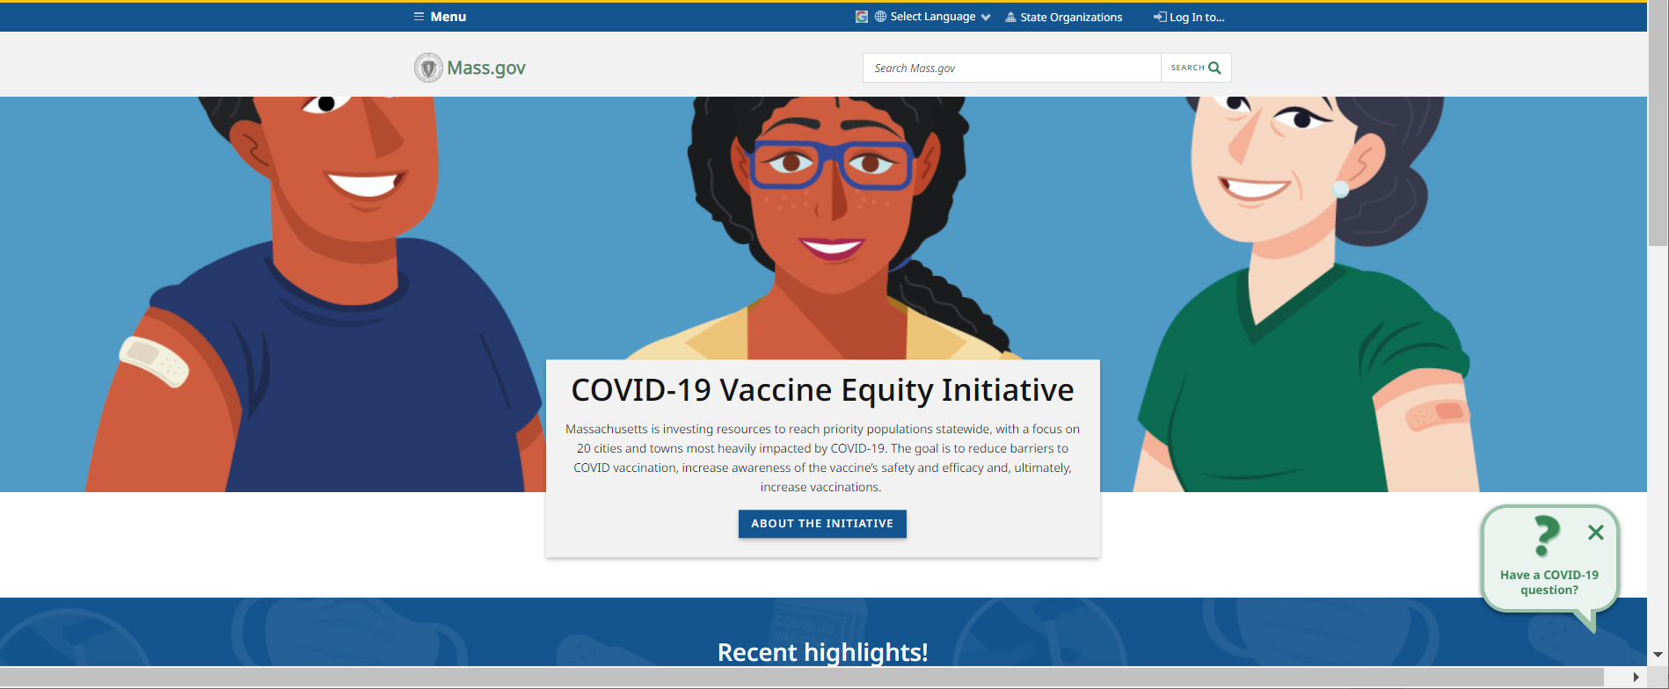
Vaccine Equity Initiative
www.mass.gov/covidvaccineequity

Slide 9
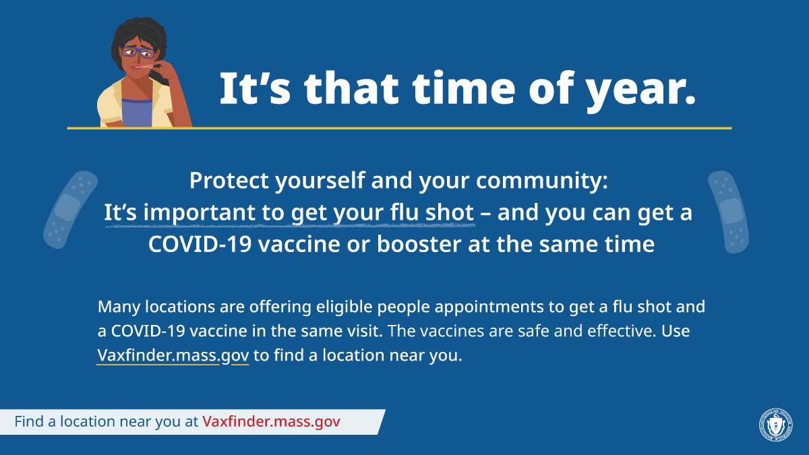
Get a Flu Shot

Slide 10
PUBLIC HEALTH COUNCIL meeting
JANUARY 12, 2022
Margret R. Cooke, Acting Commissioner

Slide 11
PROPOSED PRE-COMMENT AMENDMENTS TO 105 CMR 300.000:
Reportable Diseases, Surveillance, and Isolation and Quarantine Requirements
Kevin Cranston, MDiv, Assistant Commissioner,
Director, Bureau of Infectious Disease and Laboratory Sciences
Catherine M. Brown, DVM, MSc, MPH, State Epidemiologist
Gillian A. Haney, MPH, Director, Division of Surveillance, Analytics and Informatics

Slide 12
Summary of Regulations
This regulation lists diseases designated dangerous to public health by DPH and establishes reporting, surveillance, isolation, and quarantine requirements.
The regulation provides the foundation of the reporting, surveillance, isolation and quarantine framework being used to address the COVID-19 pandemic in the Commonwealth.
The proposed amendments update sections of the regulation that have been of particular importance during the COVID-19 pandemic as they relate to the Department’s ongoing surveillance of and response to diseases that are dangerous to the public health.
Originally promulgated in 1964, 105 CMR 300.000 was last revised in 2017.

Slide 13
Clarifying Updates
s.020: Definitions- clarifies definitions of various terms used within regulations eg: demographic data
s.050: Disease Surveillance and Case Management System- specifies how MAVEN is used
s.100: Diseases Reportable to Local Boards of Health- reformatted to reinforce/reflect modernization of reporting infrastructures that enables simultaneous visibility of disease reports
s.110 and 160: clarifies general types of data that must be included on reports by Local Health and to the Department

Slide 14
Clarifying Updates (con’t)
s. 120: strengthens the protections of confidential health information contained in MAVEN and other records; limits access to those with a specific need
s.133-134: clarifies that employers play a role in reporting illnesses (unusual or clusters/outbreaks) occurring in the workplace
s.173: reporting of negative SARS-COV2 results
s.200: updated isolation and quarantine requirements with revised language to follow recommendations for specific coronavirus infections

Slide 15
Proposed Amendment: 300.150
300.150: Declaring a Disease or Condition Immediately Reportable, Under Surveillance and/or Subject to Isolation and Quarantine: Temporary Reporting, Surveillance and/or Isolation and Quarantine
SUMMARY OF CURRENT STANDARD
Authorizes the Commissioner, to require reporting, surveillance and/or establish isolation and quarantine requirements for newly recognized diseases or conditions or recently identified or suspected to be a public health concern
SUMMARY OF PROPOSED CHANGE
Clarifying text to review an initial declaration and conditions necessary to extend the declaration
This amendment seeks to make the declaration process more applicable to novel or emerging diseases and conditions

Slide 16
Proposed Amendment: 300.170
300.170: Laboratory Findings Indicative of Infectious Disease Reportable Directly to the Department by Laboratories
SUMMARY OF PROPOSED CHANGE
Clarification of reportable laboratory findings to include results identified through sequencing
Adds unusual coronaviruses and specifically lists SARS-CoV-2
Reinforces additional clinical and/or epidemiologic information must be reported when requested
The amendment addresses the arrival of SARS-CoV-2 and the pandemic and the necessity to address other potential emerging coronaviruses and validates the Department’s authority to require laboratories report additional information when necessary
SUMMARY OF CURRENT STANDARD
Designates the laboratory findings to be reported to the Department

Slide 17
Proposed Amendment: 300.172
300.172: Submission of Selected Isolates and Diagnostic Specimens to the State Public Health Laboratory
SUMMARY OF PROPOSED CHANGE
Removes limitation that laboratories only report on residents of Massachusetts
Adds SARS-CoV-2 isolates to the reportable isolate list
Addition of text to indicate that in certain outbreak situations specimens or isolates may be required to be submitted to the State Public Health Laboratory for further examination
This amendment clarifies the application of the regulation within MA, adds the novel virus SARS-CoV-2, and provides a mechanism for the Department to obtain other specimens or isolates where necessary for disease investigation and control
SUMMARY OF CURRENT STANDARD
Designates the isolates and diagnostic specimens all laboratories shall report directly to the Department for further examination

Slide 18
Proposed Amendment: 300.190
300.190: Surveillance and Control of Diseases Dangerous to the Public Health
SUMMARY OF PROPOSED CHANGE
New text to recognize the increased adoption of electronic medical records across the healthcare system and as a mechanism for surveillance
Electronic medical record use across the healthcare system increased during the COVID-19 pandemic
SUMMARY OF CURRENT STANDARD
Authorizes the Department and local boards of health to conduct surveillance activities necessary for the investigation, monitoring, control and prevention of diseases dangerous to the public health

Slide 19
Proposed Amendment: 300.191
300.191: Access to Medical Records and Other Information
SUMMARY OF PROPOSED CHANGE
New section to allow health care providers and others to report information from medical records (paper or electronic) to the Department when determined necessary by the Commissioner
This amendment recognizes the increased adoption of electronic medical records across the healthcare system and need for additional reporting in certain circumstances
SUMMARY OF CURRENT STANDARD
Authorizes the Department and local boards of health access medical records upon request
Authorizes school nurses to access immunization information

Slide 20
Next Steps
The Department will proceed to a public comment period and public hearing on the proposed amendments to 105 CMR 300.000.
Department staff will then return to the Council to present any post-comment proposed changes and to ask for your approval to proceed with promulgation of the final amended regulation.

Slide 21
Contact Information
Thank you for the opportunity to present this information today.
For more information regarding 105 CMR 300.000: Reportable Diseases, Surveillance, and Isolation and Quarantine Requirements please find the full current regulation here:
https://www.mass.gov/regulations/105-CMR-30000-reportable-diseases-surveillance-and-isolation-and-quarantine
Please direct any questions to:
Gillian Haney gillian.haney@mass.gov

Slide 22
Final Promulgation of Revisions to 105 CMR 301.000:
Cancer Registry
Susan T Gershman, MS, MPH, PhD, CTR
Director, Massachusetts Cancer Registry
Jim Ballin, JD, MPH
Deputy General Counsel

Slide 23
Summary of Regulations
Describe cases of cancer and benign brain-related tumor disease which are required to be reported.
Specify who is required to report.
Specify what information is required to be reported.
Require access by the Mass. Cancer Registry (MCR) of patient medical records necessary to verify the accuracy of reported information.
Require confidentiality of cancer registry information and specify permitted uses.

Slide 24
Purpose of Proposed Amendments
Overall: Improved organization, added clarity, and updated standards.
301.010: Required Reporting
Clarified what information is required to be reported or made available to the Cancer Registry and who is subject to these requirements.
301.015: Information Required To Be Reported
Listed the categories of information required to be reported.

Slide 25
Purpose of Proposed Amendments (cont.)
301.035: Quality Assurance and Case Ascertainment
Clarified MCR access to records for quality assurance and ensuring accurate case ascertainment.
301.040: Confidentiality of Cancer Registry Records
Revised the confidentiality section to clarify limitations on who may access confidential cancer records.
Overall: Incorporated new provisions to facilitate the MCR’s transition to a National Cancer Institute Surveillance, Epidemiology, and End Results (SEER) Registry.

Slide 26
Public Comment Period
The Department held a public hearing on August 19, 2021, with all written comments due to the Department on August 20, 2021.
The Department received no comments on the proposed revisions.

Slide 27
Next Steps
The Department requests that Public Health Council approve the proposed regulations for promulgation.
Following Public Health Council approval, the Department will file the amended regulations with the Secretary of Commonwealth for final promulgation.

Slide 28
COVID-19
Community Impact Survey(CCIS)
Preliminary Analysis Results as of
January 12, 2022 Presented by Justine Egan
Massachusetts Department of Public Health

Slide 29
CCIS TEAM MEMBERS
CCIS Project Leads
W.W. Sanouri Ursprung, Lauren Cardoso, Beth Beatriz, Glory Song, Caroline Stack, Kathleen Fitzsimmons, Emily Sparer-Fine, Ta-wei Lin, Lisa Potratz, Heather Nelson, Amy Flynn, Lisa Arsenault, Abby Atkins
CCIS Steering Committee
Lauren Cardoso, W.W. Sanouri Ursprung, Beth Beatriz, Abbie Averbach, Ruth Blodgett, Ben Wood, Sabrina Selk,
Jessica del Rosario Nicole Daley, Lisa Potratz
CCIS Analytic Team, Data to Action Team, Data Dissemination Team, Communications Team
Allison Guarino, Andrea Mooney, Angela Laramie, Ann Marie Matteucci, Anna Agan, Arielle Coq, Barry Callis,
Beatriz Pazos Vautin, Ben Wood, Brittany Brown, Chelsea Orefice, Dana Bernson, David Hu, Dawn Fukuda,
Ekta Saksena, Elise Pechter, Emily White, Fareesa Hasan, Frank Gyan, Glennon Beresin, Hanna Shephard,
Hannah Walters, Hermik Babkhanlou-Chase, James Laing, Jena Pennock, Jennica Allen, Jennifer Halstrom,
Justine Egan, Kathleen Grattan, Kim Etingoff, Kirby Lecy, Lamar Polk, Lauren Fogarty, Lauren Larochelle,
Mahsa Yazdy, Marianne Mabida, Matthew Tumpney, Megan Hatch, Megan Young, Melody Kingsley, Michelle Reid, Miriam Scrivener, Nassira Nicola, Nicole Daniels, Nicole Roos, Rebecca Berger, Rebecca Han, Robert Leibowitz, Susan Manning, Thomas Brigham, Timothy St. Laurent, Vera Mouradian, Victoria Nielsen, Ziming Xuan,
Elizabeth Showalter, Priyokti Rana, Mayowa Sanusi, Emily Lawson, Alana LeBrón

Slide 30
CCIS COMMUNITY PARTNERS
Many groups that were critical in the success of this effort and gave important input on the development and deployment of the survey:
Academic Public Health Volunteer Corps and their work with local boards of health and on social media
Mass in Motion programs, including Springfield, Malden, and Chelsea
Cambodian Mutual Assistance
The Mashpee Wampanoag Tribe
The Immigrants’ Assistance Center, Inc
Families for Justice as Healing
City of Lawrence Mayor’s Health Task Force
The 84 Coalitions, including the Lawrence/Methuen Coalition
Boys and Girls Clubs, including those in Fitchburg and Leominster and the Metro South area
Chinatown Neighborhood Association
Father Bill’s
UTEC
MassCOSH
Stavros Center for Independent Living
Greater Springfield Senior Services
Center for Living and Working
DEAF, Inc.
Massachusetts Commission for the Deaf and Hard of Hearing
Viability, Inc.

Slide 31
OVERVIEW
Purpose and Approach of the Covid-19 Community Impact Survey (CCIS)
Preliminary Findings
Spotlight on Caregivers: caregivers of adults with special needs and parents of children & youth with special healthcare needs
Appendix

Slide 32
RESULTS TOPICS TO DATE
SOCIAL DETERMINANTS OF HEALTH
MITIGATING INDIVIDUAL RISK OF INFECTION
ACCESS TO
TESTING​
ACCESS TO HEALTHCARE​
MENTAL HEALTH
EMPLOYMENT
SUBSTANCE USE
DISCRIMINATION: & RACE SPOTLIGHTS
PARENTS & FAMILIES
YOUTH SPOTLIGHT
SOGI POPULATION SPOTLIGHTS
INTIMATE PARTNER VIOLENCE
HOUSING STABILITY
RURAL COMMUNITIES SPOTLIGHT
PERSONS WITH DISABILITIES SPOTLIGHT
NEW: CAREGIVERS SPOTLIGHT
DISCRIMINATION: & RACE SPOTLIGHTS

Slide 33
CAREGIVER SPOTLIGHT Elizabeth Beatriz, PhD Justine Egan, MPH Amy Flynn, MS Elaine M. Gabovitch, MPA Allison Guarino, MPH Beatriz Pazos Vautin, MPH

Slide 34
CAREGIVERS IN MASSACHUSETTS
Caregiver Respondents: Terms Used
Parents of Children & Youth with Special Healthcare Needs (PCYSHCN) (N=786)
Are you a parent / guardian of a child or youth with special health care needs? We define children and youth with special health care needs as those who: Have a chronic physical, developmental, behavioral or emotional condition that has lasted or will last 12 months or longer and need health and other services beyond what is generally required by children.
Caregivers of Adults with Special Needs (N=344)
Are you a caretaker of an adult(s) with special needs in your household?
The survey did not ask if caregivers were paid for their caregiving duties. The screener question may have been interpreted to indicated unpaid and/or paid caregiving, depending on the individual responding to the survey.
Caregivers - Used in this presentation to broadly refer to caregivers of adults with special needs and PCYSHCN
Other parents – Parents who did not indicate they were caring for a child with special healthcare needs
Non-caregivers of adults – Respondents who did not indicate they were caring for an adult with special needs

Slide 35
FRAMING MATTERS
Caregivers provide care to people who need some degree of ongoing assistance with everyday tasks on a regular or daily basis. Care recipients can range from children to older adults and have chronic illnesses or disabling conditions.¹
Caregiving is rewarding and meaningful but also comprised of challenges. Changes in availability of respite care during the height of the pandemic, fear of COVID-19 infection, and increased social isolation had a significant effect on caregivers during the pandemic.
Due to the large sample size of the survey, CCIS provides a unique source of data on the challenges faced by caregivers in Massachusetts and validates some of the anecdotal data that programs have received.
Source: 1) Centers for Disease Control & Prevention, https://www.cdc.gov/aging/caregiving/index.htm

Slide 36
CAREGIVERS IN MASSACHUSETTS
Caregivers were significantly more likely to be very worried about COVID-19 infection compared to non-caregivers
Caregivers may be concerned about not being able to fulfill their caregiving responsibilities if they become ill. They may also be worried about infecting those they care for with COVID-19.
51% of caregivers of adults with incomes under $35,000 reported being very worried about COVID-19 infection
Caregivers with disabilities were more likely to report being very worried about COVID-19 infection
Data notes: 1)* denotes rate is significantly different (p<0.05); 2) All percentages are weighted to the statewide age and educational distribution of those ≥25 years.; 3) Sample size (caregivers of adults) = 6,479; Effective sample size (caregivers of adults) = 6,521. Sample size (parents) = 3,676; Effective sample size (parents) = 3,460.

Slide 37
CAREGIVERS IN MASSACHUSETTS
More than 1 in 3 PCYSHCN lost their jobs, reduced their hours, or took leave during the pandemic
PCYSHCN were 45% more likely to report job loss, reduction of hours, or leave than other parents. Parents overall were 35% more likely to report job loss/reduced hours/leave compared to non-parents.
PCYSHCN were more likely than other parents to say their employment status changed due to needing to take care of a child (32% vs 23% )respectively.
PCYSHCN with disabilities, with incomes under $100K, under age 35, and PCYSHCN of color were more likely to report changes in job status
Data notes: 1)* denotes rate is significantly different (p<0.05) between parents and non-parents; 2) All percentages are weighted to the statewide age and educational distribution of those ≥25 years.; 3) Sample size = 3,676; Effective sample size = 3,460.

Slide 38
CAREGIVERS IN MASSACHUSETTS
Caregivers of adults were twice as likely to lose their jobs compared to non-caregivers. Nearly 1 in 5 caregivers of adults lost their jobs during the pandemic.
Caregivers of adults were more likely to say their employment status changed due to needing to take care of a child (36%) or sick family member (8%) compared to non-caregivers of adults (26% and 2%).
Caregivers of adults were also more likely to say their job status changed due to fear of getting COVID-19 at work (23% vs. 17%).
Caregivers of adults who themselves have disabilities and caregivers with incomes of less than $35K were 3 times more likely to report job loss than those without disabilities and those making over $35k, respectively.
Data notes: 1)* denotes rate is significantly different (p<0.05); 2) All percentages are weighted to the statewide age and educational distribution of those ≥25 years.; 3) Sample size = 4,208; Effective sample size = 3,827.

Slide 39
CAREGIVERS IN MASSACHUSETTS
Caregivers were more likely to be concerned about expenses and housing
Caregivers were 40% more likely to be worried about expenses during the pandemic
60% of caregivers of adults and 67% of PCYSHCN were worried about expenses
85% of PCYSHCN aged 25-34 and 84% of PCYSHCN of color were worried about expenses
82% of LBGTQA+ caregivers of adults were worried about expenses
Caregivers were nearly twice as likely to be worried about housing costs compared to non-caregivers
Nearly 1 in 2 caregivers were worried about housing
63% of younger caregivers of adults (aged 25-44) were worried about housing
58% of PCYSHCN of color were concerned about housing
Data notes: 1) All percentages are weighted to the statewide age and educational distribution of those ≥25 years.; 3) Sample size (caregivers of adults) = 6,159; Effective sample size (caregivers of adults) = 6,168. Sample size (parents) = 3,464; Effective sample size (parents) = 3,236

Slide 40
CAREGIVERS IN MASSACHUSETTS
Caregivers were more likely to be concerned about basic needs
Nearly 80% of caregivers were worried about at least one household need during the first 6-8 months of the pandemic compared to 65% of non-caregivers/other parents
Caregivers were nearly twice as likely to be concerned about food and groceries than non-caregivers
47% of caregivers of adults were worried about food and groceries compared to 27% of non-caregiver of adults and 43% of PCYSHCN were worried about food and groceries compared to 23% of non-caregiver other parents
68% of caregivers of adults who speak a language other than English were concerned about food or groceries
66% of PCYSHCN aged 25-34 and 64% of PCYSHCN of color were worried about groceries
Data notes: 1) All percentages are weighted to the statewide age and educational distribution of those ≥25 years.; 3) Sample size (caregivers of adults) = 6,159; Effective sample size (caregivers of adults) = 6,168. Sample size (parents) = 3,464; Effective sample size (parents) = 3,236

Slide 41
CAREGIVERS IN MASSACHUSETTS
Caregivers were more likely to have unmet technology needs compared to non-caregivers
Certain groups of caregivers were more likely to have unmet technology needs:
LGBTQA+ caregivers of adults (48%)
PCYSHCN of color (44%)
Caregivers of adults with incomes under $35K (41%)
Caregivers of adults who speak a language other than English (40%)
PCYSHCN who speak a language other than English (37%)
Data notes: 1)* denotes rate is significantly different (p<0.05); 2) All percentages are weighted to the statewide age and educational distribution of those ≥25 years.; 3) Sample size (caregivers of adults) = 6,159; Effective sample size (caregivers of adults) = 6,168. Sample size (parents) = 3,464; Effective sample size (parents) = 3,236

Slide 42
CAREGIVERS IN MASSACHUSETTS
Caregivers were 50% more likely to experience delays in care compared to non-caregivers.
1 in 4 caregivers experienced delays in healthcare during the first 6-8 months of the pandemic.
Certain groups of caregivers were more likely to experience delays in care:
1 in 2 caregivers of adults who identified as LGBTQA+ and 36% of LGBTQA+ PCYSHN
45% of younger caregivers (aged 25-44) of adults delayed care
44% of caregivers of adults with incomes less than $35K
42% of caregivers of adults and 31% of PCYSHN in rural counties
Data notes: 1)* denotes rate is significantly different (p<0.05); 2) All percentages are weighted to the statewide age and educational distribution of those ≥25 years.; 3) Sample size (caregivers of adults) = 6,159; Effective sample size (caregivers of adults) = 6,168. Sample size (parents) = 3,464; Effective sample size (parents) = 3,236

Slide 43
CAREGIVERS IN MASSACHUSETTS
Caregivers of adults were more likely to be worried about getting COVID-19 from seeing a doctor and were less likely to have a private place for a phone call or video chat.
If a caregiver becomes ill or is hospitalized, there may not be anyone to care for their family member in their absence. Caregivers may also be concerned about infecting those they care for with COVID-19.
Caregivers may also lack private spaces in their homes due to living with family members they are caring for.
Data notes: 1)* denotes rate is significantly different (p<0.05); 2) All percentages are weighted to the statewide age and educational distribution of those ≥25 years.; 3) Sample size = 894; Effective sample size = 892

Slide 44
CAREGIVERS IN MASSACHUSETTS
Caregivers were more likely to report 3+ PTSD reactions during the first 6-8 months of the COVID-19 pandemic.
Respondents were asked how many times they had any of the following reactions to the COVID-19 outbreak in the past month:​
Having nightmares or thinking about it when you didn’t want to​​
Going out of your way to avoid situations​​
Constantly being on guard, watchful, or easily startled​​
Feeling numb or detached​​
Feeling guilty or unable to stop blaming yourself​
Data notes: 1)* denotes rate is significantly different (p<0.05); 2) All percentages are weighted to the statewide age and educational distribution of those ≥25 years.; 3) Sample size (caregivers of adults) = 5,670; Effective sample size (caregivers of adults) = 5,455. Sample size (parents) = 3,113; Effective sample size (parents) = 2,850.

Slide 45
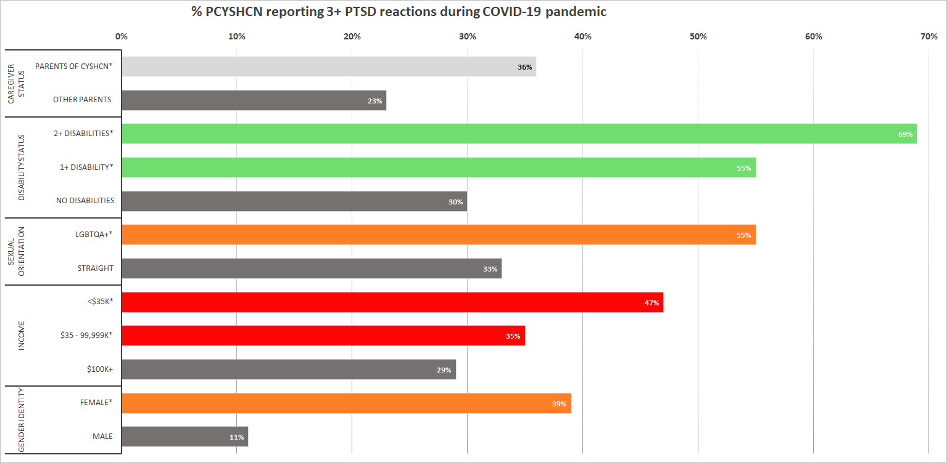
CAREGIVERS IN MASSACHUSETTS
More than 1 in 2 PCYSHCN with disabilities and LGBTQA+ PCYSHCN reported 3 or more PTSD symptoms during the pandemic
Certain groups of PCYSHCN were more likely to report 3+ PTSD reactions:
PCYSHCN with disabilities
LGBTQA+ PCYSHCN
PCYSHCN with incomes under $35K
Data notes: 1)* denotes rate is significantly different (p<0.05); 2) All percentages are weighted to the statewide age and educational distribution of those ≥25 years.; 3) Sample size = 652; Effective sample size = 611

Slide 46
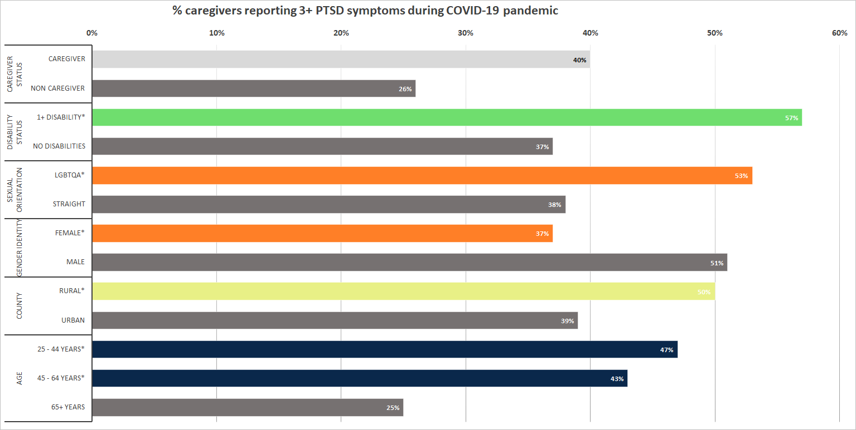
CAREGIVERS IN MASSACHUSETTS
1 in 2 caregivers of adults in certain groups reported 3 or more PTSD reactions during the first 6-8 months of the pandemic.
Half of certain groups of caregivers of adults were more likely to report 3 or more PTSD reactions:
Caregivers with disabilities
LGBTQA+ caregivers
Male caregivers
Caregivers in rural areas
Data notes: 1)* denotes rate is significantly different (p<0.05) between parents and non-parents; 2) All percentages are weighted to the statewide age and educational distribution of those ≥25 years.; 3) Sample size = 278; Effective sample size = 319

Slide 47
KEY TAKEAWAYS: ECONOMIC SECURITY
Economic security is a major concern for caregivers
Multiple household members may be supported by a caregiver’s salary, since family members they are caring for are not able to work. Economic needs may therefore be greater for caregiving households.
Lack of support for caregiving affects employment. The employer community across public, private and non-profit sectors should consider ways to support family caregivers in their workforce, such as providing increased flexibility, investing in benefits, and creating a culture that acknowledges caregiving.
Caregivers were significantly more likely to have an unmet technology need (including WiFi, tablets, computers, and cell phones)
Accessing broadband – both during the height of the pandemic and currently – is critical for accessing telehealth, accessing education, and working from home. Given caregivers’ increased concern about COVID-19 infection, working from home may allow continued employment for certain caregivers.

Slide 48
KEY TAKEAWAYS: MENTAL & PHYSICAL HEALTH
Family caregivers are experiencing increased mental and behavioral health needs and may face significant barriers accessing healthcare
Caregivers may put their mental and physical health secondary to their caregiving responsibilities.
Economic insecurity can contribute to poor mental and physical health
Caregiving is associated with poor mental health, compromised immune function, and lower life expectancy¹
Respite for caregivers is crucial so that caregivers can maintain employment, access healthcare, get groceries, and simply take a break from caregiving responsibilities.
Even if a caregiver wants to attend a support group or access mental health resources, caregivers need respite care.
Programs and policymakers should consider how to make urgent care more accessible for caregivers more accessible for caregivers, including transportation options, respite care, and assistance with telehealth access.

Slide 49
KEY TAKEAWAYS: INTERSECTIONALITY
Certain groups of caregivers were more likely to be affected by job loss, economic insecurity, and to experience delays in healthcare
Caregivers with lower incomes, caregivers of color, caregivers under the age of 45, caregivers with disabilities, LGBTQA+ caregivers, and caregivers who speak a language other than English had varying greater socio-economic and health needs

Slide 50
DATA TO ACTION
Economic security
The Paid Family & Medical Leave policies that recently went into effect in Massachusetts may provide some relief to caregivers.
Emergency support funding was provided to families with children and youth with special health needs across Massachusetts directly affected by COVID through loss of income or illness through the Care Coordination Program.
The Title V MCH Program, the Early Intervention Provider PCCD and the City of Lawrence developed a project to bridge the “digital divide” in Lawrence by providing access to a telehealth kiosk. The kiosk has been installed in the Lawrence Public Library and is a pilot to study this solution.
Physical & Mental Health
As a result of these CCIS findings, mental health is one priority that DPH is revisiting within our HRSA-MCHB Block Grant.
Programs and policies serving caregivers should examine structural barriers to engaging in those programs and ensure equitable access

Slide 51
RESOURCES
For caregiving resources visit https://www.mass.gov/topics/caregiving
MassOptions - https://www.massoptions.org/massoptions/ - and phone is 800-243-4636. MassOptions is trained to do a warm hand-off of the caller to an Aging Services Access Point or Independent Living Center (ILC – to reach DDS/MRC-type services).
Resources for employers who want to support caregivers can be found at the Mass. Employers Toolkit.

Slide 52
FUTURE CCIS LIVE WEBINAR
Caregivers
Caregivers of adults with special needs and parents of children & youth with special healthcare needs
January 13, 2022
1:00pm – 2:30pm
You can register for these webinar events on our website at mass.gov/covidsurvey
For questions about these webinars, please email us at covid19survey@mass.gov

Slide 53
Next Meeting:
February 9, 2022

