Slide 1
Public Health Council Meeting
January 14, 2026
Robert Goldstein, Commissioner
Today’s presentation is available on mass.gov/dph under “Upcoming Events” by clicking on the January 14 Public Health Council listing.​

Slide 2
Updates
Commissioner Robbie Goldstein

Slide 3
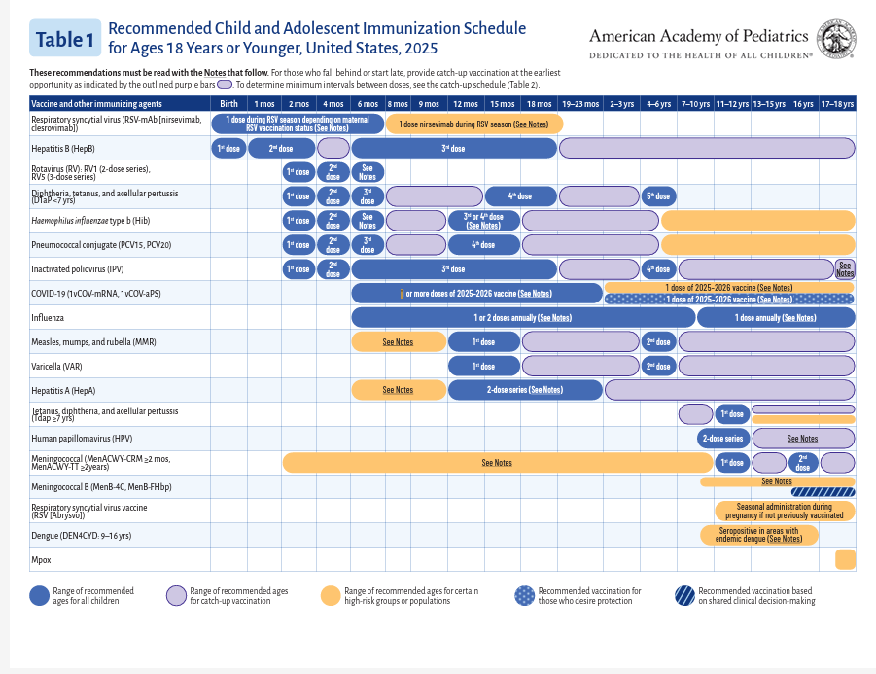
Childhood Immunization Schedule

Slide 4

Gender-affirming care

Slide 5

Martin Luther King Jr. Day
“Of all the forms of inequality, injustice in health care is the most shocking and inhumane.”
—Martin Luther King Jr.

Slide 6

Blood Donor Month
Commissioner Robbie Goldstein and former CDC Director Rochelle P. Walensky donating blood in 2023.

Slide 7
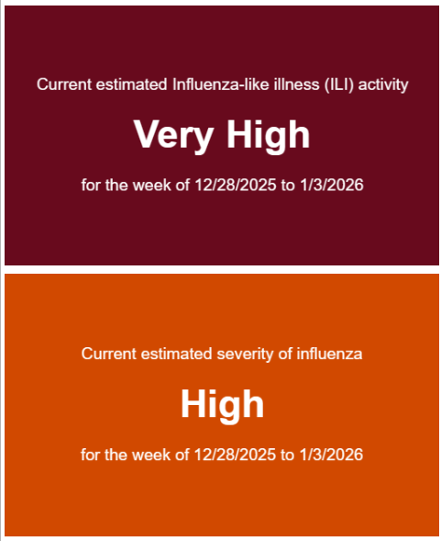
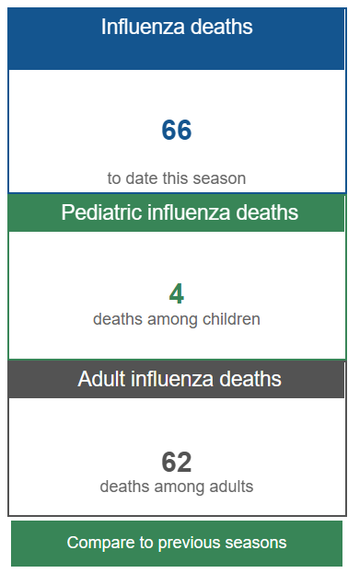
Respiratory illness, including flu
Snapshots from DPH flu dashboard, updated January 8, with data through January 3.

Slide 8
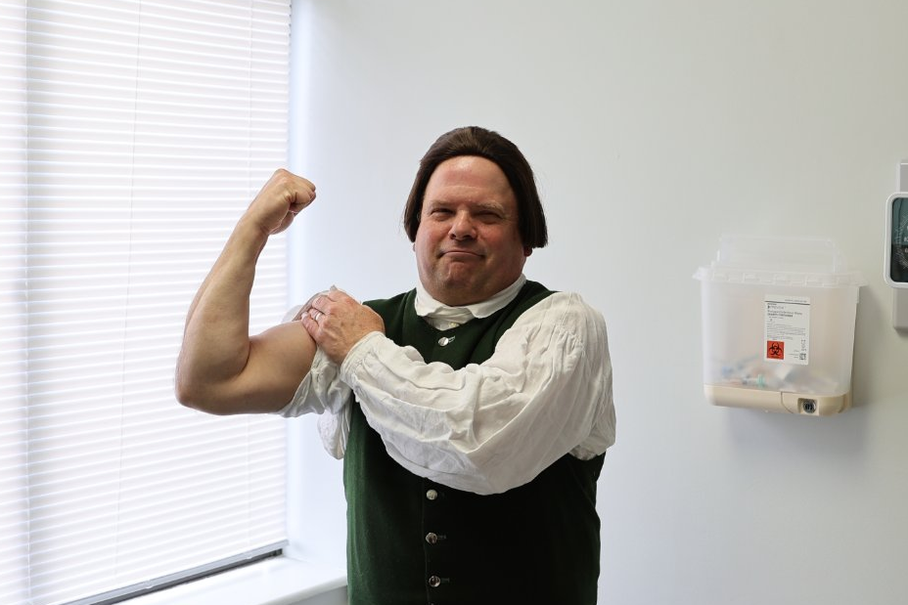
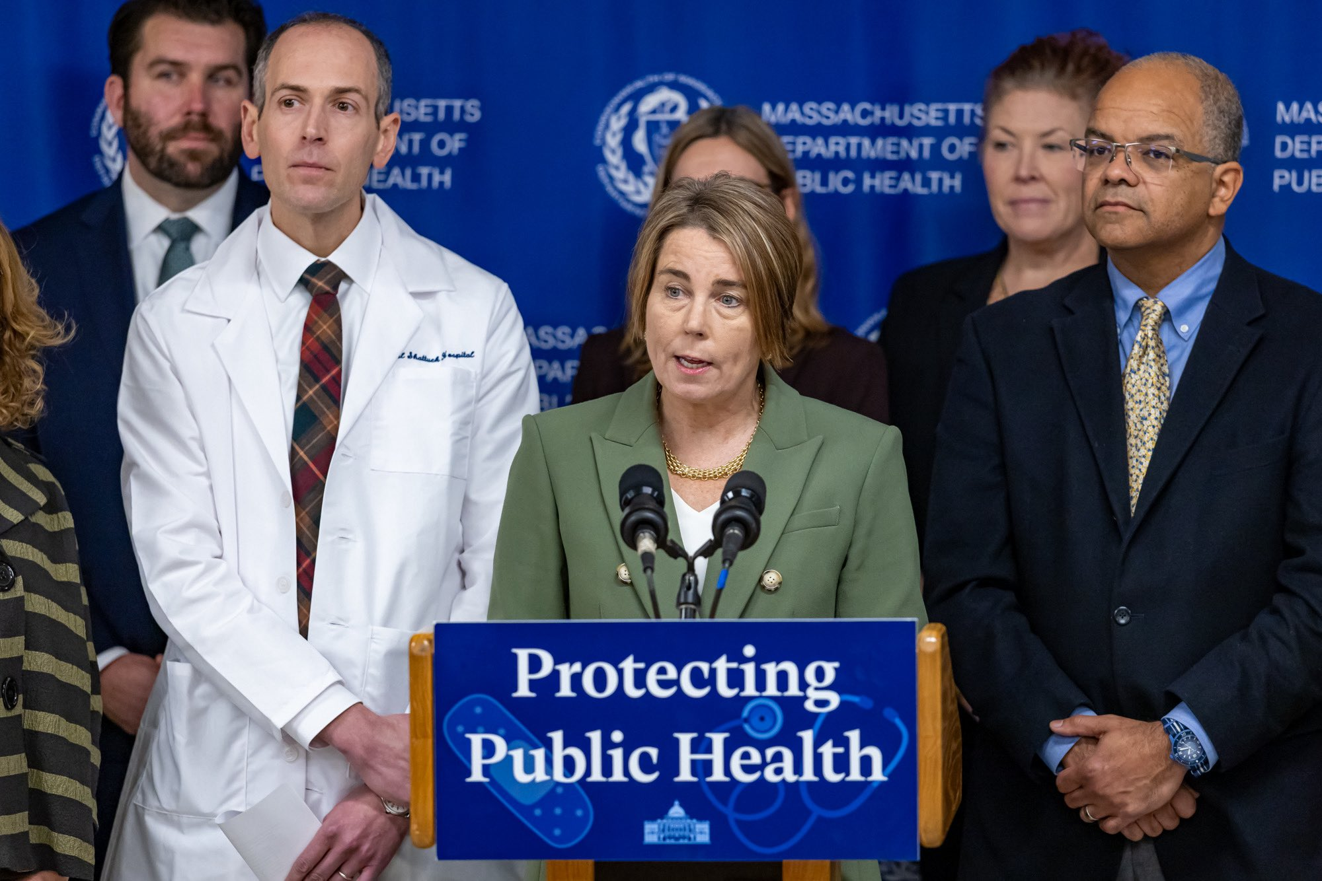
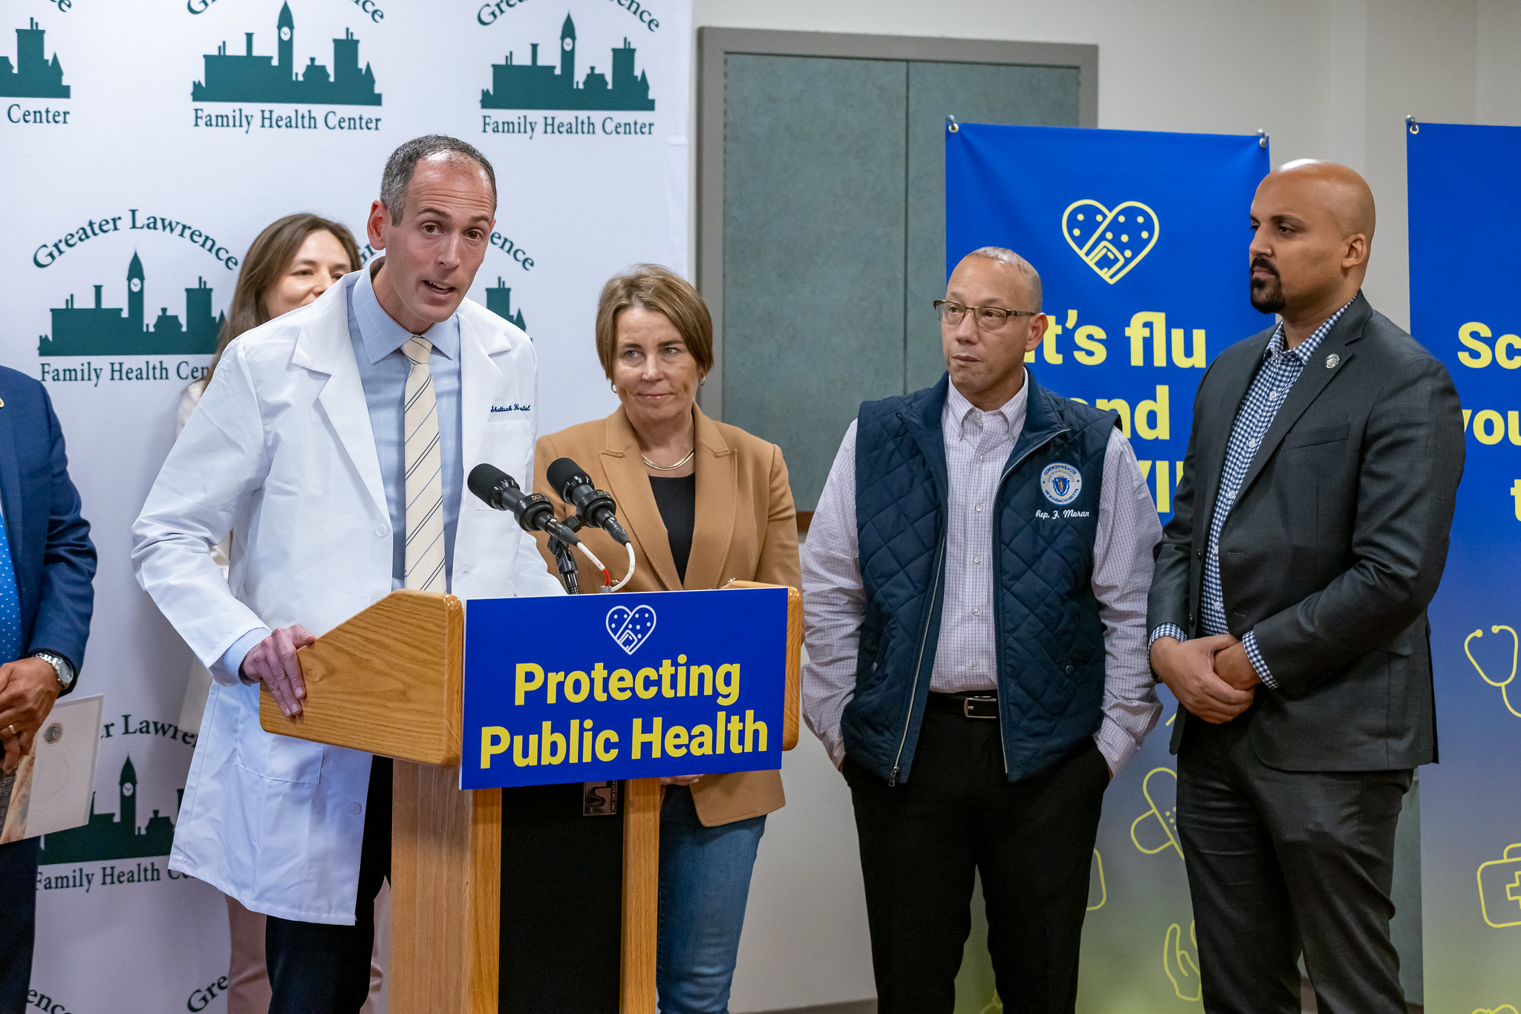

Reflecting on 2025

Slide 9
Determination of Need: UMass Memorial Health Care, Inc.
Amendment: Substantial Capital Expenditure and Substantial Change in Service
Teryl Smith​​
Director, Bureau of Health Care Safety and Quality​

Slide 10
Background Information
The Original DoN included projects at two UMMMC campuses encompassing the following:
Renovation of the North Pavillion building to accommodate:
  72 additional medical/surgical (“M/S”) beds (now completed);
  One additional computed tomography (“CT”) unit (now completed); and
  Shell space for future build-out to accommodate clinical services (now completed)
2) Renovation and new construction on UMMMC’s Memorial Campus for:
  19 additional M/S beds (not implemented)
  Renovations to improve the existing services and facilities (near completion).

Slide 11
Proposed Amendment Description
At the North Pavilion Campus of the UMass Memorial Medical Center build out the approved shell space to include:
Relocation of 19 approved but unimplemented medical/surgical beds (from Memorial to North Pavilion)
Add 5 new beds (at North Pavilion)

Slide 12
Overview of Proposed Change at UMMMC
UMMMC Campuses | Pre DoN M/S Beds | Original DoN Requested M/S Beds | Total DoN Approved M/S beds | Current Licensed M/S Beds | Requested Significant Change to M/S Beds | Total M/S Beds after Significant Change | Net New Beds after Significant Change
University | 275 | 0 | 275 | 275 | 0 | 275 | 0
Memorial | 192 | 19 | 211 | 192 | -19 | 192 | 0
North Pavilion | 0 | 72 | 72 | 72 | 24 | 96 | 5
Total/Net Beds | 467 | 91 | 558 | 539 | 5 | 563 | 5

Slide 13
Additional Background Information
Total Value of the significant change:$145,431,732
Total CHI contribution (including Amendment increase): $7,271,586
The Original DoN Application had two registered Ten Taxpayer Groups (“TTGs”)
No comments from the TTGs or Parties of Record related to this Amendment request

Slide 14
Requirements for Approval of a Significant Change Amendment
Pursuant to 105 CMR 100.635, a change to a project of a previously issued Notice of DoN, requires either:
  a new notice of DoN or
  an approval of a request for a Significant Change
Any build-out of shell space that was subject to a previously issued Notice of DoN falls within the definition of Significant Change.
To approve a request for a Significant Change, the change must be:
  Within the scope of the previously issued Notice of DoN and
  Reasonable
To support the request for a Significant Change, the Applicant must provide:
  A description of the previously issued notice of DoN and of the proposed Significant Change
  Cost Implications (to the Holder and to the Holder’s Patient Panel)
  A rationale for the change

Slide 15
Rationale for the Significant Change Amendment
The Holder has provided the following rationale for the proposed change:
North Pavilion was designed to care for lower-acuity patients admitted from the University Campus ED.
Since opening in January 2025, North Pavilion has expanded capacity and improved ED patient flow.
Proximity to the University Campus allows access to specialized care when needed.
North Pavilion has the highest inpatient M/S patient and provider experience scores systemwide.
Reallocating unimplemented beds from Memorial supports long-term planning potentially for the expansion of Maternity Services.

Slide 16
Occupancy Rates and Discharges
University | FY23 | FY24 | FY25
Occupancy Rates | 98.8% | 100.3% | 98.5%
Discharges | 22,499 | 23,629 | 22,910
Memorial | FY23 | FY24 | FY25
Occupancy Rates | 95.3% | 92.9% | 96.7%
Discharges | 20,091 | 21,438 | 21,285

Slide 17
UMMMC ED Visits by Campus
 | FY22 | FY23 | FY24 | FY25 | % Change FY22 to FY25
University Campus ED | 82,262 | 84,183 | 89,673 | 94,262 | 15%
Memorial Campus ED | 41,558 | 45,391 | 47,434 | 46,360 | 12%
Total ED | 123,820 | 129,574 | 137,107 | 140,622 | 14%

Slide 18
ED Boarding Indicators
The Holder states that UMMMC’s need for additional M/S inpatient capacity is demonstrated by:
ED boarding at the University Campus reflects inpatient capacity constraints.
Average and total ED boarding hours declined after FY25 Q1 following the North Pavilion opening.
Despite improvement, University Campus boarding remains more than twice the national average.
Additional M/S inpatient capacity is needed to further improve ED throughput and patient flow.

Slide 19
Impact on Cost to Existing Patient Panel
The Holder states that the Proposed Amendment is cost-effective and will not increase costs for its Patient Panel for the following reasons:
Shell Space & Proximity: Inpatient-dedicated, recently renovated shell space at North Pavilion is located within 1,000 feet of the University Campus.
Operating Cost Efficiency: Leveraging existing North Pavilion M/S units and staffing results in lower FTE needs and lower operating costs per bed than Memorial Campus.
Patient Cost Impact: The Proposed Change expands existing services with no increase in patient charges or co-insurance obligations.

Slide 20
Factor 6: Community Health Initiatives, Requirements
Community-based Health Initiatives (CHI)
Factor 6, or the CHI, serves to connect hospital expenditures to public health goals by making investments in Health Priority Areas—referred to interchangeably as the social determinants of health (SDoH).
CHI projects are a mechanism for Applicants to engage local partners in community health investments, addressing SDoH and advancing racial and health equity.
Factor 6 requirements and conditions depend on the Applicant and Application Type, and size of CHI contribution.

Slide 21
Total CHI Contribution
Additional CHI contribution: $109,478
  $10,509.89 will be directed to the CHI Statewide Initiative.
  $94,588.99 will be dedicated to local approaches to the DoN Health Priorities.
  $4,379.12 will be designated as the administrative fee.

Slide 22
Other Conditions
Upon approval of the Proposed Amendment, post DoN reporting for the Original DoN shall continue for five years after the completion of the Amendment Project with Amendment conditions included in the reporting.

Slide 23
Determination of need presentation thank-you
Thank you for the opportunity to present this information today.
Please direct any questions to:
Teryl Smith, RN, MPH
Director
Bureau of Health Care Safety and Quality
Teryl.A.Smith@mass.gov

Slide 24
Proposed revisions to regulations:
105 CMR 150: Standards for Long-term Care Facilities
105 CMR 153: Licensure Procedure and Suitability Requirements for Long-Term Care Facilities
Marita Callahan
Director of Policy & Health Communications, BHCSQ

Slide 25
Summary of regulations
105 CMR 150, Standards for Long-term Care Facilities, sets forth standard requirements for long-term care facilities, including rest homes and nursing homes.
105 CMR 153, Licensure Procedure and Suitability Requirements for Long-term Care Facilities, sets forth the licensure and suitability requirements for long-term care facilities.

Slide 26
Overview of the Act to Improve Quality and Oversight of Long-Term Care
In September 2024, Governor Healey signed “An Act to improve quality and oversight of long-term care” (the Act) which aims to improve oversight and standards at long-term care facilities through additional Department oversight.
Among other things, this Act requires the Department to:
Review each LTCF’s outbreak response plan;
Promulgate regulations for the establishment of small house nursing homes;
Promulgate regulations requiring mandatory staff training on the rights and care of LGBTQI+ older adults and those with HIV, and that prohibits discrimination based on sexual orientation, gender identity, or HIV status;
Inspect all LTCFs every 12 months;
Increase monetary penalties for regulatory violations;
Conduct suitability review on any management company that a LTCF wants to enter into a contract with; and
Expand the suitability review of LTCF applicants, potential transferees and licensees.

Slide 27
Overview of proposed revisions to the regulations
The Department is proposing significant revisions to 105 CMR 150 and 105 CMR 153 to align with the requirements set forth in the Act.
This presentation highlights the Department’s proposed amendments to 105 CMR 150 and 105 CMR 153 to comply with the requirements of the Act.

Slide 28
Overview of proposed revisions to 105 CMR 150
The Department is proposing the following revisions to 105 CMR 150, Standards for Long-term Care Facilities, to amend standards and language to improve clarity, reflect current practice and terminology, and align with the requirements of the Act.

Slide 29
Overview of proposed revisions to 105 CMR 150, continued
New updates:
Requiring certified nurse aides working in a LTCF to be certified in CPR, naloxone administration and the use of an automated external defibrillator;
Allowing certified medication aides to administer medications in LTCFs;
Removing the ability of a Responsible Person to administer certain medications to residents in a Rest Home;
Requiring LTCFs to prepare and submit to the Department outbreak response plans;
Requiring all LTCF staff to receive training on the care of residents and individuals who identify as LGBTQI+; and
Incorporating requirements for small house nursing homes.

Slide 30
Proposed revisions: 105 CMR 150, part 1
Current regulation
The regulation does not require nurse aides working in a LTCF to be certified in cardiopulmonary resuscitation, naloxone administration and the use of an automated external defibrillator.
Summary of proposed revisions
The Department proposes amending the regulations to require LTCFs to ensure all nurse aides working in a LTCF to be certified in cardiopulmonary resuscitation, naloxone administration and the use of an automated external defibrillator.

Slide 31
Proposed revisions: 105 CMR 150, part 2
Current regulation
The regulation requires all medication in a LTCF to be administered by a primary care provider, registered nurse, or licensed practical nurse.
Summary of proposed revisions
In accordance with the requirements of the Act and the requirements of 105 CMR 775, the Department proposes amending the regulations to allow certified medication aides (CMA) to administer medications in LTCFs; provided that, the CMA is supervised by a licensed practical nurse, registered nurse, nurse practitioner or physician.

Slide 32
Proposed revisions: 105 CMR 150, part 3
Current regulation
The regulation allows the “Responsible Person” in a Rest Home to administer medications to residents. The regulation defines “Responsible Person” as an individual 21 years of age or older, who has received a high school diploma, is of good moral character, and is able to make mature and accurate judgments.
Summary of proposed revisions
To comply with the requirements of M.G.L. chapter 94C as well as to ensure resident safety, the Department proposes amending the regulation to remove the ability of a Responsible Person to administer medications to residents, while retaining the ability of a resident to self-administer medications if authorized by a provider who confirms the resident is able to do so appropriately.

Slide 33
Proposed revisions: 105 CMR 150, part 4
Current regulation
The regulation does not require a LTCF to have an outbreak response plan.
Summary of proposed revisions
To comply with the requirements of the Act, the Department proposes amending the regulations to require LTCFs to develop and implement an outbreak response plan that must be submitted to the Department for review.
An “outbreak” is defined as any unusual occurrence of disease or any disease above endemic levels.
The outbreak response plan includes, but is not limited to, the following:
  A policy for the type and duration of isolation to be used for residents in the event of an outbreak, which must be the least restrictive possible for the residents.
  Policies for identifying, reporting, notifying, investigating, and controlling an outbreak.

Slide 34
Proposed revisions: 105 CMR 150, part 5
Current regulation
The regulation requires LTCFs to care for individuals in need of long-term care services for whom they can provide care and services appropriate to the individual’s physical, emotional, behavioral, and social needs.
Summary of proposed revisions
To comply with the requirements of the Act, the Department proposes amending the regulations to require that LTCFs:
  Ensure all LTCF facility staff receive biennial training concerning: (1) the care of residents who identify as LGBTQI+ and residents who are living with HIV; and (2) the prevention of discrimination based on sexual orientation, and gender identity or expression.
  When caring for transgender residents, include in the resident’s treatment plan: the preferred language for the resident’s anatomy, preferred names and pronouns, history of dysphoria surrounding medical treatments, and access to transition-related assessments, therapy and treatments.

Slide 35
Proposed revisions: 105 CMR 150, part 6
Current regulation
The regulation sets forth the physical plant requirements for LTCFs.
Summary of proposed revisions
To comply with the requirements of the Act, the Department proposes amending the regulations to include physical plant requirements for small house nursing homes.
A small house nursing home is defined as one or more units of a nursing home designed and modeled as a residential home including a central living space, kitchen, dining area, living area and outdoor space.
While small house nursing homes will be subject to the requirements throughout 105 CMR 150, the Department proposes specific requirements for small house nursing homes, including for resident bedrooms, bathrooms, kitchens, and the storage of medications.

Slide 36
Overview of proposed revisions to 105 CMR 153
The Department is proposing the following revisions to 105 CMR 153, Licensure Procedure and Suitability Requirements for Long-term Care Facilities, to amend standards and language to improve clarity, align with current practice and terminology, and align with the requirements of the Act.

Slide 37
Overview of proposed revisions to 105 CMR 153, continued
New updates:
  Incorporating requirements that the Department conduct a suitability review on management companies before the management company can enter into a contract with a LTCF;
  Expanding the Department’s suitability review criteria;
  Require LTCF applicants, potential transferees and licensees to report changes in financial status to the Department;
  Allowing for the appointment of a temporary manager as a potential enforcement action;
  Increasing the penalties that may be imposed on a LTCF that is not in compliance with the LTCF regulations.

Slide 38
Proposed revisions: 105 CMR 153, part 1
Current regulation
The regulation does not currently have any requirements for management companies that enter into a contract with a LTCF.
Summary of proposed revisions
To comply with the requirements of the Act, the Department proposes amending the regulations to require a LTCF, prior to entering into a contract with a management company, to notify the Department and receive a determination from the Department that the management company is suitable and responsible to manage a LTCF.
A “management company” is defined as an entity engaged by a LTCF to provide management, administrative and/or home office services to support the operation of all or part of the licensed facility for compensation.
Under the proposed amendments, a management company would be subject to the same suitability and responsibility criteria as LTCF license applicants and potential transferees.

Slide 39
Proposed revisions: 105 CMR 153, part 2
Current regulation
The regulation limits the Department’s suitability review of a LTCF license applicant or potential transferee to four factors: (1) criminal history, (2) financial capacity, (3) the history of the applicant providing long-term care in Massachusetts, and (4) in other states.
Summary of proposed revisions
To comply with the requirements of the Act, the Department proposes amending the regulations to expand the suitability review factors beyond the four factors listed above.
New suitability review factors include, but are not limited, to review of the involvement of private equity firms with the LTCF applicant, and review of applicable quality measures, such as the CMS Nursing Home Compare rating system.

Slide 40
Proposed revisions: 105 CMR 153, part 3
Current regulation
The regulation requires LTCFs to keep current all information that is submitted to the Department.
Summary of proposed revisions
In addition to the requirement above, to comply with the requirements of the Act, the Department proposes amending the regulations to require LTCF applicants, potential transferees and licensees to report to the Department within two days any change in financial status.
A change in financial status would include, but not be limited to, filing for bankruptcy, default under a lending agreement or lease, appointment of a receiver, or recording of a lien.

Slide 41
Proposed revisions: 105 CMR 153, part 4
Current regulation
The regulation does not require the appointment of a temporary manager for a LTCF.
Summary of proposed revisions
To comply with the requirements of the Act, the Department proposes amending the regulations to incorporate the appointment of a temporary manager as a potential enforcement action when the Department determines that a LTCF is not in substantial compliance with applicable laws, rules and regulations.

Slide 42
Proposed revisions: 105 CMR 153, part 5
Current regulation
The regulation sets forth the following penalties:
  A fine for operating a LTCF without a license of not more than $500 for a first offense and a fine of not more than $1,000 for a subsequent offense.
  A fine for a violation of M.G.L. chapter 111, sections 71 through 73 of not more than $500 for a first offense and a fine of not more than $1,000 for a subsequent offense.
  A fine for violation of any applicable LTCF rule or regulation of not more than $50.
Summary of proposed revisions
To comply with the requirements of the Act, the Department proposes amending the regulations to increase the penalties to the following:
  A fine for operating a LTCF without a license of not more than $1,000 for a first offense and a fine of not more than $2,000 for a subsequent offense.
  A fine for a violation of M.G.L. chapter 111, sections 71 through 73 of not more than $1,000 for a first offense and a fine of not more than $2,000 for a subsequent offense.
  A fine for violation of any applicable LTCF rule or regulation of not more than $500, with the authority to issue a fine of $500 per day for each violation that is not corrected by the prescribed correction date.

Slide 43
Next steps: Public comment
Following this presentation to the Public Health Council, staff will hold a public hearing and, as required, provide a public comment period.
After the close of the public comment period, staff will review public comments, revise as necessary to reflect comments received, and then request approval of the final revised regulation at a subsequent meeting of the Public Health Council.

Slide 44
Regulation presentation thank-you
Thank you for the opportunity to present this information today.
For more information regarding long term care facility licensure, please find the relevant statutory language and the full current regulation online.
Massachusetts law:
https://malegislature.gov/Laws/GeneralLaws/PartI/TitleXVI/Chapter111
Current regulation:
https://www.mass.gov/doc/105-cmr-150-standards-for-long-term-care-facilities/download
https://www.mass.gov/doc/105-cmr-153-licensure-procedure-and-suitability-requirements-for-long-term-care-facilities/download
Proposed amendment:
mass.gov/dph/proposed-regulations
Please direct any questions to:
Marita.Callahan@mass.gov

Slide 45
Community-based Health Initiatives
Determination of Need Factor 6
Jennica Allen (she/her), Manager of Community Engagement Practices
Katie Teague (she/her), Community Health Planning & Engagement Specialist
Division of Community Health Planning & Engagement
Bureau of Community Health & Prevention

Slide 46
Agenda
Determination of Need (DoN) Community-based Health Initiatives (CHI) Program and Process
Local investments
Statewide investments
Looking ahead

Slide 47
DoN CHI Program & Process

Slide 48
Factor 6: Community Health Initiatives - Requirements
Community-based Health Initiatives (CHI)
Factor 6, or the CHI, serves to connect hospital expenditures to public health goals by making investments in Health Priority Areas—referred to interchangeably as the social determinants of health (SDoH).
CHI projects are a mechanism for Applicants to engage local partners in community health investments, addressing SDoH and advancing racial and health equity.
Factor 6 requirements and conditions depend on the Applicant and Application Type, and size of CHI contribution.

Slide 49
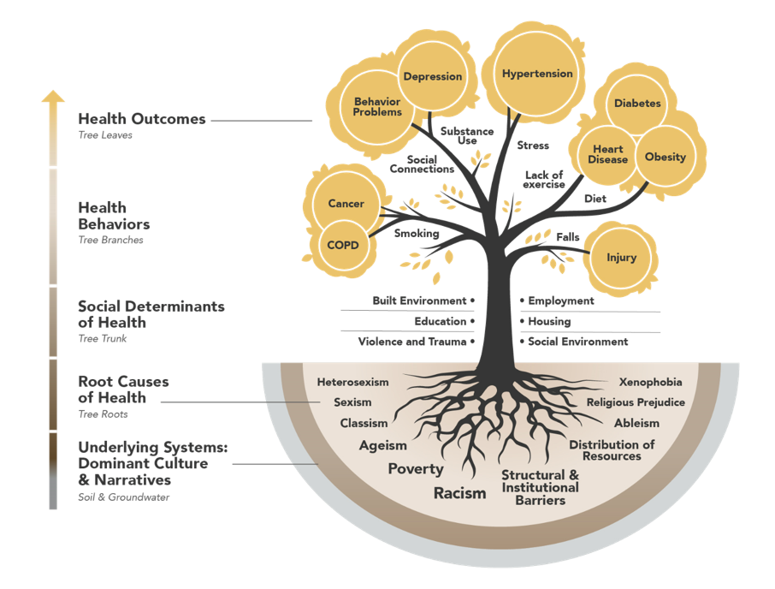
CHI Investments Must Improve Social Determinants of Health
CHI program works with health systems and their community partners to address SDoH and positively impact health outcomes.
Built Environment
Education
Violence & Trauma
Employment
Housing
Social Environment

Slide 50
The CHI Program
Builds health system community engagement and social determinants of health (SDoH) investment capacity to implement funding strategies that center community voice, address inequities and meaningfully impact SDoH.
Inform
Consult
Involve
Collaborate
Empower
Community
Driven / Led
Low level of community engagement
Mid level of community engagement
High level of community engagement
SOURCE: International Association for Public Participation, Adapted by Massachusetts Department of Public Health, 2014

Slide 51
Assessing community engagement through required DoN CHI application forms*
Community Health Needs Assessment (CHNA)
Community Health Implementa-tion Plan (CHIP)
Community Engagement Self-Assessment
Partner Assessments
(formerly known as "Stakeholder Assessments")
Community Engagement Plan
*CHI requirements depend on the Applicant/ Application Type + size of CHI contribution.
From community members
From health system

Slide 52






Overview of DoN Process
Applicant identifies a gap in service
Applicant drafts & submits DoN application to DPH
DPH reviews & drafts Staff Report
Application/ Staff Report reviewed by PHC for Approval
DoN holder carries out DoN capital project & associated CHI project*
Holder reports to DPH on capital project progress & Local and/or Statewide CHI contribution payments
*CHI requirements and funding contribution varies based on DoN project applicant and application type.

Slide 53
CHI Activities Across DoN Process
Applicant identifies a gap in service
Applicant drafts & submits DoN application to DPH
DPH reviews & drafts Staff Report
Application/ Staff Report reviewed by PHC or Commissioner for Approval
Holder carries out DoN capital project & associated CHI project
Holder reports to DPH on capital project progress & CHI contribution payments
Pre-Approval
Post-Approval
Meet with health systems leadership to confirm CHI requirements
Provide technical assistance for CHI planning and implementation
Review CHI requirements and draft Factor 6 Analysis for Staff Report
Attend community events
Present to Holder’s Community Advisory Body on CHI implementation
Receive Holder’s Health Priority Strategy Form for Local CHI Project
Ensure ongoing touch points with Holder and/or CAB to ensure CHI investments are upstream in focus & strategies
Receive Holder hospital specific evaluation efforts
  Currently developing a Local CHI Reporting Structure
Confirm Holder’s payment(s) to the Statewide Fund

Slide 54
CHI Investments: Local and State

Slide 55




Overview of DoN CHI Process:
Local and State Investments
Tier 1: 90% Local, 10% Statewide
Tier 2 & 3: 25% Local, 75% Statewide
5%
Local CHI
Hospital
Health Care System
Or Facility
Need to Expand or Improve Health Care Facilities
Determination of Need Project + Application
Project’s
Total Capital Expenditure
Community
Health Initiative
Funding*
Statewide Funds
*CHI funding contribution percentage varies based on project Applicant and application type.

Slide 56
Local & Statewide Contributions 2018-2025
Year | Local | Statewide
2018 | $21,234,945 | $1,881,657
2019 | $28,397,541 | $9,825,082
2020 | $5,864,011 | $1,946,947
2021 | $2,509,651 | $634,602
2022 | $112,836,514 | $37,756,765
2023 | $2,655,856 | $1,470,564
2024 | $3,725,118 | $9,408,282
2025 | $66,940,710 | $26,393,317
Subtotals | $244,164,346 | $89,317,216

Slide 57
Local CHI Investments

Slide 58
Local CHI Investments Background
Local CHI dollars are invested and distributed by the health system to communities within the geographical area impacted by the DoN project
Between 2018-2023, there have been 52 local DoN projects resulting in $173.5 million distributed to communities across MA
  Funding can be distributed within 1 year or over 5-8 years for larger projects

Slide 59
CHI Team Capacity Building to Ensure Success
1
Establish & Build Relationships
2
Assess Readiness to Implement CHI Project
3
Share CHI Planning & Implementation Resources
4
Provide Technical Assistance
5
Present to CABs on CHI Process & Principles
6
Attend Community Events
7
Review & Support Evaluation Efforts

Slide 60
Process is the Same For All Local CHI Projects
BID Plymouth 2025 | Tier 2 Local CHI: $2.18 Million
Health Priority | Allocation | Funding Method | Max # of Grants
Housing | 40% | Direct investment | 1
Mental Health & Substance Use | 60% | Competitive RFP | 5
MGH 2023-2026 | Tier 3 Local CHI: $62.2 Million
Health Priority | Allocation | Funding Method | Max # of Grants
Housing | 30% | Competitive RFP | 22
Economic Mobility & Financial Stability | 25% | Competitive RFP | 15
Mental & Behavioral Health | 25% | Competitive RFP | 20
Food Infrastructure | 20% | Competitive RFP | 1**
* full list of awardees as of April 2025
** $3M given to Boston Food HUB; North Suffolk CAB is revisiting sub-priorities under uncertainty of Federal funding landscape for communities of Chelsea, Revere, Winthrop

Slide 61


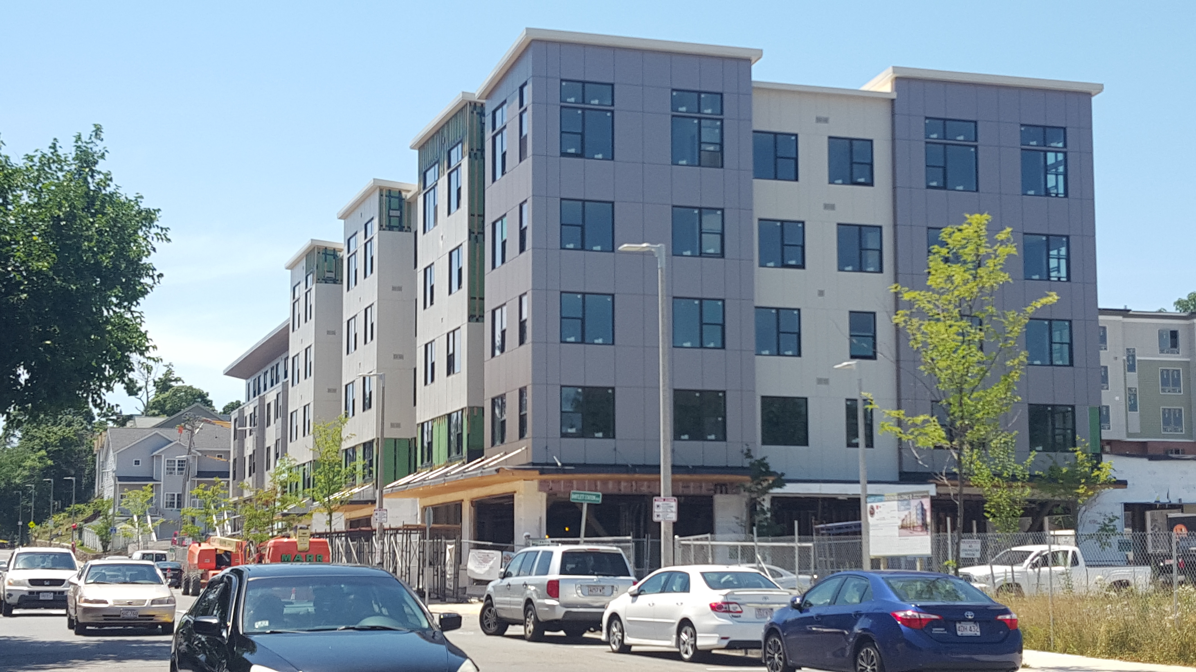

Local CHI Impact: Boston Medical Center (BMC)
Housing
Roxbury, MA
Bartlett Station + Nubian Markets
Built Environment
In 2017, BMC invested total local CHI contribution of $6M into a range of community development initiatives, including:
Bartlett Station, once a vacant MBTA bus yard, now a mixed-use development with 382 housing units, plus retail + commercial space
BMC + CAB leveraged CHI investment in Bartlett Station to ensure:
  Affordable housing for Roxbury families
  Healthy retail development—including a lease-to-own agreement for Nubian Markets’ co-owners, two longtime Roxbury residents
Also born out of this local CHI:
  Empowered the community through an Innovative Housing Stability Fund
  All 13 Boston Hospitals collaborated on one CHNA/CHIP

Slide 62


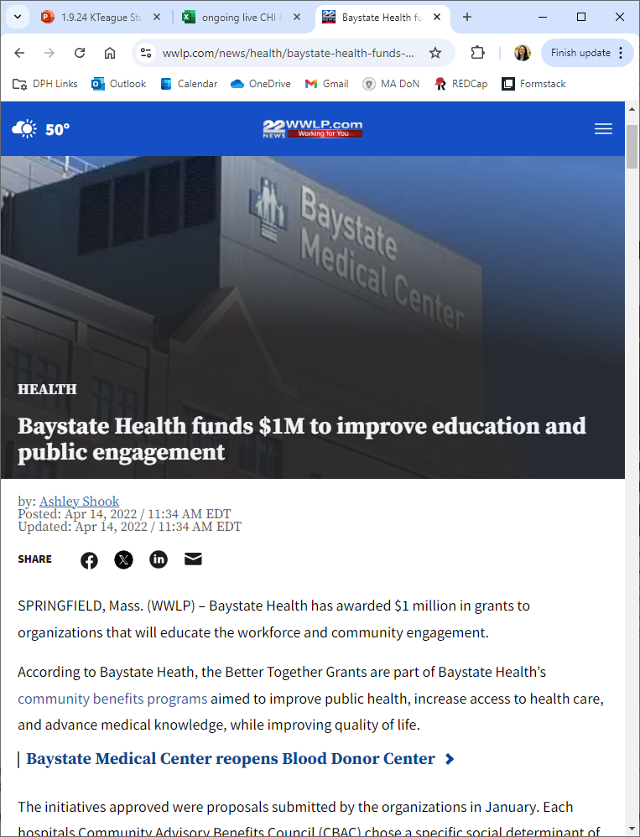
Local CHI Impact: Baystate Medical Center
Social Environment
Education
Pioneer Valley, MA
Innovative RFP Process
In 2020, Baystate invested total local CHI contribution of $1.2M
Built grant writing + development capacity among local community-based organizations:
  Offered mini grants
  Broke application process into feedback period, LOI + review
  Offered 2 cohorts of Grant writing 101
  Held feedback panels + office hours with public health professions to hear pitches + strengthen applications
  Fewer, larger grants awarded

Slide 63
Statewide Fund Investments

Slide 64
Overview of DoN CHI Process:
Local and State Investments, focus on state
5%
Local CHI
Hospital
Health Care System
Or Facility
Need to Expand or Improve Health Care Facilities
Determination of Need Project + Application
Project’s
Total Capital Expenditure
Community
Health Initiative
Funding*
Statewide Fund
*CHI funding contribution percentage varies based on project Applicant and application type.

Slide 65
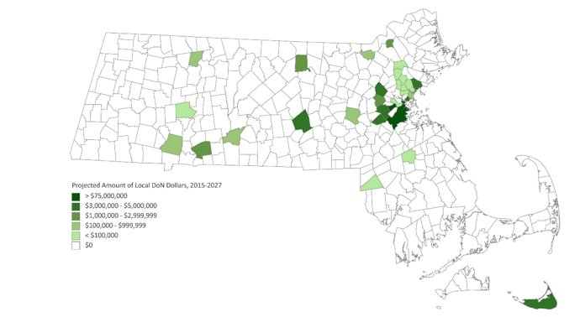
Projected amount of Local CHI Funds (2015-2027)
Projected Amount of Local DoN Dollars, 2015-2027
> $75,000,000
$3,000,000 - $5,000,000
$1,000,000 - $2,999,999
$100,000 - $999,999
$0

Slide 66

Distributing DoN CHI Funds More Equitably
MA CHHAF (“The Funds”) are born!

Slide 67

The Funds Key Takeaways
Health Resources in Action (HRiA) is the fiscal agent for the Statewide Funds (i.e., "the Funds") offering multi-year investments + capacity building to statewide awardees
  DPH and AGE play an advisory role
Since 2020, the Funds have released ~$15M every two years to geographic areas that do not have access to Local CHI dollars
  Awardees utilize a policy, systems & environmental change approach to impact structural racism, SDoH and health outcomes in their communities
  Next cycle is January 2026
Total Funding
$46.1M
Who Receives Funding
82 + > 110
Awardees
Community
Partners

Slide 68
Two Funds & Three Funding Opportunities
The Funds’ Advisory Committee
Statewide CHI Fund
Healthy Aging Fund
Policy, Systems, & Environmental Change Approaches
Community Health Improvement Processes (CHIP)
Healthy Aging
Domains

Slide 69
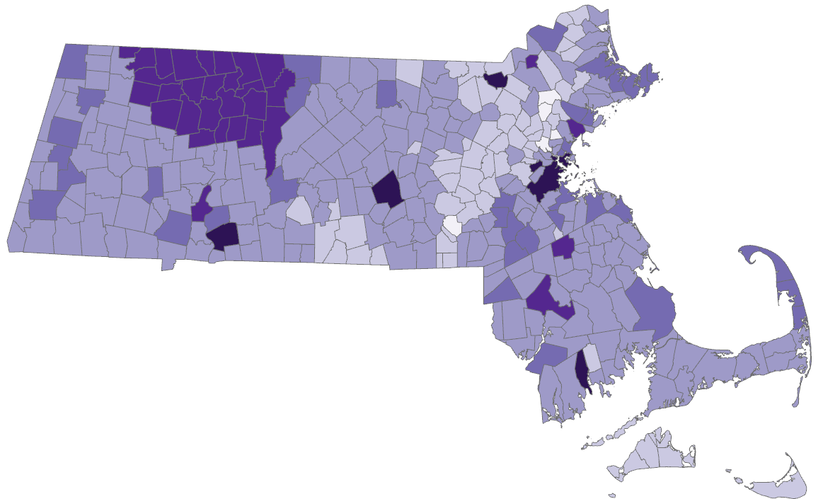

The Funds Geographic Reach (2020—2025)
Geographic Reach of Cohort 1-3 All Awardees
No awardees
1 awardee
2-3 awardees
4-5 awardees
6-8 awardees
9 or more awardees
NOTE: 9 awardees - Health Care for All (Cohort 1, PSE), Breaktime United (Cohort 2, CHIP), Housing Navigator MA, MA Law Reform Institute (Cohort 2, PSE), DEAF, Inc., Outstanding Life, Massachusetts Senior Action Council (Cohort 3, Healthy Aging Full) Empowerment Works, and Massachusetts Immigrant Refugee Advocacy (Cohort 3, PSE Full) have statewide coverage and are not otherwise represented in the map.
5 awardees - Springfield WORKS, Homes for All Massachusetts, Public Health Institute of Western MA, United Way Of Massachusetts Bay, (Cohort 3, PSE Full) and Massachusetts Association for Mental Health (Cohort 3, Healthy Aging Planning) have municipality and statewide coverage.

Slide 70
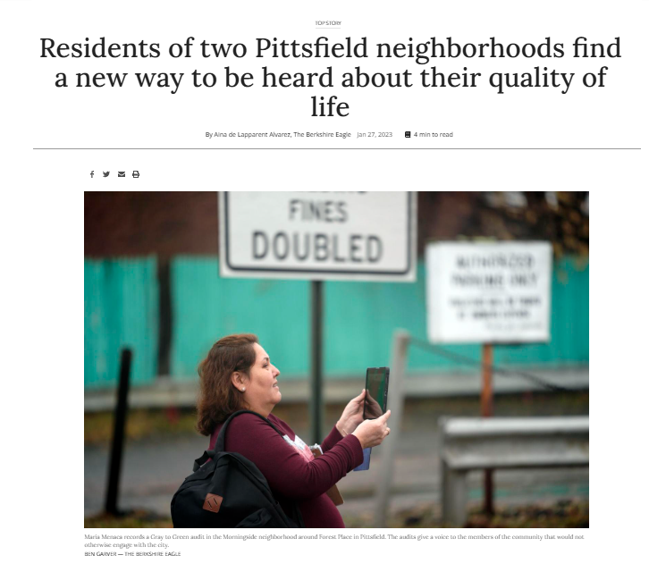

Statewide Impact: Berkshire Regional Planning Council (BRPC)
Built Environment
Social Environment
BRPC used Funds to partner with community members in Pittsfield’s Westside and Morningside neighborhoods.
Workgroup lead an environmental scan of community assets and developed recommendations for the City to increase walkability and access to green space in neighborhoods of focus
Pittsfield, MA
Grey to Green Project
Green Planning with a Racial Justice Framework

Slide 71
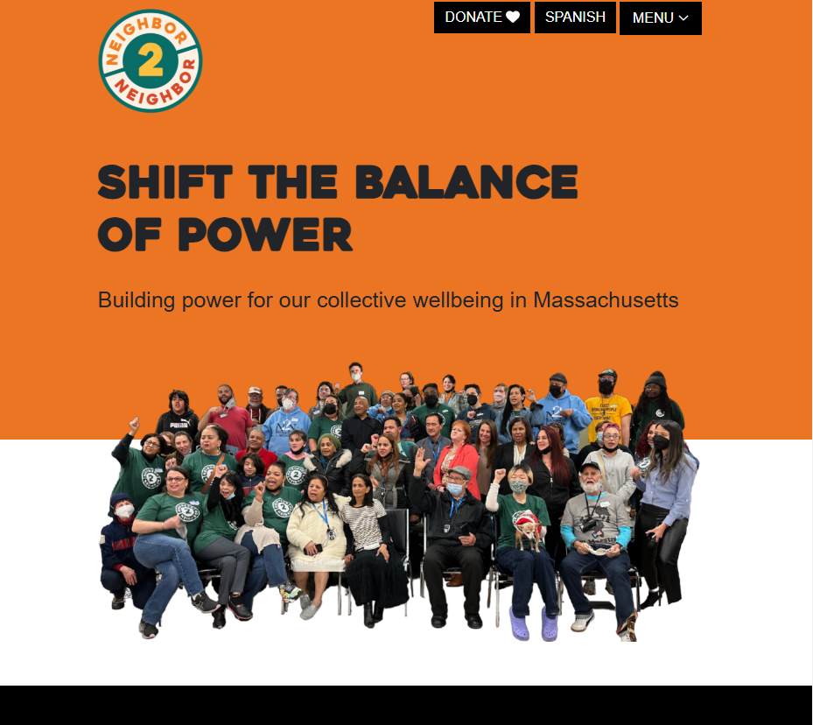
Statewide Impact: Neighbor to Neighbor MA Education Fund (N2N)
Built Environment
Social Environment
Housing
N2N with MA Public Health Association created an alliance of organizations to advance local policies
Year long community engagement process focused on better transit, cleaner air, stable housing, and more power to grow community advocacy in Central/Western MA
Worcester + Springfield, MA
Organizing for Transportation Justice

Slide 72
Key Themes of Local & Statewide Investments
Building and rebuilding trust with communities of focus
Disrupting racism and advancing equity
Authentic and transparent community engagement
Age-friendly community improvements

Slide 73
Looking Ahead

Slide 74
Looking Ahead: Local and Statewide
Local:
Reporting structure
Learn more: www.mass.gov/info-details/community-health-initiative-chi-requirements
Statewide:
Cohort 4 Application period 1/13/26 to 3/31/26
Funds at Five report
Learn more: www.mahealthfunds.org/about-the-funds/

Slide 75

Discussion
Initial thoughts?
Questions?

Slide 76
Informational presentation thank-you
Thank you for the opportunity to present this information today.
Please direct any questions to:
Jennica Allen, Manager of Community Engagement Practices
Jennica.f.allen@mass.gov
Katie Teague, Community Health Planning & Engagement Specialist
Katelyn.Teague@mass.gov
Division of Community Health Planning & Engagement
Bureau of Community Health & Prevention

Slide 77
Next meeting:
February 11, 2026

