Slide 1
Public health council
July 14, 2021
Please standby – the meeting will begin shortly
Today’s presentation is available on the mass.gov/dph website under “Upcoming Events” by clicking on the July 14 Public Health Council listing

Slide 2
Public health council
July 14, 2021
Today’s presentation is available on the mass.gov/dph website under “Upcoming Events” by clicking on the July 14 Public Health Council listing

Slide 3
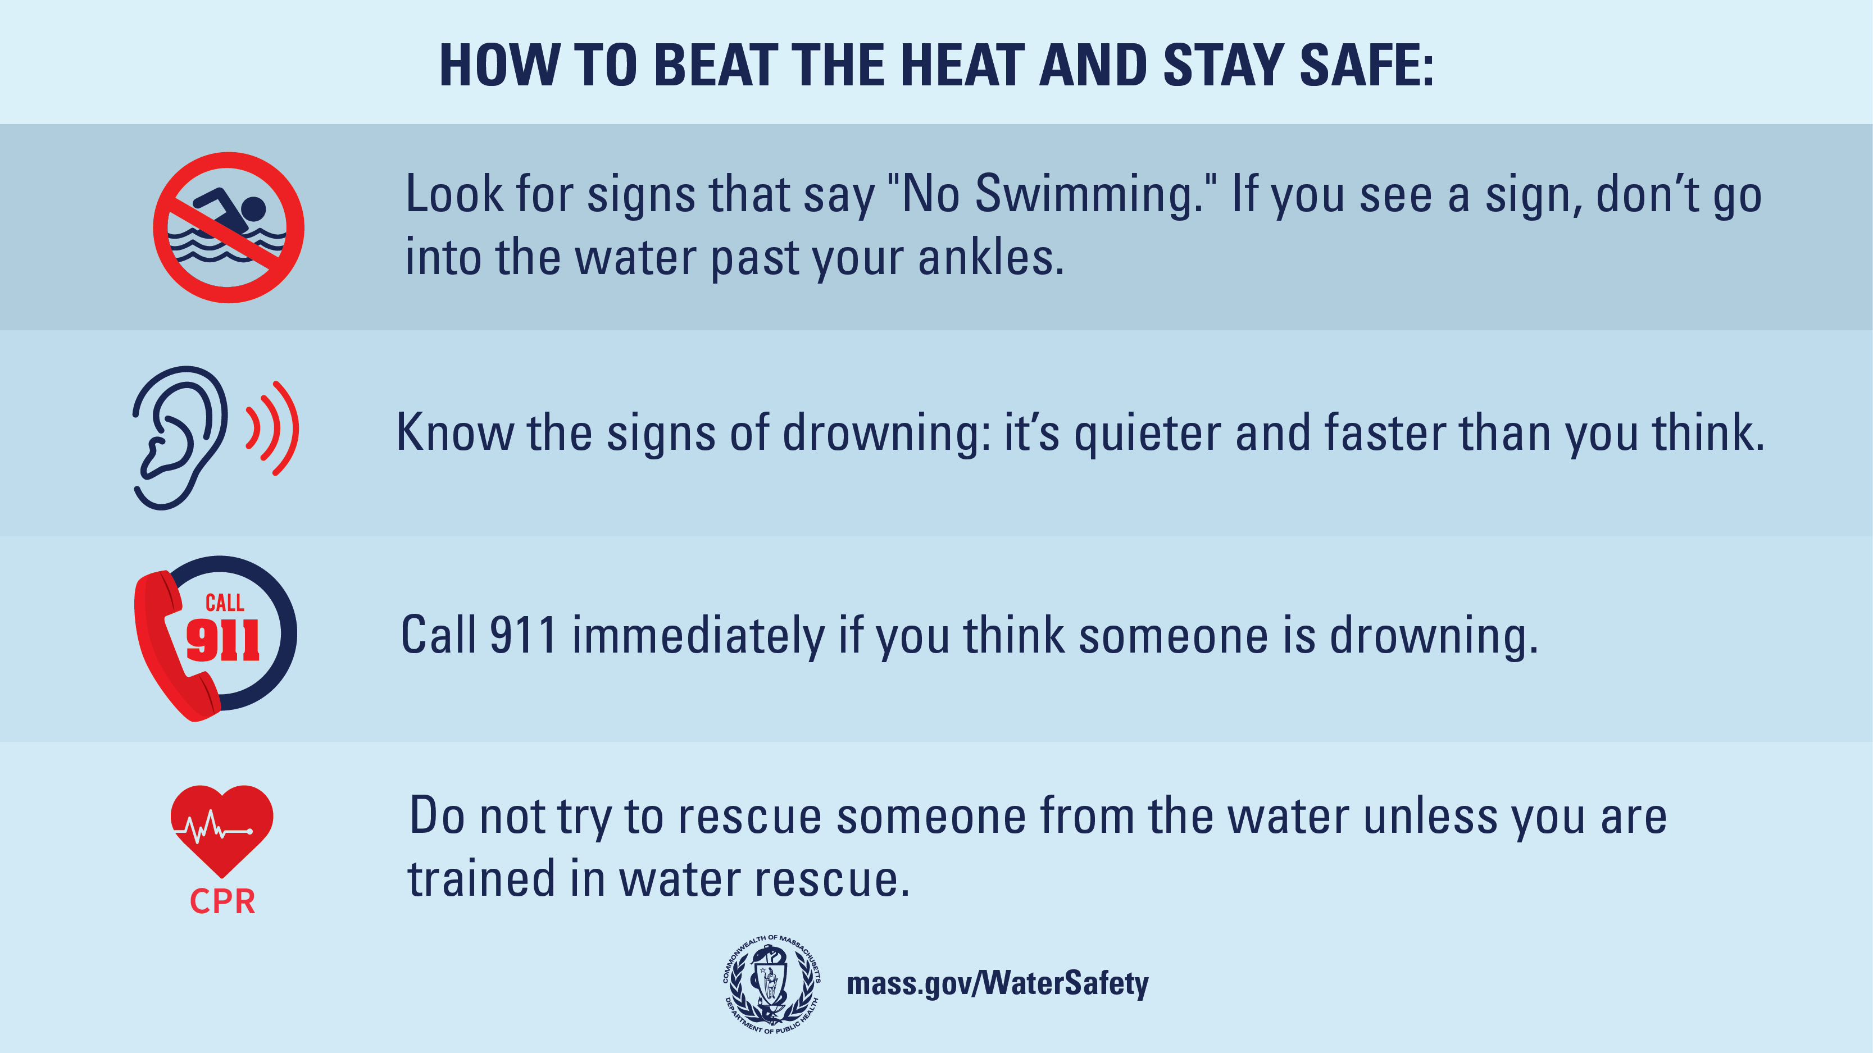
Safe Swimming

Slide 4
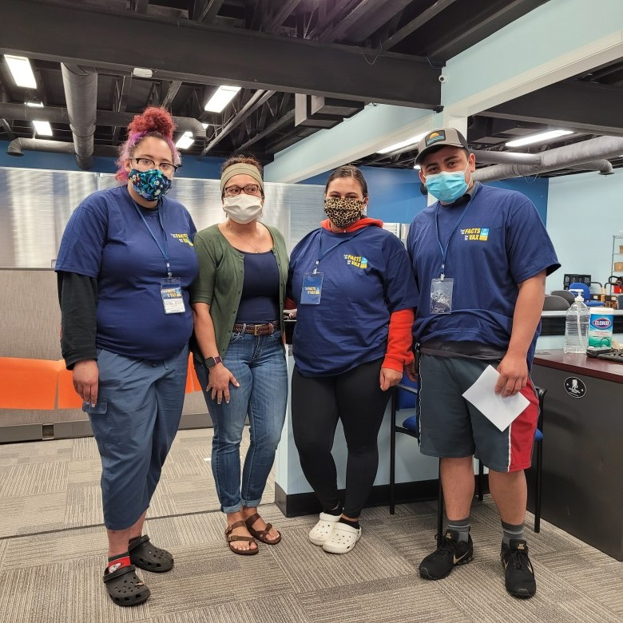
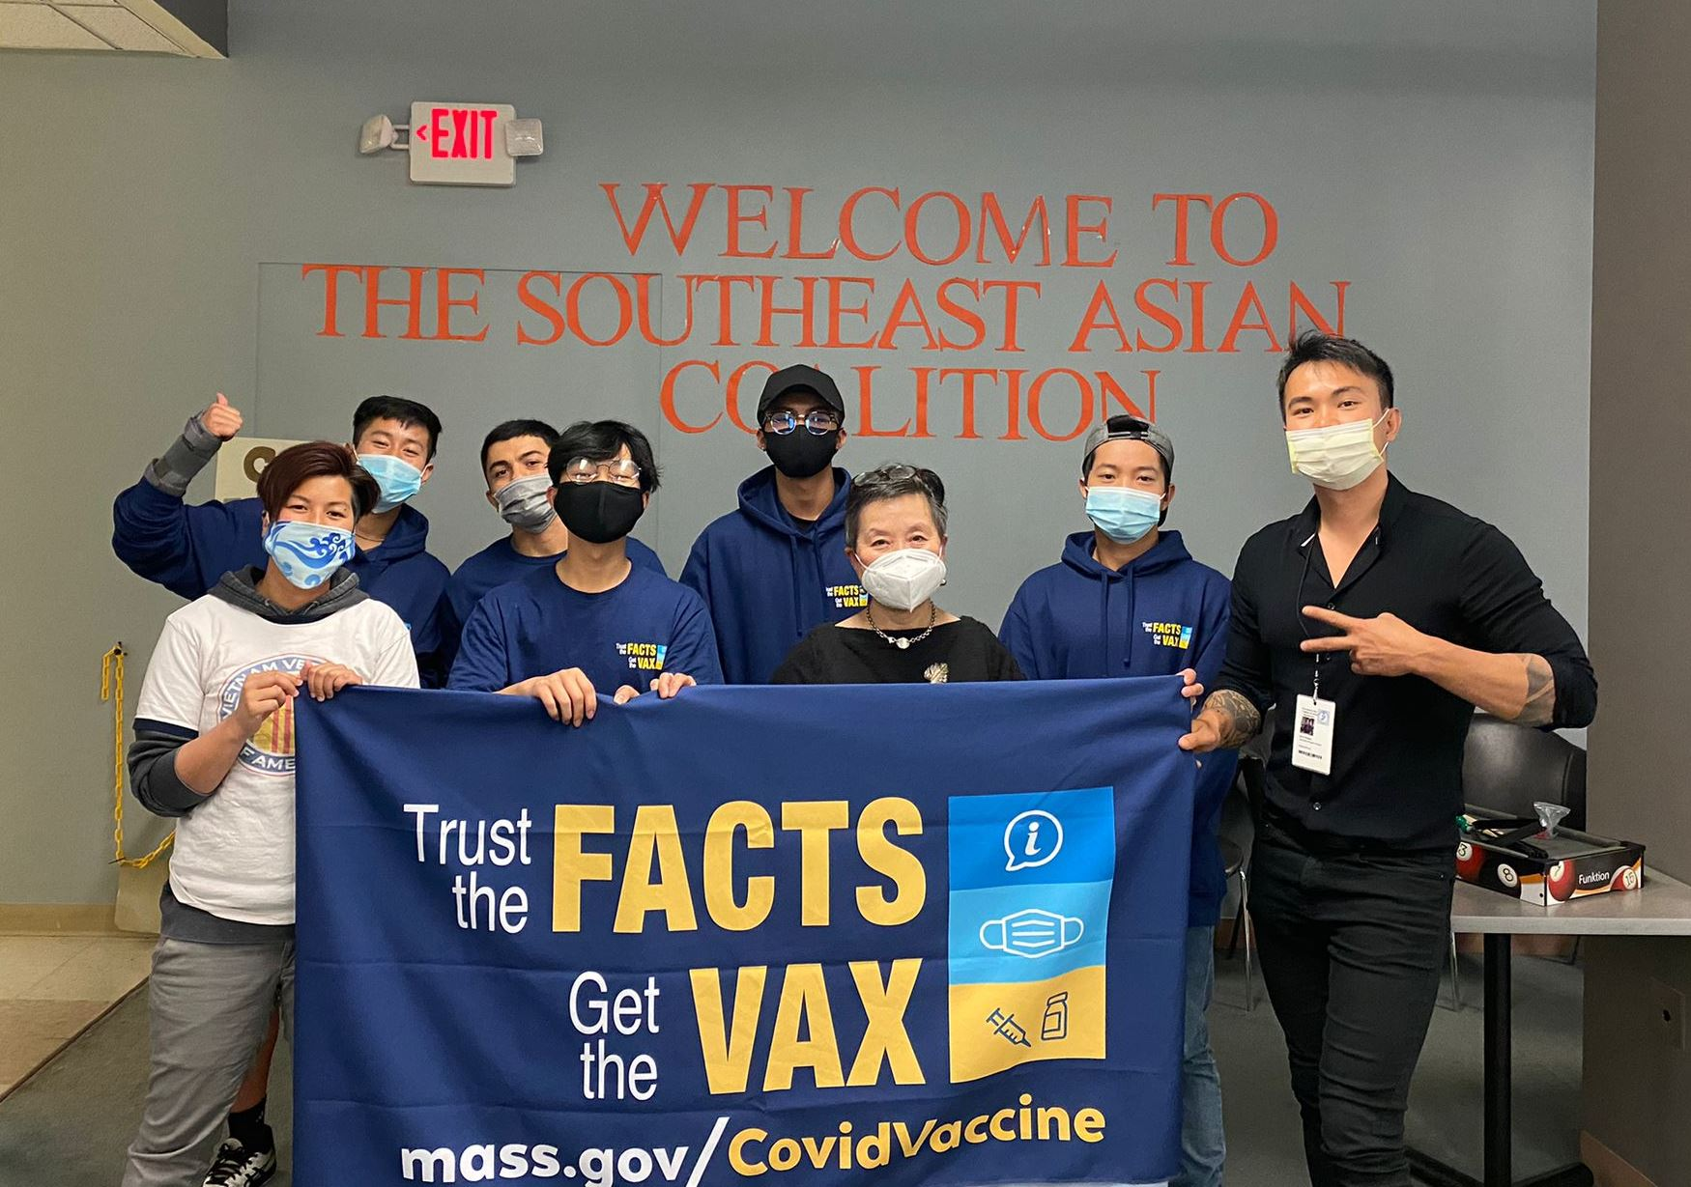
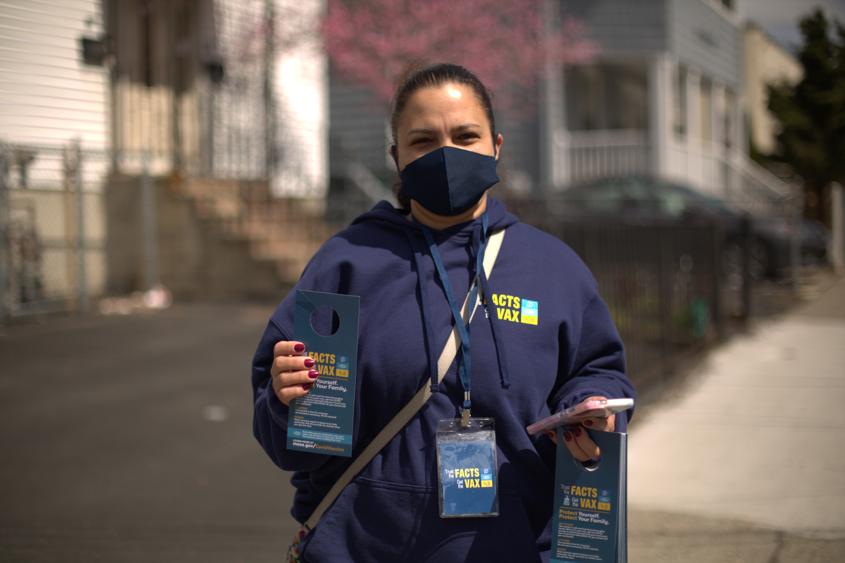
Vaccine Equity
470,000 door knocks
87,000 phone calls
800 mobile clinics
Fitchburg
Worcester
Everett

Slide 5
Trust the Facts. Get the Vax
Ahora que la vacuna COVID-19 ha sido aprobada para todas las personas mayores de 12 años, hablamos con un pediatra de MA sobre por qué todas las personas elegibles deberían recibir la vacuna.
“The past year has been hard on everyone, especially kids. The vaccine will help open their world back up while keeping them – and you – safe…Talk with your kids about it and get advice from their doctor.”

Slide 6
Dismantling Racism in Medicine

Slide 7
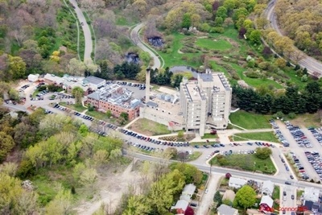
Update: Tick-borne Disease Surveillance in Massachusetts
Catherine M. Brown, DVM, MSc, MPH
State Epidemiologist and
State Public Health Veterinarian
Department of Public Health
Bureau of Infectious Disease and
Laboratory Sciences
Massachusetts State Public Health Laboratory

Slide 8
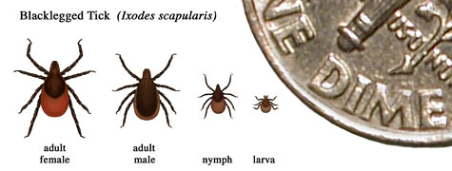
Tick-borne DiseasesTransmitted by Ixodes scapularis
Lyme Disease (Borrelia burgodorferi)
Early and late manifestations, persistent symptoms in some
Babesiosis (Babesia microti)
Red blood cell parasite: fever, chills, anemia
Anaplasmosis (Anaplasma phagocytophilum)
Bacteria that invades white blood cells: fever, headache, muscle aches, chills, sweating, nausea, and vomiting
Borrelia miyamotoi
Newly recognized bacteria as a human pathogen, relapsing fever
Powassan/Deer Tick Virus
Flavivirus related to WNV

Slide 10
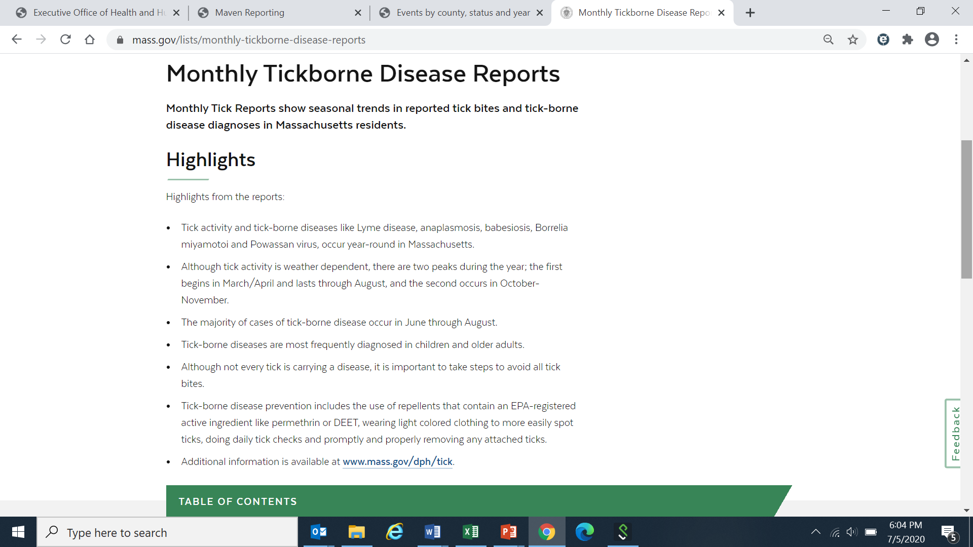
Monthly Tickborne Disease Report
https://www.mass.gov/lists/monthly-tickborne-disease-reports

Slide 11
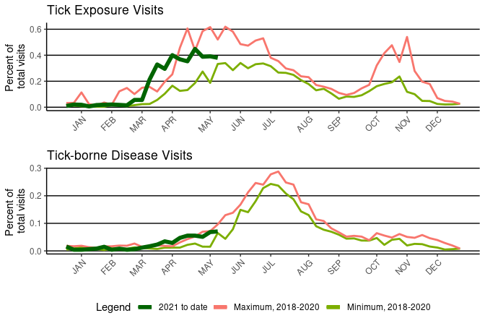
Tick Exposure Syndrome: Percent of total ED visits captured by MDPH SyS with tick exposure syndrome by week and year - 2021

Slide 12
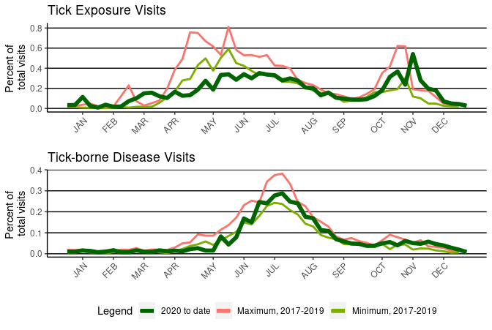
Tick Exposure Syndrome: Percent of total ED visits captured by MDPH SyS with tick exposure syndrome by week and year - 2020

Slide 13
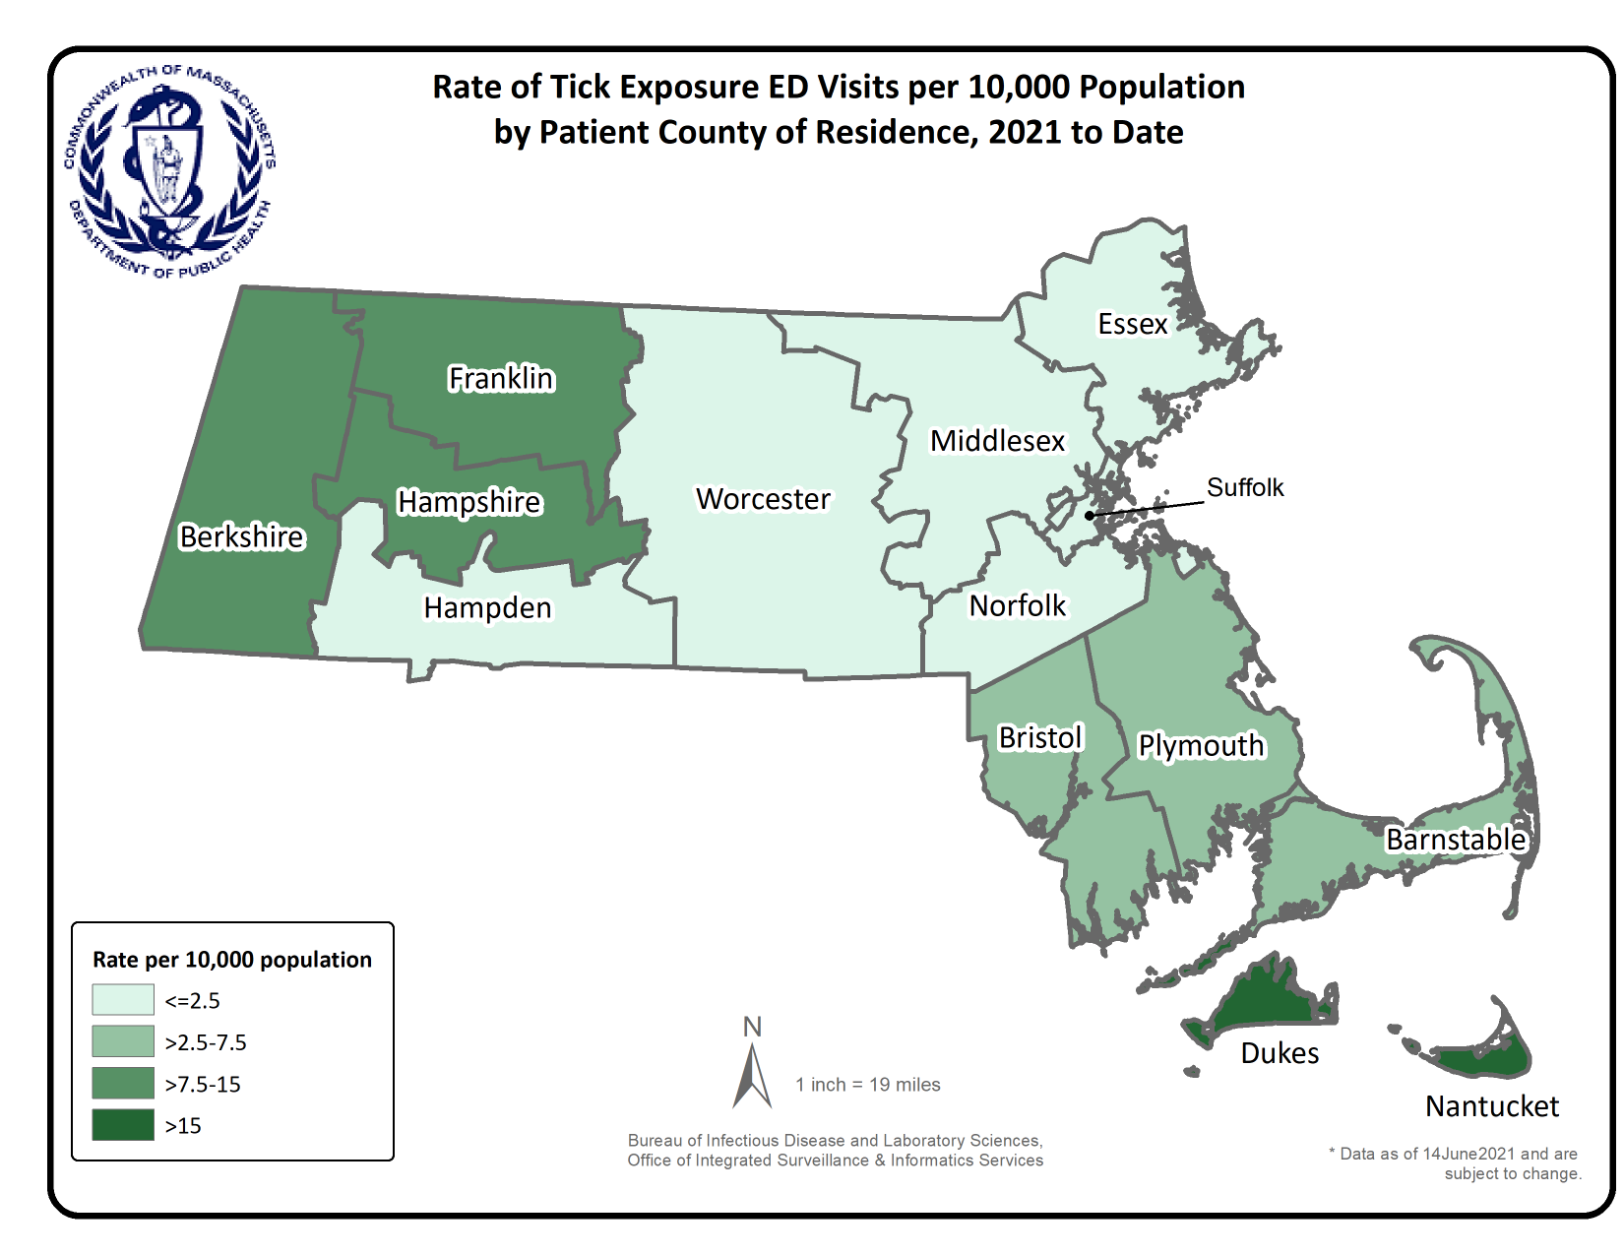
Map: Cumulative

Slide 14
Surveillance Highlights – B. miyamotoi
136 confirmed and probable cases of Borrelia miyamotoi were reported between 2014 and 2018. Overall, 306 suspect cases of Borrelia miyamotoi were investigated.
2019: 32 confirmed and probable, 92 suspect not investigated
2020: 10 confirmed and probable, 110 suspect not investigated (impact of COVID-19)
The majority of cases occurred in June July, August and September, only 35% of cases reported awareness of a recent tick bite.
The most commonly reported symptoms include: fever (91%), fatigue (87%), muscle aches/pain (85%), headache (82%), chills (82%), joint aches/pains (78%), and sweats (57%). There were no known fatalities.
People age 50 years and older continue to be at greatest risk for clinical disease (57% of patients identified with Borrelia miyamotoi were 50 or older) and 51% of the cases were male.

Slide 15
Borrelia miyamotoi
COUNTY | Number of Cases | Proportion of Cases
Barnstable County | 21 | 11.6
Berkshire County | 3 | 1.7
Bristol County | 20 | 11.0
Dukes County | 1 | 0.6
Essex County | 11 | 6.1
Franklin County | 1 | 0.6
Hampden County | 3 | 1.7
Hampshire County | 1 | 0.6
Middlesex County | 47 | 26.0
Nantucket County | 8 | 4.4
Norfolk County | 18 | 9.9
Plymouth County | 32 | 17.7
Suffolk County | 8 | 4.4
Worcester County | 7 | 3.9

Slide 16
Borrelia miyamotoi
Figure 2.
Number of confirmed and probable cases of B. miyamotoi by age group, Massachusetts, 2014-2020
Figure 3.
Number of confirmed and probable cases of B. miyamotoi by year, Massachusetts, 2014-2020

Slide 17
Surveillance Highlights - POWV
Although at least one case of Powassan virus was identified in Massachusetts before 2013, testing for the disease became more common in 2013.
Between 2013 and 2020, 39 cases of Powassan virus infection were detected in Massachusetts residents.
Twenty-one of those cases (75%) were between the ages of 51 and 82. Twenty (75.0%) of cases were male.
Twenty-three (58%) cases were diagnosed with encephalitis, twelve (30%) with meningoencephalitis and 3 (9%) cases with meningitis.
About 70% of cases reported known tick-bites before the onset of symptoms. This is in contrast to other tick-borne diseases where tick bites are not usually recognized.
38 cases required hospitalization and there were at least 8 deaths.

Slide 18
Powassan virus
COUNTY | Number of Cases | Proportion of Cases
Barnstable County | 5 | 12.8
Bristol County | 1 | 2.6
Essex County | 9 | 23.1
Hampden County | 2 | 5.1
Hampshire County | 1 | 2.6
Middlesex County | 13 | 33.3
Norfolk County | 3 | 7.7
Plymouth County | 1 | 2.6
Worcester County | 4 | 10.3

Slide 19
Powassan virus
Figure 2: Number of Powassan virus disease cases reported by year, Massachusetts 2013-2020.
Figure 3: Number of Powassan virus disease cases by month of onset, Massachusetts 2013-2020.

Slide 20
Tick Report – tick testing
https://www.tickreport.com/stats (2006-2021)

Slide 21
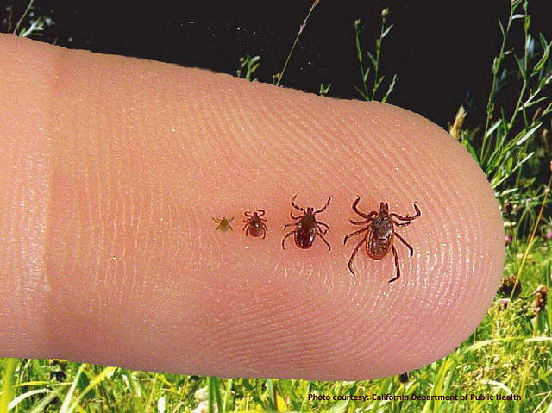

Slide 22
Serious Reportable Events Calendar Year 2020
July 14, 2021
Public Health Council
Katherine T. Fillo, Ph.D., MPH, RN-BC Katherine Saunders, MS
Bureau of Health Care Safety and Quality Bureau of Health Care Safety and Quality

Slide 23
Overview
Purpose
Background
Serious Reportable Event Category Definitions
Outcomes
Quality Improvement Activities

Slide 24
Purpose
This presentation is given for the following purposes:
To provide an update of the Serious Reportable Event program and related quality improvement activities at the Bureau of Health Care Safety and Quality; and
To share the trends in the types and volume of Serious Reportable Events reported in 2020 and previous years.

Slide 25
Background
Adverse events that occur in the health care setting are a patient safety concern and public health issue.
The Office of the Inspector General found that adverse events occur in 13.5% of hospital admissions of Medicare beneficiaries (2010).
It is also projected that 10% of Medicare patients nationally experience an adverse event during a rehabilitation hospital stay (OIG, 2016).
Section 51H of chapter 111 of the Massachusetts General Laws authorizes the Department to collect adverse medical event data and disseminate the information publicly to encourage quality improvement.

Slide 26
Background
The National Quality Forum (NQF) has operationalized a group of adverse events into measurable, evidence-based outcomes called Serious Reportable Events (SRE).
MA adopted SREs as its adverse event reporting framework in 2008.
There is no federal adverse event reporting system. Twenty-seven other states developed and implemented state-based adverse event reporting programs.
Over half use the SRE framework including Connecticut, Minnesota and New Hampshire.

Slide 27
SREs and COVID-19
As part of the COVID-19 response, all nonessential and elective invasive procedures were suspended beginning March 15, 2020 and were able to resume on June 24, 2020 under a set of limited circumstances. There was a similar restriction on these procedures again in December of 2020.
No SREs were reported by ambulatory surgical centers in calendar year 2020 and the number SREs associated with surgical or invasive procedures was significantly diminished overall.

Slide 28
SREs Defined
Section 51H of Chapter 111 of the General Laws:
“Serious reportable event”, an event that results in a serious adverse patient outcome that is clearly identifiable and measurable, reasonably preventable, and that meets any other criteria established by the department in regulations.
105 CMR 130.332 and 105 CMR 140.308:
Serious Reportable Event (SRE) means an event that occurs on premises covered by a hospital's license that results in an adverse patient outcome, is clearly identifiable and measurable, has been identified to be in a class of events that are that are largely preventable and harmful, and of a nature such that the risk of occurrence is significantly influenced by the policies and procedures of the hospital. The Department issued a list of SREs based on those events included on the NQF table of reportable events to which 105 CMR 130.332 and 105 CMR 140.308 apply in guidance.

Slide 29
Reporting Requirements
Hospitals and ambulatory surgical centers (ASCs) are required to report SREs to the patient/family and the Bureau of Health Care Safety and Quality (BHCSQ) within seven days of the incident.
An updated report to BHCSQ, the patient/family and the insurer is required within 30 days of the incident, including documentation of the root cause analysis findings and determination of preventability as required by 105 CMR 130.332(c) & 105 CMR 140.308(c).
In June 2009, the Department implemented regulations prohibiting health care facilities from charging for services provided as a result of preventable SREs.
Amendments adopted as part of the hospital regulatory review completed in 2017 streamlined the reporting process without removing transparency.

Slide 30
SRE Types
Surgical or Invasive Procedure Events
Wrong Site Surgery or Procedure
Surgery or Procedure on Wrong Patient
Wrong Surgery or Procedure
Unintended Retention of a Foreign Object
Intraoperative or Immediate Postoperative Death of an ASA Class 1 Patient
Product or Device Events
Death or Serious Injury Related to Contaminated Drugs, Biologics, or Devices
Death or Serious Injury Related to Device Misuse or Malfunction
Death or Serious Injury Due to Intravascular Air Embolism
Patient Protection Events
Discharge of a Patient/Resident of Any Age to Other Than Authorized Person
Death or Serious Injury Associated with Patient Elopement
Patient Suicide, Attempted Suicide, or Self-Harm That Results in Serious Injury

Slide 31
SRE Types
Death or Serious Injury Associated with a Medication Error
Death or Serious Injury Associated with Unsafe Blood Product Administration
Maternal Death or Serious Injury Associated with Low-Risk Pregnancy Labor or Delivery
Death or Serious Injury of a Neonate
Death or Serious Injury Associated with a Fall
Stage 3, Stage 4 or Unstageable Pressure Ulcer
Artificial Insemination With Wrong Donor Sperm or Egg
Death or Serious Injury from Irretrievable Loss of a Specimen
Death or Serious Injury from Failure to Follow Up on Test Result
Care Management Events

Slide 32
SRE Types
Environmental Events
Patient or Staff Death or Serious Injury Associated with an Electric Shock
Any Incident In Which No Gas, Wrong Gas or Contaminated Gas Delivered to Patient
Radiologic Events
Death or Serious Injury of Patient or Staff Associated with Introduction of a Metallic Object Into MRI Area
Patient or Staff Death or Serious Injury Associated with a Burn
Death or Serious Injury Associated with Restraints or Bedrails
Any Instance of Care Provided by Someone Impersonating a Health Care Provider
Resident/Patient Abduction
Sexual Abuse/Assault on a Patient or Staff Member
Death or Serious Injury of Patient or Staff Member as a Result of Physical Assault
Potential Criminal Events

Slide 33
Acute Care Hospital Data
Total Number of SREs in Acute Care Hospitals by Year
**
** An event in 2016 affected a large number of patients and is reflected in the increase in SREs reported.
Data abstracted on May 28, 2021 from the Health Care Facility Reporting System

Slide 34
Acute Care Hospital Surgical Event Data
Key Findings
For 2020, there was an increase in the number of events where there was an unintended retention of a foreign object.
The most frequently reported outcome is that patients require an additional surgery or procedure to remove the foreign object that was unintentionally retained.
Data abstracted May 28, 2021 from the Health Care Facility Reporting System

Slide 35
Acute Care Hospital: Product/Device Event Data
Key Findings
In the contaminated drugs, device or biologics event, one incident, that affected a significant number of patients in 2016, represents most of the category. The hospital engaged in a robust corrective action plan to address the root causes of these incidents.
Since 2016, the number of product/device events has decreased although there was a slight increase in device misuse or malfunction for 2020.
**
**An event in 2016 affected a large number of patients and is reflected in the increase in SREs reported.
Data abstracted on May 28, 2021 from the Health Care Facility Reporting System.

Slide 36
Acute Care Hospital: Environmental Event Data
Key Findings
Burn events represent second degree or more severe burns.
Burn events result from equipment including radiology machines and cautery devices, chemotherapy and hot beverage spills.
Data abstracted on May 28, 2021 from the Health Care Facility Reporting System.

Slide 37
Acute Care Hospital: Patient Protection Event Data
Key Findings
There was 1 completed suicide event and 57 self-harm or attempted suicide events in 2020.
Cutting and ingesting objects are the methods reported as having the highest incidence in the suicide and self-harm events.
Data abstracted on May 28, 2021 from the Health Care Facility Reporting System.

Slide 38
Acute Care Hospital: Potential Criminal Event Data
Key Findings
Over half of the physical assaults or abuse events that resulted in serious injury were patient on staff member encounters, often resulting in lost work days.
Emergency departments followed by inpatient psychiatric units are the most frequently reported location within the hospital for these events to occur.
Data abstracted on May 28, 2021 from the Health Care Facility Reporting System.

Slide 39
Acute Care Hospital: Care Management Event Data
Key Findings
Pressure injuries and falls that result in serious injury are the two most commonly reported events.
Pressure ulcers are the most common serious injury, about 56% of those reported occurred on the back, spine or buttocks and 41% occurred in patients under the age of 65 years.
Data abstracted on May 28, 2021 from the Health Care Facility Reporting System.

Slide 40
Non-Acute Care Hospital Data
Total Number of SREs in Non-Acute Care Hospitals by Year
Data abstracted on May 28, 2021 from the Health Care Facility Reporting System.

Slide 41
Non-Acute Care Hospital: Category Data
Reported SREs 2016-2020 (Non-acute care hospitals)
Key Findings
There are three types of hospitals: public health, rehabilitation or psychiatric.
Like acute care hospitals, falls and pressure ulcers continue to be the most common events.
Data abstracted on May 28, 2021 from the Health Care Facility Reporting System.

Slide 42
SRE Types by Race
Key Findings
Although most SREs reported in CY 2020 are in white patients (71% N=1046), a significant proportion of events are reported with unknown race (10% N=144), other race (4% N=56), or missing race (5% N=66). Most events with unknown race, other race or missing race were in the care management and potential criminal event domains.
Data abstracted on May 28, 2021 from the Health Care Facility Reporting System.

Slide 43
SRE Types by Ethnicity
Key Findings
Although most SREs are reported in Non-Hispanic patients (N=1084), about 6% (N=84) are reported for Hispanic patients, about 16% (N=238) are reported for patients with Unknown ethnicity and another 4% (N=59) are reported for patients with missing ethnicity.
Data abstracted on May 28, 2021 from the Health Care Facility Reporting System.

Slide 44
Quality Improvement Activities
Working with individual facilities after an SRE occurs to develop corrective action plans and prevent an event of a similar type from happening in the future.
Continued collaboration with DPH’s Suicide Prevention Program to share event data and promote use of online curriculum detailing best practices for reducing suicide and self-harm in the facility setting.
Collaborating with EHS agencies to ensure patient safety maintained during COVID-19 pandemic.
Actively participating in MA Coalition for the Prevention of Medical Errors.
Sharing electronic health system related events and opportunities to address causal factors.
Partnering with Betsy Lehman Center to address the following:
Utilize their monthly newsletter to share patient safety trends; and
Maintaining an Interagency Service Agreement to allow for more seamless data sharing, as intended by the 2012 cost containment act.
Utilizing DPH list servs for widespread education and to share appropriate guidance.
Exploring opportunities to collaborate with stakeholders to decrease incidence of pressure injuries.

Slide 45
Contact Information
Thank you for the opportunity to present this information today.
Please direct any questions to:
Katherine T. Fillo Ph.D, MPH, RN-BC
Director, Clinical Quality Improvement
Bureau of Health Care Safety and Quality
katherine.fillo@state.ma.us

Slide 46
COVID-19
Community Impact Survey(CCIS)
Preliminary Analysis Results as of
July 14, 2021 Presented by: W.W. Sanouri Ursprung PhD Chapter Authors: Elizabeth Beatriz, PhD, Justine Egan, MPH, Allison Guarino, MPH, and Beatriz Pazos Vautin, MPH
Massachusetts Department of Public Health
7.14.21 release

Slide 47
CCIS TEAM MEMBERS
CCIS Project Leads
W.W. Sanouri Ursprung, Lauren Cardoso, Beth Beatriz, Glory Song, Caroline Stack, Kathleen Fitzsimmons, Emily Sparer-Fine, Ben Wood, Lisa Bandoian, Heather Nelson, Amy Flynn, Lisa Arsenault, Abby Atkins
CCIS Analytic Team
Beth Beatriz, Glory Song, Caroline Stack, Kathleen Fitzsimmons, Emily Sparer-Fine, Ziming Xuan, Matthew Tumpney, Rebecca Han, Lauren Larochelle, Arielle Coq, Anne Marie Matteucci, Lauren Fogharty, Vera Mouradian, Melody Kingsley, Ta Wei Lin, Anna Agan, Justine Egan, Allison Guarino, Elizabeth Showalter, Beatriz Pazos Vautin, Priyokti Rana, Mayowa Sanusi, Emily Lawson, Alana LeBrón Lauren Cardoso, W.W. Sanouri Ursprung
CCIS Data to Action Workgroup
Jessica del Rosario, Kim Etingoff, Lisa Bandoian, Andrea Mooney, Ben Kingston, Lauren Cardoso; Dawn Fukuda, Lamar Polk, Hermik Babakhanlou-Chase, Glennon Beresin, Mahsa Yazdy, Emily White, Timothy St. Laurent, Fareesa Hasan, Nicole Roos
CCIS Steering Committee
Lauren Cardoso, W.W. Sanouri Ursprung, Beth Beatriz, Abbie Averbach, Ruth Blodgett, Ben Wood, Sabrina Selk, Nicole Daley, Lisa Bandoian
CCIS Data Dissemination Workgroup
Beth Beatriz, Glory Song, Emily Sparer-Fine, Ta Wei Lin, Vera Mouradian, Rebecca Han
6.9.21 release

Slide 48
CCIS COMMUNITY PARTNERS
Many groups that were critical in the success of this effort and gave important input on the development and deployment of the survey:
Academic Public Health Volunteer Corps and their work with local boards of health and on social media
Mass in Motion programs, including Springfield, Malden, and Chelsea
Cambodian Mutual Assistance
The Mashpee Wampanoag Tribe
The Immigrants’ Assistance Center, Inc
Families for Justice as Healing
City of Lawrence Mayor’s Health Task Force
The 84 Coalitions, including the Lawrence/Methuen Coalition
Boys and Girls Clubs, including those in Fitchburg and Leominster and the Metro South area
Chinatown Neighborhood Association
Father Bill’s
UTEC
MassCOSH
Stavros Center for Independent Living
Greater Springfield Senior Services
Center for Living and Working
DEAF, Inc.
Massachusetts Commission for the Deaf and Hard of Hearing
Viability, Inc.
6.9.21 release

Slide 49
PURPOSE
GOAL: share some key findings from the COVID-19 Community Impact Survey (CCIS) showing how the education and employment of youth, and young parents in particular, have been impacted by the pandemic in order to:
Inform immediate and short-term actions
Identify which populations have been most disproportionately impacted
Identify ways to advance new, collaborative solutions with community partners to solve the underlying causes of inequities
Visit http://mass.gov/covidsurvey for more detailed findings!

Slide 50
PREVIOUS KEY TAKEAWAYS: YOUTH
While not as widely discussed as a disproportionately impacted group, youth are deeply concerned about and have been significantly impacted by the pandemic, especially youth of color, LGBQA youth, youth with disabilities, and young parents.
Many youth report facing early parentification and are concerned about providing the basic needs for their families.
The pandemic has had a significant impact on the mental health of youth.
5.12.21 release

Slide 51
YOUTH: EMPLOYMENT, EDUCATION & YOUNG PARENTS Elizabeth Beatriz, PhD Justine Egan, MPH Allison Guarino, MPH Beatriz Pazos Vautin, MPH
6.9.21 release

Slide 52
YOUTH SURVEY QUESTIONS & WEIGHTING
There were two versions of the survey questions: adult (n=33,000) and youth (n=3,000). Due to their unique needs, young parents(n=148) received the adult questions.
Adult & youth results were weighted to the state distribution. Different weights were used for each population.
Data on young parents were unweighted due to methodological considerations.

Slide 53
FRAMING MATTERS: YOUTH EDUCATION & EMPLOYMENT
Youth may not be the first group we think of when considering the impacts of the pandemic, our survey responses suggest that they have had to adapt to a changing educational system while being an essential part of the workforce. To understand the immediate and lasting impact of the pandemic on youth, we must consider both.
Every year, the summer is an essential transition time for youth, but summer 2021 is especially important. As we reopen and plan for the future, we must make sure youth have access to vaccines and ensure safe spaces for youth, both as students and as workers.
6.9.21 release

Slide 54
YOUTH EDUCATION & EMPLOYMENT
Youth have had to adapt to a changing educational system while being an essential part of the workforce.
EDUCATION
EMPLOYMENT
1 in 3 surveyed youth reported worrying about continuing their education last fall (2020-2021).
Of these, 20% reported concern about getting COVID-19 as primary factor.
Youth worried about continuing their education were more likely have concerns about:
getting access to supports to fully engage in school, particularly remotely
AND
family economic stressors.
Half of surveyed youth reported working in the last year.
Young workers were 2X more likely to lose their job than adult workers.
Young workers were more likely than adult workers to work outside of the home, which increases their risk of exposure to COVID-19.
Among those working outside the home, many youth were not able to access workplace protections.
Preliminary data - 1.7.21 - Not for external distribution
6.9.21 release

Slide 55
WHERE ARE YOUTH WORKING?
Youth worked in industries hit very hard by the pandemic
Nearly 3 in 5 (57%) younger youth worked in accommodation & food services, or retail.
2 in 5 (41%) older youth worked in healthcare or education.
Reopening, recovery, and vaccine plans need to consider youth needs as many worked in jobs which were lost during the pandemic. This is particularly important in summer months when many youth work.
Preliminary data - 1.7.21 - Not for external distribution
6.9.21 release

Slide 56
EMPLOYER PROVIDED PROTECTIVE MEASURES
3 in 5 working youth worked a job outside of the home facing increased risk of exposure to COVID-19.
Among those working outside the home many youth were not able to access
workplace protections in the fall.
2 in 5 respondents worked in places that did not
provide personal protective equipment (PPE).
2 in 5 respondents worked in places that did not
implement social distancing.
3 in 5 respondents worked in places that did not provide additional health & safety training.
The lack of workplace protections in the fall was even more
pronounced for younger youth, bisexual youth, and youth of color.
Preliminary data - 1.7.21 - Not for external distribution
6.9.21 release

Slide 57
FRAMING MATTERS: YOUNG PARENTS
Though not often highlighted as a priority population, survey responses suggest that young parents have faced a confluence of pressures during the pandemic, ranging from grief due to lost loved ones, unstable housing or job loss, or significant stress related to balancing caregiving with paid work. These significant impacts must be considered in recovery planning.
Young parents are both young people in a critical period of development, and caregivers of infants or young children in a critical period of development. Among youth, the needs of young parents are particularly consequential because of this intergenerational impact. Despite the social supports available during the pandemic, such as housing and food assistance, young parents may not be able to access some of these resources.
7.14.21 release

Slide 58
YOUNG PARENT EXPERIENCES WITH COVID-19
Young Parents were especially hit by trauma and loss during the pandemic
Young parent respondents (6%) were 2x more likely to report testing positive for COVID-19 (3%)
Young parent respondents (14%) were 2x more likely to report losing someone close to them due to COVID-19 (6%)
Data notes: 1)reference groups are youth non-parent and parents aged 35-44; 3) All percentages are unweighted.

Slide 59
YOUNG PARENT NEEDS
Young Parents were especially hit by job loss (many due to caretaking responsibilities) which impacts their ability to meet basic needs from housing to formula or diapers for their children.
1 in 2 employed young parents lost their jobs or reduced hours/took leave.
Young Parents were 37% more likely to experience unmet children’s needs such as formula, diapers, wipes, baby food, etc. (48% vs. 35%)
Young workers were 2X more likely to lose their job than adult workers.
1 in 2 young parents reported being worried about housing.
50% who reduced hours/took leave and 38% who lost jobs listed needing to take care of children as a reason.
6X higher than other youth
Data notes: 1)reference groups are youth non-parent and parents aged 35-44; 3) All percentages are unweighted.

Slide 60
YOUNG PARENT NEEDS
Young Parents were especially hit by job loss (many due to caretaking responsibilities) which impacts their ability to meet basic needs from housing to formula or diapers for their children
“...it's just a lot of very huge, lack of affordability and stuff, and there's a lot of people right now that I know, especially with children, who are struggling and they're, they're being told the waitlist is at least 15 years long.”²
--MA young person living in Lynn
1 in 2 employed young parents lost their jobs or reduced hours/took leave.
Young Parents were 37% more likely to experience unmet children’s needs such as formula, diapers, wipes, baby food, etc. (48% vs. 35%)
Young workers were 2X more likely to lose their job than adult workers.
1 in 2 young parents reported being worried about housing.
50% who reduced hours/took leave and 38% who lost jobs listed needing to take care of children as a reason.
6X higher than other youth
Data notes: 1)reference groups are youth non-parent and parents aged 35-44; 3) All percentages are unweighted.

Slide 61
UNSTABLE HOUSING & YOUTH
Young parents who are homeless or have unstable housing are at risk for a range of health outcomes including violence
Young parents who are homeless are more likely to experience IPV, postpartum depression¹, concerns over expenses, & poor mental health.
Transactional sex may be used by housing and food insecure youth – including through online dating apps – to meet needs.²
IPV often leads to homelessness among survivors. Homelessness^{3,4,5} in turn puts people at risk for sexual assault and trafficking,^{4,5} creating a reinforcing cycle.
Sources: (1) Crawford, D. M., Trotter, E. C., Sittner Hartshorn, K. J., & Whitbeck, L. B. (2011). Pregnancy and mental health of young homeless women. American Journal of Orthopsychiatry, 81(2), 173–183. doi: 10.1111/j.1939-0025.2011.01086.x (2) Umass Amherst interview with Lynn Community Action Board (CAB), unpublished. (3) Breiding, M.J., Chen J., & Black, M.C. (2014). Intimate Partner Violence in the United States — 2010. Atlanta, GA: National Center for Injury Prevention and Control, Centers for Disease Control and Prevention. (4) Jasinski, J. L., Wesely, J. K., Mustaine, E., & Wright, J. D. (2005). The experience of violence in the lives of homeless women: A research report (Document No. 211976). Retrieved from the U.S. Department of Justice, Office of Justice Programs: http://www.ncjrs.gov/pdffiles1/nij/grants/211976.pdf (5) Tyler, K. A, Whitbeck, L. B., Hoyt, D. R. & Cauce, A. M. (2004). Risk Factors for Sexual Victimization Among Male and Female Homeless and Runaway Youth. Journal of Interpersonal Violence, 19, 503-520. https://doi.org/10.1177/0886260504262961

Slide 62
EXPERIENCES WITH VIOLENCE DURING THE PANDEMIC
Young parents were 4 times as likely to report intimate partner violence (IPV) during the pandemic compared to parents aged 35-44.
Data notes: 1)* denotes rate is significantly different (p<0.05) compared to the reference group; 2) reference groups is parents aged 35-44; 3) All percentages are unweighted.

Slide 63
EXPERIENCES WITH VIOLENCE DURING THE PANDEMIC
Young parents were 4 times as likely to report intimate partner violence (IPV) during the pandemic compared to parents aged 35-44.
So if there is a teen that, for some reason they were kicked out or homeless…they may have to turn to sex work in order to provide for themselves. That's a big risk factor. Also you know young adults and teens are doubled up in living situations, either with strangers or with family members that could open up other opportunities for risk. …I wonder if it could open up other opportunities for somebody to be victimized or taken advantage of, not just physically... So I think that that's definitely a big one, if a young adult child doesn't feel like they have a safe place to call home, that could lead to other things.”²
--MA young person living in Lynn
Data notes: 1)* denotes rate is significantly different (p<0.05) compared to the reference group; 2) reference groups is parents aged 35-44; 3) All percentages are unweighted.

Slide 64
WHERE ARE YOUNG PARENTS?
Young Parents are concentrated in areas hardest hit by the pandemic.
Many of the towns with the highest teen birth rates, also are those hardest hit by COVID infections
Even within a single community, historic disinvestment and structural drivers have created racial inequities in the teen birth rate.
Chelsea
Lawrence
New Bedford
Springfield
Lynn
Data notes: 1)reference groups are youth non-parent and parents aged 35-44; 3) All percentages are unweighted.

Slide 65
KEY TAKEAWAYS: YOUTH & YOUNG PARENTS
The global pandemic has had a significant impact on youth’s education and employment – as recovery continues, policies must reflect youth’s needs as both students and employees.
Supports for young parents are urgently needed. The impact of the pandemic on young parents could be multi-generational as it affects both youth/parent development and infant & child development.
Half of employed young parents reduced their hours/lost jobs, (twice as high as older parents).
More than 80% of young parents have at least one unmet household need.
Young parents experienced intimate partner violence at significantly higher rates
Nearly half of young parents are concerned about housing expenses.
Concerns about housing, childcare, expenses, and IPV significantly impact the mental and physical health of both young parents and their children.
Inequities are concentrated geographically
7.14.21 release

Slide 66
EXAMPLE DATA TO ACTION
Employment & Education Actions Taken
Coordinate the MA Youth Employment and Safety Team (MA YES TEAM), a multi-agency group that aims to keep youth safe at work including in state funded summer work programs.
Explore opportunities for vaccine ambassadors to include information specific to youth especially when giving presentations to municipalities or employers.
Connect vocational schools with industry to use the shops after school hours to offer training programs for young adults and adults through the evening academies and Technical Institute programs.
Young Parent Actions Taken
DPH is partnering with the Department of Transitional Assistance and Department of Public Health to distribute COVID response funds for assisting young families through the MA Pregnant & Parenting Teen Initiative (MPPTI).
MPPTI is working with local agencies to tailor programming to meeting the basic needs of young parents. Over 300 young parents have already been served across the state in high need communities.
DPH is exploring opportunities to partner with youth housing and homelessness organizations.

Slide 67
YOUTH & YOUNG PARENTS
Summer 2021 is especially important transition time for youth.
As we plan recovery efforts we must make sure youth have access to vaccines and ensure safe spaces for youth, both as students and as workers, and we must emergently get additional supports to young parents and their children.
For more CCIS youth results including which youth are most impacted, where youth are working, what workplace protections they were given, please visit mass.gov/COVIDsurvey.
Preliminary data - 1.7.21 - Not for external distribution
6.9.21 release

Slide 68
APPENDIX
6.9.21 release

Slide 69
CCIS DOMAINS
PERCEPTIONS & EXPERIENCES OF COVID-19
Concern, access to testing, ability to social distance
DEMOGRAPHICS
Age, geography, gender, race, ethnicity, sexual orientation, disability status, education, income
BASIC NEEDS
Access to goods, services, information, social safety nets
ACCESS TO HEALTHCARE
Healthcare needs, types of care, barriers to care
SAFETY
Intimate partner violence, discrimination
SUBSTANCE USE
Change in use, resource needs
MENTAL HEALTH
Trauma, other mental health challenges, resource needs
EMPLOYMENT
Changes in employment, barriers to employment, ability to work from home, access to protections
6.9.21 release

Slide 70
Survey Questions
Demographics
What city or town do you live in?
How many people - adults and children - currently live with you, including yourself?
How many people who are over 60 years old currently live with you, including yourself?
Are you a caretaker of an adult(s) with special needs in your household?
Are you a parent/guardian of a child or youth with special health care needs?
Please select all that apply to you: I am deaf or hard of hearing. I am blind or I have trouble seeing even when I am wearing glasses. I have trouble concentrating, remembering, or making decisions because of a physical, mental, or emotional condition. I have trouble walking or climbing stairs. I have trouble getting dressed or taking a bath or shower. I have difficulty doing errands alone such as visiting a doctor's office or shopping. None of the above apply to me.
Were you pregnant during the COVID-19 outbreak or did you give birth since February 2020?
When did you give birth?
After the start of the COVID-19 outbreak, did your birth plans change?
What is the highest grade or year of school you have finished?
In 2019, what was your total annual household income before taxes?
Have you ever been sentenced to stay overnight or longer in any type of corrections institution? Examples include a jail or prison.
What is your sexual orientation?
What is your current gender identity?
Are you transgender or of transgender experience?
Are you Hispanic or Latino?
6.9.21 release

Slide 71
Survey Questions
Demographics
Perceptions & Experiences of COVID-19
What is your race? Select all that apply.
What is your ethnicity? Select all that apply.
(For English Survey) Do you speak language(s) other than English at home?
Which language(s) do you speak at home?
(For Non-English Surveys) How well do you speak English?
Do you agree or disagree with the following statements? My community is receiving adequate support to: Prevent the spread of COVID-19 Protect workers from COVID-19 Ensure medical facilities have the capacity to treat everyone who is sick or injured? Help people who have lost income Help businesses recover
Have you had fever and/or cough or shortness of breath and/or muscle aches or loss of sense of taste or smell in the last 30 days?
Did you ever get tested for COVID-19?
Why didn't you get tested? Select all that apply.
Have you or anyone you know tested positive for COVID-19? Select all that apply.
Has someone close to you died from COVID-19?
Perceptions & Experiences of COVID-19
How worried are you about getting infected with COVID-19 in Massachusetts?
Please select the two sources that you go to for the most reliable and up-to-date information about COVID-19.
When you are outside of the home are you able to keep 6 feet between yourself and others?
Why not? Check all that apply
6.9.21 release

Slide 72
Survey Questions
Healthcare Access
Basic Needs
Do you currently have any of the following health conditions? Select all that apply.
Since July 1, 2020, what has been your experience with trying to see a doctor, counselor or another medical professional? Select all that apply.
For the care you did not get, why did you want to see a doctor or counselor at that time? Select all that apply.
What type(s) of regular care or check-up did you need at that time? Select all that apply.
What condition(s) did you need emergency or urgent care for at the time? Select all that apply
Why were you not able to get care at the time? Select all that apply.
What type(s) of health insurance do you currently have? Select all that apply.
Has your health insurance changed since the COVID-19 outbreak?
Which of the following basic needs are you worried about getting for you and your family? This could be now or in the next couple of weeks. Select all that apply. Household Items Healthcare and medication Technology Childcare supplies Other
Which of these would be helpful to you right now? Select all that apply. (Food, help getting benefits, knowledge about rights, accessible services – translation, disability, childcare, other)
Which types of expenses or bills are you most worried about paying in the next few weeks?
Are you worried about any of these that will require you to move out of where you live in the next few months? Select all that apply
Have you applied to any of these financial supports since the beginning of the COVID-19 outbreak? What is the status of your application?
6.9.21 release

Slide 73
Survey Questions
Mental Health
Substance Use
Now thinking about your mental health, which includes stress, depression, and problems with emotions, on how many days during the past 30 days was your mental health not good?
In the past month, have you had three or more of the following reactions to things you’ve seen, heard, or experienced related to the COVID-19 outbreak: Had nightmares or thought about it when you did not want to? Tried not to think about it or went out of your way to avoid situations that reminded you of it? Been constantly on guard, watchful, or easily startled? Felt numb or detached from people, activities, or your surroundings? Felt guilty or unable to stop blaming yourself or others for it or any problems it may have caused?
Which of these resources would be most helpful to you right now to help you with your mental health and well-being? Select all that apply.
During the past 30 days, have you used any of the following products Select all that apply.
Compared to before the COVID-19 outbreak (February 2020), how often are you using these products now?
Which of the following resources would be most helpful to you right now? Select all that apply.
Employment/Income
Which of the following best describes your current work situation? (Employed, Retired, unemployed, furloughed, etc.)
What kind of work do/did you do? For example, registered nurse, janitor, cashier, auto mechanic. If you have more than one job, please answer for your primary job.
What kind of business do you work in? For example, hospital, elementary school, manufacturing, restaurant. If you have more than one job, please answer for your primary job.
6.9.21 release

Slide 74
Survey Questions
Employment/Income
Safety
Has your employer given you any of the following to protect you against COVID-19? Select all that apply.
If you are currently working, do you have paid sick leave you can use through your employer?
Was your employment status or the nature of your work changed in any of the following ways due to COVID-19? Select all that apply.
Why did your employment status or the nature of your work change? Select all that apply
Since COVID-19 began (March 10, 2020), has someone you were dating or married to physically hurt you? (i.e. being shoved, slapped, hit, kicked, punched, strangled, forced into sexual activity, or anything that could have caused an injury)
Since COVID-19 began (March 10, 2020), has someone you were dating or married to done any of the following: monitored your cell phone, called or texted you a lot to ask where you were, stopped you from doing things with friends, been angry if you were talking to someone else, or prevented you from going to school or work (including remotely)?
For which of the following topics would online support be most helpful to you or someone you know right now? Please select all that apply:
Discrimination can refer to harmful words and behaviors aimed at you because of your race or ethnicity. Since the COVID-19 outbreak began (March 10, 2020), have you experienced any form of discrimination because of your race or ethnicity?
In what way(s) did you experience discrimination?
6.9.21 release

Slide 75
Recruitment among priority populations was unprecedented
Priority Populations | 2018 MA BRFSS | 2020 CCIS Final Sample | Magnitude of Difference
Overall sample | 6,669 | 33,948 | 5X
Race/Ethnicity
Hispanic | 522 | 2,506 | 5X
Black NH | 365 | 1,162 | 3X
Asian NH | 248 | 1,188 | 5X
Amer. Ind/Alaska Nat | 35 | 351 | 10X
Disability Status
Deaf/Hard of hearing | 427 | 922 | 2X
Blind/Hard to see | 258 | 236 | On par
Lesbian, Gay, Bisexual + | 359 | 3,931 | 10X
Non-English Speakers | 158 (in 2 languages) | 829 (in 8 languages) | 5X
This number of responses will enable us to conduct the critical subanalysis needed to understand the specific needs and experiences of these groups and to prioritize our deployment of resources to address them.
6.9.21 release

Slide 76
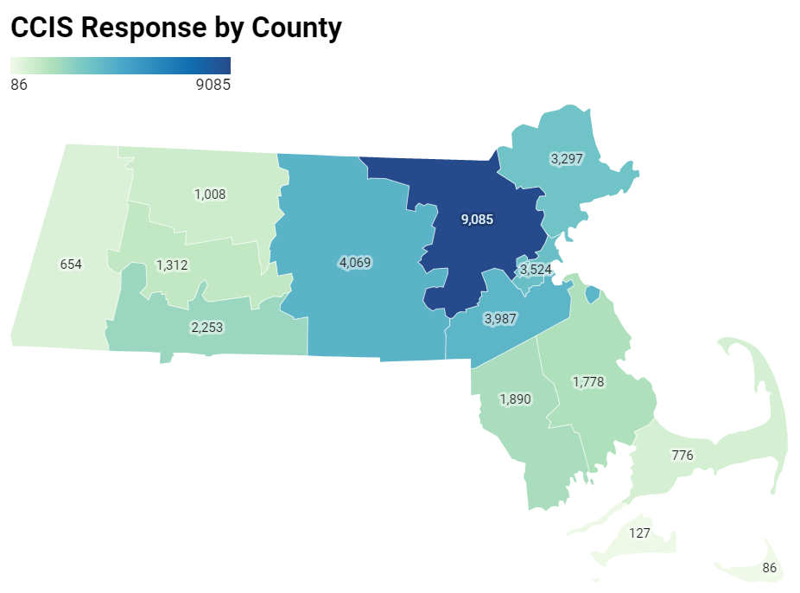
Recruitment efforts were overwhelmingly successful
For example, more people responded from western and central MA alone, than in the entire 2019 BRFSS statewide sample.
6.9.21 release

Slide 77
Demographics of the sample
 | Demographics | Freq. | Percent
Sexual Orientation | Asexual | 646 | 1.92
 | Bisexual | 1,252 | 3.73
 | Gay/Lesbian | 1,352 | 4.03
 | Heterosexual | 29,231 | 84.08
 | Queer | 464 | 1.38
 | Questioning | 217 | 0.65
 | Other/DK/refuse | 1,414 | 4.21
Disability Status | Deaf/Hard to hear | 920 | 2.72
 | Blind/With vision impairement | 233 | 0.69
 | Cognitive disability | 1,588 | 4.70
 | Mobility disability | 1,622 | 4.80
 | Self-care/Independent living disability | 912 | 2.70
Income | <$35K | 3,961 | 12.54
 | $35-74,999K | 7,163 | 22.67
 | $75-99,999K | 4,532 | 14.34
 | $100-149,999K | 6,851 | 21.68
 | $150K+ | 9,089 | 28.77
Education | Less than HS | 446 | 1.32
 | High school or GED | 2,279 | 6.73
 | Trade /Vocational | 905 | 2.67
 | Some college | 2,798 | 8.26
 | Associates degree | 2,484 | 7.33
 | Bachelor's degree | 10,635 | 31.39
 | Graduate degree | 14,338 | 42.31
 | Demographics | Freq. | Percent
Age | <25* | 148 | 0.44
 | 25-35 | 6,726 | 19.81
 | 36-49 | 11,785 | 34.71
 | 50-64 | 10,012 | 29.49
 | 65+ | 5,277 | 15.54
Race/Ethnicity | Am Indian/Alaska Native | 351 | 1.03
 | Hispanic/Latinx | 2,506 | 7.38
 | Multiracial, nH/nL | 475 | 1.40
 | Asian/Pacific Islander, nH/nL | 1,188 | 3.50
 | Black, nH/nL | 1,162 | 3.42
 | White, nH/nL | 27,605 | 81.32
 | Unknown/Other | 661 | 1.95
Gender | Male | 6,520 | 19.21
 | Female | 26,518 | 78.11
 | Non-Binary | 392 | 1.15
 | Prefer not to answer | 518 | 1.53
Transgender Identity | Of transgender experience | 245 | 0.73
 | Not of transgender experience | 32,500 | 96.29
 | Not sure/Dont know/refused | 1,007 | 2.98
Survey Lang. | English | 33,119 | 97.56
 | Other | 829 | 2.44
Notes: numbers in this table are unweighted. Subsequent analyses were weighted to the state average
nH/nL = non-Hispanic/non-Latinx; ​
American Indian/Alaska Native includes respondents who identify as Hispanic/Latinx​
Questioning/undecided/non-binary gender identity includes respondents identifying as non-binary, genderqueer, not exclusively male or female, and questioning/unsure of their gender identity
6.9.21 release

Slide 78
Demographics of the CCIS Black sample
 | Demographics | Freq. | Percent
Speak Language other than English | English | 808 | 70%
 | Languages other than English | 342 | 30%
Disability Status | Deaf/Hard of hearing​ | 8 | 1%
 | Blind/ People with vision impairment​ | 11 | 1%
 | Cognitive disability​ | 65 | 6%
 | Mobility disability​ | 74 | 6%
 | Self-care/ Independent-living disability​ | 35 | 3%
Income | <$35K | 248 | 23%
 | $35-74,999K | 430 | 39%
 | $75-99,999K | 156 | 14%
 | $100-149,999K | 148 | 14%
 | $150K+ | 110 | 10%
Education | Less than HS | 21 | 2%
 | High school or GED | 118 | 10%
 | Trade /Vocational | 53 | 5%
 | Some college | 160 | 14%
 | Associates degree | 114 | 10%
 | Bachelor's degree | 343 | 30%
 | Graduate degree | 342 | 30%
 | Demographics | Freq. | Percent
Counties | Barnstable | 9 | 1%
 | Berkshire | 11 | 1%
 | Bristol | 47 | 4%
 | Dukes | * | *
 | Essex | 56 | 5%
 | Franklin | * | *
 | Hampden | 115 | 10%
 | Hampshire | 14 | 1%
Survey Lang. | Middlesex | 179 | 16%
 | Nantucket | * | *
 | Norfolk | 151 | 13%
 | Plymouth | 99 | 9%
 | Suffolk | 403 | 35%
 | Worcester | 57 | 5%
 | Demographics | Freq. | Percent
Age | 25-34 | 261 | 23%
 | 35-44 | 314 | 27%
 | 45-64 | 477 | 41%
 | 65+ | 101 | 9%
Gender | Male | 199 | 17%
 | Female | 931 | 81%
 | Non-Binary | * | *
 | Prefer not to answer | * | *
Transgender Identity | Transgender | 6 | 1%
 | Not Transgender | 1108 | 97%
 | Not sure/DK/refuse | 33 | 3%
Sexual Orientation | Asexual | 36 | 3%
 | Bisexual | 45 | 4%
 | Gay/Lesbian | 30 | 3%
 | Heterosexual | 925 | 82%
 | Queer | 14 | 1%
 | Questioning | 8 | 1%
 | Other/DK/refuse | 72 | 6%
6.9.21 release

Slide 79
Demographics of the CCIS Hispanic/Latinx sample (n=2432)
 | Demographics | Freq. | Percent
Speak Language other than English | English | 552 | 18%
 | Languages other than English | 1875 | 82%
Disability Status | Deaf/Hard of hearing​ | 34 | 2%
 | Blind/ People with vision impairment​ | 24 | 1%
 | Cognitive disability​ | 171 | 8%
 | Mobility disability​ | 105 | 6%
 | Self-care/ Independent-living disability​ | 81 | 4%
Income | <$35K | 755 | 46%
 | $35-74,999K | 755 | 33%
 | $75-99,999K | 226 | 7%
 | $100-149,999K | 269 | 8%
 | $150K+ | 278 | 6%
Education | Less than HS | 172 | 11%
 | High school or GED | 384 | 24%
 | Trade /Vocational | 107 | 7%
 | Some college | 359 | 22%
 | Associates degree | 245 | 15%
 | Bachelor's degree | 593 | 14%
 | Graduate degree | 560 | 8%
 | Demographics | Freq. | Percent
Age | 25-34 | 695 | 37%
 | 35-44 | 791 | 24%
 | 45-64 | 853 | 33%
 | 65+ | 93 | 7%
Gender | Male | 373 | 16%
 | Female | 2001 | 82%
 | Non-Binary | 21 | 1%
 | Q/Not Sure/Oth/DU | 10 | <1%
 | Prefer not to answer | 27 | <1%
Transgender Identity | Transgender | 18 | 1%
 | Not Transgender | 2290 | 95%
 | Not sure/DK/PNTA | 98 | 5%
Sexual Orientation | Asexual | 73 | 3%
 | Bisexual | 80 | 3%
 | Gay/Lesbian | 74 | 3%
 | Heterosexual | 1919 | 78%
 | Queer | 25 | 1%
 | Questioning/NS | 16 | 1%
 | Other/DU/PNTA | 124 | 11%
 | Demographics | Freq. | Percent
Counties | Barnstable | 20 | 1%
 | Berkshire | 42 | 2%
 | Bristol | 63 | 3%
 | Dukes | * | *
 | Essex | 461 | 20%
 | Franklin | 18 | 1%
 | Hampden | 430 | 21%
 | Hampshire | 29 | 1%
Survey Lang. | Middlesex | 465 | 16%
 | Nantucket | * | *
 | Norfolk | 184 | 6%
 | Plymouth | 62 | 2%
 | Suffolk | 451 | 19%
 | Worcester | 221 | 7%
6.9.21 release

Slide 80
Demographics of the CCIS Hispanic/Latinx sample (n=2432), continued
 | Demographics | Freq. | Percent
Industry | Construction | 17 | 2%
 | Manufacturing | 59 | 5%
 | Retail | 47 | 4%
 | Transportation & Warehousing | 18 | 2%
 | Information | 10 | <1%
 | Finance & Insurance | 49 | 3%
 | Real Estate & Rental & Leasing | 16 | 1%
 | Professional, Scientific & Technical Services | 53 | 3%
Survey Lang. | Admin & Support & Waste Management & Remediation Services | 29 | 3%
 | Education Services | 211 | 12%
 | Healthcare | 372 | 26%
 | Social Assistance | 228 | 17%
 | Arts, Entertainment, & Recreation | 11 | 1%
 | Accommodation & Food Services | 51 | 5%
 | Other Services | 142 | 10%
 | Public Administration | 105 | 6%
 | Other Industries | 12 | 1%
6.9.21 release

Slide 81
Demographics of the CCIS AAPI sample
 | Demographics | Freq. | Percent
Speak Language other than English | English | 398 | 34%
 | Languages other than English | 785 | 66%
Disability Status | Deaf/Hard of hearing​ | 20 | 2%
 | Blind/ People with vision impairment​ | * | *
 | Cognitive disability​ | 37 | 3%
 | Mobility disability​ | 21 | 2%
 | Self-care/ Independent-living disability​ | 26 | 2%
Income | <$35K | 149 | 14%
 | $35-74,999K | 228 | 21%
 | $75-99,999K | 127 | 12%
 | $100-149,999K | 215 | 20%
 | $150K+ | 354 | 33%
Education | Less than HS | 30 | 3%
 | High school or GED | 62 | 5%
 | Trade /Vocational | 14 | 1%
 | Some college | 32 | 3%
 | Associates degree | 39 | 3%
 | Bachelor's degree | 376 | 32%
 | Graduate degree | 629 | 53%
 | Demographics | Freq. | Percent
Counties | Barnstable | * | *
 | Berkshire | 6 | <1%
 | Bristol | 12 | 1%
 | Essex | 45 | 4%
 | Franklin | 7 | <1%
 | Hampden | 29 | 2%
 | Hampshire | 12 | 1%
Survey Lang. | Middlesex | 467 | 40%
 | Norfolk | 171 | 14%
 | Plymouth | 16 | 1%
 | Suffolk | 191 | 16%
 | Worcester | 221 | 19%
 | Demographics | Freq. | Percent
Age | 25-34 | 347 | 29%
 | 35-44 | 395 | 33%
 | 45-64 | 375 | 32%
 | 65+ | 66 | 6%
Gender | Male | 317 | 27%
 | Female | 840 | 71%
 | Non-Binary | 12 | 1%
 | Prefer not to answer | 11 | 1%
Transgender Identity | Transgender | 7 | 1%
 | Not Transgender | 1103 | 94%
 | Not sure/DK/refuse | 68 | 6%
Sexual Orientation | Asexual | 29 | 2%
 | Bisexual | 42 | 4%
 | Gay/Lesbian | 25 | 2%
 | Heterosexual | 924 | 79%
 | Queer | 14 | 1%
 | Questioning | 13 | 1%
 | Other/DK/refuse | 124 | 11%
6.9.21 release

Slide 82
YOUTH SAMPLE
 | Population | Sample Size
 | Total | 3052
Race/ Ethnicity | American Indian/Alaska Native | 63
 | Asian, nH/nL | 278
 | Black, nH/nL | 221
 | Hispanic/Latinx | 675
 | Multiracial, nH/nL | 104
 | Other, nH/nL | 44
 | White, nH/nL | 1608
Age | <18 | 1400
 | 18+ | 1652
Geography | Rural | 203
 | Urban | 2785
 | Population | Sample Size
Sexual Orientation | Asexual | 71
Race/Ethnicity | Bisexual and/or Pansexual | 445
 | Gay or Lesbian | 175
 | Straight (Heterosexual) | 2023
 | Queer | 81
 | Questioning | 137
 | Other; Don’t understand; prefer not answer | 101
Transgender | Of transgender experience | 103
 | Not of transgender exp. | 2816
 | Population | Sample Size
Disability | Deaf/hard of hearing | 24
Race/Ethnicity | Blind/ vision impairment | 44
 | Cognitive disability | 414
 | Mobility disability | 40
 | Self-care/independent living disability | 133
Working/ employed youth | Yes | 1190
 | No | 1318
Young parents | Yes | 148
 | No | 2904
Gender Identity | Male only | 789
 | Female only | 2059
 | Non-binary | 128
 | Questioning | 31
 | Other | 36
Note: May not sum to total due to missing data for some questions.
Includes respondents under the age of 25 (both from youth survey and young parents who took the adult survey)
Language | English only | 2056
 | Speaks lang other than Eng. | 991
6.9.21 release

Slide 83
Demographics of the CCIS AAPI sample
 | Demographics | Freq. | Percent
Speak Language other than English | English | 398 | 34%
 | Languages other than English | 785 | 66%
Disability Status | Deaf/Hard of hearing​ | 20 | 2%
 | Blind/ People with vision impairment​ | * | *
 | Cognitive disability​ | 37 | 3%
 | Mobility disability​ | 21 | 2%
 | Self-care/ Independent-living disability​ | 26 | 2%
Income | <$35K | 149 | 14%
 | $35-74,999K | 228 | 21%
 | $75-99,999K | 127 | 12%
 | $100-149,999K | 215 | 20%
 | $150K+ | 354 | 33%
Education | Less than HS | 30 | 3%
 | High school or GED | 62 | 5%
 | Trade /Vocational | 14 | 1%
 | Some college | 32 | 3%
 | Associates degree | 39 | 3%
 | Bachelor's degree | 376 | 32%
 | Graduate degree | 629 | 53%
 | Demographics | Freq. | Percent
Counties | Barnstable | * | *
 | Berkshire | 6 | <1%
 | Bristol | 12 | 1%
 | Essex | 45 | 4%
 | Franklin | 7 | <1%
 | Hampden | 29 | 2%
 | Hampshire | 12 | 1%
Survey Lang. | Middlesex | 467 | 40%
 | Norfolk | 171 | 14%
 | Plymouth | 16 | 1%
 | Suffolk | 191 | 16%
 | Worcester | 221 | 19%
 | Demographics | Freq. | Percent
Age | 25-34 | 347 | 29%
 | 35-44 | 395 | 33%
 | 45-64 | 375 | 32%
 | 65+ | 66 | 6%
Gender | Male | 317 | 27%
 | Female | 840 | 71%
 | Non-Binary | 12 | 1%
 | Prefer not to answer | 11 | 1%
Transgender Identity | Transgender | 7 | 1%
 | Not Transgender | 1103 | 94%
 | Not sure/DK/refuse | 68 | 6%
Sexual Orientation | Asexual | 29 | 2%
 | Bisexual | 42 | 4%
 | Gay/Lesbian | 25 | 2%
 | Heterosexual | 924 | 79%
 | Queer | 14 | 1%
 | Questioning | 13 | 1%
 | Other/DK/refuse | 124 | 11%
6.9.21 release

Slide 84
% Reported Experiencing IPV During Covid-19
 | Demographics | Frequency | Weighted %
 | Overall | 572 | 2%
Race/ Ethnicity | American Indian/Alaska Native | 15 | 5%
 | Hispanic/Latinx | 52 | 3%
 | Multiracial, nH/nL | 16 | 6%
 | Asian, nH/nL | 30 | 4%
 | Black, nH/nL | 28 | 4%
 | White, nH/nL | 415 | 2%
 | Other Race, nH/nL | 8 | 5%
 | Unknown Race | 8 | 6%
Age | 25-34 | 146 | 4%
 | 35-44 | 201 | 4%
 | 45-64 | 193 | 2%
 | 65+ | 32 | 1%
Gender Identity | Male | 147 | 3%
 | Female | 394 | 2%
 | Non-binary, Genderqueer, Not Exclusively M/F | 18 | 7%
Sexual Orientation | Asexual | 19 | 5%
 | Bi/Pansexual | 37 | 4%
 | Gay or Lesbian | 21 | 3%
 | Heterosexual | 431 | 2%
 | Queer | 20 | 5%
 | I am questioning / not sure of my sexuality | 8 | 9%
 | Demographics | Frequency | Weighted %
Transgender Experience | Of Trans Experience | 13 | 7%
 | Not of Trans Experience | 531 | 2%
Income | <$35K | 100 | 3%
 | $35-74,999K | 146 | 3%
 | $75-99,999K | 83 | 3%
 | $100-149,999K | 107 | 2%
 | $150K+ | 116 | 1%
Educational Attainment | Less than high school | 9 | 3%
 | High school or GED | 29 | 2%
 | Trade/ vocational school | 23 | 3%
 | Some college | 76 | 3%
 | Associates Degree | 47 | 2%
 | Bachelors Degree | 193 | 2%
 | Graduate Degree | 193 | 2%
Disability | Deaf/Hard of hearing | 22 | 4%
 | Blind/Vision Impairment | 14 | 5%
 | Cognitive Disability | 76 | 6%
 | Mobility Disability | 42 | 3%
 | Self-Care/ Independent Living Disability | 34 | 5%
English language | Speaks language other than English | 105 | 3%
 | Demographics | Frequency | Unweighted %
County | Barnstable | 13 | 2%
 | Berkshire | 20 | 4%​
 | Bristol | 22 | 2%
 | Dukes | # | #​
 | Essex | 44 | 2%
 | Franklin | 31 | 4%
 | Hampden | 48 | 3%​
 | Hampshire | 37 | 3%​
 | Middlesex | 122 | 2%
 | Nantucket | # | #​
 | Norfolk | 56 | 2%
 | Plymouth | 39 | 3%
 | Suffolk | 68 | 3%
 | Worcester | 70 | 2%
Note: All percentages presented here (except County) are weighted to the statewide age and educational distribution of those 25 years old or older in Massachusetts
Data presented at sub-state geographies (county, rural cluster, municipality) were NOT weighted to the statewide age and educational distribution of those 25 years or older in MA since the age and educational distributions within those geographies may be different than the statewide distribution.
Unweighted percentages should NOT be compared to weighted percentages.
nH/nL = non-Hispanic/non-Latinx;
American Indian/Alaska Native includes respondents who identify as Hispanic/Latinx
Questioning/undecided/non-binary gender identity includes respondents identifying as non-binary, genderqueer, not exclusively male or female, and questioning/unsure of their gender identity.
‘Any IPV’ includes report from respondent of physical, sexual, and/or controlling forms of IPV experienced during the first six to eight months of the Covid-19 pandemic.
6.9.21 release

Slide 85
YOUNG PARENT SAMPLE (n=148)
 | Population | Sample Size
Age | 14-17 years | 26
Race/Ethnicity | 18-20 years | 40
 | 21- 24 years | 82
County | Barnstable | <5
 | Berkshire | <5
 | Bristol | <5
 | Essex | 43
 | Hampden | 25
 | Hampshire | <5
 | Middlesex | 19
 | Norfolk | 12
 | Plymouth | 6
 | Suffolk | 21
 | Worcester | 11
 | Population | Sample Size
Sexual Orientation | LGBQA | 22
 | Straight (Heterosexual) | 105
 | Other; Don’t understand; prefer not answer | 20
Transgender | Of transgender experience | <5
 | Not of transgender exp. | 134
 | Don’t understand; prefer not answer | 11
 | Population | Sample Size
Race/ Ethnicity | American Indian / Alaska Native | 8
Race/Ethnicity | Hispanic / Latinx | 74
 | Multiracial | <5
 | Asian nH/nL | 5
 | Black nH/nL | 9
 | White nH/nL | 44
 | Unknown | 6
Language | English only | 72
 | Language other than English | 76
Disability status | No disability | 117
 | Has mental or physical disability | 31
Gender Identity | Male only | 30
 | Female only | 111
 | Other (non-binary, don’t understand, prefer not to answer) | 7
Note: May not sum to total due to missing data for some questions.

Slide 86
YOUNG PARENT SAMPLE (n=148)
 | Population | Sample Size
Education | Less than high school | 52
Race/Ethnicity | High school or GED | 37
 | Trade school / Vocational school | 6
 | Some college | 24
 | Associates degree | 7
 | Bachelor’s degree | 14
 | Graduate degree | 6
Working/ employed | Yes | 67
 | No | 41
 | Population | Sample Size
Income | <$35K | 80
Race/Ethnicity | $35 – 74,999K | 23
 | $75K+ | 12
Household Size | 1-2 | 25
 | 3 | 48
 | 4 | 33
 | 5 | 41
Note: May not sum to total due to missing data for some questions.

Slide 87
Next Meeting:
August 11, 2021

