Slide 1
Public health council
June 9, 2021
Please standby – the meeting will begin shortly
Today’s presentation is available on the mass.gov/dph website under “Upcoming Events” by clicking on the June 9 Public Health Council listing

Slide 2
Public health council
June 9, 2021
Today’s presentation is available on the mass.gov/dph website under “Upcoming Events” by clicking on the June 9 Public Health Council listing

Slide 3
Non-Routine Items
Request to authorize the Commissioner of Public Health to continue to address COVID-19 pursuant to Governor Baker’s May 28, 2021 Declaration of Public Health Emergency

Slide 4
March 10, 2020:
Declaration of state of emergency
May 28, 2021: Termination of state of emergency, effective June 15, 2021
June 15, 2021: Termination of state of emergency
March 11, 2020:
PHC vote to approve the Commissioner’s actions
May 28, 2021: Declaration of modified public health emergency
June 9, 2021:
PHC meeting, consideration of approval for the Commissioner to take emergency actions

Slide 5
Request to Rescind on an Emergency Basis
105 CMR 316.000, Use of Face Mask and Coverings in Response to the COVID-19 Pandemic

Slide 6
Determination of Need:
Request by Chelmsford Surgery Center, LLC for Substantial Change in Service

Slide 7
COVID-19
Community Impact Survey(CCIS)
Preliminary Analysis Results as of
June 9, 2021 Presented by Sabrina Selk ScM, ScD
Massachusetts Department of Public Health
6.9.21 release

Slide 8
CCIS TEAM MEMBERS
CCIS Project Leads
W.W. Sanouri Ursprung, Lauren Cardoso, Beth Beatriz, Glory Song, Caroline Stack, Kathleen Fitzsimmons, Emily Sparer-Fine, Ben Wood, Lisa Bandoian, Heather Nelson, Amy Flynn, Lisa Arsenault, Abby Atkins
CCIS Analytic Team
Beth Beatriz, Glory Song, Caroline Stack, Kathleen Fitzsimmons, Emily Sparer-Fine, Ziming Xuan, Matthew Tumpney, Rebecca Han, Lauren Larochelle, Arielle Coq, Anne Marie Matteucci, Lauren Fogharty, Vera Mouradian, Melody Kingsley, Ta Wei Lin, Anna Agan, Justine Egan, Allison Guarino, Elizabeth Showalter, Beatriz Pazos Vautin, Priyokti Rana, Mayowa Sanusi, Emily Lawson, Alana LeBrón Lauren Cardoso, W.W. Sanouri Ursprung
CCIS Data to Action Workgroup
Jessica del Rosario, Kim Etingoff, Lisa Bandoian, Andrea Mooney, Ben Kingston, Lauren Cardoso; Dawn Fukuda, Lamar Polk, Hermik Babakhanlou-Chase, Glennon Beresin, Mahsa Yazdy, Emily White, Timothy St. Laurent, Fareesa Hasan, Nicole Roos
CCIS Steering Committee
Lauren Cardoso, W.W. Sanouri Ursprung, Beth Beatriz, Abbie Averbach, Ruth Blodgett, Ben Wood, Sabrina Selk, Nicole Daley, Lisa Bandoian
CCIS Data Dissemination Workgroup
Beth Beatriz, Glory Song, Emily Sparer-Fine, Ta Wei Lin, Vera Mouradian, Rebecca Han
6.9.21 release

Slide 9
CCIS COMMUNITY PARTNERS
Many groups that were critical in the success of this effort and gave important input on the development and deployment of the survey:
Academic Public Health Volunteer Corps and their work with local boards of health and on social media
Mass in Motion programs, including Springfield, Malden, and Chelsea
Cambodian Mutual Assistance
The Mashpee Wampanoag Tribe
The Immigrants’ Assistance Center, Inc
Families for Justice as Healing
City of Lawrence Mayor’s Health Task Force
The 84 Coalitions, including the Lawrence/Methuen Coalition
Boys and Girls Clubs, including those in Fitchburg and Leominster and the Metro South area
Chinatown Neighborhood Association
Father Bill’s
UTEC
MassCOSH
Stavros Center for Independent Living
Greater Springfield Senior Services
Center for Living and Working
DEAF, Inc.
Massachusetts Commission for the Deaf and Hard of Hearing
Viability, Inc.
6.9.21 release

Slide 10
OVERVIEW
Purpose and Approach of the Covid-19 Community Impact Survey (CCIS)
Preliminary Findings
Population Spotlight: Sexual Orientation, Gender Identity, & Transgender Identify
Appendix
6.9.21 release

Slide 11
PURPOSE AND APPROACH
6.9.21 release
3.10.21 release

Slide 12
Why did we conduct the CCIS?
Goals:
1) Identify the most pressing immediate and long-term health needs created by the pandemic, including its social and economic consequences
2) Determine which populations have been most disproportionately impacted
.... in order to inform and prioritize resource deployment and policy actions
6.9.21 release

Slide 13
OVERVIEW OF CCIS APPROACH
Conducted a self-administered online survey (Sept. and Nov. 2020) with over 33,000 adults and 3,000 youth respondents in the final sample
Covered a wide range of topics specific to adults and youth respectively
Perceptions & experiences of COVID-19, Basic needs, Access to healthcare, Pandemic-related changes in employment, Mental health, Substance use, and Safety
Available in 11 languages; additional focus groups also conducted in ASL
Open ended questions captured previously unknown needs and barriers
Weighted results to the state average, with different weights applied to youth and adult samples
Recruitment via network of community-based organizations (CBOs)
Employed a snowballing sampling strategy to ensure we reach key populations
eg. People of color, LGBTQ+ individuals, People with disabilities, Essential workers, People experiencing housing instability, Older adults, and Individuals living in areas hardest hit by COVID-19
6.9.21 release

Slide 14
RESULTS TOPICS TO DATE
MITIGATING INDIVIDUAL RISK OF INFECTION
ACCESS TO
TESTING​
ACCESS TO HEALTHCARE​
SOCIAL DETERMINANTS OF HEALTH
MENTAL HEALTH
EMPLOYMENT
MORE TO COME!
NEW: SOGI POPULATION SPOTLIGHTS
SUBSTANCE USE
DISCRIMINATION: & RACE SPOTLIGHTS
PARENTS & FAMILIES
YOUTH SPOTLIGHT
6.9.21 release

Slide 15
POPULATION SPOTLIGHT: Sexual Orientation, Gender Identity, and Transgender Experience
6.9.21 release

Slide 16
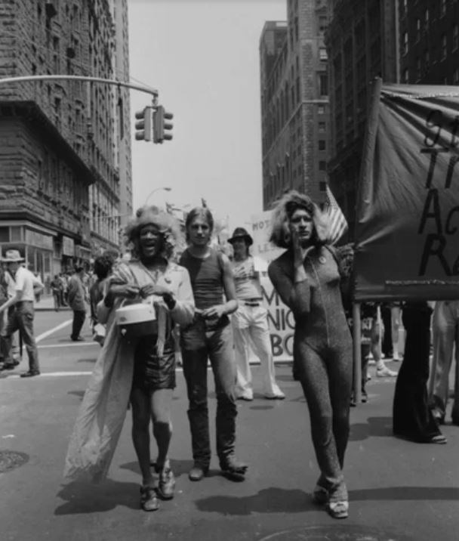
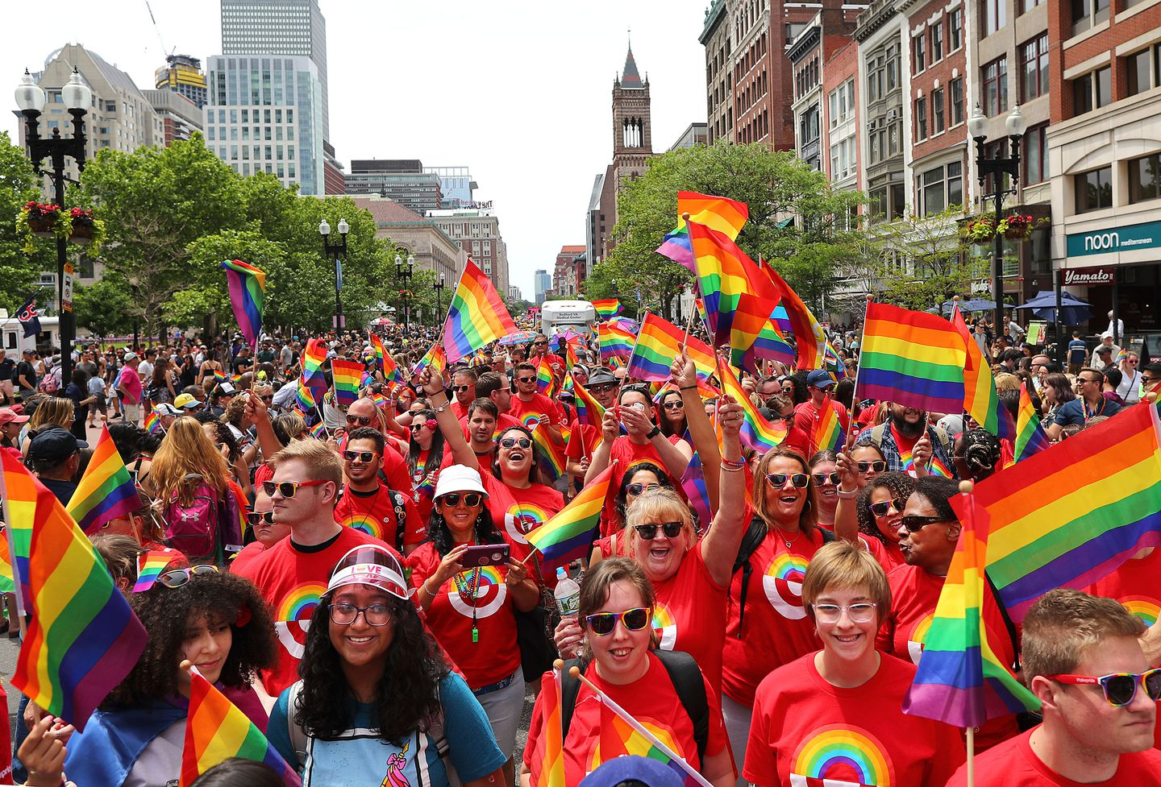
June is Pride Month.
The Pride Parade honors the Stonewall Riots of 1969, led by Black, Transgender, and Nonbinary activists like Marsha P Johnson and Sylvia Rivera.
Boston held it’s first PRIDE Parade two years later.
Since 1971, MA has made overall admirable progress in social, cultural and legislative advances to promote LGBTQ+ protections:
Sexual orientation nondiscrimination law for employment, housing and public accommodations (1989)
Safe Schools Program for Gay and Lesbian Students (1992)
Legalized same-sex marriage (2003)
Creation of Special Legislative Commission on LGBT Aging (2014)
6.9.21 release

Slide 17
This progress has not been enough.
LGBTQ+ youth and adults experience inequities in multiple domains: housing, employment, healthcare access, chronic disease, mental health, discrimination, and violence.
People in MA continue to commit acts of violence against individuals within the LGBTQ+ community, particularly against trans-identified individuals and against people of color.
MA policies protective of transgender communities lag behind those of other states.
Already in 2021, at least 27 transgender or nonbinary people have been killed by violent means nationally.¹
This persistent exclusion forces people into survival mode: LGBTQ+ folks may have to disown their sexual orientation and gender identity for fear of losing access to essential supports and services.
These exclusionary conditions, and the resulting inequities, have been exacerbated by the pandemic.
Actions are needed now: to aid this community in recovery, to address inequities, and to prevent this from happening again.
6.9.21 release
Notes:
LGBT adults more likely to earn less than $35k, be diagnosed with depression, be a victim of a hate crime
Over 25% of trans adults had experienced homelessness at some point
Over 2x as many LGB youth as straight youth experienced symptoms of 60% of LGB youth felt depressed in the past year and over ___ thought about committing suicide

Slide 18
Systems of oppression impact the social determinants of health inequities:
Education
Job Opportunity
Heteronormativity Heterosexism
Homophobia Transphobia Sexism
Socioeconomic Status
Environmental Exposure
Health
Outcomes
Health Behaviors
Access to Health Services
Safe & Affordable Housing
Classism, racism, ableism etc.
Reducing Violence
6.9.21 release
Notes:
Systems of oppression (heteronormativity, heterosexism, homophobia, etc.) manifest in and are perpetuated by the systems that determine our SDOH: healthcare, education, government, employment, housing, etc. The exclusion and discrimination from these systems lead to inequities in our health.

Slide 19
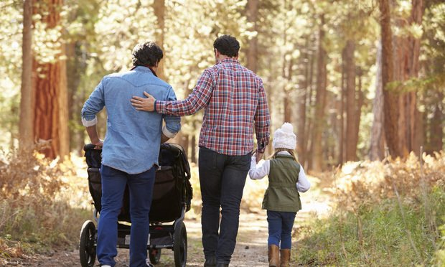
Heternormativity, heterosexism, transphobia, and other oppressions act at multiple levels:
INTERNALIZED
INTERPERSONAL
• Conforming to normative views of relationships
• Following
heteronormative scripts of binary masculinity/ femininity
• Family rejection
• Bullying
• Domestic violence
INSTITUTIONAL
STRUCTURAL
• Lack of affirmative medical care
• Denial of insurance coverage for trans-specific care
• Gatekeeping through gendered stereotypes or required therapist approval
• Discrimination in legal benefits, tax codes, immigration policies
• Exclusion of those of trans experience from bathroom access, education, & sports opportunities
6.9.21 release

Slide 20
FRAMING MATTERS
Despite the dominant perception that LGBTQ+ health inequities in MA have all been addressed through the implementation of progressive LGBTQ+-supportive laws and policies, the data shows that Massachusetts LGBTQ+ adults and youth continue to be systematically discriminated against and excluded from the systems that drive the social determinants of health, causing inequities in multiple domains. This persistent exclusion, and the resulting impacts on health, have been further exacerbated by the the pandemic.
6.9.21 release
Notes:
Call out the impact of disparities based on race and gender identity.
Persistent exclusion has led to inequities further exacerbated by the pandemic. We need to prioritize inclusion of LGBTQA residents in all areas – families, schools, state entities, healthcare, social services, and data systems – to aid recovery and address underlying conditions to prevent from happening again

Slide 21
REACHING LGBTQ+ COMMUNITIES ON CCIS
Through intentional outreach efforts conducted by CCIS partners, LGBTQ+ adults and youth participated in the survey at unprecedented rates:
4,102 Adults (aged 25+) identifying as:
Asexual (n=639) Bisexual and/or pansexual (n=1242) Gay or lesbian (n=1351) | Queer (n=464) Questioning (n=213) Other (n=107)
Of transgender experience (n=242) or not sure of transgender experience (n =108)
And/or of non-binary, qenderqueer, or not exclusively male or female gender (n=312); questioning gender (n =53), and other gender (n=26)
923 Youth (aged 14-24) identifying as:
Asexual (n=71) Bisexual and/or pansexual (n=445) Gay or lesbian (n=175) | Queer (n=81) Questioning (n=137) Other (n=15)
Of transgender experience (n=103) or not sure of transgender experience (n =36)
And/or of non-binary, qenderqueer, or not exclusively male or female gender (n=124); questioning gender (n =31); and other gender*
*Suppressed due to low sample size.
Sexual orientation and gender identity (SOGI) survey questions:
Developed under the guidance and recommendation of the MDPH SOGI Data Standards Group.
3 separate measures: sexual orientation, gender identity, transgender experience
The development of SOGI data collection and analysis recommendations are part of an on-going process that will continue to incorporate lessons learned and feedback of community members.
Thank you to our community partners and the MDPH SOGI Data Standards Group for this effort.
6.9.21 release
* Suppressed due to small count
Notes:
Unprecedented participation due to the intentional outreach to LGBTQA youth and adults by CCIS partners-- service providers, vendors, local boards of health, public health associations, and community organizations–allowed us to share the experiences of LGBTQA populations historically ‘invisibilized’ due to small sample sizes.
Note: reference groups used throughout the presentation are as follows: 1) sexual orientation: straight; 2) gender identity: male; 3) trans experience: no trans experience. When the term ‘LGBTQ’ is used, it indicates that common patterns existed in each of the mentioned sexual orientations/trans experiences in comparison to the designated reference group.
Persistent exclusion has led to inequities further exacerbated by the pandemic. We need to prioritize inclusion of LGBTQA residents in all areas – families, schools, state entities, healthcare, social services, and data systems – to aid recovery and address underlying conditions to prevent from happening again

Slide 22
The pandemic has inequitably impacted LGBTQ+ youth and adults across multiple domains affecting the social determinants of health.
Addressing any domain in isolation will not work.
Economic Stability
Over 1 out of 2 BTQA and NB adults were worried about paying a bill in the next few weeks
LGBTQA and NB youth were up to 2.1x as likely to say they may not continue their education in the fall
NB youth aged 18+ were over 2x as likely as male youth aged 18+ to report that one of the reasons for not continuing was tuition expense
Employment
1 out of 5 working nonbinary and transgender adults lost their job (vs. 1 out of 10 male and cis-gender adults).
Housing Stability
LGBTQA/NB adults were up to 2x as likely to report worrying about needing to move for any reason in the next few weeks
Access to Healthcare
BTQ and NB adults were more likely to:
Report delaying: any care (up to 3x); sexual and reproductive health care (up to 6x*); and severe mental health care (up to 2x*)
Report that not knowing where to go was a barrier to COVID testing (up to 6x)
Mental Health
LGBTQ adults were up to 3x more likely to report 15+ days of poor mental health in past 30 days & 3+ PTSD-like reactions to COVID
Social Inclusion and Support
BTQ and NB adults and those questioning their sexual orientation were up to 4x as likely to report experiencing intimate partner violence during COVID
4-9% of LGBTQ and NB youth reported experiencing violence at home during COVID (2-5x that of straight, cisgender, and male youth)
*Amongst those who had delayed routine and urgent care, respectively.
6.9.21 release
Notes:
BTQA= Bisexual and/or pansexual; transgender; Queer; Asexual
NB = Non-binary gender
*Letters indicating identities are not included when the difference was not significant between the group and reference group (e.g., when BTQ is used instead of LGBTQ, it is because the difference between “lesbian or gay” respondents was not significantly different from that of “straight (heterosexual)”, and only bi/pansexual, transgender, and queer differed significantly from their reference groups (straight for SO and ‘not trans’ for trans respondents.)

Slide 23
Meeting basic needs is among the most critical concerns
Over 63% of LGBTQ adults expressed worry about attaining at least one household need in the next few weeks.
LGBTQ and NB adults were more likely to express worry about attaining:
Healthcare (Up to 2.2x)
Technology (Up to 1.7x)†
And more likely to express that the following resources would be helpful right now:
Goods & services for people with disabilities (Up to 5x)
Help applying for benefits (Up to 2.1x)
Housing stability resources (Up to 3.1x)
Percentage of MA Adults Requesting Housing Stability Resources
†Difference was not significantly different at p<0.05 level for gay or lesbian and queer respondents when compared to straight respondents . * denotes a statistically significant difference from reference group at p<0.05 level.
6.9.21 release

Slide 24
Resources that address mental & behavioral health are needed now to aid recovery.
LGBTQ adults and youth were more likely to request immediate resources around mental health, substance use, and social support.
Behavioral Health
Social Support
LGBTQ and NB adults were more likely to request:
Info on seeing a therapist (up to 2x)
Suicide prevention resources (up to 7x)
Out of adults who reported using substances, LGBTA/NB adults were
1.4-1.7x as likely to request substance use resources.
LGBQT adults also requested mental health support other than therapy, including:
“Financial resources to access mental health care.”
“Financial resources for rent and debt payment postponement to help relieve stress”
And mental health resources for LGBTQ people specifically:
“Social support events for transgendered people”
“Peer health worker (especially LGBTQ) 1-on-1”
Bisexual, queer, non-binary, and youth questioning their gender were up to twice as likely to say that having a mentor to talk to about problems with would be helpful.
Among adults 65+, gay or lesbian adults and those questioning their sexual orientation were up to twice as likely as straight adults to request services for older adults, including social services:
“Someone from outside my social circle calling to check in with me regularly. For ex., senior center or my primary care physician…being checked on, even briefly, feels a comfort especially to people living alone” – Gay male respondent aged 65+
6.9.21 release

Slide 25
Safe, stable housing is needed now.
Housing Stability: Impact of COVID-19 on LGBTQ+ Communities
Context
Economic and employment instability affects one’s ability to attain or maintain safe housing. Family rejection and violence in the home or may require LGBTQ+ individuals to move to attain safety-- but a lack of resources may prevent them from doing so.
Impact
What we can do
LGBTQA/NB adults and LGBQ youth were up to 3x as likely to report needing a safe place to stay Provide LGBTQ+ cultural competency training to staff and providers of shelter and housing programs² Promote safety and privacy of LGBTQ+ youth and/or those transitioning genders in shelters²
LGBTQA and NB adults were 2x as likely to report worrying about needing to move for any reason in the next few weeks.
Resource Provision
BTQA and NB adults were up to 4x as likely to be worried about needing to move because of having trouble paying rent/mortgage
Policy & organizational change
LGBTQA and NB adults were 2-10x as likely to report worrying about needing to move because of conflict with family/roommates
LGBTQ youth were 2 – 5x as likely to report experiencing violence in their household during COVID
“My housemate was openly transphobic to me. They have since moved out, but the tension was at times hard to bear during the shelter-in-place.”
6.9.21 release

Slide 26
Policy and systems-level changes are needed to address structural determinants:
Develop strategies to recruit and retain a workforce of educators diverse in gender identities and sexual orientation.
Education
Train health, social service, and educational providers in LGBTQ cultural competency
Job Opportunity
Heteronormativity Heterosexism
Homophobia Transphobia Sexism
Socioeconomic Status
Provide comprehensive, youth-directed transition support for LGBTQ youth aging out of the foster care system.
Expand SOGI data collection for physicians and in electronic health records (EHRs)
Environmental Exposure
Health
Outcomes
Health Behaviors
Access to Health Services
Increase residential placement of LGBTQ youth with LGBTQ-affirming residential placements
Utilize social media and dating apps to improve health service outreach to LGBTQ youth
Safe & Affordable Housing
Classism, racism, ableism etc.
Reducing Violence
6.9.21 release
See the Massachusetts Commission on LGBTQ Youth: 2021 Report and Recommendations at https://www.mass.gov/annual-recommendations for further recommendations. The Massachusetts Commission on LGBTQ Youth is an independent state agency originally established as a commission of the Governor.
Notes:
Systems of oppression (heteronormativity, heterosexism, homophobia, etc.) manifest in and are perpetuated by the systems that determine our SDOH: healthcare, education, government, employment, housing, etc. The exclusion and discrimination from these systems lead to inequities in our health.

Slide 27
KEY TAKEAWAYS
LGBTQ+ adults and youth have been disproportionately impacted by the pandemic, particularly POC and persons of trans experience
We need to prioritize inclusion of LGBTQ+ residents in all areas – families, schools, state entities, healthcare, social services, and data systems –
1) To support pandemic recovery, and
2) To address the conditions that contributed to these inequitable impacts
3) To promote optimal health and quality of life of LGBTQ+ individuals and families
6.9.21 release
Notes:
Persistent exclusion has led to inequities further exacerbated by the pandemic. We need to prioritize inclusion of LGBTQA residents in all areas – families, schools, state entities, healthcare, social services, and data systems – to aid recovery and address underlying conditions to prevent from happening again

Slide 28
KEY TAKEAWAYS: LGBTQ+ RESIDENTS
Continued MDPH and begin statewide collection and utilization of SOGI data to address recovery and prevent future harm
Short-term resources tailored for LGBTQ+ community are needed NOW: financial, housing, mental health, healthcare, substance use, social inclusion
Long-term policy, system, and legislative change is necessary to create a social environment fully inclusive of LGBTQ+ individuals
6.9.21 release
Notes:
1) Note what ‘widespread’ data collection means to us in presentation.
2) Note how we can provide short-term resources: engage MDPH LGBTQ Working Group, MDPH advisory groups to ensure prioritization of needs and responses
3) State examples of policy, system, and legal changes

Slide 29
YOUTH EDUCATION & EMPLOYMENT PREVIEW
Youth have had to adapt to a changing educational system while being an essential part of the workforce. To understand the immediate and lasting impact of the pandemic on youth, we must consider both.
EDUCATION
EMPLOYMENT
1 in 3 youth reported worrying about continuing their education this school year (2020-2021).
Of these, 20% reported concern about getting COVID-19 as primary factor.
Youth worried about continuing their education were more likely have concerns about:
getting access to supports to fully engage in school, particularly remotely
AND
family economic stressors.
Half of youth reported working in the last year.
Young workers were more likely than adult workers to work outside of the home, which increases their risk of exposure to COVID-19. Among those working outside the home, many youth were not able to access workplace protections.
Young workers were 2X more likely to lose their job than adult workers.
Preliminary data - 1.7.21 - Not for external distribution
6.9.21 release
Notes:
Last month, we talked about how youth have been profoundly impacted by the pandemic, by focusing on their results related to COVID perceptions and infection, mental health, substance use, and mental health.
Next month, we are going to further elaborate on the impact of the pandemic on youth education and employment, but because the summer is such a crucial time for youth and their families as the school year comes to a close and youth summer employment begins, we are releasing the findings online today and giving a preview of the results.
One third of youth reported being worried about continuing their education in the fall of 2020. While the reasons why a young person may not be able to engage in school are complex, 20% said that a reason for not continuing was concern about becoming infected with COVID-19. Beyond that young people also report concerns about getting the supports that they need to be successful in school such as homework support (which has historically been provided by community-based organizations tha have been hard hit by the pandemic) and access to reliable internet. They have also been impacted by the socioeconomic stressors of the pandemic with the young people worried continuing their education also being those worried about family economic stressors. <click>
Which brings us to our next key finding – youth are an important part of the workforce and often provide econmically to their families. <click> Half of youth reported working in the past year. As we will discuss more next month, work can be both protective or risky for a young person, depending on the factors impacting reasons for work and the nature or enviornment of work. During the pandemic, that means understanding that young workers are more likely to work outside the home, increasing their risk to exposure of COVID-19. Youth working outside the home inconsistently reported being able to access the protection we know are essential to reducing COVID spread. Additionally, youth were twice as likely to lose their jobs than adults

Slide 30
YOUTH EDUCATION & EMPLOYMENT PREVIEW
Every year, the summer is an essential transition time for youth,
but summer 2021 is especially important.
As we reopen, we must make sure youth have access to vaccines and ensure safe spaces for youth, both as students and as workers.
For more CCIS youth education and employment results including which youth are most impacted, where youth are working, what workplace protections they were given, please visit mass.gov/COVIDsurvey and join us for the July PHC meeting.
Preliminary data - 1.7.21 - Not for external distribution
6.9.21 release

Slide 31
THANK YOU!
For more details please visit https://www.mass.gov/covidsurvey
6.9.21 release

Slide 32
APPENDIX
6.9.21 release

Slide 33
CCIS DOMAINS
PERCEPTIONS & EXPERIENCES OF COVID-19
Concern, access to testing, ability to social distance
DEMOGRAPHICS
Age, geography, gender, race, ethnicity, sexual orientation, disability status, education, income
BASIC NEEDS
Access to goods, services, information, social safety nets
ACCESS TO HEALTHCARE
Healthcare needs, types of care, barriers to care
SAFETY
Intimate partner violence, discrimination
SUBSTANCE USE
Change in use, resource needs
MENTAL HEALTH
Trauma, other mental health challenges, resource needs
EMPLOYMENT
Changes in employment, barriers to employment, ability to work from home, access to protections
6.9.21 release

Slide 34
Survey Questions
Demographics
What city or town do you live in?
How many people - adults and children - currently live with you, including yourself?
How many people who are over 60 years old currently live with you, including yourself?
Are you a caretaker of an adult(s) with special needs in your household?
Are you a parent/guardian of a child or youth with special health care needs?
Please select all that apply to you: I am deaf or hard of hearing. I am blind or I have trouble seeing even when I am wearing glasses. I have trouble concentrating, remembering, or making decisions because of a physical, mental, or emotional condition. I have trouble walking or climbing stairs. I have trouble getting dressed or taking a bath or shower. I have difficulty doing errands alone such as visiting a doctor's office or shopping. None of the above apply to me.
Were you pregnant during the COVID-19 outbreak or did you give birth since February 2020?
When did you give birth?
After the start of the COVID-19 outbreak, did your birth plans change?
What is the highest grade or year of school you have finished?
In 2019, what was your total annual household income before taxes?
Have you ever been sentenced to stay overnight or longer in any type of corrections institution? Examples include a jail or prison.
What is your sexual orientation?
What is your current gender identity?
Are you transgender or of transgender experience?
Are you Hispanic or Latino?
6.9.21 release

Slide 35
Survey Questions
Demographics
Perceptions & Experiences of COVID-19
What is your race? Select all that apply.
What is your ethnicity? Select all that apply.
(For English Survey) Do you speak language(s) other than English at home?
Which language(s) do you speak at home?
(For Non-English Surveys) How well do you speak English?
Do you agree or disagree with the following statements? My community is receiving adequate support to: Prevent the spread of COVID-19 Protect workers from COVID-19 Ensure medical facilities have the capacity to treat everyone who is sick or injured? Help people who have lost income Help businesses recover
Have you had fever and/or cough or shortness of breath and/or muscle aches or loss of sense of taste or smell in the last 30 days?
Did you ever get tested for COVID-19?
Why didn't you get tested? Select all that apply.
Have you or anyone you know tested positive for COVID-19? Select all that apply.
Has someone close to you died from COVID-19?
Perceptions & Experiences of COVID-19
How worried are you about getting infected with COVID-19 in Massachusetts?
Please select the two sources that you go to for the most reliable and up-to-date information about COVID-19.
When you are outside of the home are you able to keep 6 feet between yourself and others?
Why not? Check all that apply
6.9.21 release

Slide 36
Survey Questions
Healthcare Access
Basic Needs
Do you currently have any of the following health conditions? Select all that apply.
Since July 1, 2020, what has been your experience with trying to see a doctor, counselor or another medical professional? Select all that apply.
For the care you did not get, why did you want to see a doctor or counselor at that time? Select all that apply.
What type(s) of regular care or check-up did you need at that time? Select all that apply.
What condition(s) did you need emergency or urgent care for at the time? Select all that apply
Why were you not able to get care at the time? Select all that apply.
What type(s) of health insurance do you currently have? Select all that apply.
Has your health insurance changed since the COVID-19 outbreak?
Which of the following basic needs are you worried about getting for you and your family? This could be now or in the next couple of weeks. Select all that apply. Household Items Healthcare and medication Technology Childcare supplies Other
Which of these would be helpful to you right now? Select all that apply. (Food, help getting benefits, knowledge about rights, accessible services – translation, disability, childcare, other)
Which types of expenses or bills are you most worried about paying in the next few weeks?
Are you worried about any of these that will require you to move out of where you live in the next few months? Select all that apply
Have you applied to any of these financial supports since the beginning of the COVID-19 outbreak? What is the status of your application?
6.9.21 release

Slide 37
Survey Questions
Mental Health
Substance Use
Now thinking about your mental health, which includes stress, depression, and problems with emotions, on how many days during the past 30 days was your mental health not good?
In the past month, have you had three or more of the following reactions to things you’ve seen, heard, or experienced related to the COVID-19 outbreak: Had nightmares or thought about it when you did not want to? Tried not to think about it or went out of your way to avoid situations that reminded you of it? Been constantly on guard, watchful, or easily startled? Felt numb or detached from people, activities, or your surroundings? Felt guilty or unable to stop blaming yourself or others for it or any problems it may have caused?
Which of these resources would be most helpful to you right now to help you with your mental health and well-being? Select all that apply.
During the past 30 days, have you used any of the following products Select all that apply.
Compared to before the COVID-19 outbreak (February 2020), how often are you using these products now?
Which of the following resources would be most helpful to you right now? Select all that apply.
Employment/Income
Which of the following best describes your current work situation? (Employed, Retired, unemployed, furloughed, etc.)
What kind of work do/did you do? For example, registered nurse, janitor, cashier, auto mechanic. If you have more than one job, please answer for your primary job.
What kind of business do you work in? For example, hospital, elementary school, manufacturing, restaurant. If you have more than one job, please answer for your primary job.
6.9.21 release

Slide 38
Survey Questions
Employment/Income
Safety
Has your employer given you any of the following to protect you against COVID-19? Select all that apply.
If you are currently working, do you have paid sick leave you can use through your employer?
Was your employment status or the nature of your work changed in any of the following ways due to COVID-19? Select all that apply.
Why did your employment status or the nature of your work change? Select all that apply
Since COVID-19 began (March 10, 2020), has someone you were dating or married to physically hurt you? (i.e. being shoved, slapped, hit, kicked, punched, strangled, forced into sexual activity, or anything that could have caused an injury)
Since COVID-19 began (March 10, 2020), has someone you were dating or married to done any of the following: monitored your cell phone, called or texted you a lot to ask where you were, stopped you from doing things with friends, been angry if you were talking to someone else, or prevented you from going to school or work (including remotely)?
For which of the following topics would online support be most helpful to you or someone you know right now? Please select all that apply:
Discrimination can refer to harmful words and behaviors aimed at you because of your race or ethnicity. Since the COVID-19 outbreak began (March 10, 2020), have you experienced any form of discrimination because of your race or ethnicity?
In what way(s) did you experience discrimination?
6.9.21 release

Slide 39
Recruitment among priority populations was unprecedented
Priority Populations | 2018 MA BRFSS | 2020 CCIS Final Sample | Magnitude of Difference
Overall sample | 6,669 | 33,948 | 5X
Race/Ethnicity
Hispanic | 522 | 2,506 | 5X
Black NH | 365 | 1,162 | 3X
Asian NH | 248 | 1,188 | 5X
Amer. Ind/Alaska Nat | 35 | 351 | 10X
Disability Status
Deaf/Hard of hearing | 427 | 922 | 2X
Blind/Hard to see | 258 | 236 | On par
Lesbian, Gay, Bisexual + | 359 | 3,931 | 10X
Non-English Speakers | 158 (in 2 languages) | 829 (in 8 languages) | 5X
This number of responses will enable us to conduct the critical subanalysis needed to understand the specific needs and experiences of these groups and to prioritize our deployment of resources to address them.
6.9.21 release

Slide 40
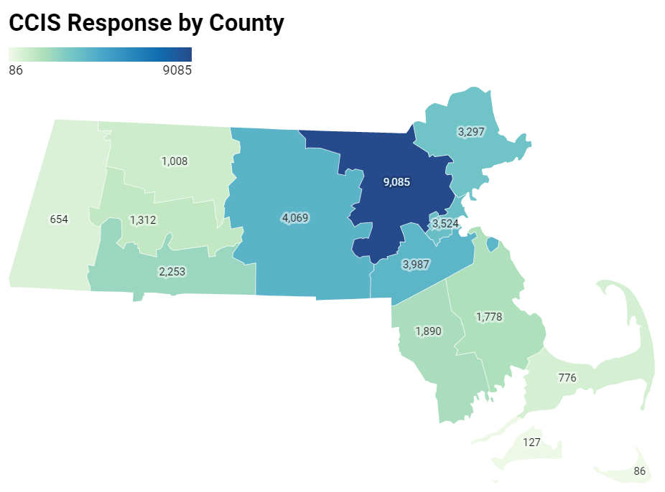
Recruitment efforts were overwhelmingly successful
For example, more people responded from western and central MA alone, than in the entire 2019 BRFSS statewide sample.
6.9.21 release

Slide 41
Demographics of the sample
 | Demographics | Freq. | Percent
Sexual Orientation | Asexual | 646 | 1.92
 | Bisexual | 1,252 | 3.73
 | Gay/Lesbian | 1,352 | 4.03
 | Heterosexual | 29,231 | 84.08
 | Queer | 464 | 1.38
 | Questioning | 217 | 0.65
 | Other/DK/refuse | 1,414 | 4.21
Disability Status | Deaf/Hard to hear | 920 | 2.72
 | Blind/With vision impairement | 233 | 0.69
 | Cognitive disability | 1,588 | 4.70
 | Mobility disability | 1,622 | 4.80
 | Self-care/Independent living disability | 912 | 2.70
Income | <$35K | 3,961 | 12.54
 | $35-74,999K | 7,163 | 22.67
 | $75-99,999K | 4,532 | 14.34
 | $100-149,999K | 6,851 | 21.68
 | $150K+ | 9,089 | 28.77
Education | Less than HS | 446 | 1.32
 | High school or GED | 2,279 | 6.73
 | Trade /Vocational | 905 | 2.67
 | Some college | 2,798 | 8.26
 | Associates degree | 2,484 | 7.33
 | Bachelor's degree | 10,635 | 31.39
 | Graduate degree | 14,338 | 42.31
 | Demographics | Freq. | Percent
Age | <25* | 148 | 0.44
 | 25-35 | 6,726 | 19.81
 | 36-49 | 11,785 | 34.71
 | 50-64 | 10,012 | 29.49
 | 65+ | 5,277 | 15.54
Race/Ethnicity | Am Indian/Alaska Native | 351 | 1.03
 | Hispanic/Latinx | 2,506 | 7.38
 | Multiracial, nH/nL | 475 | 1.40
 | Asian/Pacific Islander, nH/nL | 1,188 | 3.50
 | Black, nH/nL | 1,162 | 3.42
 | White, nH/nL | 27,605 | 81.32
 | Unknown/Other | 661 | 1.95
Gender | Male | 6,520 | 19.21
 | Female | 26,518 | 78.11
 | Non-Binary | 392 | 1.15
 | Prefer not to answer | 518 | 1.53
Transgender Identity | Of transgender experience | 245 | 0.73
 | Not of transgender experience | 32,500 | 96.29
 | Not sure/Dont know/refused | 1,007 | 2.98
Survey Lang. | English | 33,119 | 97.56
 | Other | 829 | 2.44
Notes: numbers in this table are unweighted. Subsequent analyses were weighted to the state average
nH/nL = non-Hispanic/non-Latinx; ​
American Indian/Alaska Native includes respondents who identify as Hispanic/Latinx​
Questioning/undecided/non-binary gender identity includes respondents identifying as non-binary, genderqueer, not exclusively male or female, and questioning/unsure of their gender identity
6.9.21 release

Slide 42
Demographics of the CCIS Black sample
 | Demographics | Freq. | Percent
Speak Language other than English | English | 808 | 70%
 | Languages other than English | 342 | 30%
Disability Status | Deaf/Hard of hearing​ | 8 | 1%
 | Blind/ People with vision impairment​ | 11 | 1%
 | Cognitive disability​ | 65 | 6%
 | Mobility disability​ | 74 | 6%
 | Self-care/ Independent-living disability​ | 35 | 3%
Income | <$35K | 248 | 23%
 | $35-74,999K | 430 | 39%
 | $75-99,999K | 156 | 14%
 | $100-149,999K | 148 | 14%
 | $150K+ | 110 | 10%
Education | Less than HS | 21 | 2%
 | High school or GED | 118 | 10%
 | Trade /Vocational | 53 | 5%
 | Some college | 160 | 14%
 | Associates degree | 114 | 10%
 | Bachelor's degree | 343 | 30%
 | Graduate degree | 342 | 30%
 | Demographics | Freq. | Percent
Counties | Barnstable | 9 | 1%
 | Berkshire | 11 | 1%
 | Bristol | 47 | 4%
 | Dukes | * | *
 | Essex | 56 | 5%
 | Franklin | * | *
 | Hampden | 115 | 10%
 | Hampshire | 14 | 1%
Survey Lang. | Middlesex | 179 | 16%
 | Nantucket | * | *
 | Norfolk | 151 | 13%
 | Plymouth | 99 | 9%
 | Suffolk | 403 | 35%
 | Worcester | 57 | 5%
 | Demographics | Freq. | Percent
Age | 25-34 | 261 | 23%
 | 35-44 | 314 | 27%
 | 45-64 | 477 | 41%
 | 65+ | 101 | 9%
Gender | Male | 199 | 17%
 | Female | 931 | 81%
 | Non-Binary | * | *
 | Prefer not to answer | * | *
Transgender Identity | Transgender | 6 | 1%
 | Not Transgender | 1108 | 97%
 | Not sure/DK/refuse | 33 | 3%
Sexual Orientation | Asexual | 36 | 3%
 | Bisexual | 45 | 4%
 | Gay/Lesbian | 30 | 3%
 | Heterosexual | 925 | 82%
 | Queer | 14 | 1%
 | Questioning | 8 | 1%
 | Other/DK/refuse | 72 | 6%
6.9.21 release

Slide 43
Demographics of the CCIS Hispanic/Latinx sample (n=2432)
 | Demographics | Freq. | Percent
Speak Language other than English | English | 552 | 18%
 | Languages other than English | 1875 | 82%
Disability Status | Deaf/Hard of hearing​ | 34 | 2%
 | Blind/ People with vision impairment​ | 24 | 1%
 | Cognitive disability​ | 171 | 8%
 | Mobility disability​ | 105 | 6%
 | Self-care/ Independent-living disability​ | 81 | 4%
Income | <$35K | 755 | 46%
 | $35-74,999K | 755 | 33%
 | $75-99,999K | 226 | 7%
 | $100-149,999K | 269 | 8%
 | $150K+ | 278 | 6%
Education | Less than HS | 172 | 11%
 | High school or GED | 384 | 24%
 | Trade /Vocational | 107 | 7%
 | Some college | 359 | 22%
 | Associates degree | 245 | 15%
 | Bachelor's degree | 593 | 14%
 | Graduate degree | 560 | 8%
 | Demographics | Freq. | Percent
Age | 25-34 | 695 | 37%
 | 35-44 | 791 | 24%
 | 45-64 | 853 | 33%
 | 65+ | 93 | 7%
Gender | Male | 373 | 16%
 | Female | 2001 | 82%
 | Non-Binary | 21 | 1%
 | Q/Not Sure/Oth/DU | 10 | <1%
 | Prefer not to answer | 27 | <1%
Transgender Identity | Transgender | 18 | 1%
 | Not Transgender | 2290 | 95%
 | Not sure/DK/PNTA | 98 | 5%
Sexual Orientation | Asexual | 73 | 3%
 | Bisexual | 80 | 3%
 | Gay/Lesbian | 74 | 3%
 | Heterosexual | 1919 | 78%
 | Queer | 25 | 1%
 | Questioning/NS | 16 | 1%
 | Other/DU/PNTA | 124 | 11%
 | Demographics | Freq. | Percent
Counties | Barnstable | 20 | 1%
 | Berkshire | 42 | 2%
 | Bristol | 63 | 3%
 | Dukes | * | *
 | Essex | 461 | 20%
 | Franklin | 18 | 1%
 | Hampden | 430 | 21%
 | Hampshire | 29 | 1%
Survey Lang. | Middlesex | 465 | 16%
 | Nantucket | * | *
 | Norfolk | 184 | 6%
 | Plymouth | 62 | 2%
 | Suffolk | 451 | 19%
 | Worcester | 221 | 7%
6.9.21 release

Slide 44
Demographics of the CCIS Hispanic/Latinx sample (n=2432), continued
 | Demographics | Freq. | Percent
Industry | Construction | 17 | 2%
 | Manufacturing | 59 | 5%
 | Retail | 47 | 4%
 | Transportation & Warehousing | 18 | 2%
 | Information | 10 | <1%
 | Finance & Insurance | 49 | 3%
 | Real Estate & Rental & Leasing | 16 | 1%
 | Professional, Scientific & Technical Services | 53 | 3%
Survey Lang. | Admin & Support & Waste Management & Remediation Services | 29 | 3%
 | Education Services | 211 | 12%
 | Healthcare | 372 | 26%
 | Social Assistance | 228 | 17%
 | Arts, Entertainment, & Recreation | 11 | 1%
 | Accommodation & Food Services | 51 | 5%
 | Other Services | 142 | 10%
 | Public Administration | 105 | 6%
 | Other Industries | 12 | 1%
6.9.21 release

Slide 45
Demographics of the CCIS AAPI sample
 | Demographics | Freq. | Percent
Speak Language other than English | English | 398 | 34%
 | Languages other than English | 785 | 66%
Disability Status | Deaf/Hard of hearing​ | 20 | 2%
 | Blind/ People with vision impairment​ | * | *
 | Cognitive disability​ | 37 | 3%
 | Mobility disability​ | 21 | 2%
 | Self-care/ Independent-living disability​ | 26 | 2%
Income | <$35K | 149 | 14%
 | $35-74,999K | 228 | 21%
 | $75-99,999K | 127 | 12%
 | $100-149,999K | 215 | 20%
 | $150K+ | 354 | 33%
Education | Less than HS | 30 | 3%
 | High school or GED | 62 | 5%
 | Trade /Vocational | 14 | 1%
 | Some college | 32 | 3%
 | Associates degree | 39 | 3%
 | Bachelor's degree | 376 | 32%
 | Graduate degree | 629 | 53%
 | Demographics | Freq. | Percent
Counties | Barnstable | * | *
 | Berkshire | 6 | <1%
 | Bristol | 12 | 1%
 | Essex | 45 | 4%
 | Franklin | 7 | <1%
 | Hampden | 29 | 2%
 | Hampshire | 12 | 1%
Survey Lang. | Middlesex | 467 | 40%
 | Norfolk | 171 | 14%
 | Plymouth | 16 | 1%
 | Suffolk | 191 | 16%
 | Worcester | 221 | 19%
 | Demographics | Freq. | Percent
Age | 25-34 | 347 | 29%
 | 35-44 | 395 | 33%
 | 45-64 | 375 | 32%
 | 65+ | 66 | 6%
Gender | Male | 317 | 27%
 | Female | 840 | 71%
 | Non-Binary | 12 | 1%
 | Prefer not to answer | 11 | 1%
Transgender Identity | Transgender | 7 | 1%
 | Not Transgender | 1103 | 94%
 | Not sure/DK/refuse | 68 | 6%
Sexual Orientation | Asexual | 29 | 2%
 | Bisexual | 42 | 4%
 | Gay/Lesbian | 25 | 2%
 | Heterosexual | 924 | 79%
 | Queer | 14 | 1%
 | Questioning | 13 | 1%
 | Other/DK/refuse | 124 | 11%
6.9.21 release

Slide 46
YOUTH SAMPLE
 | Population | Sample Size
 | Total | 3052
Race/ Ethnicity | American Indian/Alaska Native | 63
 | Asian, nH/nL | 278
 | Black, nH/nL | 221
 | Hispanic/Latinx | 675
 | Multiracial, nH/nL | 104
 | Other, nH/nL | 44
 | White, nH/nL | 1608
Age | <18 | 1400
 | 18+ | 1652
Geography | Rural | 203
 | Urban | 2785
 | Population | Sample Size
Sexual Orientation | Asexual | 71
Race/Ethnicity | Bisexual and/or Pansexual | 445
 | Gay or Lesbian | 175
 | Straight (Heterosexual) | 2023
 | Queer | 81
 | Questioning | 137
 | Other; Don’t understand; prefer not answer | 101
Transgender | Of transgender experience | 103
 | Not of transgender exp. | 2816
 | Population | Sample Size
Disability | Deaf/hard of hearing | 24
Race/Ethnicity | Blind/ vision impairment | 44
 | Cognitive disability | 414
 | Mobility disability | 40
 | Self-care/independent living disability | 133
Working/ employed youth | Yes | 1190
 | No | 1318
Young parents | Yes | 148
 | No | 2904
Gender Identity | Male only | 789
 | Female only | 2059
 | Non-binary | 128
 | Questioning | 31
 | Other | 36
Note: May not sum to total due to missing data for some questions.
Includes respondents under the age of 25 (both from youth survey and young parents who took the adult survey)
Language | English only | 2056
 | Speaks lang other than Eng. | 991
6.9.21 release

Slide 47
Demographics of the CCIS AAPI sample
 | Demographics | Freq. | Percent
Speak Language other than English | English | 398 | 34%
 | Languages other than English | 785 | 66%
Disability Status | Deaf/Hard of hearing​ | 20 | 2%
 | Blind/ People with vision impairment​ | * | *
 | Cognitive disability​ | 37 | 3%
 | Mobility disability​ | 21 | 2%
 | Self-care/ Independent-living disability​ | 26 | 2%
Income | <$35K | 149 | 14%
 | $35-74,999K | 228 | 21%
 | $75-99,999K | 127 | 12%
 | $100-149,999K | 215 | 20%
 | $150K+ | 354 | 33%
Education | Less than HS | 30 | 3%
 | High school or GED | 62 | 5%
 | Trade /Vocational | 14 | 1%
 | Some college | 32 | 3%
 | Associates degree | 39 | 3%
 | Bachelor's degree | 376 | 32%
 | Graduate degree | 629 | 53%
 | Demographics | Freq. | Percent
Counties | Barnstable | * | *
 | Berkshire | 6 | <1%
 | Bristol | 12 | 1%
 | Essex | 45 | 4%
 | Franklin | 7 | <1%
 | Hampden | 29 | 2%
 | Hampshire | 12 | 1%
Survey Lang. | Middlesex | 467 | 40%
 | Norfolk | 171 | 14%
 | Plymouth | 16 | 1%
 | Suffolk | 191 | 16%
 | Worcester | 221 | 19%
 | Demographics | Freq. | Percent
Age | 25-34 | 347 | 29%
 | 35-44 | 395 | 33%
 | 45-64 | 375 | 32%
 | 65+ | 66 | 6%
Gender | Male | 317 | 27%
 | Female | 840 | 71%
 | Non-Binary | 12 | 1%
 | Prefer not to answer | 11 | 1%
Transgender Identity | Transgender | 7 | 1%
 | Not Transgender | 1103 | 94%
 | Not sure/DK/refuse | 68 | 6%
Sexual Orientation | Asexual | 29 | 2%
 | Bisexual | 42 | 4%
 | Gay/Lesbian | 25 | 2%
 | Heterosexual | 924 | 79%
 | Queer | 14 | 1%
 | Questioning | 13 | 1%
 | Other/DK/refuse | 124 | 11%
6.9.21 release

Slide 48
% Reported Experiencing IPV During Covid-19
 | Demographics | Frequency | Weighted %
 | Overall | 572 | 2%
Race/ Ethnicity | American Indian/Alaska Native | 15 | 5%
 | Hispanic/Latinx | 52 | 3%
 | Multiracial, nH/nL | 16 | 6%
 | Asian, nH/nL | 30 | 4%
 | Black, nH/nL | 28 | 4%
 | White, nH/nL | 415 | 2%
 | Other Race, nH/nL | 8 | 5%
 | Unknown Race | 8 | 6%
Age | 25-34 | 146 | 4%
 | 35-44 | 201 | 4%
 | 45-64 | 193 | 2%
 | 65+ | 32 | 1%
Gender Identity | Male | 147 | 3%
 | Female | 394 | 2%
 | Non-binary, Genderqueer, Not Exclusively M/F | 18 | 7%
Sexual Orientation | Asexual | 19 | 5%
 | Bi/Pansexual | 37 | 4%
 | Gay or Lesbian | 21 | 3%
 | Heterosexual | 431 | 2%
 | Queer | 20 | 5%
 | I am questioning / not sure of my sexuality | 8 | 9%
 | Demographics | Frequency | Weighted %
Transgender Experience | Of Trans Experience | 13 | 7%
 | Not of Trans Experience | 531 | 2%
Income | <$35K | 100 | 3%
 | $35-74,999K | 146 | 3%
 | $75-99,999K | 83 | 3%
 | $100-149,999K | 107 | 2%
 | $150K+ | 116 | 1%
Educational Attainment | Less than high school | 9 | 3%
 | High school or GED | 29 | 2%
 | Trade/ vocational school | 23 | 3%
 | Some college | 76 | 3%
 | Associates Degree | 47 | 2%
 | Bachelors Degree | 193 | 2%
 | Graduate Degree | 193 | 2%
Disability | Deaf/Hard of hearing | 22 | 4%
 | Blind/Vision Impairment | 14 | 5%
 | Cognitive Disability | 76 | 6%
 | Mobility Disability | 42 | 3%
 | Self-Care/ Independent Living Disability | 34 | 5%
English language | Speaks language other than English | 105 | 3%
 | Demographics | Frequency | Unweighted %
County | Barnstable | 13 | 2%
 | Berkshire | 20 | 4%​
 | Bristol | 22 | 2%
 | Dukes | # | #​
 | Essex | 44 | 2%
 | Franklin | 31 | 4%
 | Hampden | 48 | 3%​
 | Hampshire | 37 | 3%​
 | Middlesex | 122 | 2%
 | Nantucket | # | #​
 | Norfolk | 56 | 2%
 | Plymouth | 39 | 3%
 | Suffolk | 68 | 3%
 | Worcester | 70 | 2%
Note: All percentages presented here (except County) are weighted to the statewide age and educational distribution of those 25 years old or older in Massachusetts
Data presented at sub-state geographies (county, rural cluster, municipality) were NOT weighted to the statewide age and educational distribution of those 25 years or older in MA since the age and educational distributions within those geographies may be different than the statewide distribution.
Unweighted percentages should NOT be compared to weighted percentages.
nH/nL = non-Hispanic/non-Latinx;
American Indian/Alaska Native includes respondents who identify as Hispanic/Latinx
Questioning/undecided/non-binary gender identity includes respondents identifying as non-binary, genderqueer, not exclusively male or female, and questioning/unsure of their gender identity.
‘Any IPV’ includes report from respondent of physical, sexual, and/or controlling forms of IPV experienced during the first six to eight months of the Covid-19 pandemic.
6.9.21 release

Slide 49
Next Meeting:
July 14, 2021

