Slide 1
Public Health Council Meeting
March 11, 2026
Robert Goldstein, Commissioner
Today’s presentation is available on mass.gov/dph under “Upcoming Events” by clicking on the March Public Health Council listing.​

Slide 2
Updates
Commissioner Robbie Goldstein

Slide 3
Thank you, Mary!
For your dedication, commitment, guidance, and public service to the Public Health Council and your many years of service to the health and well-being of the residents of the Commonwealth.

Slide 4

Your Options Medical lawsuit

Slide 5

Aging with Dignity Forum
March 31 | Register today

Slide 6
FY27 DPH budget testimony
March 27, Clinton Town Hall
Hosted by Senator Robyn Kennedy and Representative Megan Kilcoyne
DPH will be joined by Secretary Mahaniah, as well as leadership from some of our sister agencies: MassHealth, the Department of Mental Health, and the Executive Office of Aging and Independence

Slide 7
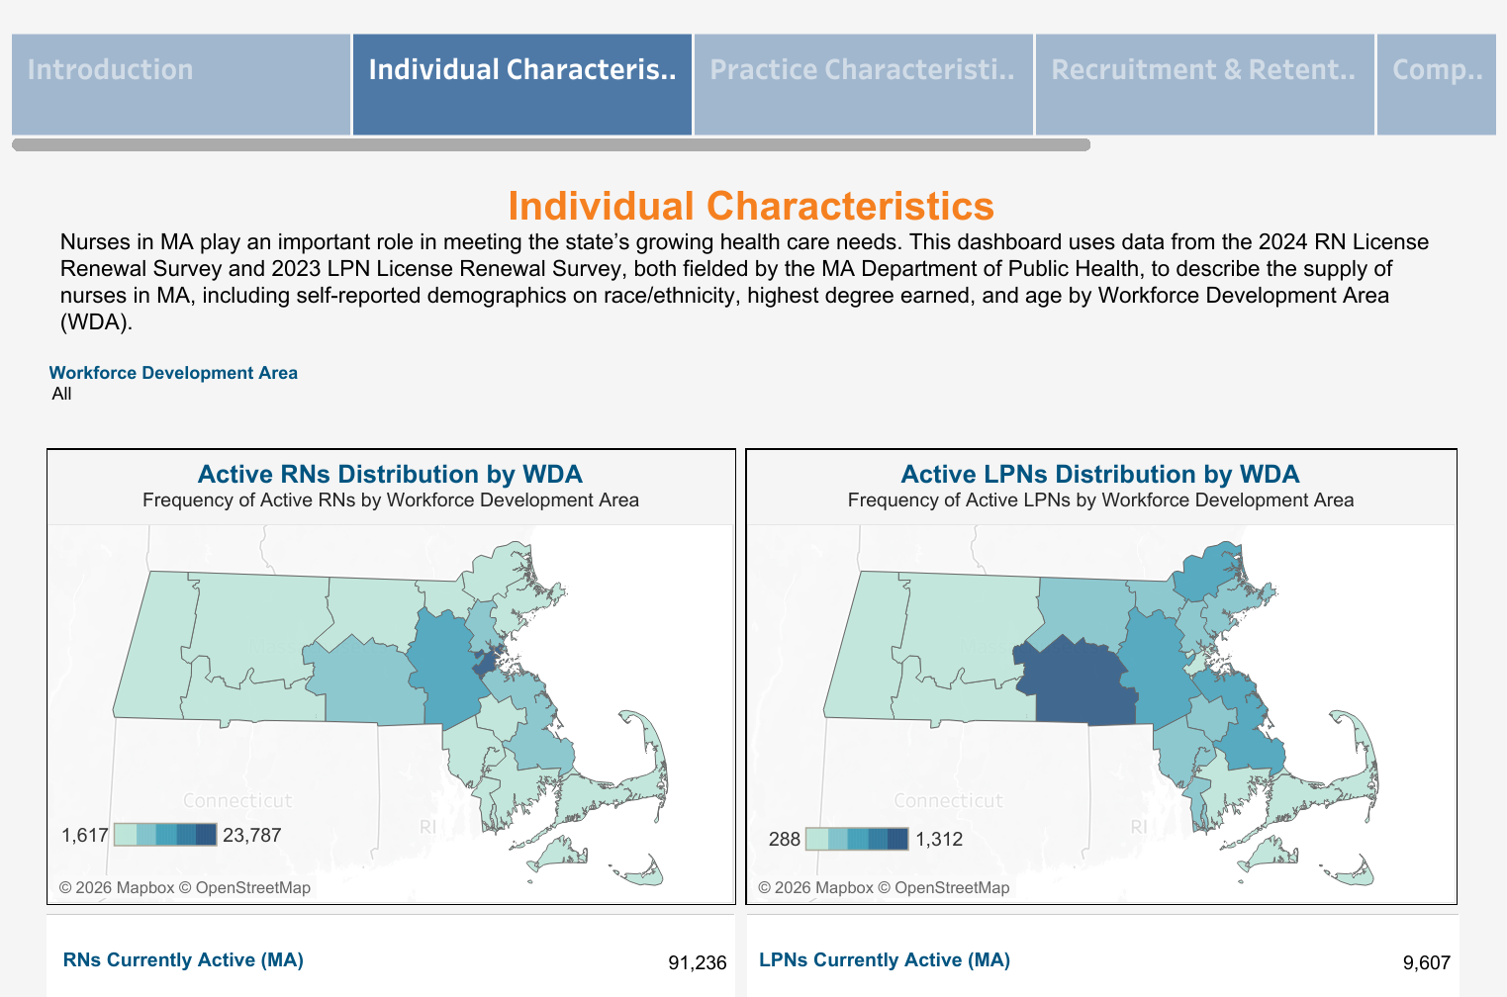
Launch of CHIA Nursing Dashboard
chiamass.gov/integrated-nursing-dashboard

Slide 8

2026 FIFA World Cup™

Slide 9
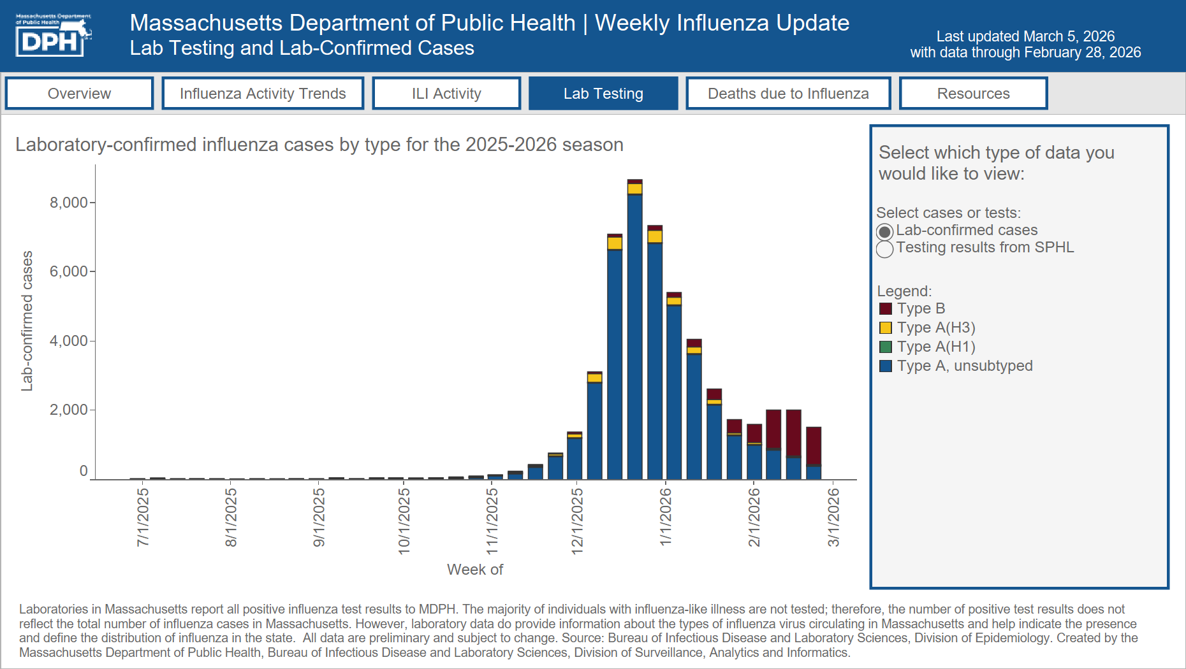
Respiratory illness

Slide 10
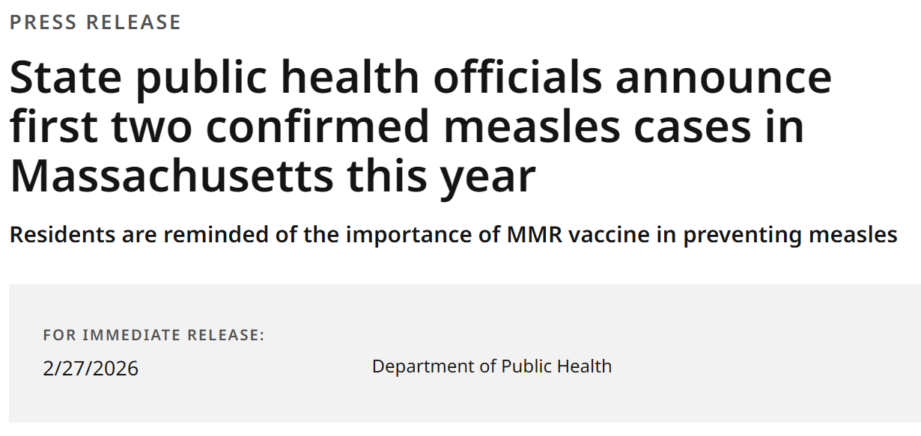
Measles

Slide 11

ACIP meeting
Next meeting (rescheduled from February): March 18-19

Slide 12
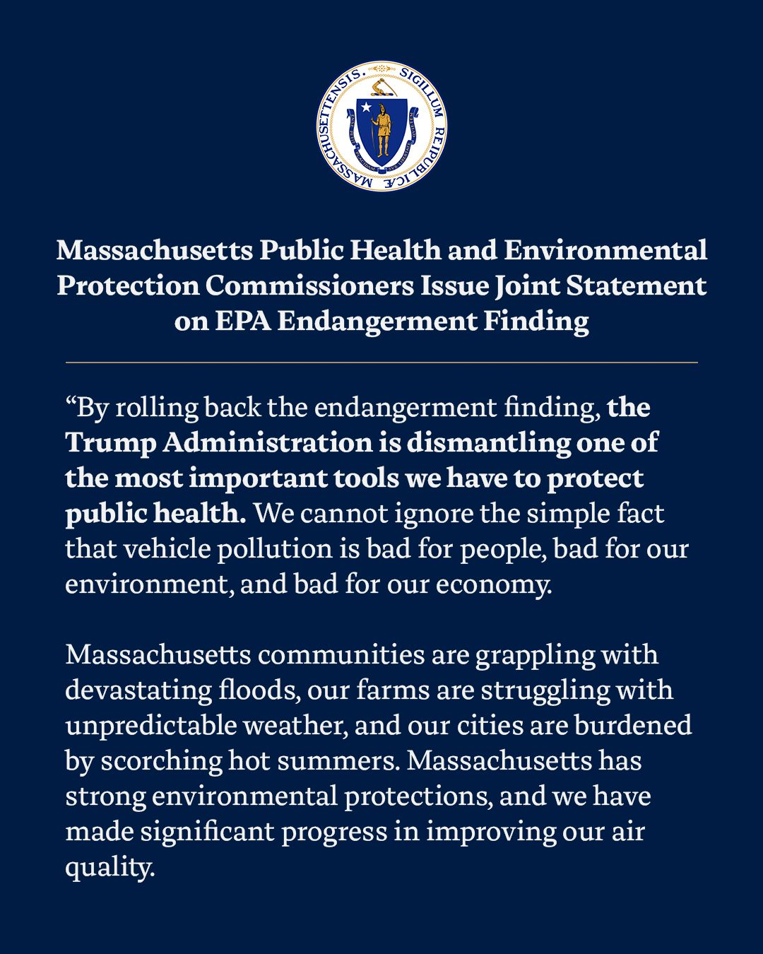
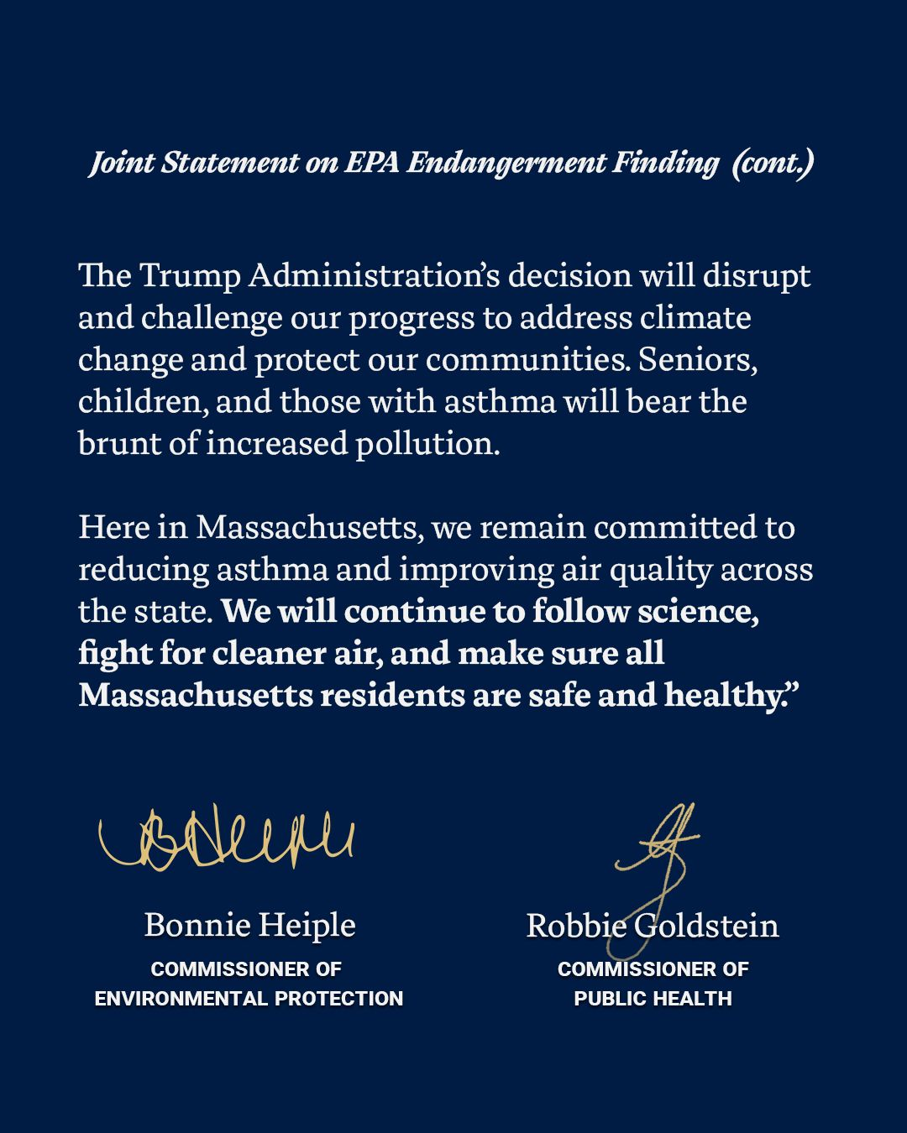
Federal update: Endangerment finding
Read the statement from MassDEP and DPH online

Slide 13
Maternal Health Briefing
March 11, 2026
Elaine Fitzgerald Lewis, DrPH
Bureau of Family Health & Nutrition
Cris Alonso, DrPH
Division of Pregnancy, Infancy & Early Childhood
Bureau of Family Health & Nutrition

Slide 14
Meeting purpose
Overview of the Bureau of Family Health and Nutrition (BFHN) and the Maternal Health Law
State investments in maternal health
BFHN's progress on two key maternal health initiatives:
  Welcome Family
  Doula certification and workforce initiative

Slide 15



What is the Bureau of Family Health and Nutrition (BFHN)?
The Bureau of Family Health & Nutrition is the lead agency of the state's Title V Maternal and Child Health Block Grant in Massachusetts.
Title V enables BFHN to support policies and programs for pregnant people, parents, infants, and children and youth—including those with special health needs—serving over 1 million families each year.

Slide 16



What is the Maternal Health Law?
"An Act promoting access to midwifery care and out-of-hospital birth options"
Goal: Strengthen maternal health practices and expand coverage for services, including midwifery, birth centers, doulas, and screening and treatment for postpartum depression for birthing and pregnant families in Massachusetts

Slide 17
Moving the Maternal Health Law into action
The Department of Public Health (DPH), in collaboration with other state agencies and partners, is leading the following activities for the Maternal Health Law:
Activity | Status
Birth center regulations | Complete
Expansion of authority for the Maternal Mortality & Morbidity Committee | Complete
Quality guidelines for the use of donor milk | Complete
Establishment of Maternal Health Task Force with the Health Policy Commission | Implemented
Pregnancy loss information campaign | In progress
Digital resource center for Perinatal Mood and Anxiety Disorders | In progress

Slide 18
Moving the Maternal Health Law into action (continued)
Activity | Status
Certified professional midwife regulations | In progress
Expansion of universal home visiting program (Welcome Family) | In progress
Newborn screening recommendations and advisory committee | In progress
Lactation consultant licensure | In progress
Establishment of Fetal & Infant Mortality Review program | In progress
Grants program to address perinatal mental health and substance use disorders | In progress

Slide 19
MA investments in maternal health

Slide 20
Total funding across maternal health grants for FY26
Grant name | Funding amount
Postpartum depression funding in community health centers | $860,000
Maternal health access | $10,000,000
Birth center capacity and accessibility | $1,000,000
Addressing mental health conditions & SUD for perinatal individuals | $220,000
Total amount | $12,070,000

Slide 21
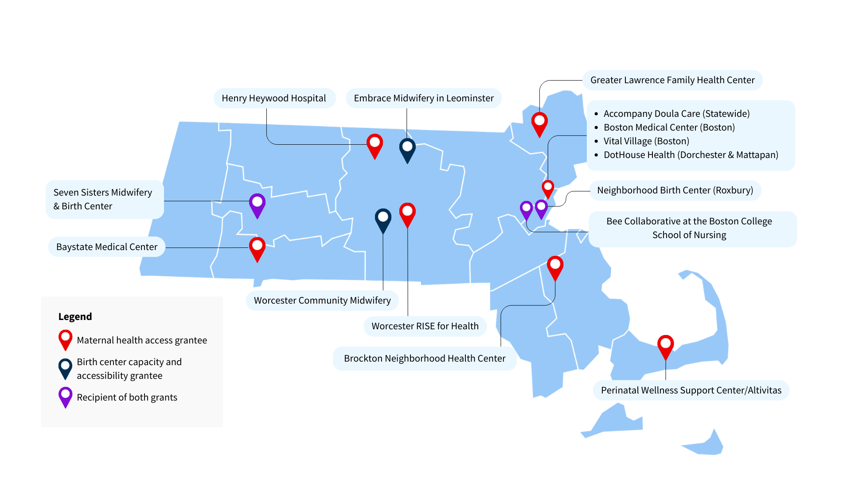
Recipients of maternal health access and birth center capacity grants

Slide 22
BFHN's progress on two key maternal health initiatives

Slide 23
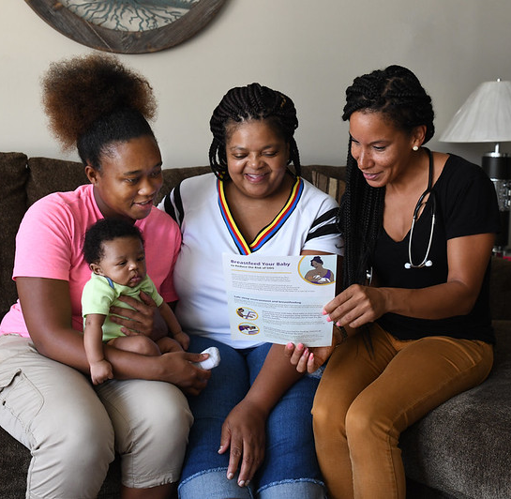
What is Welcome Family?
Program goal: Promote optimal maternal and infant physical and mental well-being and provide an entry point into a system of care for families with newborns in Massachusetts.
Service components:
Universal, one-time nurse home visit to all caregivers with newborns up to eight weeks postpartum
Referrals and warm hand-off to services
Feedback to infant’s pediatrician and caregiver’s obstetric provider
Follow-up phone call 2-3 weeks after the visit
Current reach: Implemented in 6 communities, reaching 2,400 families through federal home visiting funding (MIECHV).

Slide 24
Welcome Family expansion
The home visiting statute (G.L. Chapter 111, Section 248) requires DPH to:
Establish and administer a statewide system of programs providing universal postpartum home visiting services
Establish qualifications for programs to become a qualified provider of universal postpartum home visiting services.
Provide reimbursement for home visiting services for costs not covered by third-party payors.
Monitor and assess the effectiveness of universal postpartum home visiting services and implement quality improvement to advance equity.
Promulgate regulations that establish a statewide system and define what constitutes a qualified program and provider of universal postpartum home visiting services.

Slide 25

Current expansion efforts for Welcome Family
Kick off for Welcome Family Advisory Committee in Spring 2026
Convene internal work group to integrate feedback from Welcome Family Advisory Committee
Promulgate regulations by late Summer 2026
Continue collaboration with MassHealth to align timelines for regulations
Continue support of current Welcome Family programs to prepare for expansion
Continue to prepare onboarding package for procurement of vendors

Slide 26

Doula Initiative vision and purpose
Vision: Improve the health of pregnant and postpartum people, caregivers, and families by making doulas available to those who want them.
Purpose: Eliminate health inequities and promote positive outcomes and experiences for all birthing families, especially among Black, Indigenous, and People of Color (BIPOC) and those who experience disproportionately poor health and birth outcomes.

Slide 27

Doula certification
DPH administers the formal process for doula certification
  Establishes minimum standards for education, training, and experience for certified doulas to meet
  Certification is inclusive of full spectrum, abortion, birth, and postpartum doulas
  Includes continuing education requirements to ensure professional development
Four certification pathways:
    Experience pathway
    Training pathway
    Proof of MassHealth provider status
    Proof of certification in New York or Rhode Island

Slide 28

Doula workforce development
This year, DPH is launching the following activities to expand and support the doula workforce:
Doula Training Scholarships of up to $750 to offset training costs for new and existing doulas to gain skills to support key populations:
      Immigrant families
      Families experiencing housing instability
      Families with substance use disorder (SUD)
      Birthing people with disabilities
Community of Practice for doulas on continued support and education on billing, hospital/medical practice collaboration, and certification
29

Slide 29
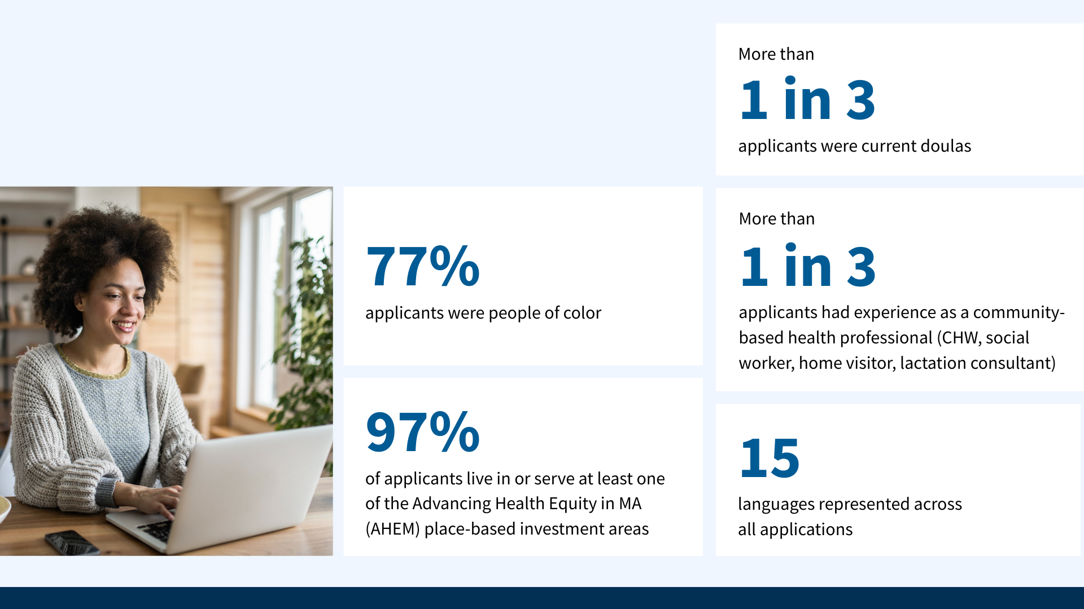
DPH Doula Training Scholarships:
By the numbers

Slide 30

Next steps for the Doula Initiative
Launch certification in March
Launch outreach plan for doula certification
Launch 30 scholarships
Collaborate with private payers to encourage and support them to cover doula services for certified doulas
Collaborate with hospitals to ensure doulas' ability to support their clients is uniform across birth settings
Continue to engage with MassHealth, BSAS, and DCF and other aligned agencies

Slide 31
Thank you
Elaine Fitzgerald Lewis, DrPH
Bureau of Family Health & Nutrition
Cris Alonso, DrPH
Division of Pregnancy, Infancy, and Early Childhood

Slide 32
Health Care Workforce Center
Silvia Aguayo, MPH
HCWC Director, Director of the Primary Care Office
Katherine T. Fillo, Ph.D., MPH, RN-BC
Chief Clinical Officer/ Director of Health Care Strategy and Planning

Slide 33
Framing Health Care Workforce and Access Issues
Massachusetts has a robust health care workforce:
47,526 physicians¹
21,491 nurse practitioners²
52,131 professionals in the mental health, social work and psychology fields³
But access to care is a significant and growing issue for the Commonwealth's residents:
Reported worsening access to primary care each year from 2019 to 2023⁴
36.2% of Massachusetts residents with an ED visit in the past year reported that they could have been treated by a general physician if one had been available⁵
1. Board of Registration in Medicine Standard Release August 2025
2. https://checkahealthlicense.mass.gov/, accessed on February 25 2026.
3. MHQP. Patient Experience Scores for Adults Improve Since Before the Pandemic, Except in One Key Area: Access. February 2024
4. Centers for Health Information and Analysis. Primary Care in Massachusetts Databook. January 2023

Slide 34
Health Care Workforce Center Overview
Office of Health Care Strategy and Planning
The Health Care Workforce Center was established and then expanded through Legislation
2008: An Act to Promote Cost Containment, Transparency, and Efficiency in the Delivery of Quality Health Care.
2012: An Act Improving the Quality of Health Care and Reducing Costs Through Increased Transparency, Efficiency and Innovation
Health Care Analytics
Clinical Expertise and Innovation
Health Care Workforce Center

Slide 35

Health Care Workforce Center Programs
The HCWC oversees and manages programs aimed at ensuring access to a diverse healthcare workforce in underserved communities, while seeking opportunities to expand our efforts to support medically underserved populations.
Actionable Recommendations
Primary Care Office
Primary Care Needs Assessment
Direct Workforce Support
Conrad 30/ J-1 Visa Waiver Program
National Health Service Corps
Data
Health Professions Data Series
Licensure Renewal Surveys
Technical Assistance & Collaboration
Shortage Designation Coordination
MA Loan Repayment Program
Data Sharing and Partnerships

Slide 36


How we define medically underserved populations
Primary Care Needs Assessment
Applying Federal Definitions
Defines our state context
Quantitative county ranking
Qualitative key informant interviews
Basis for our data-informed 5-year primary care strategic plan
What: A Health Professional Shortage Areas (HPSAs) is designated as having a critical shortage of either primary care, dental, or mental health providers.
Benefit: Qualify for federal programs, Medicare 10% physician bonus.
Strategy: Proactively and strategically review data to optimize HPSA coverage for the Commonwealth.

Slide 37
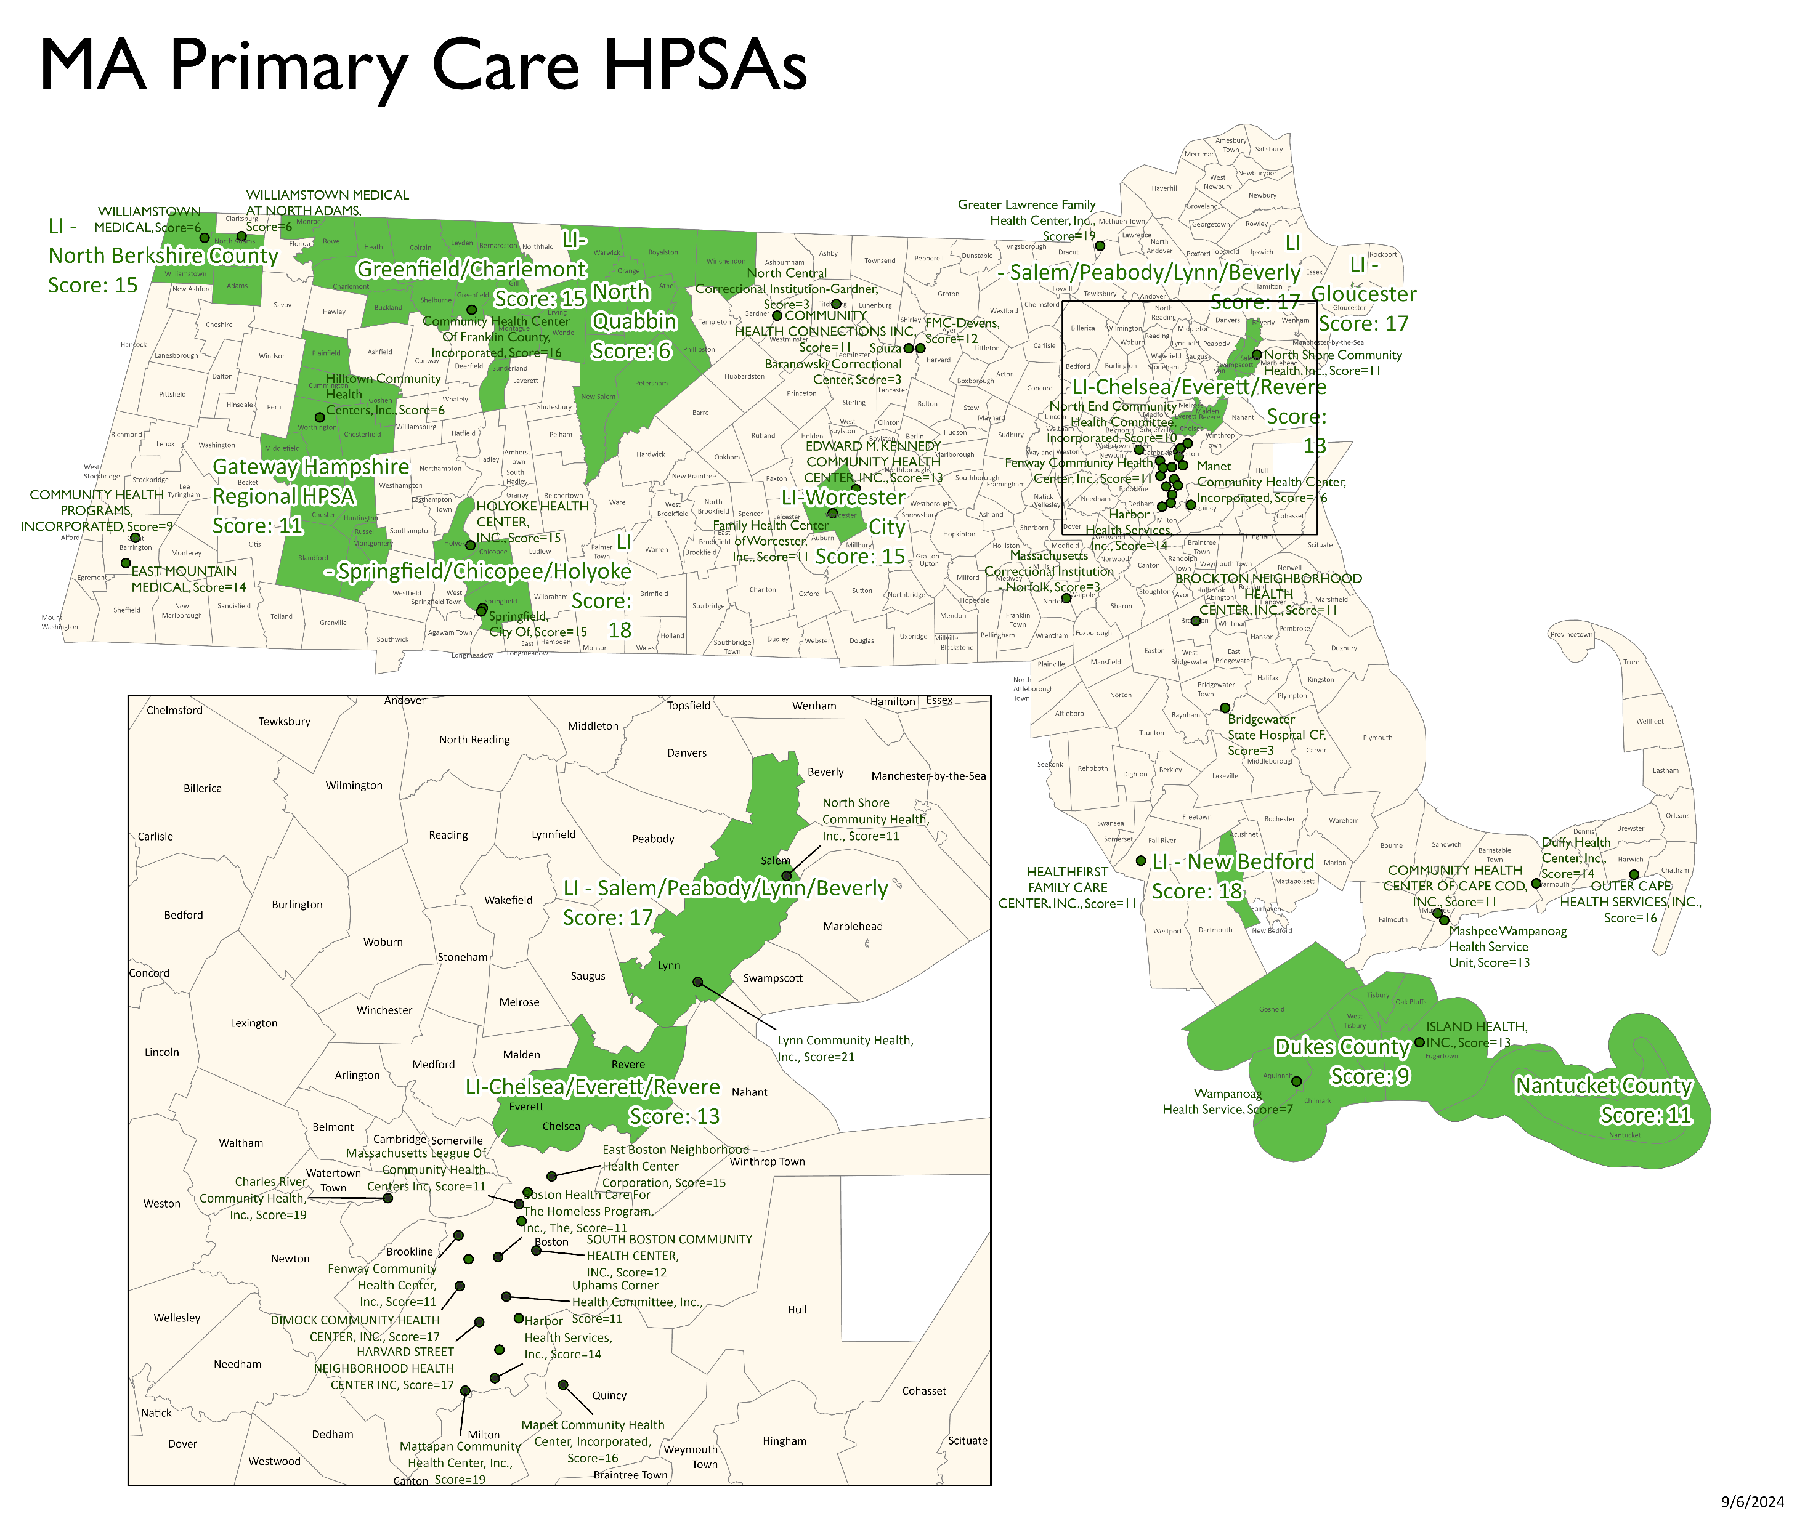
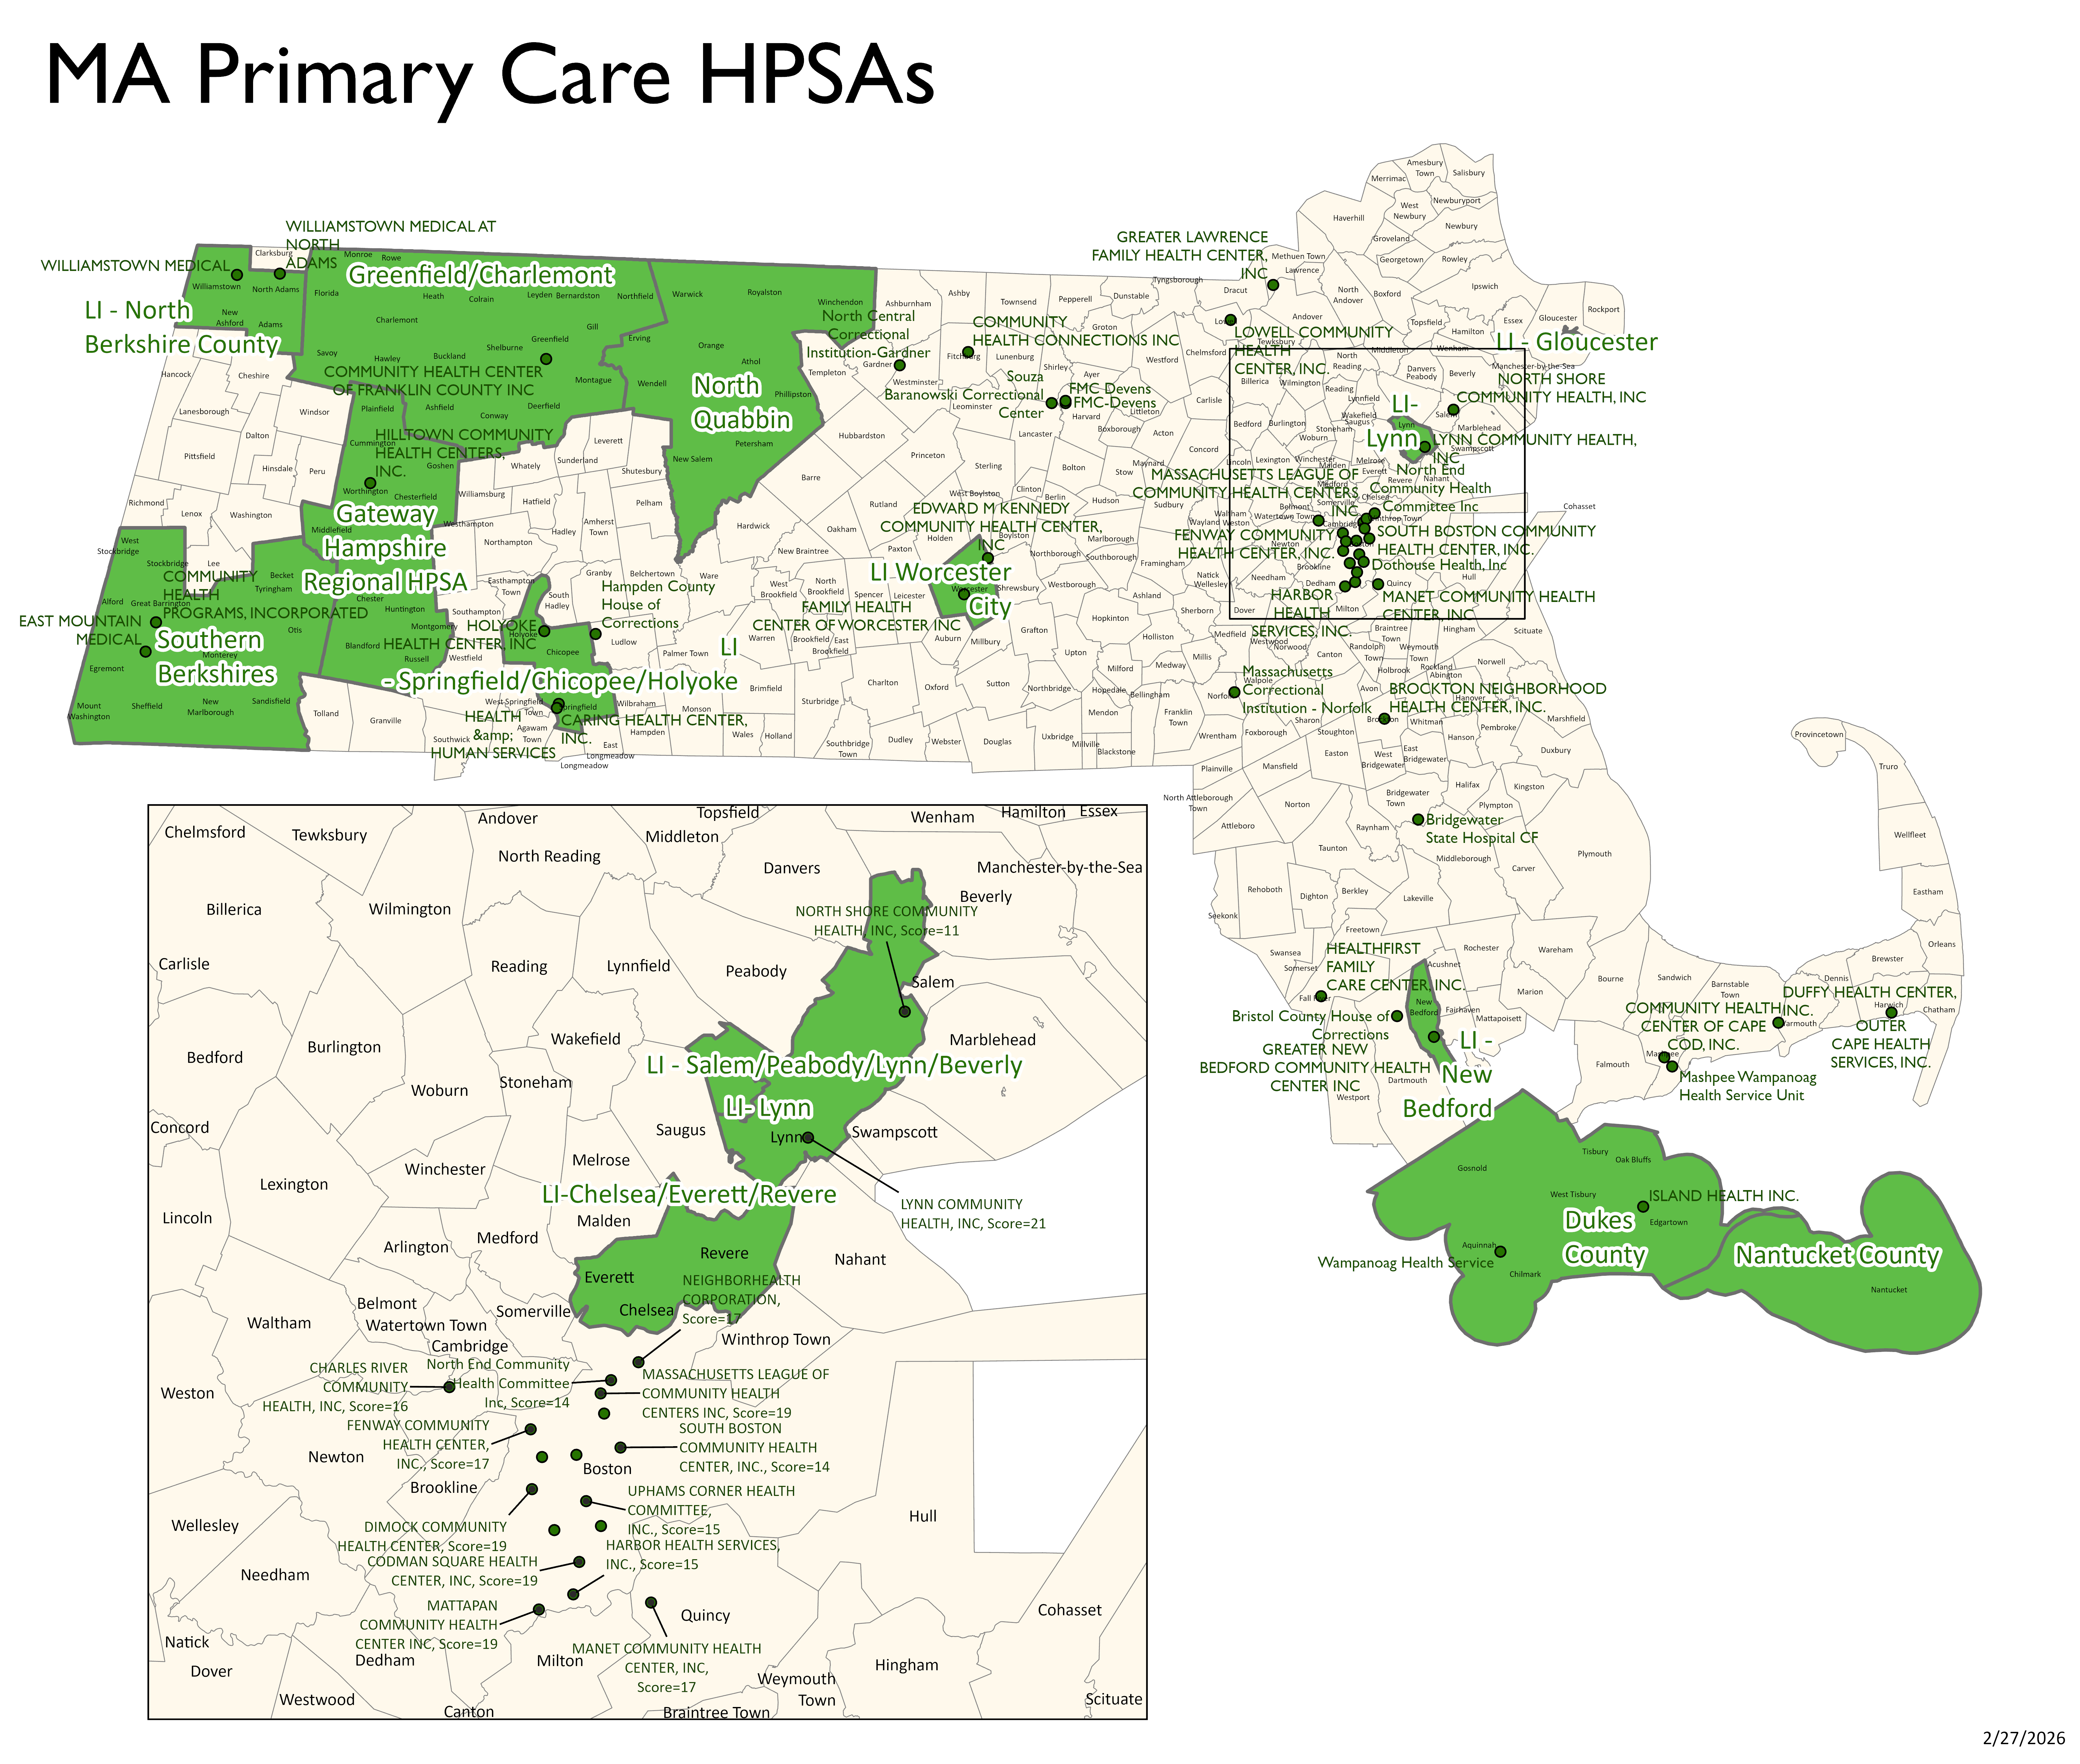
Health Provider Shortage Area Designation Progress
May 2024
January 2026
37

Slide 38





Direct Workforce Support: Conrad 30/ J-1 Visa Waiver Program
What is it?
Federal law permits state health departments to support up to 30 J-1 visa waivers for foreign physicians who plan to work in federally designated shortage areas and agree to provide safety-net services for medically underserved people for at least three years.
2025 Supported Visa Waivers
10 (33%) Boston
5 (17%) Primary Care Physicians
25 (83%) were non-primary care specialists
Impact Across Levels
Communities have improved access to primary and specialty care
Practices have improved recruitment and retention
Providers with cultural and linguistic competence
Individuals can support their families, longer-term immigration to Massachusetts

Slide 39



Direct Workforce Support: Loan Repayment
Massachusetts Loan Repayment Program
MLRP Results and Impact
State Budget
State Loan Repayment Program (HRSA)
Additional State Grant Funds (As Available)
Anecdotally, over half of recipients remain in HPSAs after completion of service
Moving to MA Repay!
Up to $50,000 of support

Slide 40

Direct Workforce Support: National Health Service Corps
National Health Service Corps supports primary care, dental, or mental health providers through scholarships and loan repayment.
More than 600 Massachusetts clinicians have participated in NHSC (2012 – 2024)
64% remain in HPSAs and
73% remain in their service community.
There are currently 257 active sites.
Last year there were 276 NHSC participants in MA.
Data source: HRSA BHW Dashboards

Slide 41
Health Professions Data Series (HPDS)
Overall Structure
The Health Care Workforce Center currently collects survey data alongside license renewals for 17 professions and is working to onboard additional professions.
From this data, we create reports and dashboards to:
  Characterize the workforce from a supply perspective
  Identify trends and patterns that impact access to health care professionals and services
  Inform healthcare workforce development, education, training, recruitment, and retention
Find out more about the Health Professions Data Series
Education: type of certification, highest degree, sources of license or degree.
Employment/ Practice: years of practice, employment status, and question about employers & the practice.
Future Plans/Professional Development: planned years of practice, 5 yrs plan, disability training.
Demographics: Zip code, sex, race, ethnicity, year of birth, language spoken, active duty.

Slide 42

Professions Included in HPDS
Currently Active Surveys
Registered Nurses (RN)
Licensed Practical Nurses (LPN)
Dentists
Dental Assistants - NEW
Dental Hygienists
Physician Assistants (PA)
Pharmacists
Mental Health Practitioners (x6) - NEW
Social Workers (x4) - NEW
Surveys In Development
Certified Nursing Assistants (CNA)
Licensed Alcohol and Drug Counselors (LADC)
Psychologists
Physicians
Emergency Medical Technicians and Paramedics

Slide 43
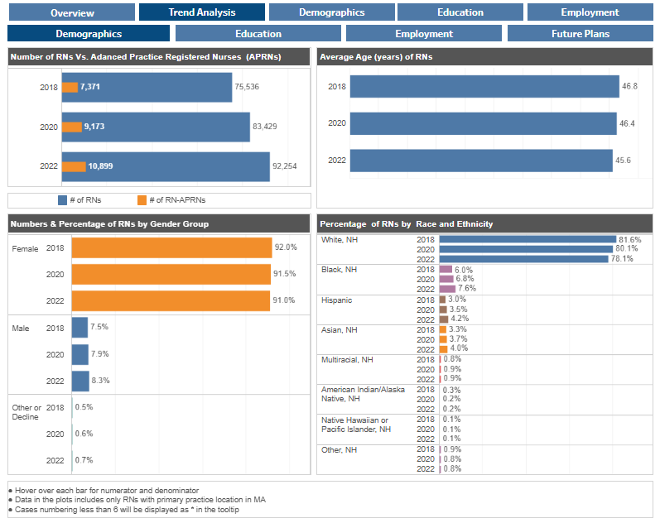
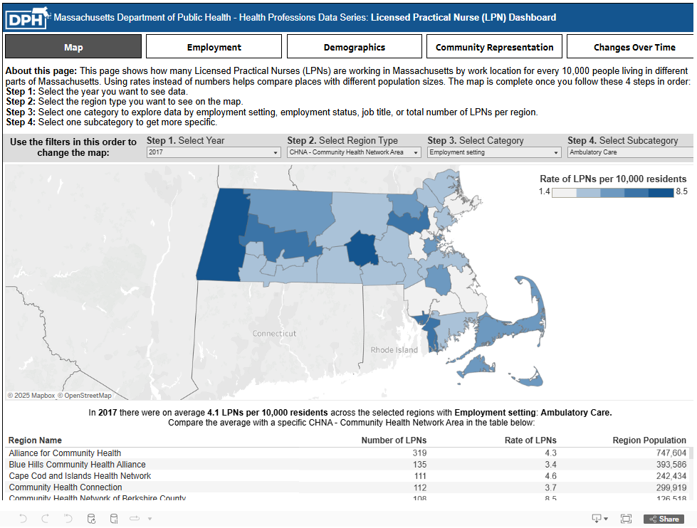
Health Professions Data Series Products
Interactive Dashboards
Summary Tables
Data Briefs
Registered Nurse Dashboard
Licensed Practical Nurse Dashboard
View the Registered Nurse Dashboard
View the Licensed Practical Nurse Dashboard

Slide 44
Health Care Workforce Center Collaborations
Partnered with the Centers for Health Information & Analysis on an Integrated Nursing Dashboard that incorporates demand data
Collaborating with Health Policy Commission on Behavioral Health
Supporting Executive Office of Health and Human Services on Direct Care Workforce
Meeting with the Nursing Council on Workforce Sustainability

Slide 45
Informational presentation thank-you
Thank you for the opportunity to share about the Health Care Workforce Center today.
Please direct any questions to:
Silvia Aguayo, MPH
HCWC Director, Director of the Primary Care Office
Office of Health Care Strategy and Planning
dph-healthcareworkforce-pco@mass.gov

Slide 46
Next meeting:
April 8, 2026

