Slide 1
Public health council
March 10, 2021
Please standby – the meeting will begin shortly
Today’s presentation is available on the mass.gov/dph website under “Upcoming Events” by clicking on the March 10 Public Health Council listing

Slide 2
Public health council
March 10, 2021
Today’s presentation is available on the mass.gov/dph website under “Upcoming Events” by clicking on the March 10 Public Health Council listing

Slide 3

COVID-19 Vaccination

Slide 4
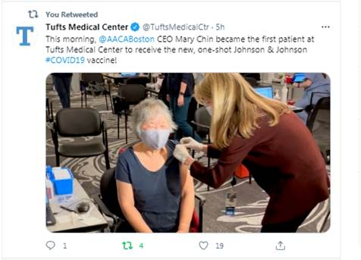
Johnson & Johnson vaccine

Slide 5
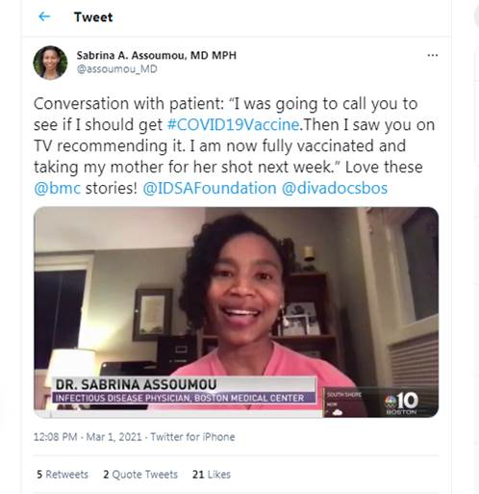
Trust the Facts. Get the Vax.

Slide 6

COVID-19 Equity Initiative
“Building trust and confidence takes time. So as people become eligible we want [them] to feel safe and understand the scientific facts about the value of this vaccine. The second goal is for all of the people currently eligible to have the barriers decreased to getting the vaccine.”

Slide 7
DPH AT A GLANCE

Slide 8
Determination of Need:
Request by Steward Health Care System, LLC for Substantial Change in Service

Slide 9
Final Promulgation of Revisions to
105 CMR 150.000
Standards for Long-Term Care Facilities
Public Health Council
Department of Public Health
March 10, 2021

Slide 10
Summary of Regulation
105 CMR 150.000, Standards for Long-Term Care Facilities:
  Sets forth standards governing long-term care facilities, including nursing homes and rest homes, and
  Provides a legal structure that promotes industry standardization, promotes higher quality of care, and stronger consumer protection for residents in long-term care facilities.

Slide 11
Nursing Facility Accountability and Supports Package 2.0
The Executive Office of Health and Human Services recently announced Nursing Facility Accountability and Supports Package 2.0, which holds facilities to higher standards of care and infection control, invests up to $140 million in new funding, and restructures Medicaid rates.
There are five key elements of the Nursing Facility Accountability and Supports Package 2.0:
  Requirements to strengthen staffing and the direct care workforce, de-densify congregate rooms, and improve standards of care
  Long term investment through MassHealth rate restructuring
  Targeted COVID-19 funding to support COVID response actions
  Sustained oversight and monitoring of facilities
  Early identification of issues and rapid response teams

Slide 12
Overview of Previous Revisions to Regulation
As a reminder, the Department previously presented to the Public Health Council proposed revisions to 105 CMR 150.000 to align the regulation with the Executive Office of Health and Human Services’ implementation of the Nursing Facility Accountability and Supports Package 2.0. Specific preliminary revisions included:
  Requiring nursing homes to provide a minimum number of 3.580 hours of care per resident per day, of which a subset of .508 hours must be care provided by a registered nurse;
  Requiring nursing homes to transition multiple occupancy resident bedrooms to single or double occupancy bedrooms by January 31, 2022; and
  Updating spacing requirements for all bedrooms and overall square footage requirements in double occupancy bedrooms.

Slide 13
Public Comment Periods
Following the first presentation to the PHC, the Department held a public comment period, including a public hearing. Based on the public comments received, the Department made additional revisions to 105 CMR 150.000.
The Department held a second public comment period, including a public hearing on March 1, 2021, and made additional revisions to the regulation.
This presentation will outline the revisions made in response to comments received or for clarity.

Slide 14
Highlights of Post-Comment Review
As a result of the comments received during the public comment periods, DPH recommends additional revisions to 105 CMR 150.000:
  Amending the proposed square footage requirements for resident bedrooms while still maximizing distance between resident beds;
  Permitting nursing homes that are unable to fully comply with the de-densify requirements by April 30, 2022 to demonstrate to the Department through the submission of evidence of the licensee’s good faith efforts to come into compliance.

Slide 15
Post-Comment Revisions: Physical Plant Updates
CURRENT REGULATION:
Sets minimum square footage requirements for floor area per bed and spacing among beds.
ORIGINAL PROPOSED REVISION:
Update spacing requirements for all bedrooms and overall square footage requirements in double occupancy bedrooms.
PROPOSED REVISION AFTER FIRST COMMENT PERIOD:
Require increased square footage and spacing requirements apply to new facilities and to any construction and/or renovation projects affecting resident bedrooms in current facilities.

Slide 16
Post-Comment Revisions: Physical Plant Updates
CURRENT REGULATION:
Permits up to four beds per resident bedroom in nursing homes, unless there is new construction or reconstruction, in which case after construction DPH allows no more than two beds in the affected bedrooms.
PROPOSED REVISION:
Requires nursing homes to transition multiple occupancy resident bedrooms to single or double occupancy bedrooms.
SUMMARY OF FURTHER REVISIONS AFTER COMMENT PERIODS:
Moves the effective date for compliance from January 2022 to April 30, 2022; and
Permits nursing homes that are unable to fully comply with the de-densify requirements by April 30, 2022 to demonstrate to the Department through the submission of evidence of the licensee’s good faith efforts to come into compliance.
  The Department will issue guidance detailing what constitutes good faith efforts as well as the process for submission of evidence and the Department’s review and expectations for licensees to continue to demonstrate ongoing good faith efforts after April 30, 2022.

Slide 17
Next Steps
  The Department requests the Public Health Council approve the proposed regulations for promulgation.
  Following Public Health Council approval, the Department will file the amended regulation with the Secretary of the Commonwealth for final enactment.

Slide 18
Thank you for the opportunity to present this information today.
For more information regarding standards for long-term care facilities, please find the relevant statutory language and the full current regulation here:
https://malegislature.gov/Laws/GeneralLaws/PartI/TitleXVI/Chapter111
https://www.mass.gov/doc/105-cmr-150-standards-for-long-term-care-facilities/download

Slide 19
DPH Housing Stability Update
Public Health Council Meeting
03/10/2021
Thomas Brigham
Housing Stability Coordinator, Office of Health Equity

Slide 20
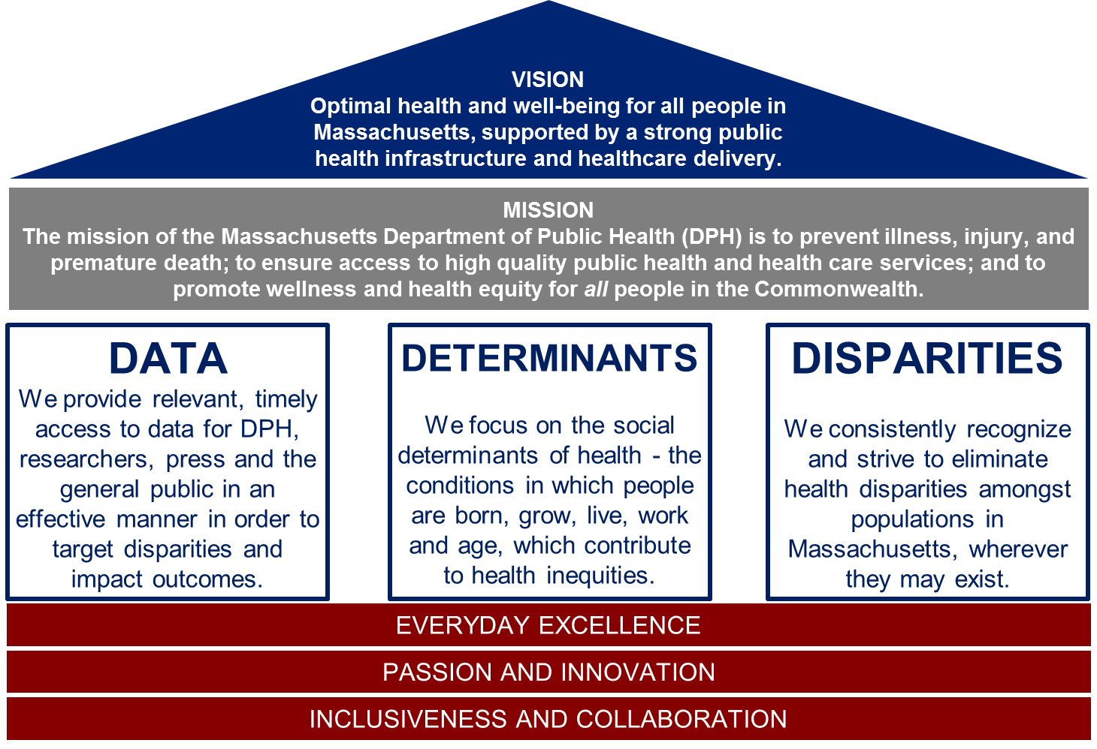

Slide 21
COVID-19 Health Equity Advisory Group
 | Social Determinants of Health Recommendations
Housing Stability | Implement policies that increases housing stability
Economic Mobility | Develop pathways to financial freedom to prevent further disparities and that support economic mobility
https://www.mass.gov/orgs/covid-19-health-equity-advisory-group

Slide 22
Office of Health Equity
OHE
Interpreter services
Health and Disability Program
Culturally and Linguistically Appropriate Services
Housing Stability
Racial Equity
22

Slide 23
Social Determinants of Health
A person’s health is influenced by many factors, including housing, education, employment, and access to food. These factors, sometimes referred to as social determinants or social influencers of health, are defined by the conditions and environment in which people are born, grow, live, work, and age.
The connection between housing and health is one of the most studied social determinants of health:
• A study published by the American Public Health Association found that hospital admissions and emergency room visits were three to four times higher for people who are homeless.
• Of people without a home, nearly 2.5 million are children under the age of 18.
• A 2018 study by the Boston Medical Center found that children aged 4 and under in low-income, unstable housing, had nearly a 20 percent increased risk of hospitalization and over a 25 percent increased risk of developmental delays.

Slide 24
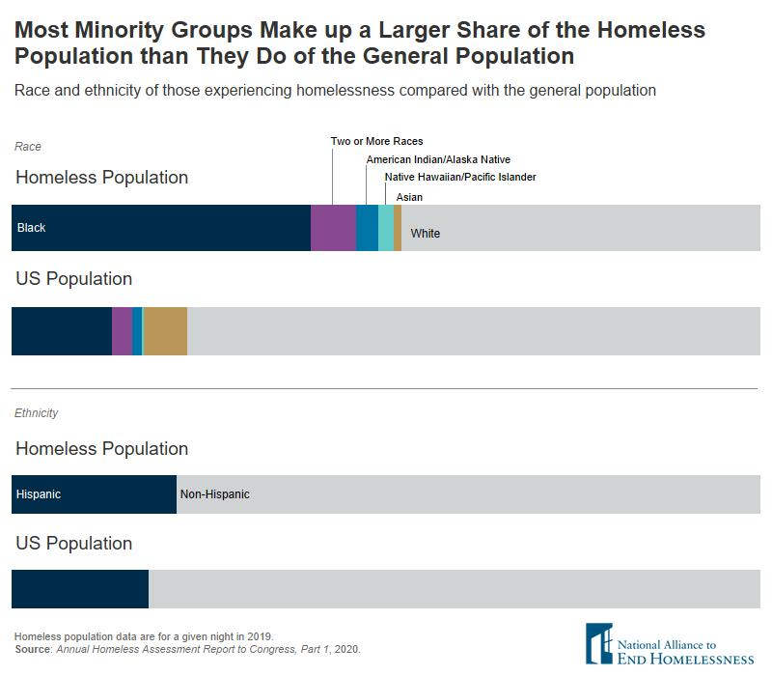
Homelessness and Racial Inequities
Most people of color, especially Black and Indigenous people, experience homelessness at higher rates than Whites, largely due to long-standing historical and structural racism.
The most striking inequities can be found among the Black, Non-Hispanic population, who represent 13 percent of the general population but account for 40 percent of people experiencing homelessness and more than 50 percent of homeless families with children. This imbalance has not improved over time.

Slide 25
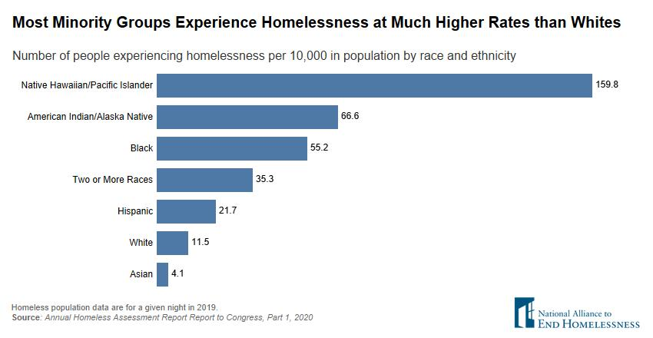
Homelessness and Racial Inequities
The rate at which most people of color experience homelessness is far greater than that of Whites and Asians. Measured as the number of people experiencing homelessness on a given night per 10,000 people in the population, Native Hawaiians and Pacific Islanders have the highest rate of homelessness. American Indians/Alaska Natives have the second highest rate, followed by those who are Black or identify as two or more races, or as Hispanic.

Slide 26
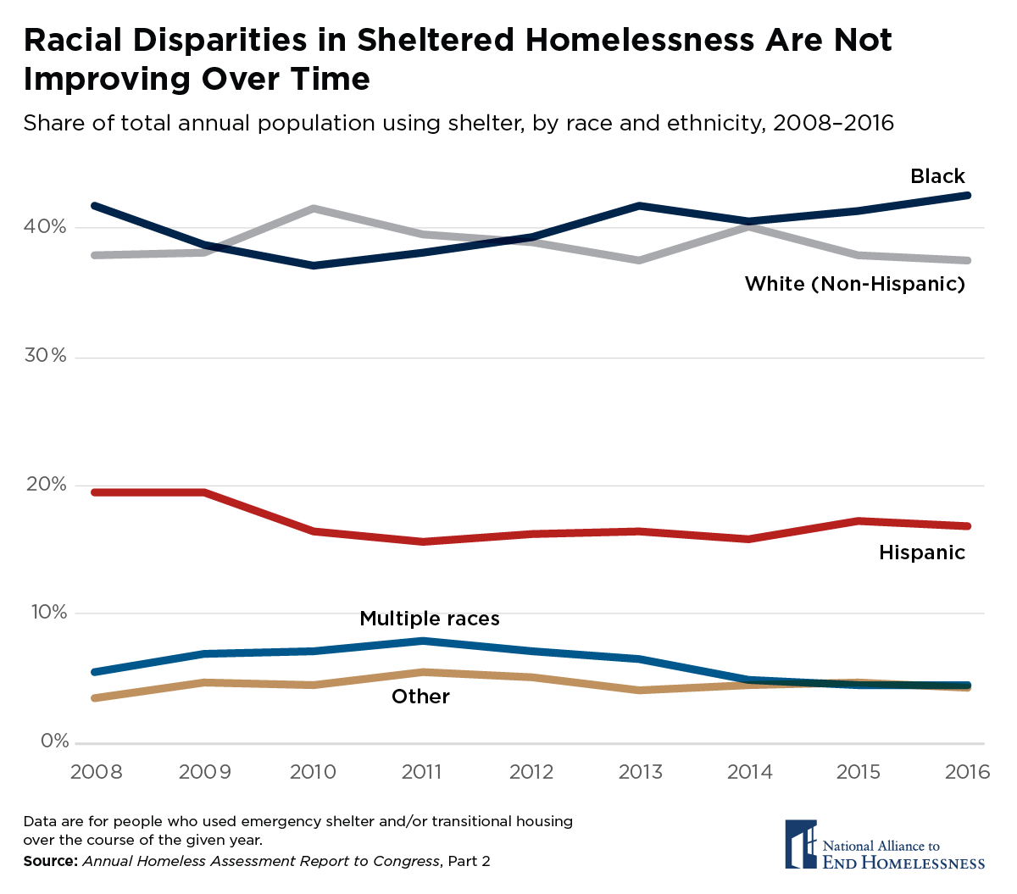
Homelessness and Racial Inequities
Racial and ethnic inequities in homelessness are not improving significantly over time. Those who identify as Black make up the largest share of all people who access shelter over the course of a given year, and their share has increased in recent years, while the share for those identifying as White has declined.

Slide 27
Access to Quality Health Care and Homelessness
People of color are far more likely to lack health insurance than White people, especially in states without Medicaid expansion. Even with expansion, overall about 30 million people are uninsured, with about half of them being people of color.
The lack of health insurance for people with chronic medical conditions and/or untreated serious mental illness can place them at risk of becoming homeless or being precariously housed. For example, people with mental health disabilities are vastly overrepresented in the population of people who experience homelessness. Of the more than 550,000 people in America who experienced homelessness on a given night in 2017, 1 in 5 had a behavioral health issue. While the rate of serious mental illness may not vary by race, studies show African Americans have more difficulty accessing treatment.

Slide 28
Homelessness in Massachusetts
Point-in-Time (PIT) Count – annual count of homeless in each CoC​
Most Recent PIT Count​
Total – 18,471​*
Families (# of persons) 12,212​
Emergency Shelter 11,248​
Transitional Housing 775​
Unsheltered 9​
Individuals (without children) 6,228​
Emergency Shelter 4,183​
Unsheltered 818​
Transitional Housing 1,227​
PIT Count Subpopulations:
Chronic Homeless Individuals-1,392​
Veterans- 917 ​
Unaccompanied Youth -480​​
Chronic Substance Use -2,525
* The 2019 PIT Count – these numbers are based on one night – an annual number would be much higher.

Slide 29
Housing & Homeless Work at DPH
Housing and Homelessness Work Group
Opioid Priority Area Team (OPAT)
Housing Data Standards
Intra-agency Council on Housing and Homelessness

Slide 30
Housing & Homelessness Work Group
Housing & Homelessness Work Group Mission:
To create a housing-aware department … utilizing a racial equity lens to mitigate hurdles faced by people of color to obtain stable housing.
This work group:
Lifts up existing resources
Coordinates housing efforts
Identifies new partnerships
Provides capacity building and technical assistance
Sustains participation on EOHHS housing and homelessness initiatives

Slide 31
Housing Instability Opioid Priority Area Team (OPAT)
The Housing Instability Opioid Priority Team (OPAT) is comprised of 11 staff from the Bureau of Infectious Diseases and Laboratory Sciences, Office of Health Equity, Bureau of Substance Addiction Services, and Bureau of Environmental Health.
The goal of the OPAT is to track DPH activities related to housing stability for Massachusetts residents with opioid use disorder; and to identify gaps and recommendations, as requested.

Slide 32
Housing & Homeless Data Standards
Housing & Homeless Data Standards Work Group
The focus of the work has been on creating data collection standards that highlights housing stability as a spectrum.
Centers the idea of primary prevention of housing instability.
Will inform future work to both identify and appropriately refer those who require housing resources across DPH programs.

Slide 33
Interagency Council on Housing and Homelessness
DPH is supporting the efforts of the Interagency Council of Housing and Homelessness (ICHH) and the Department of Housing and Community Development (DHCD) to use COVID-19 relief funding for homelessness prevention and shelter improvement. This includes identifying additional units to keep shelter numbers down for social distancing and increase number of people served.

Slide 34
Updates on DPH Housing Stability Initiatives
Low-Threshold/Housing First in Suffolk County
  DPH is contracting with Boston-based nonprofit organizations Commonwealth Land Trust and Victory Programs to provide low-threshold housing and supportive case management services for 30 to 60 unaccompanied adults experiencing homelessness at high risk for HIV acquisition with essential support services that help people maintain their housing.
Housing Model for People Diagnosed with HIV Infection
  DPH using $300,000 for housing support for people who are experiencing homelessness or who are marginally housed, who inject drugs.
  DPH will fund 1-2 organizations that propose models intended to link individuals meeting these criteria to temporary, transitional, or permanent housing and/or to provide housing stabilization services.

Slide 35
Updates on DPH Housing Stability Initiatives
DPH’s Follow-up, Outreach, and Referral (FOR) Homeless Families
  The F.O.R. Families Program [follow-up, outreach and referral] is a joint program of the Massachusetts Department of Housing and Community Development and the Massachusetts Department of Public Health. Funding is provided by DHCD to serve families in select shelters within the Commonwealth.
  Home Visitors are providing telehealth visits.
  FOR Families is assisting clients with obtaining the necessary documentation to apply for the MRVP and encouraging housing search in preparation for receiving the voucher.
  DHCD is providing 250 MRVPs to their longest stayers in shelter and has set aside 45 MRVPs for medically complex families.

Slide 36
Updates on DPH Housing Stability Initiatives
Housing Stability for Survivors of Domestic Violence and Sexual Assault
  A pilot project has started that will match families that have been in emergency domestic violence shelters for a year or more with affordable housing through the use of permanent, mobile vouchers from the Massachusetts Rental Voucher Program.
Housing Stability Support to assist People in Recovery
  DPH has approved a procurement of the Housing Stability Support (HSS) program.
  The primary goal of Housing Stability Support (HSS) is to assist adults, families, and young adults in their recovery, in the stabilization of their housing and in achieving self-sufficiency.

Slide 37
Thank You!
Questions?

Slide 38
Results from the COVID-19
Community Impact Survey(CCIS)
Public Health Council, March 10, 2021 presented by W.W. Sanouri Ursprung PhD
Massachusetts Department of Public Health

Slide 39
CCIS TEAM MEMBERS
CCIS Project Leads
Lauren Cardoso, Sanouri Ursprung, Beth Beatriz, Glory Song, Caroline Stack, Kathleen Fitzsimmons, Emily Sparer-Fine, Nicole Daniels, Lisa Bandoian, Heather Nelson, Amy Flynn, Lisa Arsenault,
CCIS Analytic Team
Beth Beatriz, Glory Song, Caroline Stack, Kathleen Fitzsimmons, Emily Sparer-Fine, Ziming Xuan, Matthew Tumpney, Rebecca Han, Lauren Larochelle, Arielle Coq, Anne Marie Matteucci, Lauren Fogharty, Vera Mouradian, Melody Kingsley, Ta Wei Lin, Anna Agan, Justine Egan, Allison Guarino, Elizabeth Showalter, Beatriz Pazos Vautin, Priyokti Rana, Lauren Cardoso, Sanouri Ursprung
CCIS Data to Action Workgroup
Jessica del Rosario, Kim Etingoff, Lisa Bandoian, Andrea Mooney, Ben Kingston, Lauren Cardoso, Dawn Fukuda
CCIS Steering Committee
Lauren Cardoso, Sanouri Ursprung, Beth Beatriz, Abbie Averbach, Ruth Blodgett, Ben Wood, Sabrina Selk, Nicole Daley, Lisa Bandoian
CCIS Data Dissemination Workgroup
Beth Beatriz, Glory Song, Emily Sparer-Fine, Ta Wei Lin, Vera Mouradian

Slide 40
CCIS COMMUNITY PARTNERS
Many groups that were critical in the success of this effort and gave important input on the development and deployment of the survey:
Academic Public Health Volunteer Corps and their work with local boards of health and on social media
Mass in Motion programs, including Springfield, Malden, and Chelsea
Cambodian Mutual Assistance
The Mashpee Wampanoag Tribe
The Immigrants’ Assistance Center, Inc
Families for Justice as Healing
City of Lawrence Mayor’s Health Task Force
The 84 Coalitions, including the Lawrence/Methuen Coalition
Boys and Girls Clubs, including those in Fitchburg and Leominster and the Metro South area
Chinatown Neighborhood Association
Father Bill’s
UTEC
MassCOSH
Stavros Center for Independent Living
Greater Springfield Senior Services

Slide 41
OVERVIEW
Review Purpose and Approach of the Covid-19 Community Impact Survey (CCIS)
Review highlights of new findings section:
  Mental Health
Review Data to Action Next Steps
Appendix

Slide 42
PURPOSE AND APPROACH

Slide 43
Why did we conduct the CCIS?
Goals:
1) Identify the most pressing immediate and long-term health needs created by the pandemic, including its social and economic consequences
2) Determine which populations have been most disproportionately impacted
.... in order to inform and prioritize resource deployment and policy actions

Slide 44
OVERVIEW OF CCIS APPROACH
Conducted a self-administered online survey between Sept. and Nov. 2020
Covered a wide range of topics
  Perceptions & experiences of COVID-19, Basic needs, Access to healthcare, Pandemic-related changes in employment, Mental health, Substance use, and Safety
Available in 11 languages; additional focus groups also conducted in ASL
Open ended questions captured previously unknown needs and barriers
Weighted results to the state average
Recruitment via network of community-based organizations (CBOs)
Employed a snowballing sampling strategy to ensure we reach key populations
  eg. People of color, LGBTQ+ individuals, People with disabilities, Essential workers, People experiencing housing instability, Older adults, and Individuals living in areas hardest hit by COVID-19

Slide 45





RESULTS TOPICS TO DATE
ACCESS TO TESTING​
ACCESS TO HEALTHCARE​
SOCIAL DETERMINANTS OF HEALTH
MITIGATING INDIVIDUAL RISK OF INFECTION
TESTING ACCESS
HEALTHCARE
ACCESS
MENTAL HEALTH

Slide 46
MENTAL HEALTH

Slide 47
MENTAL HEALTH INDICATORS
Two aspects of Mental Health were captured by the survey:
How has the pandemic impacted the mental health of all residents?
      Adapted from “Primary Care PTSD Screen for DSM-5 (PC-PTSD-5)*”
      “3+ PTSD-like reactions” - Respondents were asked how many PTSD related reactions to the pandemic they had experienced in the past month from a validated list of reactions.
How have residents with the most persistent poor mental health been impacted by the pandemic?
Standard item from the CDC Behavioral Risk Factor Surveillance System**
“15+ days of poor mental health” - Respondents were asked how many days during the past 30 days their mental health was not good, which includes stress, depression, and problems with emotions​
      * See Appendix for more details; Reference: Prins, A., Bovin, M. J., Kimerling, R., Kaloupek, D. G, Marx, B. P., Pless Kaiser, A., & Schnurr, P. P. (2015). Primary Care PTSD Screen for DSM-5 (PC-PTSD-5) [Measurement instrument]. Available from https://www.ptsd.va.gov
      ** Reference: Centers for Disease Control and Prevention (CDC). Behavioral Risk Factor Surveillance System Survey Questionnaire. Atlanta, Georgia: U.S. Department of Health and Human Services, Centers for Disease Control and Prevention
Preliminary data - 1.7.21 - Not for external distribution

Slide 48
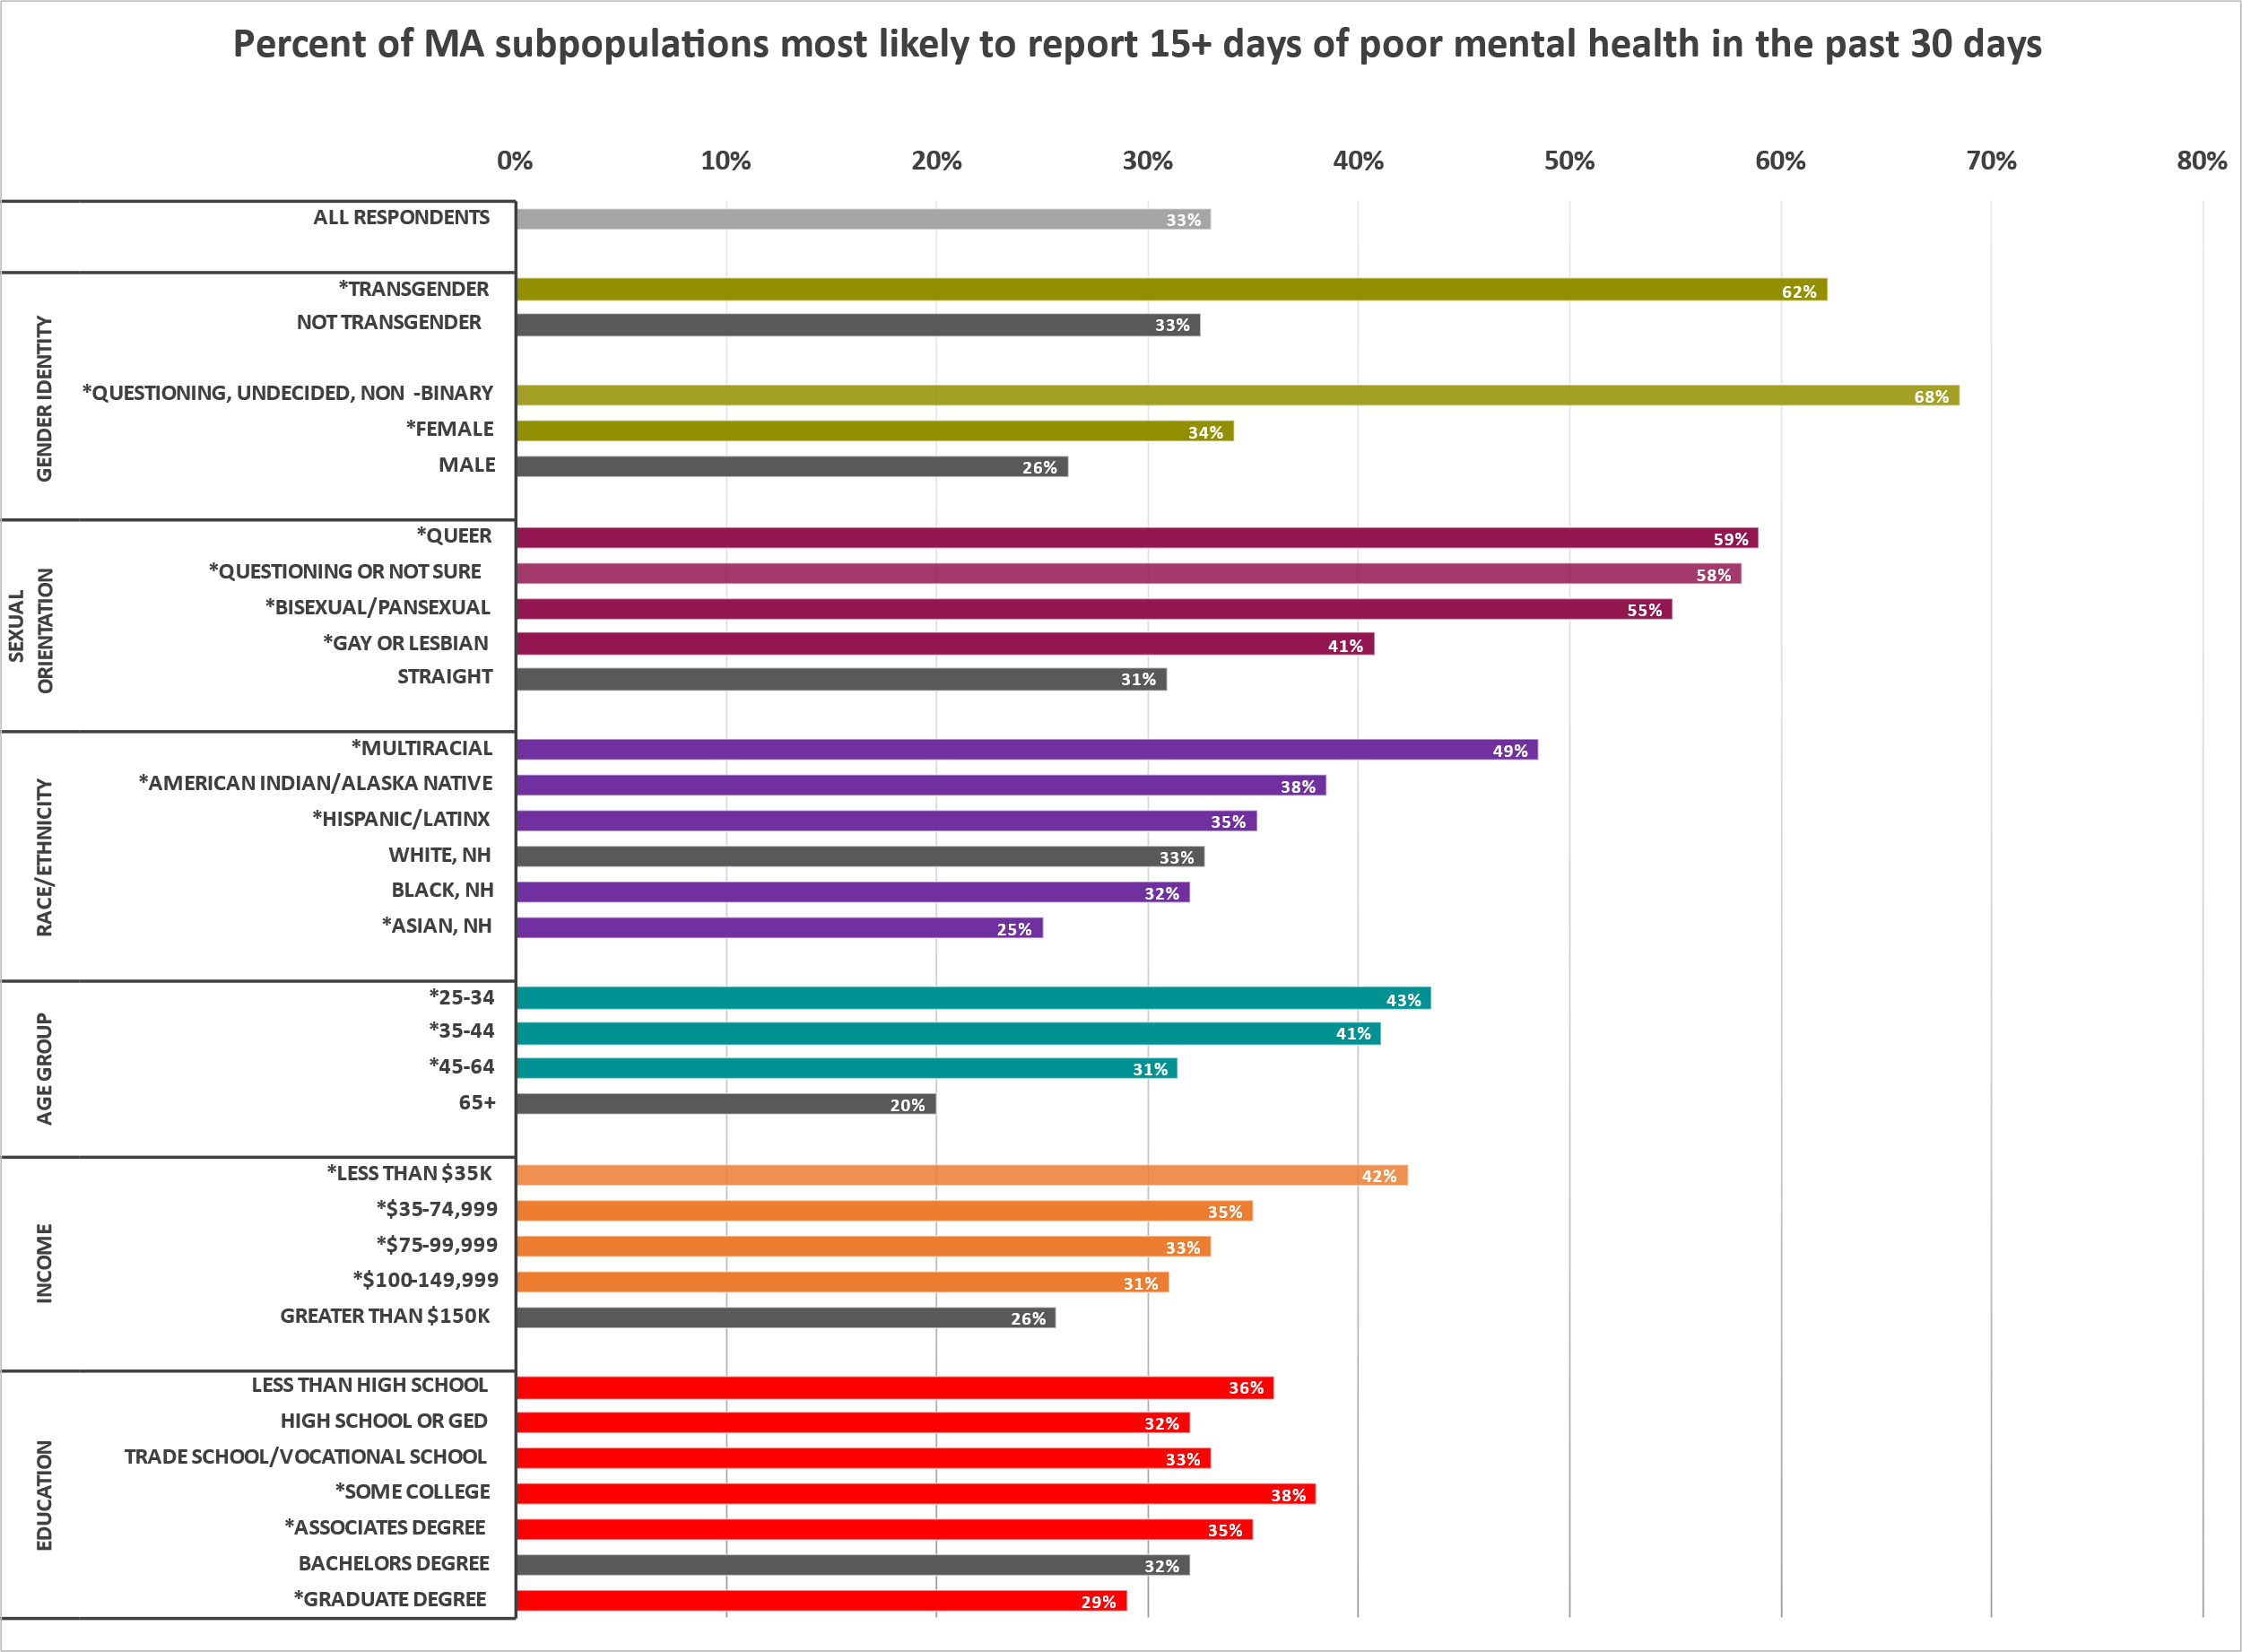
MENTAL HEALTH STATUS
All demographic groups in MA are experiencing increases in poor mental health.
1 in 3 MA adults reported 15+ days of poor mental health in the past 30 days.
This is 3X higher than the 2019 MA BRFSS.
The groups reporting the highest rates of poor mental health include:
Transgender respondents, Non-binary respondents, and respondents questioning their gender identity
LGBQ+ respondents
Multiracial, American Indian/Alaska Native, and Hispanic/Latinx respondents
Younger respondents
Respondents with low income <$35k
Those with lower educational attainment
These are the same demographic groups who were more likely to have 3+ PTSD-like reactions in the past 30 days, with the exception of Hispanic/Latinx race group which was not statistically significant.
1 in 4 adults reported 3+ PTSD-like reactions.
* significant at the p<0.05 level as compared to the grey referent group in each cluster
Preliminary data - 1.7.21 - Not for external distribution

Slide 49
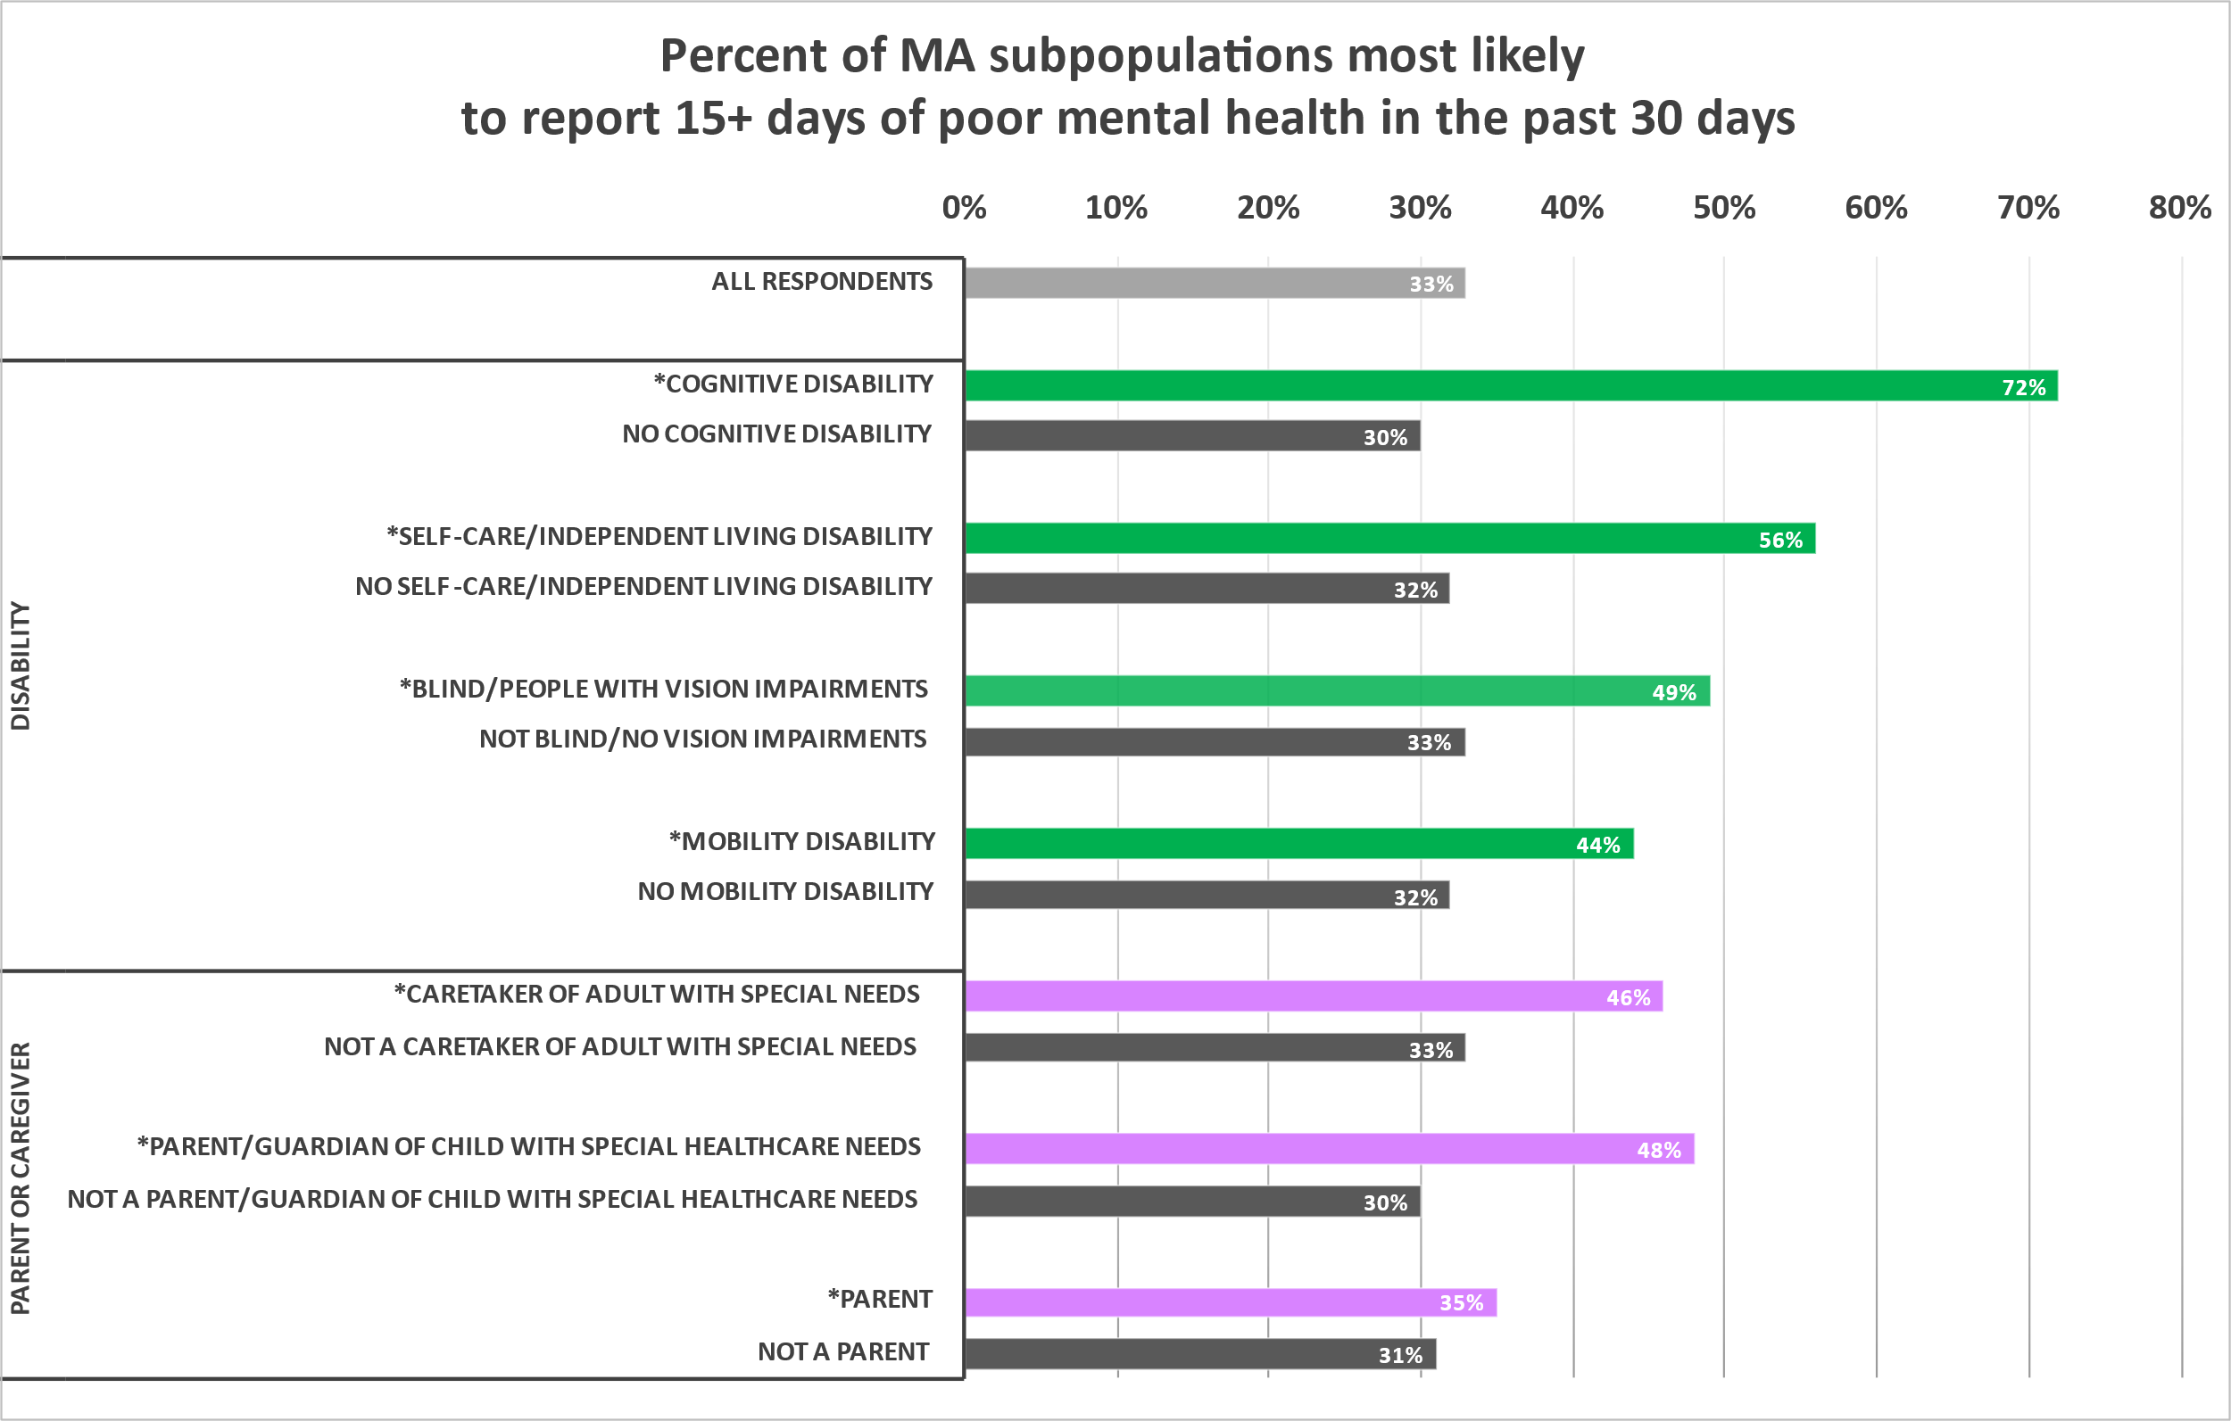
MENTAL HEALTH STATUS, CONT.
1 in 3 MA adults reported 15+ days of poor mental health in the past 30 days.
All demographic groups in MA are experiencing increases in poor mental health.
Of the subpopulations experiencing high rates of poor mental health, respondents with disabilities reported the highest rates of 15+ days of poor mental health
This was true across all categories
Almost 1 in 2 caregivers of persons with special needs and parents of children with special healthcare needs are experiencing high rates of poor mental health
* significant at the p<0.05 level as compared to the grey referent group in each cluster
Preliminary data - 1.7.21 - Not for external distribution

Slide 50
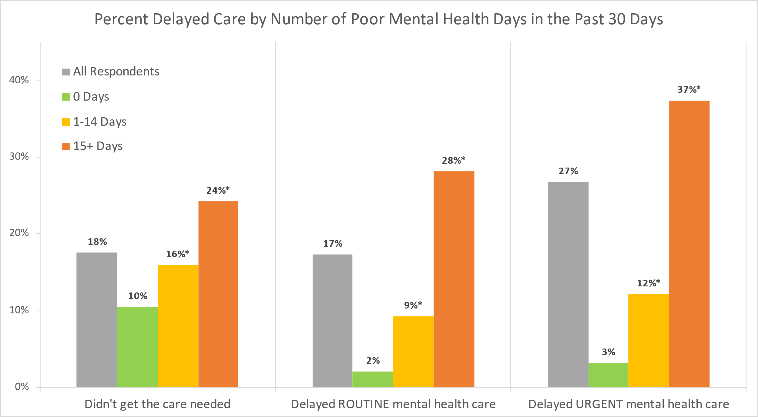
DELAY IN HEALTH CARE
Respondents who reported any days of poor mental health were more likely to experience delayed care,
including routine and urgent mental health care, compared to those who reported 0 days of poor mental health.
Among respondents who reported 15+ days of poor mental health, the following groups experienced delayed urgent mental health care at the highest rates:
Bisexual/Pansexual respondents
Respondents with Cognitive Disabilities
Respondents between ages 25-44
* subgroup is significantly different compared to respondents with 0 poor mental health days at the p<0.05 level
NOTE: Similar results were seen when comparing delays in care by the number of PTSD-like reactions to COVID-19.
Preliminary data - 1.7.21 - Not for external distribution

Slide 51
DELAY IN HEALTH CARE, CONT.
Respondents reporting poor mental health were more likely to experience delayed care,
including routine and urgent mental health care, compared to those who reported no poor mental health days.
Among respondents who reported 15+ days of poor mental health, the top reasons for delays in any health care included:
Appointment was cancelled/delayed
Worried about getting COVID-19 from in-person care
Worried they could not afford the care or that their insurance didn’t cover it
Not having a private place for a phone call or video chat
* subgroup is significantly different compared to respondents with 0 poor mental health days at the p<0.05 level
NOTE: Similar results were seen when comparing delays in care by the number of PTSD-like reactions to COVID-19.
Preliminary data - 1.7.21 - Not for external distribution

Slide 52
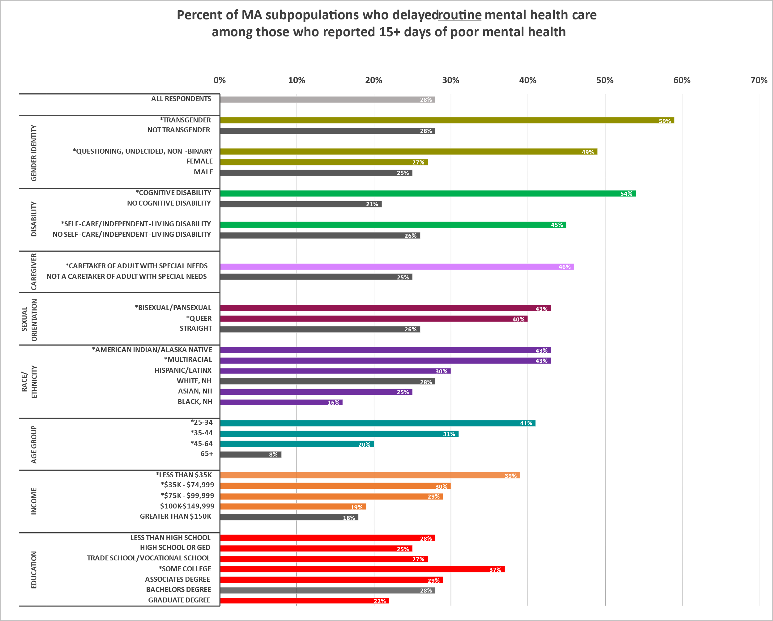
DELAY IN ROUTINE MENTAL HEALTH CARE
Almost 30% of adults who reported
15+ days of poor mental health experienced delayed routine mental health care.
Among adults who reported 15+ days of poor mental health, the following groups delayed routine mental health care at the highest rates:
Transgender respondents, Non-binary respondents, and respondents questioning their gender identity
Respondents with disabilities
Caregivers of adults with special needs
Bisexual/Pansexual and Queer respondents
American Indian/Alaska Native and Multiracial respondents
Respondents between ages 25-34
Respondents with income <$35k and high educational attainment
* significant at the p<0.05 level as compared to the grey referent group in each cluster
Preliminary data - 1.7.21 - Not for external distribution

Slide 53
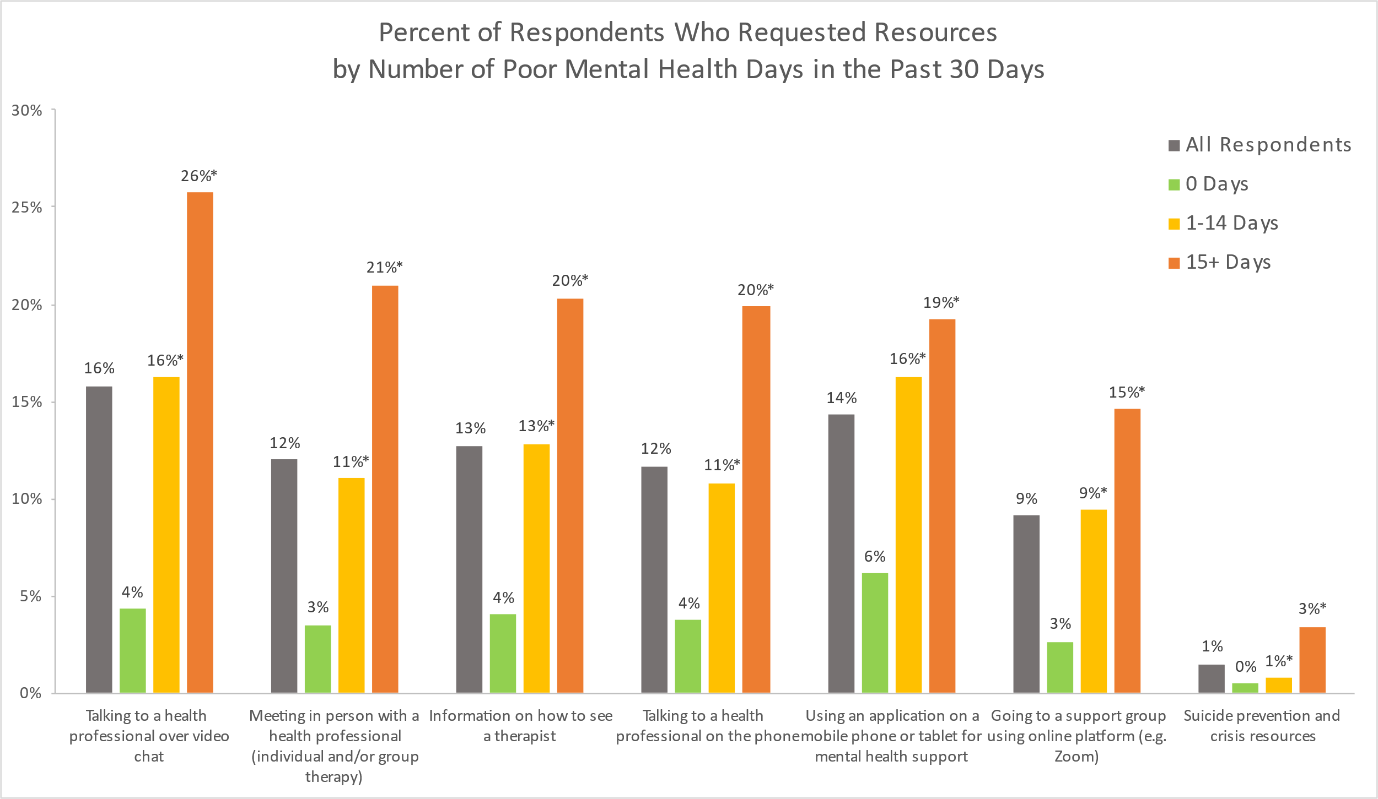
REQUESTED RESOURCES
Respondents who reported poor mental health were more likely to request health resources
compared to those who reported no days of poor mental health.
TOP 5 RESOURCES REQUESTED among respondents with 15+ days of poor mental health
1. Talking to a health professional over video chat
2. Meeting in person with a health professional (individual and/or group therapy)
3. Information on how to see a therapist
4. Talking to a health professional on the phone
5. Using an application on a mobile phone or tablet for mental health support
TOP 5 RESOURCES REQUESTED among respondents with 15+ days of poor mental health
1. Talking to a health professional over video chat
2. Meeting in person with a health professional (individual and/or group therapy)
3. Information on how to see a therapist
4. Talking to a health professional on the phone
5. Using an application on a mobile phone or tablet for mental health support
* subgroup is significantly different compared to respondents with 0 poor mental health days at the p<0.05 level
Preliminary data - 1.7.21 - Not for external distribution

Slide 54
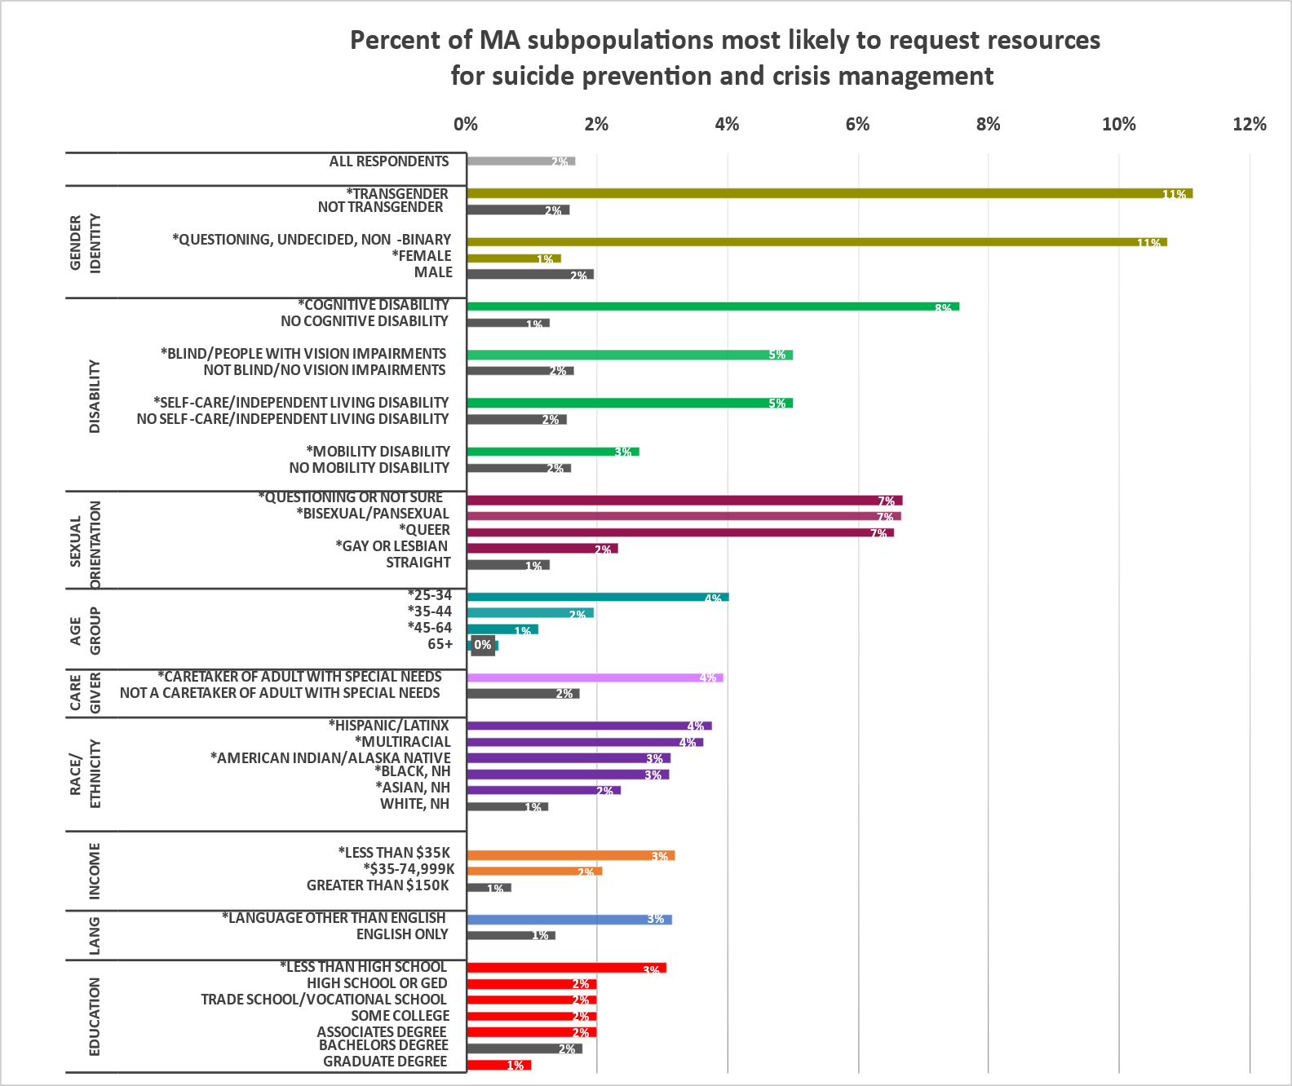
SUICIDE PREVENTION RESOURCES
Requests for suicide prevention and crisis management resources were as high as 11% among certain subpopulations
Among all survey respondents, about 2% requested resources for suicide prevention and crisis management, although that proportion varied among certain groups.
In this survey, the groups that reported the highest need for suicide prevention and crisis management resources were:
Transgender respondents, non-binary respondents, and respondents questioning their gender identity
LGBQ+ respondents
Respondents with disabilities
Respondents ages 25-34
Caretakers of Adults with Special Needs
Hispanic/Latinx respondents
Respondents with lower incomes
Many of these groups also reported higher rates of poor mental health across both indicators
* significant at the p<0.05 level as compared to the grey referent group in each cluster
Preliminary data - 1.7.21 - Not for external distribution

Slide 55




RESPONDENTS WITH POOR MENTAL HEALTH
Compared to respondents who experienced 0 days of poor mental health, those who reported 15+ days
of poor mental health were much more likely to impacted by social determinants of health.
2x more likely to have delay in health care
2.4x more likely to have change in employment to take care of child/children
2.6x more likely to worry about getting medication
2x more likely be “very worried” about getting covid-19
2-3x more likely to worry about the following basic needs: healthcare, technology, and childcare
2.5X more likely to worry about expenses/bills
2-3X more likely to request resources that would be helpful to them
Preliminary data - 1.7.21 - Not for external distribution

Slide 56
QUESTIONS & FEEDBACK?

Slide 57
DATA TO ACTION

Slide 58
DATA TO ACTION
We are getting input from both internal and external stakeholders
in order to convert these data to action.
INTERNAL GROUPS
Established a Data to Action (DTA) Workgroup to convene Bureaus, Offices, work groups etc. in integrating findings into DPH actions.
Eg. integrate population specific lessons learned into the launch of the Targeted Community Outreach initiative among the top 20 impacted towns/cities
COLLABORATORS
We are eliciting input from our advisory groups (eg. PHC, HEAG) to help us interpret and identify possible actions resulting from the data.
Eg. improve accessible options on the vaccine website after hearing from external partners that existing measures still posed accessibility barriers
LOCAL PARTNERS
We are also providing the data presented here by granular geographies, and populations. to equip our local partners in tailoring their own pandemic response.
Eg. Providing data by race, ethnicity groups, sexual orientation, gender identity, transgender status, types of disability, income, education, language spoken, geography, rural cluster, age, etc.

Slide 59







RESOURCE INFORMATION
How can we help people access needed supports, services, and resources?
COMMUNICATION / PSAs
How can we utilize alternative channels to reach key populations (not currently being reach)? What modes to use?
HEALTH LITERACY & TRUST
How can we craft understandable messaging that also addresses concerns and fears not just recommended actions?
Key Themes of Actions Needed Emerging from Findings
SDOH OVERLAP
How do we address the multiple layers of barriers and burden?
HEALTHCARE CAPACITY
How can we increase appointments, telehealth infrastructure, culturally competent providers, CHWs?
EMPLOYMENT
How can we promote more equitable worker protections (physical conditions, testing, and benefits/leave)?
ACCESSIBILITY
How can we improve accessibility of information and services (e.g., language, technology, cultural competence of providers)?
TELEHEALTH & TECHNOLOGY
How can we reduce technology-related barriers to accessing services?
59

Slide 60
APPENDIX

Slide 61
Survey Questions
Demographics
What city or town do you live in?
How many people - adults and children - currently live with you, including yourself?
How many people who are over 60 years old currently live with you, including yourself?
Are you a caretaker of an adult(s) with special needs in your household?
Are you a parent/guardian of a child or youth with special health care needs?
Please select all that apply to you: I am deaf or hard of hearing. I am blind or I have trouble seeing even when I am wearing glasses. I have trouble concentrating, remembering, or making decisions because of a physical, mental, or emotional condition. I have trouble walking or climbing stairs. I have trouble getting dressed or taking a bath or shower. I have difficulty doing errands alone such as visiting a doctor's office or shopping. None of the above apply to me.
Were you pregnant during the COVID-19 outbreak or did you give birth since February 2020?
When did you give birth?
After the start of the COVID-19 outbreak, did your birth plans change?
What is the highest grade or year of school you have finished?
In 2019, what was your total annual household income before taxes?
Have you ever been sentenced to stay overnight or longer in any type of corrections institution? Examples include a jail or prison.
What is your sexual orientation?
What is your current gender identity?
Are you transgender or of transgender experience?
Are you Hispanic or Latino?

Slide 62
Survey Questions
Demographics
Perceptions & Experiences of COVID-19
What is your race? Select all that apply.
What is your ethnicity? Select all that apply.
(For English Survey) Do you speak language(s) other than English at home?
Which language(s) do you speak at home?
(For Non-English Surveys) How well do you speak English?
Do you agree or disagree with the following statements? My community is receiving adequate support to: Prevent the spread of COVID-19 Protect workers from COVID-19 Ensure medical facilities have the capacity to treat everyone who is sick or injured? Help people who have lost income Help businesses recover
Have you had fever and/or cough or shortness of breath and/or muscle aches or loss of sense of taste or smell in the last 30 days?
Did you ever get tested for COVID-19?
Why didn't you get tested? Select all that apply.
Have you or anyone you know tested positive for COVID-19? Select all that apply.
Has someone close to you died from COVID-19?
Perceptions & Experiences of COVID-19
How worried are you about getting infected with COVID-19 in Massachusetts?
Please select the two sources that you go to for the most reliable and up-to-date information about COVID-19.
When you are outside of the home are you able to keep 6 feet between yourself and others?
Why not? Check all that apply

Slide 63
Survey Questions
Healthcare Access
Basic Needs
Do you currently have any of the following health conditions? Select all that apply.
Since July 1, 2020, what has been your experience with trying to see a doctor, counselor or another medical professional? Select all that apply.
For the care you did not get, why did you want to see a doctor or counselor at that time? Select all that apply.
What type(s) of regular care or check-up did you need at that time? Select all that apply.
What condition(s) did you need emergency or urgent care for at the time? Select all that apply
Why were you not able to get care at the time? Select all that apply.
What type(s) of health insurance do you currently have? Select all that apply.
Has your health insurance changed since the COVID-19 outbreak?
Which of the following basic needs are you worried about getting for you and your family? This could be now or in the next couple of weeks. Select all that apply. Household Items Healthcare and medication Technology Childcare supplies Other
Which of these would be helpful to you right now? Select all that apply. (Food, help getting benefits, knowledge about rights, accessible services – translation, disability, childcare, other)
Which types of expenses or bills are you most worried about paying in the next few weeks?
Are you worried about any of these that will require you to move out of where you live in the next few months? Select all that apply
Have you applied to any of these financial supports since the beginning of the COVID-19 outbreak? What is the status of your application?

Slide 64
Survey Questions
Mental Health
Substance Use
Now thinking about your mental health, which includes stress, depression, and problems with emotions, on how many days during the past 30 days was your mental health not good?
In the past month, have you had three or more of the following reactions to things you’ve seen, heard, or experienced related to the COVID-19 outbreak: Had nightmares or thought about it when you did not want to? Tried not to think about it or went out of your way to avoid situations that reminded you of it? Been constantly on guard, watchful, or easily startled? Felt numb or detached from people, activities, or your surroundings? Felt guilty or unable to stop blaming yourself or others for it or any problems it may have caused?
Which of these resources would be most helpful to you right now to help you with your mental health and well-being? Select all that apply.
During the past 30 days, have you used any of the following products Select all that apply.
Compared to before the COVID-19 outbreak (February 2020), how often are you using these products now?
Which of the following resources would be most helpful to you right now? Select all that apply.
Employment/Income
Which of the following best describes your current work situation? (Employed, Retired, unemployed, furloughed, etc.)
What kind of work do/did you do? For example, registered nurse, janitor, cashier, auto mechanic. If you have more than one job, please answer for your primary job.
What kind of business do you work in? For example, hospital, elementary school, manufacturing, restaurant. If you have more than one job, please answer for your primary job.

Slide 65
Survey Questions
Employment/Income
Safety
Has your employer given you any of the following to protect you against COVID-19? Select all that apply.
If you are currently working, do you have paid sick leave you can use through your employer?
Was your employment status or the nature of your work changed in any of the following ways due to COVID-19? Select all that apply.
Why did your employment status or the nature of your work change? Select all that apply
Since COVID-19 began (March 10, 2020), has someone you were dating or married to physically hurt you? (i.e. being shoved, slapped, hit, kicked, punched, strangled, forced into sexual activity, or anything that could have caused an injury)
Since COVID-19 began (March 10, 2020), has someone you were dating or married to done any of the following: monitored your cell phone, called or texted you a lot to ask where you were, stopped you from doing things with friends, been angry if you were talking to someone else, or prevented you from going to school or work (including remotely)?
For which of the following topics would online support be most helpful to you or someone you know right now? Please select all that apply:
Discrimination can refer to harmful words and behaviors aimed at you because of your race or ethnicity. Since the COVID-19 outbreak began (March 10, 2020), have you experienced any form of discrimination because of your race or ethnicity?
In what way(s) did you experience discrimination?

Slide 66
Recruitment among priority populations was unprecedented
Priority Populations | 2018 MA BRFSS | 2020 CCIS Final Sample | Magnitude of Difference
Overall sample | 6,669 | 33,948 | 5X
Race/Ethnicity
Hispanic | 522 | 2,506 | 5X
Black NH | 365 | 1,162 | 3X
Asian NH | 248 | 1,188 | 5X
Amer. Ind/Alaska Nat | 35 | 351 | 10X
Disability Status
Deaf/Hard of hearing | 427 | 922 | 2X
Blind/Hard to see | 258 | 236 | On par
Lesbian, Gay, Bisexual + | 359 | 3,931 | 10X
Non-English Speakers | 158 (in 2 languages) | 829 (in 8 languages) | 5X
This number of responses will enable us to conduct the critical subanalysis needed to understand the specific needs and experiences of these groups and to prioritize our deployment of resources to address them.

Slide 67
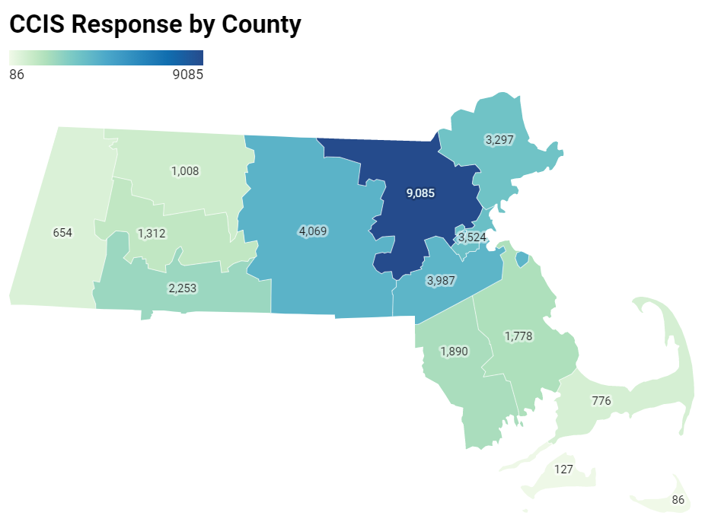
Recruitment efforts were overwhelmingly successful
For example, more people responded from western and central MA alone, than in the entire 2019 BRFSS statewide sample.

Slide 68
Demographics of the sample
 | Demographics | Freq. | Percent
Sexual Orientation | Asexual | 646 | 1.92
 | Bisexual | 1,252 | 3.73
 | Gay/Lesbian | 1,352 | 4.03
 | Heterosexual | 29,231 | 84.08
 | Queer | 464 | 1.38
 | Questioning | 217 | 0.65
 | Other/DK/refuse | 1,414 | 4.21
Survey Lang. | English | 33,119 | 97.56
 | Other | 829 | 2.44
Disability Status | Deaf/Hard to hear | 922 | 2.72
 | Blind/Hard to see | 236 | 0.70
 | Hard to concentrate | 1,612 | 4.75
 | Hard to walk | 1,628 | 4.75
 | Hard to dress/bath | 370 | 1.09
 | Trouble w/errands | 838 | 2.47
 | None | 29,307 | 86.33
Income | <$35K | 3,961 | 12.54
 | $35-74,999K | 7,163 | 22.67
 | $75-99,999K | 4,532 | 14.34
 | $100-149,999K | 6,851 | 21.68
 | $150K+ | 9,089 | 28.77
Education | Less than HS | 446 | 1.32
 | High school or GED | 2,279 | 6.73
 | Trade /Vocational | 905 | 2.67
 | Some college | 2,798 | 8.26
 | Associates degree | 2,484 | 7.33
 | Bachelor's degree | 10,635 | 31.39
 | Graduate degree | 14,338 | 42.31
 | Demographics | Freq. | Percent
Age | <25* | 148 | 0.44
 | 25-35 | 6,726 | 19.81
 | 36-49 | 11,785 | 34.71
 | 50-64 | 10,012 | 29.49
 | 65+ | 5,277 | 15.54
Race/Ethnicity | AI/AN | 351 | 1.03
 | Hispanic | 2,506 | 7.38
 | Multiracial | 475 | 1.40
 | Asian NH | 1,188 | 3.50
 | Black NH | 1,162 | 3.42
 | White NH | 27,605 | 81.32
 | Unknown/Other | 661 | 1.95
Gender | Male | 6,520 | 19.21
 | Female | 26,518 | 78.11
 | Non-Binary | 392 | 1.15
 | Prefer not to answer | 518 | 1.53
Transgender Identity | Transgender | 245 | 0.73
 | Not Transgender | 32,500 | 96.29
 | Not sure/DK/refuse | 1,007 | 2.98

Slide 69
MENTAL HEALTH

Slide 70
PTSD MENTAL HEALTH INDICATOR
How has the pandemic has impacted all residents’ mental health?
Screening for community-wide post-traumatic stress disorder (PTSD) has been done in past community surveys that assessed populations’ reactions to a natural disasters, epidemics, and other traumatic events
The CCIS question was adapted from “Primary Care PTSD Screen for DSM-5 (PC-PTSD-5),” a screening tool developed for use in primary care settings for determining if referral for PTSD (due to any traumatic experience) might be advisable
In figures, this variable is labeled as “3+ PTSD-like reactions”
      Respondents were asked how many times they had any of the following reactions to the COVID-19 outbreak in the past month:
              Having nightmares or thinking about it when you didn’t want to​
              Going out of your way to avoid situations​
              Constantly being on guard, watchful, or easily startled​
              Feeling numb or detached​
              Feeling guilty or unable to stop blaming yourself​
      Reference: Prins, A., Bovin, M. J., Kimerling, R., Kaloupek, D. G, Marx, B. P., Pless Kaiser, A., & Schnurr, P. P. (2015). Primary Care PTSD Screen for DSM-5 (PC-PTSD-5) [Measurement instrument]. Available from https://www.ptsd.va.gov
Preliminary data – 2.6.21 - Not for external distribution
Preliminary data - 1.7.21 - Not for external distribution

Slide 71
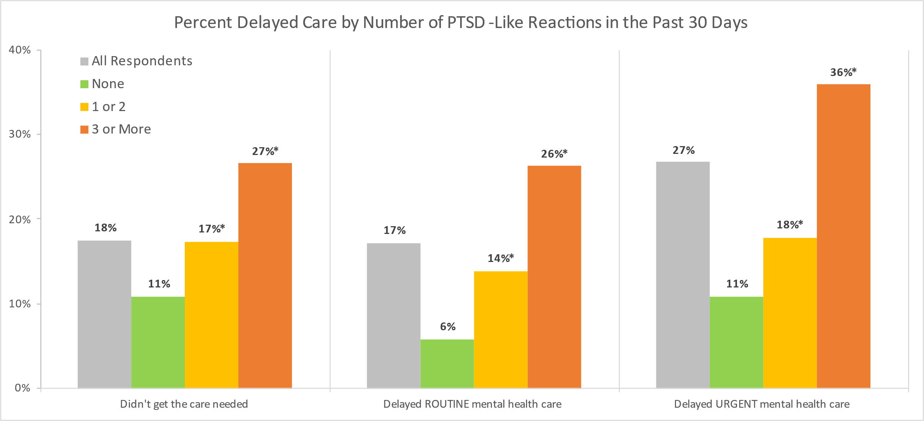
DELAY IN HEALTH CARE
Respondents who reported having any PTSD-like reactions were more likely to experience delayed care,
including routine and urgent mental health care, compared to those who reported having no PTSD-like reactions.
* subgroup is significantly different compared to respondents with 0 poor mental health days at the p<0.05 level
Preliminary data – 2.6.21 - Not for external distribution
Preliminary data - 1.7.21 - Not for external distribution

Slide 72
CONNECTION TO RESOURCES
Respondents who reported any days of poor mental health were more likely to request information that would be helpful to them compared to those reporting 0 days of poor mental health.
Respondents with 15+ days of poor mental health reported 2x –3x higher rates for information that would be helpful to them compared to respondents who reported 0 days of poor mental health.
Information that would be most helpful for respondents with poor mental health are:
    Knowing Rights as an Employee
    Benefits & Help Applying for them
    Knowing Rights as renters
* Subgroup is significantly different compared to people with 0 poor mental health days
Preliminary data – 2.6.21 - Not for external distribution
Preliminary data - 1.7.21 - Not for external distribution

Slide 73
% 15 or more Poor Mental Health Days in past 30 Days
 | Demographics | Frequency | Weighted %
 | Overall | 8973 | 33%
Race/ Ethnicity | American Indian/Alaska Native | 113 | 38%
 | Hispanic/Latinx | 654 | 35%
 | Multiracial, Non-Hispanic | 165 | 49%
 | Asian, Non-Hispanic | 221 | 25%
 | Black, Non-Hispanic | 285 | 32%
 | White, Non-Hispanic | 7346 | 33%
 | Other Race, Non-Hispanic | 91 | 29%
 | Unknown Race | 98 | 40%
Age | 25-34 | 1999 | 43%
 | 35-44 | 2772 | 41%
 | 45-64 | 3466 | 31%
 | 65+ | 736 | 20%
Gender Identity | Male | 1333 | 26%
 | Female | 7264 | 34%
 | Questioning, Undecided, Non-binary | 221 | 68%
Sexual Orientation | Asexual | 202 | 39%
 | Bisexual and/or Pansexual | 580 | 55%
 | Gay or Lesbian | 439 | 41%
 | Straight (Heterosexual) | 6994 | 31%
 | Queer | 246 | 59%
 | I am questioning / not sure of my sexuality | 100 | 58%
 | Demographics | Frequency | Weighted %
Transgender Experience | ​ Transgender | 134 | 62%
 | Not Transgender | 8480 | 33%
Income | <$35K | 1312 | 42%
 | $35-74,999K | 2163 | 35%
 | $75-99,999K | 1302 | 33%
 | $100-149,999K | 1792 | 31%
 | $150K+ | 1998 | 26%
Educational Attainment | Less than high school | 104 | 36%
 | High school or GED | 543 | 32%
 | Trade/ vocational school | 245 | 33%
 | Some college | 859 | 38%
 | Associates Degree | 686 | 35%
 | Bachelors Degree | 2884 | 32%
 | Graduate Degree | 3646 | 29%
Disability | Deaf/Hard of hearing | 237 | 34%
 | Blind/Vision Impairment | 83 | 49%
 | Cognitive Disability | 989 | 72%
 | Mobility Disability | 565 | 44%
 | Self-Care/ Independent Living Disability | 410 | 56%
English language | Speaks language other than English | 1279 | 34%
 | Demographics | Frequency | Unweighted %
County | Barnstable | 199 | 30%​
 | Berkshire | 199 | 36%​
 | Bristol | 451 | 30%​
 | Dukes | 30 | 29%​
 | Essex | 886 | 33%​
 | Franklin | 304 | 35%​
 | Hampden | 671 | 36%​
 | Hampshire | 397 | 35%​
 | Middlesex | 2423 | 32%​
 | Nantucket | 12 | 18%​
 | Norfolk | 929 | 29%​
 | Plymouth | 493 | 35%​
 | Suffolk | 966 | 34%​
 | Worcester | 987 | 30%​
Preliminary analysis. Statistical significance testing forthcoming.
Note: All percentages presented here (except County) are weighted to the statewide age and educational distribution of those 25 years old or older in Massachusetts
Data presented at sub-state geographies (county, rural cluster, municipality) were NOT weighted to the statewide age and educational distribution of those 25 years or older in MA since the age and educational distributions within those geographies may be different than the statewide distribution.
Unweighted percentages should NOT be compared to weighted percentages.

Slide 74
% 3 or more PTSD-like reactions in past month
 | Demographics | Frequency | Weighted %
 | Overall | 7620 | 27%
Race/ Ethnicity | American Indian/Alaska Native | 109 | 39%
 | Hispanic/Latinx | 528 | 28%
 | Multiracial, Non-Hispanic | 138 | 41%
 | Asian, Non-Hispanic | 164 | 20%
 | Black, Non-Hispanic | 203 | 24%
 | White, Non-Hispanic | 6312 | 26%
 | Other Race, Non-Hispanic | 73 | 25%
 | Unknown Race | 93 | 37%
Age | 25-34 | 1747 | 36%
 | 35-44 | 2237 | 32%
 | 45-64 | 2966 | 26%
 | 65+ | 670 | 16%
Gender Identity | Male | 1127 | 21%
 | Female | 6175 | 27%
 | Questioning, Undecided, Non-binary | 206 | 63%
Sexual Orientation | Asexual | 152 | 29%
 | Bisexual and/or Pansexual | 547 | 50%
 | Gay or Lesbian | 413 | 38%
 | Straight (Heterosexual) | 5870 | 24%
 | Queer | 237 | 55%
 | I am questioning / not sure of my sexuality | 90 | 54%
 | Demographics | Frequency | Weighted %
Transgender Experience | ​ Transgender | 129 | 60%
 | Not Transgender | 7222 | 26%
Income | <$35K | 1021 | 31%
 | $35-74,999K | 1790 | 29%
 | $75-99,999K | 1073 | 26%
 | $100-149,999K | 1534 | 25%
 | $150K+ | 1837 | 23%
Educational Attainment | Less than high school | 74 | 27%
 | High school or GED | 400 | 23%
 | Trade/ vocational school | 197 | 26%
 | Some college | 642 | 28%
 | Associates Degree | 540 | 26%
 | Bachelors Degree | 2488 | 28%
 | Graduate Degree | 3271 | 26%
Disability | Deaf/Hard of hearing | 201 | 26%
 | Blind/Vision Impairment | 69 | 41%
 | Cognitive Disability | 785 | 57%
 | Mobility Disability | 441 | 33%
 | Self-Care/ Independent Living Disability | 335 | 45%
English language | Speaks language other than English | 1016 | 27%
 | Demographics | Frequency | Unweighted %
County | Barnstable | 170 | 25%
 | Berkshire | 166 | 31%
 | Bristol | 385 | 25%
 | Dukes | 31 | 29%
 | Essex | 770 | 28%
 | Franklin | 269 | 30%
 | Hampden | 487 | 27%
 | Hampshire | 359 | 32%
 | Middlesex | 2099 | 27%
 | Nantucket | 17 | 25%
 | Norfolk | 806 | 25%
 | Plymouth | 383 | 27%
 | Suffolk | 871 | 30%
 | Worcester | 789 | 23%
Preliminary analysis. Statistical significance testing forthcoming.
Note: All percentages presented here (except County) are weighted to the statewide age and educational distribution of those 25 years old or older in Massachusetts
Data presented at sub-state geographies (county, rural cluster, municipality) were NOT weighted to the statewide age and educational distribution of those 25 years or older in MA since the age and educational distributions within those geographies may be different than the statewide distribution.
Unweighted percentages should NOT be compared to weighted percentages.

Slide 75
UPDATE ON THE Office of Problem Gambling Services:
Engagement, Equity, and Empowerment
Public Health Council
March 10th, 2021
Victor Ortiz
Director of the Office of Problem Gambling Services
Rachael Cain
Asst. Director of Programs and Services

Slide 76
March: Problem Gambling Awareness Month
National
Problem gambling has a high level of co-morbidity with substance use disorder and mental health (Alegría, Petry, Hasin, Liu, Grant, & Blanco, 2009).
Disproportionately impacts individuals with mental health disorders, substance use disorders, and communities of color (Alegría, Petry, Hasin, Liu, Grant, & Blanco, 2009).
Community-level experiences of gambling and communities of color are often not the focus of problem gambling services and efforts.
Massachusetts
Research demonstrates that the prevalence of Recreational Gambling in MA was 57.4% and gamblers are more likely to: be obese, smoke heavily, use alcohol, and use prescription drugs (Okunna, N. C., Rodríguez-Monguió, R., Smelson, D. A., Poudel, K. C., & Volberg, R. (2016).

Slide 77

Expanded Gaming in the Commonwealth
The Expanded Gaming Act (2011) allows for up to three destination resort casinos to be opened in three geographically diverse regions across the state. Additionally, a single slots facility can be competitively awarded for one location statewide.
The Expanding Gaming Act established the Public Health Trust Fund (PHTF) to allocate significant resources to research, prevention, intervention, treatment, and recovery support services in order to mitigate the harmful effects of problem gambling and related issues.

Slide 78
Public Health Trust Fund: Strategic Plan - 2016
Priorities Areas/Key Areas of Concern
Prevention for Youth
Prevention for High-Risk Populations
Focus on Community-Level Interventions
Coordination of Problem Gambling Services
Integration of Addiction Services, Mental Health Services, and Primary Care
Decrease in Stigma and Unsupportive Social Norms
Increase in Availability of Support Services
Increase in Availability of Culturally Appropriate Services
Contribution to the Evidence Base for Problem Gambling Services
Establishment of an Evaluation Infrastructure
Expansion of Institutional Capacity to Address
Problem Gambling and Related Issues

Slide 79
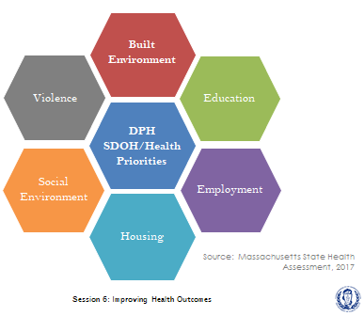
Problem Gambling and SDoH
Problem gambling is governed by a complex set of interrelating factors, causes and determinants ranging from biology and family history to social norms and existing statutes (Messerlian, Derevensky, Gupta, 2005).
The Office of Problem Gambling Services takes a community-driven approach that is rooted in the Social Determinants of Health, with a racial equity lens.

Slide 80
FY17 – FY21: Office of Problem Gambling Services Initiatives
Workforce Development – CHWs and Providers
Suicide Prevention
Laid the groundwork for services to mitigate the harms associated with problem gambling.
Built the capacity of community-based organizations to provide services related to gambling.
Raised awareness of the risks associated with problem gambling.
Engaged community stakeholders.
Prevention – Youth, Parents, and At-Risk Populations
Intimate Partner Abuse Education Program
Communications Campaign

Slide 81

COVID-19 Approach and Support
Throughout the COVID-19 pandemic, many of the communities most impacted by the virus are also disproportionately impacted by problem gambling, exacerbating existing inequities. OPGS continued to focus on reducing inequities through its programs and services in three key ways:
Communications
  OPGS increased contact with all vendors to support the change to all virtual work, answer questions, and assist in navigating a rapidly changing landscape.
Support
  OPGS worked through the MA Center of Excellence on Problem Gambling Prevention to provide technical assistance to adapt to virtual programming.
Social Determinants of Health
  OPGS listened to the needs of its communities and worked with its programs to alleviate issues exacerbated by the pandemic such as food insecurity and the digital divide.
This Photo by Unknown Author is licensed under CC BY-NC-ND

Slide 82
2020: Community Level Health Project: Springfield
Goal: Work alongside communities disproportionately impacted by gambling to develop and implement a community level plan (building from Community Health Improvement Plans) addressing a gambling-related health concern in the casino host communities of Greater Springfield.
Result:
Provide resources and support to improve youth behavioral health in Springfield and reduce stigma.
FY21
Convene a coalition, including youth, to guide the interventions
Conduct professional development for Springfield Public Schools and host community education sessions
Examine feasibility of evidence-based screening and support interventions within Springfield Public Schools
Full report here: Problem Gambling Evaluation & Community Engagement Reports | Mass.gov

Slide 83
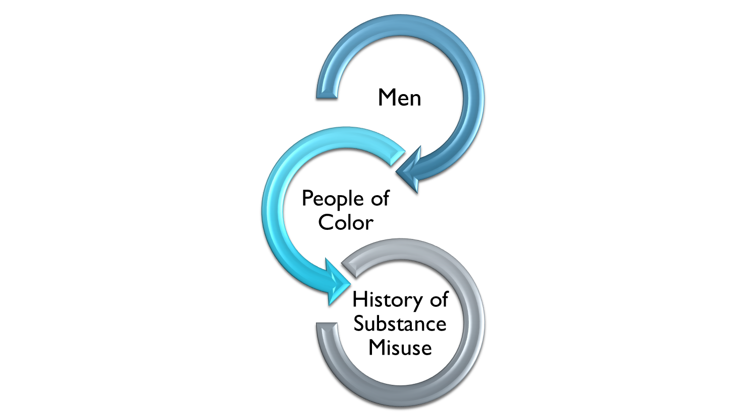
Massachusetts Ambassador Project
The Massachusetts Ambassador Project was conceptualized as a peer-based, community-centered, participatory, and culturally responsive approach to reach populations at highest risk for problem gambling and engage them in prevention discussions through individual-, group-, and community-level interactions.

Slide 84
2020: Massachusetts Ambassador Project
Impact Report Highlights:
  553 individuals were engaged through one-to-one conversations and street outreach
  3,067 individuals received problem gambling prevention education through presentations and small group sessions
  36 different organizations across 14 communities received presentations and group sessions
  768 individuals were reached through the distribution of gambling prevention materials
Full report here: mass.gov/doc/massachusetts-ambassador-project-impact-brief-office-of-problem-gambling-services-2019/download
Publication (in process)- Our Voice Matters: Using Lived Experience to Promote Equity in Problem Gambling Prevention

Slide 85

2020: Problem Gambling Helpline Services
As of 7/1/2020, integrating PG within SA helpline will enhance caller experience, maximize cost effectiveness, and expand reach.
Providing 24/7 bilingual services (Spanish) and capacity for additional languages
Screening an estimated 15,000-20,000 annual Substance Use Helpline callers for problem gambling
Conducting direct transfers to referral treatment sources that will improve access and engagement of treatment
Providing follow-up services from Helpline clinicians to callers
Robust quality assurance protocols to ensure efficiency and effectiveness.

Slide 86
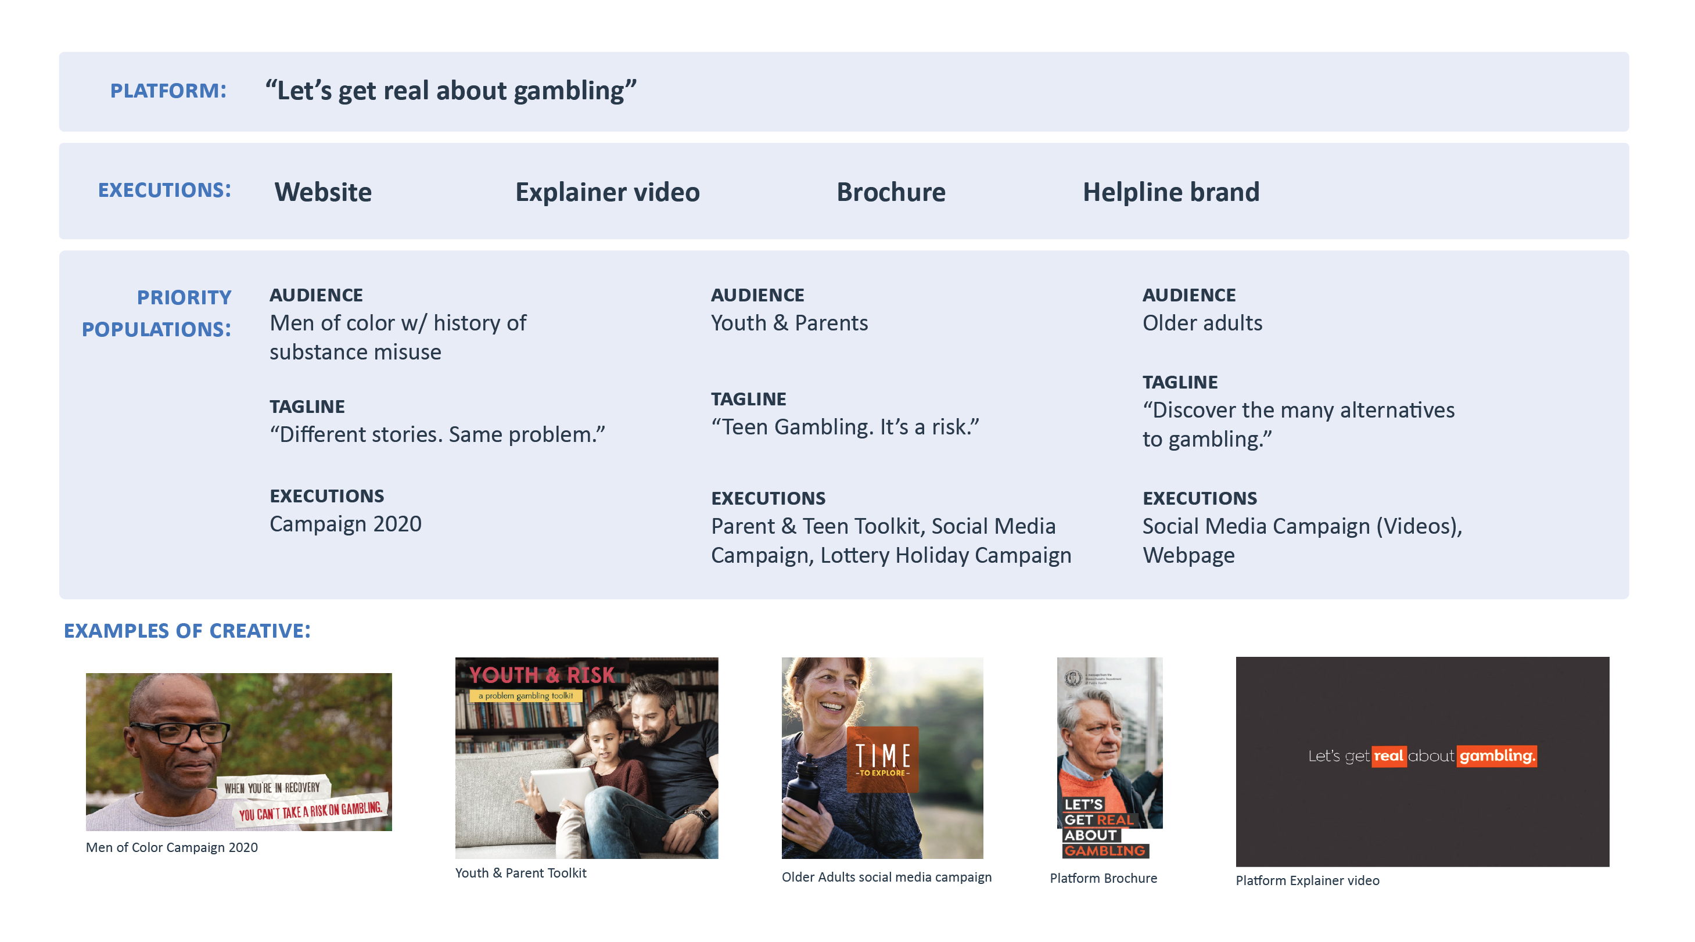
2020: OPGS Communications Campaign

Slide 87

2020: Communications Campaign

Slide 88

Key Principles for a Public Health Path Forward
Utilize data to inform the allocation of resources for precise public health.
Focus on the social determinants of health to address, plan, and develop problem gambling services.
Engage communities to inform, develop, and implement services with a specific emphasis on marginalized populations.
Break down silos and create meaningful integration that will promote health and wellness for everyone.

Slide 89
Thank You!
Victor Ortiz
Victor.Ortiz@state.ma.us
Office of Problem Gambling Services
https://www.mass.gov/orgs/office-of-problem-gambling-services

Slide 90
Next Meeting:
April 28, 2021

