Slide 1
Public health council
March 9, 2022
Please standby – the meeting will begin shortly
Today’s presentation is available on the mass.gov/dph website under “Upcoming Events” by clicking on the March 9th Public Health Council listing

Slide 2
PUBLIC HEALTH COUNCIL meeting
March 9, 2022
Margret R. Cooke, Commissioner

Slide 3
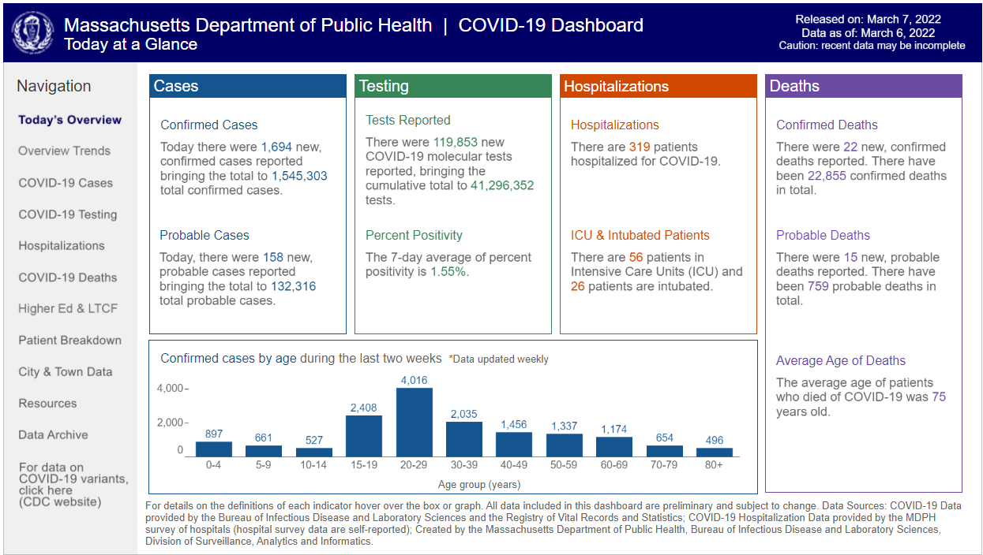
Metrics Moving in the Right Direction
mass.gov/CovidData

Slide 4
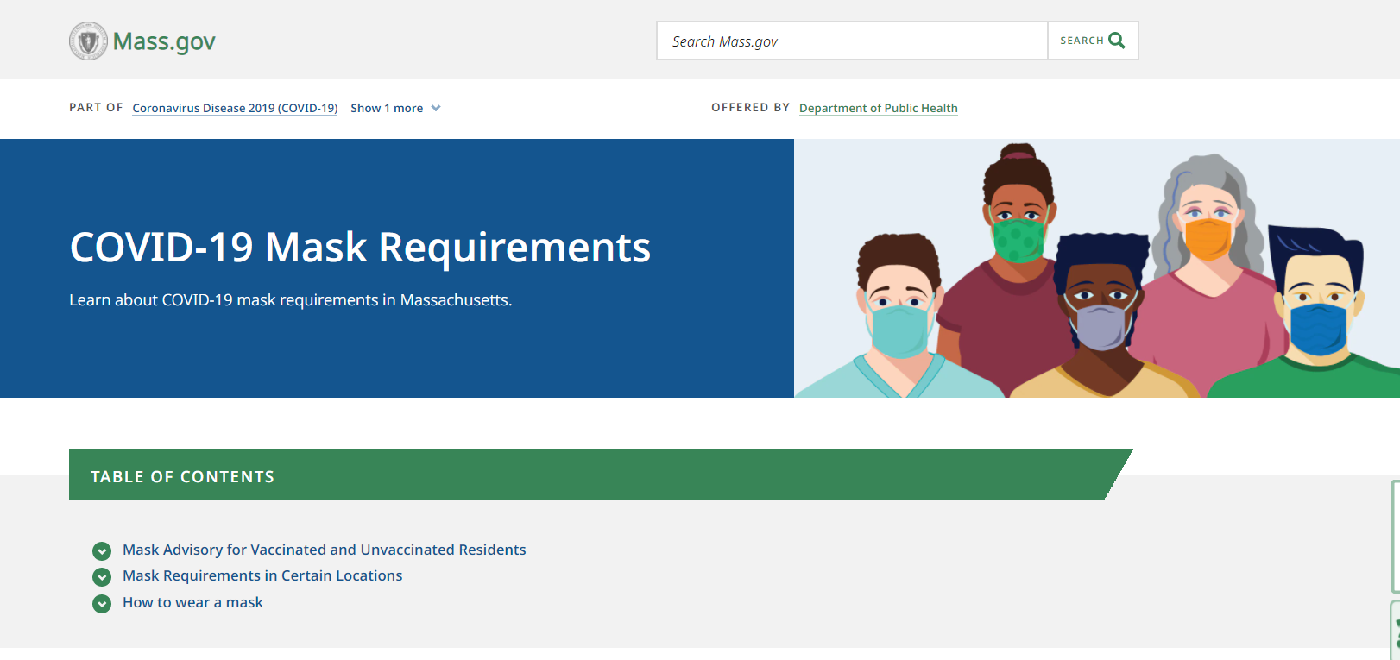
New Mask Guidance
mass.gov/MaskRules

Slide 5
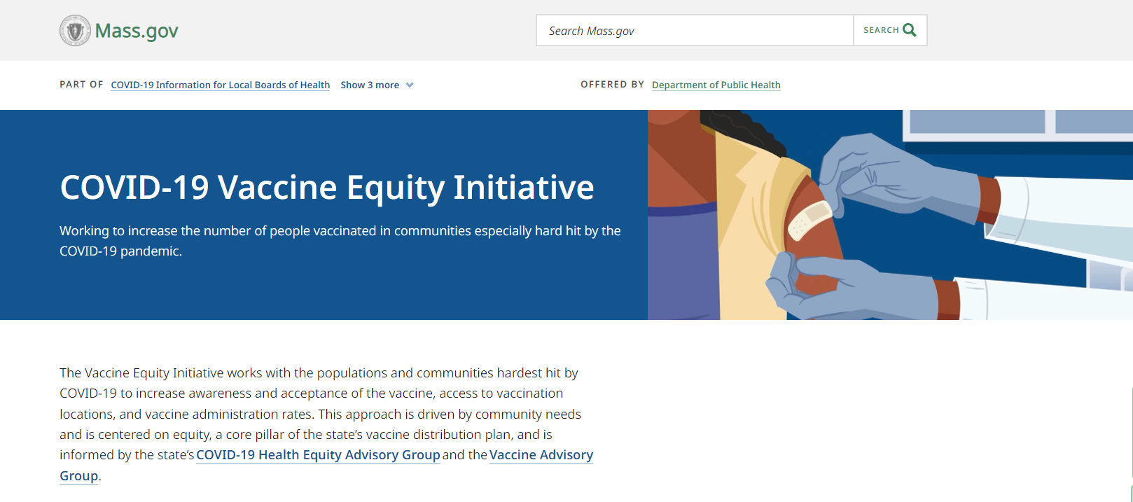
Vaccine Equity Initiative Marks Progress

Slide 6
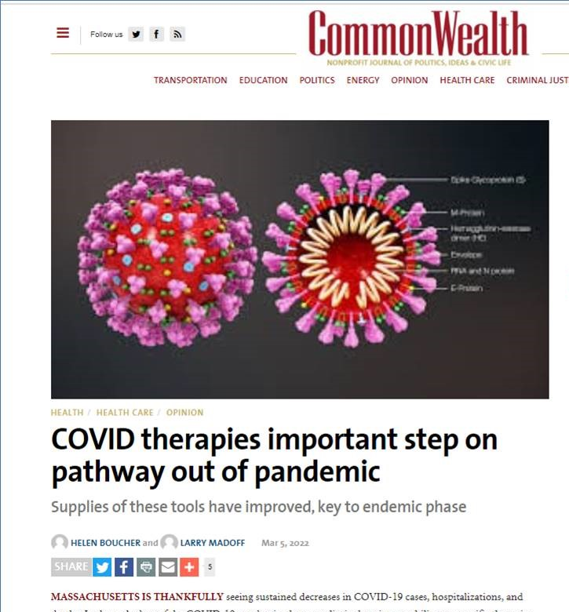
Promoting COVID-19 Treatments

Slide 7

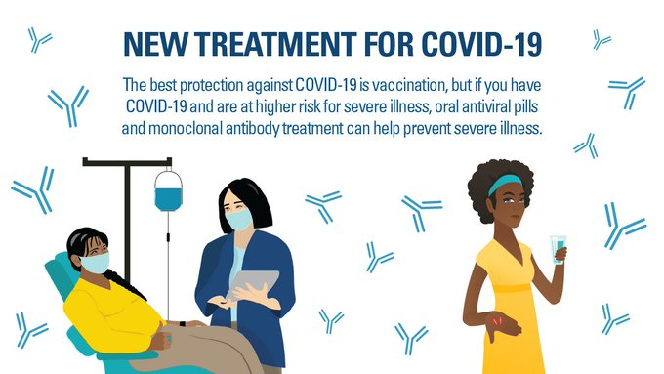
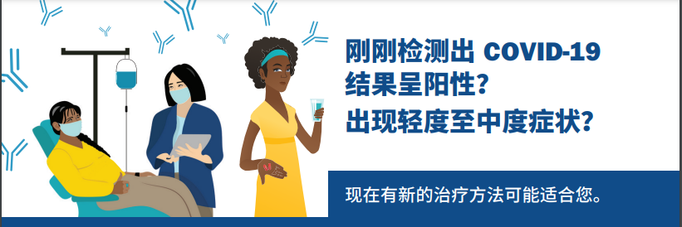
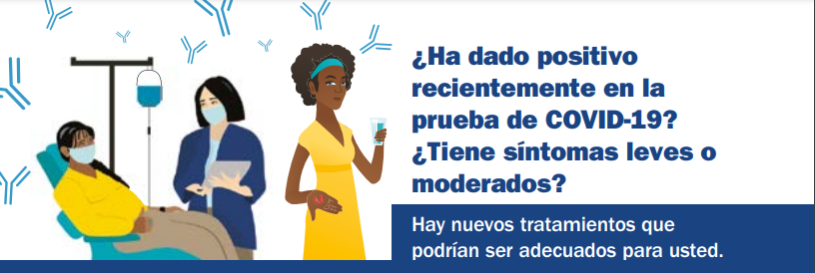
Promoting COVID-19 Treatments
mass.gov/CovidTreatments

Slide 8
PUBLIC HEALTH COUNCIL meeting
March 9, 2022
Margret R. Cooke, Commissioner

Slide 9
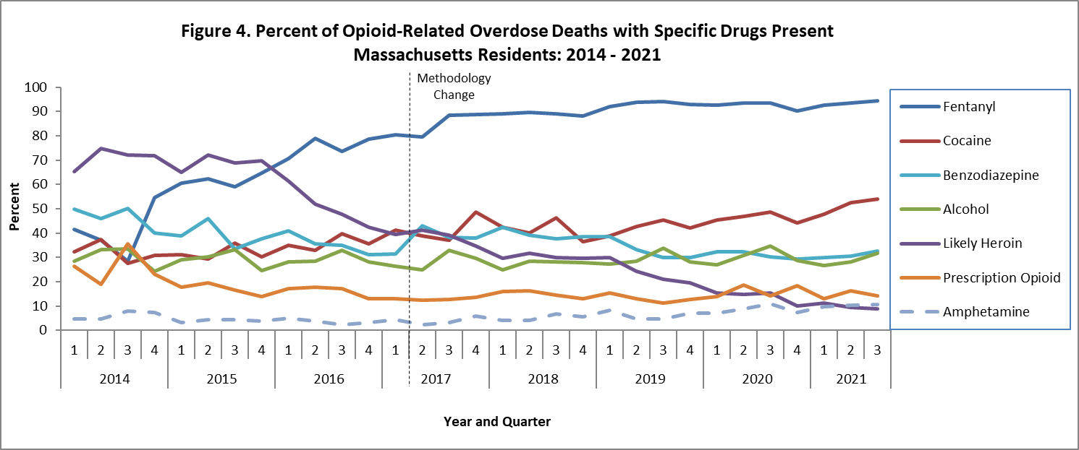
Toxicology results 2014 through Q3 2021
Fentanyl remains a key factor in opioid-related overdose deaths (94% present in toxicology screen through Q3 2021).

Slide 10
PUBLIC HEALTH COUNCIL meeting
March 9, 2022
Margret R. Cooke, Commissioner

Slide 11
Final Promulgation of Revisions to
105 CMR 172.000:
Implementation of Massachusetts General Laws C. 111 Section 111C, Regulating the Reporting of Infectious Diseases Dangerous to the Public Health

Slide 12
Summary of Regulation
105 CMR 172.000, Implementation of Massachusetts General Laws C. 111 Section 111C, Regulating the Reporting of Infectious Diseases Dangerous to the Public Health:
Sets forth a process for reporting unprotected exposures that EMTs, first responders and correction officers may experience in caring for patients with certain enumerated infectious diseases dangerous to the public health.
Lists the applicable infectious diseases and creates reporting mechanisms for
  1) responders to notify the patient’s receiving hospital of the potential unprotected exposure, and
  2) the hospital to provide information back to the responder’s employing agency’s or ambulance service’s designated infection control officer regarding the exposure.

Slide 13
Overview of Previous Revisions to Regulation
  As a reminder, the Department previously presented to the Public Health Council proposed revisions to 105 CMR 172.000 for clarity and to update the regulation by:
  Streamlining the title of the regulation to clarify the purpose of the regulation; and
  Updating the definition of “infectious diseases dangerous to the public health” to include Hepatitis D and Coronavirus 2019 (COVID-19), caused by the virus SARS-CoV-2.

Slide 14
Public Comment Period
Following the presentation to the PHC, the Department held a public comment period in January 2022, including a public hearing.
No comments were received during the public comment period.
As a result, the Department proposes no additional revisions to this regulation.

Slide 15
Next Steps
  The Department requests the Public Health Council approve the proposed regulations for promulgation.
  Following Public Health Council approval, the Department will file the amended regulation with the Secretary of the Commonwealth for final enactment.

Slide 16
Thank you for the opportunity to present this information today.
For more information regarding the reporting of unprotected exposures to infectious diseases dangerous to the public health, please find the relevant statutory language and the full current regulation here:
https://malegislature.gov/Laws/GeneralLaws/PartI/TitleXVI/Chapter111/Section111c
https://www.mass.gov/doc/105-cmr-172-implementation-of-mgl-regulating-the-reporting-of-infectious-diseases-dangerous-to/download

Slide 17
Update on the Office of Problem Gambling Services:
Engagement, Equity, and Empowerment
Victor Ortiz
Director of the Office of Problem Gambling Services

Slide 18
March: Problem Gambling Awareness Month
National
Problem gambling has a high level of co-morbidity with substance use disorder and mental health (Alegría, Petry, Hasin, Liu, Grant, & Blanco, 2009).
Disproportionately impacts individuals with mental health disorders, substance use disorders, and communities of color (Alegría, Petry, Hasin, Liu, Grant, & Blanco, 2009).
Community-level experiences of gambling and communities of color are often not the focus of problem gambling services and efforts.
Massachusetts
The overall prevalence of past year recreational gambling in Massachusetts was 57.4%:
And gamblers are more likely to be obese, smoke heavily, use alcohol, and use prescription drugs (Okunna, N. C., Rodríguez-Monguió, R., Smelson, D. A., Poudel, K. C., & Volberg, R. (2016).

Slide 19
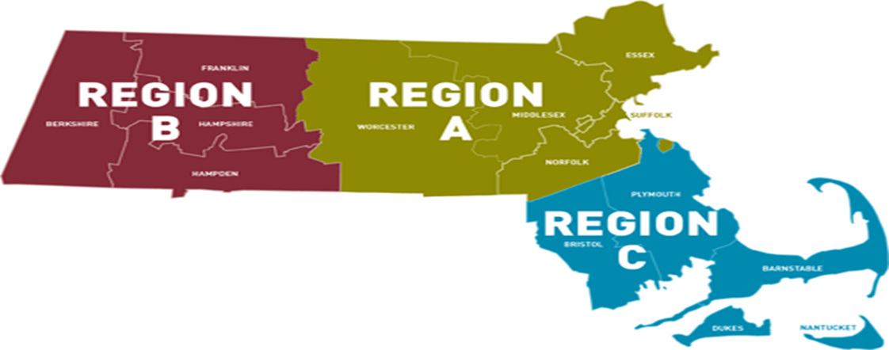
Expanded Gaming in the Commonwealth
The Expanded Gaming Act (2011) allows for up to three destination resort casinos to be opened in three geographically diverse regions across the state. Additionally, a single slots facility can be competitively awarded for one location statewide.
The Expanding Gaming Act established the Public Health Trust Fund (PHTF) to allocate significant resources to research, prevention, intervention, treatment, and recovery support services in order to mitigate the harmful effects of problem gambling and related issues.
LINK: Public Health Trust Fund | Mass.gov

Slide 20
Public Health Trust Fund: Strategic Plan - 2016
Priorities Areas/Key Areas of Concern:
Prevention for Youth
Prevention for High-Risk Populations
Focus on Community-Level Interventions
Coordination of Problem Gambling Services
Integration of Addiction Services, Mental Health Services, and Primary Care
Decrease in Stigma and Unsupportive Social Norms
Increase in Availability of Support Services
Increase in Availability of Culturally Appropriate Services
Contribution to the Evidence Base for Problem Gambling Services
Establishment of an Evaluation Infrastructure
Expansion of Institutional Capacity to Address
Problem Gambling and Related Issues

Slide 21
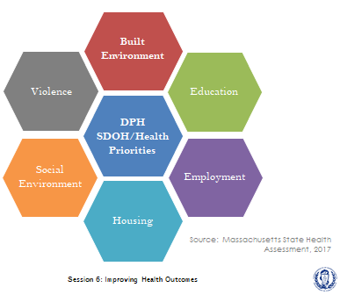
Problem Gambling and Social Determinants of Health
Problem gambling is governed by a complex set of interrelating factors, causes and determinants ranging from biology and family history to social norms and existing statutes (Messerlian, Derevensky, Gupta, 2005).
The Office of Problem Gambling Services (OPGS) takes a community-driven approach that is rooted in the Social Determinants of Health, with a racial equity lens.

Slide 22
FY17 – FY21: OPGS Initiatives
Workforce Development – CHWs and Providers
Suicide Prevention
Laid the groundwork for services to mitigate the harms associated with problem gambling.
Built the capacity of community-based organizations to provide services related to gambling.
Raised awareness of the risks associated with problem gambling.
Engaged community stakeholders.
Prevention – Youth, Parents, and At-Risk Populations
Intimate Partner Abuse Education Program
Communications Campaign

Slide 23
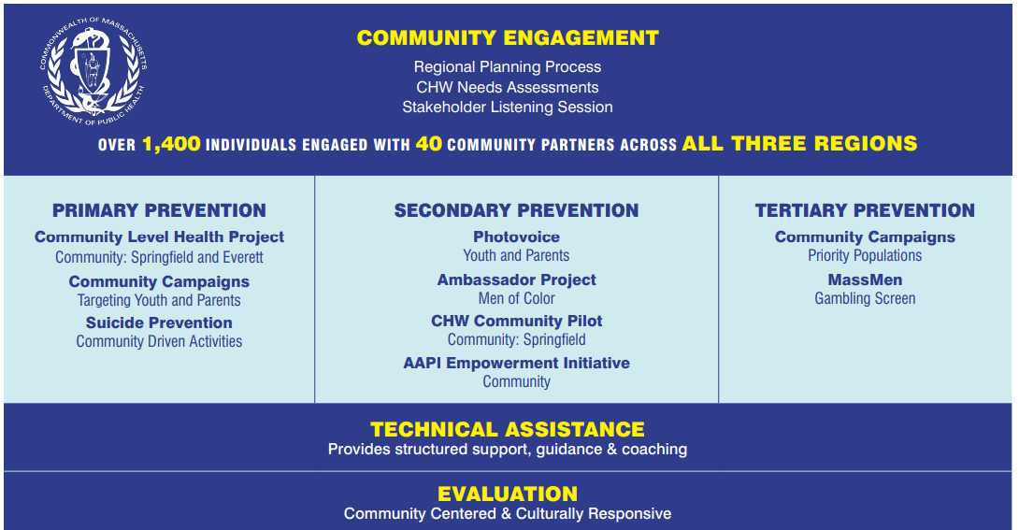

Slide 24

2021: Massachusetts Center of Excellence
Goal:
The Massachusetts Center of Excellence on Problem Gambling Prevention (MCOE PGP) is the official resource for capacity building, training, and resource development services to address the prevention of problem gambling and related health issues in the Commonwealth.
This innovative center will ensure uniformity of prevention best practice, promotion of equity, and the highest level of impact.
Activities:
Capacity Building
Community Planning
Information dissemination
Prevention Training & Health Equity Academy
LINK: Problem Gambling Prevention - Massachusetts Center of Excellence (mcoepgp.org)

Slide 25
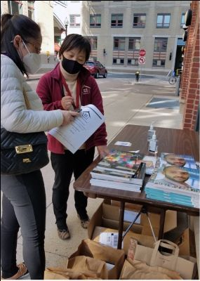
2021: Asian American and Pacific Islanders (AAPI)
Empowerment Initiative
Goal:
Increase community awareness of mental health and problem gambling among the AAPI community.
Community Partnerships:
Boston, Quincy, Randolph, and Malden.
Activities:
Alternative activities
Information dissemination
Family educational groups
Referrals

Slide 26
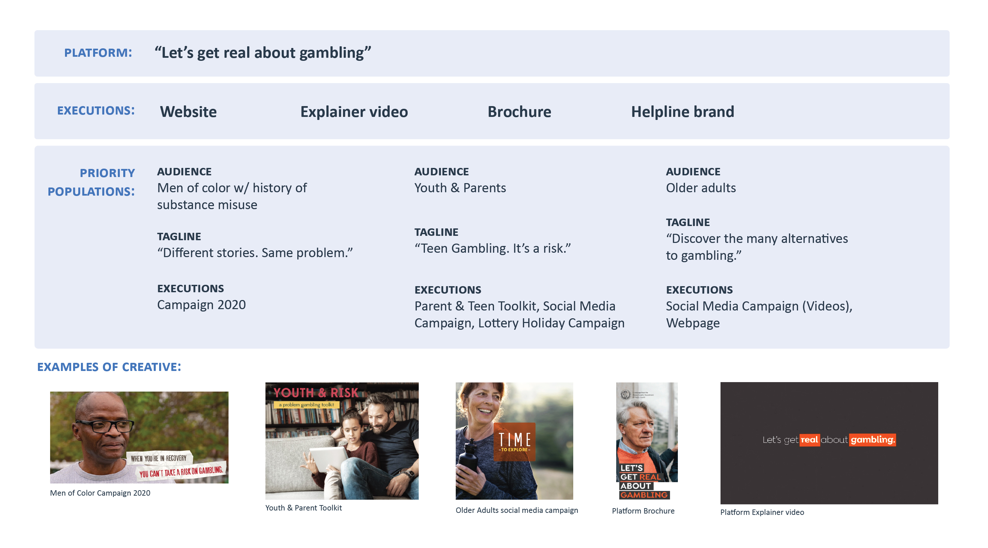
2021: OPGS Communications Campaign

Slide 27

2021: Holiday Campaign
Objective
Spread awareness that lottery tickets are not a suitable holiday gift for children, reaching parents during the busy holiday season.
Target Audience & Geography
Primary: Parents/Trusted Adults w/children under 18
Tactics
Social Media, Radio & Streaming, Convenience Stores, And Gas Stations (English & Spanish).
Metrics
2020:The OPGS Lottery campaign delivered 787,407 Facebook impressions with an overall CTR of 1.06%
2021: 7,065,590 impressions across social media, radio, and out of home.
For Facebook specifically 496,360 impression with a 3.08% CTR

Slide 28
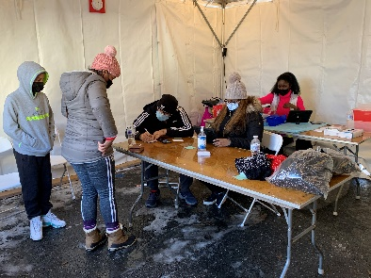
2021: Working Together in Partnership – COVID Vaccine
Partnership
The Massachusetts State Lottery and Massachusetts Department of Public Health joined together to bring free pop-up COVID-19 vaccination clinics to select Mass Lottery retail locations.
This is an example of how OPGS takes a holistic approach and looks beyond its own walls to improve public health.
Communities
Lawrence, New Bedford and Springfield – January 8th & 9th
These clinics were very successful, and reached populations that would otherwise not have interacted with the healthcare/vaccine system.
“Public health is the foundation of the Lottery’s partnership with the DPH and we are proud to be able to activate available resources to implement this important effort.”
Michael Sweeney, Executive Director of the Mass Lottery.

Slide 29

COVID-19 Approach and Support
Throughout the COVID-19 pandemic, many of the communities most impacted by the virus are also disproportionately impacted by problem gambling, exacerbating existing inequities.
OPGS recognizes the importance of supporting communities in these areas, and continued to focus on reducing inequities through its programs and services in three key ways:
Communications
  OPGS continues to guide, share, and support all vendors with the transition to a virtual workplace.
Support
  OPGS continue to worked through the MA Center of Excellence on Problem Gambling Prevention to provide technical assistance to adapt to virtual programming.
Social Determinants of Health
  OPGS listened to the needs of its communities and worked with its programs to alleviate issues exacerbated by the pandemic such as food insecurity and the digital divide.

Slide 30
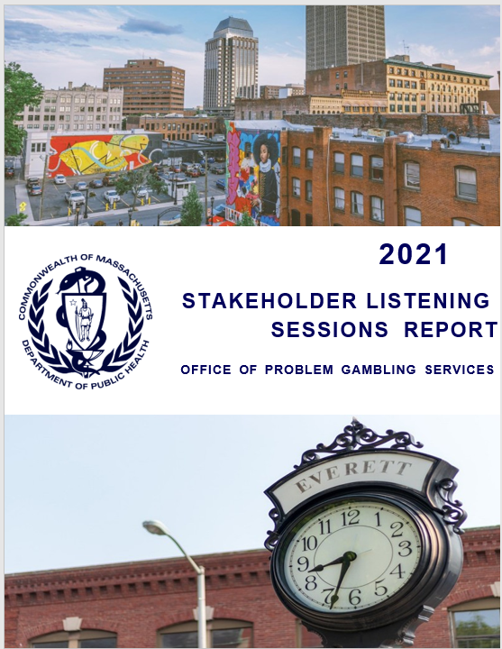
2021: Stakeholder Listening Sessions (SLS)
2021 Annual SLS Report Highlights:
Goal:
To engage the community to promote health and racial equity and to gain input on the continued development of programs and services regarding problem gambling.
Engagement:
There were 85 participants in the 2021 SLS representing 39 distinct communities, organizations, academic institutions, service providers, and government agencies.
Community Voice:
“One of the challenges that we find is while there are a lot of resources, they’re inaccessible to those marginalized communities, those immigrant communities, those who are limited English proficient.”
LINK: Microsoft Word - FINAL- OPGS SLS 2021 Report 01_18.docx (mass.gov)

Slide 31
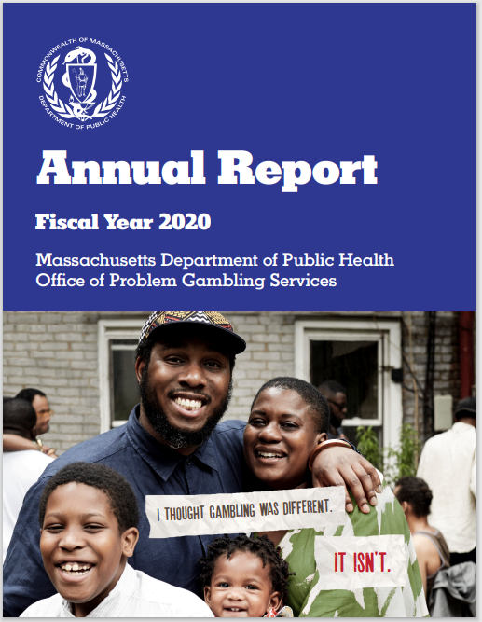
2020: OPGS Annual Report Highlights
OPGS Strategic Vision
  Partnerships and Collaboration
  Centered on Promoting Equity
  Empowering Community Voice
2016-2020 OPGS Milestones
  Engaged over 1,400 Community Stakeholders
  Launched over 18 programs and initiatives
Programmatic Highlights
  3,167 individual reached – Ambassador Project
  46 caregivers and 67 youth trained- Photovoice Project
  >44m impression via communication campaign
LINK: Office of Problem Gambling Services Annual Reports | Mass.gov

Slide 32
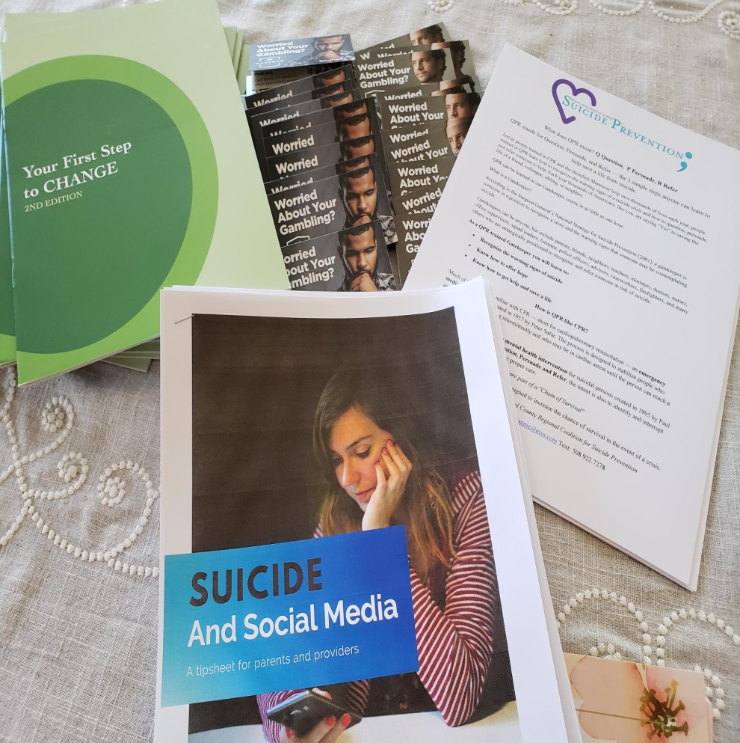
Key Principles for a Public Health Path Forward
Utilize data to inform the allocation of resources for precise public health.
Focus on the social determinants of health to address, plan, and develop problem gambling services.
Engage communities to inform, develop, and implement services with a specific emphasis on marginalized populations.
Break down silos and create meaningful integration that will promote health and wellness for everyone.

Slide 33
Thank you!
Victor Ortiz
Victor.Ortiz@mass.gov
Office of Problem Gambling Services
https://www.mass.gov/orgs/office-of-problem-gambling-services

Slide 34
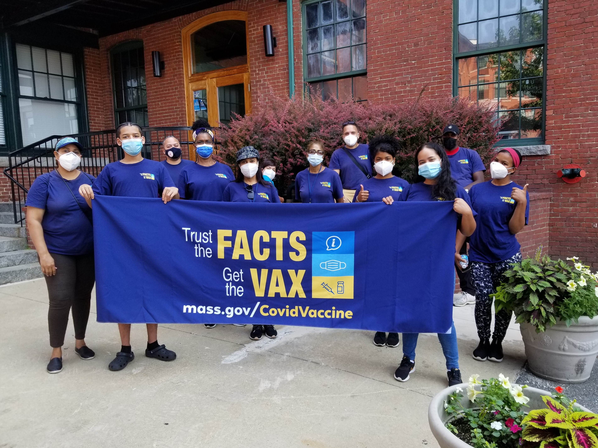
Vaccine Equity Initiative &
Public Health
Ruth Blodgett
Director, Bureau of Community Health and Prevention
Abigail R. Averbach, MSc
Assistant Commissioner and Director, Office of Population Health
Eduardo Nettle
Population Health Manager and VEI Community Liaison, Boston

Slide 35
About the Vaccine Equity Initiative
The Baker-Polito administration launched the Vaccine Equity Initiative in February 2021 to work with the populations and communities hardest hit by COVID-19. The Initiative works to increase awareness and acceptance of the vaccine, increase access to vaccination locations, and increase administration rates.
This approach is driven by community needs and is centered on equity.
VEI has improved trust in the vaccine and boosted vaccination rates in the 20 municipalities most disproportionately impacted by COVID-19.
20 Priority Municipalities
Boston
Brockton
Chelsea
Everett
Fall River
Fitchburg
Framingham
Haverhill
Holyoke
Lawrence
Leominster
Lowell
Lynn
Malden
Methuen
New Bedford
Randolph
Revere
Springfield
Worcester

Slide 36
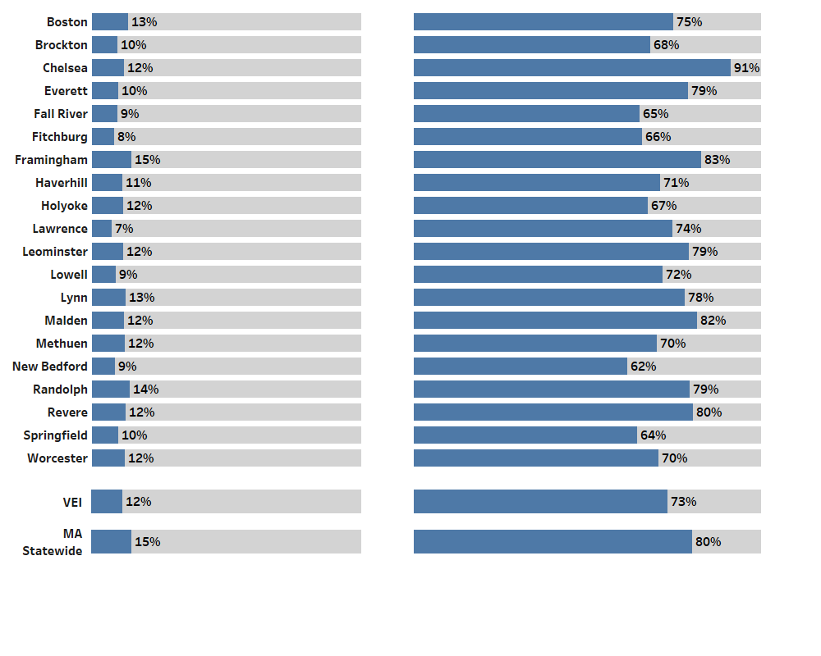
All 20 of the Vaccine Equity Initiative communities have made strong progress in vaccinations
Data through 3/1/2022 show eligible residents fully vaccinated
March 2021
March 2022
More information available at https://www.mass.gov/info-details/covid-19-vaccine-equity-initiative

Slide 37
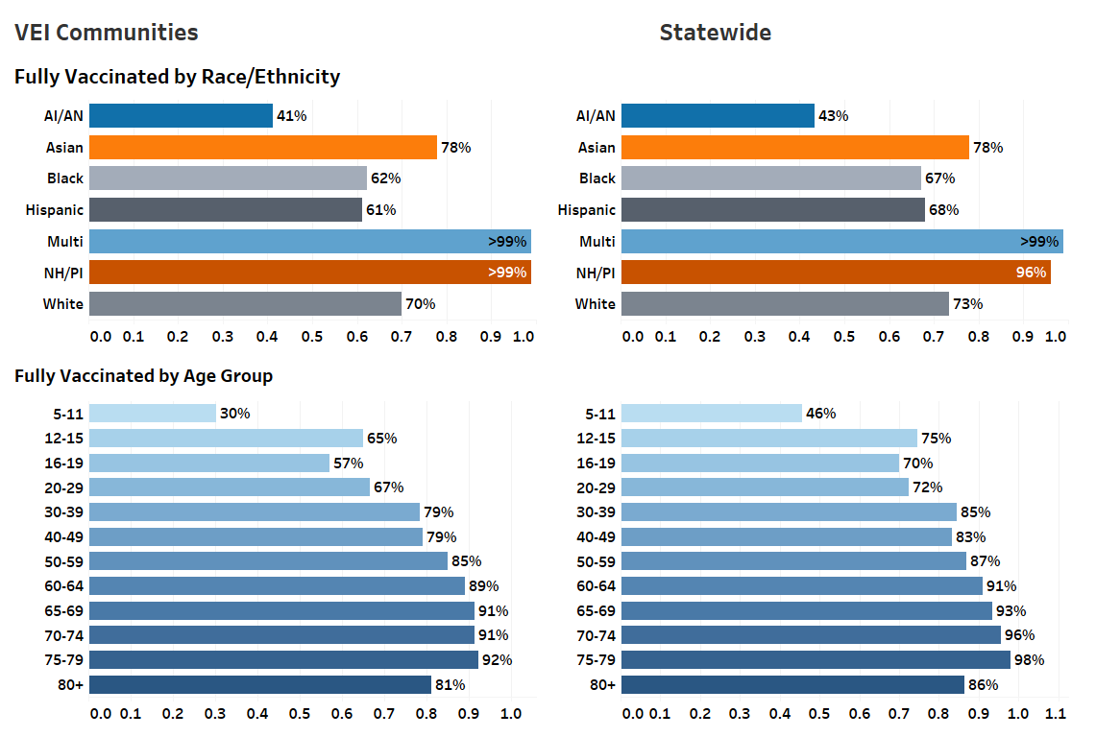
Fully vaccinated rates across VEI communities
are approaching statewide rates
Fully Vaccinated Residents in VEI and Non-VEI Communities as of 3/1/2022

Slide 38
Supporting communities for vaccine equity
In the 20 equity municipalities alone, a total of 3,357 mobile clinics and nearly 154,480 doses have been administered through mobile clinics.
The Administration has invested over $46.5 million in municipal and local vaccine equity initiatives to increase vaccine awareness and access, in addition to $4.7M for municipalities and their Local Boards of Health.
167 community organizations funded to increase trust in the vaccine and get people vaccinated.
In the first phase of outreach, HCFA and ASG hired community members who knocked on nearly 900,000 doors (899,000) and held over a quarter of a million one-on-one interactions (260,000).
During February school vacation week, equity municipalities ran family friendly clinics with special promotion and school vacation week prizes, including local grocery and popular local store gift cards as well as big ticket items such as PlayStation 5 and iPads.

Slide 39
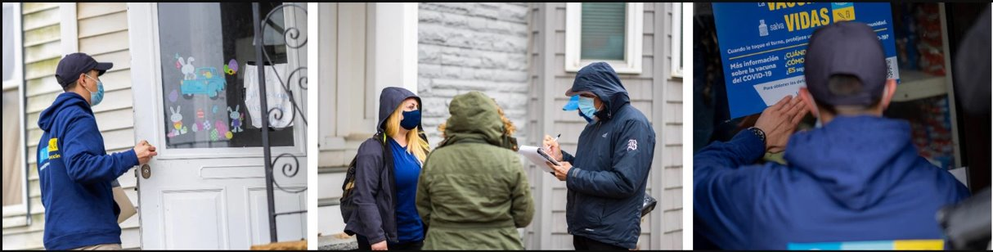
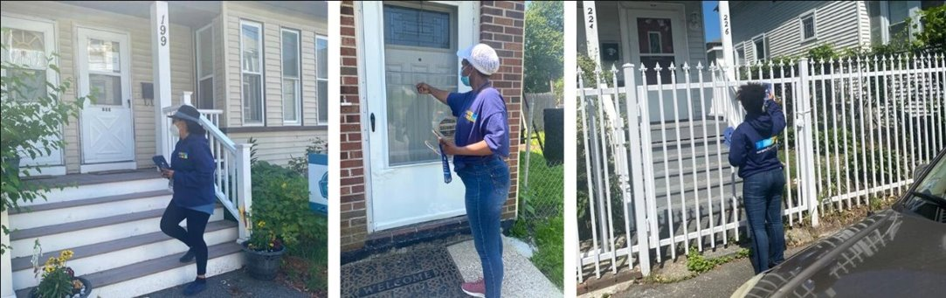
Outreach in communities
Boston
Methuen

Slide 40
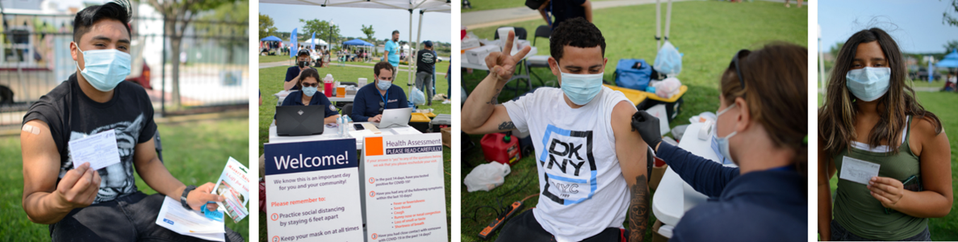
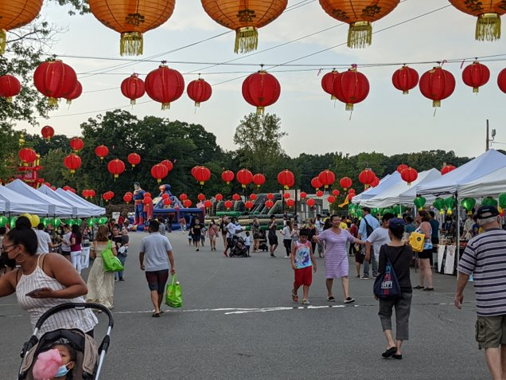
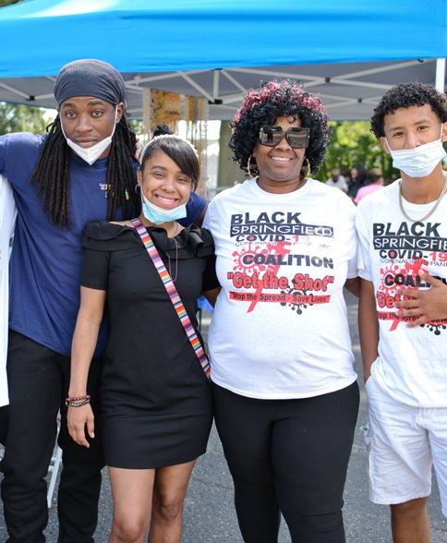
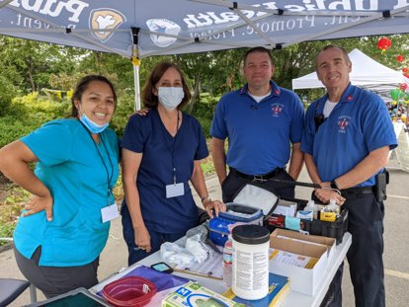
New Bedford
Randolph
Springfield

Slide 41
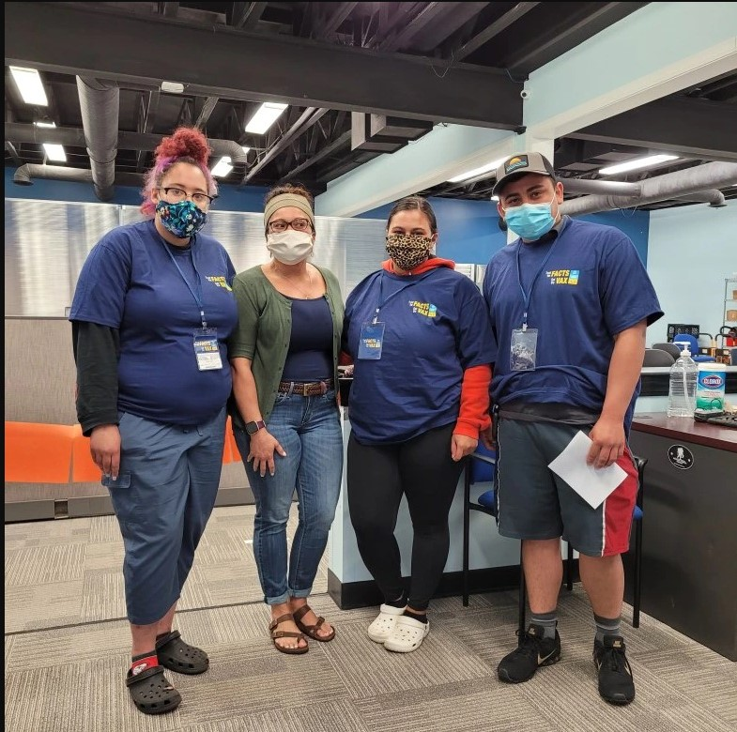
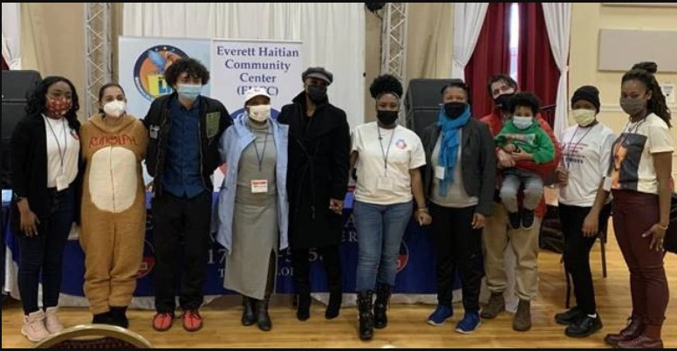
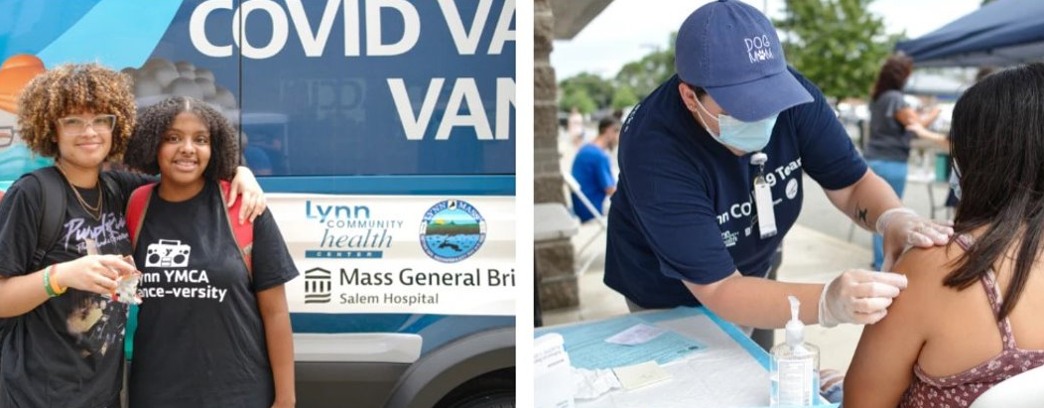
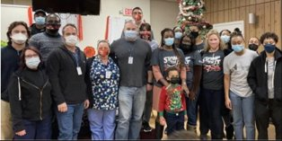
Fitchburg
Everett
Lynn
Brockton

Slide 42
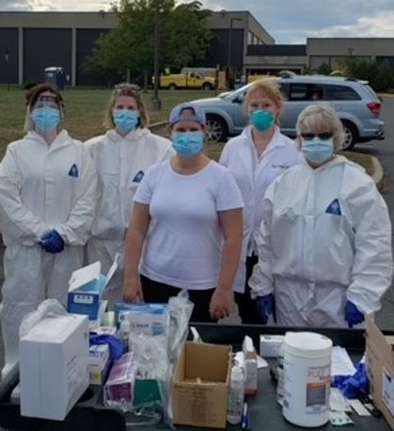
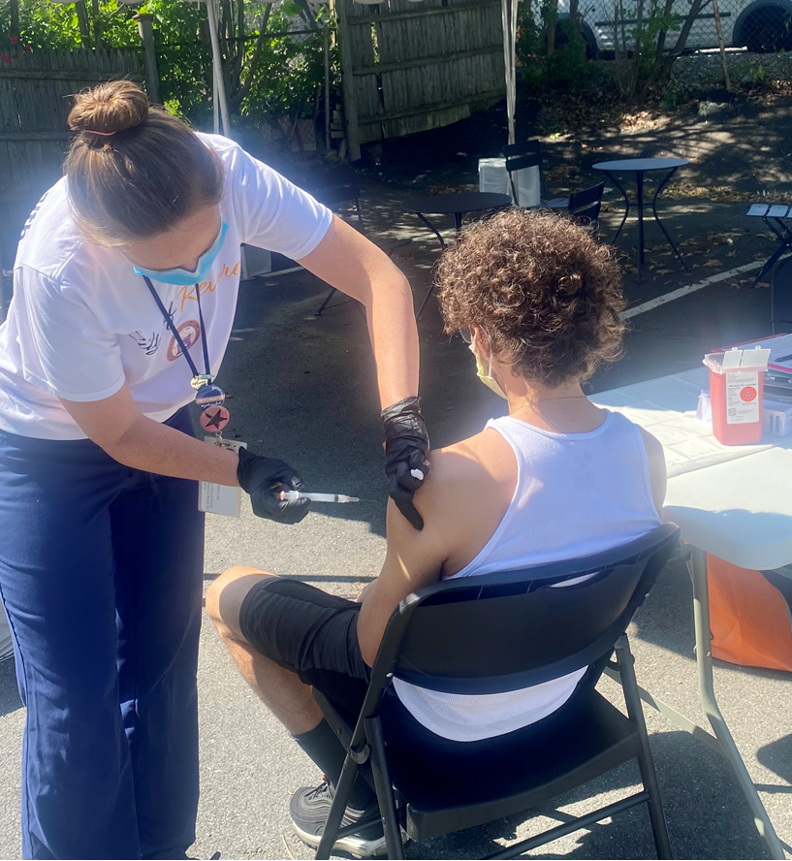
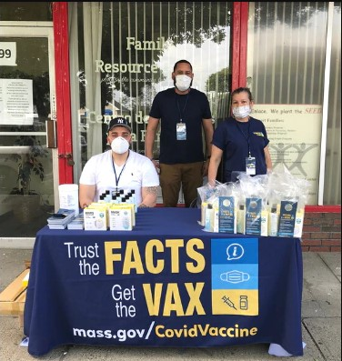
Holyoke
Framingham
Revere

Slide 43
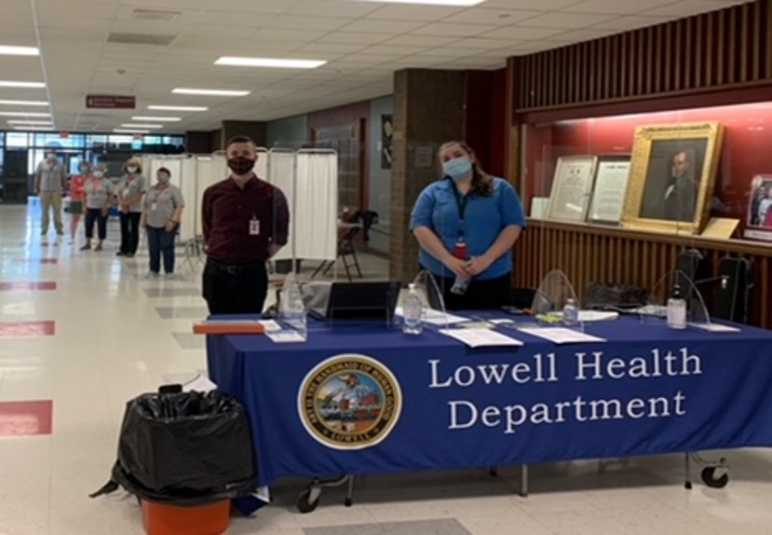
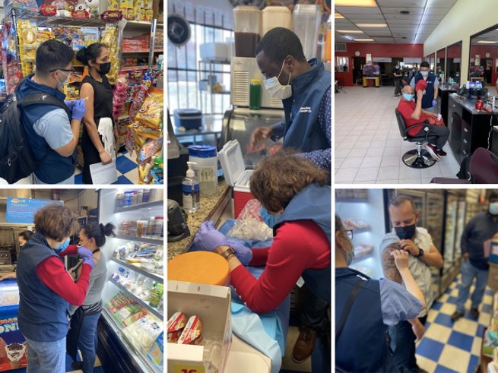
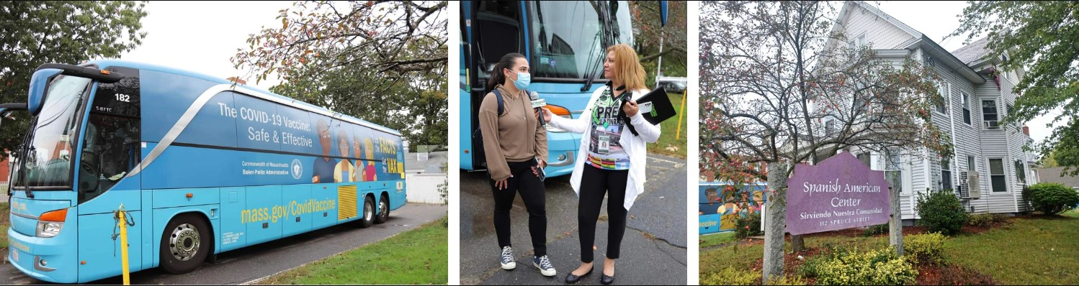
Lowell
Worcester
Leominster

Slide 44
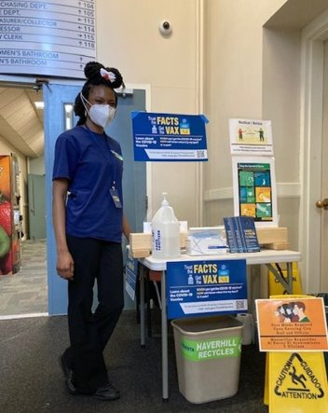
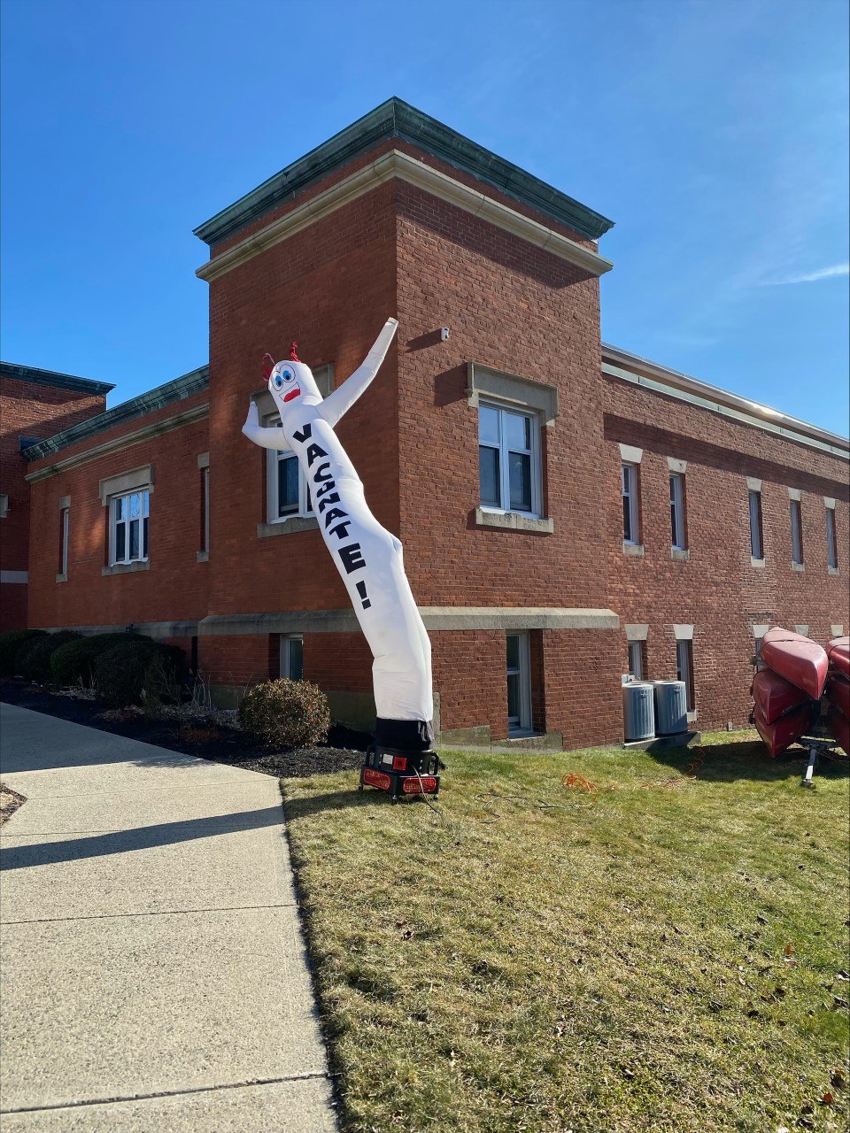
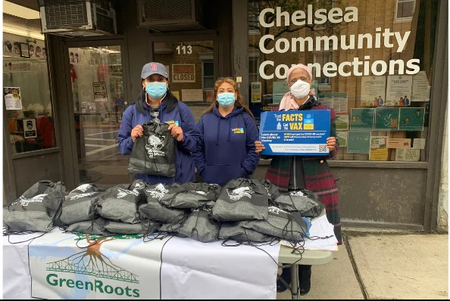
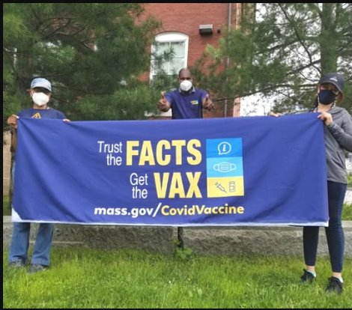
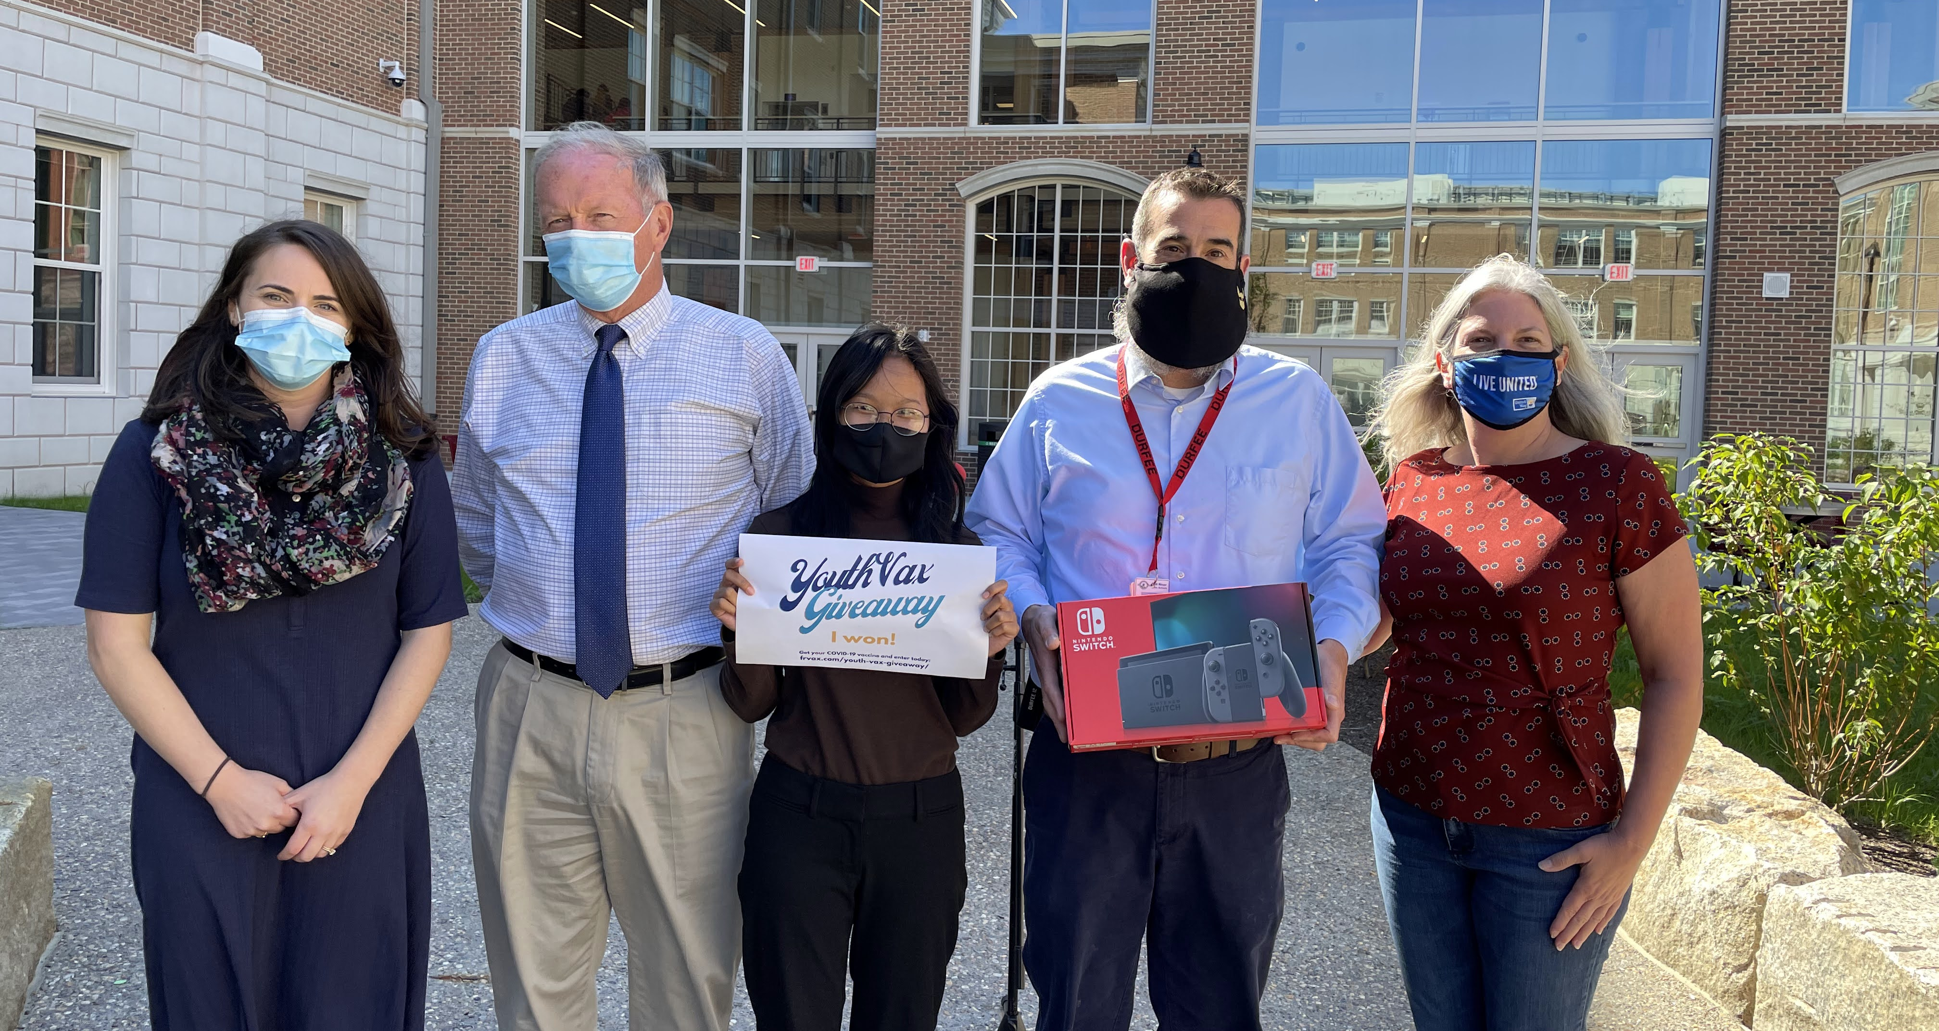
Chelsea
Malden
Chelsea
Haverhill
Lawrence
Fall River

Slide 45











Resources
COVID-19 Vaccine Equity Initiative Data Dashboard
Community specific data reports for vaccine administration results, updated weekly; and data from the Public Health (DPH) COVID Community Impact Survey to help target approaches.
Vaccine Equity Initiative Website
Overview of VEI, list of priority communities and populations, programmatic components, funding information, weekly highlights, and communications resources.
Trust The Facts/Get the Vax Campaign
Contains flyers, fact sheets, posters, videos, and other media in 12 languages.

Slide 46
COVID-19
Community Impact Survey(CCIS)
Preliminary Analysis Results as of
March 9, 2022
Presented by Emily Sparer-Fine, ScD
Co-authors: Kathleen Fitzsimmons, PhD; Alison Celigoi, MPH; Lauren Cardoso, PhD; W.W. Sanouri Ursprung, PhD
Massachusetts Department of Public Health

Slide 47
CCIS TEAM MEMBERS
CCIS Project Leads
W.W. Sanouri Ursprung, Lauren Cardoso, Beth Beatriz, Glory Song, Caroline Stack, Kathleen Fitzsimmons, Emily Sparer-Fine, Ta-wei Lin, Lisa Potratz, Heather Nelson, Amy Flynn, Lisa Arsenault, Abby Atkins
CCIS Steering Committee
Lauren Cardoso, W.W. Sanouri Ursprung, Beth Beatriz, Abbie Averbach, Ruth Blodgett, Ben Wood, Sabrina Selk,
Jessica del Rosario Nicole Daley, Lisa Potratz
CCIS Analytic Team, Data to Action Team, Data Dissemination Team, Communications Team
Allison Guarino, Andrea Mooney, Angela Laramie, Ann Marie Matteucci, Anna Agan, Arielle Coq, Barry Callis,
Beatriz Pazos Vautin, Ben Wood, Brittany Brown, Chelsea Orefice, Dana Bernson, David Hu, Dawn Fukuda,
Ekta Saksena, Elise Pechter, Emily White, Fareesa Hasan, Frank Gyan, Glennon Beresin, Hanna Shephard,
Hannah Walters, Hermik Babkhanlou-Chase, James Laing, Jena Pennock, Jennica Allen, Jennifer Halstrom,
Justine Egan, Kathleen Grattan, Kim Etingoff, Kirby Lecy, Lamar Polk, Lauren Fogarty, Lauren Larochelle,
Mahsa Yazdy, Marianne Mabida, Matthew Tumpney, Megan Hatch, Megan Young, Melody Kingsley, Michelle Reid, Miriam Scrivener, Nassira Nicola, Nicole Daniels, Nicole Roos, Rebecca Berger, Rebecca Han, Robert Leibowitz, Susan Manning, Thomas Brigham, Timothy St. Laurent, Vera Mouradian, Victoria Nielsen, Ziming Xuan,
Elizabeth Showalter, Priyokti Rana, Mayowa Sanusi, Emily Lawson, Alana LeBrón

Slide 48
CCIS COMMUNITY PARTNERS
Many groups that were critical in the success of this effort and gave important input on the development and deployment of the survey:
Academic Public Health Volunteer Corps and their work with local boards of health and on social media
Mass in Motion programs, including Springfield, Malden, and Chelsea
Cambodian Mutual Assistance
The Mashpee Wampanoag Tribe
The Immigrants’ Assistance Center, Inc
Families for Justice as Healing
City of Lawrence Mayor’s Health Task Force
The 84 Coalitions, including the Lawrence/Methuen Coalition
Boys and Girls Clubs, including those in Fitchburg and Leominster and the Metro South area
Chinatown Neighborhood Association
Father Bill’s
UTEC
MassCOSH
Stavros Center for Independent Living
Greater Springfield Senior Services
Center for Living and Working
DEAF, Inc.
Massachusetts Commission for the Deaf and Hard of Hearing
Viability, Inc.

Slide 49
OVERVIEW
Purpose and Approach of the Covid-19 Community Impact Survey (CCIS)
Preliminary Findings
  Mental Health and Potential Stressors among Workers
Appendix

Slide 50












RESULTS TOPICS TO DATE
SOCIAL DETERMINANTS OF HEALTH
MITIGATING INDIVIDUAL RISK OF INFECTION
ACCESS TO
TESTING​
ACCESS TO HEALTHCARE​
MENTAL HEALTH
EMPLOYMENT
SUBSTANCE USE
DISCRIMINATION: & RACE SPOTLIGHTS
PARENTS & FAMILIES
YOUTH SPOTLIGHT
SOGI POPULATION SPOTLIGHTS
INTIMATE PARTNER VIOLENCE
HOUSING STABILITY
RURAL COMMUNITIES SPOTLIGHT
PERSONS WITH DISABILITIES SPOTLIGHT
CAREGIVERS SPOTLIGHT
YOUTH SAFETY & HEALTHCARE ACCESS
NEW: ESSENTIAL WORKERS
DISCRIMINATION: & RACE SPOTLIGHTS

Slide 51
MENTAL HEALTH AND POTENTIAL STRESSORS AMONG WORKERS
FINDINGS FROM THE COVID-19
COMMUNITY IMPACT SURVEY (CCIS)
Co-Authors:Kathleen Fitzsimmons, PhD; Emily Sparer-Fine, ScD; Alison Celigoi, MPH; Lauren Cardoso, PhD; W.W. Sanouri Ursprung, PhD

Slide 52
FRAMING MATTERS
Employment is good for health, in general
  Income, benefits(e.g., health insurance), psychosocial support
Type and quality of work matter
  Conditions/exposures - toxic chemicals, heat/cold, infectious disease, dangerous equipment, heavy lifting, violence, stress
  Organizational - shift work, long hours, high demand/low control
Burden of occupational risks is not borne equally
  Low wage workers, including many immigrants and workers of color, disproportionately employed in physically demanding, high risk, high-stress jobs
COVID-19 has highlighted the role that work plays on health and healthcare access
  Throughout the pandemic many workers have had to leave home to do their jobs, facing increased risk of COVID-exposure and other stressors related to their work. Those unable to work remotely were also more susceptible to disruptions to employment during the pandemic
  Increasingly, the indirect impact of COVID-19 on health and the role that work plays has come to light (e.g., mental health impacts)

Slide 53
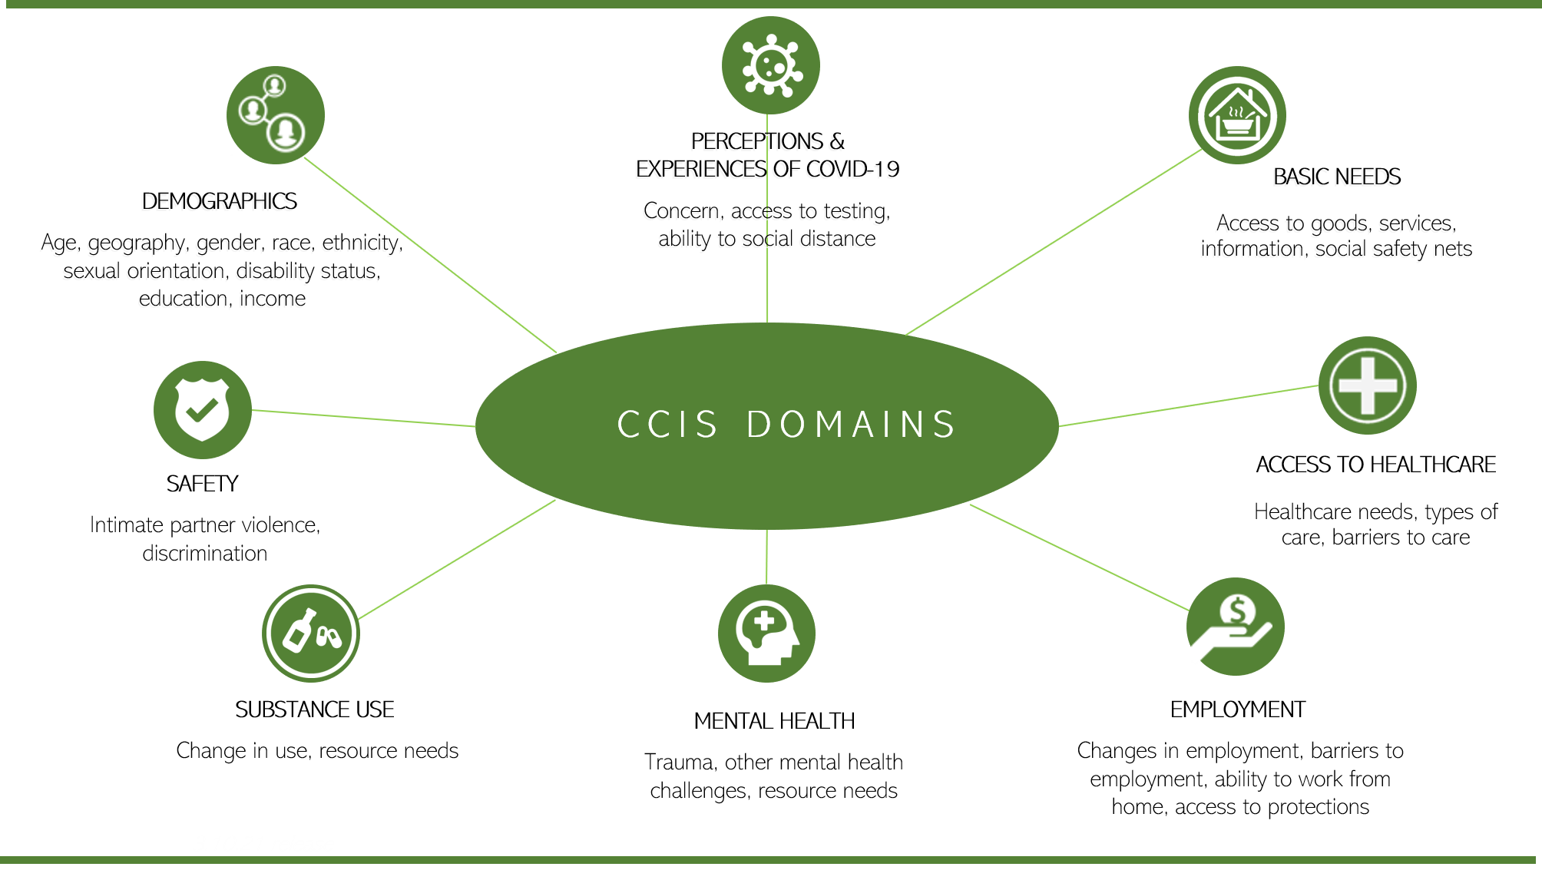
COVID-19 COMMUNITY IMPACT SURVEY (CCIS)
Online survey of Massachusetts residents administered September – November 2020
Adult and Youth versions, 11 languages
Goal: to understand specific needs of populations disproportionately impacted by the pandemic
Hard-to-reach subpopulations who are typically underrepresented in surveillance
Sample:
33,800 respondents aged ≥25 years
  Of those, 23,098 were employed in the past year
https://www.mass.gov/info-details/covid-19-community-impact-survey

Slide 54
MENTAL HEALTH AMONG WORKERS
“15 or more days of poor mental health” - Respondents were asked how many days during the past 30 days their mental health was not good, which includes stress, depression, and problems with emotions​.
Standard item from CDC Behavioral Risk Factor Surveillance System*
      “3 or more PTSD-like reactions” - Respondents were asked how many PTSD related reactions to the pandemic they had experienced in the past month from a validated list of reactions.
      Adapted from “Primary Care PTSD Screen for DSM-5 (PC-PTSD-5)**”
Overall, 1 in 3 (34%) employed respondents reported 15 or more days of poor mental health in the past 30 days.
  4% of these workers thought that suicide prevention and crisis management resources would be helpful.
More than 1 in 4 (28%) employed respondents reported 3 or more PTSD-like reactions.
      * Reference: Centers for Disease Control and Prevention (CDC). Behavioral Risk Factor Surveillance System Survey Questionnaire. Atlanta, Georgia: U.S. Department of Health and Human Services, CDC.
      ** See Appendix for more details; Reference: Prins, A., Bovin, M. J., Kimerling, R., Kaloupek, D. G, Marx, B. P., Pless Kaiser, A., & Schnurr, P. P. (2015). Primary Care PTSD Screen for DSM-5 (PC-PTSD-5) [Measurement instrument]. Available from https://www.ptsd.va.gov
      Notes: 1) ‘Employed refers to employed in the year prior to the survey completion in fall of 2020; 2) Sample Ns: N=19,809 (15+ days poor mental health), N=19,912 (3+ PTSD reactions)

Slide 55
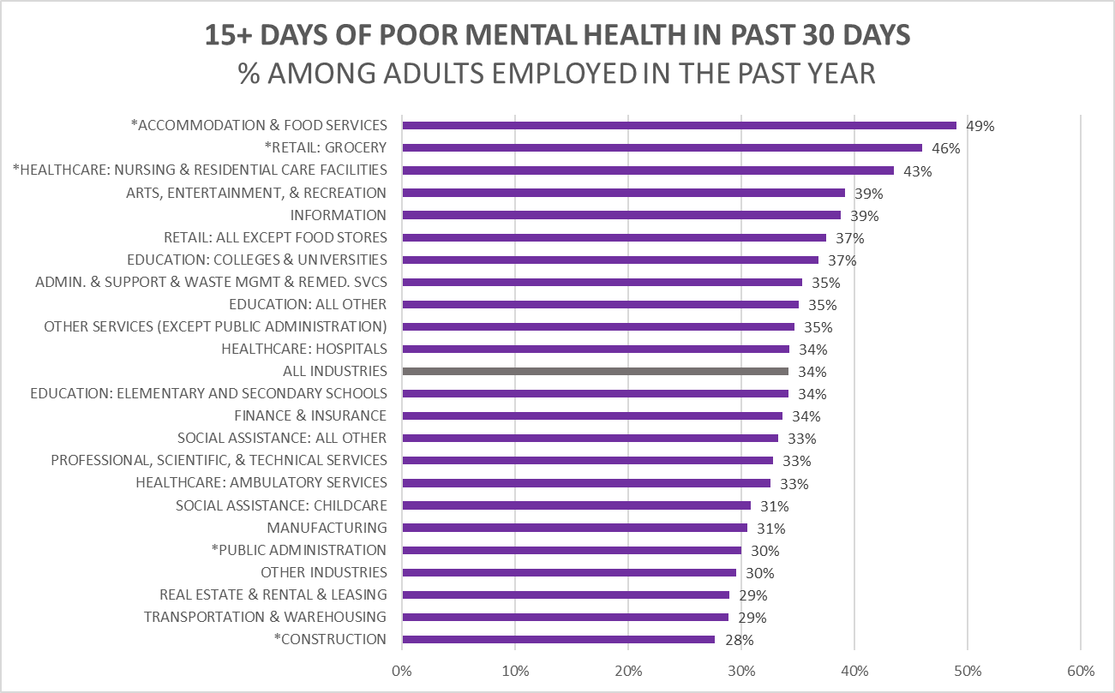
EMPLOYED RESPONDENTS IN CERTAIN INDUSTRY GROUPS WERE MORE LIKELY TO EXPERIENCE POOR MENTAL HEALTH
2 of these same 3 industry groups were also more likely to report 3 or more PTSD-like reactions.
Notes: 1) "Retail: Grocery" = CIC 4970 Grocery Stores, 4980 Specialty Food Stores, 5090 Gas Stations [includes those with convenient stores]; "Other Industries" = Mining; Agriculture, Forestry, Fishing and Hunting; Utilities; Wholesale Trade; Management of Companies and Enterprises; Military; 2) Employed refers to employed in the year prior to the survey completion in fall of 2020; 3) Overall Sample N=19,809

Slide 56


2020 POTENTIAL WORK-RELATED STRESSORS
  WORKING OUTSIDE THE HOME (i.e., frontline workers)
  EMPLOYER-PROVIDED PROTECTIVE MEASURES:
    paid sick leave
    personal protective equipment (PPE)
    implemented social distancing
    additional health and safety training
  EMPLOYMENT DISRUPTION DUE TO THE PANDEMIC:
    job loss (e.g., layoffs)
    reduced hours or took leave (e.g., needed to provide childcare)

Slide 57
2022 POTENTIAL WORK-RELATED STRESSORS
  WORKING OUTSIDE THE HOME (i.e., frontline workers)
  EMPLOYER-PROVIDED PROTECTIVE MEASURES:
    paid sick leave
    personal protective equipment (PPE)
    implemented social distancing
    additional health and safety training
    ventilation
    vaccine resources and/or mandates
  EMPLOYMENT DISRUPTION DUE TO THE PANDEMIC:
    job loss (e.g., “great resignation”)
    reduced hours or took leave (e.g., needed to provide childcare)

Slide 58
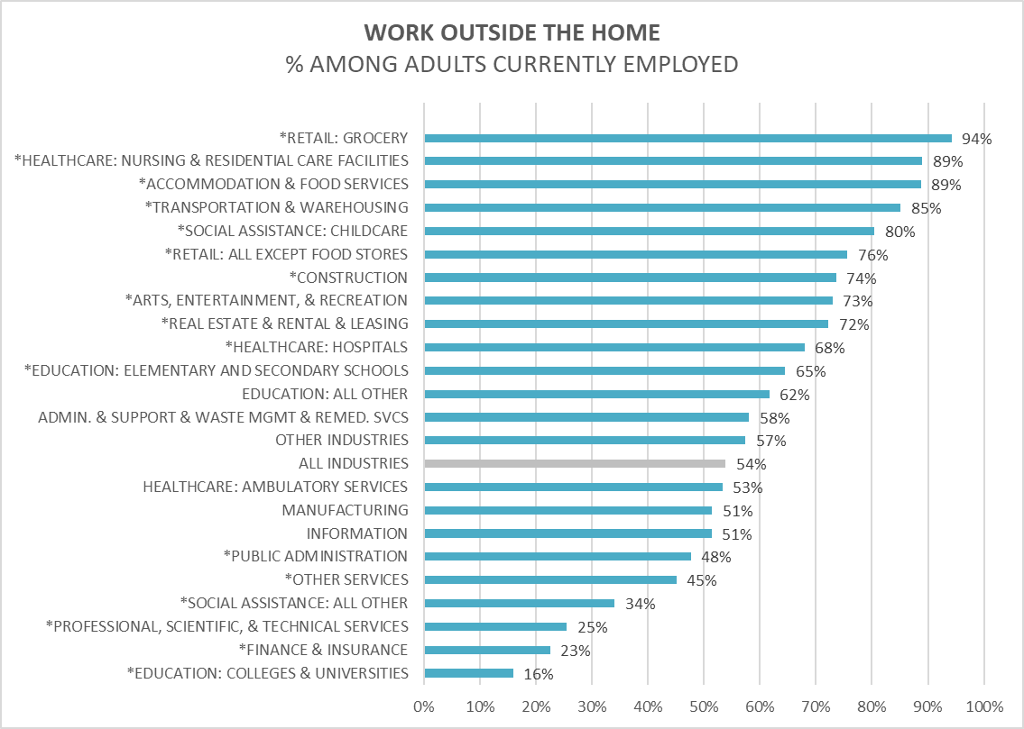
POTENTIAL STRESSOR:
WORKING OUTSIDE THE HOME
POTENTIAL STRESSORS: WORKING OUTSIDE THE HOME
Overall, 1 in 2, employed respondents were frontline workers, facing increased risk of COVID-19 exposure.
The percentages varied widely across industries.
Even within certain industries, the percentage who worked outside the home varied by subgroup.
The three industry groups with the highest percentage of workers experiencing poor mental health, also had the highest percentages working outside the home.
Notes: 1) "Retail: Grocery" = CIC 4970 Grocery Stores, 4980 Specialty Food Stores, 5090 Gas Stations [includes those with convenient stores]; "Other Industries" = Mining; Agriculture, Forestry, Fishing and Hunting; Utilities; Wholesale Trade; Management of Companies and Enterprises; Military; 2) Currently employed refers to employed full-time, part-time or self employed at the time of the survey in fall of 2020; 3)Sample N=19,408

Slide 59
POTENTIAL STRESSOR:
employer-provided protective measures
Accommodation & Food Services | Retail: Grocery | Healthcare: Nursing and Residential Care
40% | 57% | 77%^
53% | 73%^ | 90%
54% | 60%^ | 65%^
31% | 37% | 64%
Overall, among those working outside the home:
77% reported having paid sick leave.
76% worked in places that
provided personal protective equipment (PPE).
66% worked in places that
implemented social distancing.
44% worked in places that
provided additional health & safety training.
Notes: 1) Full industry breakdowns are available upon request; 2)^ denotes estimate is not statistically significantly different from the average for all occupations; 3) Sample Ns: N=7,722 (sick leave), N=7,771 (other protections)

Slide 60
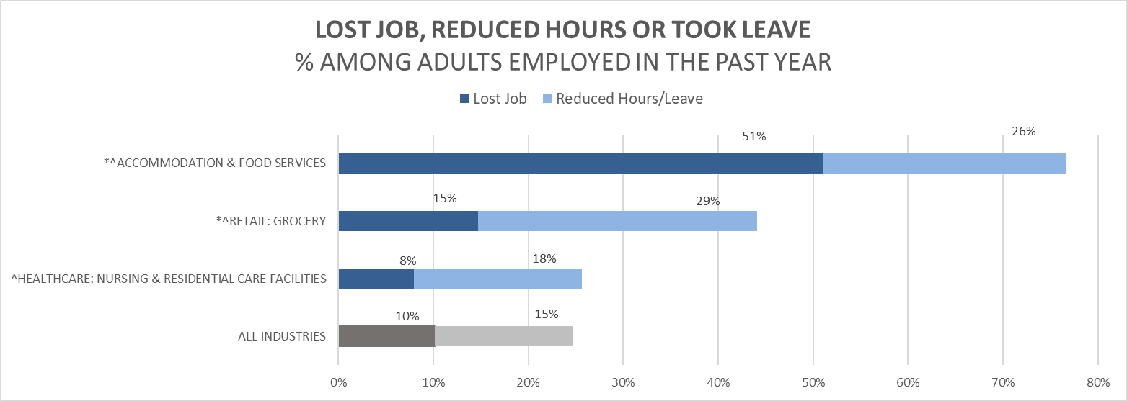
POTENTIAL STRESSOR:
employment DISRUPTION due to the pandemic
Notes: 1) "Retail: Grocery" = CIC 4970 Grocery Stores, 4980 Specialty Food Stores, 5090 Gas Stations [includes those with convenient stores]; 2) Employed refers to employed in the year prior to the survey completion in fall of 2020; 3) Sample N=18,992

Slide 61


POTENTIAL STRESSORS (HEALTHCARE WORKERS):
Factors related to possible contact with COVID-19 patients
Not being able to distance from others because of work
  9 in 10 (89%) frontline workers in Healthcare listed work-related reasons for not being able to socially distance (i.e. maintain 6 ft. of distance from others), which was higher than the average for all frontline workers.
Testing positive (among respondents who had ever been tested)
  Those working outside the home were nearly 2X more likely to report testing positive than those working from home.
  Workers in Healthcare: Hospitals were nearly 3X more likely and those in Healthcare: Nursing & Residential Care Facilities were nearly 4X more likely than those working from home.
Knowing someone who died from COVID-19
  Nearly 1 in 5 workers in Healthcare: Nursing & Residential Care Facilities reported that someone close to them died from COVID-19

Slide 62
KEY TAKEAWAYS
The CCIS captured important information on the disparate impact of the pandemic on subgroups of Massachusetts’ workers. Findings suggest that work may contribute to observed inequities related to COVID-19.
Industries with among the highest proportions of frontline workers were most likely to report poor mental health outcomes. This might reflect differences in stressors related to working outside of the home, employer-provided protective measures, and/or disruptions to employment.
  Frontline workers in accommodation and food services and grocery stores were less likely to have paid sick leave and employer provided protections. They were also more likely to report losing jobs, reduced hours or taking leave.
  Frontline workers in healthcare were more likely to report testing positive for COVID, and those in nursing and residential care were more likely to report someone close to them dying of COVID, suggesting additional stressors for healthcare workers whose work may have involved working directly with COVID-positive patients.
While some of these work-related stressors might have changed from 2020 to 2022, the experiences felt in 2020 are still likely impacting the workforce now. There are also newer work-related stressors not captured in the CCIS that may be impacting the mental health of frontline workers today.

Slide 63
CURRENT EFFORTS TO SUPPORT MENTAL HEALTH AND RELATED RESOURCES
Vaccine Equity Initiative (VEI): Employer and employee workstream
  Providing resources to employers and workers to assist with vaccination and broader COVID-19 mitigation
  Promoting “COVID-19 Temporary Emergency Paid Sick Leave Program” – Requires employers to make paid leave time available to employees for COVID-related illnesses, quarantine, and vaccinations and provides employers with an opportunity to apply for reimbursement from the state
Trainings and other resources
  Injury Prevention & Control Program: Conducted an assessment on the impact of COVID-19 on social service and Emergency Medical Service providers, with a specific focus on burnout. Based on the findings, developed trainings/resources on self-care, and trauma-informed practices, and developed an awareness campaign with Riverside Trauma Center. Moving forward, the team is building trauma-informed practices, self-care, and suicide prevention into training for home visitors, community health workers, and youth-serving providers.
  Suicide Prevention Program: Promoting National Suicide Prevention Hotline 1-800-273-8255 (e.g., collaborating with MBTA to advertise this number) and related programs, including suicide prevention trainings
    As of July 16, the NSPL the 10-digit number will be available as a three-digit 988 number
    The new Behavioral Health Help Line (BHHL) will launch in January 2023 and will be a centralized access point for all Behavioral Health needs, including crisis, urgent, & routine
  Mental Health Resources for Healthcare Workers Experiencing Stress, Anxiety and Trauma – DPH website: www.mass.gov/resource/mental-health-resources-for-healthcare-workers-experiencing-stress-anxiety-and-trauma

Slide 64
CURRENT EFFORTS TO SUPPORT MENTAL HEALTH AND RELATED RESOURCES
Other state-wide programs to support workers
  COVID-19 Essential Employee Premium Pay provides $500 payments to 500,000 low-income workers
  Paid Family and Medical Leave (PFML) (Chapter 121 of the Acts of 2018) provides resources to help people in Massachusetts take paid time off for work for family or medical reasons
  Complaint lines established at different agencies throughout the Commonwealth at various points of the pandemic to address concerns about COVID exposure/enforcement, as well as experiences in nursing homes/health care facilities
  MEMA and DPH facilitating mask and other PPE distribution to targeted entities across the Commonwealth.
  DPH’s planned analytic work
  Topics raised in this presentation will inform a future survey on the COVID-19 impact (“CCIS2.0”)
  Multiple programs within DPH are collaborating on an in-depth “COVID-19 Healthcare Worker Trauma Study”

Slide 65
CURRENT EFFORTS TO SUPPORT MENTAL HEALTH AND RELATED RESOURCES
Efforts to support the substance use disorder workforce:
Bureau of Substance Addiction Services (BSAS) implemented the following staffing-related flexibilities to better support substance use disorder (SUD) providers and staff who were already facing ongoing workforce shortages:
  Withdrew staffing guidelines requiring licensed SUD facilities to staff to their licensed capacity, allowing programs to staff according to daily census of patients providing needed flexibility to programs and staff
  Allowed LPNs or other Qualified Health Care Professionals (as defined by 105 CMR 164.006) to supervise nursing staff, provided supervisor educationally prepared at or above the level of the nursing staff under their supervision.
  Allowing Opioid Treatment Programs to close one day per week in alignment with federal regulations.
  Due to persistent nature of the workforce shortage, BSAS intends to maintain these flexibilities and identify other opportunities to support staff recruitment, retention and wellness particularly for staff with lived experience who may be at higher risk for relapse due to the ongoing stress and trauma associated with COVID.

Slide 66
CURRENT EFFORTS TO SUPPORT MENTAL HEALTH AND RELATED RESOURCES
Select efforts to support healthcare workers (not exhaustive):
Bureau of Health Care Safety and Quality (BHCSQ) and epidemiologists from the Bureau of Infectious Disease and Lab Sciences (BIDLS) conducted regular calls with facilities to provide clinical and regulatory guidance, link facilities to resources rapidly, and provide collaborative problem solving for facilities managing active outbreaks.
  BHCSQ conducted a qualitative study among workers in long-term care facilities (LTCF) to understand their experiences participating in the COVID-19 Outreach Project.
  The results indicated that most LTCFs found the Outreach Project to be a source of information and resources, as well as emotional support for LTCF staff, opening opportunities for more collaborative relationships between facilities and DPH. However, facilities also felt that there could have been improvements in communication of expectations and streamlining data collection efforts across regulatory entities. All participants expressed feeling overwhelmed and emotionally drained during the course of the pandemic.
Pursuant to an Order issued by the Commissioner of Public Health to focus health care personnel resources on responding to COVID-19, DPH directed all MA healthcare facilities to implement their policies and procedures for expedited provider credentialing in their emergency management plan and transfer of licensed and certified clinical staff between healthcare facilities.
To help nursing homes address staffing shortages during the pandemic, CMS provided a blanket waiver for the nurse aide training and certification requirements to permit nurse aides to work for longer than four months without having completed their training.
DPH provided PPE, COVID-19 testing supplies, and COVID-19 vaccine clinics to facilities.
DPH coordinated and deployed clinical staffing support to facilities through the MA National Guard and Rapid Response Teams.

Slide 67
Kathleen.Fitzsimmons@mass.gov
Emily.sparer-fine@mass.gov
Thank you!

Slide 68
APPENDIX

Slide 69
15 or more poor mental health days in past 30 days among respondents employed in the past year
Industry Group | Frequency | Weighted %
All Industries | 6599 | 34%
CONSTRUCTION | 72 | 28%
MANUFACTURING | 203 | 31%
RETAIL: GROCERY | 66 | 46%
RETAIL: ALL EXCEPT FOOD STORES | 203 | 37%
TRANSPORTATION & WAREHOUSING | 51 | 29%
INFORMATION | 156 | 39%
FINANCE & INSURANCE | 257 | 34%
REAL ESTATE & RENTAL & LEASING | 56 | 29%
PROFESSIONAL, SCIENTIFIC, & TECHNICAL SERVICES | 460 | 33%
ADMIN. & SUPPORT & WASTE MGMT & REMED. SVCS | 69 | 35%
EDUCATION: ELEMENTARY AND SECONDARY SCHOOLS | 967 | 34%
EDUCATION: COLLEGES & UNIVERSITIES | 432 | 37%
EDUCATION: ALL OTHER | 29 | 35%
HEALTHCARE: AMBULATORY SERVICES | 685 | 33%
HEALTHCARE: HOSPITALS | 713 | 34%
HEALTHCARE: NURSING & RESIDENTIAL CARE FACILITIES | 184 | 43%
SOCIAL ASSISTANCE: CHILDCARE | 150 | 31%
SOCIAL ASSISTANCE: ALL OTHER | 537 | 33%
ARTS, ENTERTAINMENT, & RECREATION | 108 | 39%
ACCOMMODATION AND FOOD SERVICES | 159 | 49%
OTHER SERVICES | 422 | 35%
PUBLIC ADMINISTRATION | 560 | 30%
OTHER INDUSTRIES | 60 | 30%
Notes: 1) Industry groups are based on Bureau of Census Industry Codes (CIC); 2)"Retail: Grocery" includes Grocery Stores, Specialty Food Stores, Gas Stations [includes those with convenient stores]; 3) Other Industries
includes Mining; Agriculture, Forestry, Fishing and Hunting; Utilities; Wholesale Trade; Management of Companies and Enterprises; Military; 4) Percentages are weighted to the statewide age and educational distribution of those 25 years old or older in Massachusetts

Slide 70
3 or more PTSD-like reactions in past month among respondents employed in the past year
Industry Group | Frequency | Weighted %
All Industries | 5599 | 28%
CONSTRUCTION | 55 | 22%
MANUFACTURING | 169 | 25%
RETAIL: GROCERY | 43 | 29%
RETAIL: ALL EXCEPT FOOD STORES | 181 | 30%
TRANSPORTATION & WAREHOUSING | 37 | 19%
INFORMATION | 143 | 36%
FINANCE & INSURANCE | 218 | 26%
REAL ESTATE & RENTAL & LEASING | 56 | 29%
PROFESSIONAL, SCIENTIFIC, & TECHNICAL SERVICES | 433 | 29%
ADMIN. & SUPPORT & WASTE MGMT & REMED. SVCS | 61 | 31%
EDUCATION: ELEMENTARY AND SECONDARY SCHOOLS | 830 | 30%
EDUCATION: COLLEGES & UNIVERSITIES | 414 | 34%
EDUCATION: ALL OTHER | 31 | 32%
HEALTHCARE: AMBULATORY SERVICES | 539 | 26%
HEALTHCARE: HOSPITALS | 578 | 27%
HEALTHCARE: NURSING & RESIDENTIAL CARE FACILITIES | 141 | 33%
SOCIAL ASSISTANCE: CHILDCARE | 120 | 26%
SOCIAL ASSISTANCE: ALL OTHER | 430 | 27%
ARTS, ENTERTAINMENT, & RECREATION | 96 | 34%
ACCOMMODATION AND FOOD SERVICES | 125 | 37%
OTHER SERVICES | 374 | 30%
PUBLIC ADMINISTRATION | 478 | 23%
OTHER INDUSTRIES | 47 | 26%
Notes: 1) Industry groups are based on Bureau of Census Industry Codes (CIC); 2)"Retail: Grocery" includes Grocery Stores, Specialty Food Stores, Gas Stations [includes those with convenient stores]; 3) Other Industries
includes Mining; Agriculture, Forestry, Fishing and Hunting; Utilities; Wholesale Trade; Management of Companies and Enterprises; Military; 4) Percentages are weighted to the statewide age and educational distribution of those 25 years old or older in Massachusetts

Slide 71
Working outside of the home among employed residents
Industry Group | Frequency | Weighted %
All Industries | 8921 | 54%
CONSTRUCTION | 151 | 74%
MANUFACTURING | 253 | 51%
RETAIL: GROCERY | 120 | 94%
RETAIL: ALL EXCEPT FOOD STORES | 328 | 76%
TRANSPORTATION & WAREHOUSING | 123 | 85%
INFORMATION | 185 | 51%
FINANCE & INSURANCE | 143 | 23%
REAL ESTATE & RENTAL & LEASING | 137 | 72%
PROFESSIONAL, SCIENTIFIC, & TECHNICAL SERVICES | 331 | 25%
ADMIN. & SUPPORT & WASTE MGMT & REMED. SVCS | 91 | 58%
EDUCATION: ELEMENTARY AND SECONDARY SCHOOLS | 1696 | 65%
EDUCATION: COLLEGES & UNIVERSITIES | 162 | 16%
EDUCATION: ALL OTHER | 46 | 62%
HEALTHCARE: AMBULATORY SERVICES | 1005 | 53%
HEALTHCARE: HOSPITALS | 1379 | 68%
HEALTHCARE: NURSING & RESIDENTIAL CARE FACILITIES | 361 | 89%
SOCIAL ASSISTANCE: CHILDCARE | 351 | 80%
SOCIAL ASSISTANCE: ALL OTHER | 469 | 34%
ARTS, ENTERTAINMENT, & RECREATION | 156 | 73%
ACCOMMODATION AND FOOD SERVICES | 184 | 85%
OTHER SERVICES | 426 | 45%
PUBLIC ADMINISTRATION | 742 | 48%
OTHER INDUSTRIES | 82 | 57%
Notes: 1) Industry groups are based on Bureau of Census Industry Codes (CIC); 2)"Retail: Grocery" includes Grocery Stores, Specialty Food Stores, Gas Stations [includes those with convenient stores]; 3) Other Industries
includes Mining; Agriculture, Forestry, Fishing and Hunting; Utilities; Wholesale Trade; Management of Companies and Enterprises; Military; 4) Percentages are weighted to the statewide age and educational distribution of those 25 years old or older in Massachusetts

Slide 72
Employer provided protective measures among respondents working outside the home
 | Personal Protective Equipment (PPE) |  | Implemented Social Distancing |  | Additional Health and Safety Training |  | Sick Leave
Industry Group | Frequency | Weighted % | Frequency | Weighted % | Frequency | Weighted % | Frequency | Weighted %
All Industries | 5932 | 76% | 5325 | 66% | 3644 | 44% | 6194 | 77%
CONSTRUCTION | 77 | 72% | 59 | 50% | 26 | 22% | 79 | 66%
MANUFACTURING | 159 | 69% | 173 | 73% | 90 | 37% | 183 | 78%
RETAIL: GROCERY | 84 | 73% | 71 | 60% | 41 | 37% | 62 | 56%
RETAIL: ALL EXCEPT FOOD STORES | 177 | 70% | 155 | 61% | 76 | 30% | 164 | 62%
TRANSPORTATION & WAREHOUSING | 79 | 75% | 67 | 63% | 34 | 29% | 67 | 64%
INFORMATION | 97 | 68% | 111 | 82% | 52 | 41% | 101 | 73%
FINANCE & INSURANCE | 70 | 63% | 82 | 71% | 34 | 26% | 95 | 81%
REAL ESTATE & RENTAL & LEASING | 38 | 65% | 43 | 75% | 18 | 36% | 40 | 70%
PROFESSIONAL, SCIENTIFIC, & TECHNICAL SERVICES | 102 | 63% | 115 | 67% | 44 | 25% | 123 | 72%
ADMIN. & SUPPORT & WASTE MGMT & REMED. SVCS | 24 | 48% | 28 | 53% | 8 | 20% | 27 | 53%
EDUCATION: ELEMENTARY AND SECONDARY SCHOOLS | 1118 | 70% | 1309 | 78% | 956 | 57% | 1417 | 85%
EDUCATION: COLLEGES & UNIVERSITIES | 93 | 69% | 122 | 77% | 74 | 45% | 114 | 72%
EDUCATION: ALL OTHER | 12 | 66% | 12 | 66% | 9 | 38% | 13 | 71%
HEALTHCARE: AMBULATORY SERVICES | 715 | 82% | 547 | 62% | 401 | 46% | 663 | 76%
HEALTHCARE: HOSPITALS | 1270 | 91% | 845 | 59% | 721 | 51% | 1137 | 83%
HEALTHCARE: NURSING & RESIDENTIAL CARE FACILITIES | 315 | 90% | 224 | 65% | 225 | 64% | 278 | 77%
SOCIAL ASSISTANCE: CHILDCARE | 212 | 76% | 172 | 59% | 170 | 58% | 218 | 78%
SOCIAL ASSISTANCE: ALL OTHER | 369 | 83% | 339 | 72% | 224 | 46% | 386 | 86%
ARTS, ENTERTAINMENT, & RECREATION | 48 | 67% | 52 | 83% | 16 | 26% | 40 | 59%
ACCOMMODATION AND FOOD SERVICES | 84 | 55% | 85 | 56% | 49 | 32% | 69 | 45%
OTHER SERVICES | 194 | 62% | 192 | 58% | 99 | 31% | 209 | 63%
PUBLIC ADMINISTRATION | 544 | 74% | 476 | 65% | 246 | 32% | 652 | 91%
OTHER INDUSTRIES | 51 | 71% | 46 | 61% | 31 | 41% | 57 | 89%
Notes: 1) Industry groups are based on Bureau of Census Industry Codes (CIC); 2)"Retail: Grocery" includes Grocery Stores, Specialty Food Stores, Gas Stations [includes those with convenient stores]; 3) Other Industries
includes Mining; Agriculture, Forestry, Fishing and Hunting; Utilities; Wholesale Trade; Management of Companies and Enterprises; Military; 4) Percentages are weighted to the statewide age and educational distribution of those 25 years old or older in Massachusetts

Slide 73
Job loss or reduced hours of work/took leave due to the pandemic among respondents employed in the past year
 | Job Loss |  | Reduced Hours/Took Leave
Industry Group | Frequency | Weighted % | Frequency | Weighted %
All Industries | 1492 | 10% | 2419 | 15%
CONSTRUCTION | 32 | 18% | 37 | 18%
MANUFACTURING | 59 | 12% | 100 | 17%
RETAIL: GROCERY | 20 | 15% | 40 | 23%
RETAIL: ALL EXCEPT FOOD STORES | 119 | 25% | 100 | 22%
TRANSPORTATION & WAREHOUSING | 24 | 16% | 46 | 26%
INFORMATION | 44 | 13% | 43 | 14%
FINANCE & INSURANCE | 25 | 3% | 57 | 9%
REAL ESTATE & RENTAL & LEASING | 10 | 11% | 13 | 10%
PROFESSIONAL, SCIENTIFIC, & TECHNICAL SERVICES | 93 | 10% | 174 | 13%
ADMIN. & SUPPORT & WASTE MGMT & REMED. SVCS | 36 | 26% | 24 | 15%
EDUCATION: ELEMENTARY AND SECONDARY SCHOOLS | 149 | 7% | 260 | 12%
EDUCATION: COLLEGES & UNIVERSITIES | 88 | 10% | 138 | 13%
EDUCATION: ALL OTHER | 15 | 25% | 14 | 21%
HEALTHCARE: AMBULATORY SERVICES | 137 | 8% | 315 | 16%
HEALTHCARE: HOSPITALS | 78 | 4% | 271 | 14%
HEALTHCARE: NURSING & RESIDENTIAL CARE FACILITIES | 34 | 8% | 68 | 18%
SOCIAL ASSISTANCE: CHILDCARE | 74 | 17% | 60 | 15%
SOCIAL ASSISTANCE: ALL OTHER | 53 | 3% | 214 | 13%
ARTS, ENTERTAINMENT, & RECREATION | 79 | 39% | 38 | 21%
ACCOMMODATION AND FOOD SERVICES | 158 | 51% | 83 | 26%
OTHER SERVICES | 114 | 13% | 161 | 16%
PUBLIC ADMINISTRATION | 37 | 3% | 137 | 7%
OTHER INDUSTRIES | 14 | 13% | 26 | 14%
Notes: 1) Industry groups are based on Bureau of Census Industry Codes (CIC); 2)"Retail: Grocery" includes Grocery Stores, Specialty Food Stores, Gas Stations [includes those with convenient stores]; 3) Other Industries
includes Mining; Agriculture, Forestry, Fishing and Hunting; Utilities; Wholesale Trade; Management of Companies and Enterprises; Military; 4) Percentages are weighted to the statewide age and educational distribution of those 25 years old or older in Massachusetts

Slide 74
Next Meeting:
April 6, 2022

