Slide 1
Public health council
May 12, 2021
Please standby – the meeting will begin shortly
Today’s presentation is available on the mass.gov/dph website under “Upcoming Events” by clicking on the May 12 Public Health Council listing

Slide 2
Public health council
May 12, 2021
Today’s presentation is available on the mass.gov/dph website under “Upcoming Events” by clicking on the May 12 Public Health Council listing

Slide 3
OPIOID OVERDOSE DEATH REPORT:
2020 Annual Overview and First Quarter 2021

Slide 4
Preliminary data show 507 confirmed and estimated opioid-related overdose deaths in the first three months of 2021, an estimated 2% increase compared with the same period in 2020.
Estimated 498 deaths
Estimated 507 deaths

Slide 5
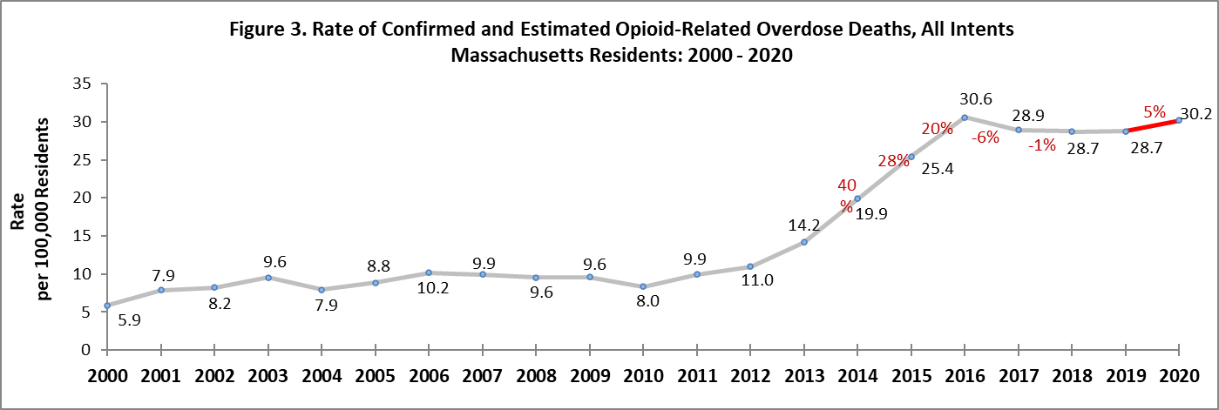
The rate of opioid-related overdose deaths has increased 5% in 2020 compared with 2019 and is
1% lower than the 2016 peak.

Slide 6
Fentanyl remains a key factor in opioid-related overdose deaths (92% present in toxicology screen in 2020).

Slide 7
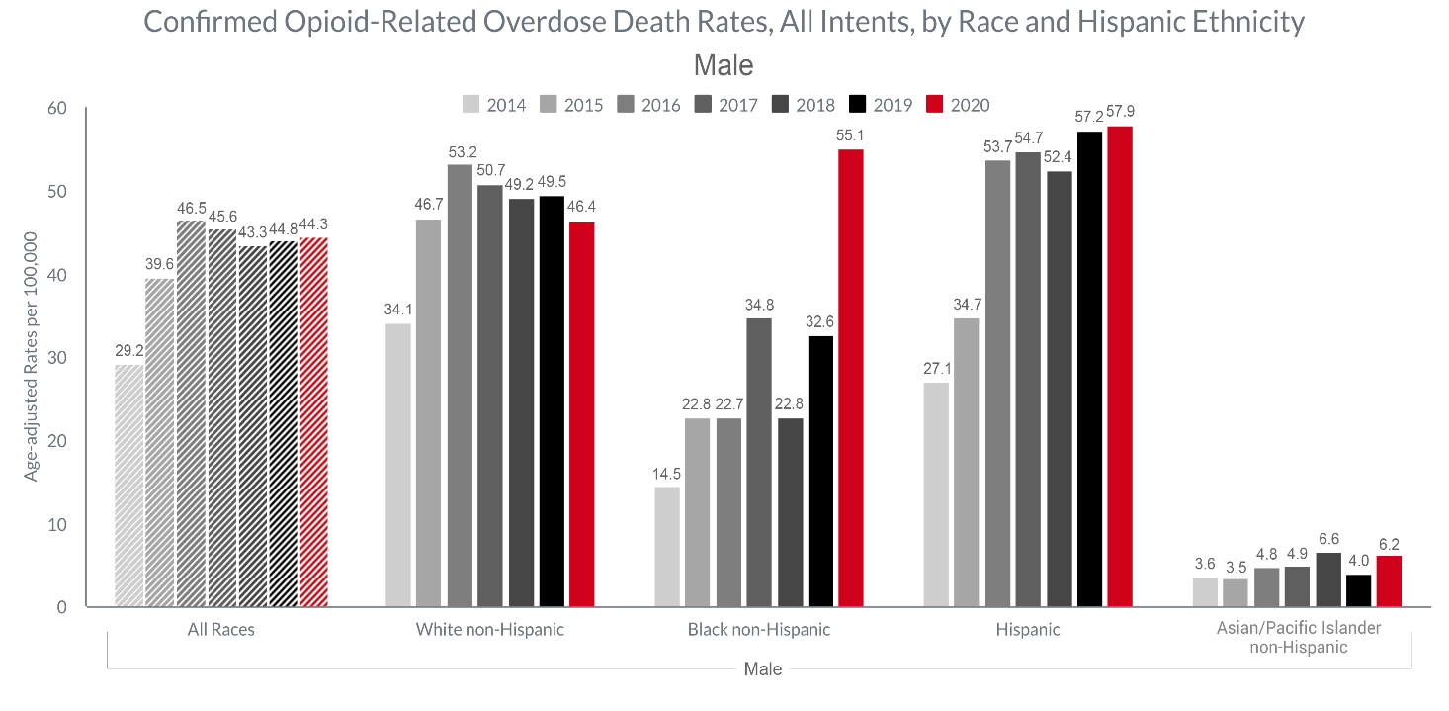
Between 2019 & 2020, the confirmed opioid-related overdose death rates for Black non-Hispanic men increased significantly at 69%.

Slide 8
DPH/BSAS is implementing new investments to enhance treatment and recovery support, particularly in communities of color
BSAS is dedicating a significant portion of supplemental funding from SAMHSA’s Substance Abuse Prevention & Treatment Block Grant towards addressing racial equity, including:
  Increasing behavioral healthcare workforce diversity, recruitment, and retention through workforce development initiatives
  Funding community-led programming in communities of color through grant making and support for increasing community-based organizations’ ability to contract with the Commonwealth
  Increasing the number of culturally-specific programs across the continuum of prevention, outreach/engagement, treatment, and recovery support services
  Increasing investments in pre-arrest diversion/co-response models, in order to divert people with SUD from the criminal justice system, in partnership with the Department of Mental Health
  Increasing funding for low-threshold housing/housing first models in Suffolk County, with program expansions expected in Merrimack Valley, Springfield, and Worcester to address communities in need

Slide 9
DPH/BSAS addresses health and racial equity by continuing and enhancing existing programs
  Current BSAS programs dedicated to addressing overdoses in the Black/Latinx community include:
    Recovery-Based Re-Entry Services for Black and Latino Men, a pilot program for Black and Latino men leaving incarceration that will be provided by the following agencies:
      Fathers’ Uplift
      Casa Esperanza
      Legendary Legacies
      New North Citizens’ Council
      Greater Lawrence Family Health Center/Lynn Community Health Center
    Increased investments in the Black Addiction Counselor Education (BACE) and Latinx Addiction Counselor Education (LACE) programs to support Black and Latinx people seeking to enter the SUD workforce
BSAS is also partnering with other existing culturally-specific agencies/programs in the Commonwealth to expand their services and provide increased access for communities of color

Slide 10
DPH/BSAS has aggressively maximized access to SUD treatment during the COVID-19 pandemic, and is continuing the fight against the opiate crisis
Increasing access to naloxone – from March 2020 to April 2021 over 110 thousand naloxone kits have been distributed to Opioid Treatment Providers (OTP), Syringe Service Programs, community health centers, hospital emergency departments, and county Houses of Correction.
Implementing a new standing order for naloxone allowing providers/organizations such as first responders, co-response/jail diversion teams, criminal justice personnel, and health and human services workers (such as those in homeless shelters, drop-in centers, and soup kitchens) to give naloxone to individuals at risk and their friends/family.
Obtaining a blanket exception from SAMHSA on behalf of Massachusetts Opioid Treatment Programs (OTP) for take home doses of MOUD. As of December 2020, 48.5% of OTP patients are receiving take home doses, compared to the pre-COVID average of 15.6% in December 2019.
Implementing the broad adoption of a DEA waiver allowing prescriptions for buprenorphine and naltrexone to patients for whom providers have conducted telehealth sessions, as well as induct patients on buprenorphine and naltrexone.
Reimbursing contracted Office Based Opioid Treatment (OBOT) providers for cell phones and data plans to maintain patients’ ability to keep in contact with their providers for telehealth.
Establishing COVID+ ATS and CSS units to facilitate positive patient transfers and maintain capacity within the rest of the treatment system.
Leveraging the second round of State Opioid Response (SOR) funding from SAMHSA to increase access in Massachusetts to all FDA-approved forms of MOUD, reduce unmet treatment needs, and reduce opioid/stimulant misuse and overdose.
Working with programs to prevent and mitigate the spread of COVID-19, including distributing guidance on surveillance testing, screening and isolation of patients/staff, and increased flexibility in bed allocation between different service settings to accommodate changing patient needs at individual programs.

Slide 11
Determination of Need:
Request by UMass Memorial Health Care, Inc. for Substantial Change in Service

Slide 12
Massachusetts cancer registry
Amendments to 105 CMR 301.000: Cancer Registry
Susan T Gershman, MS, MPH, PhD, CTR
Director, Massachusetts Cancer Registry
Jim Ballin, JD
Deputy General Counsel

Slide 13
1995:
Treatment
1980:
MCR Established (MGL c. 111, s. 111B)
2014:
MU Stage 2 cancer reporting for Eligible Providers
1992:
In Situ Cases
2000:
Outpatient Reporting
1997:
Death Clearance
2004:
Reporting of
benign
brain-related tumors; Collaborative Staging
2018:
Federal
funding
(NCI/SEER)
1982:
Began case
reporting
1994:
Federal funding (CDC/NPCR)

Slide 14
Improve organization, add clarity, and update standards
Clarify what information is required to be reported or made available to the Cancer Registry and who is subject to these requirements
Revise the confidentiality section to clarify limitations on who may access confidential cancer records.
Incorporate new requirements as a National Cancer Institute’s Surveillance, Epidemiology, and End Results (SEER) Registry
Purpose of Proposed Amendments

Slide 15
105 CMR 301.005: Definitions
The definition for “Health Care Provider” has been revised to clarify which providers are intended to be included under this definition and explicitly includes nurse practitioners and physician assistants.

Slide 16
105 CMR 301.010: Required Reporting
This section was revised to clarify required reporting by health care facilities and incorporates language from 301.020. It also adds subsection (B) which describes when a health care provider must report and when such reporting can be done by the facility where the provider works.

Slide 17
105 CMR 301.015: Information Required to be Reported
Minor changes were made to clarify what types of information must be reported and expands on a “catch all” provision. This section was revised to include only the categories of information required to be reported rather than a complete list of data items. The complete list of data items required to be reported is provided in a data manual produced by the MCR that is periodically revised in accordance with national standards and is made available to all mandated reporters.

Slide 18
105 CMR 301.035: Quality Assurance and Case Ascertainment
This section was revised to clarify that MCR staff may have access to health care facility and provider records in order to verify the accuracy and completeness of reporting and to identify any missing required reports. Some unnecessary provisions were deleted. A specific provision was added to require pharmacists to provide pharmacy records related to cancer treatment medications upon request by the MCR. This is a priority of NCI/SEER to enhance data collection from all treatment providers.

Slide 19
105 CMR 301.040: Confidentiality of Cancer Registry Records
The confidentiality section was revised to clarify limitations on who may access confidential cancer records and specific limited public health purposes for which data sharing is permissible. These updates incorporate data sharing practices and standards that specifically include the Cancer Registry’s new requirements as an NCI/SEER Registry.

Slide 20
Conclusion
The proposed amendments incorporate important revisions to the state Cancer Registry regulations to improve organization, clarify regulatory requirements, and incorporate new requirements as an NCI/SEER Registry.
The Department will hold one public hearing and collect comments during a public comment period, make any final revisions based on those comments, and then return to the PHC to request approval for final promulgation of these amendments.

Slide 21
COVID-19
Community Impact Survey(CCIS)
Preliminary Analysis Results as of
May 12, 2021
Presented by
Jennica Allen, MPH
W.W. Sanouri Ursprung PhD
Ben Wood, MPH
Massachusetts Department of Public Health
5.12.21 release

Slide 22
CCIS TEAM MEMBERS
CCIS Project Leads
W.W. Sanouri Ursprung (presenter), Lauren Cardoso, Beth Beatriz, Glory Song, Caroline Stack, Kathleen Fitzsimmons, Emily Sparer-Fine, Ben Wood, Lisa Bandoian, Heather Nelson, Amy Flynn, Lisa Arsenault, Abby Atkins
CCIS Analytic Team
Beth Beatriz, Glory Song, Caroline Stack, Kathleen Fitzsimmons, Emily Sparer-Fine, Ziming Xuan, Matthew Tumpney, Rebecca Han, Lauren Larochelle, Arielle Coq, Anne Marie Matteucci, Lauren Fogharty, Vera Mouradian, Melody Kingsley, Ta Wei Lin, Anna Agan, Justine Egan, Allison Guarino, Elizabeth Showalter, Beatriz Pazos Vautin, Priyokti Rana, Mayowa Sanusi, Emily Lawson, Alana LeBrón, Lauren Cardoso, W.W. Sanouri Ursprung
CCIS Data to Action Workgroup
Jessica del Rosario, Kim Etingoff, Lisa Bandoian, Andrea Mooney, Ben Kingston, Lauren Cardoso; Dawn Fukuda, Lamar Polk, Hermik Babakhanlou-Chase, Glennon Beresin, Mahsa Yazdy, Emily White, Timothy St. Laurent, Fareesa Hasan, Nicole Roos
CCIS Steering Committee
Lauren Cardoso, W.W. Sanouri Ursprung, Beth Beatriz, Abbie Averbach, Ruth Blodgett, Ben Wood, Sabrina Selk, Nicole Daley, Lisa Bandoian
CCIS Data Dissemination Workgroup
Beth Beatriz, Glory Song, Emily Sparer-Fine, Ta Wei Lin, Vera Mouradian, Rebecca Han
5.12.21 release

Slide 23
CCIS COMMUNITY PARTNERS
Many groups that were critical in the success of this effort and gave important input on the development and deployment of the survey:
Academic Public Health Volunteer Corps and their work with local boards of health and on social media
Mass in Motion programs, including Springfield, Malden, and Chelsea
Cambodian Mutual Assistance
The Mashpee Wampanoag Tribe
The Immigrants’ Assistance Center, Inc
Families for Justice as Healing
City of Lawrence Mayor’s Health Task Force
The 84 Coalitions, including the Lawrence/Methuen Coalition
Boys and Girls Clubs, including those in Fitchburg and Leominster and the Metro South area
Chinatown Neighborhood Association
Father Bill’s
UTEC
MassCOSH
Stavros Center for Independent Living
Greater Springfield Senior Services
Center for Living and Working
DEAF, Inc.
Massachusetts Commission for the Deaf and Hard of Hearing
Viability, Inc.
5.12.21 release

Slide 24
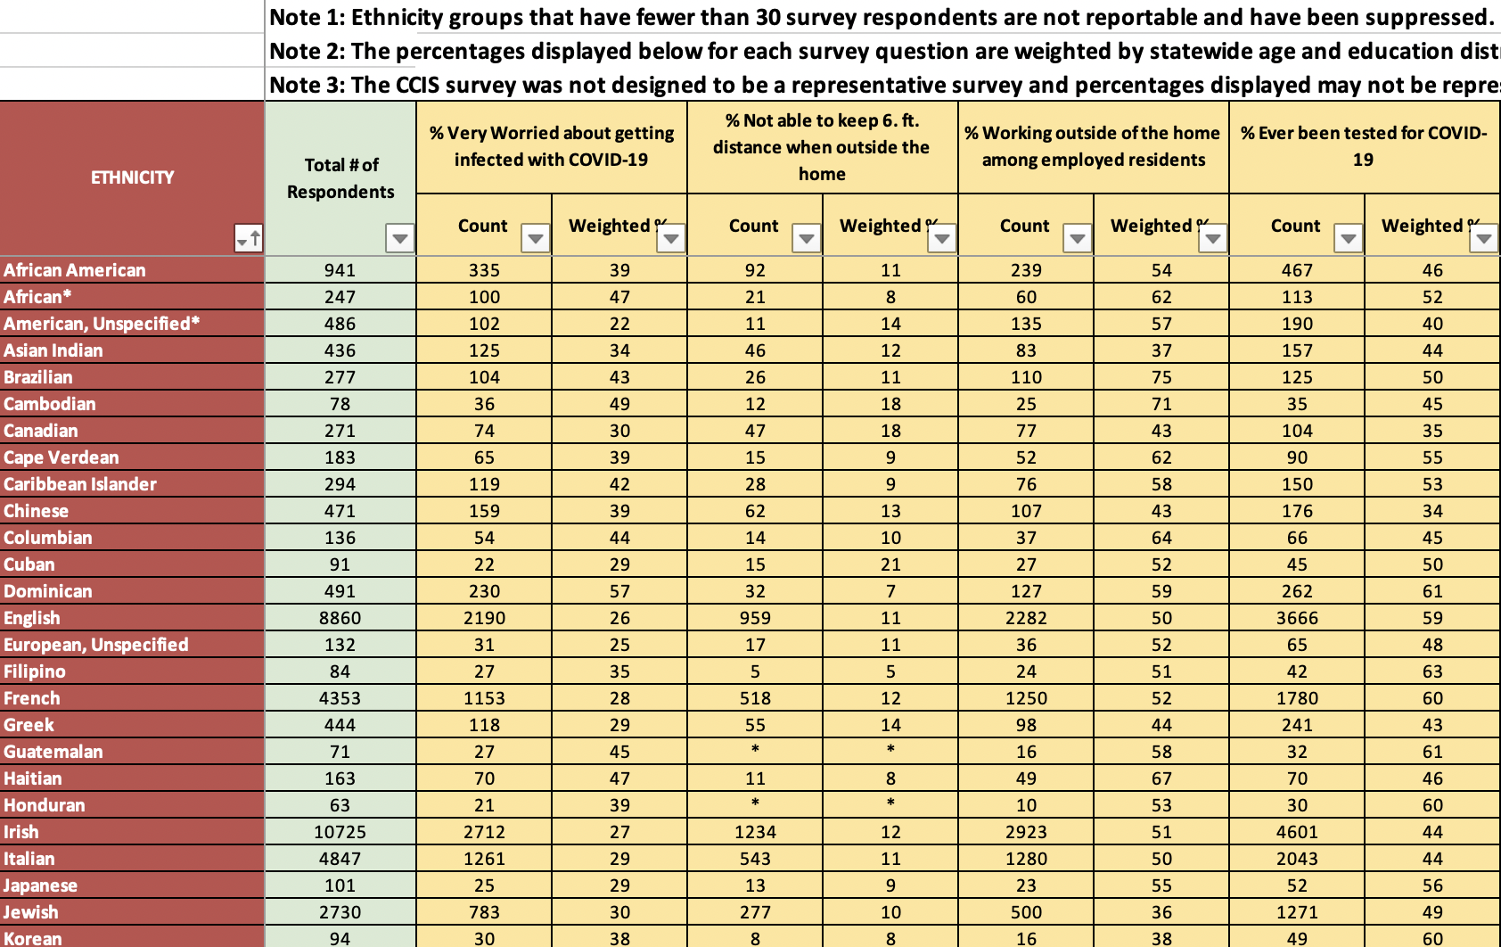
What is included in today’s presentation is a small preview of out findings. For a more detailed information, additional topics, and town/population specific data tables, please visit: https://www.mass.gov/covidsurvey

Slide 25
OVERVIEW
Leading with Race & Racism to Address Health Inequities
Discrimination & Population Spotlights
    Overall Discrimination
    Asian Residents
    Latinx Residents
    American Indian & Alaska Native Residents
    Black Residents
    Youth
Converting these Data to Action with our partners
Appendix
5.12.21 release

Slide 26
Racism is…
A system of advantage based on race.
-David Wellman, Portraits of White Racism

Slide 27
RACIAL JUSTICE
Racial Justice ≠ Diversity
(Diversity = Variety)
Racial Justice ≠ Equality
(Equality = Sameness)
Racial Justice = Equity
(Equity = Fairness, Justice)

Slide 28

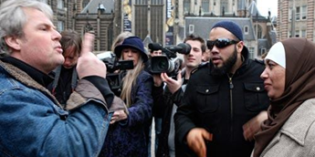


LEVELS OF RACISM
INTERNALIZED
INTERPERSONAL
MICRO-LEVEL
INSTITUTIONAL
STRUCTURAL
MACRO-LEVEL

Slide 29
KEY TAKEAWAYS
Lead with race and racism explicitly, but not exclusively.
Keep your analysis structural.
Don’t personalize critiques of systems.
The analysis is the tool.
Racial justice work is not work done FOR people of color.
Systems that are failing communities of color, are actually failing all of us.

Slide 30



Period | Years (% of History) | Characteristics | Health Systems | Example
Chattel Slavery | 1619 - 1865 (62%) | Abolition of Atlantic Slave Trade (1808) – Black influx stopped; Black immigration since: scant | Disparate/inequitable treatment; poor health status and outcomes; “Slave health deficit” and “Slave health subsystem” in effect | 1721 Cotton Mather and Zabdiel Boylston conduct first large-scale smallpox inoculation in the English-speaking world – inspired by enslaved African man, Onesimus
Jim Crow Segregation | 1865 – 1965 (25%) | 13th, 14th, and 15th Amendments virtually nullified; legal segregation implemented in 1896 | Absent or inferior treatment and facilities; de jure segregation / discrimination in South, de facto throughout most of the health system; health system recreates racial ideology | 1875 and 1915 Johnson and Graves on negro health are example of how health professions are place where racial ideology is created
Structural Racism | 1965 – Today (13%) | School desegregation (1954), Civil Rights Act (1964), Voting Rights Act | Southern medical school desegregation (1948), hospital desegregation in federal courts (1964), disparate health status, outcome, services, discrimination in effect | 1999 NEJM study is example of clear physician bias present across health systems

Slide 31
Racial inequity persists in every system across the country without exception.
System | Term | Definition
Child welfare | Disproportionality | Refers to the proportion of ethnic or racial groups of children in child welfare compared to those groups in the general population.¹
Health | Health disparity | Healthcare disparities refer to differences in access to or availability of facilities and services. Health status disparities refer to the variation in rates of disease occurrence and disabilities between socioeconomic and/or geographically defined population groups.²
Juvenile justice | Disproportionate minority contact (“DMC”) | Refers to the disproportionate number of minority youth who come into contact with the juvenile justice system ³
Education | Achievement gap | When one group of students (such as, students grouped by race/ethnicity, gender) outperforms another group and the difference in average scores for the two groups is statistically significant.⁴
Housing | Housing discrimination | Housing discrimination is discrimination in which an individual or family is treated unequally when trying to buy, rent, lease, sell or finance a home based on certain characteristics, such as race, class, sex, religion, national origin, and familial status.⁵
Economic Development | Historically underutilized businesses | Businesses that are disadvantaged and are deemed in need of assistance to compete successfully in the marketplace.⁶

Slide 32
SOCIAL DETERMINANTS OF HEALTH INEQUITIES
Education
Job Opportunity
Socioeconomic Status
Racism
Environmental Exposure
Health
Outcomes
Health Behaviors
Access to Health Services
Classism, Sexism, Heterosexism, etc.
Safe & Affordable Housing
Reducing Violence

Slide 33

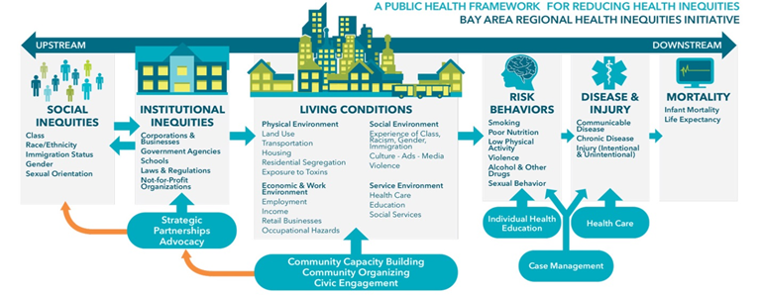

Addressing the Health Inequity Pathway: Groundwater, Upstream, Midstream, and Downstream
Interconnected Systems
Policies & Environment
Increased Risk
Health-Related Social Needs
Address policies and interconnected systems to change unjust systems at the macro level and include global forces and governmental policies.
Address policies and environments to change these unjust systems ex: housing policies, land trusts, etc.
Mitigate the impact of the increased risk caused by these unjust systems ex: supportive housing, new development, stabilization initiatives
Address the immediate health related social needs caused by these unjust systems ex: air conditioner vouchers
[Emerging Public Health Practice]
[Current Public Health Practice]
GROUNDWATER
UPSTREAM
MIDSTREAM
DOWNSTREAM

Slide 34
UNDERSTANDING FRAMES

Slide 35
WHAT ARE FRAMES?
“Frames are mental structures that shape the way we see the world. As a result, they shape the goals we seek, the plans we make, the way we act, and what counts as a good or bad outcome of our actions…frames shape our social policies and the institutions we form to carry out policies.” George Lakoff

Slide 36
DOMINANT FRAMES
Dominant frames are ideas, attitudes and beliefs that are shared collectively
They evoke certain standards, values and morals that are reinforced and continued throughout society and across time

Slide 37
How should we interpret these findings?
Framing Element | Traditional Approach | Racial Justice Approach
1. What’s the Problem?
2. What’s the Cause? What/Who’s Responsible?
3. What’s the Solution?
4. What Action is Needed?
5. What Values are highlighted?

Slide 38

DISCRIMINATION
5.12.21 release

Slide 39
FRAMING MATTERS
Being discriminated against is not just a feeling. Discrimination, especially within the context of structural racism, impacts mental and physical health by increasing allostatic load - wear and tear on the body, due to the cumulative burden of repeated chronic stress.
Compared to Whites, other race/ethnicity groups experienced discrimination at much higher levels during the pandemic.
5.12.21 release

Slide 40
DISCRIMINATION DEMOGRAPHICS
MA Subpopulations Reporting Experiences of Discrimination based on Race/Ethnicity During COVID-19 Pandemic
Compared to Whites, persons of color experienced discrimination at much higher levels during the pandemic.
Black, Asian, and Multiracial groups experienced more discrimination than other subpopulations.
Other subpopulations experiencing greater discrimination include Questioning/Not Sure gender identity, Speaks language other than English, Less than high school education, and those with disabilities
5.12.21 release

Slide 41
UNDERSTANDING THE CONTEXT OF DISCRIMINATION
6.5x
11.5x
11.5x
12x
5.12.21 release

Slide 42





UNDERSTANDING THE CONTEXT OF DISCRIMINATION
Within the context of structural racism, discrimination is pervasive in institutions, organizations, businesses, in public interpersonal encounters, and in systems like policing and security. Understanding this widespread manifestation is crucial to preventing it.
Among those who reported experiencing discrimination during the pandemic:
DISCRIMINATION WHILE WORKING
Was highest among indigenous(21%) and Black, nH/nL (16%) respondents
POOR SERVICE OR REFUSAL OF SERVICE
6.1% of Black, nH/nL and 5.8% of Multiracial, nH/nL reported poor service or refusal of service.
ACCUSATIONS: CARRYING COVID-19
23% of Asian, nH/nL reported being accused of carrying the virus or blamed for the pandemic.
BY POLICE/SECURITY GUARDS
Compared to all other race/ethnicity groups, some groups were more likely to report being discriminated against by police or security guards:
17X for Black, nH/nL
15X for Multiracial, nH/nL
8X for AI/AN
6X for Hispanic/Latinx
STORES, RESTAURANTS, ETC
discrimination while in stores, restaurants, or other face-to-face environments was higher in all race groups compared to whites:
6X for Black, nH/nL
5X for Multiracial nH/nL
3X for Asian, nH/nL
3X for Indigenous
2X for Hispanic/Latinx
5.12.21 release

Slide 43
DISCRIMINATION, HEALTH & COVID-19
Those who experienced discrimination also faced barriers to health and basic needs. These residents were:
  More likely to have co-morbidities that put them at higher risk for COVID-19 complications
  75% less likely to have access to healthcare
  More worried about meeting basic needs
Those who experienced discrimination were more likely to be worried about paying for or accessing:
Cleaning products
Face masks
Medications
Medical care
Food and groceries
Mental or emotional support
Internet access
Computers, cell phones, tablets
Childcare
Formula/baby food
5.12.21 release

Slide 44
KEY TAKEAWAYS: DISCRIMINATION
There is a relationship between discrimination and health.
Residents experiencing discrimination are also facing crucial barriers to accessing healthcare and basic needs.
Groups who are already suffering health consequences of structural racism, such as Black, Latinx, Asian and AI/AN are facing discrimination more than Whites.
5.12.21 release

Slide 45

POPULATION SPOTLIGHT:
ASIAN RESIDENTS

Slide 46
FRAMING MATTERS
Despite the common belief that the Asian community is a monolith, the data shows us that the stories, struggles, and experiences of these individuals vary greatly, especially during the pandemic.
5.12.21 release

Slide 47
REACHING THE AAPI COMMUNITIES ON CCIS
CCIS intentionally worked to reach diverse AAPI subgroups through survey translation (Chinese, Vietnamese, Khmer) and partnership with AAPI community partners.
Over 1,100 residents representing over 10 AAPI ethnicities residing across 134 communities were captured in the survey.
While we were not able to reach all AAPI ethnic groups equally, these extensive outreach efforts still allowed us to capture and report on the experiences for many ethnic groups, like the Cambodian community, that have historically been “invisible” due to small sample sizes.
What we found was that the pandemic has disproportionately impacted many of these AAPI communities in significant and uniquely different ways.
CCIS AAPI PROFILE
(N = 1,183)
5.12.21 release

Slide 48
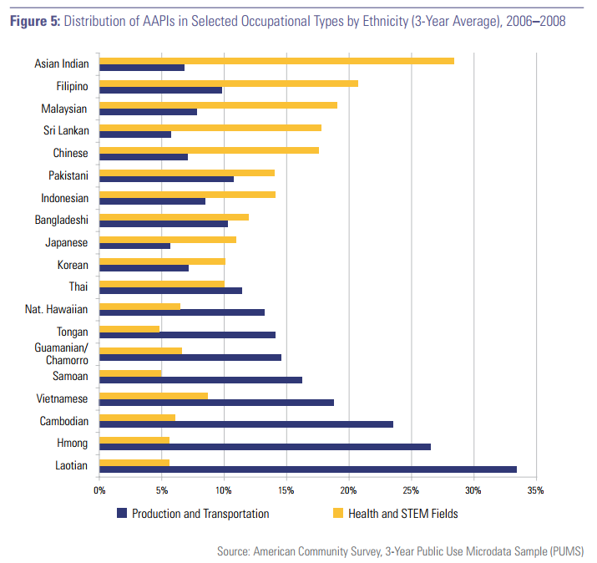
SOME HISTORY ON AAPI IMMIGRATION
Nationally, immigrants accounted for 81% of the growth in the Asian adult population from 1970 to 2016.⁴
This surge followed the Immigration and Nationality Act in 1965, drawing migrants from many countries for family reunification or as refugees, and later through skill-based programs such as the H-1B visa program.⁴
The result is a wide variation in education levels and incomes among Asians in the U.S.⁴
  In 2015, the share with at least a bachelor’s degree among adults ages 25 and older ranged from 9% among Bhutanese to 72% among Indians
  median household income varied from $36,000 among Burmese to $100,000 among Indians,
  poverty rates were as high as 35% among Burmese and 33% among Bhutanese (incomes not adjusted for household size).
5.12.21 release

Slide 49
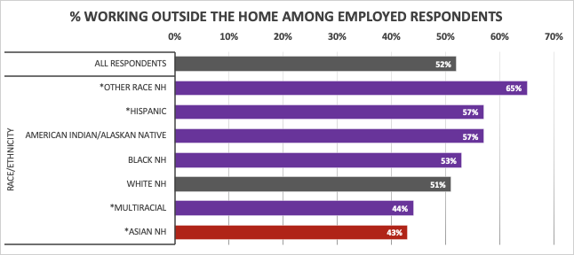
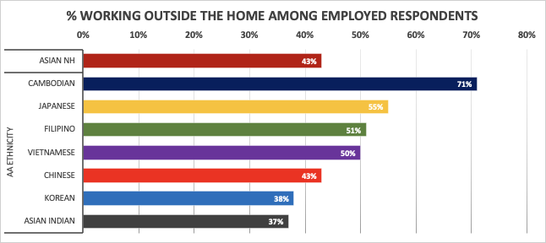
DATA DISAGGREGATION MATTERS
Asians as a single group appear to do as well as White respondents. However, CCIS highlighted the wide socio-economic inequities among AAPI ethnicities, evidence that the AAPI population in Massachusetts is far from the “model monolith” it is commonly perceived to be.
Overall, 43% of employed Asian respondents reported to be working outside of the home, significantly lower than White, NH.
However, further disaggregation revealed that over 70% of Cambodians were working outside of the home, in stark contrast with just 37% of Asian Indians.
5.12.21 release

Slide 50




ZOOMING IN: CAMBODIANS
Context
Massachusetts has the second largest Cambodian American population in the US, after California. Many Cambodians in Massachusetts live in Lowell and Lynn.⁵
Origin Story
Since 1975, Lowell has served as a central migration hub for many Cambodian refugees, fleeing the Khmer Rouge regime.⁶
Outcome
Many Cambodian Americans in Massachusetts continue to face significant economic and employment hardships that have left them extremely vulnerable to the multi-faceted impact of the pandemic.
Impact of COVID-19 on Cambodian Americans
71% of Cambodians work outside the home, the 2nd highest among all CCIS ethnic groups
Half (49%) of all Cambodians were “very worried” about getting infected with COVID-19, the 3rd highest among all CCIS ethnic groups
1 in 5 (19%) employed Cambodians experienced a recent job loss in the past year, the 2nd highest among all CCIS ethnic groups
Nearly half (48%) worried about getting food or groceries in the coming few weeks, nearly 2X as high compared to all CCIS respondents.
5.12.21 release

Slide 51
INEQUITIES WITHIN THE AAPI “MONOLITH”
The AAPI population in Massachusetts is far from the “monolith” it is commonly perceived to be:
Nationally, immigrants accounted for 81% of the growth in the Asian adult population since 1970.⁴
This followed two major policy enactments 1) the 1965 Immigration and Nationality Act, drawing migrants from many countries for family reunification or as refugees, and 2) through skill-based programs such as the H-1B visa program.⁴
The result is a widest variation in education levels and incomes within any race group.⁴
However, this does NOT mean that the AAPI ethnicities with higher socio-economic status were not impacted by the pandemic.
Each AAPI ethnic group faced its own set of unique but significant challenges during the pandemic.
5.12.21 release

Slide 52


ZOOMING IN: VIETNAMESE
Impact of COVID-19 on Vietnamese Americans
Context
Massachusetts is home to over 53,000 Vietnamese Americans, who live primarily in Boston (Field’s Corner in Dorchester), Quincy, Randolph, Lowell, and Worcester.⁷
Origin Story
Since 1975, when the US military left Vietnam, many Vietnamese arrived in Massachusetts as refugees. The majority were non-English speaking with less formal education.⁸
Outcome
Like Cambodian Americans, Vietnamese Americans continue to face significant economic and social hardships, including high unemployment rates, housing instability, and family separation.
Half of Vietnamese work outside of the home, leaving them more likely to be exposed to COVID-19.
1 in 10 (11%) of employed Vietnamese experienced a recent job loss & 14% had reduced work hours.
2 out of 3 (62%) worried about paying for 1 or more types of expenses or bills in the coming few weeks, the 2nd highest among all AAPI ethnic groups.
Nearly half (48%) worried about getting food or groceries in the coming few weeks, nearly 2X as high compared to all CCIS respondents.
More than 1 in 4 (27%) worried about getting medication in the coming few weeks, 2X as high compared to all CCIS respondents.
5.12.21 release

Slide 53
INEQUITIES WITHIN THE AAPI “MONOLITH”
Nationally, immigrants accounted for 81% of the growth in the Asian adult population since 1970.⁴
This followed two major policy enactments 1) the 1965 Immigration and Nationality Act, drawing migrants from many countries for family reunification or as refugees, and 2) through skill-based programs such as the H-1B visa program.⁴
The result is a widest variation in education levels and incomes within any race group.⁴
However, this does NOT mean that the AAPI ethnicities with higher socio-economic status were not impacted by the pandemic.
5.12.21 release

Slide 54


ZOOMING IN: EAST ASIANS
Context
East Asians in Massachusetts come from China, Japan, South Korea, Mongolia, and Taiwan.
Origin Story
There is much diversity even among this group, ranging from the first wave of working-class immigrants that took up jobs in restaurants and other service industries, to later waves of scholars and professionals now working in predominantly academic and STEM fields.⁹
Outcome
Though socioeconomically-driven health inequities are not immediately apparent from the data, East Asians still faced a unique set of significant challenges during the pandemic. Heightened concerns about COVID-19 related discrimination, as well as financial concerns and job loss may explain, in part, the extremely high rates of delayed medical care among these communities.
Impact of COVID-19 on East Asians
Japanese and Koreans experienced some of the highest rates of job loss and reduced work hours among all CCIS ethnic groups.
Chinese, Korean, and Japanese residents
reported some of the highest rates of discrimination among all CCIS ethnic groups.
Over 2 in 5 (41%) Koreans have not gotten the medical care that they needed. This is the highest reported rate among all CCIS ethnic groups.
Over 1 in 3 (34%) Japanese have also not gotten the medical care that they needed. This is the 4th highest reported rate among all CCIS ethnic groups.
5.12.21 release

Slide 55
ANTI-ASIAN SENTIMENTS
As we have seen on the news countless times over the last year, Asian Americans have increasingly become victims of Anti-Asian violence. Though this violence is not new, it has been exacerbated since the beginning of the pandemic with a spike in racism and xenophobia linked to pandemic-related rhetoric.
AAPI communities in Massachusetts were among those most severely impacted by experiences of discrimination during the pandemic:
5.12.21 release

Slide 56
ANTI-ASIAN SENTIMENTS
“My 12 year old child is Asian and was called derogatory names, including 'coronavirus' while out publicly in a store back in March. This experience has made a lasting impression and was emotionally harmful.”
“…people curse me during pandemic, ‘your Chinese people brought the virus to USA. You should go back to China.’ As a matter of fact, I have been living in the United States for over 7 years and never been out of the states or visited China.”
- Chinese respondent
“1 person looked at me and screamed 'Corona' and ran out of public restroom while we at the sink washing our hands. There were only two of us in the bathroom. People have looked at me and immediately crossed the street in order to avoid me.”
- Japanese respondent
5.12.21 release

Slide 57
More Data on Cambodian, Vietnamese, East Asian, Indian respondents, and more are available at mass.gov/covidsurvey

Slide 58
KEY TAKEAWAYS: AAPI RESIDENTS
While the common umbrella of "AAPI" unites this community, we must be nuanced when addressing the experiences and needs of Asian Americans/Pacific Islanders during the pandemic.
Data Disaggregation matters.
Each ethnicity is being impacted by the pandemic differently. We must understand their stories in order to understand their experiences.
AAPI communities in Massachusetts were among those most severely impacted by experiences of discrimination during the pandemic.
5.12.21 release

Slide 59
POPULATION SPOTLIGHT:
HISPANIC/LATINX RESIDENTS

Slide 60
FRAMING MATTERS
While much emphasis is placed on the personal responsibility of masking and social distancing, and the increased morbidity and mortality of COVID-19 experienced by Hispanic/Latinx groups, less emphasis is placed on the structural drivers of these, including lack of workplace protections against COVID-19, and the importance of work in order to meet expenses for basic needs.
In addition to being disproportionally impacted by COVID cases and deaths, Latinx respondents facing significant employment/work related stressors while also struggling to meet basic needs.
The above stressors influence their health in many ways including mental health impacts
5.12.21 release

Slide 61




FOR HISPANIC/LATINX RESIDENTS, WORK INCREASED RISK OF COVID-19
+
+
+
WORK OUTSIDE THE HOME
57% of Hispanic/Latinx workers worked outside the home,
65% received PPE from their employer
37% received additional health and safety training
60% were able to social distance while at work
65% had paid sick leave
HIGH-RISK INDUSTRIES
Hispanic/Latinxs worked in a number of industries that puts them at increased risk of COVID-19 infection:
26% worked in healthcare
17% worked in social assistance
12% worked in education
10% worked in other services (not public administration)
HIGHER RATES OF INFECTION + HOSPITALIZATION
Hispanics were 3.2X as likely to get infected w/COVID compared to White nH/nL*,
and were 1.7X as likely to be hospitalized for COVID compared to White nH/nL*
LOW VACCINE RATES
Vaccine access remains a major issue
Hispanics make up 28% of COVID cases but just 7% of vaccinations in MA*
5.12.21 release
*as of 4/29/21 dashboard

Slide 62
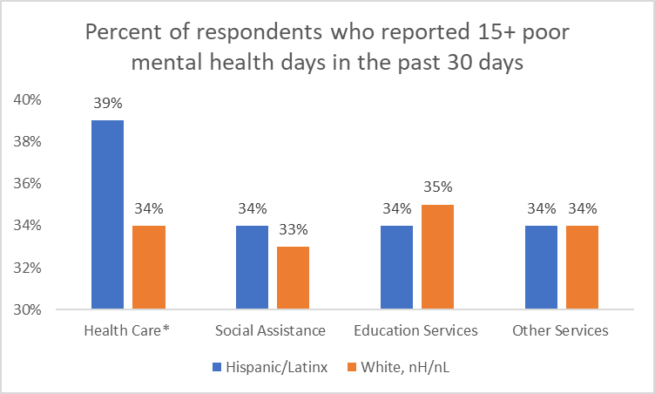
WHERE YOU WORK IMPACTS YOUR MENTAL HEALTH
Health Care
26% of Hispanic/Latinx worked in Health Care
39% reported 15+ poor mental health days last month
Social Assistance
17% of Hispanic/Latinx worked in Social Assistance
34% reported 15+ poor mental health days last month
Education Services
12% of Hispanic/Latinx worked in Education
34% reported 15+ poor mental health days last month
Other Services (not Public Administration)
10% of Hispanic/Latinx worked in Other Services
34% reported 15+ poor mental health days last month
5.12.21 release
* denotes statistically significant findings

Slide 63
WHERE YOU WORK IMPACTS YOUR MENTAL HEALTH
Top 5 Occupations in the Health Care Industry among Hispanic/Latinx workers:
Health Care
26% of Hispanic/Latinx worked in Health Care
39% reported 15+ poor mental health days last month
Social Assistance
17% of Hispanic/Latinx worked in Social Assistance
34% reported 15+ poor mental health days last month
Education Services
12% of Hispanic/Latinx worked in Education
34% reported 15+ poor mental health days last month
Other Services (not Public Administration)
10% of Hispanic/Latinx worked in Other Services
34% reported 15+ poor mental health days last month
Community and Social Services (19%)
Healthcare Support (17%)
Office and Administrative Support (16%)
Management (14%)
Healthcare Practitioners and Technical (13%)
* denotes statistically significant findings
5.12.21 release

Slide 64



HISPANIC/LATINX PARENTS WERE PARTICULARLY IMPACTED BY STRESS
80% of younger Hispanic/Latinx parents (age 25-34) reported poor mental health days
The rate of Hispanic/Latinx respondents requesting suicide prevention and crisis management services was 4x higher than their white counterparts
28% of Hispanic/Latinx parents reported one or more PTSD reactions during COVID-19
5.12.21 release

Slide 65




HISPANIC/LATINX WERE WORRIED ABOUT MEETING THEIR BASIC NEEDS
Though working increased risk of contracting COVID-19, job loss and reduced work hours created barriers to affording expenses for basic needs like food, bills, internet. This was associated with poor mental health.
JOB LOSS: 11% of employed Hispanic/Latinxs experienced a recent job loss in the past year
REDUCED WORK: Another 17% experienced reduced work hours or had to take leave
FOOD INSECURITY
Nearly half (49%)
worried about getting food or groceries in the coming few weeks.
PAYING BILLS
70% worried about paying for 1 or more types of expenses or bills in the coming few weeks.
INTERNET FOR SCHOOL/WORK
24% worried about getting internet in the coming few weeks.
MENTAL HEALTH
1 in 3 reported having 15 or more poor mental health days in the past month.
5.12.21 release

Slide 66
KEY TAKEAWAYS: HISPANIC/LATINX RESIDENTS
Hispanic/Latinx groups face barriers to affording basic needs, which makes work even more crucial. Unfortunately, work is also increasing this group's risks to COVID-19, by requiring them to work outside the home, offering few opportunities for social distancing, and providing inconsistent access to PPE.
5.12.21 release

Slide 67
POPULATION SPOTLIGHT: INDIGENOUS RESIDENTS

Slide 68
FRAMING MATTERS
  Despite high rates of need, AI/AN residents and their data are often ”invisible” - many report their AI/AN identity in combination with other race categories and get categorized into other groups. This yields very low aggregate numbers, which makes understanding and quantifying their needs difficult.
5.12.21 release

Slide 69




INVISIBLE NEED
Although we often do not hear AI/AN stories through data, AI/AN residents have significant needs and face challenges in many areas, including employment, economics, and healthcare access.
AI/AN residents were hardest hit by employment-related changes among all race groups.
1.6x as likely to experience recent job loss 1.4x as likely to experience reduced work hours or took leave
AI/AN residents had some of the highest rates of need for many essential items.
1.6x as likely to report concern for paying 1 or more bills
1.9x as likely to be worried about getting food or groceries
2x as likely to be worried about getting face masks
2.1x as likely to be worried about getting medication
2.3x as likely to be worried about having access to broadband
AI/AN residents were the most likely to experience delays in routine medical and mental health care among all race groups
1.5x as likely to experience delays in routine mental
health care
1.9x as likely to experience delays in any type of
medical care
AI/AN residents already faced mental health and substance use challenges prior to the pandemic.
These were only exacerbated.
1.2x as likely to report poor 15+ days of poor mental
health – 43% of AI/AN residents with poor mental health reported delaying mental healthcare.
1.2x as likely report increased substance use since
prior to the pandemic
5.12.21 release

Slide 70
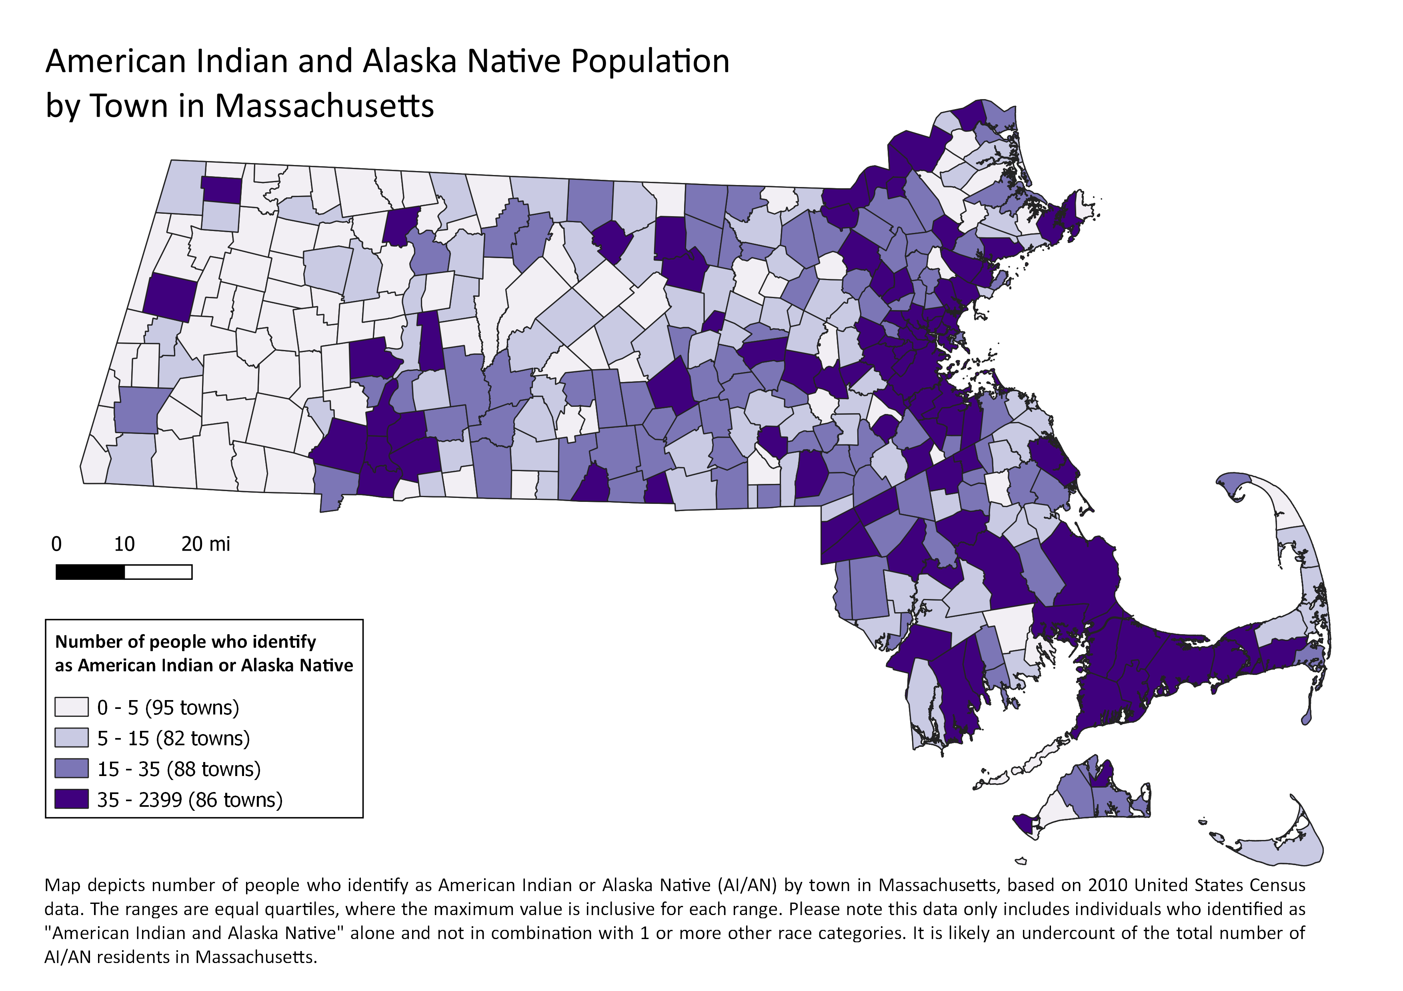
WE NEED TO FIND THEM TO SUPPORT THEM
AI/AN residents reside in nearly every city or town in Massachusetts- not just a handful of communities.
Yet with the exception of Mashpee where AI/AN population make up 3-5% of the overall population, in almost all other communities, they make up less than a fraction of a percent of the population overall.
Statewide, regional, and municipal public health efforts should prioritize the identification and reach of AI/AN residents, many of whom may identify as AI/AN in combination with other races.
5.12.21 release

Slide 71
KEY TAKEAWAYS: AI/AN RESIDENTS
Although AI/AN residents are often 'invisible' in the data, they are facing unique struggles and challenges during the pandemic.
AI/AN residents were hardest hit by employment-related changes among all race groups.
AI/AN residents were the most likely to experience delays in routine medical and mental health care among all race groups.
AI/AN residents are spread widely across the Commonwealth, where they typically make up less than a fraction of a percent of the population overall, making it challenging to identify and reach them.
5.12.21 release

Slide 72
POPULATION SPOTLIGHT:
BLACK RESIDENTS

Slide 73
FRAMING MATTERS
Despite the common belief that inequities are caused by people's culture and/or behavior, the data shows us:
  Differences in socioeconomic status (education and income) do not explain inequities alone
  Differences in where people live do not explain inequities alone
  Inequities are caused by systems and are cumulative and compounding
5.12.21 release

Slide 74
There are significant inequities in SDoH between Black and White respondents.
31% difference between White and Black
5.12.21 release

Slide 75
Differences in education and income do not explain these inequities.
5.12.21 release

Slide 76
Spotlight on the 20 Vaccine Equity Initiative Communities
20 communities that were particularly hard hit by COVID-19 were identified as Vaccine Equity Initiative Communities. Compared to the other 331 municipalities, respondents from these communities were:
  45% more likely to report being worried about paying any type of expense in the next few weeks
50% more likely to report being worried about getting food or groceries in the next few weeks
5.12.21 release

Slide 77
Inequities are cumulative.
Populations who experience inequities who are also Black experience even greater inequities.
44% of all respondents were worried about expenses.
50% of all respondents who are parents were worried about expenses.
69% of all respondents who are Black were worried about expenses.
74% of all respondents who are parents & are Black were worried about expenses.
+
=
5.12.21 release

Slide 78
KEY TAKEAWAYS: BLACK RESIDENTS
To truly understand how Black populations have been impacted by the pandemic, we must consider the multiple identities people hold and the systems and structures they interact with. Intersectionality matters.
5.12.21 release

Slide 79

YOUTH SURVEY
5.12.21 release

Slide 80
FRAMING MATTERS
Despite the common belief that youth are not impacted or worried about COVID-19, the data shows us that youth are deeply concerned and have been significantly impacted by the pandemic, especially youth of color, LGBQA youth, youth with disabilities, and young parents.
5.12.21 release

Slide 81



YOUTH EXPERIENCE WITH COVID-19
72% of Massachusetts youth reported being "somewhat" or "very" worried about getting infected with COVID-19
Certain groups of youth were more likely to report testing positive for, being exposed to, or losing someone due to COVID-19.
Compared to all youth respondents:
Young parents and Black nH/nL youth were 2x as likely to report testing positive for COVID-19.
Young parents and Hispanic/Latinx youth were more than 2X as likely to report having a household member who tested positive for COVID-19.
Young parents, American Indian/Alaska Native youth, and Black nH/nL youth were 2x as likely to report losing someone close to them due to COVID-19.
5.12.21 release

Slide 82




YOUTH CONCERNS ABOUT BASIC NEEDS
Certain groups of youth are much more likely to be worried.
1 in 4 Hispanic/Latinx youth, Black nH/nL youth, youth with disabilities, non-binary youth, and queer youth are worried about getting enough food.
Youth with disabilities are 3 times as likely to be worried about having a place to live compared to youth without disabilities. Hispanic/Latinx and American Indian/Alaska Native youth are 3 times as likely and Black nH/nL youth are 2 times as likely to be worried about having a place to live compared to White nH/nL youth.
Youth with disabilities, Hispanic/Latinx youth, and Black nH/nL youth are more than 2 times as likely to be worried about paying for a cell phone compared to all youth.
Nearly half of young parents are worried about housing expenses.
5.12.21 release

Slide 83
CHANGES IN YOUTH RESPONSIBILITIES
Youth have been asked to take on more adult responsibilities to meet family needs.
CHILDCARE SUPPORT
More than 1 in 5 (21%) Hispanic/Latinx youth report having to babysit or watch their siblings more
Youth with cognitive disabilities (16%) are more likely than youth without cognitive disabilities (11%) to have to babysit their siblings more often
Youth who speak a language other than English (18%) are more likely to have to watch their siblings, compared to youth who only speak English (11%)
FINANCIAL SUPPORT
Youth of Color (22% of Hispanic/Latinx youth, 20% of Asian nH/nL youth, 20% of American Indian/Alaska Native youth)
Youth with disabilities (28% of youth with a mobility disability and 23% of youth with a cognitive disability)
Youth who speak a language other than English (20%)
5.12.21 release

Slide 84



IMPACT ON YOUTH MENTAL HEALTH
Almost half of all youth in MA (48%) report feeling sad or hopeless almost every day for 2 weeks or more in a row that they stopped doing some usual activities.
This is 21% percent higher than the Youth Risk Behavior Survey (MA YRBS: 27% in 2017)
78% of youth of transgender experience report feeling sad or hopeless every day for 2+ weeks, as well 83% of Non-binary youth and 84% of queer youth
75% of youth with any disability report feeling sad or hopeless every day for 2+ weeks
Over half (55%) of working youth report feeling sad or hopeless every day for 2+ weeks
10% of LGBQA and Youth of Transgender experience need access to suicide and crisis resources
5.12.21 release

Slide 85
KEY TAKEAWAYS: YOUTH
"Solutions" to the pandemic have not addressed the experiences and/or needs of youth. The consequences are felt acutely and in lasting ways:
Youth are deeply concerned and have been significantly impacted by the pandemic, especially youth of color, LGBQA youth, youth with disabilities, and young parents.
Many youth are facing early parentification and are concerned about providing the basic needs for their families.
The pandemic has had a significant impact on the mental health of youth.
5.12.21 release

Slide 86
DATA TO ACTION
5.12.21 release

Slide 87
RACIAL JUSTICE REFRAMING
AND A CALL TO ACTION

Slide 88
How should we interpret these findings?
Framing Element | Traditional Approach | Racial Justice Approach
1. What’s the Problem?
2. What’s the Cause? What/Who’s Responsible?
3. What’s the Solution?
4. What Action is Needed?
5. What Values are highlighted?

Slide 89
Framing Element | Traditional Approach | Racial Justice Approach
1. What’s the Problem? | High rates of Diabetes | Persistent racial inequities in diabetes rates
2. What’s the Cause? What/Who’s Responsible? | -Poor Nutrition -Lack of Exercise -Overweight/Obesity Individuals | -Food deserts, income inequity, racial redlining in transit and zoning for green space, etc., in communities of color -Disinvestment in communities of color -Residential segregation Businesses; policy makers
3. What’s the Solution? | -Improve nutrition -Increase physical activity | -Food security in all communities -Economic investment in low-income communities/communities of color -Accessible and affordable healthy foods in all communities, particularly communities of color
4. What Action is Needed? | -Nutrition education classes -Exercise classes | -Food access policies that target roots of inequities -Economic policies that invest in communities of color -Partnerships across sectors and with community residents
5. What Values are highlighted? | Individualism; Personal Responsibility; Choice; Individual Freedom | Equity; Justice; Fairness; Shared Responsibility

Slide 90
Framing Element | Traditional Approach | Racial Justice Approach
1. What’s the Problem? | High rates of COVID infection among Latinx populations | Persistent racial inequities in COVID-19 infection rates, with Latinx populations 3.2x more likely to be infected
2. What’s the Cause? What/Who’s Responsible? | -Failure to wear a mask appropriately -Failure to socially distance -Underlying conditions Individuals | -Income inequity -Occupational segregation -Pipelines into low wage jobs -Racial redlining in transit, zoning, etc. -Disinvestment in communities of color -Residential segregation -Businesses; policy makers
3. What’s the Solution? | -Improved masking practices -Improved physical distancing -Improved adherence to medical advice | -Economic mobility in all communities -Economic investment in low-income communities/communities of color -Effective and enforced workplace safety practices -Accessible jobs paying a living wage in all communities, particularly communities of color
4. What Action is Needed? | -Prevention campaigns -Enforcement practices -Medical advice fact sheets -Readyfill of rx medication | -Pay equity; living wage measures -Economic policies that invest in communities of color -Partnerships across employment sectors and with community residents
5. What Values are highlighted? | Individualism; Personal Responsibility; Choice; Individual Freedom | Equity; Justice; Fairness; Shared Responsibility

Slide 91
GROUNDWATER MATRIX TOOL: what solutions should we propose?
Upstream
SNAP benefits for healthy food
Mass in Motion
Fish
Groundwater
Technical Assistance to grocery stores in low-income communities
Healthy Food Cooking Classes
Downstream
5.12.21 release

Slide 92
FINAL TAKEAWAYS
Socio-economic differences do not explain racial inequities.
Racial inequities look the same across systems.
Inequities are caused by systems, regardless of people’s culture or behavior.
Reliance on dominant framing prevents us from seeing real problems and developing real solutions.
5.12.21 release

Slide 93
THANK YOU!
For more details including geographic and population specific data, please visit https://www.mass.gov/covidsurvey
5.12.21 release

Slide 94
DATA TO ACTION
We are getting input from both internal and external stakeholders
in order to convert these data to action.
INTERNAL GROUPS
Established a Data to Action (DTA) Workgroup to convene Bureaus, Offices, work groups etc. in integrating findings into DPH actions.
Eg. integrate population specific lessons learned into the launch of the Vaccine Equity Initiative among the top 20 impacted towns/cities
COLLABORATORS
We are eliciting input from our advisory groups (eg. HEAG, Tribal Partners) to help us interpret and identify possible actions resulting from the data.
Eg. improve accessible options on the vaccine website after hearing from external partners that existing measures still posed accessibility barriers
LOCAL PARTNERS
We are also providing the data presented here by granular geographies, and populations. to equip our local partners in tailoring their own pandemic response.
Eg. Providing data by race, ethnicity groups, sexual orientation, gender identity, transgender status, types of disability, income, education, language spoken, geography, rural cluster, age, etc.
5.12.21 release

Slide 95






RESOURCE INFORMATION
How can we help people access needed supports, services, and resources?
COMMUNICATION / PSAs
How can we utilize alternative channels to reach key populations (not currently being reach)? What modes to use?
HEALTH LITERACY & TRUST
How can we craft understandable messaging that also addresses concerns and fears not just recommended actions?
Key Themes of Actions Emerging from Findings
SDOH OVERLAP
How do we address the multiple layers of barriers and burden?
HEALTHCARE CAPACITY
How can we increase appointments, telehealth infrastructure, culturally competent providers, CHWs?
EMPLOYMENT
How can we promote more equitable worker protections (physical conditions, testing, and benefits/leave)?
ACCESSIBILITY
How can we improve accessibility of information and services (e.g., language, technology, cultural competence of providers)?
TELEHEALTH & TECHNOLOGY
How can we reduce technology-related barriers to accessing services?
5.12.21 release

Slide 96
ENGAGEMENT– EXAMPLE
Key Finding: Certain groups of youth were more likely to report testing positive for, being exposed to, or losing someone due to COVID-19: American Indian/Alaska Native, Black non-Hispanic, Latinx, young parents, speak a language other than English
Heard: Youth are getting conflicting messaging about re-opening without having access to a vaccine for those <16; impacts of the pandemic are going to be long lasting
Actions Taken:
Presented findings, gathered feedback, and facilitated data to action conversations to the DPH Youth Vaccine Workgroup, the Positive Youth Development Roundtable, and the Division of Child/Adolescent Health and Reproductive Health
Will be presenting findings to the Young Parent Statewide Convening in May
5.12.21 release

Slide 97
DATA TO ACTION – EXAMPLE
Key Finding: Substance Use – Respondents are burdened with a range of social determinant related needs, and are more likely to delay care
Heard: Need to increase integration of mental health and substance use disorder services, address recent changes in substances used, and provide for basic needs and wrap-around support
Action Taken: BSAS’ comprehensive portfolio of programs/initiatives, including:
Funding triage-urgent care centers to address co-occurring MH/SUD, allowing for immediate access at the initial point of care
Reinforcing the use of Screening, Brief Intervention and Referral to Treatment (SBIRT) to address increased alcohol consumption during COVID
Addressing stimulant use by allowing admissions into MAT Enhanced settings
Leverage use of telehealth for induction/intake for Medications for Opioid Use Disorder (MOUD), including telehealth induction on buprenorphine and naltrexone and promoting the use of telehealth by reimbursing providers for patient cell phones/data plans
Providing recovery-based/culturally-responsive services for Black and Latino men at risk of fatal overdoses following release from incarceration
Increasing investments in new and existing housing-related initiatives, including expanding low threshold/housing first and recovery housing programs
5.12.21 release

Slide 98
DATA TO ACTION – EXAMPLE
Key Finding: Parents and Families – Parents and guardians have additional stressors during the pandemic, including balancing childcare and making ends meet. Parents worried about paying for expenses were 88% more likely to report poor mental health.
Heard: Parents, particularly younger parents and parents of children with special healthcare needs, need flexible services to meet their needs
Actions Taken:
Expanded the Massachusetts Pregnant and Parenting Teens Initiative (MPPTI) in collaboration with DTA
Collaborate with Young Parent Statewide Convening to share results, gather feedback, and discuss implications
Shared with programs aimed at providing flexible, multigenerational support to families, including Project LAUNCH and the Division of Children and Youth with Special Healthcare Needs
5.12.21 release

Slide 99
DATA TO ACTION – EXAMPLE
Key Finding: The effect of COVID-19 on workers in Massachusetts has been severe, and has disproportionately impacted specific groups of workers
Heard: As we move continue to make efforts to increase vaccination efforts state-wide, as well as ensure that other COVID-19 prevention strategies are in place, we need to recognize that work is an important contributor to COVID-19 risk.
Action Taken:
Community Liaisons to the 20 VEI communities are being briefed on the CCIS employment findings. We are also adding contextual information about the employment make-up of the 20 communities prioritized in the Vaccine Equity Initiative to help increase vaccinations of high-risk worker populations in those communities.
Advocating for employee centric considerations in vaccination uptake efforts such as appointments available outside of regular working hours, increased mobile units, educating employers about tax credits, etc.
We have met with the HEAG as well as our OHSP Advisory Board to strategize about ways to engage with workers and employers and are working to implement these ideas.
5.12.21 release

Slide 100
DATA TO ACTION – EXAMPLE
Key Finding: Mental Health - Requests for suicide prevention and crisis management resources were as high as 11% among certain subpopulations and was the highest among Transgender respondents, non-binary respondents, and respondents questioning their gender identity.
Heard: Need to expand and adapt services
Action Taken: DPH's Suicide Prevention Program with intra- & inter-agency partners:
Supporting expanded/adapted services including offering virtual support groups, new in-language groups, tele-check calls, peer programs (for youth and attempt survivors)
Increased support to crisis centers who provide emotional support for those experiencing suicidal crisis or emotional pain, contracted with Riverside Trauma Center to provide services to schools/communities after the death of a youth by suicide
New/modified online training modules on Behavioral Health among Older Adults, providing suicide prevention training to MA Corrections, first offering for state employees, Zero Suicide monthly learning series provided to health care, behavioral health care and community organizations in southeast MA, trainings for the public, Annual Suicide Prevention Conference to be held virtually 5/19 & 5/20
5.12.21 release

Slide 101
Next Meeting:
June 9, 2021

