Slide 1
Public health council
November 18, 2020
Today’s presentations are available on the mass.gov/dph website under “Upcoming Events” by clicking on the November 18 Public Health Council listing

Slide 2
Preliminary data show 1,517 confirmed and estimated opioid-related overdose deaths in the first nine months of 2020, an estimated 2% increase compared with the same period in 2019.
Estimated 1,485 deaths
Estimated 1,517 deaths

Slide 3
The rate of opioid-related overdose deaths has stabilized in 2019 compared with 2018 and is approximately 5% lower than in 2016.

Slide 4
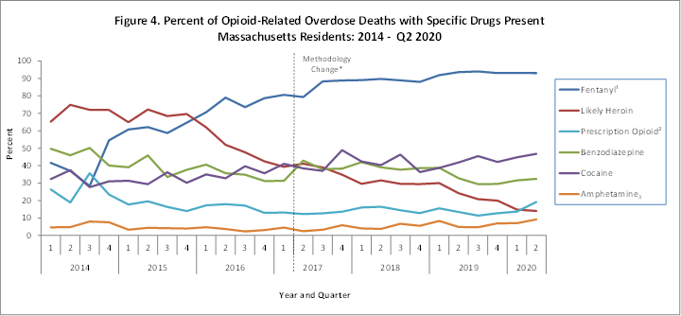
Fentanyl remains a key factor in opioid-related overdose deaths (93% present in toxicology screen in first six months of 2020).

Slide 5
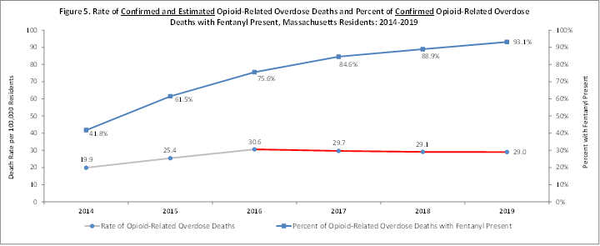
Although the presence of fentanyl in opioid-related overdose deaths continues to rise, the opioid-related overdose death rate has remained relatively stable since 2016.

Slide 6
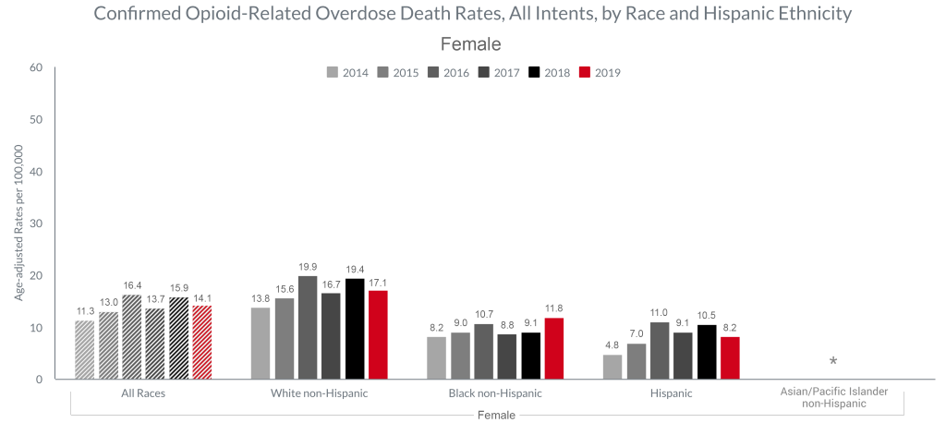
The confirmed opioid-related overdose death rate for females decreased in 2019 compared with 2018. Death rate for Black non-Hispanic females increased, while the death rates for White non-Hispanic and Hispanic women decreased.

Slide 7
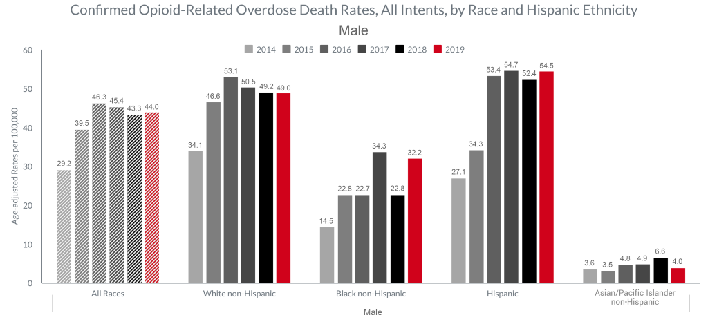
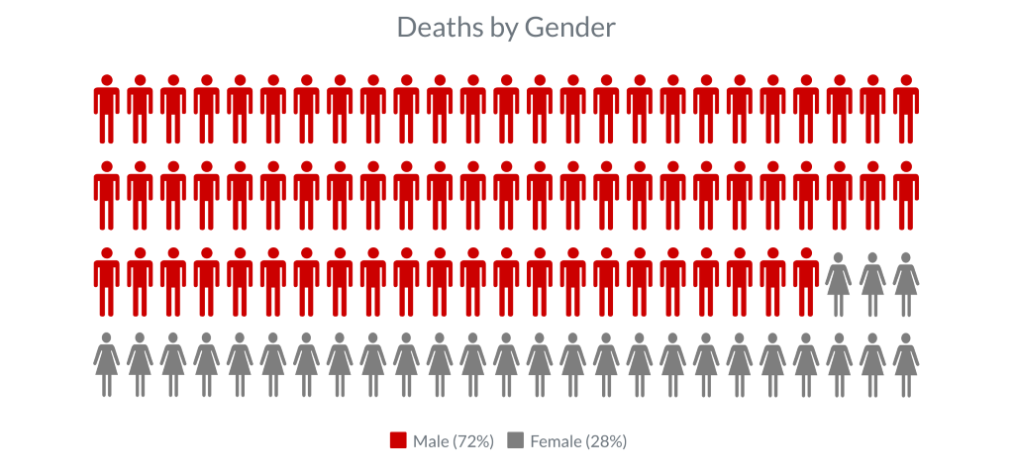
Between 2018 & 2019, the confirmed opioid-related overdose death rates for Black non-Hispanic and Hispanic men increased, while death rates for White non-Hispanic and Asian/PI non-Hispanic men decreased

Slide 8
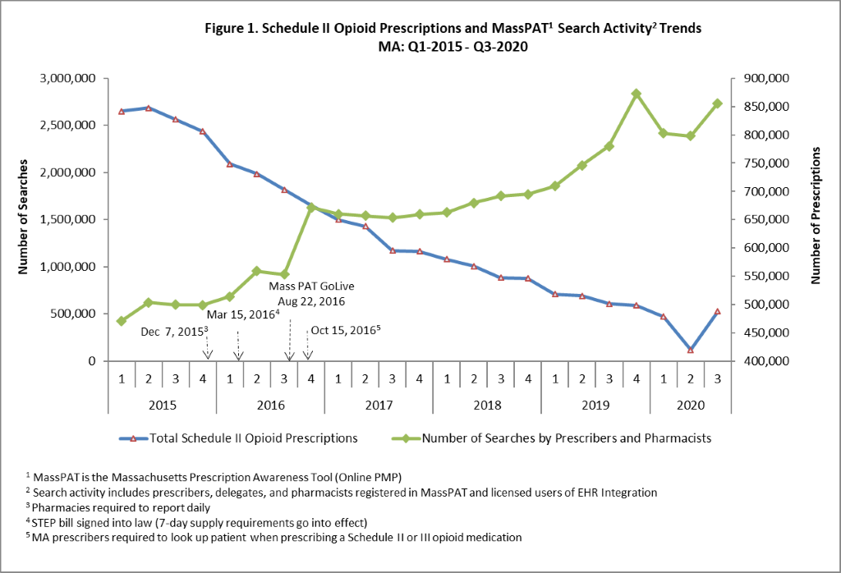
Prescription Monitoring Program – Data Trends
Registered MassPAT providers conducted over 2.7 million searches in the 3rd quarter of 2020; there was an increase of approximately 344,000 searches from the previous quarter (the quarter most impacted by COVID closings), and approximately 100,000 fewer searches than Q4 2019 (pre-COVID).
In the 3rd quarter of 2020 there were approximately 488,000 Schedule II opioid prescriptions reported to the MA PMP; this is a notable increase from the previous quarter and just over a 42% decrease from the 1st quarter of 2015 (n = 841,990 Schedule II opioid prescriptions).
NOTE: Both opioid prescribing and search activity in quarter 2, and to a lesser extent in quarter 1, were likely reduced due to COVID-19 as restrictions of elective procedures and routine office visits were in effect.

Slide 9
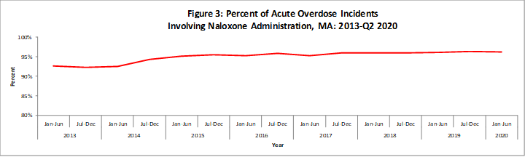
57% of all opioid-related EMS incidents were
Acute Opioid Overdoses
Naloxone was administered in 96% of these incidents

Slide 10
Proposed Emergency Amendments to 105 CMR 700.000
Implementation of M.G.L. c. 94C
Public Health Council
November 18, 2020
Lauren B. Nelson, Esq.
Director of Policy and Regulatory Affairs
Bureau of Health Professions Licensure

Slide 11
Summary of Regulation
105 CMR 700.000, Implementation of M.G.L. c. 94C:
Sets forth consistent standards for the safety, security and storage of controlled substances;
Outlines Drug Control Program (DCP) requirements for practitioners and facilities to receive a Massachusetts Controlled Substances Registration (MCSR); and
Manages oversight of the Massachusetts Prescription Awareness Tool (MassPAT) through the Prescription Monitoring Program (PMP).

Slide 12
Summary of Amendments
The proposed emergency amendment to this regulation was drafted to provide greater access to designated vaccines for the prevention of a pandemic, novel or other vaccine-preventable disease by authorizing their possession and administration by DPH licensed or certified health care professionals or qualified medical or nursing students.

Slide 13
Current Regulation: Influenza Vaccine
105 CMR 700.003 (H) allows the Commissioner to expand flu vaccine administration:
by authorizing DPH licensed or certified health care professionals; or
medical or nursing students;
  duly enrolled in an approved or accredited program for licensure and acting in accordance with the policies of that program;
to possess and administer vaccine;
for the prevention of a pandemic, novel, or seasonal influenza virus;
provided the Commissioner determines that there are or will be insufficient health care professionals available for timely vaccine administration and issues an order authorizing such administration.

Slide 14
Current Regulatory Action: Influenza
On November 2, 2020, the Commissioner issued the necessary order, based on a determination that the authorization is presently appropriate and necessary, for paramedics, medical students and nursing students to administer influenza vaccine.
These additional individuals were utilized for influenza vaccination during the H1N1 pandemic.
Link to Order and Guidance:
https://www.mass.gov/news/order-of-the-commissioner-of-public-health-allowing-certain-individuals-to-administer

Slide 15
Regulation Changes: Vaccine-Preventable
Proposed changes:
The proposed emergency amendment to this regulation would expand the types of vaccine eligible for health care professional and medical or nursing student possession and administration to:
any vaccine designated by the Commissioner
for the prevention of a pandemic, novel, or other vaccine-preventable disease
Rather than only for the prevention of a pandemic, novel or seasonal influenza virus
This change will allow the commissioner to expand access to designated vaccines for the prevention of any vaccine-preventable disease.
For more information, please see the CDC’s list of 17 vaccine-preventable diseases and their vaccines: https://www.cdc.gov/vaccines/vpd/vaccines-diseases.html

Slide 16
Next Steps
It is respectfully requested that the Public Health Council vote to approve the proposed regulation, 105 CMR 700.000, on an emergency basis.
This will allow the regulation to take effect upon filing with the Secretary of State’s office while the Department conducts a public comment period.
Final approval of the proposed amendments, along with a review of public comments, will be requested at a subsequent meeting of the Public Health Council.

Slide 17
Thank you for the opportunity to present this information today.
For more information regarding Drug Control, including the Prescription Monitoring Program, please find the relevant statutory language and the full current regulation here:
https://www.mass.gov/doc/105-cmr-700-implementation-of-mgl-c94c/download
Please direct any questions to:
David E. Johnson, Director
Drug Control Program
Bureau of Health Professions Licensure
dcp.dph@mass.gov
617-983-6700

Slide 18
BUREAU OF SUBSTANCE ADDICTION SERVICES
COVID-19 RESPONSE
November 18, 2020
Deirdre C. Calvert, MSW, LICSW
Director, BSAS

Slide 19
DPH/BSAS is aggressively maximizing access to SUD treatment during the COVID-19 pandemic and continuing the fight against the opiate crisis
Increasing access to naloxone – from March to September over 75 thousand naloxone kits have been distributed to Opioid Treatment Providers (OTP), Syringe Service Programs, community health centers, hospital emergency departments, and county Houses of Correction.
Obtaining a blanket exception from SAMHSA on behalf of Massachusetts Opioid Treatment Programs (OTP) for take home doses of MOUD. As of June 2020, 52% of OTP patients are receiving take home doses, compared to the pre-COVID average of 15.6% in December 2019.
Implementing the broad adoption of a DEA waiver allowing prescriptions for buprenorphine and naltrexone to patients for whom providers have conducted telehealth sessions, as well as induct patients on buprenorphine and naltrexone.
Piloting reimbursement to contracted Office Based Opioid Treatment (OBOT) providers for cell phones and data plans to maintain patients’ ability to keep in contact for telehealth, and exploring implementation of similar reimbursement frameworks for other types of SUD treatment providers.
Working with programs to prevent and mitigate the spread of COVID-19, including distributing guidance on surveillance testing, screening and isolation of patients/staff, and increased flexibility in bed allocation between different service settings to accommodate changing patient needs at individual programs.

Slide 20
DPH/BSAS is working diligently with providers and Communities of Color to address their COVID-19 and equity-related concerns
Providing extensive messaging and support to providers on the implementation of telehealth in licensed/contracted facilities, including recurring calls between BSAS and congregate care bedded programs, OTPs, and infant/child serving programs to hear and address their concerns through technical assistance and recommended best practices for use of telehealth.
Leveraging the second round of State Opioid Response (SOR) funding from SAMHSA to increase access in Massachusetts to all FDA-approved forms of MOUD, reduce unmet treatment needs, and reduce opioid/stimulant misuse and overdose.
Expanding the Black Addiction Counselor Education (BACE) and Latinx Addiction Counselor Education (LACE) programs, which support highly affordable and flexible programming by providing 300 education hours and practicum required for licensure for individuals who identify as Black and Latinx.
Initiating the Recovery-Based Re-Entry Services for Black and Latino Men Pilot, which will provide enhanced support to Black and Latino men at risk of fatal overdose following release from incarceration, including culturally-responsive, wrap-around, re-entry services both pre- and post-release.

Slide 21
DPH/BSAS is developing and implementing a flexible action guide to continue to sustain equitable access to lifesaving care in the continuing response to the COVID-19 pandemic
During the past several months, the COVID Response Team has engaged in a structured planning process to analyze and respond to key challenges and risks, including:
  The increased risk of overdose due to social isolation, changes to the drug supply, underutilization of treatment for fear of infection, and the economic and mental health toll of the pandemic;
  The risk of program closures and/or reduced bed capacity in SUD treatment programs, due to financial strain from low bed utilization and increased costs of operation, COVID outbreaks among patients and staff, and staffing shortages; and
  Potential barriers to access to treatment—and inequities in access—due to program closures and/or reduced bed capacity, lack of care capacity for COVID+ individuals, and lack of access to the technology required to engage in telehealth.

Slide 22
The BSAS COVID Response Action Plan builds on prior and ongoing initiatives to address these risks and challenges
Highlights of the Action Plan include:
1. COVID Technical Assistance to Individual Programs
  Strengthen internal systems and medical capacity to provide direct technical assistance to providers to implement infection control guidance and respond to outbreaks without closing
2. COVID+ Care Capacity & Access to Care
  Work with providers proactively to make a plan to address/prevent issues across the system, within each region, e.g., training and technical assistance on COOP (Continuity of Operations Plans), including addressing staffing shortages; and planning for flexible COVID+ care capacity across service settings (levels of care)
3. Special Funding
  Fund specific initiatives, e.g., supplemental payments for COVID+ units; distributing additional naloxone across settings, cell phones (with data) and other telehealth equipment, and lockboxes for take-home methadone doses
4. Collaboration, Coordination & Communication Among Stakeholders
  Streamline & standardize systems to collaborate and communicate important info with providers; and expand communication platforms with provider groups to solicit feedback and input on guidance development and COVID support

Slide 23
Serious Reportable Events
Calendar Year 2019
November 18, 2020
Public Health Council
Katherine T. Fillo, Ph.D., MPH, RN-BC Katherine Saunders, MS
Bureau of Health Care Safety and Quality Bureau of Health Care Safety and Quality

Slide 24
Overview
Purpose
Background
Serious Reportable Event Category Definitions
Outcomes
Quality Improvement Activities

Slide 25
Purpose
This presentation is given for the following purposes:
To provide an update of the Serious Reportable Event program and related quality improvement activities at the Bureau of Health Care Safety and Quality; and
To share the trends in the types and volume of Serious Reportable Events reported in 2019 and previous years.

Slide 26
Background
Adverse events that occur in the health care setting are a patient safety concern and public health issue.
  The Office of the Inspector General found that adverse events occur in 13.5% of hospital admissions of Medicare beneficiaries (2010).
  It is also projected that 10% of Medicare patients nationally experience an adverse event during a rehabilitation hospital stay (OIG, 2016).
Section 51H of chapter 111 of the Massachusetts General Laws authorizes the Department to collect adverse medical event data and disseminate the information publicly to encourage quality improvement.

Slide 27
Background
The National Quality Forum (NQF) has operationalized a group of adverse events into measurable, evidence-based outcomes called Serious Reportable Events (SRE).
MA adopted SREs as its adverse event reporting framework in 2008.
There is no federal adverse event reporting system. Twenty-seven other states developed and implemented state-based adverse event reporting programs.
  Over half use the SRE framework including Connecticut, Minnesota and New Hampshire.

Slide 28
SREs Defined
Section 51H of Chapter 111 of the General Laws:
“Serious reportable event”, an event that results in a serious adverse patient outcome that is clearly identifiable and measurable, reasonably preventable, and that meets any other criteria established by the department in regulations.
105 CMR 130.332 and 105 CMR 140.308:
Serious Reportable Event (SRE) means an event that occurs on premises covered by a hospital's license that results in an adverse patient outcome, is clearly identifiable and measurable, has been identified to be in a class of events that are usually or reasonably preventable, and of a nature such that the risk of occurrence is significantly influenced by the policies and procedures of the hospital. The Department issued a list of SREs based on those events included on the NQF table of reportable events to which 105 CMR 130.332 and 105 CMR 140.308 apply in guidance.

Slide 29
Reporting Requirements
Hospitals and ambulatory surgical centers (ASCs) are required to report SREs to the patient/family and the Bureau of Health Care Safety and Quality (BHCSQ) within seven days of the incident.
An updated report to BHCSQ, the patient/family and the insurer is required within 30 days of the incident, including documentation of the root cause analysis findings and determination of preventability as required by 105 CMR 130.332(c) & 105 CMR 140.308(c).
In June 2009, the Department implemented regulations prohibiting health care facilities from charging for services provided as a result of preventable SREs.
Amendments adopted as part of the hospital regulatory review completed in 2017 streamlined the reporting process without removing transparency.

Slide 30
SRE Types
Surgical or Invasive Procedure Events
Wrong Site Surgery or Procedure
Surgery or Procedure on Wrong Patient
Wrong Surgery or Procedure
Unintended Retention of a Foreign Object
Intraoperative or Immediate Postoperative Death of an ASA Class 1 Patient
Product or Device Events
Death or Serious Injury Related to Contaminated Drugs, Biologics, or Devices
Death or Serious Injury Related to Device Misuse or Malfunction
Death or Serious Injury Due to Intravascular Air Embolism
Patient Protection Events
Discharge of a Patient/Resident of Any Age to Other Than Authorized Person
Death or Serious Injury Associated with Patient Elopement
Patient Suicide, Attempted Suicide, or Self-Harm That Results in Serious Injury

Slide 31
SRE Types
Death or Serious Injury Associated with a Medication Error
Death or Serious Injury Associated with Unsafe Blood Product Administration
Maternal Death or Serious Injury Associated with Low-Risk Pregnancy Labor or Delivery
Death or Serious Injury of a Neonate
Death or Serious Injury Associated with a Fall
Stage 3, Stage 4 or Unstageable Pressure Ulcer
Artificial Insemination With Wrong Donor Sperm or Egg
Death or Serious Injury from Irretrievable Loss of a Specimen
Death or Serious Injury from Failure to Follow Up on Test Result
Care Management Events

Slide 32
SRE Types
Environmental Events
Patient or Staff Death or Serious Injury Associated with an Electric Shock
Any Incident In Which No Gas, Wrong Gas or Contaminated Gas Delivered to Patient
Radiologic Events
Death or Serious Injury of Patient or Staff Associated with Introduction of a Metallic Object Into MRI Area
Patient or Staff Death or Serious Injury Associated with a Burn
Death or Serious Injury Associated with Restraints or Bedrails
  Any Instance of Care Provided by Someone Impersonating a Health Care Provider
  Resident/Patient Abduction
  Sexual Abuse/Assault on a Patient or Staff Member
  Death or Serious Injury of Patient or Staff Member as a Result of Physical Assault
Potential Criminal Events

Slide 33
Acute Care Hospital Data
Total Number of SREs in Acute Care Hospitals by Year
**
** Two events in 2015 and 2016 affected a large number of patients and is reflected in the increase in SREs reported.
Data abstracted on October 27, 2020 from the Health Care Facility Reporting System

Slide 34
Acute Care Hospital Surgical Data
Key Findings
Increasingly SREs occur outside of the operating room in radiology, intensive care, and outpatient procedure units.
The most frequently reported outcome is that patients require an additional surgery or procedure to remove the foreign object that was unintentionally retained.
Data abstracted on October 27, 2020 from the Health Care Facility Reporting System

Slide 35
Acute Care Hospital: Product/Device Data
Key Findings
In the contaminated drugs, device or biologics event, one incident, that affected a significant number of patients in 2015, represents most of the category.
The hospital engaged in a robust corrective action plan to address the root causes of these incidents.
**
**
**Two events in 2015 and 2016 affected a large number of patients and is reflected in the increase in SREs reported.
Data abstracted on October 27, 2020 from the Health Care Facility Reporting System.

Slide 36
Acute Care Hospital: Environmental Data
Key Findings
Burn events represent second degree or more severe burns.
Burn events result from equipment including radiology machines and cautery devices, chemotherapy and hot beverage spills.
Data abstracted on October 27, 2020 from the Health Care Facility Reporting System.

Slide 37
Acute Care Hospital: Patient Protection Data
Key Findings
There were 3 completed suicide events and 35 self-harm or attempted suicide events in 2019.
Cutting and ingesting objects are the methods reported as having the highest incidence in the suicide and self-harm events.
Data abstracted on October 27, 2020 from the Health Care Facility Reporting System.

Slide 38
Acute Care Hospital: Potential Criminal Event Data
Key Findings
Over half of the physical assaults or abuse events that resulted in serious injury were patient on staff member encounters, often resulting in lost work days.
Emergency departments followed by inpatient psychiatric units are the most frequently reported location within the hospital for these events. This has changed from last year when inpatient psychiatric units were the most frequent location.
Data abstracted on October 27, 2020 from the Health Care Facility Reporting System.

Slide 39
Acute Care Hospital: Care Management Data
Key Findings
Falls that result in serious injury and pressure ulcers are the two most commonly reported events.
Pressure ulcers are the most common serious injury, about 64% of those reported occurred on the back, spine or buttocks and 40% occurred in patients under the age of 65 years.
Data abstracted on October 27, 2020 from the Health Care Facility Reporting System.

Slide 40
Non-Acute Care Hospital Data
Total Number of SREs in Non-Acute Care Hospitals by Year
Data abstracted on October 27, 2020 from the Health Care Facility Reporting System.

Slide 41
Non-Acute Care Hospital: Category Data
Reported SREs 2015-2019 (Non-acute care hospitals)
Key Findings
There are three types of hospitals: public health, rehabilitation or psychiatric.
Like acute care hospitals, falls and pressure ulcers continue to be the most common events.
Data abstracted on October 27, 2020 from the Health Care Facility Reporting System.

Slide 42
Ambulatory Surgical Centers Data
Key Findings
There are 54 ASCs in Massachusetts.
All SREs were related to cataract procedures.
DPH continues to outreach and provide education regarding reporting and trends in order to encourage submissions.
Data abstracted on October 27, 2020 from the Health Care Facility Reporting System.

Slide 43
SRE Types by Race
Key Findings
Although most SREs are reported in white patients (75%), a significant proportion of events are reported with unknown race (9%), other race (4%), or missing race (3%). Most events with unknown race, other race or missing race are from acute care hospitals.
Data abstracted on October 27, 2020 from the Health Care Facility Reporting System.

Slide 44
SRE Types by Ethnicity
Key Findings
Although most SREs are reported in Non-Hispanic patients (N=1104), about 7% (N=78) are reported for Hispanic patients, about 10% (N=121) are reported for patients with Unknown ethnicity and another 3% (N=36) are reported for patients with missing ethnicity.
Data abstracted on October 27, 2020 from the Health Care Facility Reporting System.

Slide 45
CY 2019 SREs by Type compared with Preliminary CY 2020 SREs
Key Findings
Although data are still incomplete, and preliminary, there does not appear to be a great difference in the frequency of events by type when comparing CY 2019 to CY 2020.
Data abstracted on October 27, 2020 from the Health Care Facility Reporting System.

Slide 46
SRE Types Among Veterans
Key Findings
Similar to the total population, the most common SRE reported for Veterans (N=49) across all reporting settings was pressure ulcers (N=26) and falls (N=16).
Data abstracted on October 27, 2020 from the Health Care Facility Reporting System.

Slide 47
Quality Improvement Activities
Working with individual facilities after a SRE occurs to develop corrective action plans and prevent an event of a similar type from happening in the future.
Continued collaboration with DPH’s Suicide Prevention Program to share event data and promote use of online curriculum detailing best practices for reducing suicide and self-harm in the facility setting.
Actively participating in MA Coalition for the Prevention of Medical Errors.
  Sharing electronic health system related events and opportunities to address causal factors.
Partnering with Betsy Lehman Center to address the following:
  Utilize their monthly newsletter to share patient safety trends; and
  Maintaining an Interagency Service Agreement to allow for more seamless data sharing, as intended by the 2012 cost containment act.
Utilizing DPH list servs for widespread education and to share appropriate guidance.

Slide 48
Contact Information
Thank you for the opportunity to present this information today.
Please direct any questions to:
Katherine T. Fillo Ph.D, MPH, RN-BC
Director, Clinical Quality Improvement
Bureau of Health Care Safety and Quality
katherine.fillo@state.ma.us

Slide 50
Next Meeting:
December 9, 2020

