Slide 1
Public health council
October 14, 2020
Today’s presentations are available on the mass.gov/dph website under “Upcoming Events” by clicking on the September 17 Public Health Council listing

Slide 2
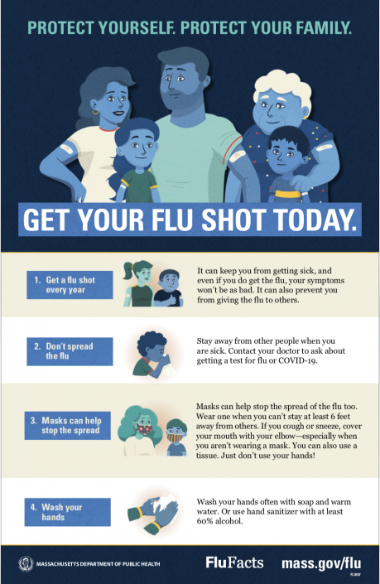

Slide 3
Draft Proposed Revisions to 105 CMR 150.000 Standards for Long-Term Care Facilities
Public Health Council Department of Public Health
October 14, 2020

Slide 4
Summary of Regulation
105 CMR 150.000, Standards for Long-Term Care Facilities:
Sets forth standards governing long-term care facilities, including nursing homes and rest homes, and
Provides a legal structure that promotes industry standardization, promotes higher quality of care, and stronger consumer protection for residents in long-term care facilities.

Slide 5
Nursing Facility Accountability and Supports Package 2.0
The Executive Office of Health and Human Services recently announced Nursing Facility Accountability and Supports Package 2.0, which holds facilities to higher standards of care and infection control, invests up to $140 million in new funding, and restructures Medicaid rates.
There are five key elements of the Nursing Facility Accountability and Supports Package 2.0:
Requirements to strengthen staffing and the direct care workforce, de-densify congregate rooms, and improve standards of care
Long term investment through MassHealth rate restructuring
Targeted COVID-19 funding to support COVID response actions
Sustained oversight and monitoring of facilities
Early identification of issues and rapid response teams

Slide 6
Overview of Proposed Revisions to Regulation
The proposed revisions to 105 CMR 150.000 are to align the regulation with the Executive Office of Health and Human Services’ implementation of the Nursing Facility Accountability and Supports Package 2.0 by:
Setting a minimum hours of care per resident per day (105 CMR 150.010, 150.007); and
Updating physical plant requirements for nursing homes (105 CMR 150.017, 150.320).

Slide 7
Regulation Changes: Hours of Resident Care Per Day
CURRENT REGULATION:
Requires nursing homes to have sufficient nursing personnel to meet resident nursing care needs, based on acuity, resident assessments, care plans, census and other relevant factors as determined by the facility.
SUMMARY OF PROPOSED REVISIONS
Sets minimum number of hours of care per resident per day using the minimum identified by CMS for 3-star rated nursing homes.
Requires nursing homes to provide a minimum number of 3.580 hours of care per resident per day, of which a subset of .508 hours must be care provided by a registered nurse.

Slide 8
Regulation Changes: Physical Plant Updates
CURRENT REGULATION:
Permits up to four beds per resident bedroom in nursing homes, unless there is new construction or reconstruction, in which case after construction DPH allows no more than two beds in the affected bedrooms.
Sets minimum square footage requirements for floor area per bed and spacing among beds.
SUMMARY OF PROPOSED REVISIONS:
Requires nursing homes to transition multiple occupancy resident bedrooms to single or double occupancy bedrooms by January 31, 2022; and
Updates spacing requirements for all bedrooms and overall square footage requirements in double occupancy bedrooms.

Slide 9
Next Steps
Following this presentation to the Public Health Council, staff will hold a public hearing and, as required, will provide a public comment period during which the public may provide written comments on the proposed revisions.
After the close of the public comment period, staff will review public comments, revise as necessary to reflect comments received, and then request approval of the final version of the revised regulation at a subsequent meeting of the Public Health Council.

Slide 10
Thank you for the opportunity to present this information today.
For more information regarding standards for long-term care facilities, please find the relevant statutory language and the full current regulation here:
https://malegislature.gov/Laws/GeneralLaws/PartI/TitleXVI/Chapter111
https://www.mass.gov/doc/105-cmr-150-standards-for-long-term-care-facilities/download

Slide 11
2019 Health Care Associated Infections: Acute Care Hospitals
Public Health Council
October 14, 2020
Christina Brandeburg, MPH, Epidemiologist
Katherine T. Fillo, Ph.D, MPH, RN-BC, Director of Clinical Quality Improvement
Eileen McHale, RN, BSN, Healthcare Associated Infection Coordinator

Slide 12
Introduction
Healthcare-associated infections (HAIs) are infections that patients acquire during the course of receiving treatment for other conditions within a healthcare setting.
HAIs are among the leading causes of preventable death in the United States, affecting 1 in 17 hospitalized patients, accounting for an estimated 1.7 million infections and an associated 98,000 deaths.*
The Massachusetts Department of Public Health (DPH) developed this data update as a component of the Statewide Infection Prevention and Control Program created pursuant to Chapter 58 of the Acts of 2006.
Massachusetts law provides DPH with the legal authority to conduct surveillance, and to investigate and control the spread of communicable and infectious diseases. (MGL c. 111,sections 6 & 7)
DPH implements this responsibility in hospitals through the hospital licensing regulation. (105 CMR 130.000)
Section 51H of chapter 111 of the Massachusetts General Laws authorizes the Department to collect HAI data and disseminate the information publicly to encourage quality improvement. (https://malegislature.gov/Laws/GeneralLaws/PartI/TitleXVI/Chapter111/Section51H)
*Haque M, Sartelli M, McKimm J, Abu Bakar M. Healthcare-associated Infections - an Overview. Infect Drug Resist. 2018;11:2321–2333.

Slide 13
Purpose
This HAI presentation is the 11th annual Public Health Council update:
It is an important component of larger efforts to reduce preventable infections in health care settings
It presents an analysis of progress on infection prevention within Massachusetts acute care hospitals
It is based upon work supported by state funds and the Centers for Disease Control and Prevention (CDC)
It provides an overview of antibiotic resistance and stewardship activities

Slide 14
Methods
This data summary includes the following statewide measures for the 2019 calendar year (January 1, 2019 – December 31, 2019) as reported to the CDC’s National Healthcare Safety Network (NHSN).
The DPH required measures are consistent with the Centers for Medicare and Medicaid Services (CMS) quality reporting measures.
Central line associated bloodstream infections (CLABSI) in intensive care units and wards (New this year)
Catheter associated urinary tract infections (CAUTI) in intensive care units and wards (New this year)
Specific surgical site infections (SSI)
Specific facility wide laboratory identified events (LabID)
* National baseline data for each measure are based on a statistical risk model derived from 2015 national data
^ All data were extracted from NHSN on September 21,2020

Slide 15
Measures
Standardized Infection Ratio (SIR)
Actual Number of Infections
Standardized Infection Ratio (SIR) =
Predicted Number of Infections
Standard Utilization Ratio (SUR)
Standard Utilization Ratio=
Number of Device Days
Predicted Number of Device Days
If the SIR/SUR > 1.0, then more infections/device days were reported than predicted
If the SIR/SUR = 1.0, then the number of infections/number of device days is equal to the predicted number
If the SIR/SUR < 1.0, then fewer infections/device days were reported than predicted
Notes:
15

Slide 16
How to Interpret SIRs and 95% Confidence Intervals (CIs)
Significantly higher than predicted
Not significantly different than predicted
SIR
Significantly lower than predicted
The green horizontal bar represents the SIR, and the blue vertical bar represents the 95% confidence interval (CI). The 95% CI measures the probability that the true SIR falls between the two parameters.
If the blue vertical bar crosses 1.0 (highlighted in orange), then the actual rate is not statistically significantly different from the predicted rate.
If the blue vertical bar is completely above or below 1.0, then the actual is statistically significantly different from the predicted rate.

Slide 17
Central Line-Associated Bloodstream Infections (CLABSI): Standard Infection Ratio in Adult and Pediatric ICUs and Wards
ICU
Ward
T= Major teaching hospital
NT=Not major teaching hospital
SIR Upper and Lower Limit
Key Findings
Four unit types experienced a significantly lower number of infections than predicted, based on 2015 national aggregate data.
*SIRs and CIs are currently not calculated when the number of predicted infections is less than 0.5.
Cardiothoracic ICU
Medical (T) Ward
Medical/Surgical (NT) Ward
Surgical Ward

Slide 18
Central Line-Associated Bloodstream Infections (CLABSI): Standard Utilization Ratio in Adult and Pediatric ICUs and Wards
ICU
Ward
T= Major teaching hospital
NT=Not major teaching hospital
SIR Upper and Lower Limit
Key Findings
Three unit types experienced a significantly higher number of device days than predicted, based on 2015 national aggregate data.
Cardiac ICU
Cardiothoracic ICU
Pediatric Ward

Slide 19
CLABSI Adult & Pediatric Pathogens for 2018 and 2019
ICU Pathogens
N=192
N=155
N=183
N=138
Ward Pathogens

Slide 20
Central Line-Associated Bloodstream Infections (CLABSI): Standard Infection Ratio in Neonatal ICUs
Key Findings
There were no birthweight categories experiencing a significantly higher or lower number of infections than predicted, based on 2015 national aggregate data.
There were 18 CLABSIs reported in Neonatal ICUs in 2019.
SIR Upper and Lower Limit
Notes:
≤ 750 grams
751-1,000 grams
1,001-1,500 grams
1,501-2,500 grams
> 2,500 grams

Slide 21
Central Line-Associated Bloodstream Infections (CLABSI): Standard Utilization Ratio in Neonatal ICUs
Key Findings
All five birthweight categories experienced a significantly lower number of device days than predicted, based on 2015 national aggregate data.
SIR Upper and Lower Limit
Notes:
≤ 750 grams
751-1,000 grams
1,001-1,500 grams
1,501-2,500 grams
> 2,500 grams

Slide 22
CLABSI NICU Pathogens for 2018 and 2019
Calendar Year 2018
January 1, 2018 – December 31, 2018
N=18
Calendar Year 2019
January 1, 2019 – December 31, 2019
N=18

Slide 23
State CLABSI SIR in ICU and Wards
Key Findings
In 2019, adult ICUs experienced a significantly lower number of infections than predicted, based on 2015 national aggregate data.
Between 2015-2019, adult Wards experienced a significantly lower number of infections than predicted, based on 2015 national aggregate data.
ICU
Ward
Notes:
Between 2016-2019, pediatric ICUs saw a decrease in the number of infections.

Slide 24
State CLABSI SUR in ICU and Wards
Key Findings
Between 2015-2019, neonatal ICUs and adult Wards experienced a significantly lower number of device days than predicted, based on 2015 national aggregate data.
Between 2015-2019, pediatric Wards experienced a significantly higher number of device days than predicted, based on 2015 national aggregate data
ICU
Ward
Notes:
Between 2017-2019, pediatric ICUs saw a decrease in the number of device days.

Slide 25
Catheter-Associated Urinary Tract Infections (CAUTI): Standard Infection Ratio in Adult and Pediatric ICUs and Wards
ICU
Ward
T= Major teaching hospitals
NT=Not major teaching hospitals
SIR Upper and Lower Limit
Key Findings
Three unit types experienced a significantly lower number of infections than predicted, based on 2015 national aggregate data.
Cardiothoracic ICU
Medical (T) ICU
Trauma ICU

Slide 26
Catheter-Associated Urinary Tract Infections (CAUTI): Standard Utilization Ratio in Adult and Pediatric ICUs and Wards
ICU
Ward
T= Major teaching hospital
NT=Not major teaching hospital
SIR Upper and Lower Limit
Key Findings
Five unit types experienced a significantly higher number of device days than predicted, based on 2015 national aggregate data.
Cardiac ICU
Cardiothoracic ICU
Pediatric ICU
Surgical ICU
Trauma ICU
Notes:
All other unit types experienced a significantly lower number of device days than predicted

Slide 27
CAUTI Adult & Pediatric Pathogens for 2018 and 2019
ICU Pathogens
N=292
N=223
N=242
N=205
Ward Pathogens

Slide 28
State CAUTI SIR in ICU and Wards
Key Findings
In 2019, adult ICUs experienced a significantly lower number of infections than predicted, based on 2015 national aggregate data.
Between 2017-2019, adult and pediatric Wards saw a decrease in the number of infections but in 2019 were no different than predicted, based on 2015 national aggregate data.
ICU
Ward
Notes:
Pediatric ICUs saw an increase in the number of infections between 2018 and 2019.

Slide 29
State CLABSI SUR in ICU and Wards
Key Findings
In 2019, adult ICUs experienced a significantly lower number of device days than predicted, based on 2015 national aggregate data.
For the past two years, adult and pediatric Wards experienced a significantly lower number of device days than predicted, based on 2015 national aggregate data.
ICU
Ward
Notes:
Over the past five years, pediatric ICUs saw a decrease in the number of device days.

Slide 30
Surgical Site Infections (SSI) Coronary Artery Bypass Graft (CABG) SIR and Colon Procedure (COLO) SIR
Key Findings
For the past five years, MA acute care hospitals performing coronary artery bypass graft procedures (CABG) and colon procedures (COLO) experienced the same number of infections as predicted, based on 2015 national aggregate data.
There were 31 CABG SSIs reported in 2019.
There were 182 COLO SSIs reported in 2019.
SIR Upper and Lower Limit

Slide 31
Surgical Site Infections (SSI) Knee Prosthesis (KPRO) SIR and Hip Prosthesis (HPRO) SIR
Key Findings
For the past two years, Massachusetts acute care hospitals performing knee prosthesis procedures (KPRO) experienced significantly higher number of infections than predicted, based on 2015 national aggregate data.
There were 83 KPRO SSIs reported in 2019.
There were 80 HPRO SSIs reported in 2019.
SIR Upper and Lower Limit

Slide 32
Surgical Site Infections (SSI) Abdominal Hysterectomy (HYST) SIR and Vaginal Hysterectomy (VHYS) SIR
Key Findings
In 2019, Massachusetts acute care hospitals performing vaginal hysterectomy (VHYS) procedures experienced significantly higher number of infections than predicted, based on 2015 national aggregate data.
There were 40 HYST SSIs reported in 2019.
There were 13 VHYS SSIs reported in 2019.
SIR Upper and Lower Limit
Notes:
VHYS procedures performed in 2019: 786

Slide 33
SSI Pathogens for 2018-2019 CABG, KPRO, HPRO, HYST, VHYS, COLO
Calendar Year 2018
January 1, 2018 – December 31, 2018
N=416
Calendar Year 2019
January 1, 2019 – December 31, 2019
N=429

Slide 34
Statewide SSI Trends by Year 2015-2019
Statistically Higher
than Predicted
Statistically
the Same
as Predicted
Statistically Lower
than Predicted
CABG
KPRO
HPRO
HYST
VHYS
COLO
Notes:
34

Slide 35
Laboratory Identified Events (LabID) Clostridioides difficile (CDI) SIR
Key Findings
For the past three years, Massachusetts hospitals reporting CDI events experienced significantly lower number of infections than predicted, based on 2015 national aggregate data.
There were 1,605 CDI events reported in 2019.
SIR Upper and Lower Limit

Slide 36
Laboratory Identified Events (LabID) Methicillin-resistant Staphylococcus aureus (MRSA) SIR
Key Findings
For the past five years, Massachusetts acute care hospitals reporting MRSA events experienced significantly lower number of infections than predicted, based on 2015 national aggregate data.
There were 181 MRSA events reported in 2019.
SIR Upper and Lower Limit

Slide 37
Statewide LabID Trends by Year 2015-2019
Statistically Higher
than Predicted
Statistically
the Same
as Predicted
Statistically Lower
than Predicted
CDI
MRSA
Notes:
37

Slide 38
DPH HAI Prevention Activities
Implemented new reporting requirements for CLABSI and CAUTI from non-acute care hospitals, public health hospitals, and out-of-hospital dialysis units.
Began external data validation of methicillin resistant Staphylococcus aureus and Clostridioides difficile infections, at 13 non-acute care hospitals, and dialysis event data, at 20 outpatient-dialysis facilities.
Three hemodialysis infection prevention simulation trainings were held for hemodialysis nurses and technicians.
On-site Infection Control Assessment and Response (ICAR) visits were conducted at nursing homes, long-term acute care facilities, and community health centers.
Ongoing data sharing with the Neonatal Quality Improvement Collaborative (NeoQIC) to address opportunities for improvement.
DPH continues to monitor progress by providing quarterly Data Cleaning Reports to all hospitals and select long-term care facilities, voluntarily reporting Clostridioides difficile in NHSN, to identify areas where focused infection prevention efforts are needed.
Continued outreach to hospitals with higher than expected SIRs to ensure the need for improvement.

Slide 39
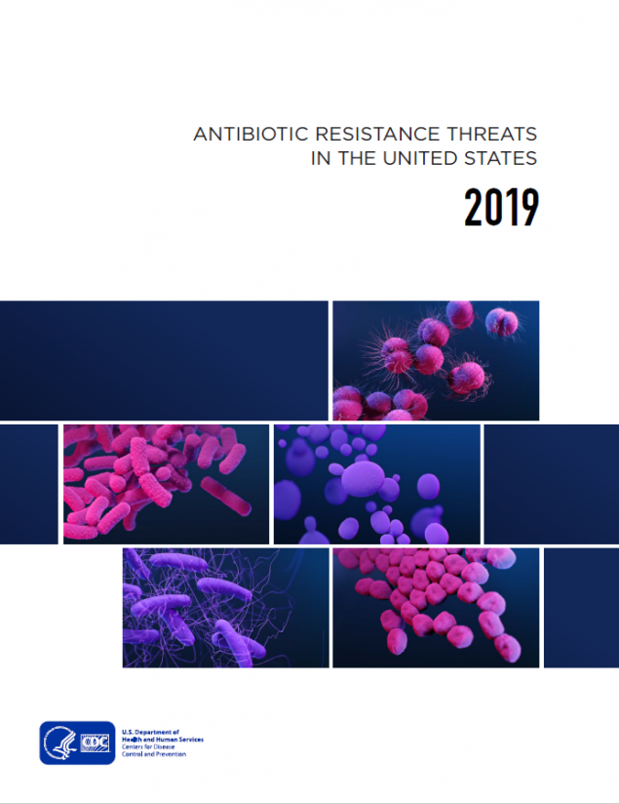
Antibiotic Resistance: Urgent Threats in MA
CDC 2019 AR Threats Report
More than 2.8 million antibiotic-resistant infections occur in the U.S. each year, and more than 35,000 people die as a result.
Dedicated prevention and infection control efforts are working to reduce the number of infections and deaths caused by antibiotic-resistant germs, but the number of people facing antibiotic resistance is still too high.
Urgent threats targeted in MA through surveillance, detection
and containment
Carbapenem-resistant Acinetobacter
Candida auris
Clostridioides difficile
Carbapenem-resistant Enterobacteriaceae

Slide 40
Antibiotic Resistance: Targeting Carbapenemase-producing Organisms (CPO) in MA
Carbapenems are a class of antibiotics often considered a “last resort” to treat infections caused by Enterobacteriaceae, Pseudomonas and Acinetobacter
One way these organisms are resistant to carbapenems is by producing carbapenemases
A carbapanemase is an enzyme that can break down (and thus resist) many classes of antibiotics, including carbapenems, making infections with these organisms harder to treat
Genes that program the organism to produce a carbapenemase can be shared between bacteria
Carbapenemase gene targets: KPC, NDM, VIM, OXA and IMP
KPC
NDM
VIM
OXA
IMP

Slide 41
Antibiotic Resistance Surveillance: Reporting
and Laboratory Testing
Electronic laboratory reporting (ELR) of mandatory MDROs of concern into the Massachusetts Virtual Epidemiologic Network (MAVEN)
Mandatory submission of selected MDRO isolates to the Massachusetts State Public Health Laboratory (MA SPHL) for advanced testing here and at our partner ARLN laboratory, The Wadsworth Center in New York:
Identify novel resistance mechanisms such as genes that code for carbapenemase production or colistin resistance
Identify Candida auris
Test swabs to identify colonization with target organisms to detect transmission within a healthcare facility
Conduct whole-genome sequencing to determine relatedness of organisms to identify transmission pathways within and across healthcare facilities
Notes:
Carbapenem-resistant Enterobacteriaceae (CRE), including carbapenemase-producing CRE
Candida auris
Organisms containing the mcr gene, conferring mobilized resistance to colistin, a last-resort antibiotic used for treating resistant infections
Isolates are sent to the regional Antibiotic Resistance Laboratory Network (ARLN) – NY Wadsworth Laboratory for testing

Slide 42
Antibiotic Resistance Surveillance: Carbapenemase-producing Organisms (CPOs) in MA

Slide 43
Antibiotic Stewardship
Studies indicate that between 30-50% of antibiotics prescribed in hospitals and between 40-75% of antibiotics prescribed in nursing homes are unnecessary*
Improved prescribing practices can help reduce rates of Clostridioides difficile and antibiotic resistance
Appropriate antibiotic prescribing can improve patient outcomes and reduce healthcare costs
*https://www.cdc.gov/antibiotic-use/healthcare/
https://www.cdc.gov/longtermcare/prevention/antibiotic-stewardship.html

Slide 44
Antibiotic Stewardship: Prevention and Educational Activities
NEW: 18 new acute care hospitals participating in NHSN antibiotic use (AU) module to better understand trends in antibiotic use and to monitor stewardship activities- will soon have access to antibiotic prescribing data for nearly 50% of all acute-care facilities in MA
2019 Component of Advanced Educational Series entitled “Navigating Infection Control and Antibiotic Stewardship in Long-Term Care” with three “ask the experts” calls
Collection, monitoring and benchmarking of facility-level antibiotic use data in long-term care facilities (n=70 participating facilities)
Held a statewide webinar for long-term care facilities on MDROs and Infection Control (n=150 participants) in February, 2020
NEW: Publication of 10-year trends in MA Hospital Antibiograms : https://doi.org/10.1017/ice.2020.395
Engagement with subject matter experts and stakeholders during quarterly statewide HAI/AR Technical Advisory Group (TAG) meetings with formation of Antibiotic Use Subcommittee
Partnered with the Northeast Branch of American Society of Microbiology (ASM) to host a regional conference on antibiotic resistance and stewardship in November, 2019

Slide 45
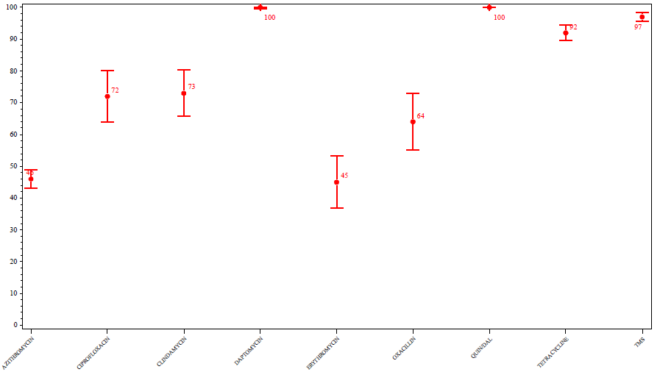
Antibiotic Resistance and Antibiotic Stewardship: DPH Antibiograms and NHSN AU Data
Staphylococcus aureus Susceptibility Rates – 2017
Statewide
% Susceptibility
Antibiotic

Slide 46
Contact Information
Thank you for the opportunity to present this information today.
Please direct any questions to:
Eileen McHale, RN, BSN
Healthcare Associated Infection Coordinator
Bureau of Health Care Safety and Quality
eileen.mchale@state.ma.us

Slide 48
Next Meeting:
November 18, 2020

