Slide 1
Public health council
September 8, 2021
Please standby – the meeting will begin shortly
Today’s presentation is available on the mass.gov/dph website under “Upcoming Events” by clicking on the September 8th Public Health Council listing

Slide 2
PUBLIC HEALTH COUNCIL meeting
September 8, 2021
Margret R. Cooke, Acting Commissioner

Slide 3
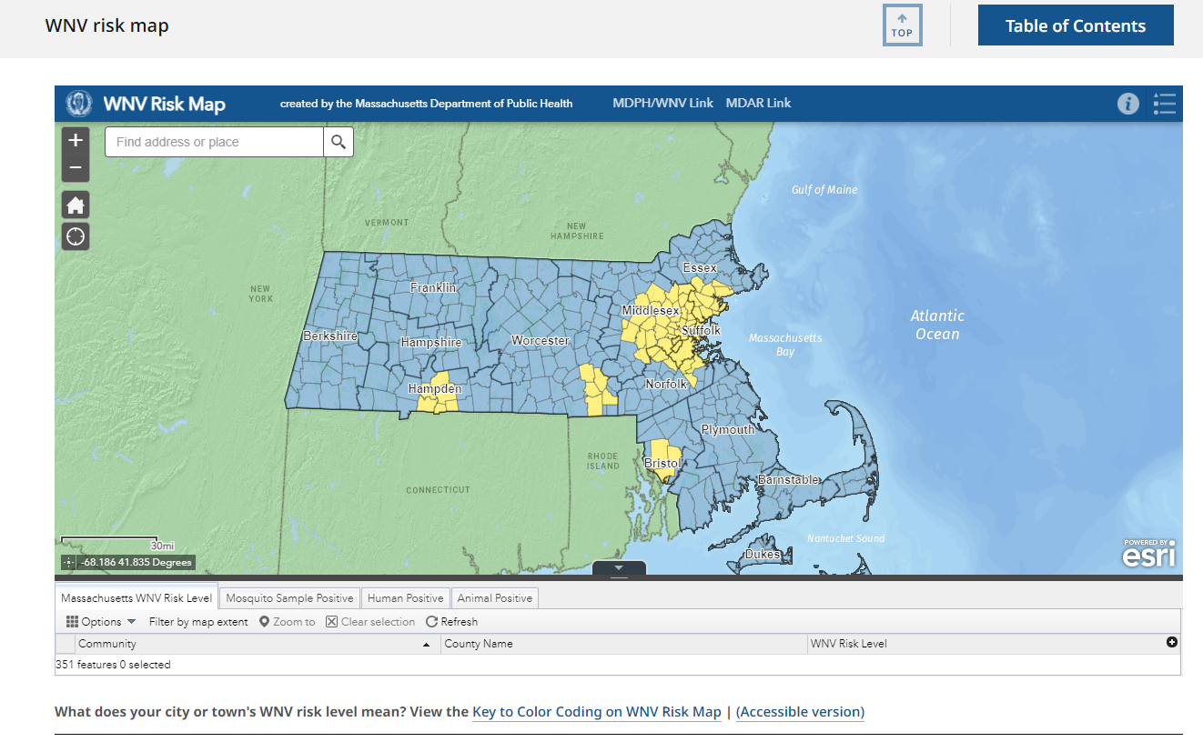
West Nile Virus

Slide 4
Overdose Awareness Day

Slide 5
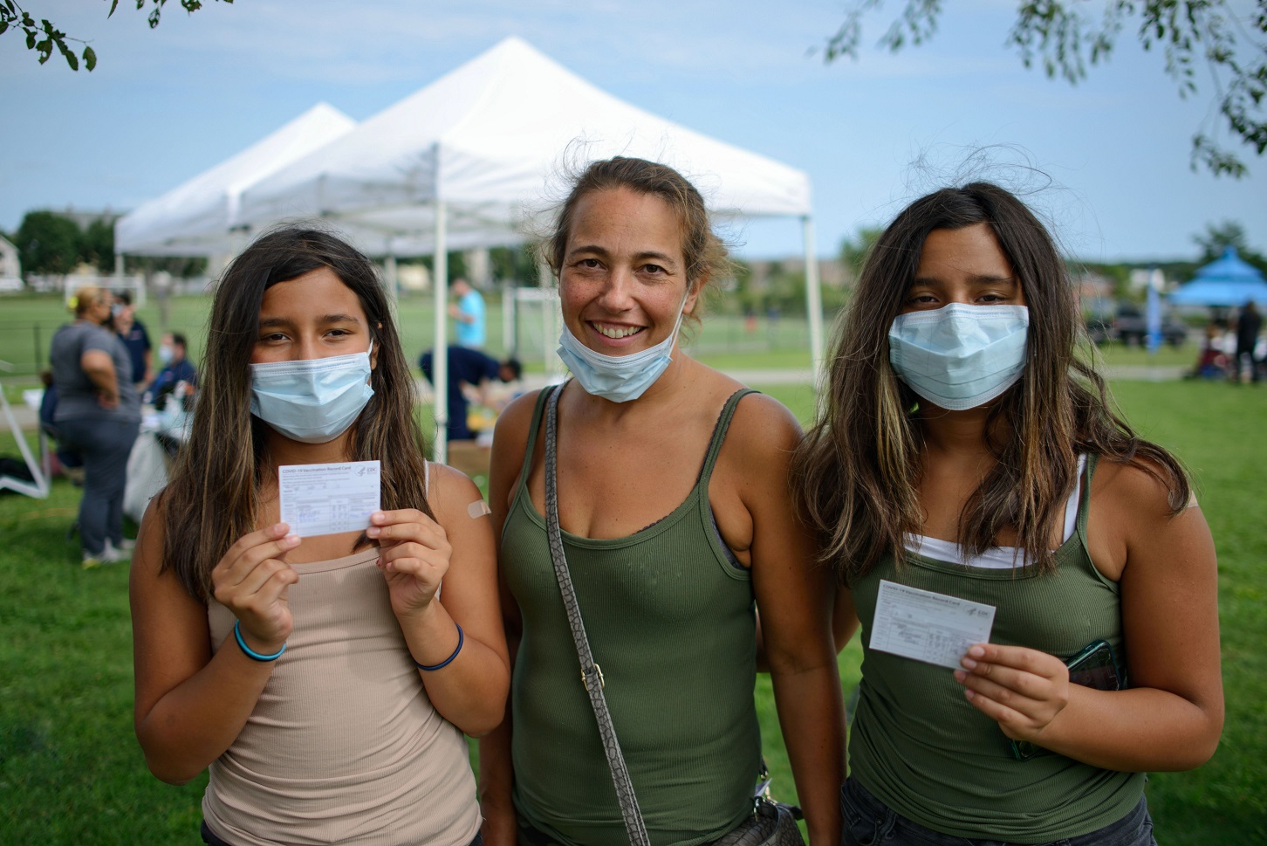
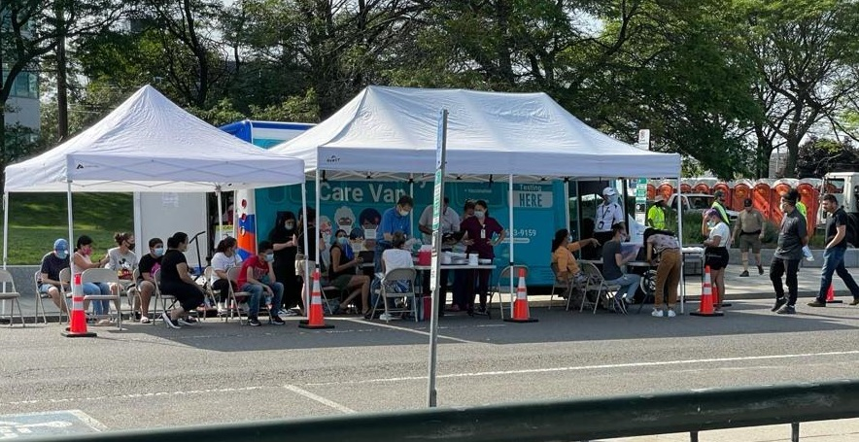
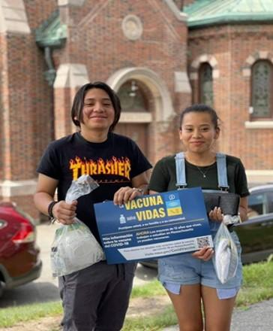
Vaccination Update
Everett
New Bedford community event
Revere “pop up” clinic
Worcester info sharing
Lynn mobile clinic
and vaccination event

Slide 6
Proposed Emergency Amendments to 105 CMR 150.000 Standards for Long-Term Care Facilities
Public Health Council September 8, 2021

Slide 7
Summary of Regulation
105 CMR 150.000, Standards for Long-Term Care Facilities:
Sets forth standards governing long-term care facilities, including nursing homes and rest homes, and
Provides a legal structure that promotes industry standardization, promotes higher quality of care, and stronger consumer protection for residents in long-term care facilities

Slide 8
Nursing Home Personnel Vaccination Requirement
As a reminder, at the August Public Health Council meeting, in an effort to strengthen infection control in nursing homes and protect vulnerable nursing home residents, PHC approved emergency amendments to this regulation to require nursing home personnel to be fully vaccinated against COVID-19.

Slide 9
Regulation Changes: COVID-19 Vaccination Requirement
The Department is proposing an emergency amendment to the regulations to require all rest home personnel be fully vaccinated against COVID-19.
Personnel includes all individuals employed directly or by contract by the rest home.
Exemptions from vaccination are provided for those personnel with medical restrictions or sincerely held religious beliefs that prevent them from receiving vaccination.
COVID-19 vaccination is the most effective method for preventing infection and serious illness from the virus, and personnel at rest homes serving vulnerable individuals are critical in efforts to protect rest home residents.
This amendment ensures that personnel of all licensed long-term care facilities are required to be vaccinated against COVID-19.

Slide 10
Next Steps
The Department respectfully requests that the Public Health Council vote to approve the proposed amendments to 105 CMR 150.000 on an emergency basis.
This will allow the regulation to take effect upon filing with the Secretary of State’s office while the Department conducts a public comment period.
Final approval of the proposed amendments, along with a review of public comments, will be requested at a subsequent meeting of the Public Health Council.

Slide 11
Thank you for the opportunity to present this information today.
For more information regarding standards for long-term care facilities, please find the relevant statutory language and the full current regulation here:
https://malegislature.gov/Laws/GeneralLaws/PartI/TitleXVI/Chapter111
https://www.mass.gov/doc/105-cmr-150-standards-for-long-term-care-facilities/download

Slide 12
Proposed Emergency Amendments to 105 CMR 141.000 Licensure of Hospice Programs
Public Health Council September 8, 2021

Slide 13
Summary of Regulation
105 CMR 141.000: Licensure of Hospice Programs
Sets forth standards for hospice services, which may be offered in multiple types of health care settings and in the community, including a patient's home, a nursing home, or a free-standing hospice facility operated by a hospice program.
Provides a legal structure that promotes industry standardization, promotes higher quality of care and stronger consumer protection for patients receiving care.

Slide 14
Regulation Changes: COVID-19 Vaccination Requirement
The Department is proposing an emergency amendment to the regulation to require hospice program personnel be fully vaccinated against COVID-19.
Personnel includes all hospice personnel who work at or volunteer at a hospice inpatient facility and all hospice personnel providing residential hospice services that include direct care.
Exemptions from vaccination are provided for those personnel with medical restrictions or sincerely held religious beliefs that prevent them from receiving vaccination.
COVID-19 vaccination is the most effective method for preventing infection and serious illness from the virus, and personnel at hospice programs serving vulnerable individuals are critical in efforts to protect patients receiving hospice care.

Slide 15
Next Steps
The Department respectfully requests that the Public Health Council vote to approve the proposed amendments to 105 CMR 141.000 on an emergency basis.
This will allow the regulation to take effect upon filing with the Secretary of State’s office while the Department conducts a public comment period.
Final approval of the proposed amendments, along with a review of public comments, will be requested at a subsequent meeting of the Public Health Council.

Slide 16
Thank you for the opportunity to present this information today.
For more information on 105 CMR 141, Licensure of Hospice Programs, please find the relevant statutory language (M.G.L. c. 111, §3, 57D) and the full current regulation here:
https://malegislature.gov/Laws/GeneralLaws/PartI/TitleXVI/Chapter111
http://www.mass.gov/courts/docs/lawlib/104-105cmr/105cmr141.pdf

Slide 17
Proposed Emergency Regulation COVID-19 VACCINATIONS FOR CERTAIN STAFF PROVIDING HOME CARE SERVICES IN MASSACHUSETTS
Public Health Council September 8, 2021

Slide 18
Summary of Regulation
The regulation requires all in-home care workers providing direct care under a state-based program to be vaccinated against COVID-19.
The vaccination requirement will provide exemptions for those personnel with medical restrictions or sincerely held religious beliefs that prevent them from receiving vaccination.
COVID-19 vaccination is the most effective method for preventing infection and serious illness from the virus, and vaccination of home care staff serving vulnerable populations including older residents is critical in this effort.

Slide 19
Summary of Regulation
Home Care Worker includes individuals providing in-home, direct care who are employed by an agency that is contracted or subcontracted with the Commonwealth or a Commonwealth-contracted managed care entity, including:
Home health agencies enrolled in the MassHealth program
Home care agencies providing services under EOEA’s home care program
Continuous Skilled Nursing agencies enrolled in the MassHealth program
Group Adult Foster Care agencies enrolled in the MassHealth program delivering personal care services that assist individuals with eating, toileting, dressing, bathing, transferring, and mobility.
The regulation also applies to independent, non-agency-based home care workers that contract with the Commonwealth to provide in-home, direct care including:
Independent Nurses enrolled in the MassHealth program
Personal Care Attendants (PCAs) providing services through the MassHealth program
Consumer Directed Care (CDC) workers providing services under EOEA’s self-directed program

Slide 20
Next Steps
The Department respectfully requests that the Public Health Council vote to approve the proposed regulation on an emergency basis.
This will allow the regulation to take effect upon filing with the Secretary of State’s office while the Department conducts a public comment period.
Final approval of the proposed amendments, along with a review of public comments, will be requested at a subsequent meeting of the Public Health Council.

Slide 21
Thank you for the opportunity to present this information today.

Slide 22
Next Meeting:
October 13, 2021

