Slide 1
Population Health Information Tool (PHIT)
Updates
Public Health Council Meeting
August 2020
Abigail Averbach, MSc
Assistant Commissioner & Director
Office of Population Health
Avae Thomas Quartey, MPH
Program Manager, Population Health Information Tool
Office of Data Management and Outcomes Assessment
Natalie Nguyen Durham, MPH
Director,
Office of Data Management and Outcomes Assessment

Slide 3
The DPH Health Equity Advisory Group
Recommendations were generated in four areas:
Social Determinants of Health
Data and Metrics
COVID-19 Mitigation
Community Engagement and Support

Slide 4
Agenda
Recap PHIT vision
Examples of current uses of PHIT
Moving forward
Explore the newly available Housing Report

Slide 5
The PHIT Vision
Social Determinants of Health
Targeted Health Improvement Planning
Community Health Data

Slide 6
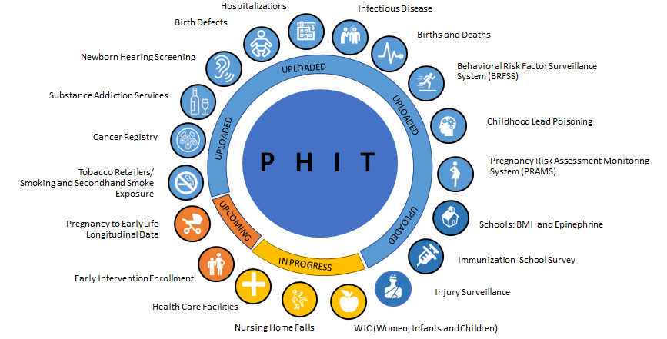
PHIT Datasets

Slide 7
Example of Current Uses of PHIT
Local Health Center’s FQHC Needs Assessment:
Chronic Disease Hospitalizations
Employment Report
Various cities and towns from across the state developed CHNA’s in 2019 using PHIT data
State agency incorporated PHIT data into their development of a scoring system to prioritize and approve the project applications that they receive
Health Behavior Data
Chronic Disease Hospitalization
Central MA Non-Profit used PHIT to complete a BCBS grant application
Incidence of mental illness and substance misuse

Slide 8
Moving Forward
2020-2021:
Updating current datasets in PHIT
Addition of new datasets
Publishing remaining 4 SDoH reports
Inclusion of additional dashboards
2021 and Beyond:
Platform Aesthetics
Platform Speed and Functionability

Slide 9
Social Determinants of Health (SDoH) Reports
Education
Built
Environment
Employment
V-BSHE²
Housing
Violence
Social
Environment

Slide 10
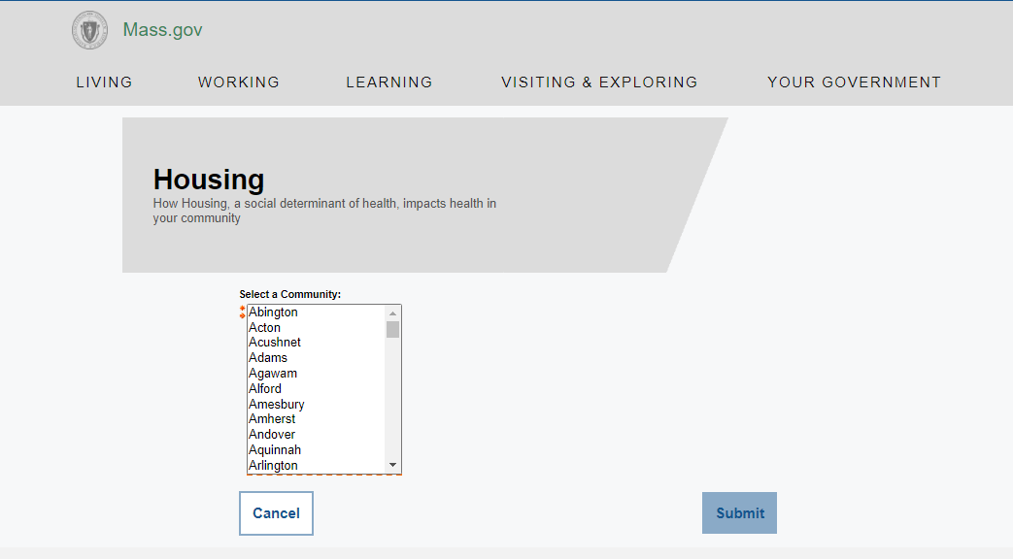
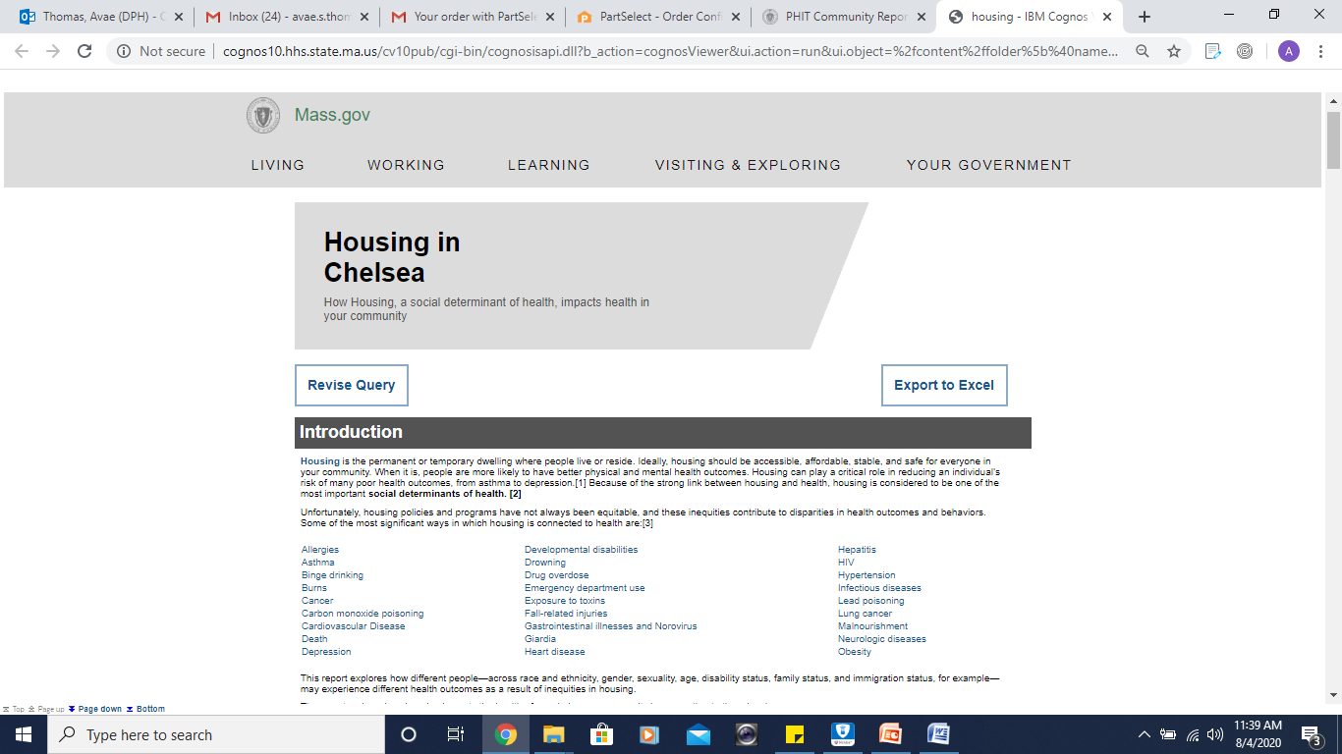
Housing Report Demo
Select Community & Review Health Outcomes
City XYZ

Slide 11
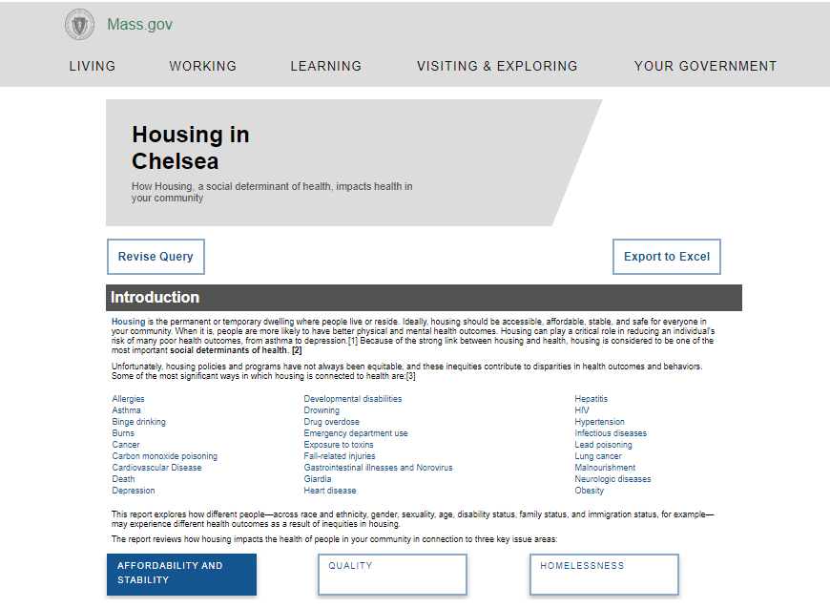
Explore Key Issue Areas & Strategies
City XYZ

Slide 12
Housing Report: Affordability and Stability
City XYZ
City XYZ

Slide 13
Housing Report: Quality
City XYZ
City XYZ

Slide 14
Housing Report: Homelessness

Slide 15
Thank You!
PHIT Website: https://www.mass.gov/dph/phit
Natalie Nguyen Durham, MPH
Natalie.Nguyen@state.ma.us
Avae Thomas Quartey, MPH
Avae.Thomas@state.ma.us

