Slide 1
CCFA PLACEMENTS: Creating and Modifying
Updated: April 2017

Slide 2
Agenda
Overview
Placement Types
Placement Schedules
Transportation
Steps to Add a Placement
Placement Actions
FAQs

Slide 3
Placements Overview
Family
Authorization
Placements
Families must have an active and approved authorization to add a placement.
Add a placement from the action drop down on either the Family Details or the Authorization Details page.
Alternatively, add a placement from the Intake menu.
Multiple children may be placed under the same authorization
Children may have more than one placement per authorization
This accommodates changing schedule needs. For example, summer schedules versus school year schedules
CCFA allows overlapping placements in certain circumstances. For example
A child attending care at one provider before school and another after school.
In these cases, the two placements must have the same dates so that the co-pay is correct.
CCFA NEVER allows overlapping billing for the same child on the same day.

Slide 4
Placement Types
Placements fall into one of five of the below categories:
Regular
Child attends care on a set schedule
Example: MWF every week
Intermittent
School Age child who attends partial days on school days and for more hours on days when school is closed
Intermittent hours allowed depend on the authorization (part-time or full-time)
Example: child in an after school program but full day on school closure days
Flexible Schedule
Child attends care on different days in different weeks
When entering this schedule, select the number of days per week.
Example: child attends 4 days per week, but days of the week are different
Intermittent Flexible Schedule
Child needs a Flexible Schedule, but also requires intermittent care
School Closure Only
Child attends care only on vacation days or when school is closed.
Cannot create with certain program types and intermittent or intermittent flexible placements

Slide 5
Placement Schedules
Along with type, placements must also have a schedule. CCFA allows the following options:
Weekly: Same schedule every week
Bi-weekly: Different schedule every other week
Four Week Alternate: Different schedule each week of the month
When creating the placement, the days of the week will display on the Weekly Schedule based on the provider’s schedule.
Select the scheduled days needed for the child.
Saturday and Sunday will only be an option if the provider is open on those days.
If transportation is provided and covered, select Transportation for each day of the week.
This will allow the provider to enter transportation when entering attendance.
See following slides for more details.
Authorizations and Placement schedules allow the maximum values for transportation and hours billed. Attendance documents the actuals:
Transportation
If the placement schedule allows for two-way transportation, but the child only used one-way transportation on a given day, providers should select the one-way code when entering attendance.
The exception to the above is if the provider incurs the cost of the transportation whether the children utilize the service or not.
Hours billed
Part-time authorizations allow for up to 30 hours of care each week
Full-time authorizations allow for up to 50 hours of care each week
Placements are not required to utilize the maximum allowed.
Notes:
Starts over in months with five weeks.

Slide 6
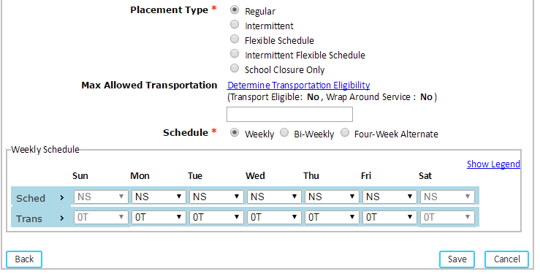
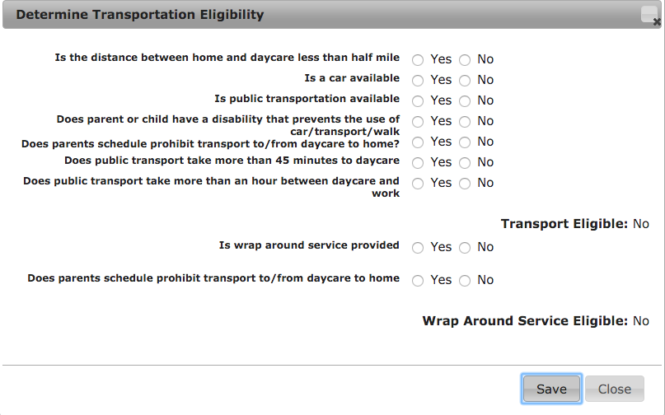
Transportation
By default the “Max Allowed Transportation” is set to “No.”
If the provider offers transportation, the questionnaire to determine transportation Eligibility must be answered.
Click the “Determine Transportation Eligibility” link to open the questionnaire.
Based on the answers, CCFA will determine maximum allowable transportation for
Transportation Eligible: One-way or two-way to and/or from home to care and/or care to home
Wrap Around Service Eligible: One-way or two-way to and/or from care to school and/or school to care
Notes:
NEEDS TO BE CLARIFIED (TRANSPORTATION DOCUMENT TO INCLUDE)
DISCUSS HAVING TO FILL OUT QUESTIONNAIRE
0T – None
1I - One Way Intermittent Transportation (Can be provided on school closure days)
1T - One Way Transportation (To Provider OR To Home)
2I - Two Way Intermittent Transportation (Can be provided on school closure days) EXAMPLES?
2T - Two Way Transportation (To Provider AND To Home)

Slide 7
Transportation
If the child is eligible for transportation, select the transportation type on the schedule
0T—Default, no transportation
1I—One-way wrap around service for use with a School Age placement where provider provides one-way transportation on regular days and not on school closure days.
One-way from care to school OR from school to care, depending on the placement schedule and needs.
1T—One-way transportation offered on all days
2I—Two-way wrap around service for use with a School Age placement where provider provides two-way transportation on regular days and not on school closure days.
Two-way from care to school AND from school to care
2T—Two-way transportation offered on all days

Slide 8
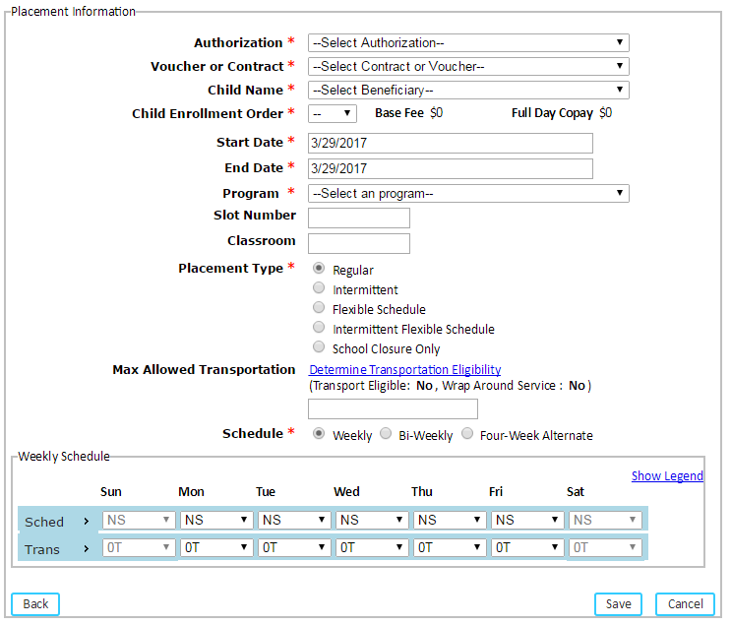
Steps to Add a Placement
Select “add placement” from either the Family Details or Authorization Details page.
Select the location of care.
You will be taken to the placement information page. The LOC details will populate at the top of the page.
CCFA will say if transportation is available
Enter the required placement information.
Select the authorization
Select Voucher or Contract
May prepopulate based on authorization
Select the Child
Will prepopulate if the family has only one beneficiary on the authorization
Select the enrollment order
Make sure this is accurate. It affects the base fee and full day co-pay.

Slide 9
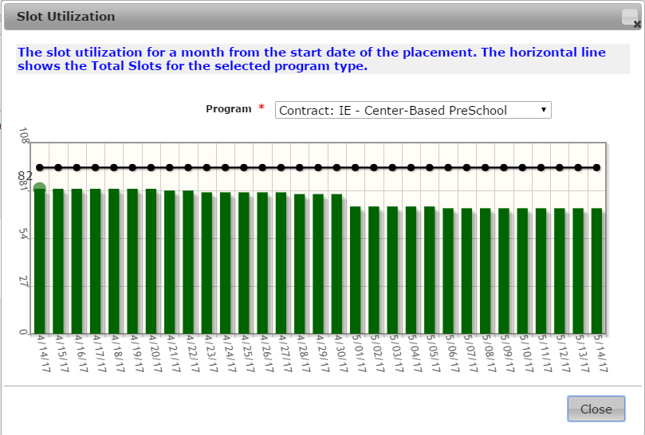
Steps to Add a Placement – cont.
Enter the required placement information, continued
Enter the placement start date
Cannot be before the authorization start date
Enter the placement end date
Cannot be outside the end date of the authorization
Select the program
Drop down populates based on programs offered at provider selected
For contract placements, an information bubble will appear that will give you the slot utilization for that program type.
Slot number and classroom are optional fields
These fields are not editable once the placement is created

Slide 10
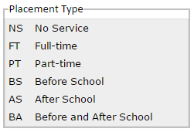
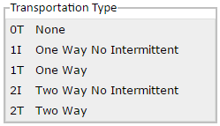
Steps to Add a Placement – cont.
Select the placement type.
Determine transportation eligibility if applicable.
Select and enter the placement schedule.
Use the radio buttons to change the schedule to bi-weekly or four-week alternate.
Select the daily schedule for the placement.
Select transportation if applicable.
Save
CCFA will notify you if the placement was created successfully. You will be redirected to the Placement Details page.

Slide 11
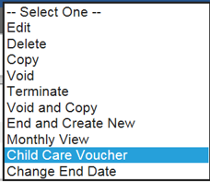
Placement Actions
Edit
Option to edit the LOC
Allows you to edit other placement information such as start and end dates, program, transportation, etc.
You cannot edit a placement if there are attendance or billing records against the placement.
Unbilled attendance can be deleted
Delete
When you want to remove the record
from CCFA.
All attendance must be deleted first
Cannot delete a placement if there are billing records against that placement.
Child Care Voucher
Prints a PDF of the voucher for the child.
Only an option for voucher placements
Notes:
VOID WILL REMOVE PLACEMENT AND ANY ATTENDANCE BILLING ASSOCIATED WITH IT; SHOWS UP AS DEBIT AGAINST NEXT MONTH; NEED TO REPLACE ANY VOIDS
FOCUS ON DELETING AND VOIDING, SEEM TO BE MOST RELEVANT CURRENTLY
IF SUBMITTED, CAN’T DELETE, MUST VOID

Slide 12
Placement Actions
Copy
Makes a copy
This action is useful when you are placing multiple children within a family at the same LOC, or
If you need to create multiple placements for the same child.
Void
Voids the record from CCFA.
Use Void when you cannot delete a placement due to billing/attendance associated
If you need to recreate the placement, use the “void and copy” action (see below).
Void and Copy
Voids the current placement and makes a copy
Most useful for when you need to make changes to a placement after billing has been submitted (i.e. schedule or transportation changes)
Removes all billing and attendance records. Attendance needs to be re-entered for the length of the placement.

Slide 13
Placement Actions
Terminate
When you need to remove a placement from your program
You will be prompted to select a reason from a drop-down list
Must also list a Notice Date, Termination Date, and a comment
Be detailed in your comments. Just because a child is terminated from your program doesn’t mean he or she isn’t still eligible to receive subsidized care.
Change End Date
Allows you to change the end date for the placement.
Cannot change the end date to extend beyond the end date of the authorization.
Cannot change the end date to a date that has already been billed.
In this case, you would need to complete a placement adjustment
End and Create New
Ends the current placement and creates a new one
Most useful for if you need to make a change to a placement moving forward (i.e. schedule or transportation changes).

Slide 14
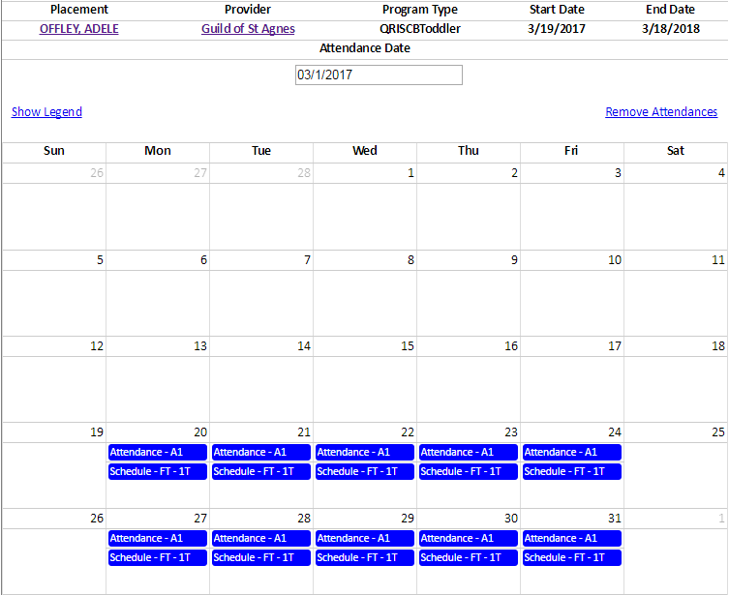
Placement Actions
Monthly View
Allows you to see the monthly view for the placement including attendance, billing ledger entries, and their status.
Use this action when you need to delete unbilled attendance entries.

