Slide 1

Commonwealth of Massachusetts
COMBINED STATE PLAN
At-A-Glance
Alice Sweeney, Director DCS
Revised January 2017

Slide 2
WORKFORCE INNOVATION AND OPPORTUNITY ACT
(WIOA)
The Workforce Innovation and Opportunity Act (WIOA), a federal act, was signed into law on July 22, 2014. WIOA is designed to help job seekers access employment, education, training, and support services to succeed in the labor market and to match employers with the skilled workers they need to compete in the global economy. WIOA is the first legislative reform of the public workforce system in fifteen years.
WIOA Principles: The federal Act promotes an integrated, job-driven public workforce system that links diverse, talented individuals to businesses to improve employment outcomes.
WIOA Enacted
July 2014
Policy and Planning in Regional and Local Areas
November 2016 – June, 2017
Combined State Plan Draft
November 2015
Implementation Phase:
Technical Assistance & WIOA State Policy Guidance for local areas
April – July 2016
Lead Operator
In Place
Local Signed
Umbrella
MOUJuly 1, 2017
MWIB
Establishes
WIOA Steering Committee
October, 2014
Steering Committee &
Workgroups
October, 2014 – November, 2015
Final Rules
Enacted
August, 2016
Provisions
Take Effect
July 2015
*ETPL
*Eligibility
Submission of Combined State Plan
March, 3, 2016
Adjusted
April 1, 2016
DOL Final Approval
October, 2016

Slide 3
WIOA Planning & Stakeholder Engagement
WIOA Steering Committee
System Priorities
Eligible Training Provider List (ETPL) Workgroup
Workforce Board Standards/ Certification
(BS&E Sub-group)
Career Center Standards & Selection Process (statewide baselines)
(BS&E Sub-group)
Performance Measurement
(BS&E Sub-group)
Business Strategies
(BS&E Sub-group)
Youth Workgroup
Job Seeker and Business (BS&E) Workgroup
Business Focus Groups
(direct input on “demand driven”)
Notes:
WIOA STEERING COMMITTEE: VISION BRAINSTORM
Demand Driven
Employer-driven model, “flip the model”
Be truly job-driven
Regular/routine contact with industry re: changing hiring needs/process (e.g. online applications)
Define why we have an employer-driven model, and make mission/vision clear: to gather intelligence and form operational partners
Look at effective models like Apprenticeship
Partnerships
Look at system in partnership with all stakeholders
Stabilize partner networks
Service Delivery & Systems Improvement
Re-think approach to workforce system, refocus service delivery models
Think about those “screened out”, and resources that can be brought to bear to address their needs, ramps to basic skills
Look at local Board composition (effective & engaged Board members)
Need better system collecting and sharing consumer information on training (Community Colleges, proprietary training programs)
Robust use of technology and social media
Professional development of staff (training about training)

Slide 4
WIOA COMBINED STATE PLAN
The State Plan was developed by WIOA Steering Committee which included all Partners and Stakeholders
The Commonwealth submitted a Combined State Plan including: WIOA Title I (Adult, Dislocated Worker, Youth); Title II (Adult Education and Family Literacy);Title III (Wagner Peyser/Employment Service);Title IV (Vocational Rehabilitation); Temporary Assistance to Needy Families (TANF); Supplemental Nutrition Assistance Program (SNAP); Unemployment Insurance (UI); Trade Adjustment Assistance (TAA); Jobs for Veterans State Grant (JVSG) and Senior Community Service Employment Program (SCSEP)
Plan was fully vetted by all stakeholders and the MA Workforce Development System
Four public hearings were conducted to garner public feedback and comments
MA WIOA State Plan Website
www.mass.gov/massworkforce/state-plan

Slide 5
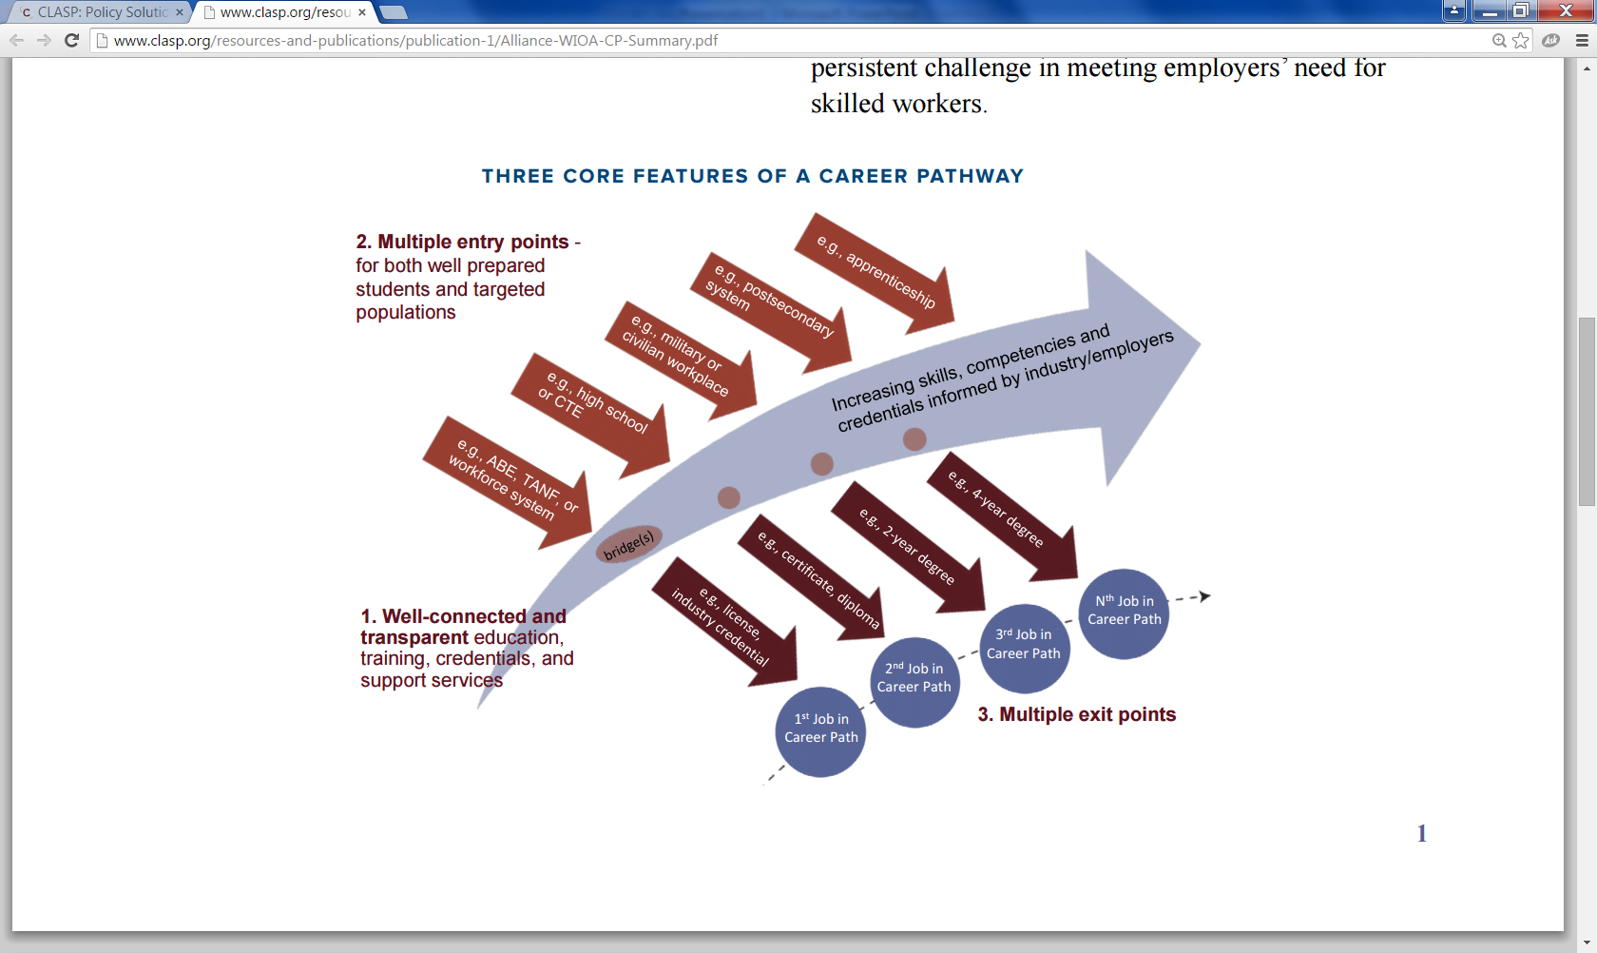
INTEGRATED SERVICE DESIGN: PERSON - CENTRIC
State and Local MOUs are designed around a “career pathway” approach based on customer perspective, not focused on the operations of funding streams.
CLASP GRAPHIC: http://www.clasp.org/resources-and-publications/publication-1/Alliance-WIOA-CP-Summary.pdf

Slide 6
Combined Plan: Vision Statement
All Massachusetts residents will benefit from a seamless system of education and workforce services that supports career pathways for individuals and leads to a more informed, educated, and skilled workforce, which meets the Commonwealth’s businesses’ demands and sustains a thriving economy.
To achieve this vision, Massachusetts will engage businesses to understand their needs and develop an integrated education and workforce system that supports career pathways to prepare residents with foundation, technical, professional skills and information and connections to postsecondary education and training. WIOA partners will work to:
Design career pathways across partners aligned with business demand
Improve foundation skills and transition to postsecondary education and training for individuals with barriers to employment
Assist low-income individuals and families to achieve economic self-sufficiency through support services, labor-market driven credentialing, and employment
Meet the needs of job seekers and businesses who engage in the public workforce system (including partner programs)

Slide 7
Adult Job Seeker Customer Flow Model
GOAL: New statewide customer flow to manage individuals from various referral sources who are triaged based on new, intensive skill assessment tools to Job Ready and Skill Building Teams within the Career Center.

Slide 8
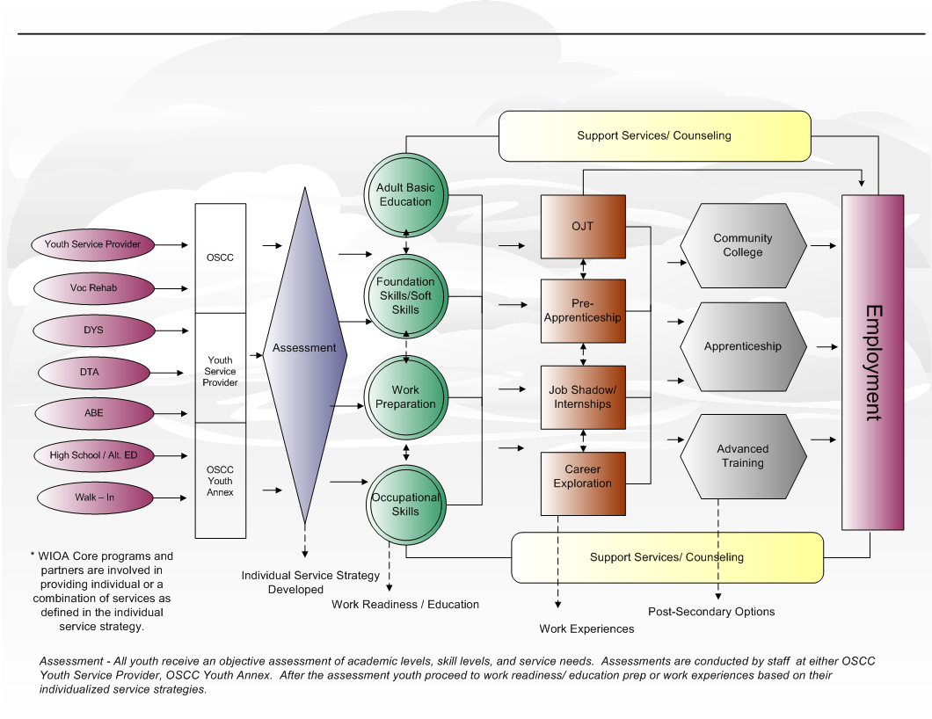
Youth Career Pathway &
Customer Flow Model
GOAL: Increase credentialing and job placement outcomes for youth, including youth with barriers to employment.

Slide 9
Demand-Driven Design: Business Centric
Entry Point for Business
Assessment, Triage & Referral
Account Management
Service Delivery
Outcomes
Core Partner Agencies (Career Center, WDB, MRC, MCB, DTA, ABE)
Community College
Economic Development
Business to Business Referral
Job Fair
Job Posting
Assess business need and priorities
What are the skill needs?
Are there existing programs, resources, or capacity to meet business needs?
Are work-based training models appropriate?
Is customer eligible for Workforce Training Fund?
Account manager (agency) based on business need. Examples:
Talent sourcing & development = career center
Incumbent worker training = Workforce Training Fund
Economic incentives = MOBD
Layoff aversion
Business access to education and training resources
Referral to incentives
Successful hires
Employee retention
Repeat business/ referrals
Talent sourcing
GOAL: Increase talent recruitment and hiring for business partners through business outreach, talent recruitment, matching and education and training activities that match business need.

Slide 10
LABOR MARKET
WORKFORCE INFORMATION
GOAL: Develop a state of the are Labor Market and Workforce Information (LMWI) system by which timely and accurate information is provided to consumers, and from which a customer service focus ensures that the workforce partners, economists, researchers, businesses and job seekers have the support they require in accessing labor market and workforce date, no just within MA but nationwide.
Conduct a redesign of the EOLWD LMI website
Support Boards and Partners in ability to provide LMWI to customers
Establish a reliable LMWI product line of data resources that addresses stakeholder needs
Expand access to and develop additional sources of information LMWI and economic data
Engage LMWI partners in forward thinking discussions and innovative project collaborations.

Slide 11
CROSS-AGENCY/WORKFORCE SYSTEM COORDINATION
REGIONAL PLANNING
The 16 Workforce Regions will now work across economic development, education and Workforce Development Boards in seven regions
Workforce Boards will drive partnership with education and economic development
Regional Planning Teams will review labor market analysis and build consensus on priority career pathways and industries across the three systems
Workforce Skills Cabinet conducted Labor Market Analysis and established 7 Regional Planning Areas

Slide 12
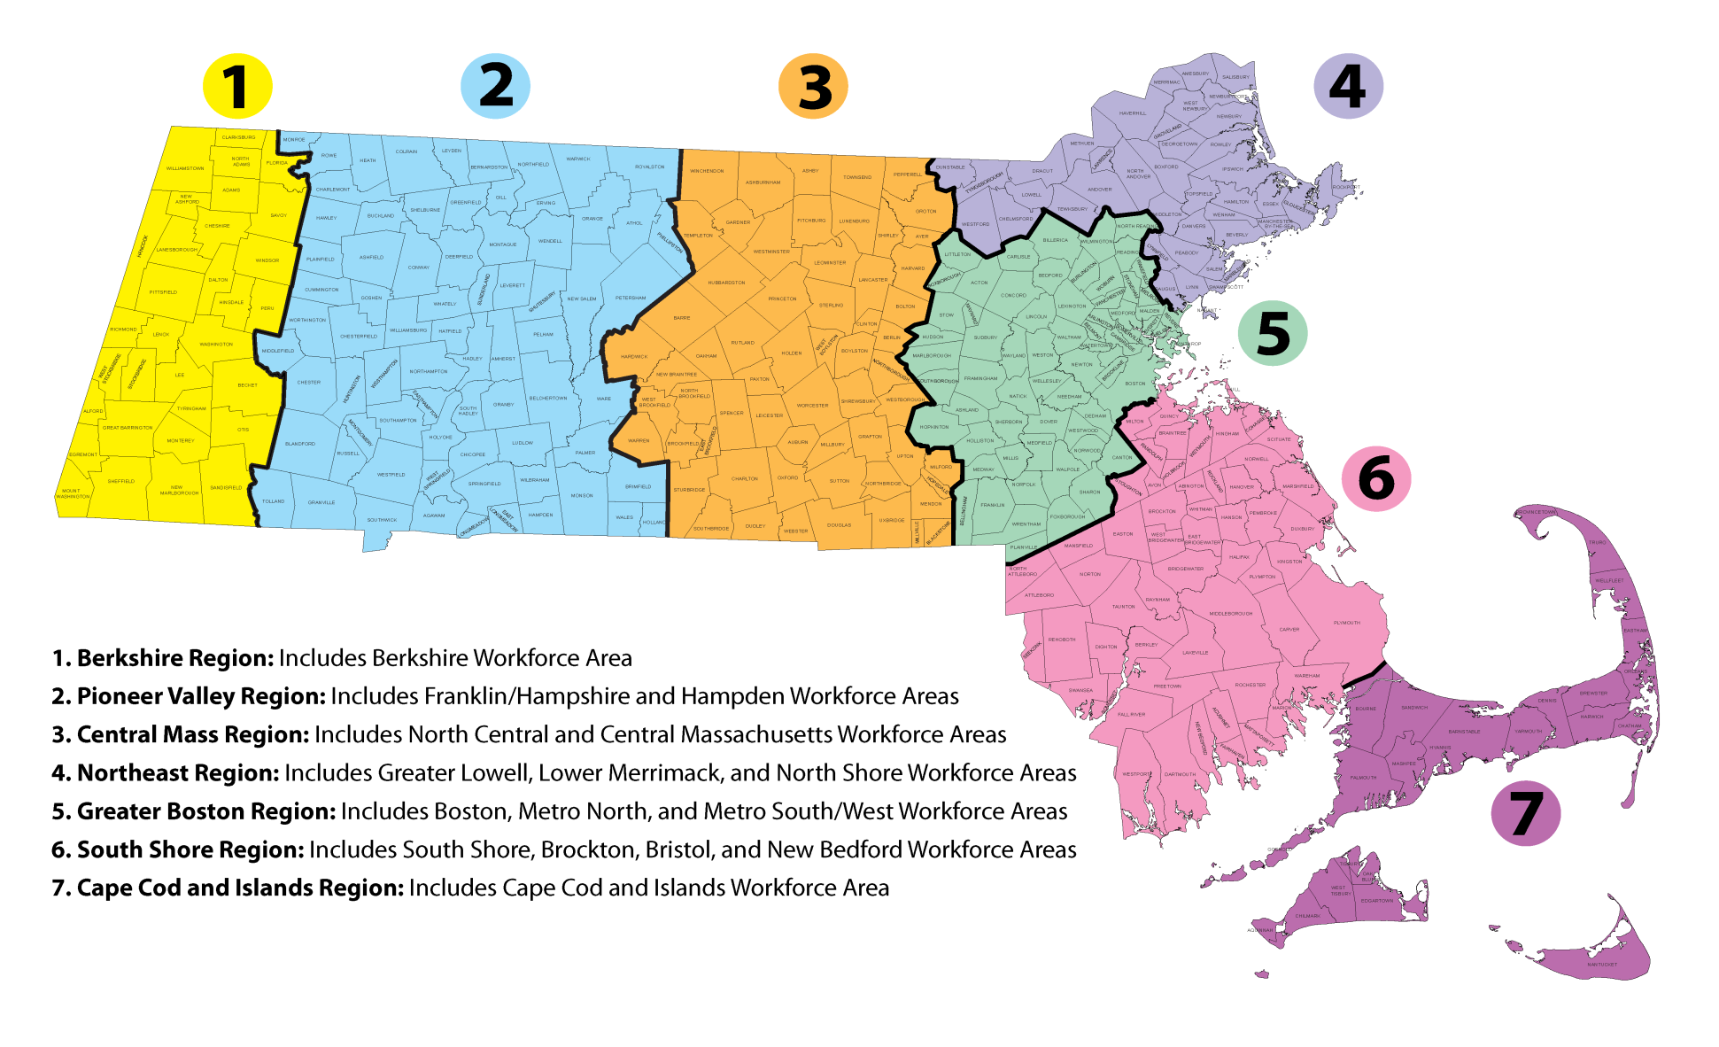
Alignment
Align economic, workforce and education systems to coordinate systems based on skill needs in regions.

Slide 13
CROSS-AGENCY/WORKFORCE SYSTEM
COORDINATION
STATEWIDE MEMORANDUM OF UNDERSTANDING (MOU)
Articulates a coordinated vision for organizing the broadly defined public workforce system
Establishes agreement at the state level focused on designing partnerships and service delivery systems through the WIOA Core Program partners
Priority Populations (low-income, TANF/SNAP, disability, veterans, homeless, CORI, etc.)
Will establish a definition and set of shared and infrastructure costs
Will guide the establishment of local area partnerships and MOU agreements

Slide 14
CROSS-AGENCY/WORKFORCE SYSTEM
COORDINATION
LOCAL UMBRELLA MOU
The 16 Workforce Boards will convene stakeholders to:
Establish the roles of local partners in the development of an integrated education and workforce system that supports career pathways in each region to prepare residents with foundation, technical, and professional skills, and provide information and connections to postsecondary education and training
Design and develop “Umbrella” MOUs that focus on populations and service design (not funding streams)
Workforce Boards will lead partners to develop “Umbrella” MOUs and focus on demand-driven practice and integrate service design
Agree to operational costs of service delivery (shared and infrastructure costs)

Slide 15
CROSS AGENCY-COORDINATION
DEFINITION SHARED CUSTOMER
A shared customer is a job seeker or a business who is formally enrolled in services by more than one core program (at the same time or sequential) *
*If applicable a “shared” customer must meet the eligibility criteria of the partner agency providing services.

Slide 16
CROSS AGENCY – COORDINATION
Roles and Responsibilities of the
Required OSCC Partners
Each required Partner must:
Provide access to its programs or activities through the OSCC delivery system, in addition to any other appropriate locations;
Use a portion of funds made available to the partner’s programs to:
Provide applicable career services;
Work collaboratively with State and Local Boards to establish and maintain the one-stop delivery system this includes jointly funding the one-stop infrastructure through partner contributions.

Slide 17
CROSS AGENCY – COORDINATION
SHARED COSTS
DEFINITION: Cost of shared services that are provided through the Partner programs to an individual or business.
EXAMPLES INCLUDED BUT NOT LIMITED TO:
Initial Intake
Assessment
Review of Basic Skills
Identification of and Referral to Appropriate Services
Business Services
HOW ARE SHARED COSTS CALCULATED?
The federal government has not provided a consistent methodology across agencies (i.e. % of FTE, cost for % of program partner customer using OSCC, etc)
Methodology/ calculations are defined by local partners

Slide 18
CROSS AGENCY – COORDINATION
Roles and Responsibilities of the
INFRASTRUCTURE COSTS
Each required Partner must support the one-stop delivery system by jointly funding the OSCC infrastructure through Partner contributions.
Each Partner must contribute to the OSCC whether or not they are physically located in the OSCC.
DEFINITION: Infrastructure Costs are non-personnel costs that support the general operation of the One Stop Center.
EXAMPLES
Rental of Facilities
Utilities and Maintenance
Equipment including assessment – related products and assistive technology for individuals with disabilities
Technology to facilitate access to the one-stop center

Slide 19

OSCC FUNDING
WIA
Reemployment
Services
Eligibility
Assessment
Grant
(RESEA)
WIOA Title I
Adult
MA Workforce System funded primarily through Federal Funds
Local allocations are determined by Federal Formula
WIOA
Title I Youth
Trade
Adjustment
Assistance
WIOA Title I Dislocated Worker
Local Board
Career Center
Locally
Obtained
Funding
State Funding
Federal Discretionary Grants
National Dislocated
Worker Grants
DUA
Funding
Jobs for Veteran
State Grant
(JVSG)
Wagner
Peyser
Or
Employment
Services
Federal Funds
State Career Center Line Item
Locally Obtained Funding

Slide 20
OSCC FUNDING
WIOA
Infrastructure Costs are determined by:
Local One-Stop Infrastructure funding mechanism
or
State Infrastructure funding mechanism
Reemployment
Services
Eligibility
Assessment
WIOA Title I
Adult
Trade
Adjustment
Assistance
(TAA)
WIOA
Title I Youth
DUA
WIOA Title I National
Dislocated
WIB
Career Center
ABE
VOC REHAB
WIOA
Federal Discretionary
National Dislocated
Worker Grants
(NWDG)
State Funding
DOL Funding
ABE Funding
Voc Rehab Funding
TANF Funding
TANF
Wagner
Peyser
Employment
Services
State
Funding
Jobs for Veteran
State Grant
(JVSG)

Slide 21
ALSO INCLUDED IN
COMBINED PLAN
FEDERAL PERFORMANCE STANDARDS
STATE PERFORMANCE METRICS
WORKFORCE DEVELOPMENT BOARD STANDARDS
ONE STOP CAREER CENTER STANDARDS

Slide 22
STILLL TO COME
Integrated Data Systems
Completion Competitive Selection of Lead Operator
Determining Shared & Infrastructure Costs
Staff Development Across Core Partners
Regional Planning
Annual Planning
Workforce Board Certification
Career Center Certification

Slide 23
WHERE IS COMMONWEALTH
IN IMPLEMENTATION
April 16, 2015 - Publish Notices of Proposed Rulemaking
July 1, 2015 — Majority of Provisions take effect
WIA State and local plan provisions continue to apply
Current performance accountability system remains in effect
July 1, 2015 — ETPL provisions are implemented by Governors and Boards
January 22, 20l6 - DOL, ED and HHS publish Final Rules to implement WIOA
The final regulations issued August, 2016
March 3, 20l6 - Deadline for state Combined Plan submissions
Final plan guidance was not available until February, 2016 due date changed to April 1, 2016. The Commonwealth submitted on time.
July 1, 2016 - Full Implementation – Program, services and activities
One-stop infrastructure cost requirements pushed out to July, 2018
Use of common One-Stop identifier must be implemented – Currently in compliance beginning re-branding project.
July 1, 2017 – Lead Operator of Local One-Stops in place.

