Slide 1

Plymouth
Alcohol Licensee Seminar
June 17, 2024

Slide 2
WELCOME!
TODAY’S SPEAKERS:
Commissioner Jean M. Lorizio, Esq., Chair of the Alcoholic Beverages Control Commission (ABCC)
Ralph Sacramone, Executive Director of the Alcoholic Beverages Control Commission (ABCC)
Kyle E. Gill, Esq., General Counsel, Alcoholic Beverages Control Commission (ABCC)
Ryan Melville, Deputy Executive Director of the Alcoholic Beverages Control Commission (ABCC)
Thomas Carroll Community Outreach & Resource Planning Specialist US Department of Labor

Slide 3
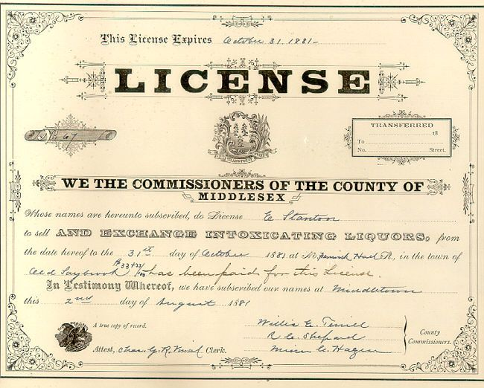
Changes to an existing license:
Change of Ownership
Transfer of Stock, Issuance of stock/new stockholders
Change of Name and/or change of d/b/a
Change of Officers/Directors/Trustees or change in the corporate structure (such as changing from INC to LLC)
Renovations or alterations to the premises (Abutter notification requirement.)
Change of Manager
Change of Hours (including Sundays)
Change of location

Slide 4


2024 Updates on outdoor patios and seating
Source: 05/01/24 ABCC Advisory
ABCC approval is no longer required for amendments to add outdoor alcoholic beverage table service areas.
Licensees should contact their Local Licensing Authority “LLA” with any questions and apply directly with them.
Local Boards must provide the ABCC notice of any amended license and can do so by submitting an updated Licensing Authority Certification form describing the entire licensed premises, including but not limited to the newly approved outdoor alcoholic beverage table service area(s).
Nothing in the new law prevents the ABCC “from exercising [its] enforcement authority over an amended license nor limit(s) any appeals that can be submitted to the commission pursuant to section 67 of chapter 138.”

Slide 5
ABCC
Navigation of Website
https://www.mass.gov/orgs/alcoholic-beverages-control-commission
Applications
Commission Advisories
Commission Decisions
Frequently Asked Questions and Guidelines in Multiple Languages

Slide 6
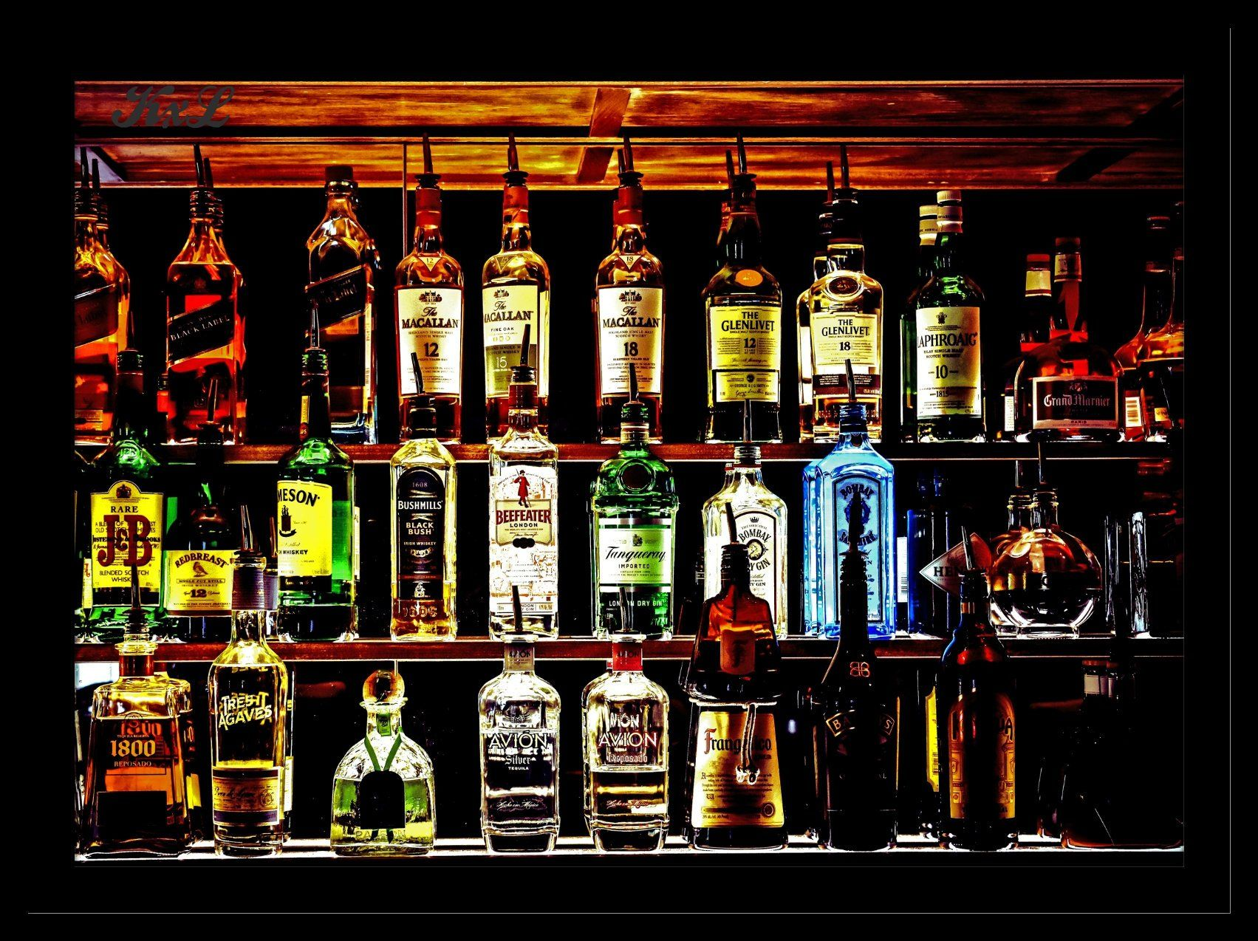
Purchasing alcohol from authorized sources:
Restaurants, clubs and package stores cannot purchase any alcohol from a package store, big box store and/or out-of-state entities. Alcohol must be purchased from a licensed wholesaler.
MGL c. 138 §23

Slide 7

Section 12 and Section 15 Licensees with Same Owner Entity
Alcohol cannot be transferred between entities.
Each entity is its own business.
If this action occurs, the Licensee is acting as a wholesaler and this is a violation.

Slide 8

Delivery of alcohol:
A Section 15 licensee is allowed to deliver to Massachusetts consumers if the entity holds a Section 22 transportation permit. They may also use third parties licensed pursuant to M.G.L. c. 138, Section 22 as an express transportation licensee.
Takeaway/delivery of mixed drinks (Mixed Drinks To-Go): Section 12 establishments licensed for on-premises consumption of mixed drinks may permanently continue takeaway and delivery sales of mixed drinks. All mixed drinks sold for takeaway/delivery must be sold with food and at the same price/proportion as mixed drinks for on-premises consumption. Beer and wine by themselves are not included nor are unopened “ready to drink” cocktails.
A Section 12 licensee is allowed to deliver mixed drinks to Massachusetts consumers if the entity holds a Section 22 transportation permit. They may also use third parties licensed pursuant to M.G.L. c. 138, Section 22 as an express transportation licensee.
Sale and delivery of the alcohol extends to the front door of the home to which alcohol is being delivered.
Licensee’s Delivery Agent must verify the legal age and check ID of recipient at the time of delivery.

Slide 9
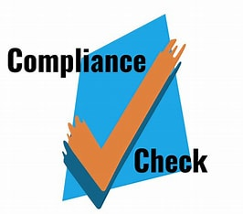
COMPLIANCE CHECKS
Compliance Checks are a training tool required by law.
Municipality and ABCC must conduct compliance checks.
Compliance checks are intended to help the licensee comply with the law and local regulations.

Slide 10
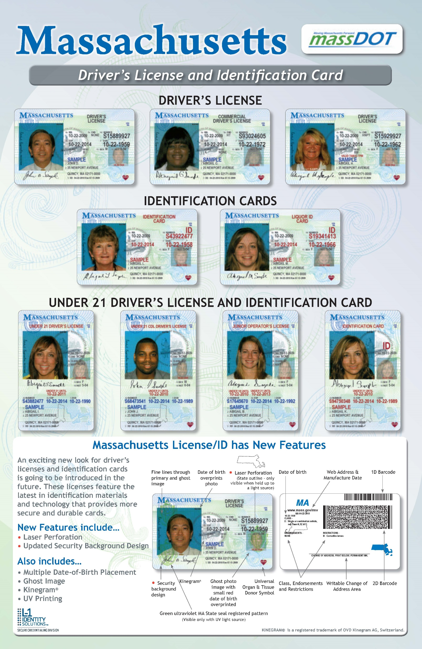
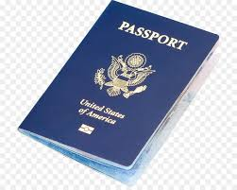
ALCOHOL SALES AND SERVICE REQUIRES THE LICENSEE TO CHECK IDs
Identification of Patrons. Licensees shall ensure that the identification of persons purchasing alcoholic beverages occurs at the point of sale or service.
KNOW THE SIX ACCEPTABLE FORMS OF IDENTIFICATION
  Massachusetts Driver’s License
  Massachusetts Liquor ID Card
  Massachusetts ID Card
  Passport Issued by the United States or a government that is officially recognized by the United States
  A Passport Card for a Passport issued by the United States
  A Military Identification Card

Slide 11

OVERSERVING COMES BACK TO THE LICENSEE
“last place of drink”
MGL c. 90 § 24J
Prior to sentencing for conviction of DUI or guilty plea for DUI, the guilty party must identify the name and location of the last place at which the individual was served.

Slide 12

Hours of Operation “Last Call”
Local Licensing authorities often have regulations specific to “Last Call.”
Statewide: Licensees cannot utilize their alcoholic beverages license before or after their approved hours.

Slide 13

ABCC, Police, Fire, City Inspectors are authorized to inspect the licensed premises at any time.
Police Department has authority to investigate potential violations of the law at a licensed premises on behalf of the Board, and conduct enforcement.
The Licensee should ensure that staff is aware and prepared to assist in allowing inspection of the licensed premises and responsive to questions during inspection.
MGL c. 138 § 63A- Hindering or delaying investigator, inspector, or agent of Commission

Slide 14
OTHER ISSUES
Overcrowding
Overserving
Not licensed for certain entertainment activities but promoting and allowing those anyway at the premises
Not amending alcohol licenses to serve in another area or floor of the establishment
Not knowing or training staff on the right of police to enter a licensed establishment and perform inspections of the licensed establishment
Lack of familiarity with what on-scene officers will be requesting and what Police follow up entails in the event of an issue
Cover Charges-cannot be charged in advance of gaining entrance to the license premises, requires a printed receipt presented to each customer charged, licensee must keep records of such receipts for at least two (2) years, a sign must be conspicuously posted at every entrance to any dining room or rooms to which charges are being collected stating the amount of the charge, and no person under thirteen (13) shall pay a cover charge
Entertainment Issues-no licensee shall provide or allow entertainment unless an entertainment license has been obtained
Annual Renewal Deadlines – all annual licensees must renew alcohol license by November 30th annually, authorized representative must sign application, renewal fee must accompany application, application must be the same type as the expiring license and cover the same licensed premises, section 12 licensees must provide proof of liquor liability insurance and Fire Safety Inspection Certificates– failure to sign and file application and pay application fee by November 30th results in requirement for licensee to file an application for new/original license, abutter notice, DOR and DUA releases to accompany application for new license

Slide 15

Know the Requirements for Club Licenses
MGL c. 138, §12
Alcoholic beverages may only be served to members of the club who are 21/older.
If the member leaves the club, the member’s guest must leave the premises and can no longer be served alcohol.
Clubs are required to file annual reports with the Board and the Commonwealth of Massachusetts.

Slide 16


Working Together
Connect with the Police Department for Assistance
Contact Local Police Department and seek other resources for assistance
TEAMWORK AND COMMUNICATION ARE THE KEYS TO A WELL-RUN ESTABLISHMENT
Licensee should use and seek available resources
Licensee should connect with local police to assist with and prevent issues
Municipalities want Licensees to contact ABCC, DIA, Local Police, and keep communications open to assist Licensees to run an establishment in compliance with Municipal Licensing rules and ordinances and Massachusetts statutes and regulations

Slide 17
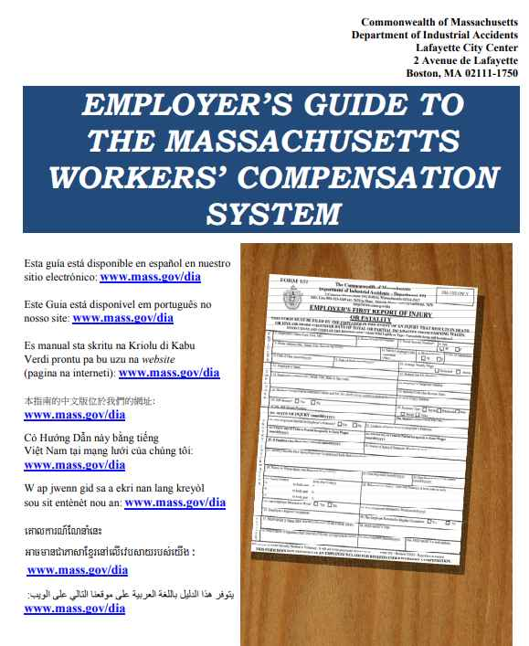
Department of Industrial Accidents https://www.mass.gov/orgs/department-of-industrial-accidents
Workers’ Compensation Insurance Requirements
-all employers are required to carry workers’ compensation insurance for their employees and themselves
-stop work order can be issued to employers who don’t have workers’ compensation insurance, and fines are $100/day beginning on the date the SWO is issued
DIA online Guides and Resources:
Employer’s Guide to Workers Compensation – in multiple languages
https://www.mass.gov/doc/employers-guide-to-workers-compensation-english-0/download

Slide 18
An Overview of the Fair Labor Standards Act (FLSA) with focus on the MA restaurant industry.
Restaurant Workers

Slide 19
FLSA in the restaurant industry
Minimum Wage Minimum Wage and minimum wage for Tipped Employees
Hours Worked
Rest / Meal Periods (20 minute rule)
Illegal Deductions for minimum employees (uniform / walk outs / breakage)
Overtime Time and ½ the employees regular rate of pay for all hours worked over 40 in a work week (total wages for week divided by total hours) i.e Dual Jobs Overtime wages for tipped employees All hours counted and each work week stands alone
Child Labor 14 and 15 year olds (limit on hours/time worked and hazardous occupation restrictions
16 and 17 year olds (hazardous occupation restrictions)
Record Keeping Employer must maintain the following for 3 years:
name and contact information for all employees (including workers from third party agencies such as a temp agencies. Joint employers
All information on any independent contractors used by the employer.
Accurate time records, payroll and general ledgers

Slide 20
Common violations in the restaurant industry:
Federal minimum wage for tipped employee is $2.13 per hour plus tips; hourly minimum wage is $7.25.
MA state minimum wage for tipped employees is $6.75 per hour plus tips; hourly minimum wage is $15
The employer must comply with both federal and state regulations thus: minimum wage for tipped employees is $6.75 per hour plus tips; hourly minimum wage is $15.00. Tips are the property of the employee. Tip Pool.
_________________________________________________________________
MA state law does not require overtime pay in the hospitality industry.
Federal law requires overtime be paid at time and ½ the employees’ regular rate of pay for all hours worked over 40 in a workweek.
The employer must comply with both state and federal regulations, thus: overtime must be paid at time and ½ the employees’ regular rate of pay for all hours worked over 40 in a workweek.

Slide 21
If a tipped employee works overtime, the tipped employee must be paid $14.25 per hour plus tips for all hours worked over 40 in a work week. ($6.75 PLUS half time of $15 or $7.50 which = $14.25)
A common error – employer pays time and ½ of $6.75 which is incorrect.
___________________________________________________________________________
Not all salaried employees are exempt from overtime pay. Kitchen employees such as prep cooks, line cooks, dishwashers are not exempt form overtime pay and must be paid time and ½ their regular rate of pay for all hours worked over 40 in a work week. Example…if a line cook receives a weekly salary of $1000 for all hours worked, and works 50 hours in a workweek, the regular rate of pay would be $1000 divided by 50 hours or $20 per hour. The employee needs to be paid half time of $20 or $10 for 10 hours of overtime or an additional $100 for the week. Only managers of 2 or more full time employees, and chefs are exempt from overtime pay if they receive a guarantee of $684 per week, every week.
Labor laws cover all workers, regardless of immigration status
Common violations in the restaurant industry continued:
x

Slide 22
Child Labor
Hours Restrictions in non-agricultural jobs…
Apply to 14- and 15-year-olds only
Not during school hours
No more than 3 hours on a school day or 8 hours on a non-school day
No more than 18 hours during school weeks or 40 hours during non-school weeks
Not before 7 a.m. and not after 7 p.m. except from June 1 to Labor Day when the time is extended until 9 p.m.

Slide 23

Rest and Meal Periods
Short rest breaks (20 min or less) are compensable.
Bona fide meal periods (typically 30 minutes or more) need not be paid as hours worked.
Worker must be completely relieved of duty for meal period not to be paid time.

Slide 24
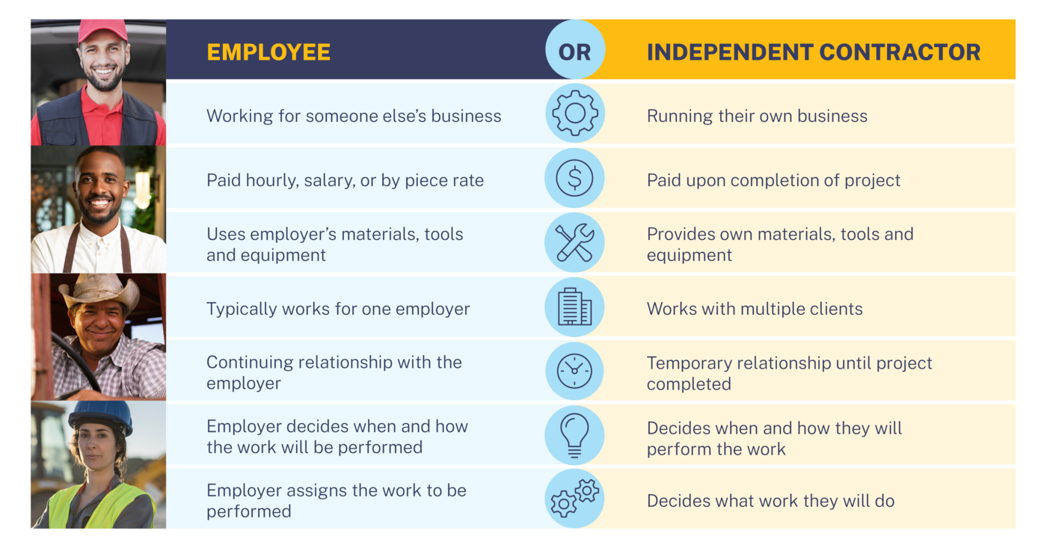
Misclassification
Misclassified employees are
often denied:
Minimum wage
Overtime pay
Health insurance
Workers’ compensation
Unemployment insurance
Notes:
As mentioned in the last slide, a worker must be an employee for the FLSA’s minimum wage, overtime, and youth employment protections to apply. Employers also have record keeping obligations when they hire employees and must refrain from retaliating against workers who seek information about or attempt to exercise their rights.​
This slide shows a screen shot from our “Misclassification” webpage. The image from the page on the right lists characteristics typically associated with being an employee versus an being an independent contractor.
We should note that in March of this year a district court in the Eastern District of Texas vacated the Department’s Delay Rule and stated that the “Independent Contractor Status Under the Fair Labor Standards Act” Final Rule from January 2021, went into effect on March 8, 2021, which was the rule’s original effective date.
The March 2021 Final rule discusses the factors used in making this determination including:
2 CORE Factors:
1. The nature and degree of control over the work, and
2. The individual’s opportunity for profit or loss;
Other Factors: include
3. The amount of skill required for the work;
4. The degree of permanence of the working relationship between the individual and the potential employer; and
5. Whether the work is part of an integrated unit of production
The Misclassification of employees as independent contractors is a focus for the agency. Its’s a serious concern under the FLSA – as well as for businesses and the government generally.
Misclassification denies workers benefits and protections which they are entitled to receive under the FLSA, such as minimum wage and/or overtime pay. WHD remains committed to addressing misclassification of employees as independent contractors. Importantly, employers may not misclassify an employee for any reason under the FLSA.​
As an example of this violation in our day to day work, WHD recovered $435,785 in back wages for 36 restaurant workers at a Minnesota business last June. Among other violations suffered by the employees, the restaurant misclassified cooks and dishwashers as independent contractors instead of employees and paid them a flat rate without regard to the number of hours they worked.
When workers are misclassified, they are denied not only the protections of the FLSA, but also health insurance, workers’ compensation, and unemployment insurance. They bear the tax burden of both the employee and employer contributions and contribute less to social security which results in a reduced benefit. Additionally, law-abiding businesses must compete against an employer working with unfair and artificially lower labor costs, and the federal government loses millions of dollars in tax revenue that funds critical programs. ​

Slide 25

FIND ABCC information and resources and FAQs in Multiple Languages ONLINE
Website Resources: ABCC: https://www.mass.gov/orgs/alcoholic-beverages-control-commission
Frequently Asked Questions https://www.mass.gov/doc/faqsenglish/download
Alcoholic Beverages Control Commission | Mass.gov
Frequently Asked Questions (Multilingual) | Mass.gov

Slide 26
RESOURCES
ABCC Frequently Asked Questions Fall 2022 Update:
https://www.mass.gov/doc/faqs-english/download?_ga=2.160262840.484087346.1704376859-1564321691.1675104142&_gl=1*gpx8zn*_ga*MTU2NDMyMTY5MS4xNjc1MTA0MTQy*_ga_MCLPEGW7WM*MTcwNDQwMjEwOC4xMy4wLjE3MDQ0MDIxMTIuMC4wLjA.
DIA Employer’s Guide to Workers’ Compensation
https://www.mass.gov/info-details/employers-guide-to-workers-compensation

