Slide 1



GIC FY2026

Slide 2

GIC Annual Enrollment for Active/Non- Medicare plans
Harvard Pilgrim Health Care has created this virtual guide to help inform GIC members about Harvard Pilgrim Health Care’s plan offerings available in the upcoming GIC annual enrollment period taking place April 2 – May 1, 2025
For additional information, please visit www.harvardpilgrim.org/gic

Slide 3
Non-Medicare Plans at a Glance
Harvard Pilgrim Explorer POS
Harvard Pilgrim Quality HMO
Harvard Pilgrim Access America
Enrollees must live in CT, MA, ME, NH, RI, or VT
Enrollees must live in mainland Massachusetts — the Cape and Islands are excluded
Enrollees must live in the US outside of CT, MA, ME, NH, RI and VT
Broad network
In Network and Out of Network level of benefits
Network is tiered into Tiers 1, 2, and 3
A PCP and referrals are required to receive care at the In-Network level of benefits
Deductible:
In Network (Medical and Pharmacy Services): Individual - $500/Family - $1000
Out of Network (Medical Services): Individual - $500/Family - $1000
Narrow network
The network is limited to Tier 1 and 2, with no Tier 3 providers and no out of network benefits
Except for emergencies, a PCP and referrals are required to receive care
Deductible:
Individual - $400/Family - $800
Access America is a Harvard Pilgrim-UnitedHealthcare joint venture plan offering a national network for employees throughout the country
Network is not tiered, a flat copay for services with a PCP or specialist
A PCP is not required, but is recommended
Deductible:
In Network (Medical and Pharmacy Services): Individual - $500/Family - $1000
Out of Network (Medical Services): Individual - $500/Family - $1000

Slide 4

How to enroll Enroll in or update your GIC benefits during annual enrollment or within 60 days of a qualifying event
Members are encouraged to review their plan options each year during annual enrollment; if you decide not to make any changes to your coverage, no action is needed.
If you would like to update or change your coverage, please use the secure self-service member benefits portal on the GIC website, MyGICLink, to enroll in or update your benefits and view additional resources available through the GIC.
Login or register for portal access here: MyGICLink Member Benefits Portal | Mass.gov
** If you are an existing member and make no changes to your coverage, you will not receive a new ID card. New members, or those who have made changes will receive an ID card prior to July 1^{st.} **

Slide 5


Dedicated Member Guides
Dedicated member guides which include additional information about:
How This Plan Works
Plan Highlights
Discounts & Savings
And more!
Please visit our dedicated GIC website at www.harvardpilgrim.org/gic

Slide 6
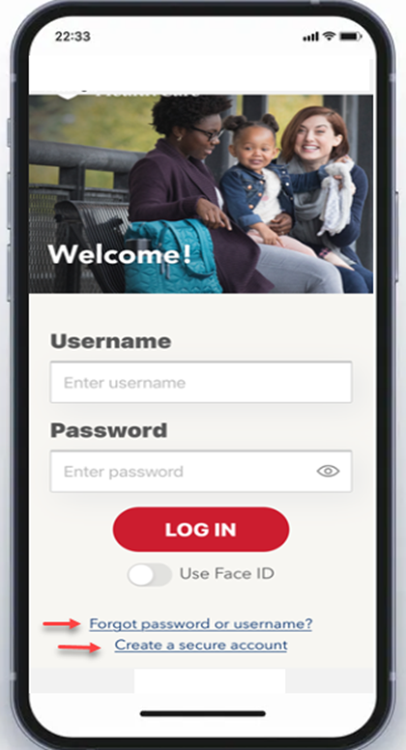
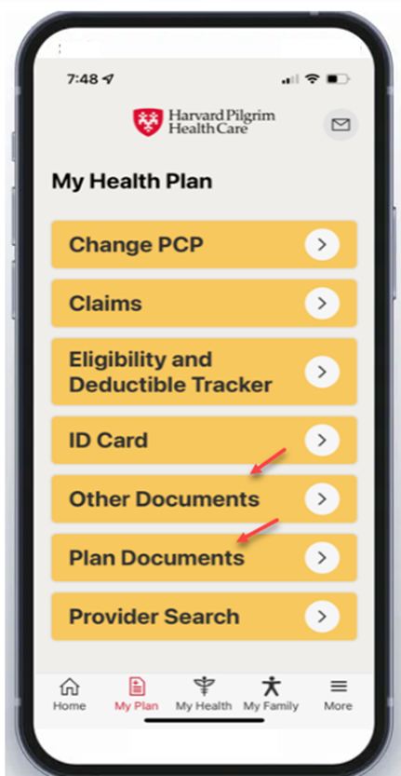
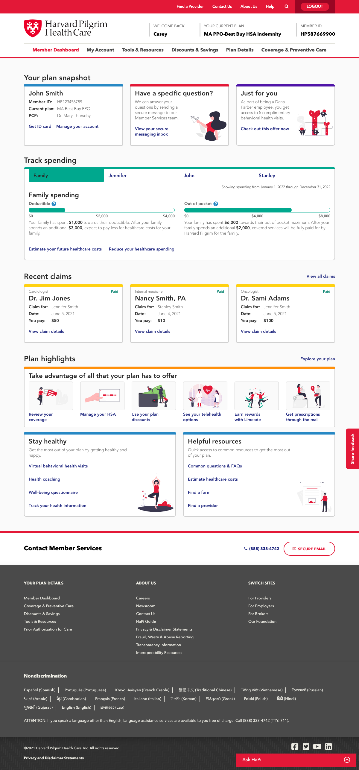
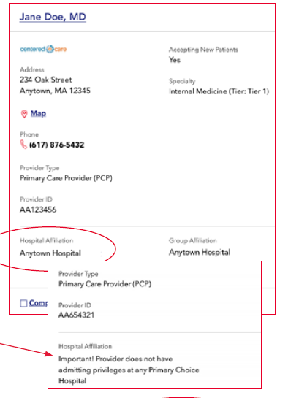
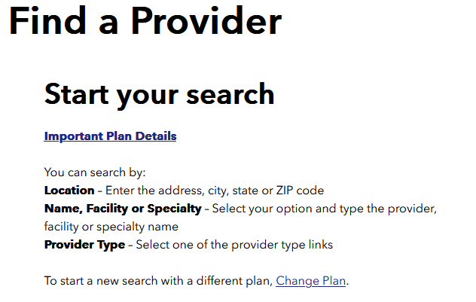
Maximize Your Health: Digital Tools & More
Your secure online account + Mobile App
Access ALL your health plan information
Telehealth through Doctor on Demand
Talk to a doctor by web, phone or mobile app 24/7
Discounts & Savings
Save on a variety of products and services that can help you stay healthy
Find a doctor or hospital
Search for doctors or hospitals by name or location and check provider tier to find out how much you will pay out of pocket
Health Cost Estimator
Help find less expensive options for hundreds of services and procedures

Slide 7

We’re here to help!
Pharmacy coverage:
For prescription benefit information, call CVS Caremark at: (877) 876-7214 or visit: https://info.caremark.com/oe/gichome
Dedicated Member Services Representatives can be reached at:
(844) 442-7324: Quality HMO, Explorer POS, Access America
Representatives are available Monday, Tuesday, and Thursday 8 a.m. to 6 p.m., Wednesday 10 a.m. to 6 p.m. and Friday 8 a.m. to 5:30 p.m.
Dedicated GIC Microsite:
For more information on the Quality HMO, Explorer POS, and Access America plans visit: www.harvardpilgrim.org/gic

Slide 8





Member Discounts & Savings
The GIC provides a $100 individual and $200 for family Fitness reimbursement
Complementary and alternative medicine
Acupuncture
Chiropractic
Tai chi
Mind-body therapies
Mindfulness
Fitness
Marathon Sports (MA)
Runner’s Alley (NH)
Workout Fitness Store (ME)
Appalachian Mountain Club membership
Eyewear discounts
EyeMed network optical providers
Laser vision correction
FREE prescription eyeglasses with a covered routine eye exam at Visionworks
Additional discounts include:
Hearing aid savings
Healthy eating
FREE lifestyle management coaching, e.g., for smoking cessation, nutrition
And more!

