Slide 1


GIC FY2026

Slide 2

GIC Annual Enrollment for Medicare plans
This virtual guide has been created to help inform GIC members about Harvard Pilgrim Health Care and Tufts Health Plan’s plan offerings available to you in the upcoming GIC annual enrollment taking place April 2 – May 1, 2025
For additional information, please visit www.harvardpilgrim.org/gic (Medicare Enhance) or https://tuftshealthplan.com/employer-microsites/gic (Tufts Medicare Preferred)

Slide 3
Medicare Plans at a Glance
Harvard Pilgrim Medicare Enhance
Tufts Health Plan Medicare Preferred*
Enrollees must live in the US
Available to enrollees residing in most of MA, excluding Berkshire, Nantucket, Dukes, and Franklin counties
Supplement Plan: Medicare is Primary
No PCP required
No Network/Referrals: Members may see any provider that accepts Medicare
Enhanced coverage: routine vision, hearing aids, wellness benefits
HMO Plan: Medicare Replacement
PCP and Referrals required
Network: Providers who only participate in the Tufts Medicare Preferred Network
Enhanced coverage: routine vision, hearing aids, wellness benefits
*Tufts Health Plan Medicare Preferred is the only Medicare Advantage plan available to GIC retirees

Slide 4

How to enroll Enroll in or update your GIC benefits during annual enrollment or within 60 days of a qualifying event
Members are encouraged to review their plan options each year during annual enrollment; if you decide not to make any changes to your coverage, no action is needed.
If you would like to update or change your coverage, please use the secure self-service member benefits portal on the GIC website, MyGICLink, to enroll in or update your benefits and view additional resources available through the GIC.
Login or register for portal access here: MyGICLink Member Benefits Portal | Mass.gov
** If you are an existing member and make no changes to your coverage, you will not receive a new ID card. New members, or those who have made changes will receive an ID card prior to July 1^{st.} **

Slide 5


Dedicated Member Guides
We have created dedicated member guides which include how your plan works, plan highlights, discounts & savings, and more!
Tufts Medicare Preferred members can access plan documents, provider directories, and information on discounts and other savings at https://tuftshealthplan.com/employer-microsites/gic
Medicare Enhance members can access plan documents, information on discounts and other savings at www.harvardpilgrim.org/gic

Slide 6
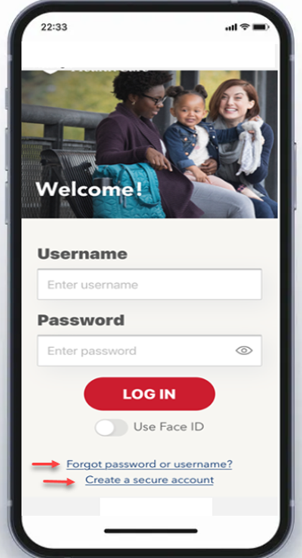
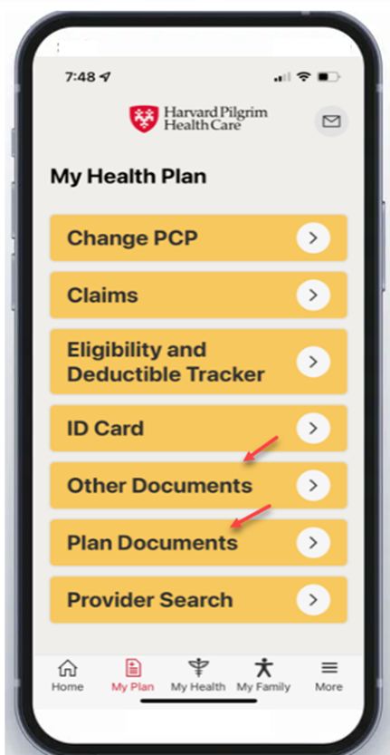
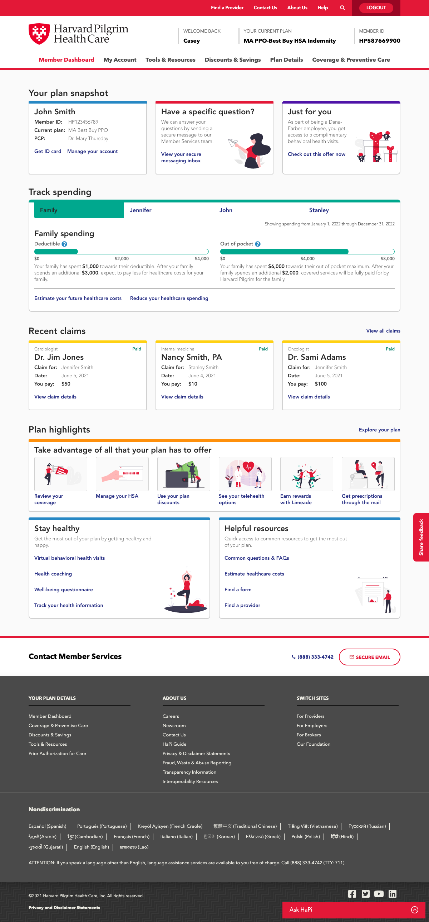
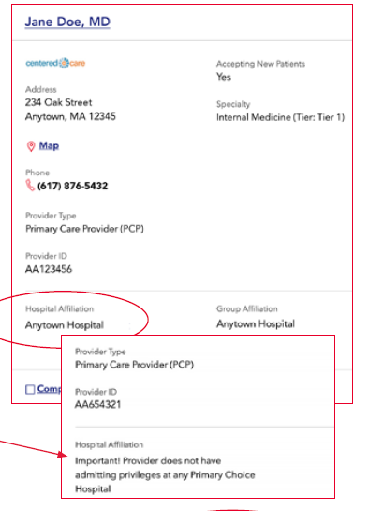
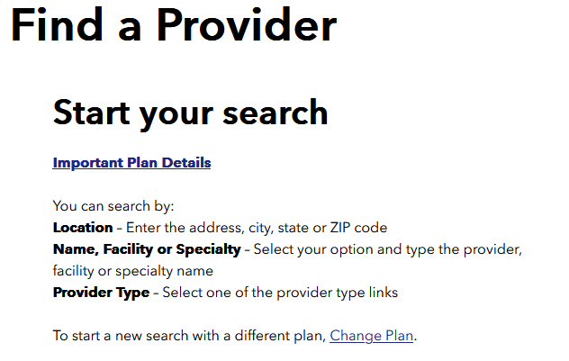
Maximize Your Health: Medicare Enhance Digital Tools & More
Your secure online account + Mobile App
Access ALL your health plan information
Telehealth through Doctor on Demand
Talk to a doctor by web, phone or mobile app 24/7
Discounts & Savings
Save on a variety of products and services that can help you stay healthy
Find a doctor or hospital
Search for doctors or hospitals by name or location and check provider tier to find out how much you will pay out of pocket
Health Cost Estimator
Help find less expensive options for hundreds of services and procedures

Slide 7
Member Support
Member Services:
(844) 442-7324: Medicare Enhance
Hours: Monday, Tuesday, and Thursday 8 a.m. to 6 p.m., Wednesday 10 a.m. to 6 p.m. and Friday 8 a.m. to 5:30 p.m.
(855) 852-1016: Tufts Medicare Preferred
Hours: Monday-Thursday: 8 a.m. to 7 p.m. Fri: 8 a.m. to 6 p.m.
Pharmacy coverage:
SilverScript, an affiliate of CVS Caremark, administers prescription drug benefits for GIC Medicare Rx participants, providing predictable copays and convenient delivery options.
For prescription benefit information, call CVS Caremark at
(877) 876-7214 or visit https://info.caremark.com/oe/gichome

Slide 8





Medicare Enhance: Member Discounts & Savings
$100 Fitness reimbursement
Complementary and alternative medicine
Acupuncture
Chiropractic
Tai chi
Mind-body therapies
Mindfulness
Fitness
Marathon Sports (MA)
Runner’s Alley (NH)
Workout Fitness Store (ME)
Appalachian Mountain Club membership
Eyewear discounts
EyeMed network optical providers
Laser vision correction
FREE prescription eyeglasses with a covered routine eye exam at Visionworks
Additional discounts include:
Hearing aid savings
Healthy eating
FREE lifestyle management coaching, e.g., for smoking cessation, nutrition
And more!

Slide 9





Tufts Medicare Preferred: Discounts & Savings
Eyewear Benefit
$150 per calendar year towards eyewear at an EyeMed Vision Care participating provider, or $90 per calendar year at non-participating providers
Wellness Allowance
$150 per calendar year toward fitness club membership, instructional fitness classes, participation in online instructional fitness classes, nutritional counseling, acupuncture, and/or wellness programs such as memory fitness activities
Hearing Aids
Members 22 and over — First $500 covered in full by the plan, then you pay 20% of the next $1,500 (for both ears combined). Plan coverage is limited to $1,700 per member every 24 months. Member is responsible for any amount over $1,700 every two years
Weight Management Programs
$150 per calendar year towards program fees for weight loss programs such as WeightWatchers, Jenny Craig, or a hospital- based weight loss program

