Slide 1
PowerPoint Accessibility
This is a practice document that contains accessibility errors to fix.

Slide 2
Agenda
Accessibility Assistant
Slide masters and layouts
Text considerations
  Slide titles
  Fonts and colors
  Links
Images
Tables
Charts and graphs
Video and audio
Animations and transitions
Reading order

Slide 3
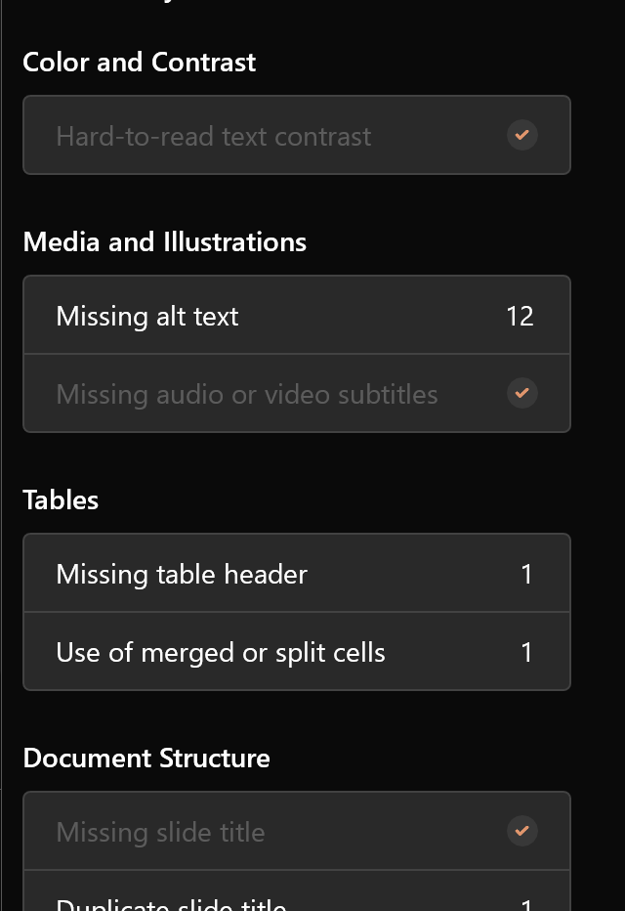
Accessibility Assistant
The Accessibility Assistant in Microsoft PowerPoint is one of the better automated accessibility checkers
Keep the Accessibility Assistant running as you create your slides
Fix any errors it finds

Slide 4
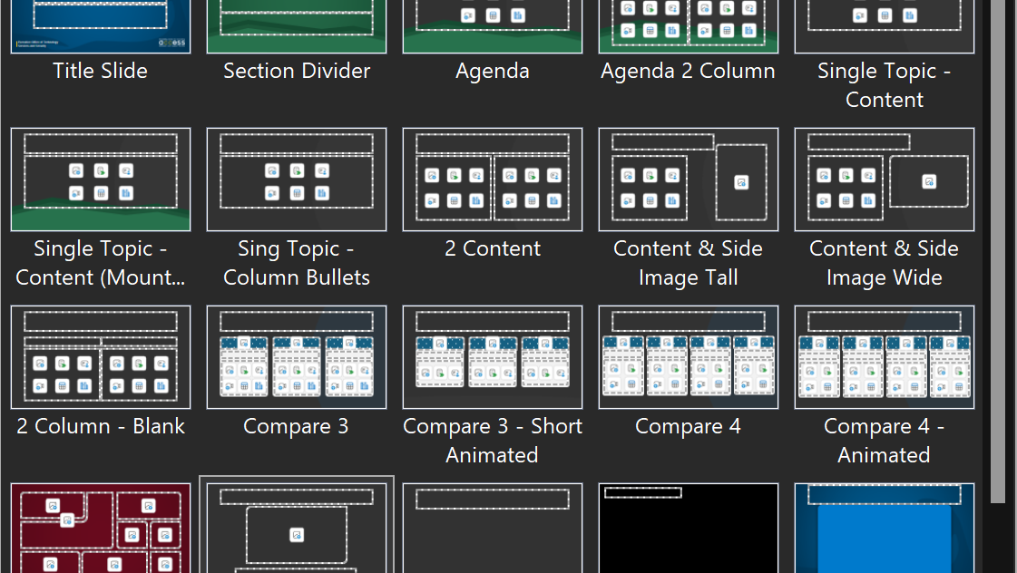
Slide Masters
Different layout masters keep content organized
and minimize reading order adjustments.

Slide 5
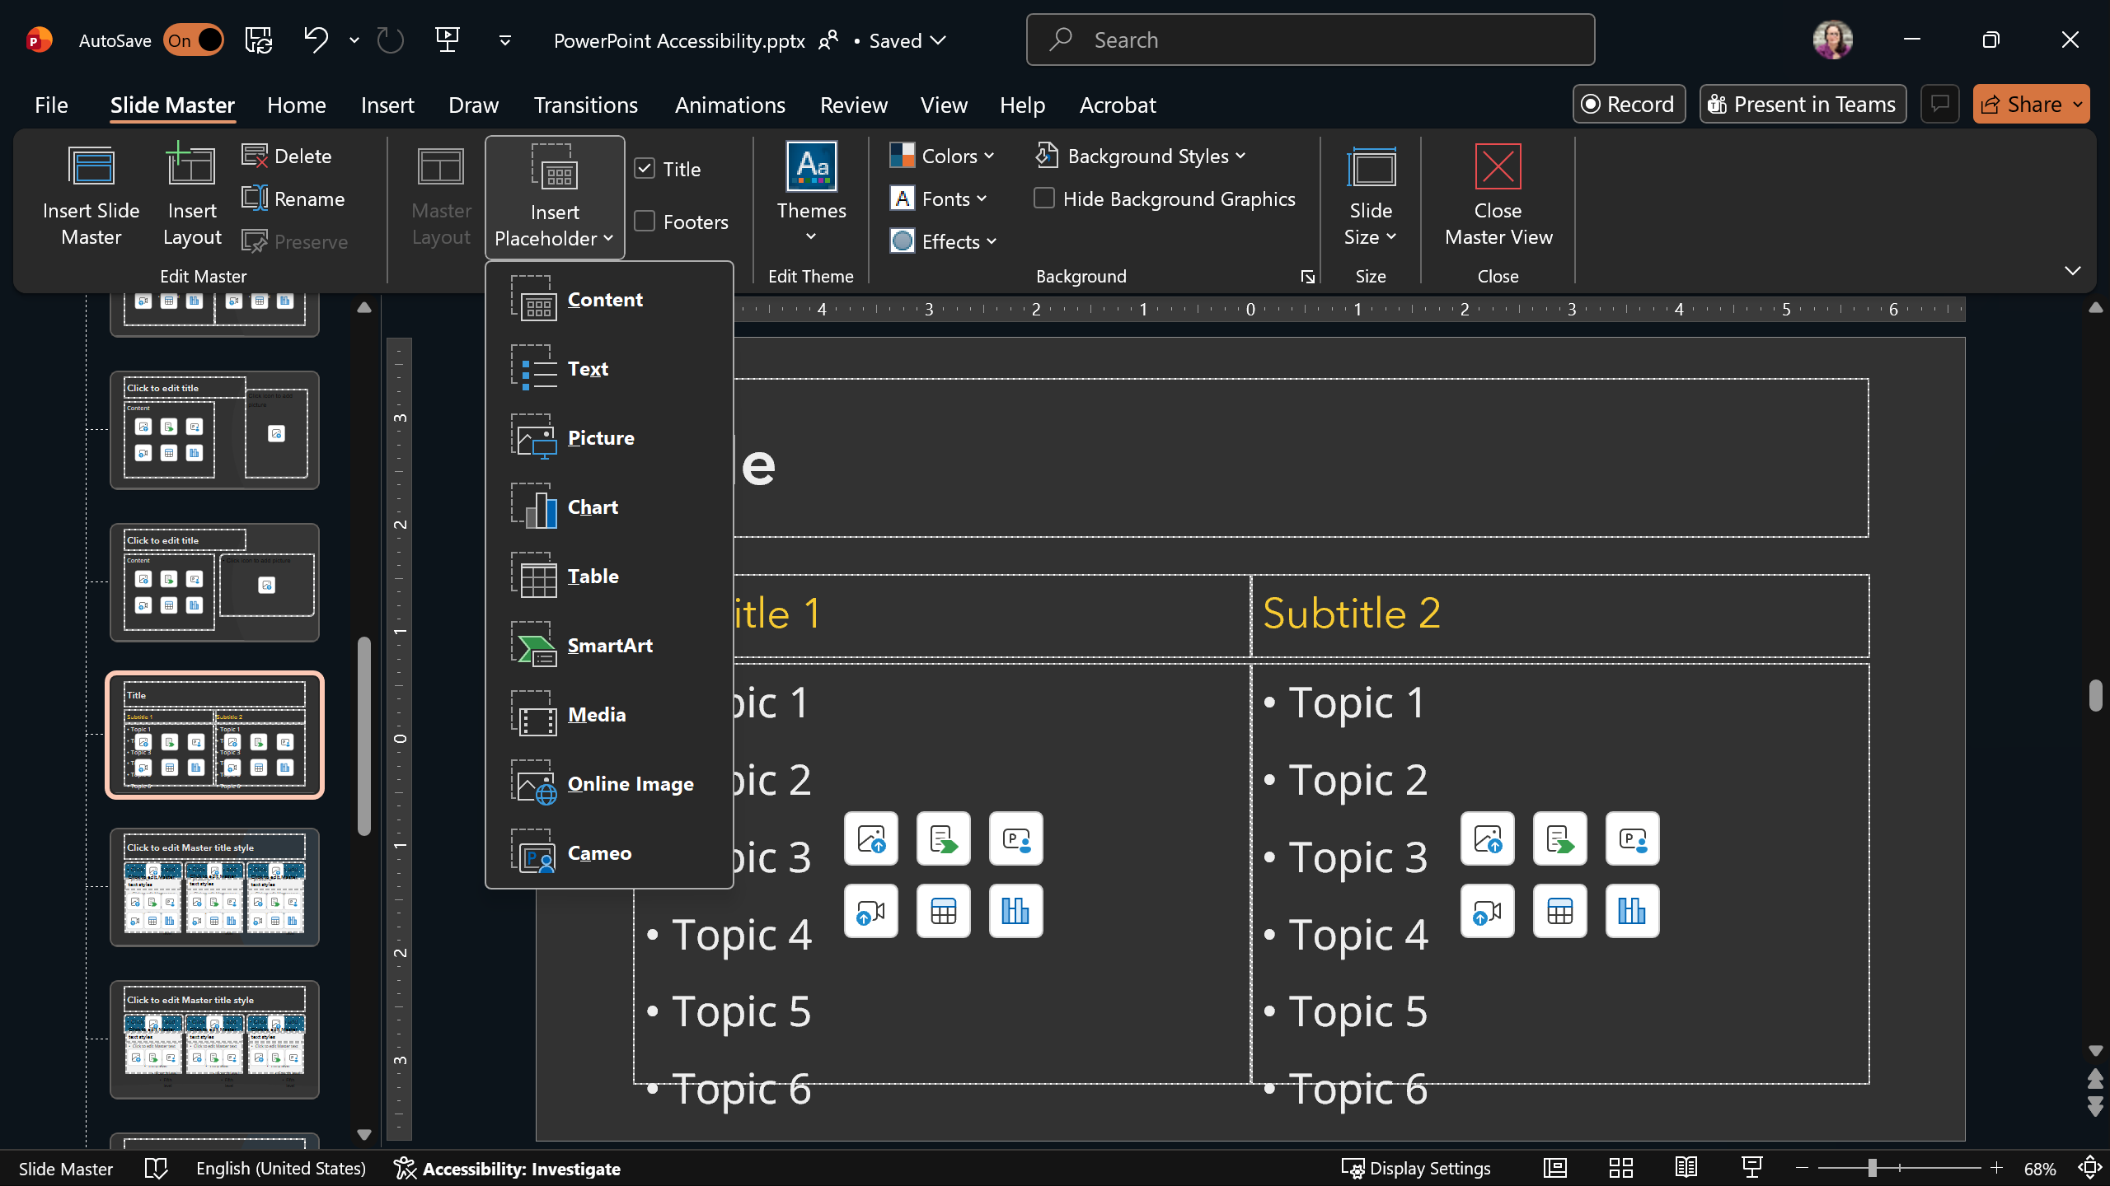
Slide Masters
Insert Placeholders in slide masters rather than textboxes. Placeholders identify the type of content for assistive technology.

Slide 6
Text Considerations
Every slide must have a title
Each slide title must be unique
Fonts should be clear, legible, and consistent
Minimum text size = 18 pts
Text must meet contrast requirements (4.5:1)
  Note that the Accessibility Assistant did not catch this bad color contrast above, because it is a custom background slide, and did not use a built-in design theme.
For hyperlinks, consider the context of the slide deck

Slide 7



Hyperlinks
Live, in-person
Live, virtual
Self-paced
Create a single document with all resources as a digital handout
Include a QR code with a shortened link
Create a single document with all resources as a digital handout
Include a shortened link
Properly format URLs behind meaningful and unique text
Avoid QR codes

Slide 8

Images
Consider the purpose of the image
All images either need alt text or to be marked as decorative
Always check auto-generated alt text

Slide 9
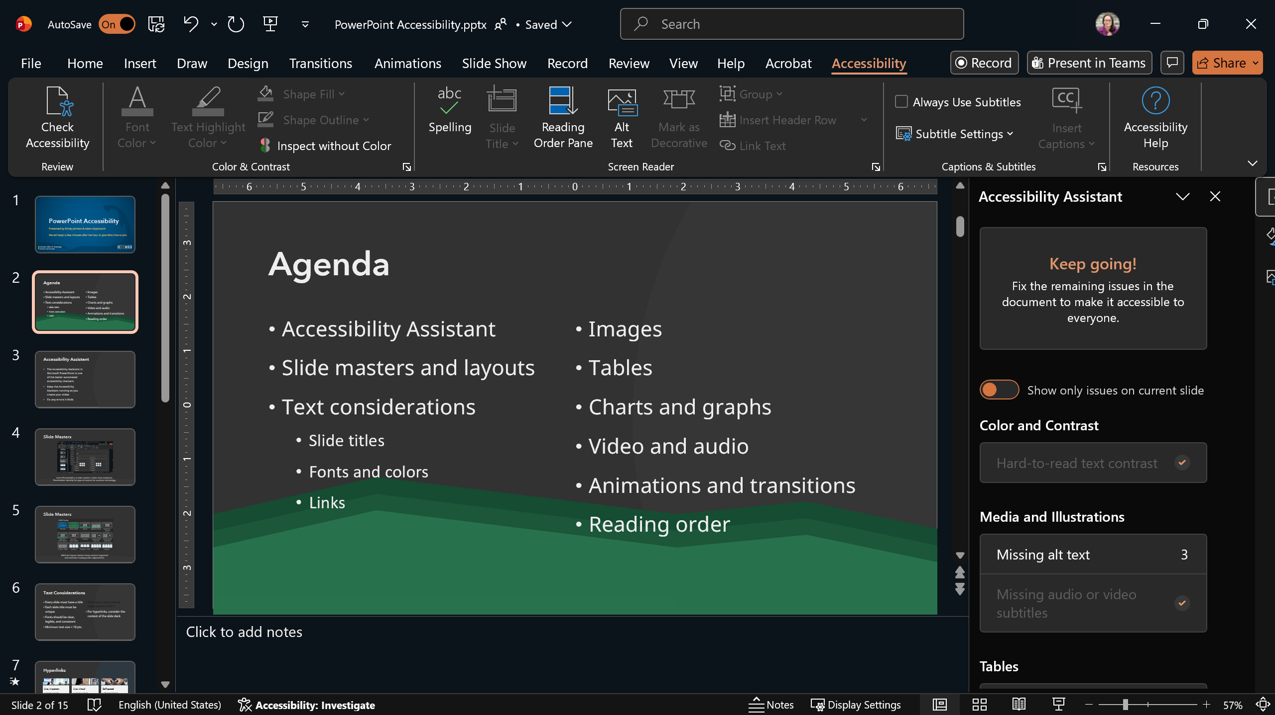
Complex Images
Accessibility Ribbon
Accessibility Assistant
Notes:
Screenshot of the Microsoft PowerPoint interface with an open slide deck. A callout labeled “Accessibility Ribbon” points to the Accessibility ribbon at the top of the PowerPoint interface. This ribbon is active in the screenshot. A callout labeled “Accessibility Assistant” points to three areas of the interface: The Check Accessibility tools on the left side of the ribbon, the open Accessibility Assistant in the right sidebar, and the Accessibility overview at the bottom of the PowerPoint window.

Slide 10
Tables
Disability Prevalence by Disability Type in Massachusetts, 2020-2022
Disability Type |  | 2020 | 2021 | 2022
Cognitive |  | 10.2% | 11.7% | 13.9%
Hearing |  | 4.5% | 5.1% | 5.6%
Mobility |  | 9.3% | 9.6% | 9.6%
Vision |  | 3.6% | 3.5% | 4.9%
Self-care |  | 2.9% | 3.0% | 3.0%
Independent living |  | 6.2% | 5.8% | 6.5%
Any Disability |  | 22.6% | 23.5% | 26.4%
Centers for Disease Control and Prevention, National Center on Birth Defects and Developmental Disabilities, Division of Human Development and Disability. Disability and Health Data System (DHDS) Data [online]. https://dhds.cdc.gov

Slide 11
Charts and Graphs
Slide 16: Prevalence of Disability Types in Massachusetts (Ages 18-64 | 2023)

Slide 12

Videos
Ensure the video has captions and display those captions
Include a transcript
Display the audio described version, if available

Slide 13


Animations and Transitions
Animations are added to slide elements. Transitions happen between slides.
Minimize the number and types of animations and transitions
Avoid blinking, flashing, rotating, or looping

Slide 14
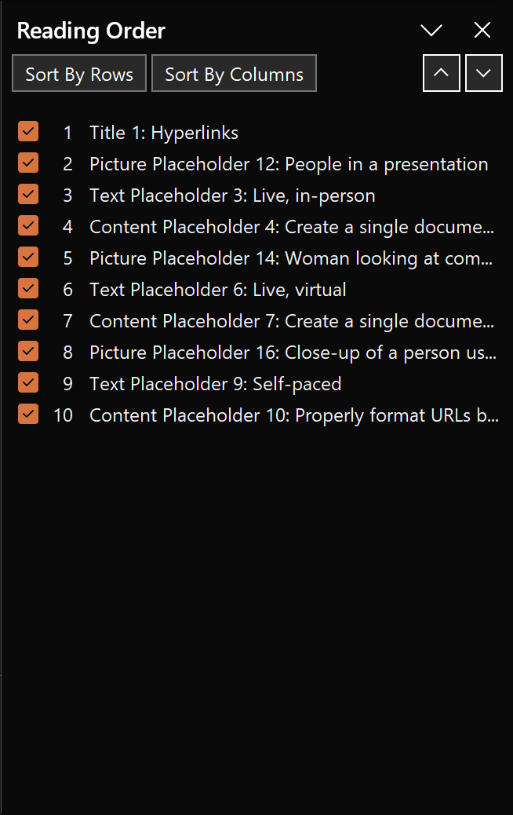
Reading Order
Each slide must have a defined reading order from top to bottom
Items can be marked as decorative in the Reading Order Pane
Outline View will also provide reading order information

Slide 15

Sharing Your Slides
Consider the contexts in which your audience will access the slides
Create a digital document to share rather than your slide deck
Do not convert to PDF

Slide 16
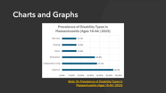

Slide 11 Details: Prevalence of Disability Types in Massachusetts (Ages 18-64 | 2023)
Disability Type | Percentage
Cognitive | 54.4%
Independent Living | 37.2%
Ambulatory | 34.9%
Vision | 15.4%
Hearing | 15.3%
Self-care | 15.1%

