Slide 1
WCAA Spring Meeting
March 18, 2026
Afternoon session - MassGIS
Addressing Best Practices, ADUs, Assessor Attribute Impacts on the Massachusetts Master Address Database (MAD), and Suggestions on how to Improve Data Quality
Dan Marrier
Senior GIS Specialist and Database Architect, MassGIS, EOTSS

Slide 2

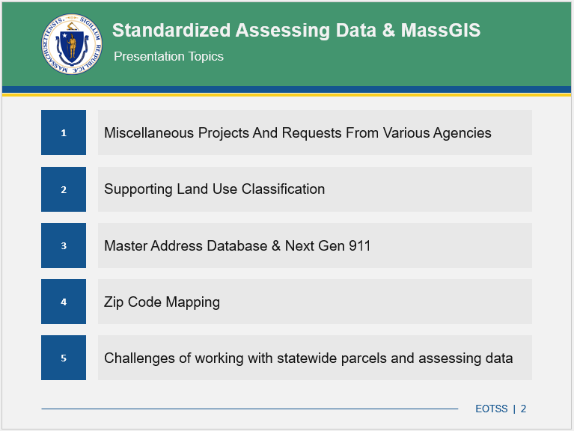
Previous Relevant Presentation
October 2024 MAAO presentation discussed several topics relevant to this one.
https://www.mass.gov/doc/the-utility-and-importance-of-parcels-and-assessor-records-in-massgis-projects
Notes:
There will be some repetition, but primarily in the context of today’s addressing guidance and how it will continue to affect the work MassGIS does.

Slide 3

Addressing Best Practices
Massachusetts Municipalities Address Standard
https://www.mass.gov/doc/municipal-address-standard
Written by previous MassGIS Director and released in 2016, under
authority granted by MGL Chapter 7D, Section 5
Contents influenced by national addressing guidance (FGDC, NENA)
as well as input from public and private stakeholders
Questions about addresses should be sent to Massgismail@mass.gov with the subject line “address issue”
Notes:
FGDC = Federal Geographic Data Committee, NENA = National Emergency Number Association (911). IETF = Internet Engineering Task Force
“They extend and improve upon USPS mailing address standard (Publication 28), but are mostly compatible with it”
Highly recommended to use this document as an addressing resource, but I will summarize some of it today, particularly chapters 4 and 5.

Slide 4
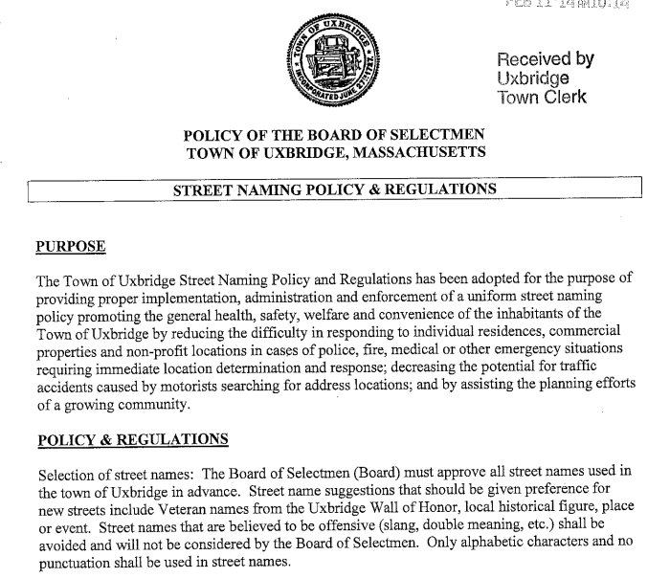
Addressing Best Practices – Street Naming
Street Naming Authority
(Assumes) Municipality has
authority within its boundaries
One designated naming
authority recommended
Workflow should be
documented and transparent
Naming private ways does
not imply acceptance
https://www.uxbridge-ma.gov/sites/g/files/vyhlif3971/f/uploads/streetnamingpolicyregulations.pdf

Slide 5
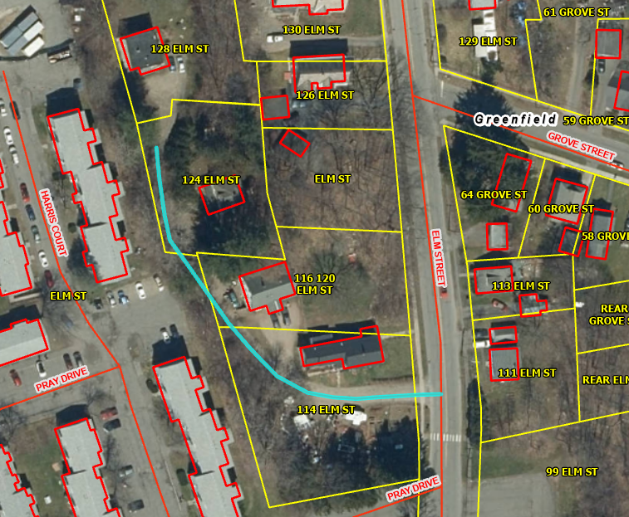
Addressing Best Practices – Street Naming
When Street Names Are Needed (Scenario 1)
Name any street, access road, or long shared driveway serving 2+
developed parcels

Slide 6
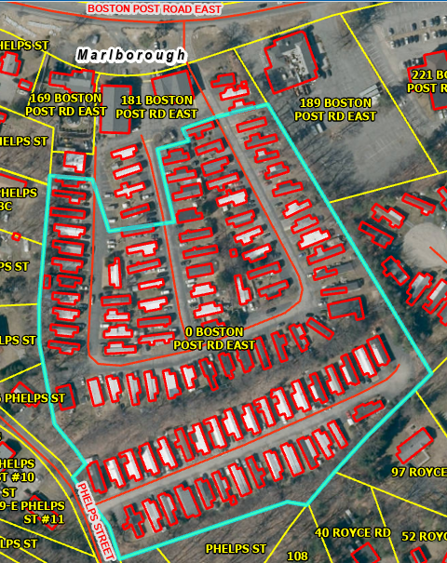
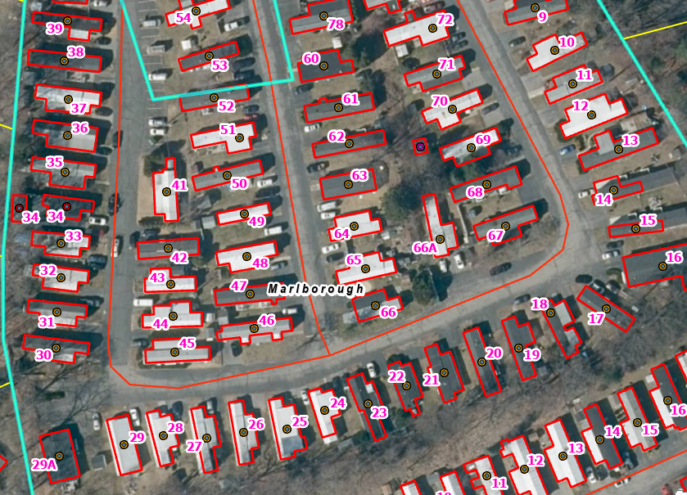
Addressing Best Practices – Street Naming
When Street Names Are Needed (Scenario 2)
Internal roads on large sites
should be named to avoid
public safety confusion

Slide 7
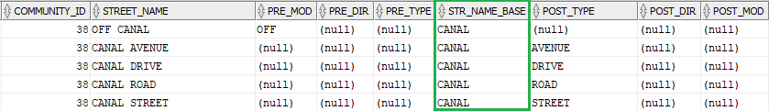
Addressing Best Practices – Street Naming
Name Selection And Formatting
Spell out all parts of official street names (with a couple exceptions)
“ST JOHN ST” → “SAINT JOHN STREET” (and “DR” = “DOCTOR” or “DRIVE”)
“MASS AVE” → “MASSACHUSETTS AVENUE” or is “MASS” intentional?”
“X-ROAD EXT” → “CROSSROAD EXTENSION” vs. “CROSS ROAD EXTENSION”
“2nd ALLEYWAY” → “SECOND ALLEY WAY”
“STONY MT RD” = “STONY MOUNT ROAD” or “STONY MOUNTAIN ROAD”?
Avoid duplicate base names (“I’m at the corner of Main and Canal…”)

Slide 8
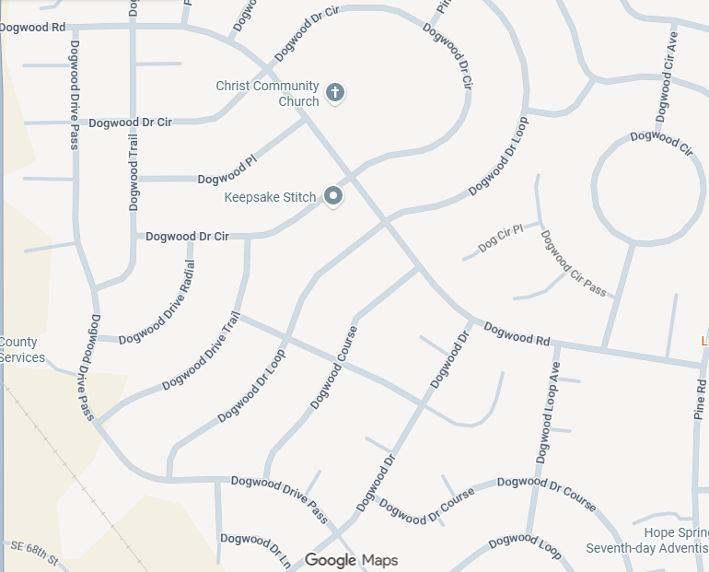
Addressing Best Practices – Street Naming
Name Duplication
Silver Springs Shores
Florida
Dogwood Drive Pass
Dogwood Drive Circle
Dogwood Place
Dogwood Drive Radial
Dogwood Drive Trail
Dogwood Drive Loop
Dogwood Drive Lane
Dogwood Drive
Dogwood Circle
Dogwood Circle Pass
Dogwood Circle Court
Dogwood Circle Ave
Dogwood Circle Road
Dogwood Loop Ave
Dogwood Course
Dogwood Drive Course
Dogwood Loop
Dogwood Road

Slide 9
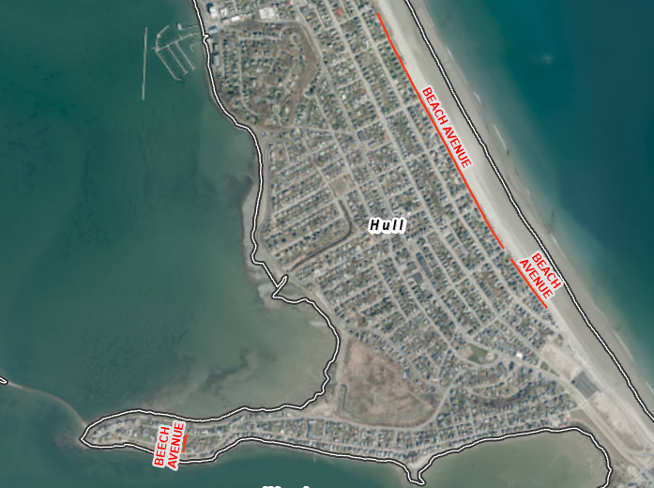
Addressing Best Practices – Street Naming
Street Naming Guideline
Avoid similar-sounding names…
Main Street vs Maine Street
Beach Ave vs Beech Ave →
Fairview Rd vs Fareview Rd
Deer Run vs Dear Run
Knight Street vs Night Street
Plain Road vs Plane Road
C Road vs Sea Road
Jay Street vs J Street
One correct name per street
  Not every alias or alternate name may be known to everyone
  Shared jurisdiction over a single street can also create confusion

Slide 10
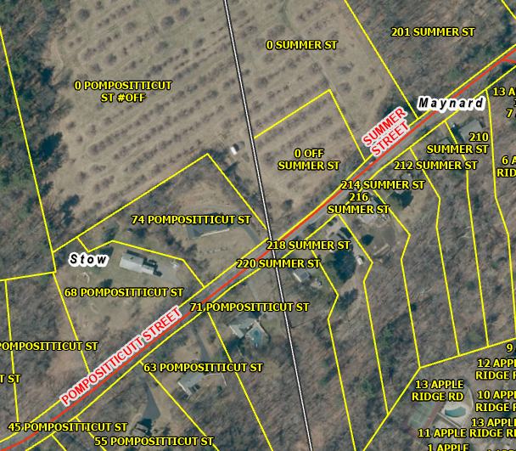
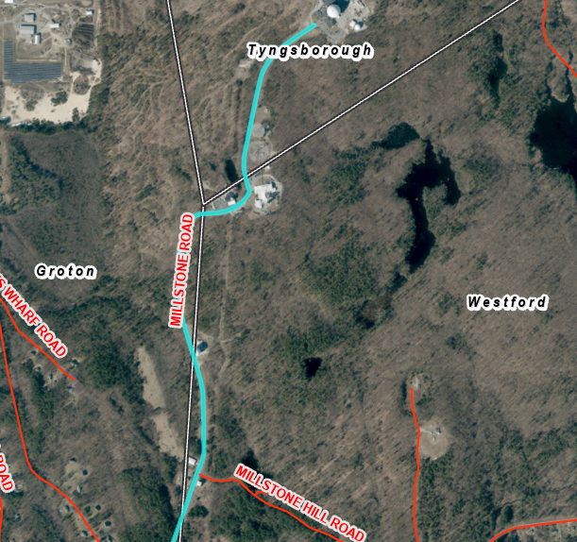
Addressing Best Practices – Street Naming
Street Names At Boundaries
Name may change at municipal boundary, but if boundary follows the
ROW, preserve the name
Name Change Acceptable (but not required)
Name Stays Consistent

Slide 11
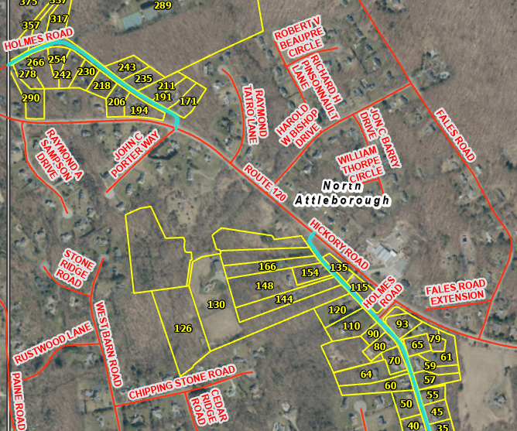
Addressing Best Practices – Street Naming
Renaming Streets
Consider renaming non-contiguous duplicate names

Slide 12
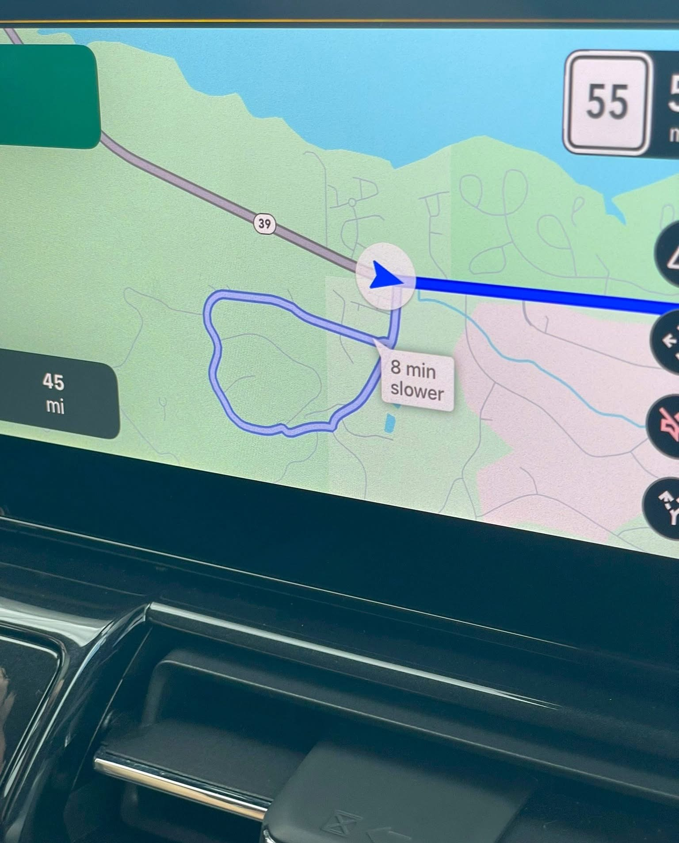
Addressing Best Practices – Street Naming
Technology Challenges
GPS has made life easier,
but can’t always be
trusted either…
Courtesy of @TerribleMaps

Slide 13
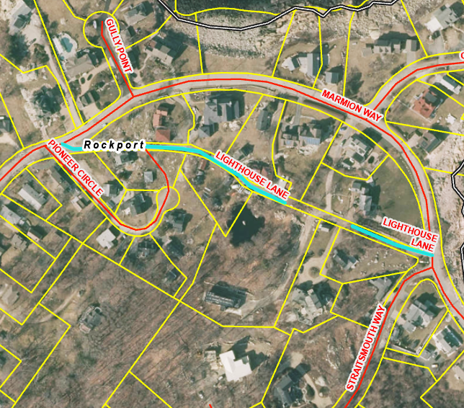
Addressing Best Practices – Street Naming
Renaming Streets (example 2)
Add directionals if street permanently divided
Generally, violations of
best practices in street
naming are candidates
for renaming consideration
(see Section 6 of standard
for guidance)

Slide 14
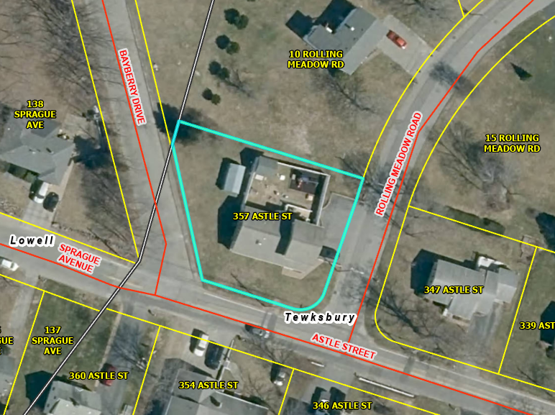
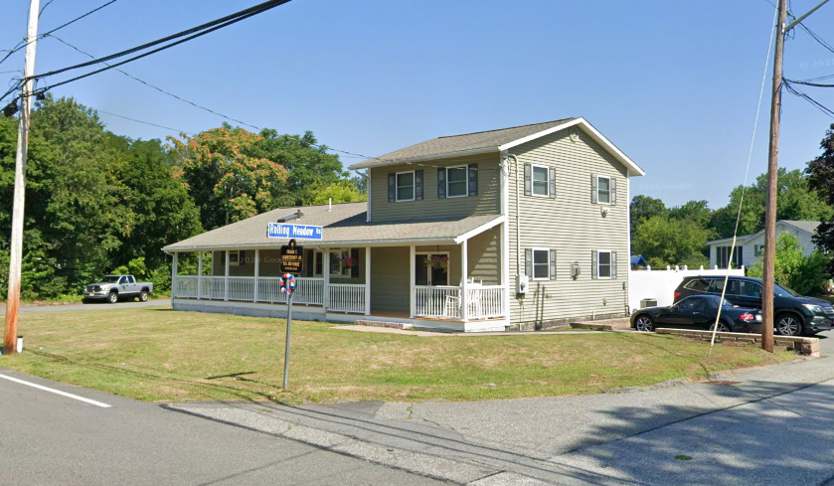
Addressing Best Practices – Street Naming
Street Names in Addresses
The street name used in a building’s address should reflect the street
that is used to provide primary access to the building.

Slide 15
Addressing Best Practices – Street Address Numbers
When to Assign Address Numbers (Scenario 1)
Assign to every substantial structure with distinct occupancy and active
use
Examples that qualify:
1. Side-by-Side Two-Family Structure
2. Converted Carriage House with Independent Access
3. Commercial Building with Two Ground-Level Storefronts
4. Industrial Building Divided into Fully Separated Bays
5. 2+ Standalone “Substantial” Buildings on Same Parcel
Examples that don’t qualify:
1. Detached Garage Serving a Residence
2. Storage Shed or Barn
3. Accessory Workshop for Homeowner
4. Interior Subdivision of a Building
5. Vacant or Inactive Structure

Slide 16
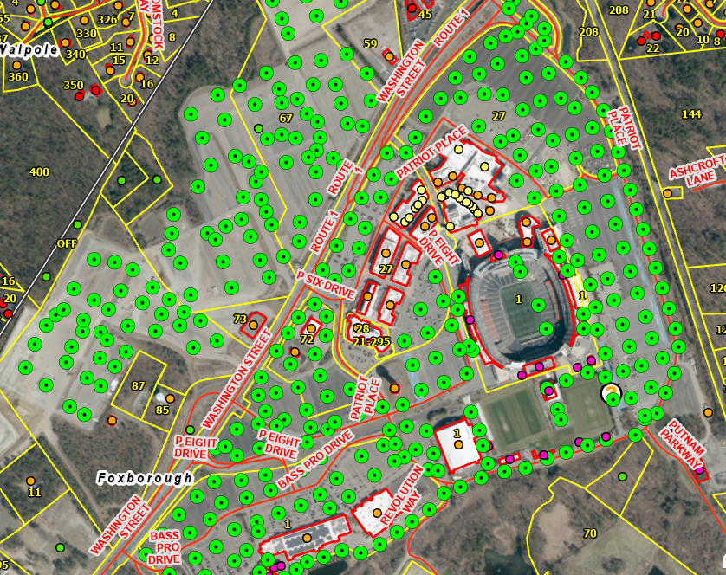
Addressing Best Practices – Street Address Numbers
When to Assign Address Numbers (Scenario 2)
Public safety concerns may allow some flexibility…

Slide 17
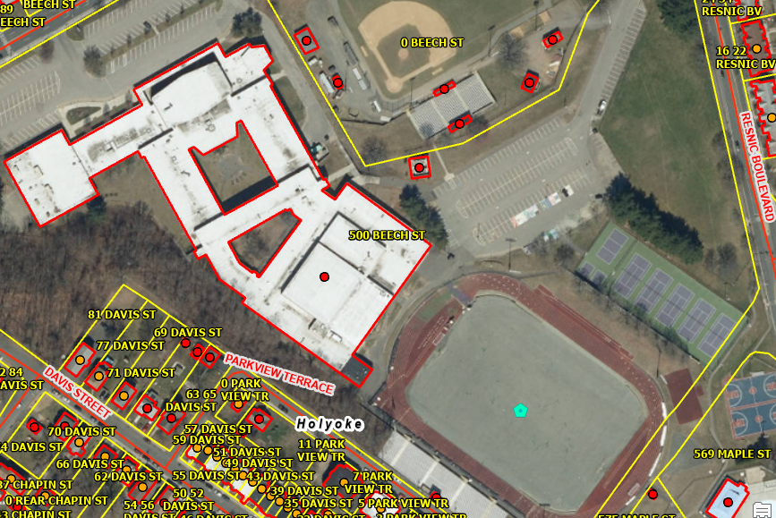
Addressing Best Practices – Street Address Numbers
When to Assign Address Numbers (Scenario 3)
Parks, fields, and other places may receive numbers if needed
Roberts Field
assigned a civic address of
‘86 Resnic Blvd’ per public safety request

Slide 18
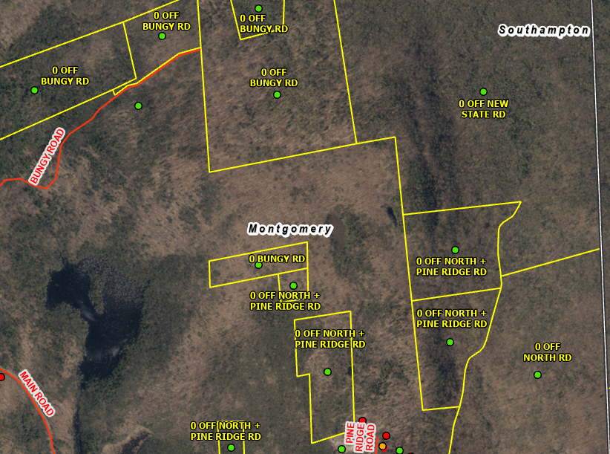
Addressing Best Practices – Street Address Numbers
Address Numbers and Vacant Parcels
Should vacant parcels receive an address / address number?
More specific ancillary guidance has been considered by MassGIS
(shared later in this presentation)
From Section 6.4.1: “This is generally a good idea, as it provides a useful identifier for record-keeping and for fieldwork, but you need to consider what happens to the address when the parcel is subdivided or multiple structures built on it. An orderly process for ‘retiring’ or transferring the original address is needed.”

Slide 19
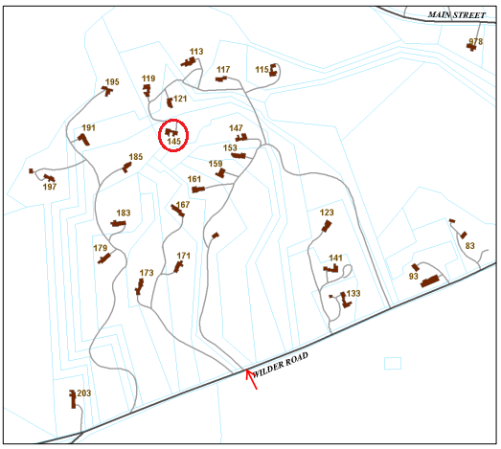
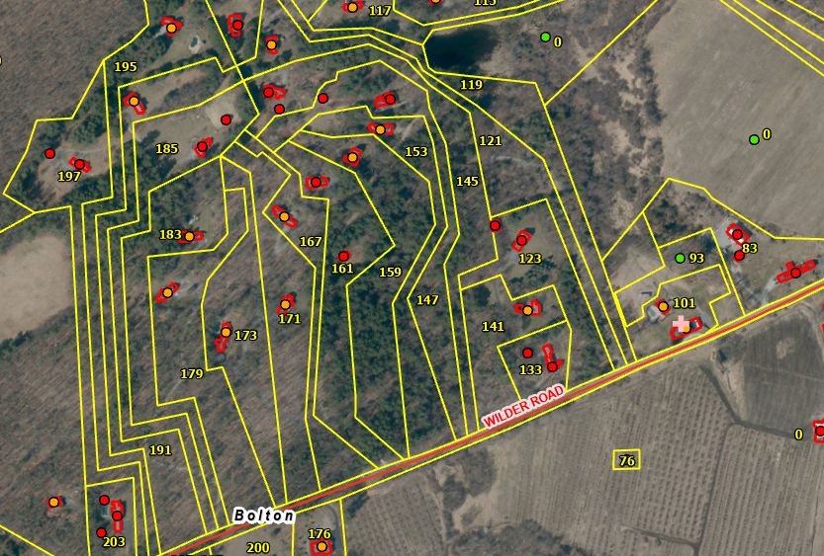
Addressing Best Practices – Street Address Numbers
Parity and Sequence
Even numbers on one side, odd on the other, ascending logically
Assign based on
driveway access
point, not frontage
of parcels
Preserve numeric
sequence at all
times

Slide 20
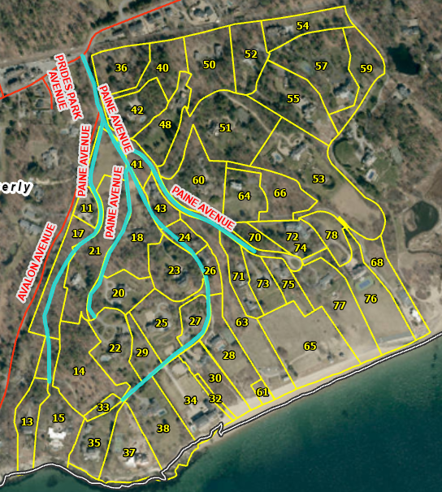
Addressing Best Practices – Street Address Numbers
Parity and Sequence (Example 2)
When street name and
numbering best practices are
both not followed…

Slide 21
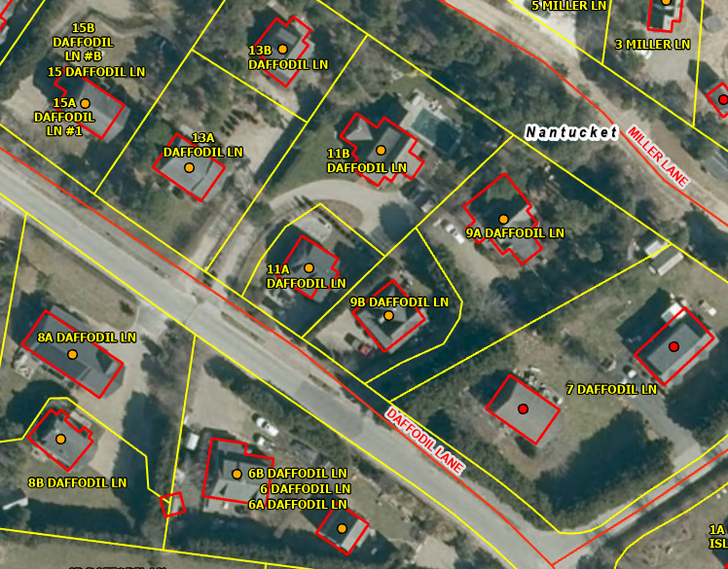
Addressing Best Practices – Street Address Numbers
Formatting of Street Numbers
Use whole numbers and avoid fractions for new assignments
Use alpha suffix only
when necessary
(to maintain sequence)

Slide 22
Addressing Best Practices – Street Address Numbers
Formatting of Street Numbers (General Guidance)
Avoid unnecessary punctuation or spaces
“12A”, not “12 A” or “12-A”
Decimal values like “10.5” are not recommended either
Relative Locational Terms are not address numbers
Dashes only included when representing an address range
  “12A-12B” is allowable as needed
White space only included when fractions are involved
“22 ½”, “4-4 ½”
“&” is preferable to “+” or “AND”

Slide 23
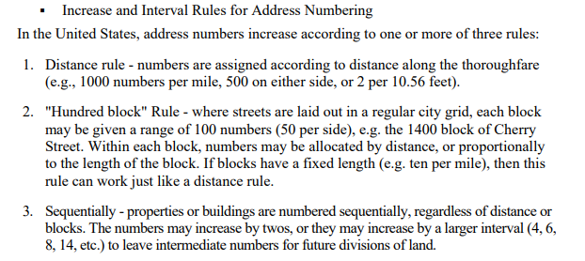
Addressing Best Practices – Street Address Numbers
Planning For Future Development
Increment numbers at fixed intervals
(from https://www.fgdc.gov/standards/projects/address-data/AddressDataContentStandardPart2/at_download/file)
Allow spacing for infill
Avoid renumbering later

Slide 24
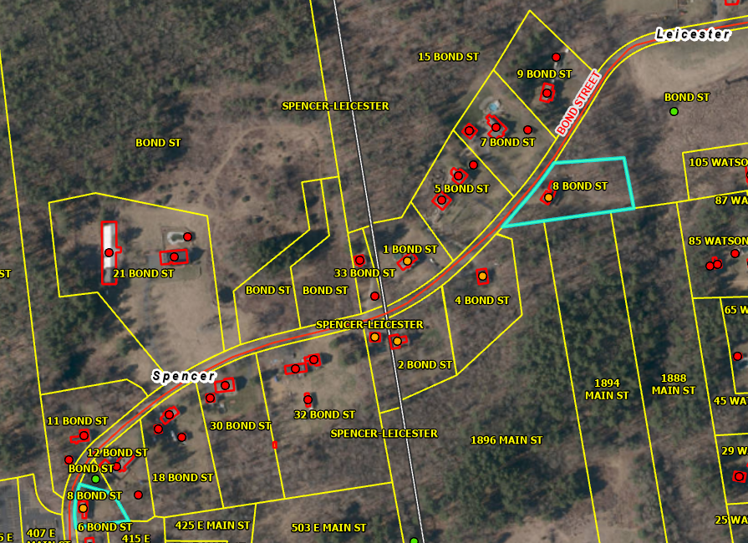
Addressing Best Practices – Street Address Numbers
Address Numbers at Boundaries
If street name stays the same, numbering should continue in sequence
Restarting
numbering at
boundary is not
recommended
Sequence and
parity must
remain consistent
Cross-boundary
numbering must
align with access
location

Slide 25
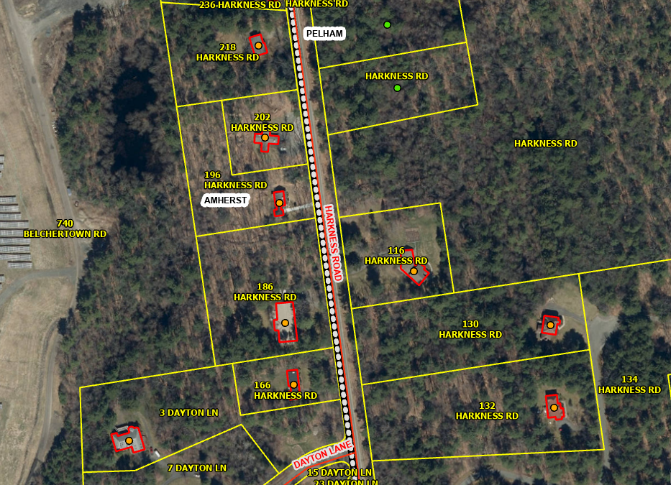
Addressing Best Practices – Street Address Numbers
Address Numbers at Boundaries (Example 2)
Parity and Sequencing violations at town boundary

Slide 26
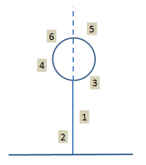
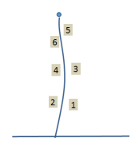
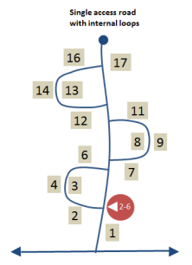

Addressing Best Practices – Street Address Numbers
Special Street Configurations
Numbering should follow intuitive travel patterns.
Apply consistent numbering rules to:
Dead-end streets
Cul-de-sacs
Loop roads
U-shaped configurations
One-way loops

Slide 27
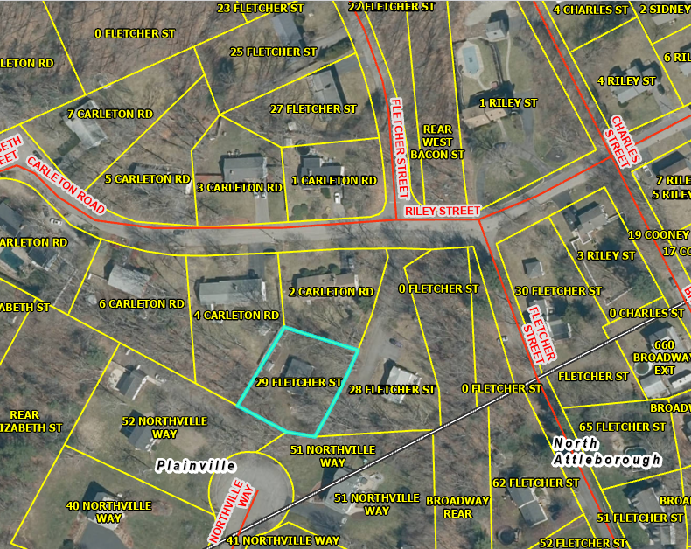
Addressing Best Practices
Diagnose Problems and Consider Solutions
Pop Quiz!
Describe the issues with 29 Fletcher Street and possible solutions.

Slide 28
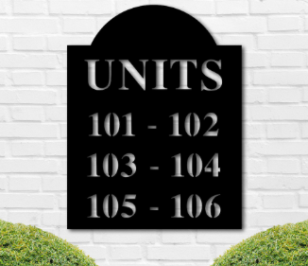
Addressing Best Practices – Subaddressing
Assignment of Unit Identifiers
Owner should be responsible for assigning
unique identifiers
Must match visible signage and be
unambiguous
Sequential identifiers preferred
Prefer floor-based identifiers (1A, 2B)
with multiple floors
Avoid positional identifiers (Rear, Left) unless exterior access
Units must be unique across multi-building sites (incorporating building IDs when needed)
Store unit identifiers separately from unit types (“Unit”, “Apt”, etc…”)

Slide 29
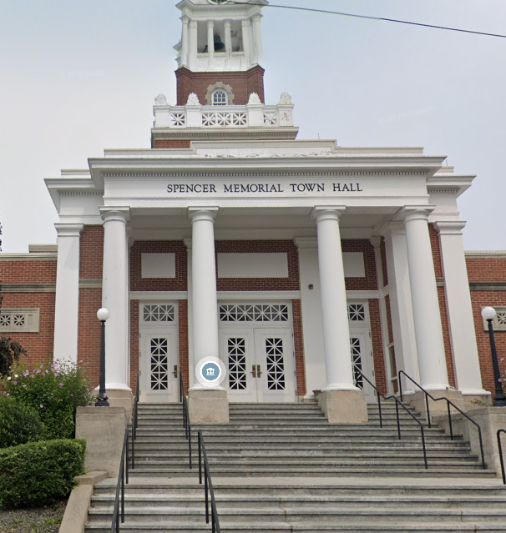
Addressing Best Practices – Subaddressing
Assignment of Building Identifiers
Multiple substantial structures on same parcel should have identifiers
Owners responsible for documenting identifiers
Must support public safety response
Use descriptive or proper names if able
Include type word if sequential (Building 1)
Identifiers must be unique within site

Slide 30
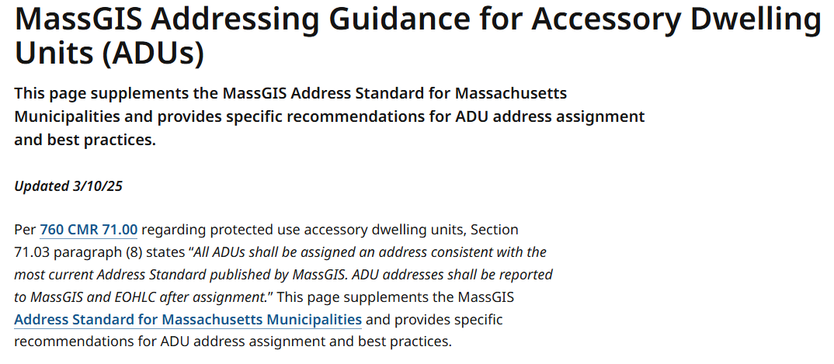
Addressing Best Practices
Accessory Dwelling Units (ADUs) - Guidance
Supplemental addressing guidance was developed for ADUs, per the
request of the Executive Office of Housing and Livable Communities
(EOHLC)
https://www.mass.gov/info-details/massgis-addressing-guidance-for-accessory-dwelling-units-adus

Slide 31
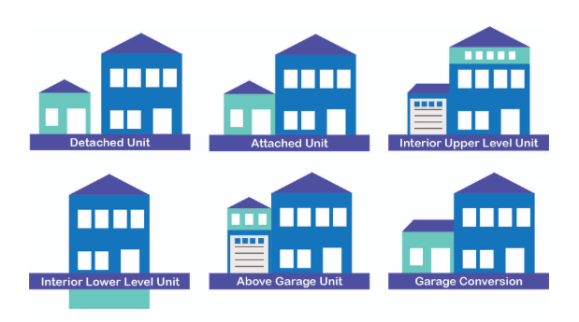
Addressing Best Practices
ADU Configurations
ADUs are generally categorized in 3 possible configurations…
Detached Units
Attached Units
Internal Units

Slide 32
Addressing Best Practices
ADU Addresses… Address Number Suffixes vs. Unit
Every ADU should receive an address that is compliant with best
practices and uniquely distinguishes it from any other address in the
municipality. The ADU should be assigned the same street name as the principal dwelling and an address number that matches the numeric portion of the principal dwelling’s address number, but…
Use an address number suffix when access is only available through
a dedicated exterior entry (e.g. “19 Pine St.” → “19A Pine St.”)
    All detached ADUs
    Any attached or internal ADUs with no interior access to primary residence
OR
Assign a Unit identifier when the ADU is accessible through an interior
hallway/stairwell/doorway in the principal dwelling without having to
exit the building (e.g. “19 Pine St.” → “19 Pine St., Unit 1”)

Slide 33
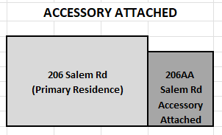
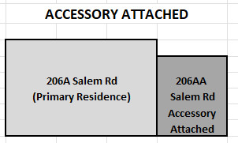
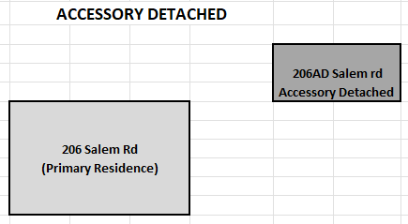
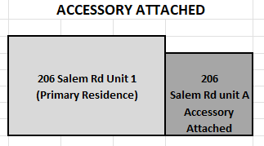
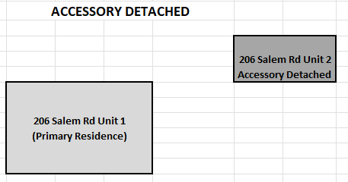
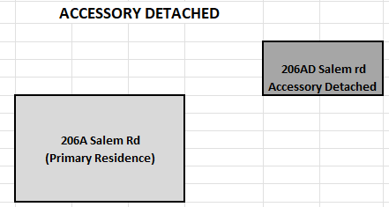
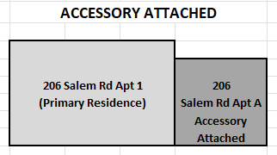
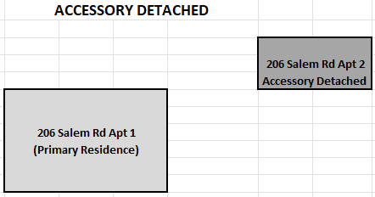
Addressing Best Practices
ADU Addressing USPS Recommendations
Examples provided by USPS Address Management Systems Manager
for the Massachusetts and Rhode Island district…
MassGIS guidance is similar, but there are some small conflicts…

Slide 34
Addressing Best Practices
Notification and Synchronization
Report new addresses and address retirement promptly…
Addressing Authority
Town Clerk
Engineering
Public
Works
Public
Safety
Building Dept
MassGIS
EOHLC
Planning
Assessing
Update GIS, CAMA, and all other municipal departments together
Keep systems aligned
MassGIS
notify911address@mass.gov
EOHLC (for ADUs)
EOHLC-ADUaddresses@mass.gov
Google Maps Content Partners (GMCP)
https://contentpartners.maps.google.com/

Slide 35

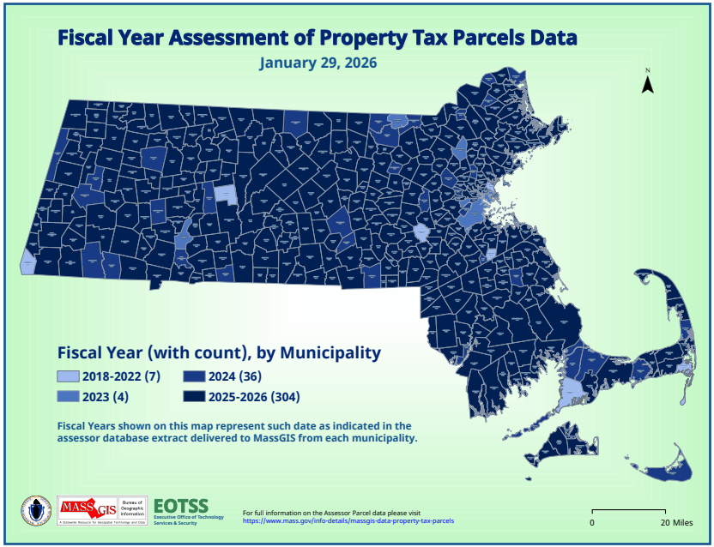


Assessing Data
Notification and Synchronization
State 911 Parcel Map and Address Update Requirements
Parcel Mapping Dashboard (on ArcGIS Online)

Slide 36

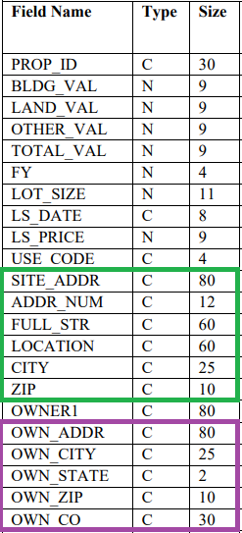
Assessing Data
Standardized Address Attributes
Digital Parcel Standard discusses both
geographic and attributional requirements
Property Address
Owner Address

Slide 37
Assessing Data
Property Address Attributes
SITE_ADDR = “Contains the complete original site address as listed in the tax record. Additionally, in many input address records, there will be secondary location information to specify the relative or absolute location of the property, the unit number etc..”
ADDR_NUM = “Contains address number information, either a single house number with alpha prefix (this is extremely rare) or fractional or letter suffix (e.g. A14, 25, 103 ½ or 12A) or a range of valid address numbers (e.g., 12-16 or 12A–12B). The only characters permitted are numbers, letters, “/” for fractional addresses and hyphens separating ranges of numbers as well as “&” or ”+” to indicate a collection rather than a range.”
FULL_STR = “Contains the full street name, which may be stored in separate fields in the assessor database.”
LOCATION = “Secondary location information. Frequently, descriptors such as “Side”, “South Side”, “Rear”, “Basement” as well as building and unit descriptors such as “#1” or “Unit A” are found in assessor data.”
CITY = “City or town where the property is located”
ZIP = “ZIP code where the property is located, if available”

Slide 38
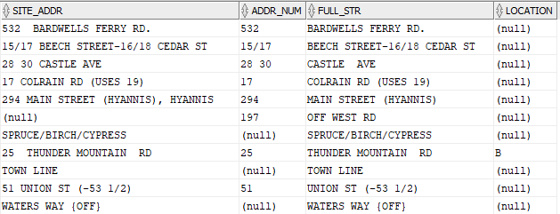
Supplementary CAMA Attribute Recommendations
Property Address Attributes
Recommendations:
SITE_ADDR should represent a concatenation or aggregation of the information recorded in ADDR_NUM, FULL_STR, and LOCATION. There should not be any addressing information recorded in the 3 individual fields that is excluded from SITE_ADDR and vice versa.
Only the address number portion of an address should be recorded in ADDR_NUM, only the street name portion of the address should be recorded in FULL_STR, and anything else that is part of the address, but is not an address number or street name, should be recorded in LOCATION.
Ideally, street names are fully spelled out and standardized in the Assessor attributes as outlined in section 5.3 of the addressing standard.

Slide 39
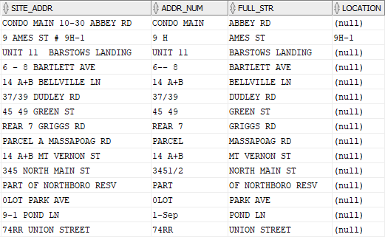
Supplementary CAMA Attribute Recommendations
Property Address Attributes (address number issues)
More unexpected values, primarily in ADDR_NUM…

Slide 40
Assessing Data
Owner Address Attributes
OWN_ADDR = “the complete owner mailing address, including the street number, name, etc. This is not the site address, rather it is the address to which the tax bill is sent, thus it may include PO Boxes, out-of-state addresses and other entries which would not be allowed in the site address field.”
OWN_CITY = “the city for the property owner’s address”
OWN_STATE = “for US addresses, the state where the property owner lives, using the postal service abbreviations for state”
OWN_ZIP = “the zip code of the owner’s address”
OWN_CO = “the country where the owner lives”
Owner addresses can have significant value in data validation if they are accurate and recorded with consistency.

Slide 41
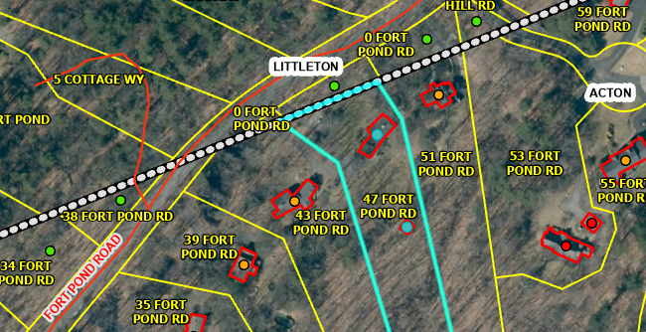
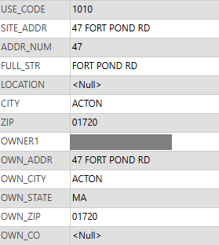
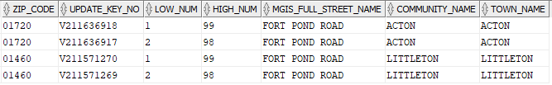
Assessing Data
Owner Address Attributes – ZIP Code Impact
47 Fort Pond Road, Acton
Assessor Record
USPS ZIP+4 Records

Slide 42
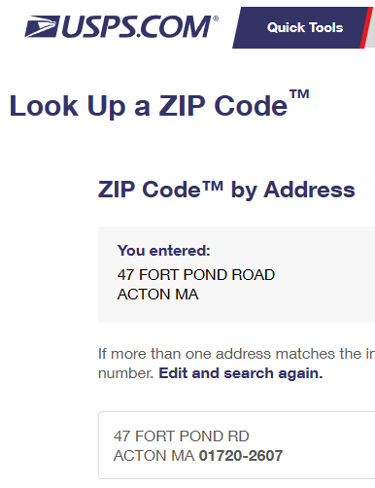
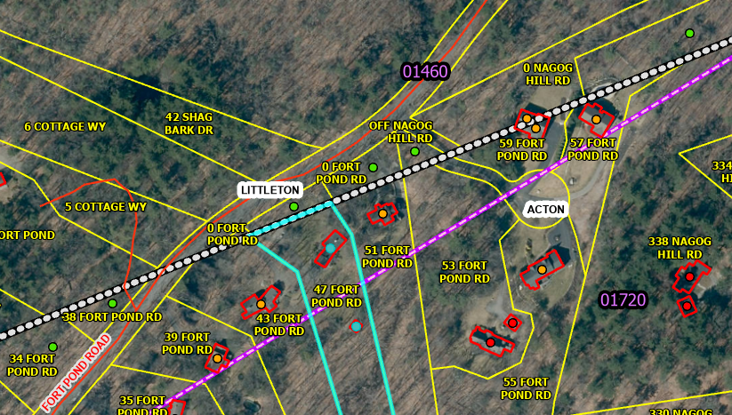


Assessing Data
Owner Address Attributes – ZIP Code Impact (2)
USPS ZIP Code Validation Website: https://tools.usps.com/zip-code-lookup.htm?byaddress
47 Fort Pond Road (w/commercial ZIP Code boundary in purple)

Slide 43
Supplementary CAMA Attribute Recommendations
Owner Address Attributes
Recommendations:
When OWN_ADDR reflects an address in Massachusetts, it should contain the same standardization of address information found in SITE_ADDR.
When OWN_CITY represents a place in Massachusetts, it should reflect the fully spelled out official town/city name or the officially recognized USPS postal community (preferably the latter if known).
For U.S. addresses, the OWN_ZIP value should be a ZIP Code that is associated with that OWN_CITY community by the US Postal Service. If they do not correctly associate, either OWN_ZIP or OWN_CITY may need to be validated and fixed. ZIP Code validation can be conducted using the USPS website: ZIP Code™ Lookup | USPS.
When OWN_ZIP represents a ZIP Code in the United States, it should contain only acceptable values and be formatted as either:
  A 5-digit ZIP Code (01230)
  A 5-digit ZIP Code followed by a dash followed by the ZIP+4 value (no spaces). (e.g., 01230-1257)
** OWN_ADDR and SITE_ADDR should therefore be identical if the owner receives mail at that property. If this is true, ZIP should also be the same as OWN_ZIP (or at least the first 5 digits match). OWN_CITY should be the same as CITY or represent a postal community name that serves that CITY.

Slide 44







Supplementary CAMA Attribute Recommendations
Property Address Attributes - Examples
Examples of data integrity issues with owner address fields…

Slide 45
Massachusetts MAD Model Architecture
(not shown: MSAG Community Polygons, MA Towns)
Address Variants
Master Address
Address Points (Multipoints)
Address Points
& Structure Lookup Table
ADDRESS_VARIANT_ID
MASTER_ADDRESS_ID
ADDRESS_POINT_ID
Street Name Variants
Master Street Names
Address Point
Centroids
Structure Polygons
STREET_NAME_VARIANT_ID
STREET_NAME_ID
CENTROID_ID
STRUCTURE_ID
Source Table
Base Range Variants
Base Street Arcs
Parcel Polygons
& Assessor Data
SOURCE_NAME_ID
BASE_RANGE_VARIANT_ID
BASE_SEGMENT_ID
LOC_ID
Table
Site Names
Site Polygons
(geographic relationships)
Feature Class
SITE_NAME_ID
SITE_ID

Slide 46


MAD Address Record Example
Input Addresses
Address Variants Input Address Fields
Address Variants Additional Relevant Fields
Address Source Record(s)
Why isn’t there an assessor source for ‘284 East Temple Street, Boylston, MA’?

Slide 47


MAD Address Record Example
Assessor Address vs Functional Address
The site address of the parcel where Cyprian Keyes Golf Club is located is just ‘SCHOOL ST’.

Slide 48


MAD Address Record Example
Master Records
Master Address Fields (subset)
National Map Address ID
Master Street Name
MSAG Communities

Slide 49

MAD Address Record Example
Address Town vs. Geographic Town
If the house with the driveway identifies as an Elm Street address, you don’t want a public safety response looking for it along the Elm Street in Town A.
courtesy of Google Gemini

Slide 50

MAD Address Record Example
Subaddressing
Master Address Subaddress Fields
Building Name, Wing, Floor, Unit, Unit Type, Room, Other Location
Of the 10 million+ records in address variants, more than 2.2 million of them have something in addition to an address number and street name that may qualify as a value belonging in one or more subaddress fields.

Slide 51

MAD Address Record Example
Subaddressing Review
Address Variant Subaddress Review
SF_FLAG Values (Assigned by looking at assessor USE_CODE)
1 = Single-Family Residence 2 = Two-Family Residence
3 = Three-Family Residence APT = Apartment Complex
CONDO = Condominium MBLHM = Mobile Home Park
MIXRC = Mixed Use Residential/Commercial

Slide 52


Supplementary CAMA Attribute Recommendations
Use Code Standardization
USE CODE
The MA Dept. of Revenue’s Bureau of Local Assessment provides guidance about standardized property classification codes…
“The coding structure has three-digit level of detail. The first digit indicates a major classification. The second digit is a major division, and the third digit is a subdivision, both within the major classification of property.”

Slide 53

Supplementary CAMA Attribute Recommendations
Use Code Inconsistency
USE CODE – Inconsistency in interpretation and description
Some towns think “0316” is mixed use while others seem to interpret it as the standard use code “316”.
Additionally, entries in USE_DESC often use abbreviations that may not be obvious to users of the data.
Number of custom codes currently in use across MA?
10,673
116 municipalities (about 1/3 of state) have a mix of 3 and 4 digit/character use codes and have some 4-digit codes that start with “0”

Slide 54
Supplementary CAMA Attribute Recommendations
Use Code Recommendations
Recommendations:
Any/all current 4 digit/character use code values should be replaced with the standard 3-digit values.
If it is determined that the time and effort in complying with the requested update is not feasible, or there is compelling evidence that the existing 4-digit/character values provide a necessary function in helping differentiate between two or more specific variations of uses within a 3-digit classification, there is a more modest alternate request that MassGIS suggests as a possible compromise solution, provided BLA agrees:
If any municipality currently uses 4-digit use codes starting with “0” that should not or do not represent a mixed-use property, those use codes should be modified such that the first 3 digits represent the expected BLA use code.
Example: If a single-family property’s use code is currently recorded as “0101”, it should be edited to be “1010”, but only if “101” is not available as an option within the CAMA.
Example 2: If a property’s use code is currently recorded as “0130”, it needs to be accurately determined whether it is intended to represent the “013” mixed use or the “130” vacant residential use. If it is the mixed use, then “0130” would be acceptable if “013” is not available, but if it is the vacant residential use, the code should be edited to be “1300” if “130” is not available.

Slide 55

Supplementary CAMA Attribute Recommendations
Addressing Uniqueness
Every parcel, regardless of development
status, should be assigned a unique situs
address (SITE_ADDR in the standardized
parcel deliverables to MassGIS). Wherever
two or more parcels currently share the
same SITE_ADDR in a given community,
those addresses should be edited to
become unique.
A 911 call to respond to an emergency at
“13 FINN ST” could yield three possible
houses to choose from if the only
information available was parcel site
address.

Slide 56

Supplementary CAMA Attribute Recommendations
Addressing Uniqueness – Vacant Parcels
Several parcels addressed “0 WEST RD” with several address points

Slide 57

Supplementary CAMA Attribute Recommendations
Addressing Uniqueness – Multiple Address Points
Inappropriate to arbitrarily choose a single address point for the address…
Inappropriate to dissolve the points into multipart geometry because the
geographic center of those points is a meaningless location
Any product or service that uses the MAD to show points and addresses
will miss this address

Slide 58
Supplementary CAMA Attribute Recommendations
Addressing Uniqueness Recommendations
Recommendations:
If an address number that is not “0” has been assigned to multiple undeveloped parcels with the same street name and no other identifier that would convey uniqueness, that number can remain in effect if desired, but should be modified to incorporate address number suffixes to uniquely identify each parcel. Or re-number if possible.
If there is currently no address number or an address number of “0” assigned to multiple undeveloped parcels with the same street name, either of those pre-existing options remains acceptable, though there is a preference for converting “0” to be empty/no address number at all. At a minimum, be consistent.
If “0” or an empty address number remains in effect, the LOCATION attribute of the standardized assessor address attributes must be populated with a value that conveys uniqueness… preferably the LOT value from its existing MAP/BLOCK/LOT identifier.

Slide 59
Supplementary CAMA Attribute Recommendations
CAMA Improvement Recommendations
Summary of CAMA attribute improvement recommendations
Standardize property address attributes and fix erroneous values
Standardize owner address attributes and fix erroneous values
Standardize land use codes (either all 3 digits from the BLA guidance,
or possibly 4 digits where the first 3 match the BLA list)
Enforce address uniqueness, even in undeveloped properties where
the LOT portion of its MAP/BLOCK/LOT identifier can be added to
LOCATION and SITE_ADDR
MassGIS can help identify some of these records and propose corrections when there is a clear solution or suggestions when there isn’t.

Slide 60

Outreach and Support
daniel.marrier@mass.gov
Massgismail@mass.gov
notify911address@mass.gov
Questions??

