Slide 1
MassDEP Lead and Copper Rule Revisions (LCRR) Service Line Inventory (SLI) PowerPoint Materials

Slide 2
What is a Service Line?
The service line is the pipe that connects your house to the water main in the street.
Some service lines that run from older homes, usually those built before 1940, to the utility water main are lead.
Many of these older service lines have been replaced, but your home could still have one.

Slide 3
Why is Lead in your Drinking Water Concerning?
Lead can cause serious health problems if too much enters your body from drinking water or other sources.
Overexposure to lead may cause problems ranging from stomach distress to brain damage.
It can cause damage to the kidneys and can interfere with the production of red blood cells that carry oxygen to all parts of your body.
The greatest risk of lead exposure is to infants, young children, and pregnant women.
Scientists have linked the effects of lead on the brain with lowered IQ in children.
Adults with kidney problems and high blood pressure can be affected by low levels of lead more than healthy adults.
Our bones store lead and can release it later in life. During pregnancy, the child receives lead from the mother's bones, which may affect brain development.

Slide 4
What Must Public Water Systems (PWS) Do?
Community (COM) and Non-Transient Non-Community (NTNC) PWS must inventory (identify) all service lines by October 16, 2024.

Slide 5
What can you do to help?

Slide 6
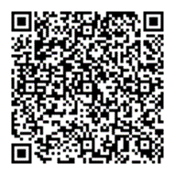
What Can You do to Help?
Protect your Tap: A Quick Check for Lead Guide
You can find out what materials your service line is made of!
The Environmental Protection Agency (EPA) has an online step-by-step guide- “Protect your Tap: A Quick Check for Lead” to help people identify lead service lines in their homes. It also provides tips on actions to reduce lead exposure in drinking water, information on certified laboratories for water testing, and resources to learn more.
Find it here: https://www.epa.gov/ground-water-and-drinking-water/protect-your-tap-quick-check-lead

Slide 7
Service Line Material Examples
The EPA “Protect Your Tap” Guide provides examples of different service line materials you may find, to help you identify your service line material.

Slide 8
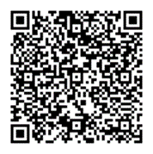
What Can You do to Help?
MA-LSLI Web Application:
Inform your Public Water System (PWS)!
If your PWS is working with MassDEP, you may be able to send them a photo of your service line and your identification from the EPA guide using the MA-LSLI Web Application.
MA-LSLI Web Application: https://app.smartsheet.com/b/form/f9ee39b7972f443ca63e8b936cd7f92b

Slide 9
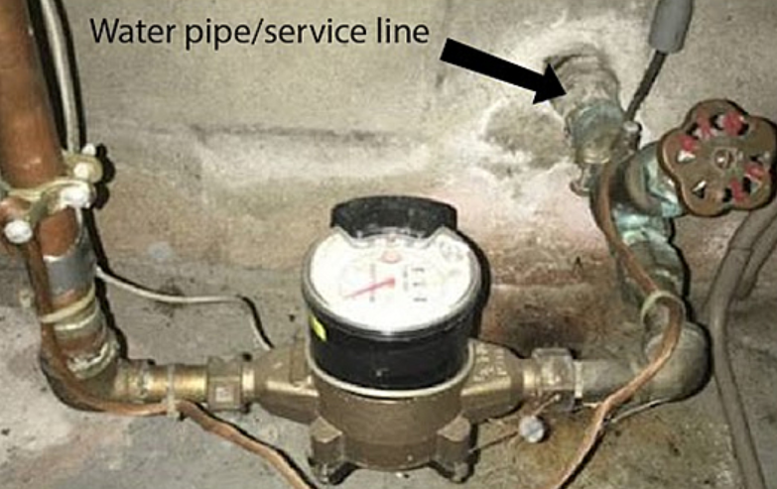
How to submit your photo to the MA – LSLI Web Application
This side entering the rest of the home is considered premise plumbing and is not required for the system inventory.
Make sure to include this section of your service line that is entering the home from outside in your photo! This section closest to your house’s exterior is your service line!

Slide 10
Do I Need to Replace My Service Line?
Homeowners are not required to replace their service line if it is identified as lead.
The recommendation is to replace all lead service lines, to protect your health from the risk of lead exposure.
Homeowners worried about the cost of replacement should contact their PWS about possible Lead Service Line Replacement Programs.
Some PWS have Replacement Programs which offer financial incentives, ranging from covering part of the replacement cost to the entire replacement cost.
Homeowners can also check with their homeowner’s insurance company to see if they cover lead service line replacement.

Slide 11
I am not sure who my Public Water System (PWS) is?
To find out who your public water system is, there are 2 ways.
1. If you have your most recent water bill, your public water system’s information should be on the water bill. This includes ways to get in contact with your water system.
2. If you do not have your most recent water bill handy, you can go here: https://www.mass.gov/drinking-water-health-safety and look under additional resources for a list of all active PWS, their city/town of service, and contact information to confirm. This list is updated monthly. Use this contact information to let them know what your service line is made of.

