Slide 1
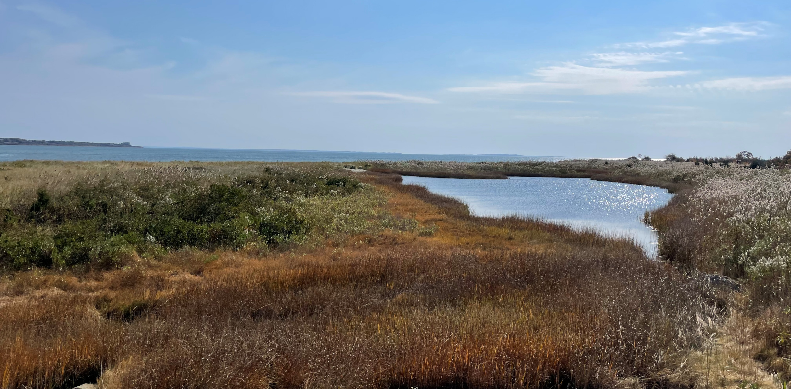
Demarest Lloyd State Park Ecological Restoration and Phased Retreat Feasibility Study
Public Meeting
April 29, 2026
Massachusetts Department of Conservation and Recreation

Slide 2
Commonwealth of Massachusetts

Slide 3
DCR’s Mission and Core Principles

Slide 4
Meeting Logistics

Slide 5
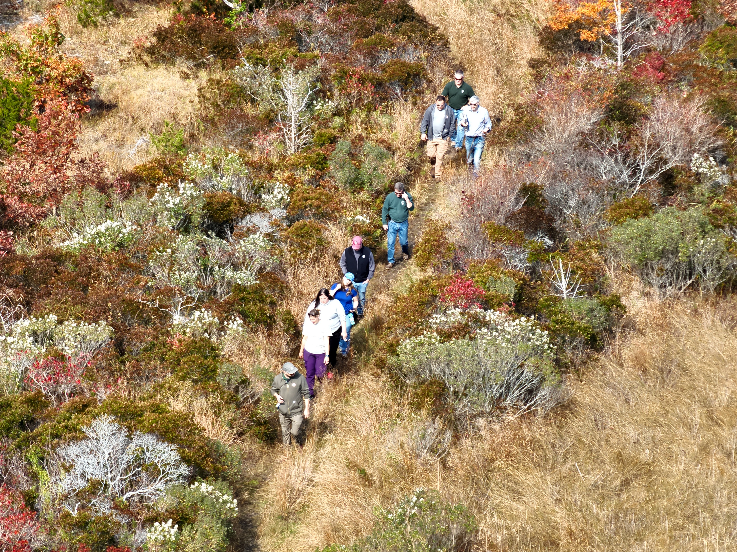
Feasibility Study Team Introductions
DCR Project Management Team:
Celeste De Palma, Resilience Coordinator
Jorge Ayub, Sr. Coastal Ecologist
Mark Georgian, Coastal Engineer
Sarah White, Resilience Director
Design Consulting Team:
Mark Costa, Consulting Team’s Study Manager, VHB
Bryce Corlett, Coastal Engineer, VHB
Michael Kluchman, Landscape Architect, VHB
Scott Morrison, Wetlands Scientist, VHB
Ora Elquist, Archaeology Expert, Gray & Pape
Tribal Outreach Team:
Dr. Casey Thornbrugh, Just Collective
Sarah Thornbrugh, Just Collective
Renée Lopes-Pocknett, Just Collective
Justin Beatty, Just Collective

Slide 6
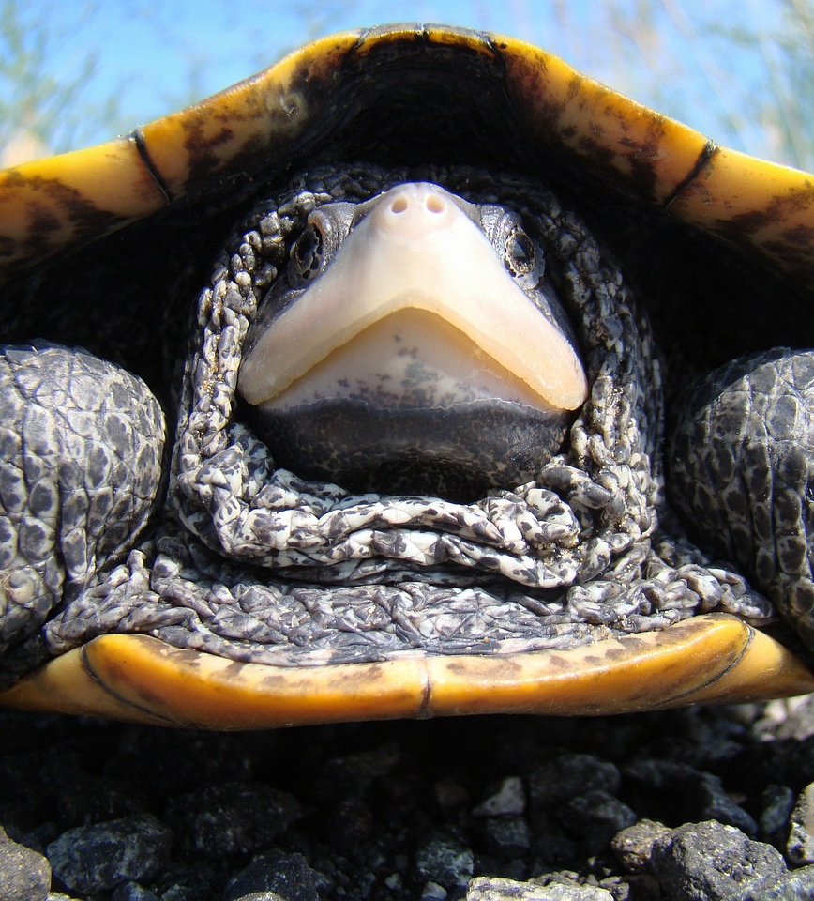
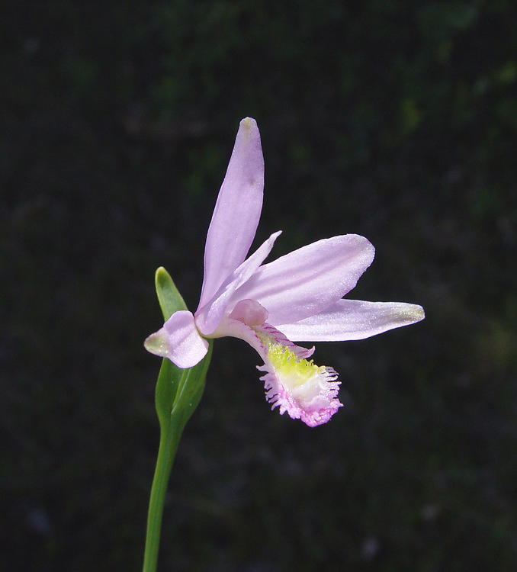
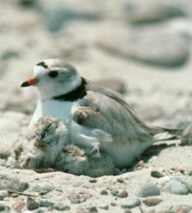
Meeting Agenda
Feasibility Study Purpose and Significance
Share Findings to Date
Review Draft Retreat Concepts
  - Phase 1, Draft Concepts A, B, C
  - Phase 2, Draft Concepts A, B, C
Public Comment

Slide 7
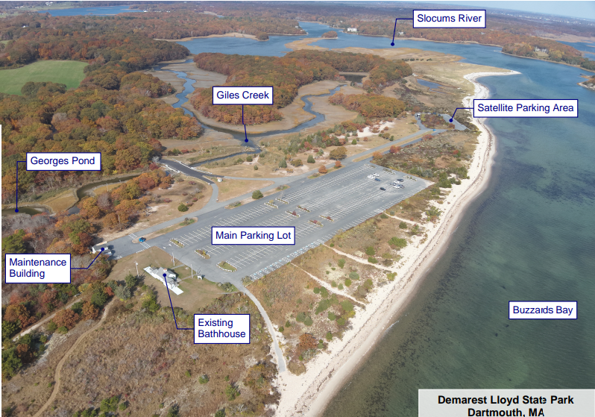
Park features

Slide 8
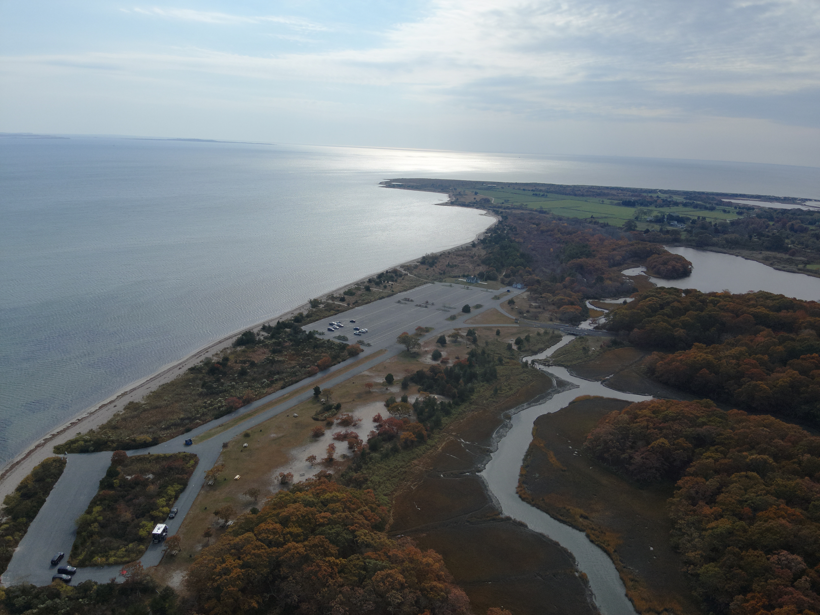
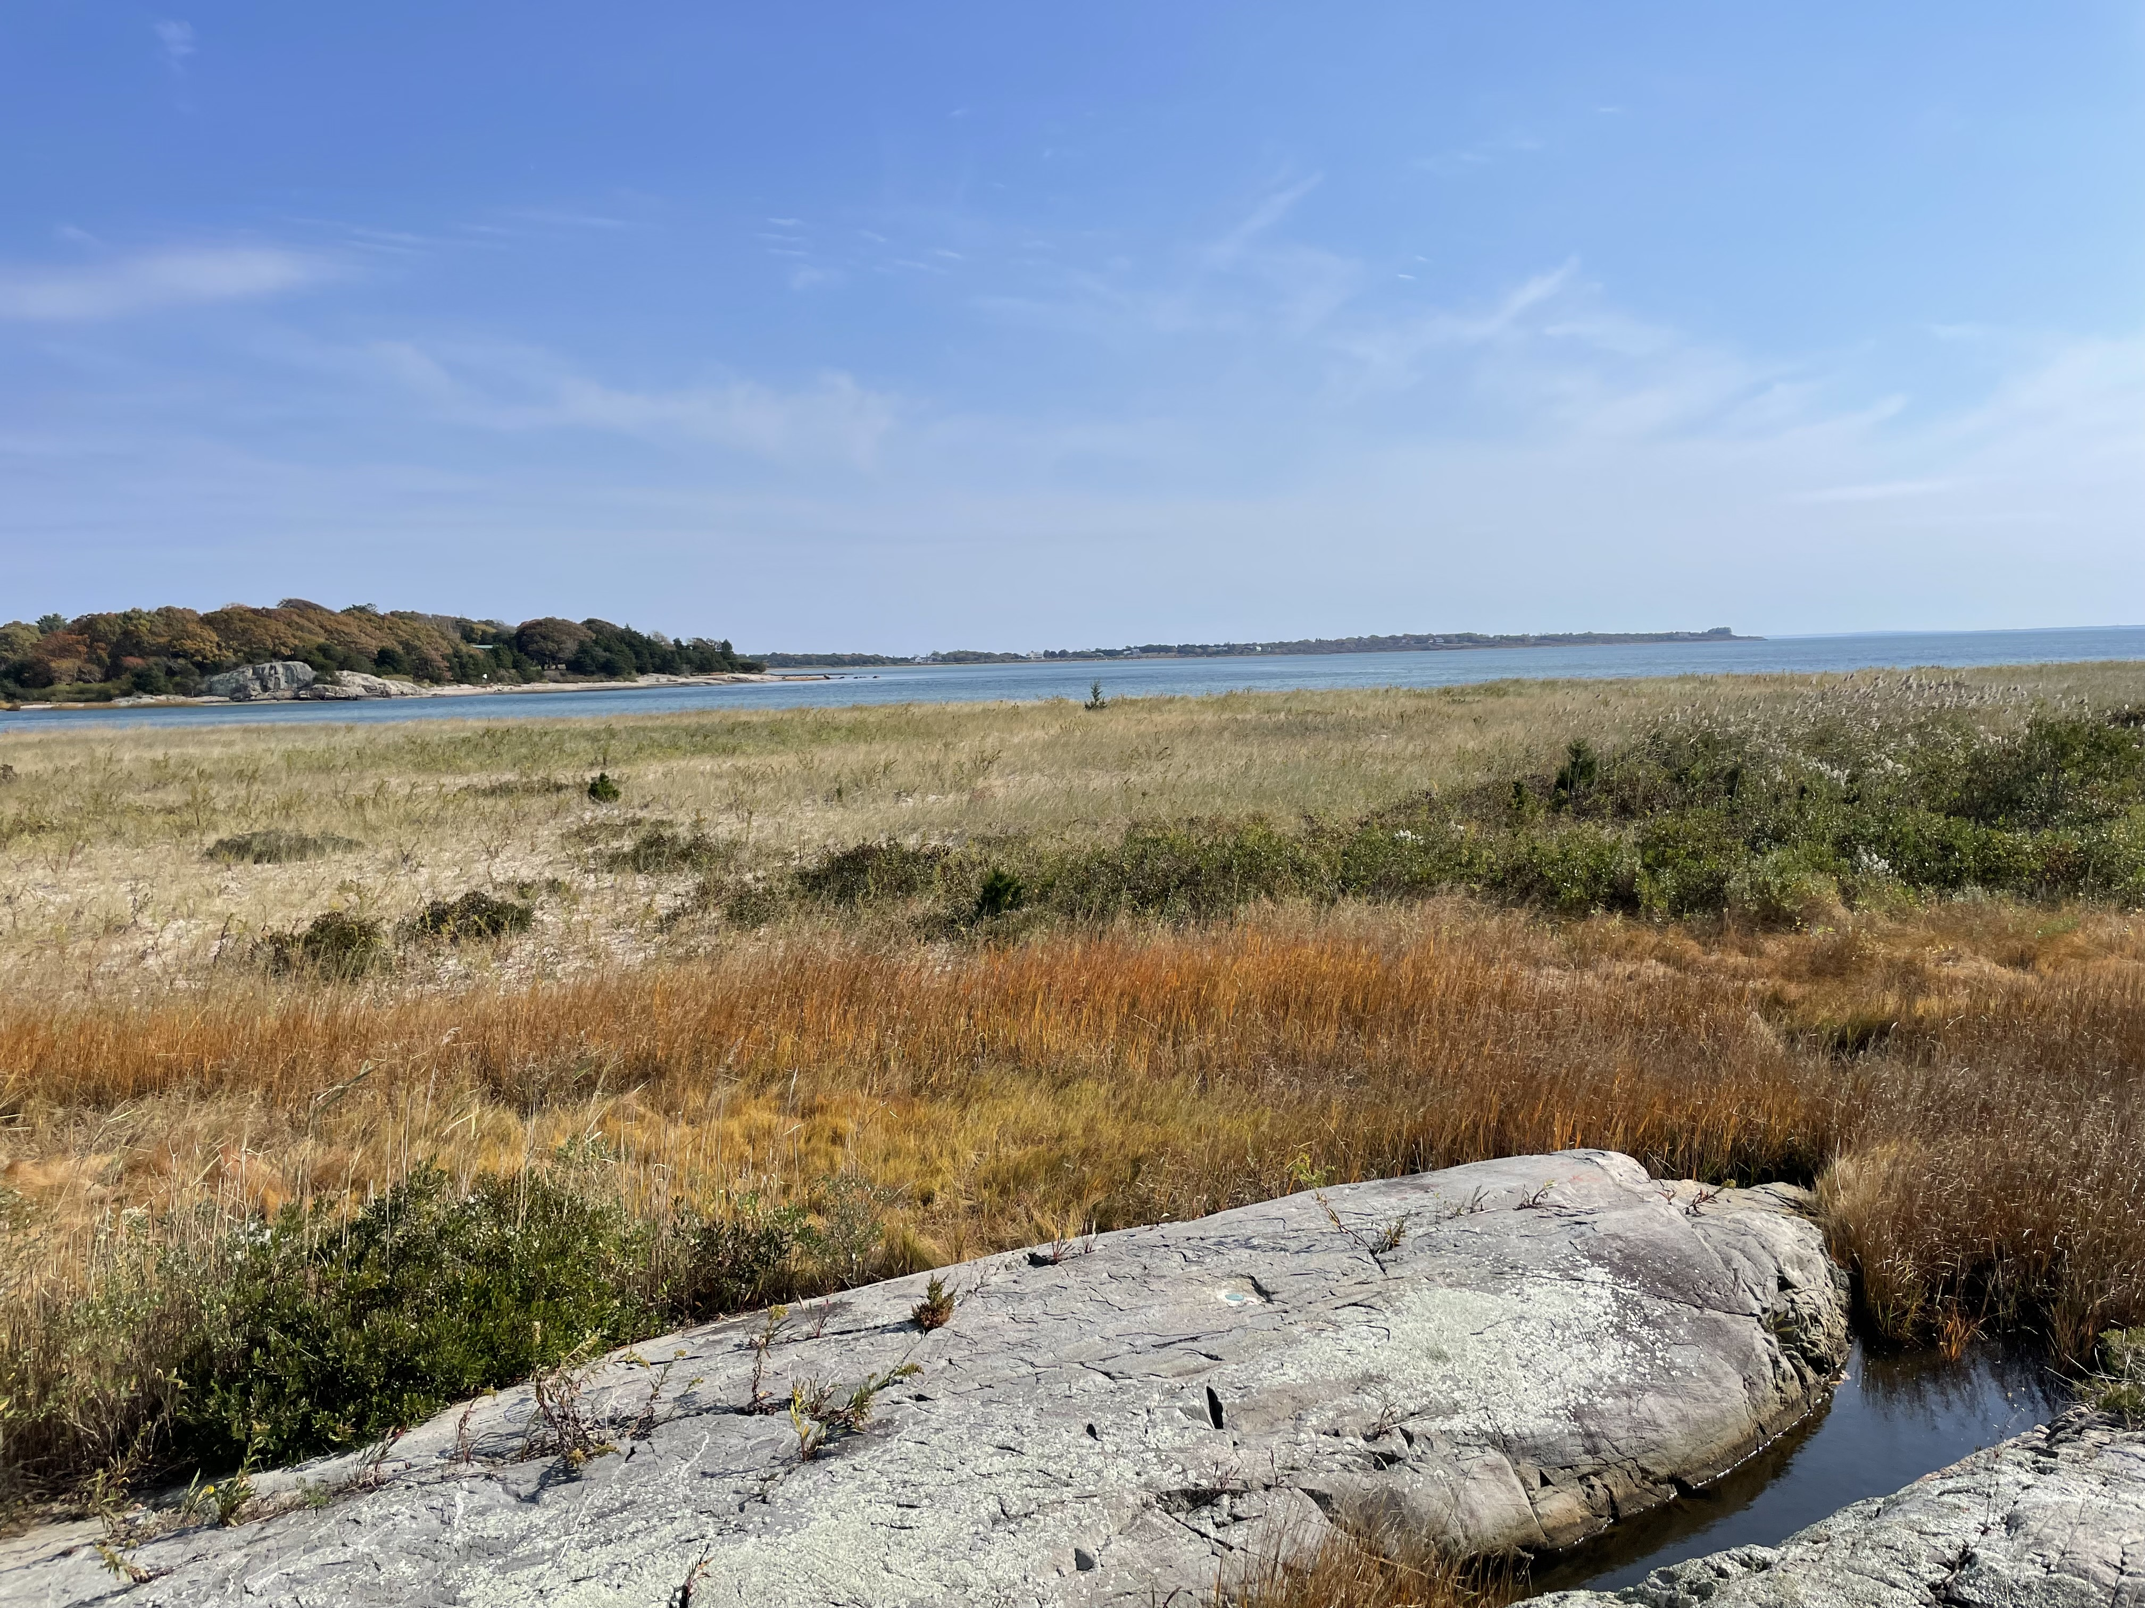
Demarest Lloyd State Park is an active part of the homelands of Wampanoag Nation, including the Mashpee Wampanoag Tribe, the Wampanoag Tribe of Gay Head (Aquinnah), the Herring Pond Wampanoag Tribe, and the Assonet Wampanoag.

Slide 9
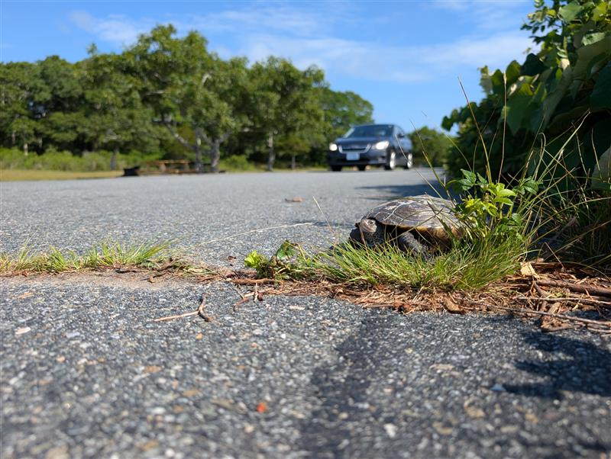
Feasibility Study’s Purpose and Significance
STUDY’S PURPOSE
To develop concept designs for climate-based phased retreat and ecological restoration in support of threatened and endangered species at the park.
WHY
Demarest Lloyd State Park among top ten most vulnerable state parks to climate-induced coastal flooding and erosion.
Cultural significance – Part of the ancestral homelands of Wampanoag Nation, including Tribe of Gay Head (Aquinnah), the Mashpee Wampanoag, Assonet, and Herring Pond Wampanoag Tribes.
Rich biodiversity – leverage prior ecological resotration work.
Opportunity to realign the park experience with climate impacts.
SIGNIFICANCE
First study of its kind for DCR.
Inform retreat process for similar coastal sites
Collaboration with the First Peoples, the First Stewards of the land.
Support ecological restoration and Biodiversity E.O. 618

Slide 10
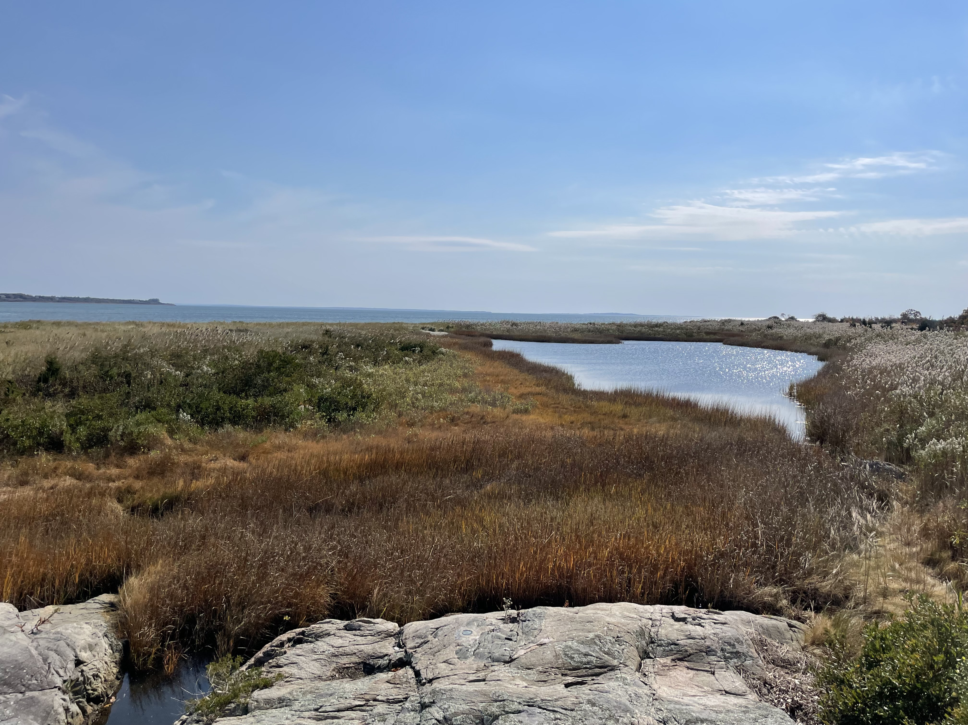
What does “phased retreat” mean to DCR?
Retreat means:
Moving buildings, roads, and other public resources away from places that are high risk from climate hazards, like rising sea levels and erosion.
It can also include changing how areas are used for recreation and helping nature recover by restoring habitats
It can happen in phases, or step by step over time. This is called phased retreat.
For DCR, phased retreat is a chance to act early and rethink how a place is used with climate impacts in mind, instead of leaving it unmanaged.
Why is phased retreat a climate strategy?
Informs investment.
Lowers liability – redesign for impacts, rather than constant repairs.
Proactive, flexible, and adaptable – thoughtful planning that can change over time to changing factors.

Slide 11
Tasks performed to date
Mar-Apr 2025: Project Kickoff and Data Review
Mar-Jun 2025: Existing Conditions Plan
Jun 2025: Site Visit
May-Dec 2025: Basis of Design, Climate and Coastal Models
Mar-May 2025: Archaeological Sensitivity Assessment
Jan-Mar 2026: Draft Retreat Concepts
July 2025: Park Visitor Survey

Slide 12
Findings

Slide 13
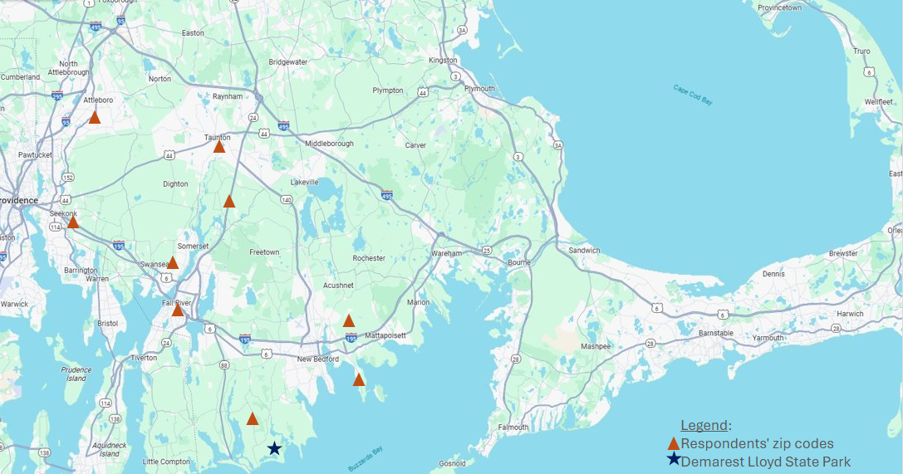
Park Visitor Intercept Survey
Methodology at-a Glance
Four, 120-min, in-person, non-consecutive survey collection sessions and online survey.
Seven responses collected July 14-28, 2025
  Very few visitors. Talked to all in attendance each day.
Low visitation – regional hidden gem.
All respondents accessed park by car.
Map showing where Survey respondents were visiting from.

Slide 14
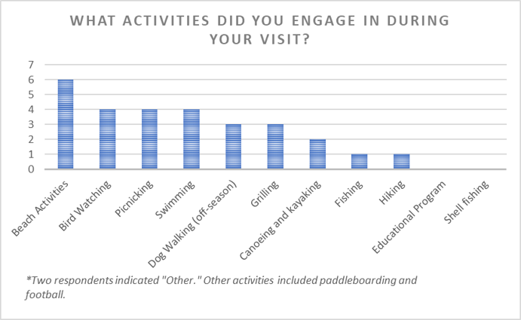
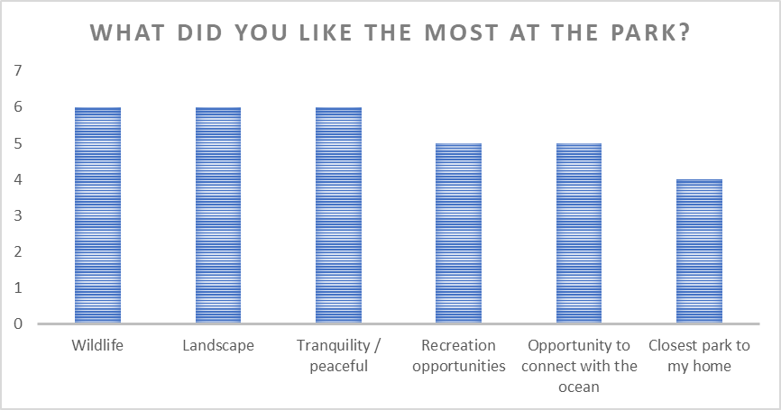
Park Visitor Survey – What they did and what they liked the most about the park
*One participant indicated access to ADA beach chair as one of the things they liked
most at the park, among other selected choices

Slide 15
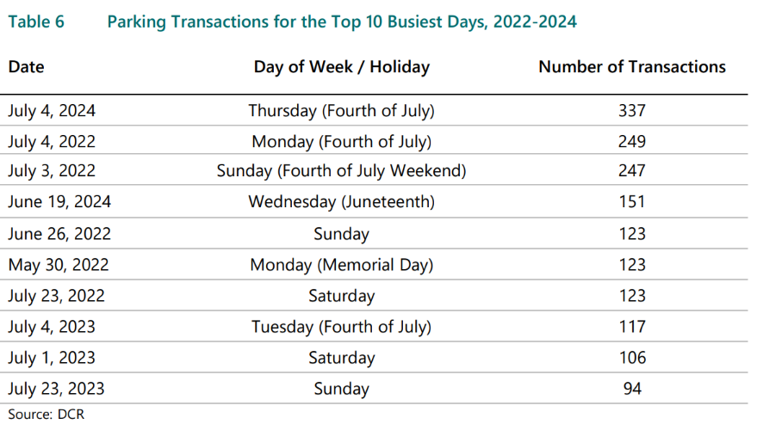
Parking data
Current: 411 parking spaces

Slide 16
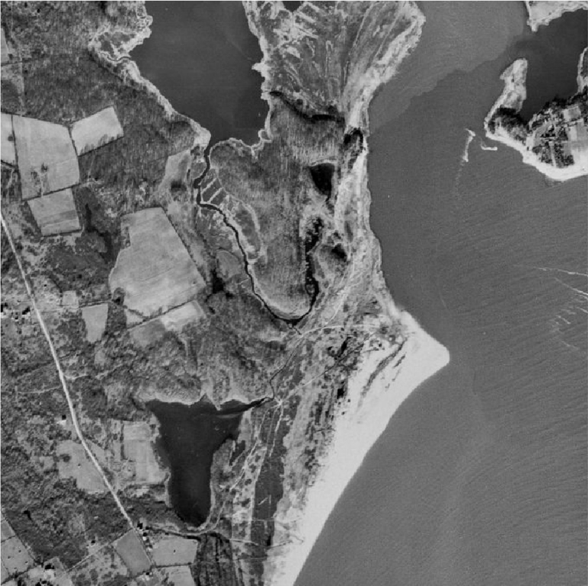
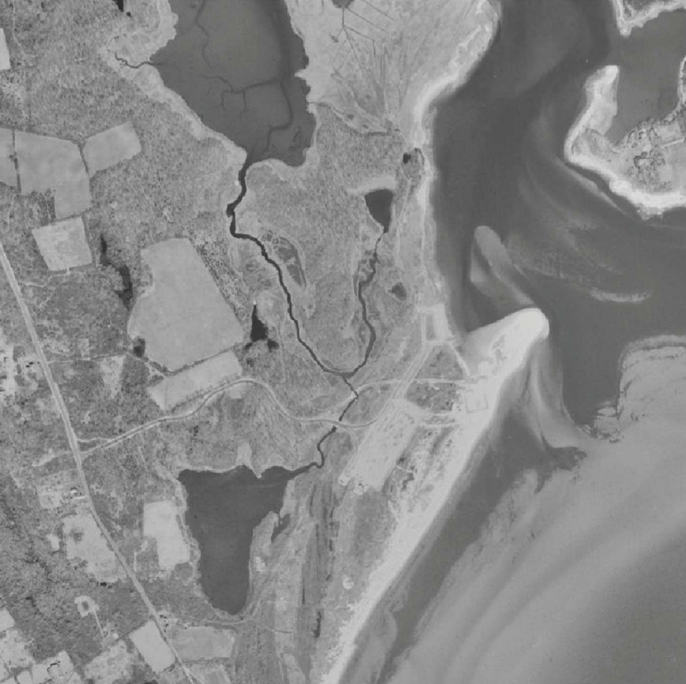
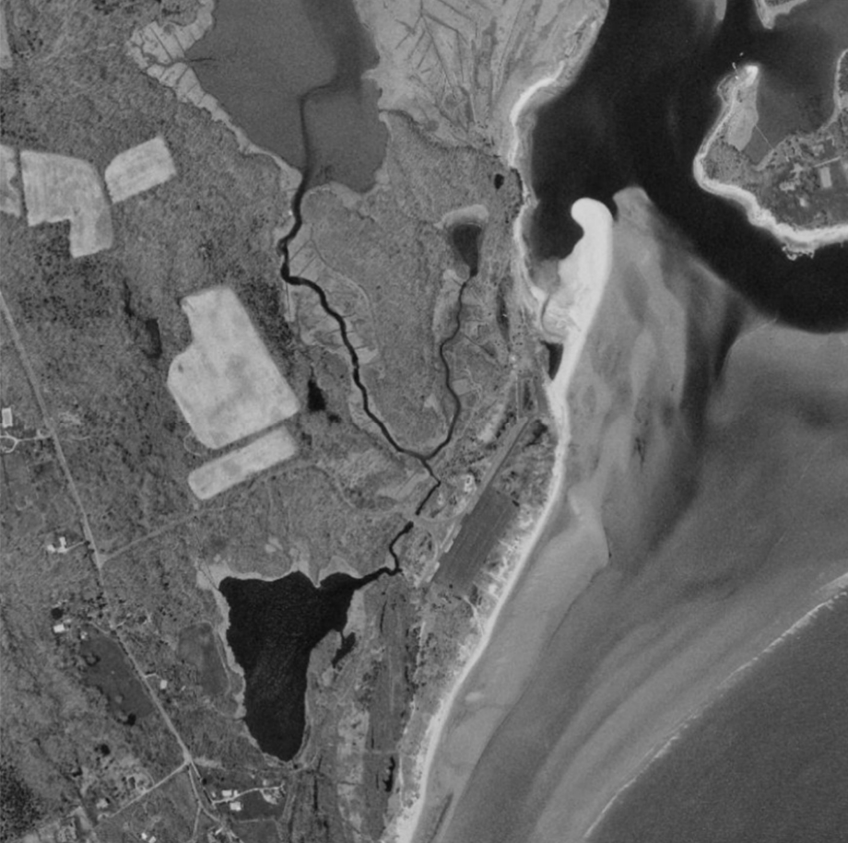
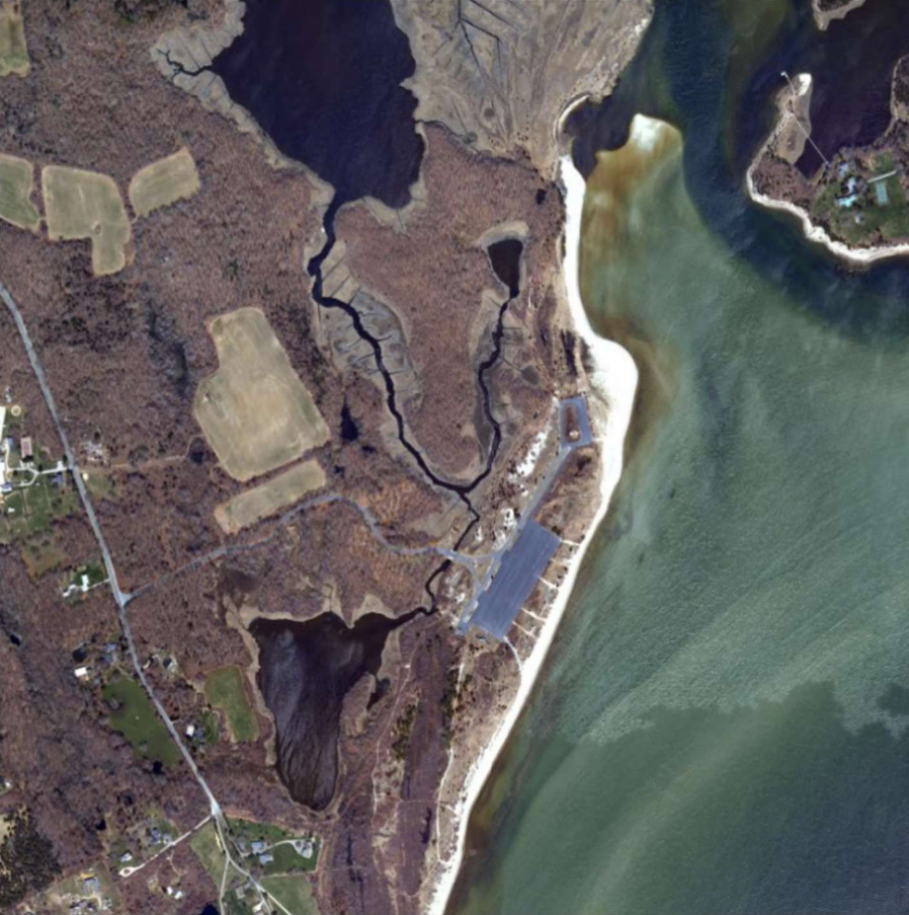
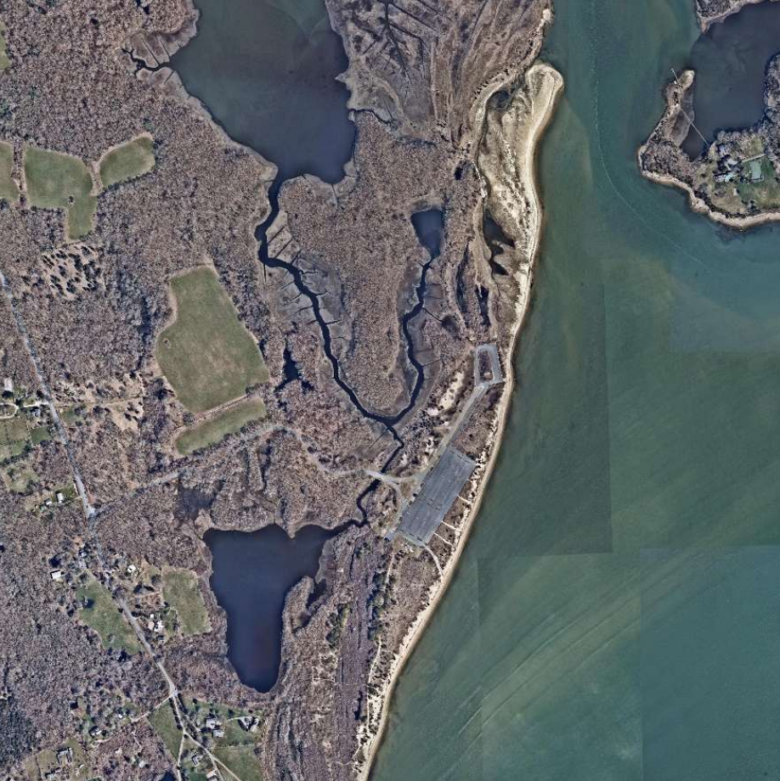
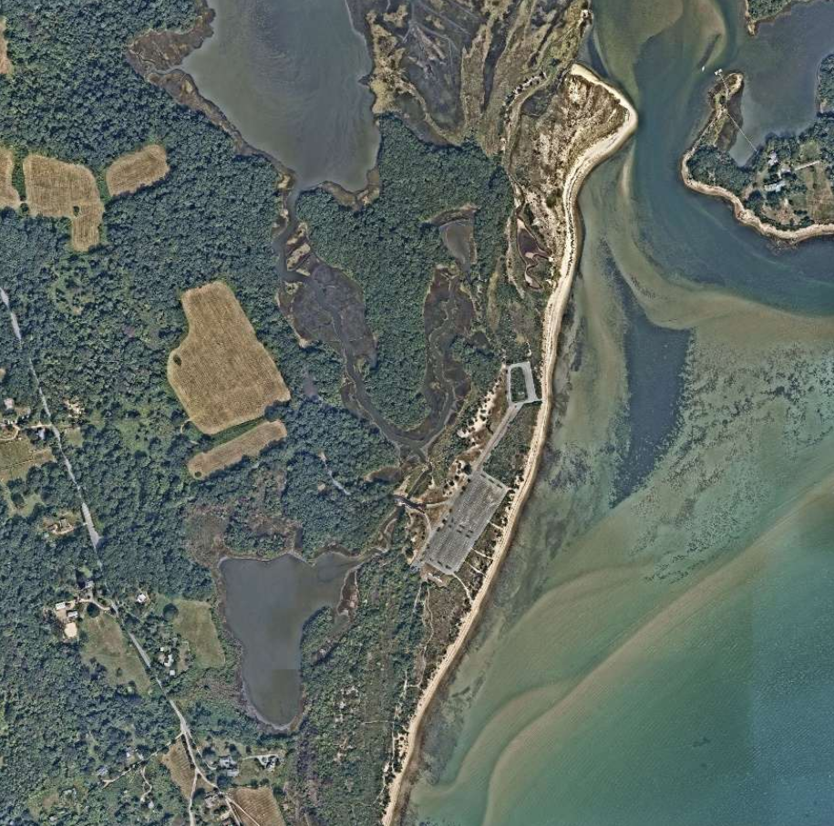
Evolving Coastline
1938
(USGS)
1938
(USGS)
1961
(USGS)
1996
(MassGIS)
2005
(MassGIS)
2016
(Nearmap)
2024
(Nearmap)

Slide 17
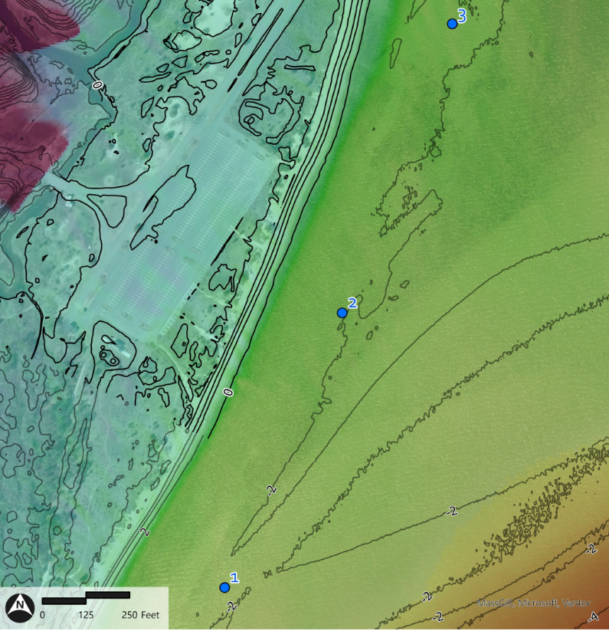
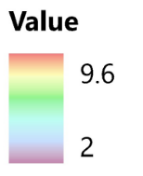
2070 Storm Event
Project completed coastal hydraulic modeling for a 2070 – 100 Year Storm Event Simulation.
Wave Heights of greater than 7-ft in some areas
Potential to significantly change the landscape of the park

Slide 18
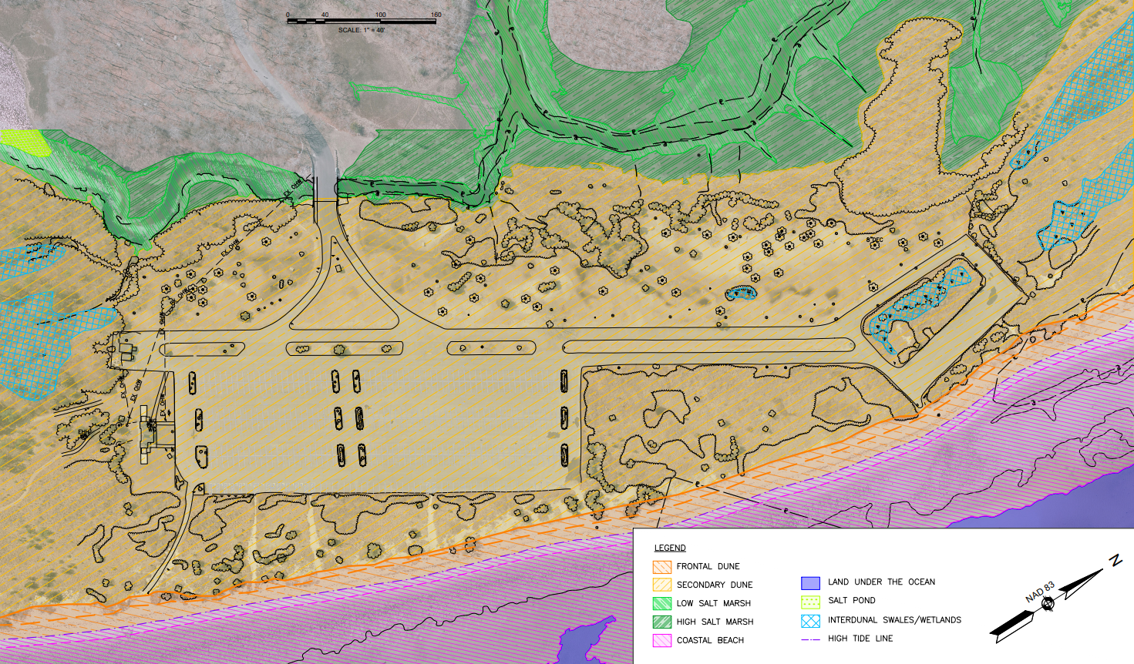
Existing Resource Areas

Slide 19
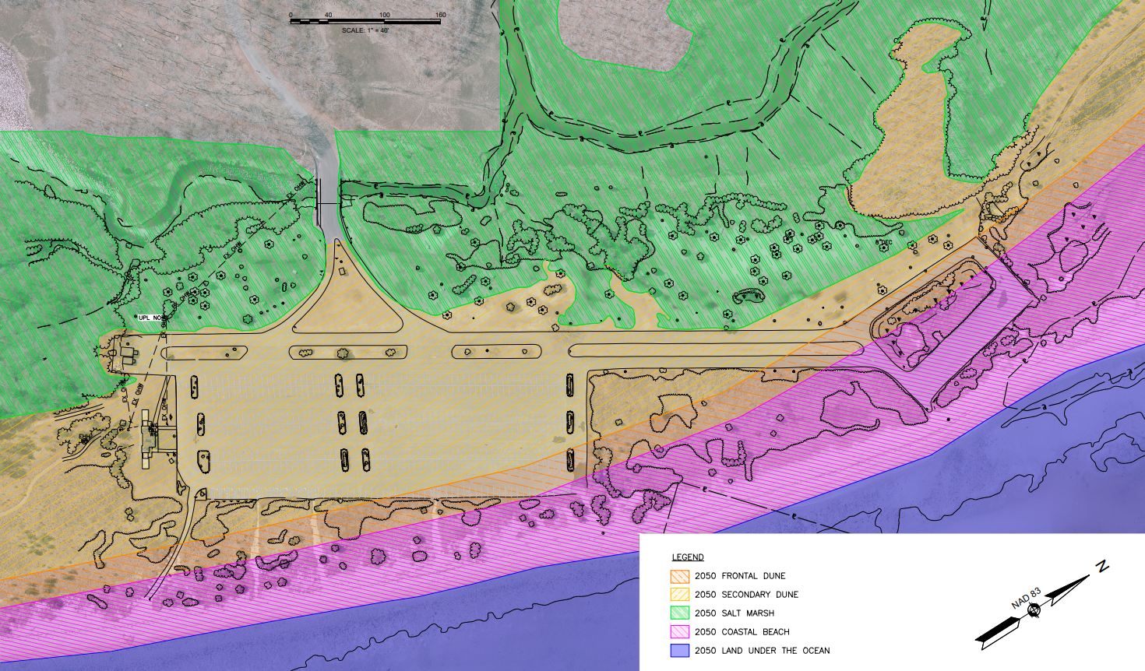
2050 Projected Resource Areas
2.5 ft SLR

Slide 20
Projected Climate Change Impacts
Time Horizon | High Tide | Climate Impacts
2030 | ~2.7 ft | Gradual dune retreat; parking lot mostly unaffected during normal conditions.
2042 (approximately) | ~3.5 ft | Continued dune retreat. Groundwater reaches the bottom of the parking lot pavement box, potentially affecting pavement stability. Early flooding risks during high tide and rain events.
2050 | ~4.0 ft | Dunes migrate to edge of main parking lot, cut across satellite parking area. Marsh expands to edge of parking on west side of park. Giles Creek picnic areas now marsh. Regular tidal flooding begins. Septic tank system at risk. 5% storm: parking lot 2.5 ft underwater. 1% storm: water 12.5 ft + 3-3.5 ft waves over parking areas
2070 | ~5.8 ft | Dunes migrate over both parking areas – becoming beach, salt marsh, or open water. Continued marsh expansion; marsh frequently submerged – becoming mudflats or open water. Parking areas at/below high tide. Entirety of original developed park area under water daily. Bathhouse above daily tides, but vulnerable during storms. 5% storm: parking lot 4.5 ft underwater 1% storm: water 14.5 ft + 6 ft waves over the lot

Slide 21
Retreat Concepts Design Criteria
Parking and pavement reduction: existing parking at the site is above the required capacity, given local and state guidelines, as well as visitation parking data.
Ecological improvements: pavement reduction as an opportunity to restore ecosystems in support of rare and threatened species.
Cultural resources: Concepts will be developed to avoid, minimize or mitigate potential adverse effects to significant historic and archaeological resources.
Recreational Uses: Opportunity to realign recreation uses in the park with projected climate impacts and conservation goals.
Accessibility: alternatives will consider accessibility improvements to the waterfront, bathroom, and picnic areas.
Phased approach: phases will be tied to planning horizons and forecasted sea level rise.

Slide 22
Draft Retreat Concepts

Slide 23
Near-term through 2050 Draft Concepts
Options A, B, C (2.5ft sea level rise)

Slide 24
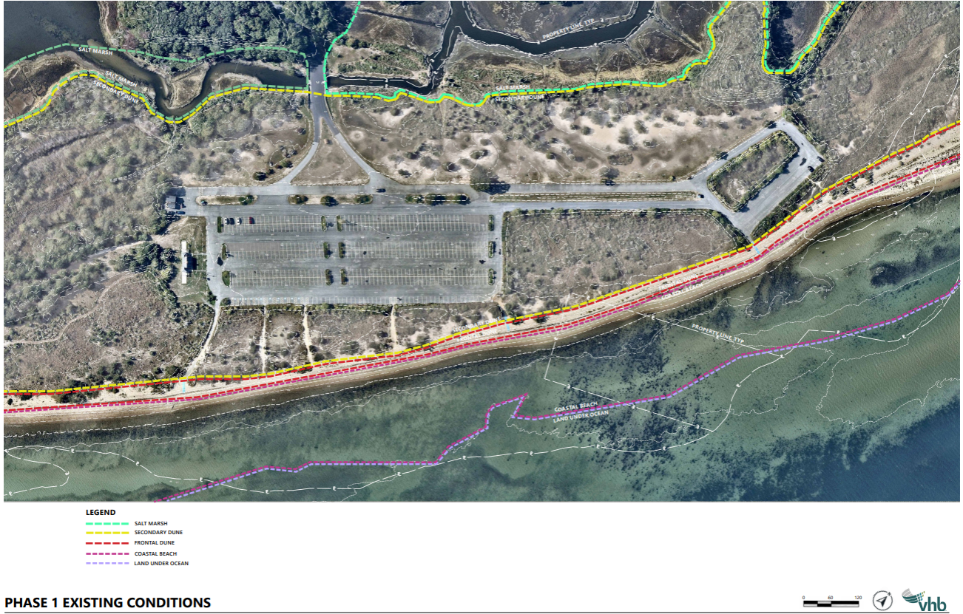
Existing Conditions
E
X
I
S
T
I
N
G

Slide 25
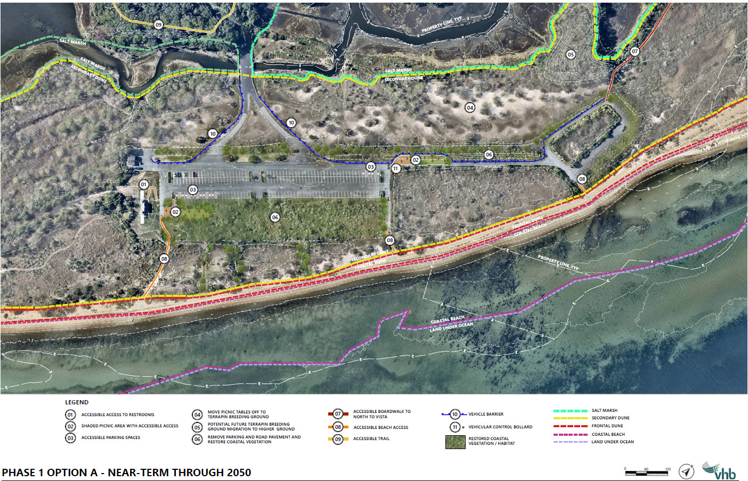
Phase 1 Option A
P
H
A
S
E
1
O
P
T
I
O
N
A

Slide 26
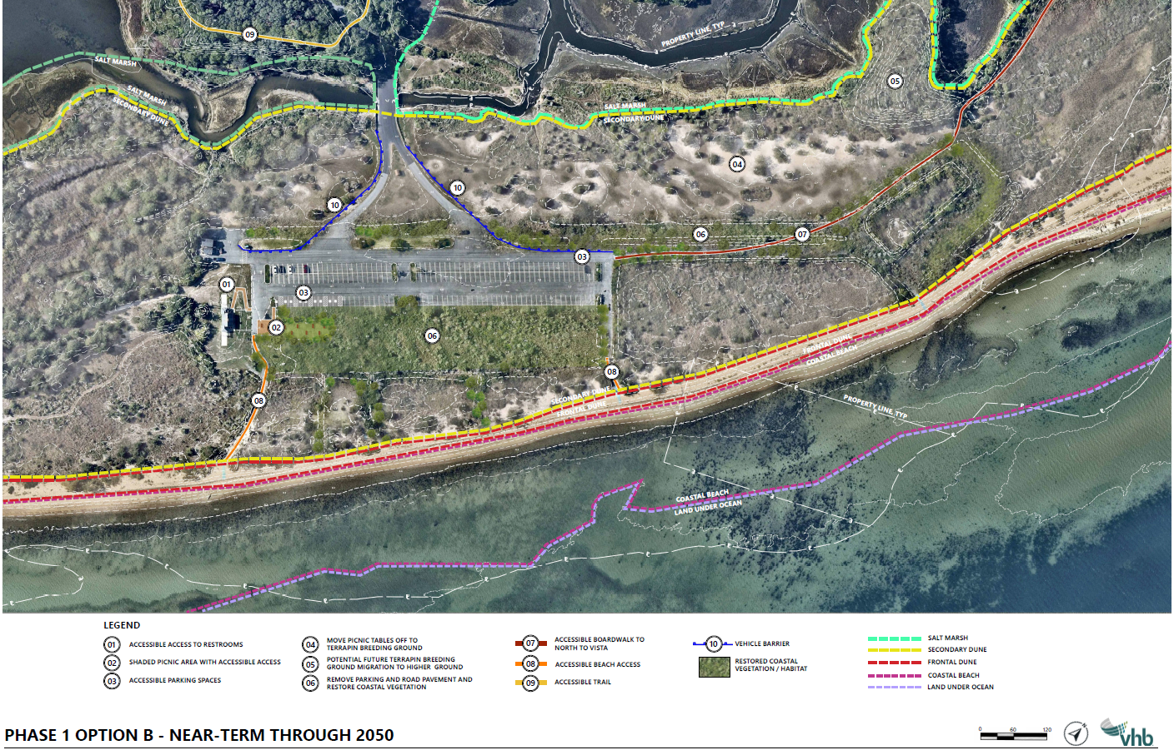

Phase 1 Option B
P
H
A
S
E
1
O
P
T
I
O
N
B

Slide 27
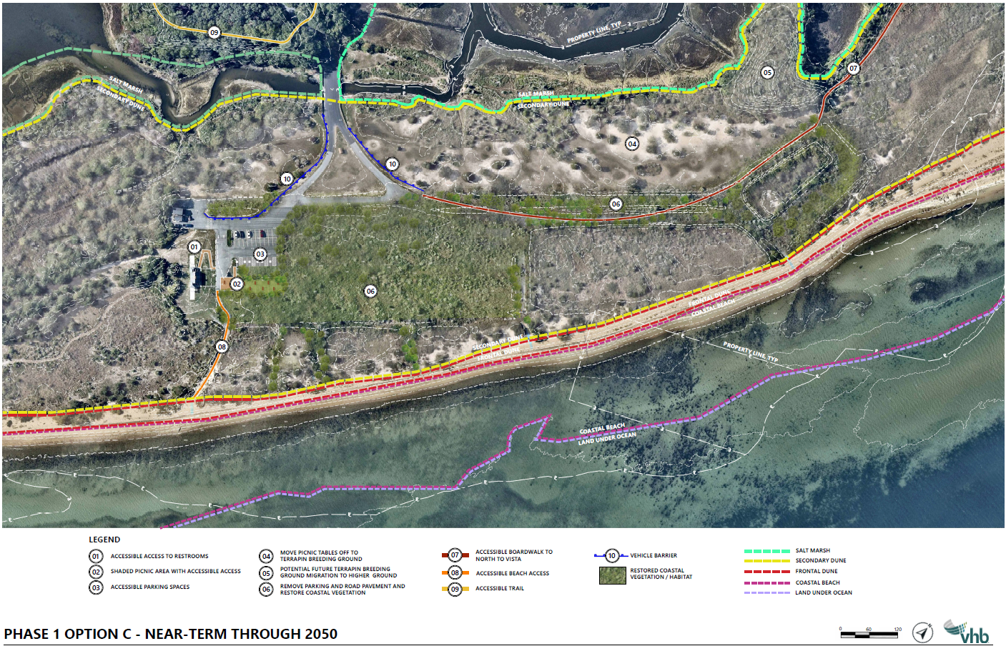
Phase 1 Option C
P
H
A
S
E
1
O
P
T
I
O
N
C

Slide 28
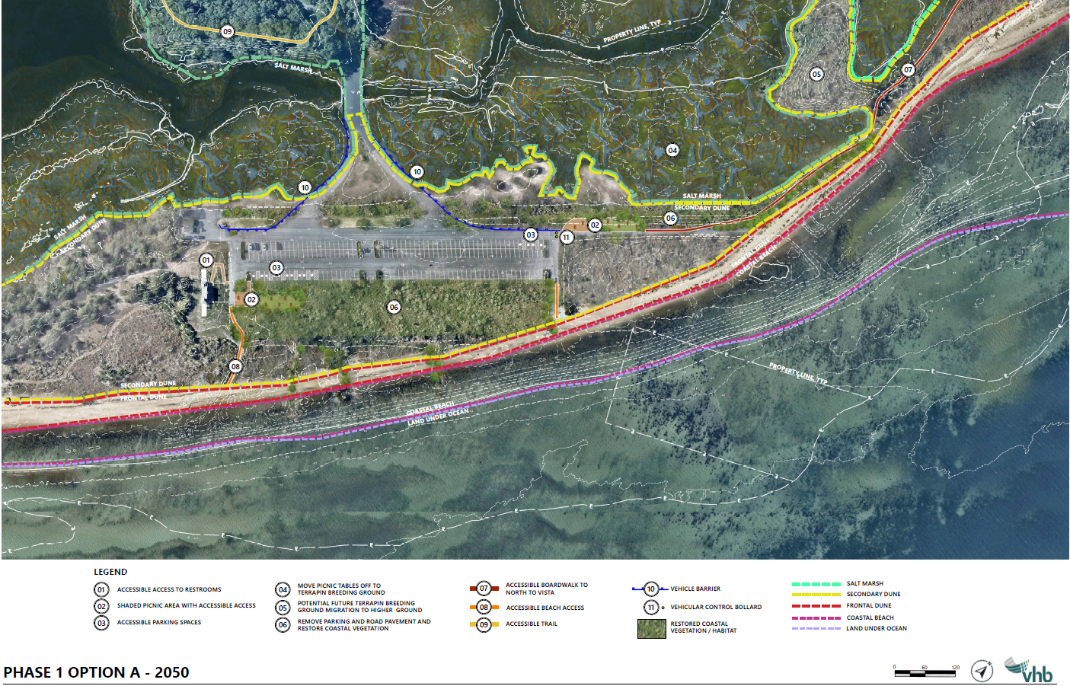
Near-term concepts can withstand 2050 conditions – Concept A

Slide 29
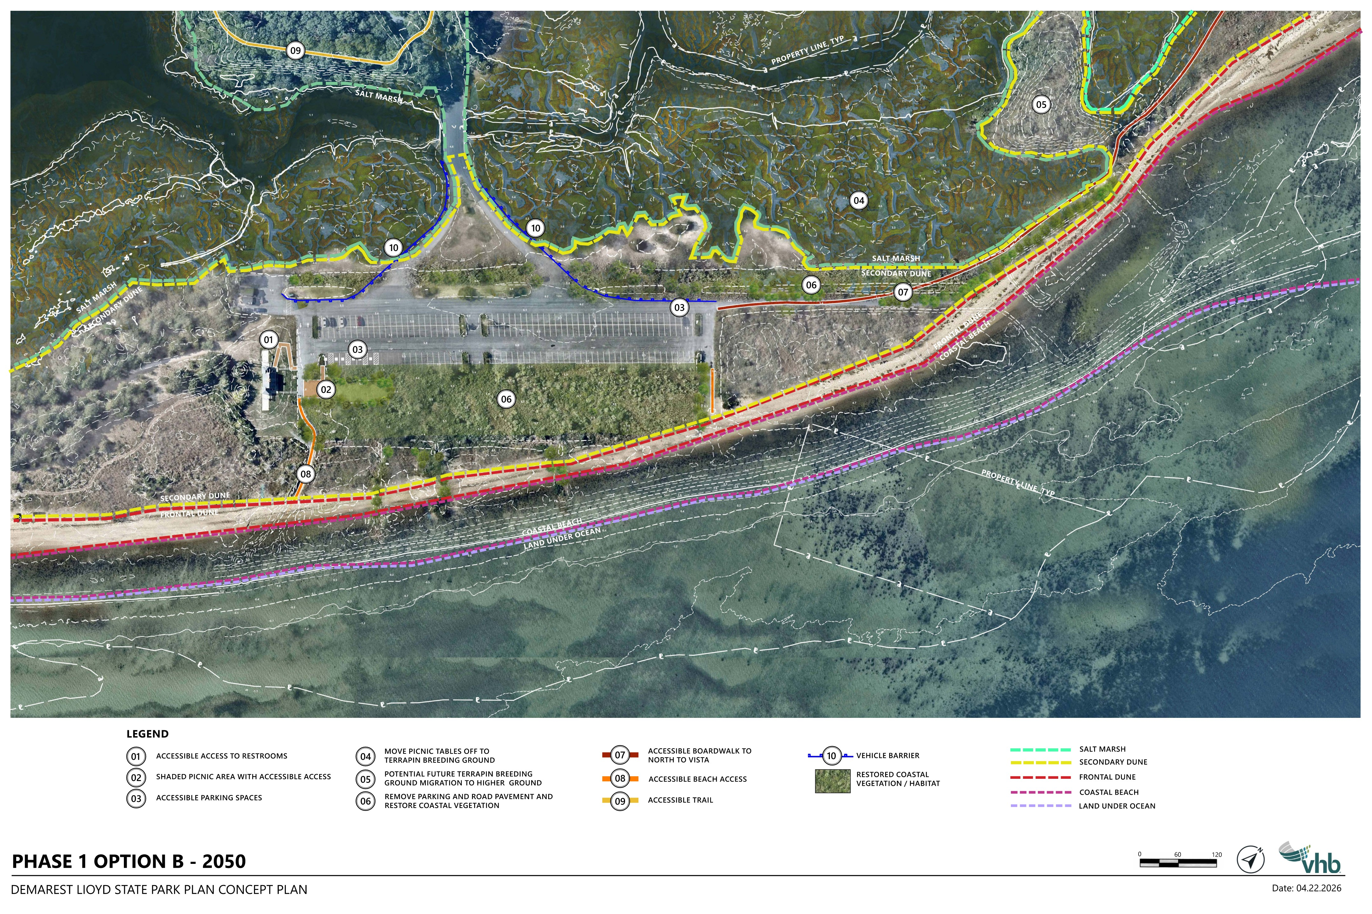
Near-term concepts can withstand 2050 conditions – Concept B

Slide 30
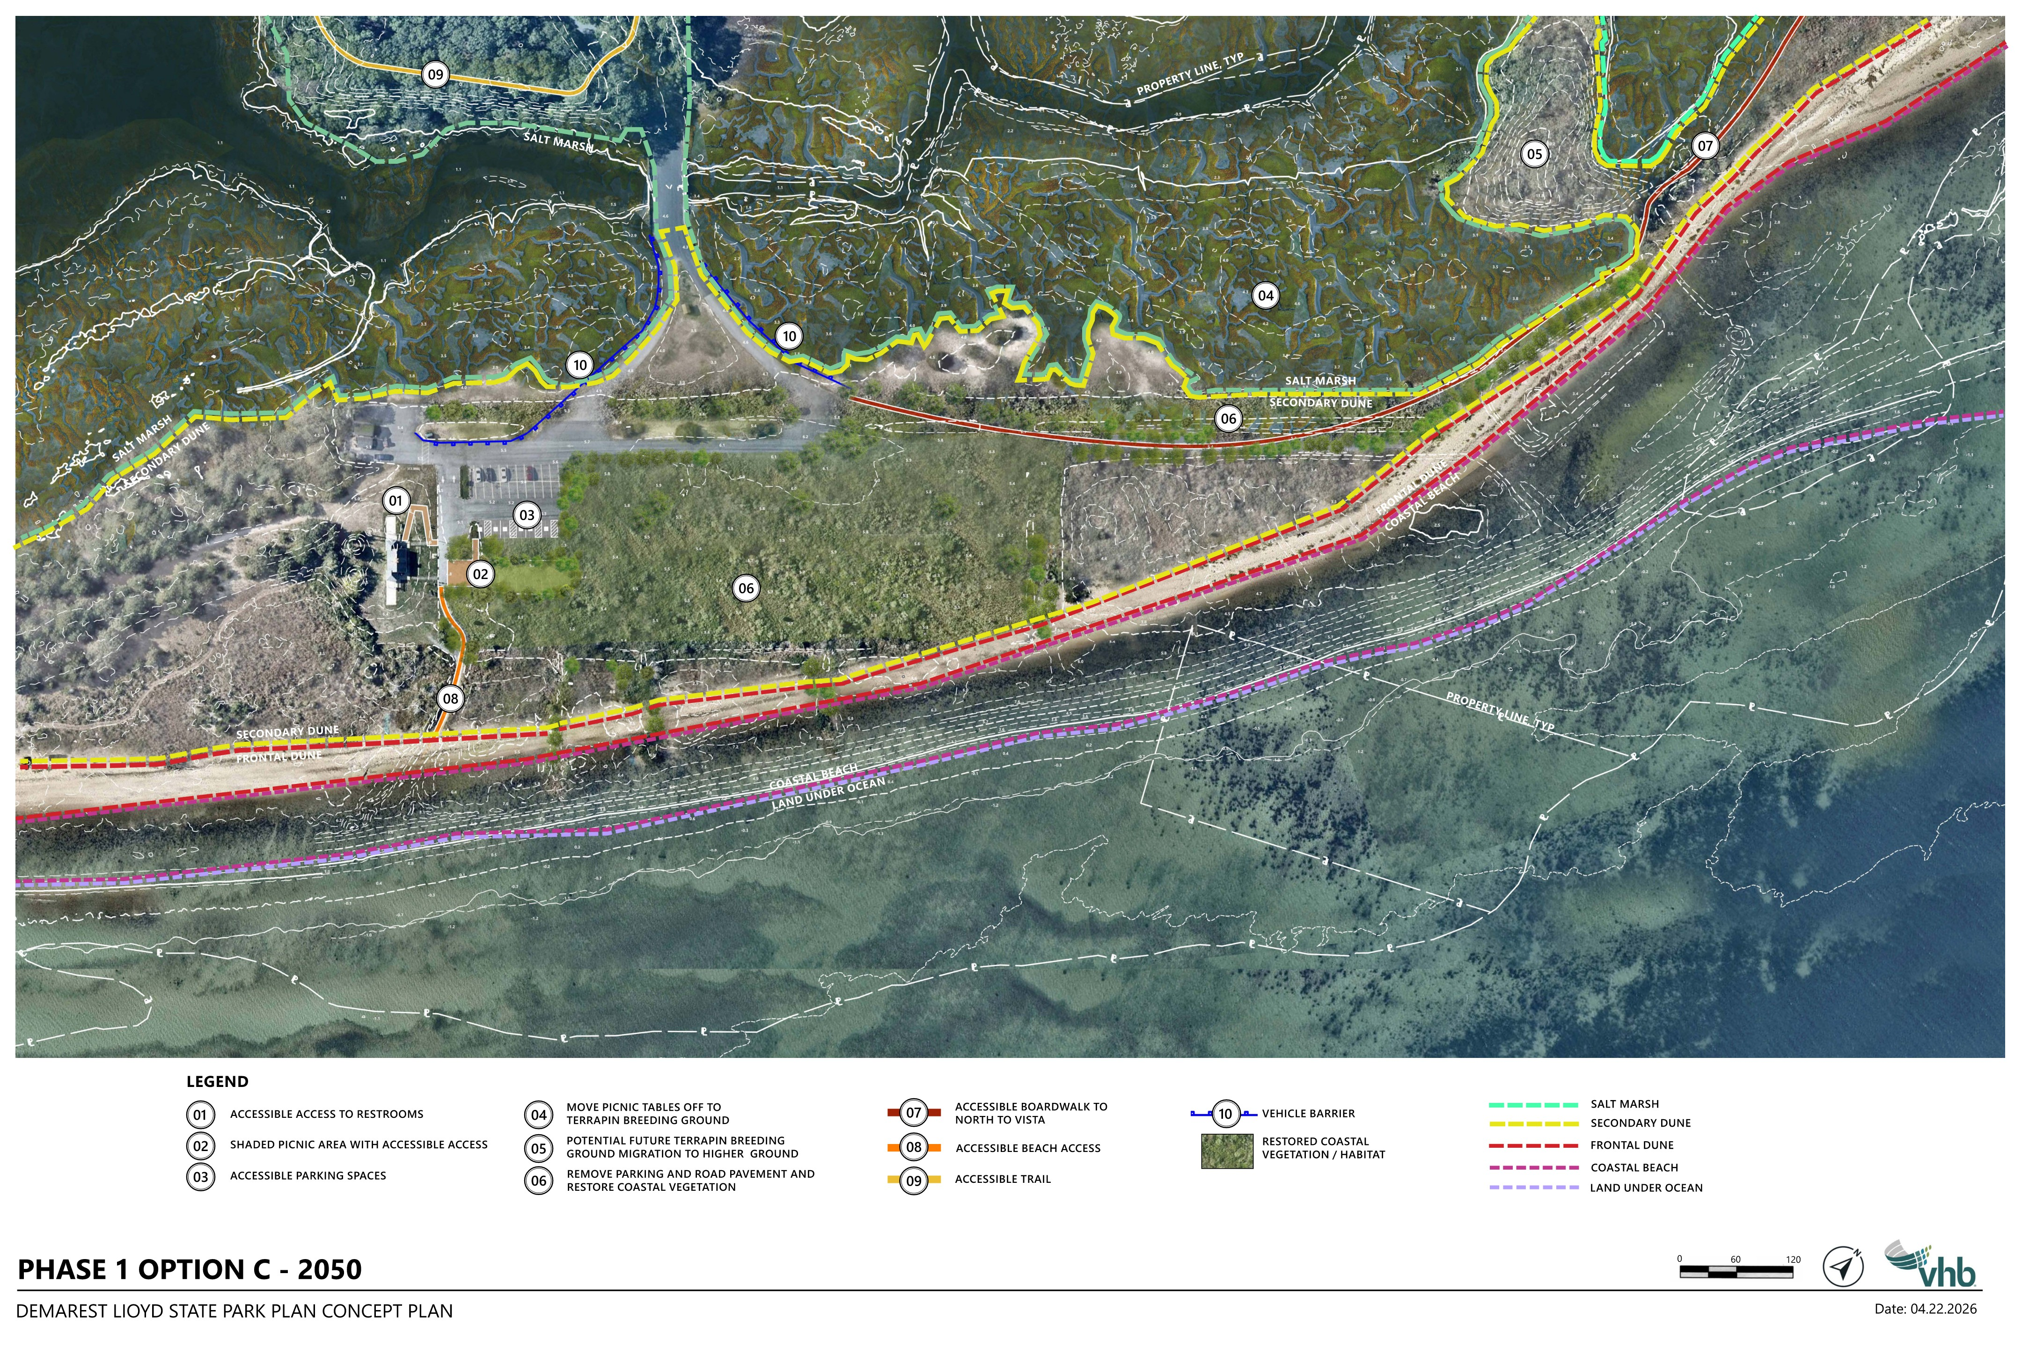
Near-term concepts can withstand 2050 conditions – Concept C

Slide 31
Future 2050+ Draft Concepts
Options A, B, C (4.3ft SLR)

Slide 32
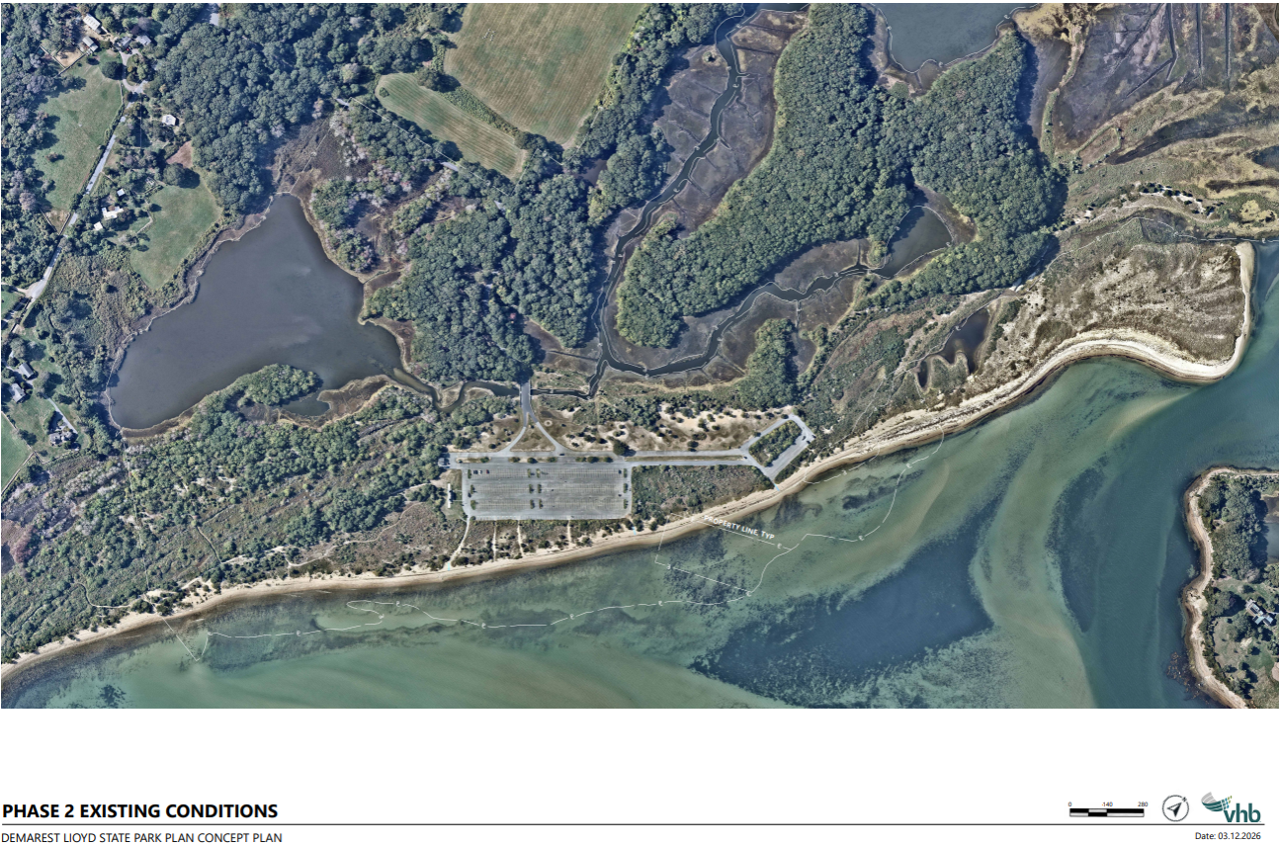
Phase 2 Existing Conditions

Slide 33
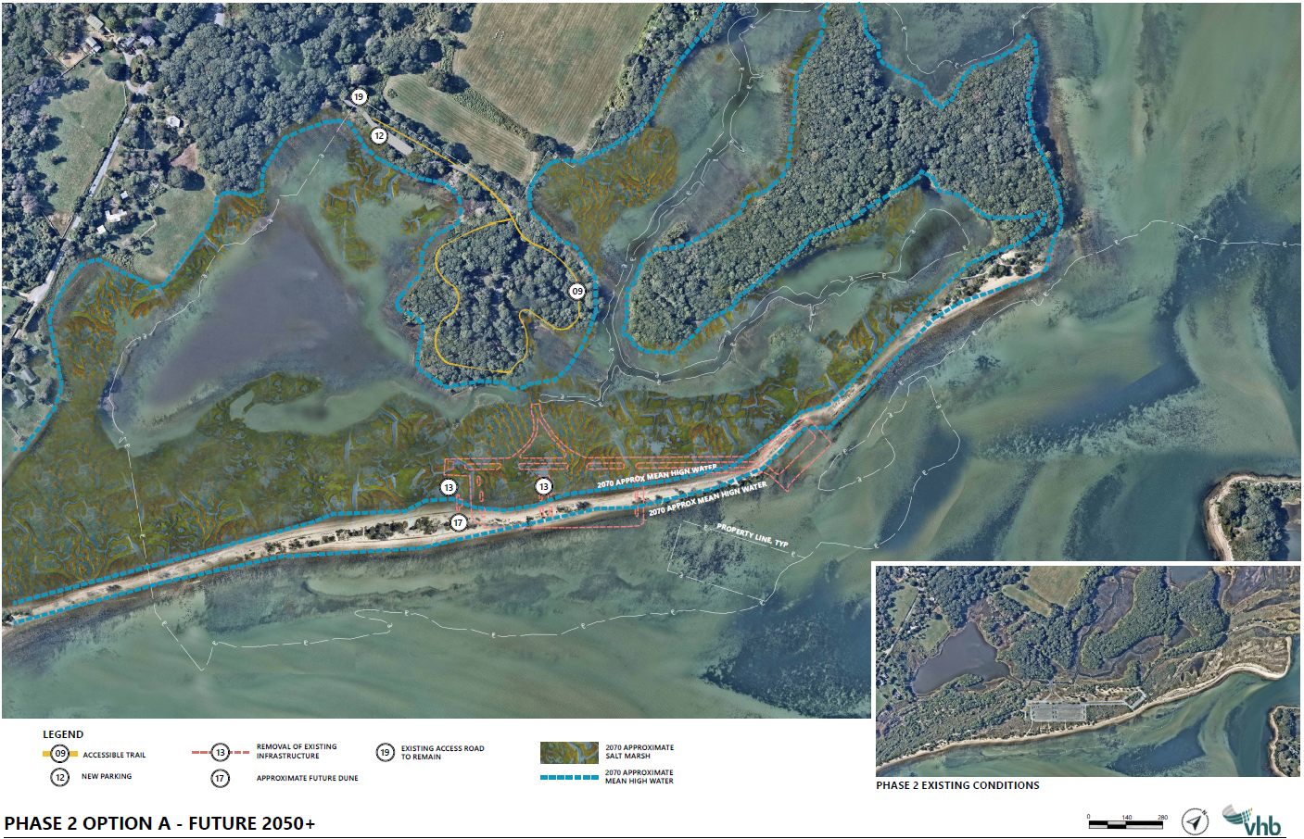
Phase 2 Option A
P
H
A
S
E
2
O
P
T
I
O
N
A

Slide 34
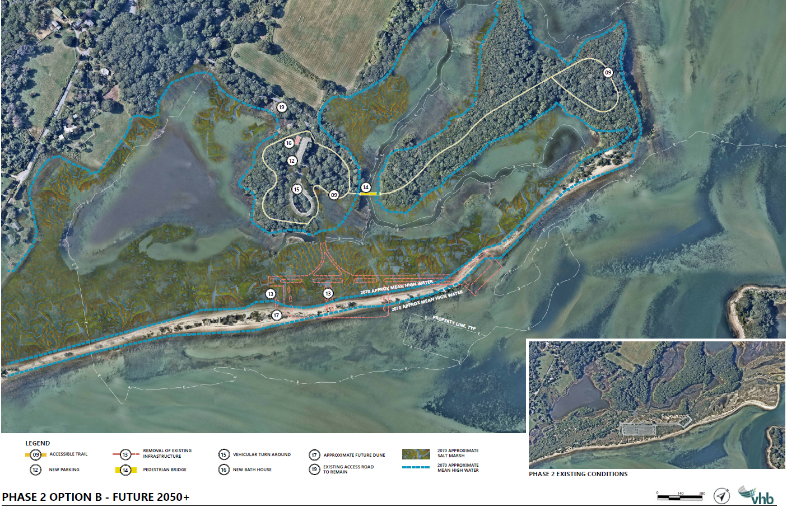
Phase 2 Option B
P
H
A
S
E
2
O
P
T
I
O
N
B

Slide 35
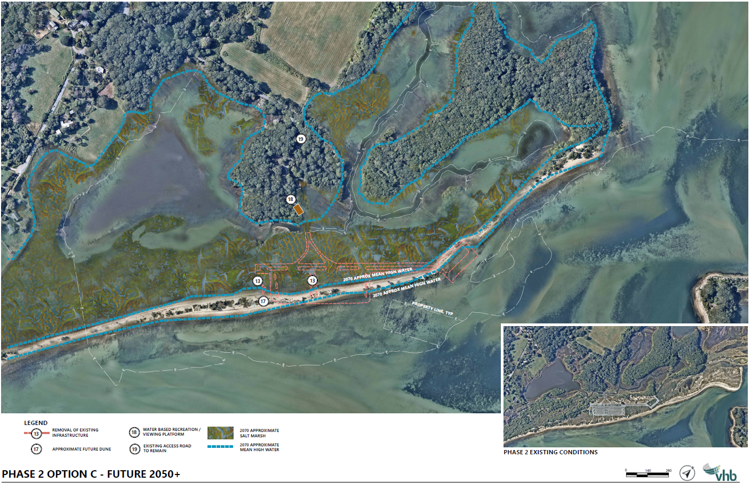
Phase 2 Option C
P
H
A
S
E
2
O
P
T
I
O
N
C

Slide 36
Draft Retreat Concepts Summary
Near-Term through 2050 (2.5ft SLR)
Future 2050+ (4.3 ft SLR)
Option A Two picnic areas | Option B One picnic area | Option C Most restoration
180 parking spaces | 180 parking spaces | 30 parking spaces
3.25 Acres restored | 3.5 Acres restored | 5 Acres restored
Two picnic areas (accessible and lawn) | One picnic area (accessible and lawn) | One picnic area (accessible and lawn)
Accessible trails | Accessible trails | Accessible trails
Bike loop
Shortest boardwalk 0.25mi | Longer boardwalk 0.35 miles | Longest boardwalk 0.39 miles
Option A Light footprint | Option B Greater footprint | Option C Water-based recreation
10-20 parking spaces (6,300 SF new impervious) | 10-20 parking spaces (6,300 SF new impervious) | Pull off/roadside parking at entry
One accessible trail loop | Two accessible trail loops + pedestrian bridge | Existing access road
 | New/relocated Bathroom
 |  | Viewing platform for observation, fishing, kayak launch
Sensitive Archaeological Areas identified throughout the park.

Slide 37
Next Steps
Receive and incorporate public feedback
Finalize Draft Concepts
Prepare Draft Concepts Feasibility Report
The current effort is a planning study only.
No additional phases are currently funded or scheduled.
Contingent on funding availability and reaching a consensus with Tribal Nations and stakeholders around a preferred approach, future steps would involve pursuing separate design, permitting and construction bids.
Feasibility Study
Design
Construction
Permitting
Monitoring
We are here

Slide 38
Public comment
General Guidelines:
Raise your virtual hand
Please wait to be recognized by the moderator
Please state:
  Affiliation (if speaking on behalf of a group)
  Property/Properties on which you are commenting

Slide 39
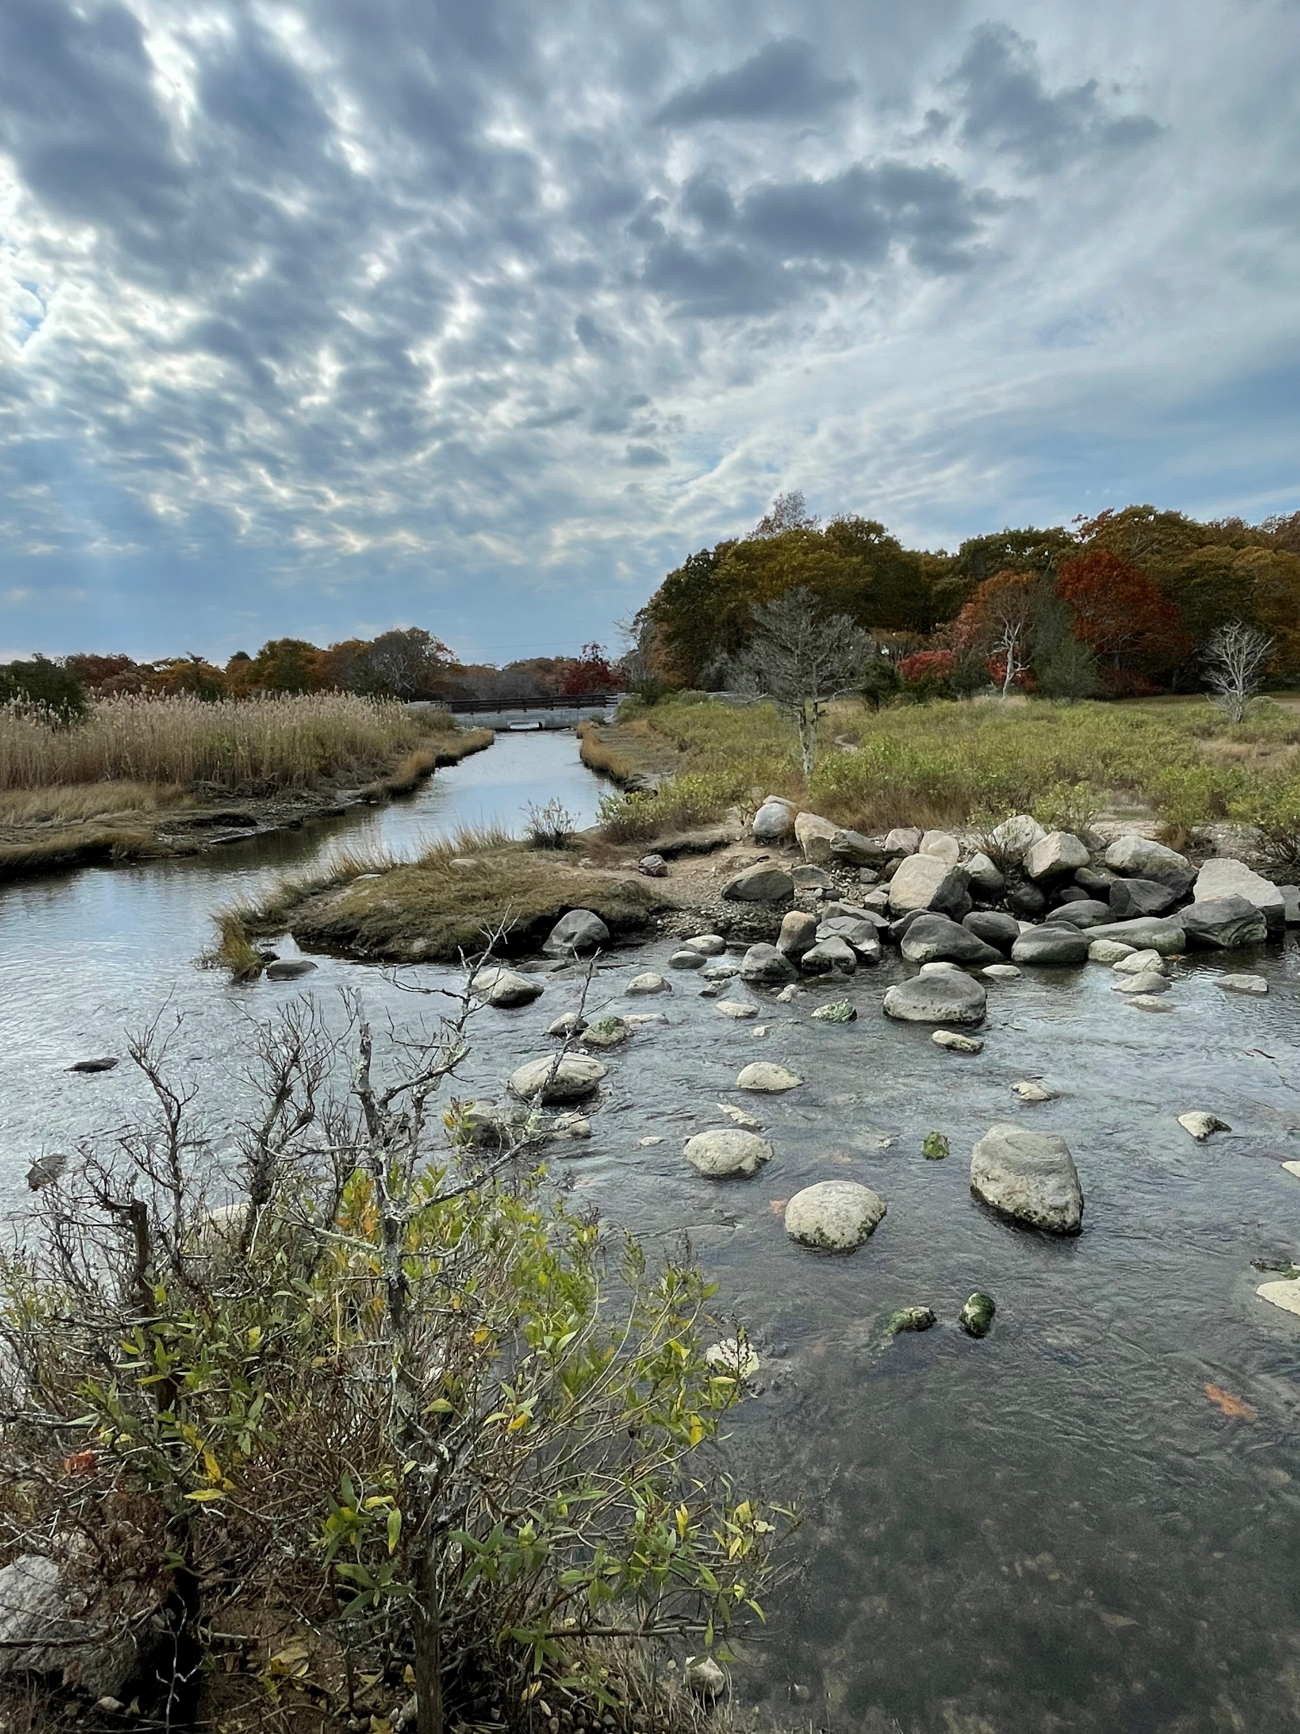
Additional Information
Recording and tonight's slide deck will be available at DCR’s Past events for DCR Public Meetings Information web page
If you have comments on this study:
  Submit online: https://www.mass.gov/forms/dcr-public-comments
  Deadline: May 13, 2026
Please note: the contents of comments submitted to DCR, including your name, town, and zip code, will be posted on DCR's website. Additional contact information provided, notably email address will only be used for outreach on future updates on the subject study
If you wish to subscribe to a DCR general information or project-related listserv: contact DCR's Office of Community Relations via email at mass.parks@mass.gov

Slide 40
Thank You

