Slide 1
MOAKLEY PARK
MVP Summary
September 30, 2020
Mayor Martin J. Walsh

Slide 2
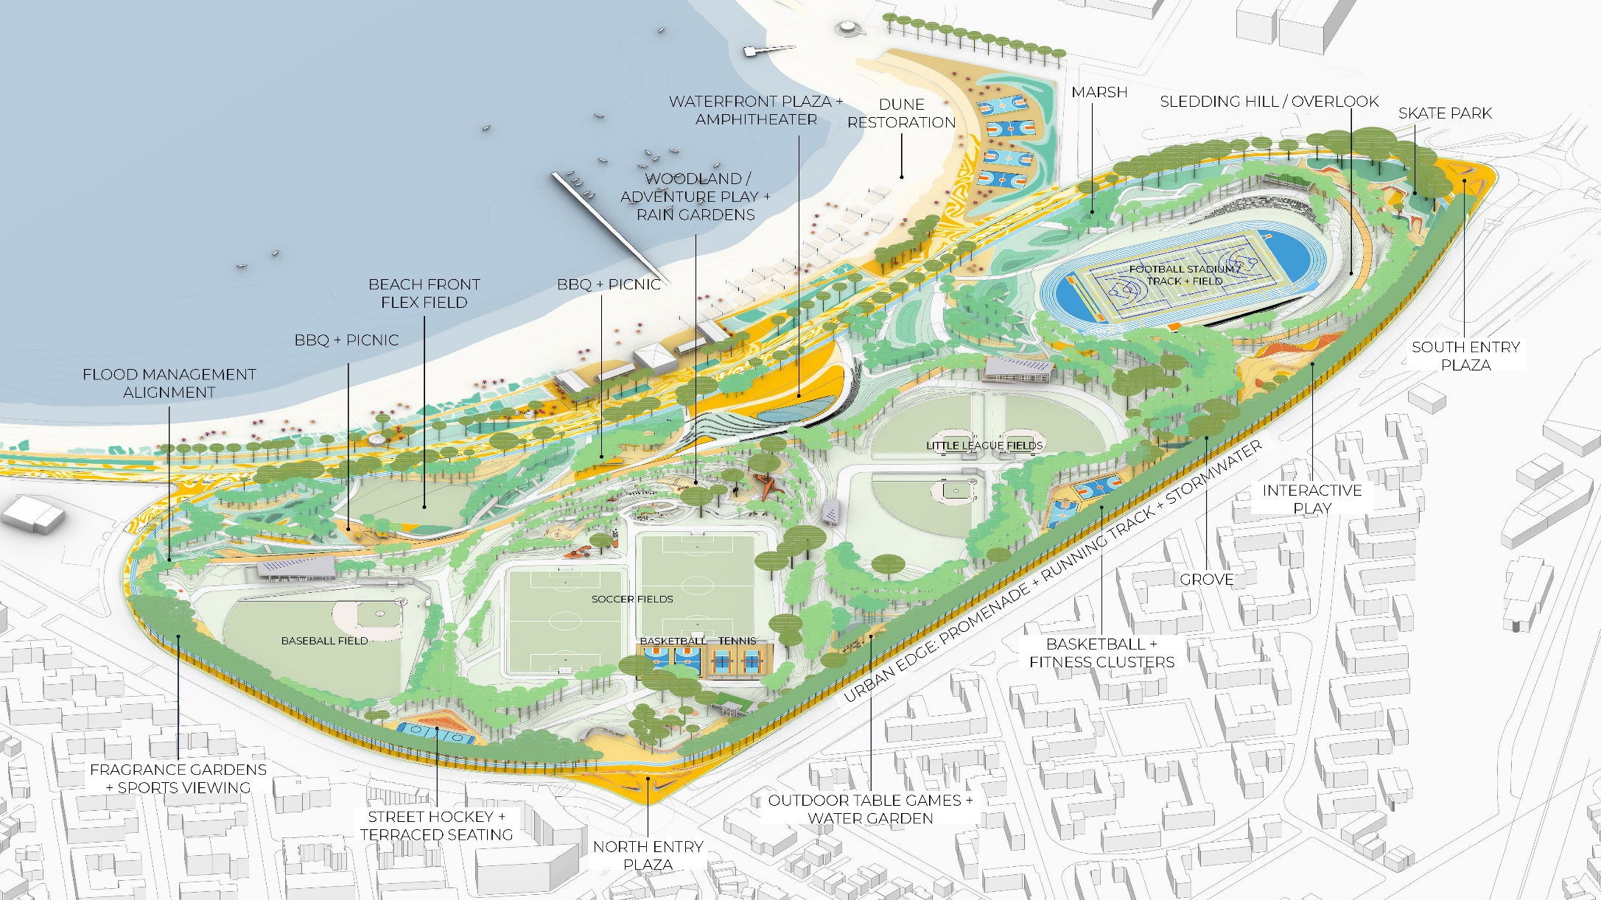
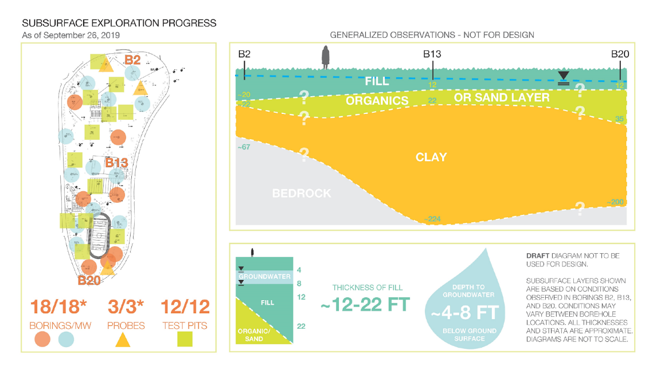
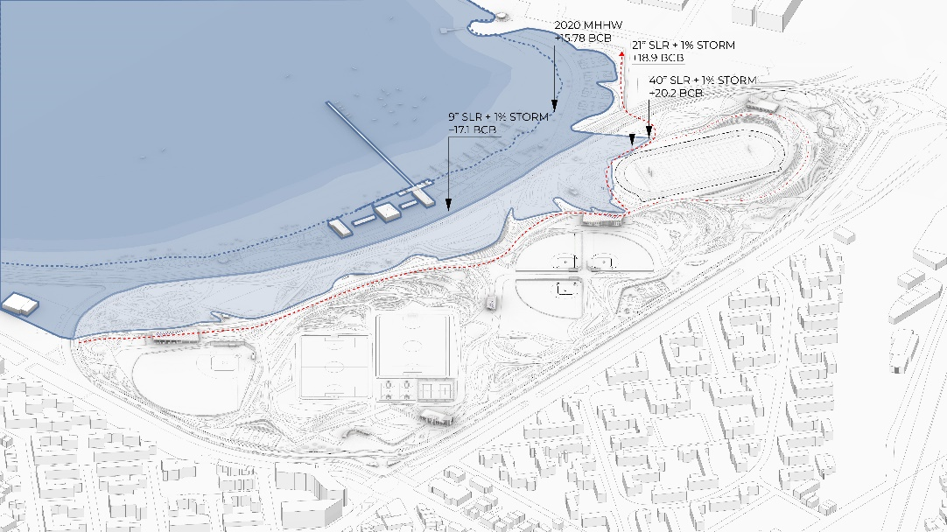
MOAKLEY PARK PRELIMINARY RESILIENCY DESIGN, TECHNICAL ANALYSIS, AND PRE-PERMITTING
FY20 Action Grant Projects
MVP Grant: $1,500,000
Match Amount: $619,595.00
Total Project Cost: $2,119,595.00
Project Priorities:
Technical Analysis and Revised Vision Plan
Advance the Vision Plan through resilience technical analysis, permitting feasibility assessments and concept design refinement.
Provide a higher level of detail design and clarify potential conflicts between existing conditions and the park vision.
Schematic Design for Flood Protection Park and Berm Infrastructure
Develop a design strategy for flood management barrier.
Propose off-site alignments options and coordinate with relevant stakeholders.
Prepare for the federal, state and local permits required to implement the park and coastal resilience infrastructure design.
Multi-faceted Community Engagement
Build on Vision Plan engagement efforts and expand outreach to engage a broad and diverse audience not reached previously; providing opportunities for City residents from EJ neighborhoods who are at risk of being heavily impacted by future coastal flooding from the South Boston flood pathways.
SITE OVERVIEW OF REVISED VISION PLAN
September 30, 2020
FIELD WORK SUMMARY
COASTAL FLOOD MANAGEMENT SUMMARY

Slide 3
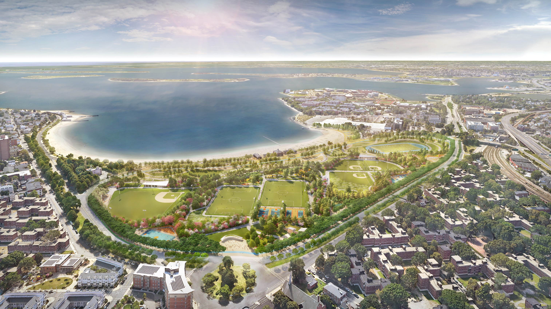
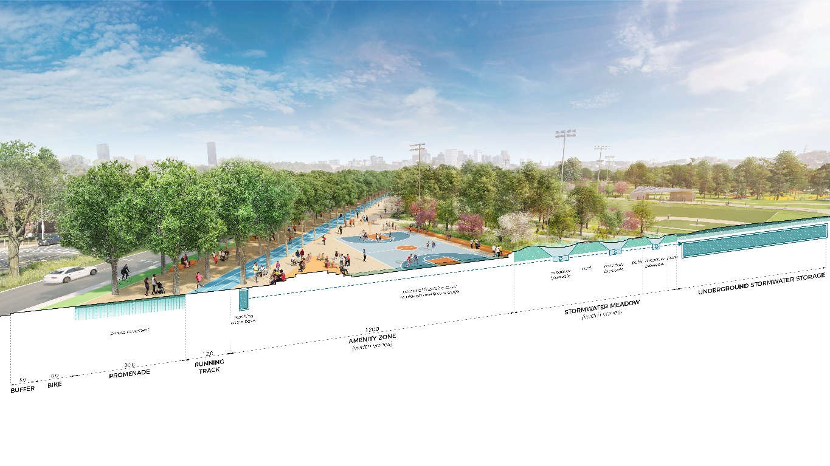
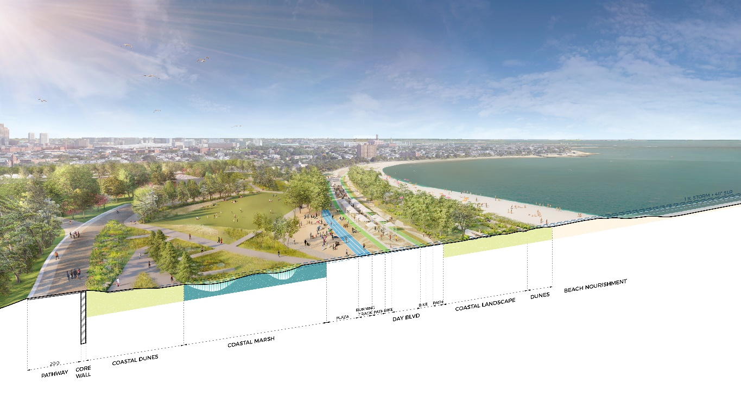
MOAKLEY PARK PRELIMINARY RESILIENCY DESIGN, TECHNICAL ANALYSIS, AND PRE-PERMITTING
CITY EDGE PROGRAM + STORMWATER STRATEGY
SECTION PERSPECTIVE
REVISED VISION PLAN SHOWING REORGANIZED FIELDS, CITY EDGE AND COASTAL LANDSCAPE
NORTHWEST: AERIAL
COASTAL LANDSCAPE + COASTAL FLOOD STRATEGY
SECTION PERSPECTIVE
September 30, 2020

