Slide 1
BRIDGING SKILL GAP
WORKFORCE DEVELOPMENT OF EARLY EDUCATION & CARE
Global semifinalist

Slide 2
FUTURE OF WORK: CHALLENGES
Learners
Job Seekers
Training
Providers
Colleges
Employers
Onboarding
NEED STRONGER AWARENESS OF CAREER OPTIONS
COLLEGE PATHWAYS OFTEN INACCESSIBLE
SUPPLY/DEMAND MATCH + ACCESS ISSUES (Location, Schedules, Languages, etc)
LOW COMPLETION RATES
NEED TIGHTER CONNECTIONS BETWEEN TRAINING AND JOB SKILLS
WIDESPREAD SHORTAGES

Slide 3
FUTURE OF WORK: LEARNER REQUIREMENTS
Career Progression requires lifelong learning and support
Personalized career guidance
Rapid on-demand reskilling
Stackable learning and credentials
Learners looking for a clear ROI in educational choices
Clear connection between learning and career outlook and options
Learning aligned to job skills and competencies

Slide 4
PRAGYA MISSION AND APPROACH
AI-powered Career Compass & Skilling
Personalized guidance connecting learning to career pathways
Skill-aligned, competency-based self-paced learning to meet working learners where they are
Insights/analytics to enable wrap around support (with partners) at scale
Stack and track training and credentials for career progression
Future of Work Grand Challenge
One of 8 semifinalists selected globally for XPRIZE Rapid Reskilling
Goal: Highly scalable rapid skilling of displaced workers into high growth career pathways
Partnered with Capital Workforce Partners in CT

Slide 5
Learner
Pragya
(Career Compass)
Training
Pragya + College
(Competency-based learning & support)
Job
Pragya
(Career Compass)
PRAGYA’s AI POWERED WORKFORCE SKILLING
Job specific competencies
Upskilling / Onboarding
AI-based Personalized Skill Analysis & Career Guidance
Job-specific, Competency-based Learning
AI-backed Personalized Learner Support

Slide 6
CASE STUDY: XPRIZE / FOW GRAND CHALLENGE (CT)
Rapid Reskilling of Displaced Workers (no more than a HS diploma)
85% women, 40% African American, 37% LatinX
60% have child and family responsibilities
High growth career pathways
Medical Admin Assistant, Clinical Research Assistant, Direct Support Professional
Competency-based Learning & Support
Job-oriented training (human skills and hard skills)
Accredited curriculum from certification providers, publishers, colleges
Self-paced learning to meet the constraints of working learners
Tech-backed wrap-around support (instructional and career coaching)
Learning & support through training, job search and job onboarding to ensure success

Slide 7
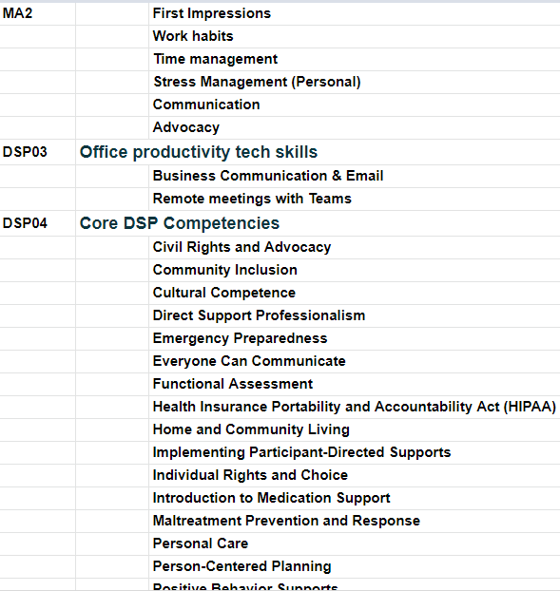
DIRECT SUPPORT PROFESSIONAL PROGRAM
SAMPLE COMPETENCIES & MICROCOMPETENCIES
Curriculum
Developed by Research and Training Center on Community Living at the University of Minnesota
Accredited by the National Alliance for Direct Support Professionals (NADSP)
Online Learning supported by instructional coaching and Human skills workshops
Competencies
Career Relevant Human Skills
Office Productivity skills
DSP Core competencies

Slide 8
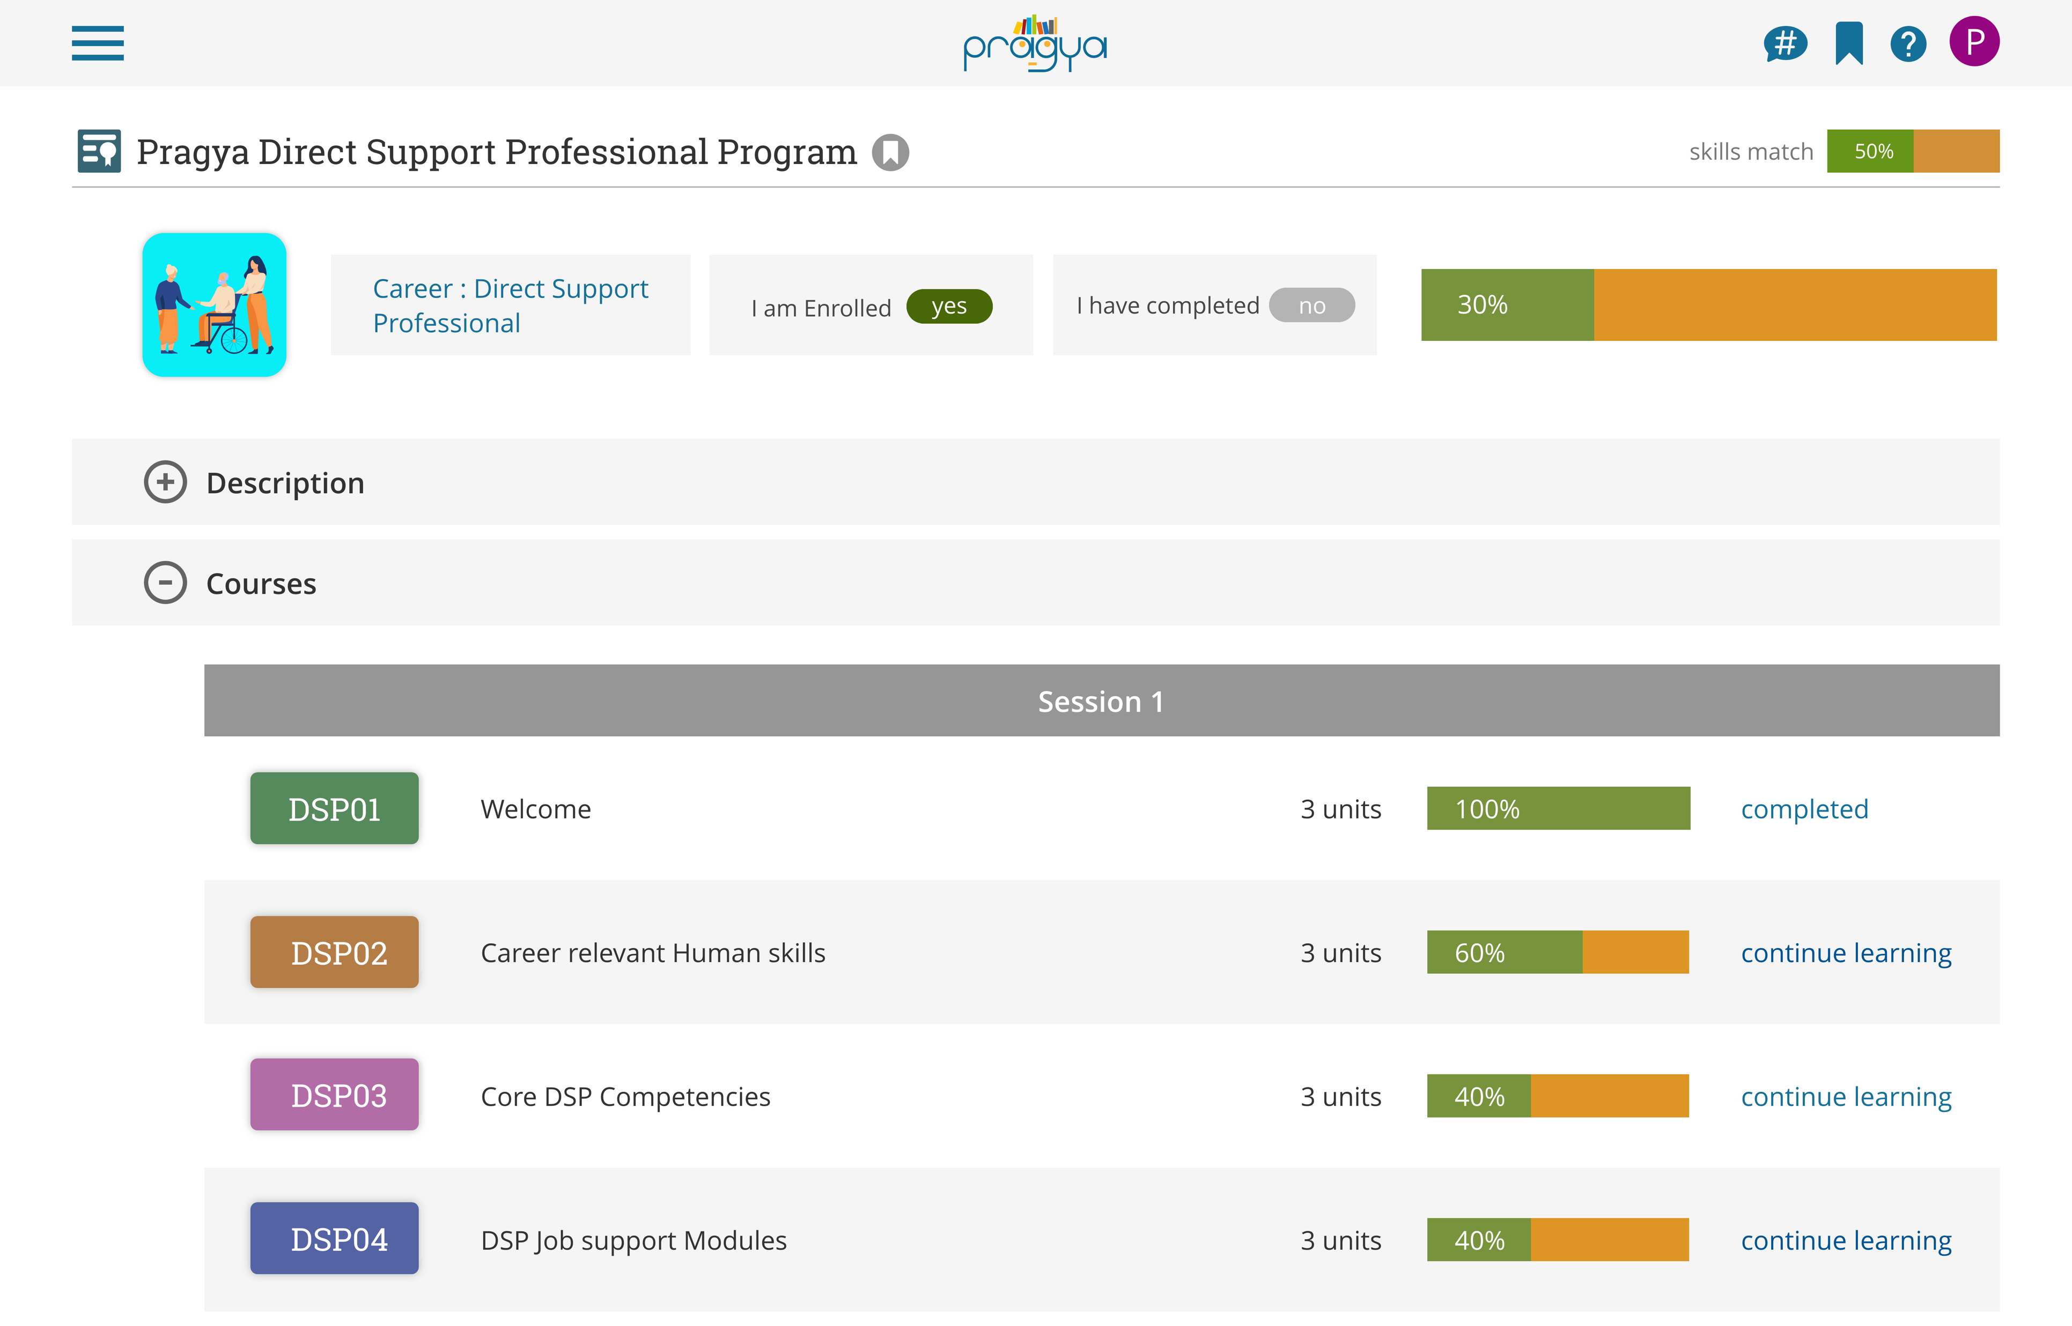
COMPETENCY-BASED LEARNING

Slide 9
ONBOARDING PROCESS
Identify target sources of core courses / curriculum
Map curriculum into competency blocks based on job requirements
Set up wrap around support infrastructure (instructional / career coaches etc.)
Onboard learners into app for personalized career guidance and training
Design formative assessments where necessary

Slide 10
LIFELONG CAREER COMPASS
THANK YOU
Ramji Raghavan
Pragya Systems Corp.
One Broadway, 14th floor,
Cambridge, MA 02142
ramji@pragyasystems.com

