Slide 1
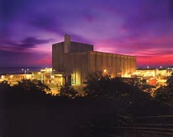
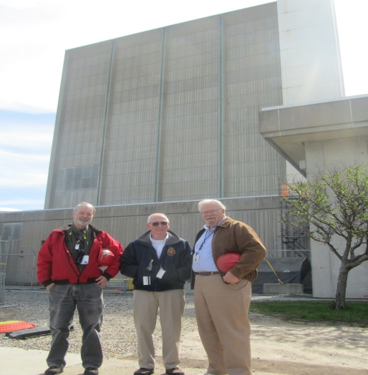
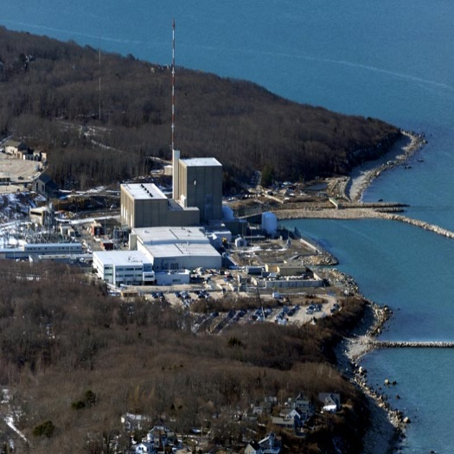
Pilgrim Nuclear Power Station Post-Shutdown Decommissioning Activities Report (PSDAR)
February 15, 2018

Slide 2
Introductions
John Ohrenberger
Decommissioning Director
Pilgrim Nuclear Power Station

Slide 3
Pilgrim Future Milestones
Pilgrim Nuclear Power Station is planning to cease power operations on or about May 31, 2019.
Focus will then be on removing all nuclear fuel from the reactor and place it in the Spent Fuel Pool (SFP).
Pilgrim will then certify to the NRC that the reactor had permanently ceased operations and was permanently defueled.
Pilgrim will exit the NRC Reactor Oversight Process (ROP) and commence the decommissioning inspection program a short time later.
The focus of Pilgrim and its employees will continue to be our ongoing commitment to safety.

Slide 4
Staffing Transition to Decommissioning
Operation
Dormancy Preparation
SAFSTOR
Defuel
Fuel Cool
Fuel in Dry Storage
Site Operation
Operation Safety
~600 Personnel
1st ISFSI Pad Constructed ;
2nd Pad Needed
Wet Fuel (Hot) Management
~300 Personnel
Wet Fuel (Cool) Management
~150 Personnel
Dry Fuel Management
~60 Personnel
Organizations
Decom Planning
SAFSTOR II
SAFSTOR I

Slide 5
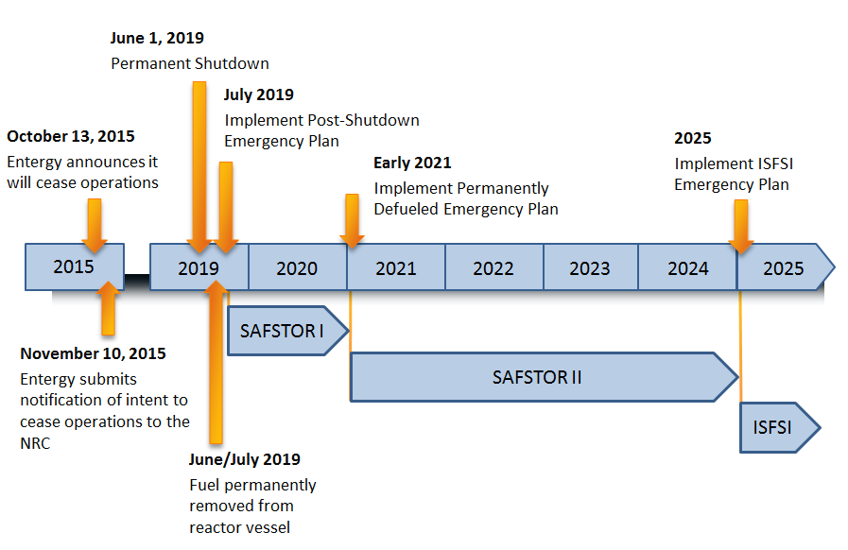
Draft Pilgrim Staffing Timeline
1

Slide 6
Post-Shutdown Decommissioning Activities Report
Requirements/Guidance
10 CFR 50.82(a)(4)
NRC Regulatory Guide 1.185, Revision 1 (June 2013)
Review of recent PSDAR submittals to the USNRC by plants in decommissioning
Written by an experienced team including TLG Services and Pilgrim Decommissioning Project Organization.
PSDAR Content
Description of Planned Decommissioning Activities
Decommissioning Schedule
Decommissioning Cost Estimate (DCE)
Discussion of Environmental Impacts

Slide 7
Spent or Irradiated Fuel Management

Slide 8
Irradiated Fuel Management Plan
Requirements/Guidance
10 CFR 50.54 (bb)
NRC review is conducted in accordance with its standard process
Irradiated Fuel Management Plan Content
Written notification will be submitted to USNRC discussing changes to the Pilgrim Program for Management of Irradiated Fuel.
Program by which Pilgrim intends to manage and provide funding for the management of all spent nuclear fuel until it is transferred to the Department of Energy for ultimate disposal.
Will describe Pilgrim plan to move the fuel from the Spent Fuel Pool (Wet Storage) to the ISFSI (Dry Storage).
1

Slide 9
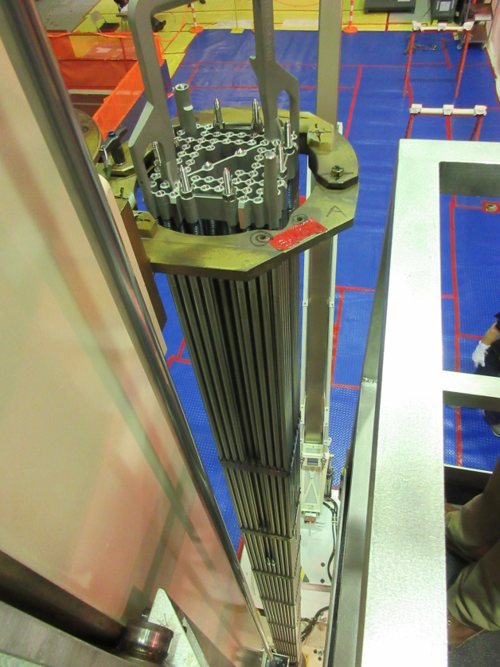
Pilgrim Dry Fuel Storage - Background
The Pilgrim Nuclear Power Station Spent Fuel Pool is designed and licensed to store 3,859 fuel assemblies.
There are currently 2,990 spent fuel assemblies stored in the Spent Fuel Pool.
With Pilgrim in its final operating cycle, the remaining 580 assemblies in the reactor will be added to the pool in 2019.
There are currently 544 spent fuel assemblies stored in 8 dry casks on the first Independent Spent Fuel Storage Installation (ISFSI) pad.
Since commercial operation began in 1972, a total of 4,114 spent fuel assemblies have been generated.
1

Slide 10
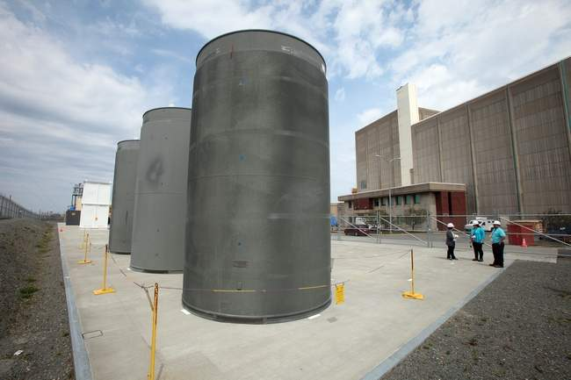
Pilgrim Dry Fuel Storage – Background (Cont’d)
Pilgrim currently has one (1) operational ISFSI pad with a capacity of 40 casks administratively limited to 38 casks to facilitate shuffling/cask access.
The current pad has eight (8) loaded Holtec System 100 Multi-Purpose Canisters (MPCs) each with 68 fuel assemblies.
Current plans are to load additional casks in 2018.
A second ISFSI pad is required to store all spent nuclear fuel on-site.
Design, engineering and vendor selection will determine specifics such as the size of the second pad and the total number of cask systems.
1

Slide 11
Pilgrim Aerial View

Slide 12
Decommissioning Cost Estimate

Slide 13
Decommissioning Cost Estimate (DCE)
Requirements/Guidance
10CFR50.75(c), 10CFR72.30, 10CFR50.54(bb)
TLG Services cost estimating model and data
Plant specific data from walk downs and plant design info
DCE Content
Discusses the Decommissioning Plan assumptions
Specific Costs for:
NRC License Termination
Spent Fuel Management (SFM)
Site Restoration
Provides Total Costs by Decommissioning Period
1

Slide 14
Decommissioning Cost Estimate Breakdown

Slide 15
Nuclear Decommissioning Trust Update
The Pilgrim Decommissioning Trust (NDT) balance was approximately $1.07 Billion on December 31, 2017
1

