Slide 1
Mobile Integrated Health Care and Community EMS Programs
Community EMS Program Application Overview
September 21, 2018

Slide 2
Objectives
Review the Community EMS Program application requirements
Understand the process for Community EMS program application submission to the Department, including the review timeline
Learn more about each pre-approved service included in the Defined List of Community EMS Program Services

Slide 3
Benefits of Community EMS
Paramedics and EMTs are familiar with their communities and their patients:
Trusted in their community
Mandated reporters
See things in the home setting, that other health care providers may not be aware of:
Loose rugs
Piles of mail
Nutrition issues
Exercise habits
Transportation issues
Lack of hygiene
Inability to read fine print (medication labels)
Literacy issues
Medication compliance
Prescription Shopping
Early signs of Dementia
Timely input from family members

Slide 4
Community EMS Background
Utilizes a primary ambulance service’s EMS Personnel in partnership with a local public health authority to address illness or injury prevention through high value public health services.
Operated under the local public health authority
Developed in coordination with the designated primary ambulance service
Approved by the local jurisdiction and the ambulance service's affiliate hospital medical director (AHMD)
Community EMS services must fit in the scope of practice of the Emergency Medical Technician (EMT, AEMT or EMT-P) and should be high impact with low risk.
Approved services are defined in a DPH list, and Programs may petition to add new services to this list.

Slide 5
Community EMS Application Submission
The Department of Public Health will begin to accept Community EMS Program applications on Monday, October 1, 2018
All program and application information will be posted online at www.mass.gov/MIH
Applicants for all programs will submit completed applications by fax
There are no application or registration fees for Community EMS programs
Program registration is valid for two (2) years; approved programs will be required to apply to renew their approval

Slide 6
Community EMS Program Application

Slide 7
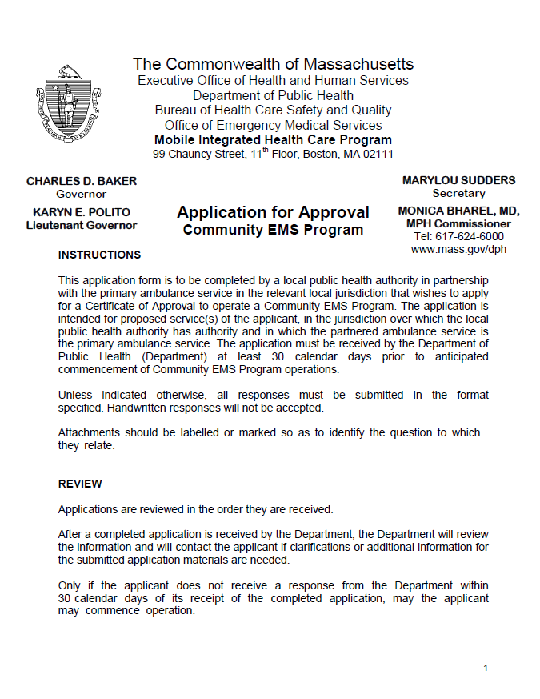
Page 1: Instructions and Review Process
Once a complete Community EMS program application is received, it will be reviewed and the applicant will be notified of program approval within 30 days
An application is considered to be complete when DPH has received the completed application form and all required descriptions and attachments

Slide 8
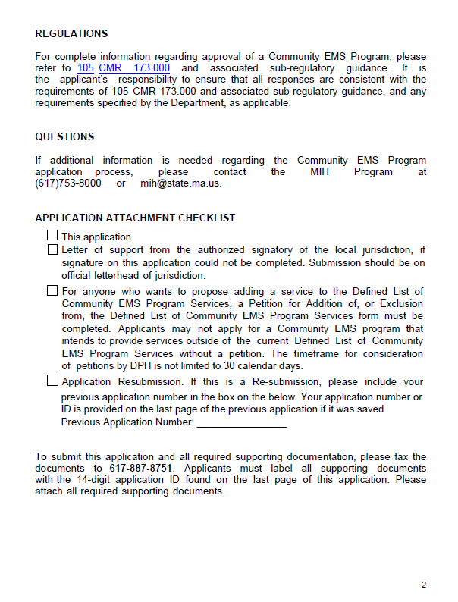
Page 2: Application Checklist
A complete application includes:
Completed application form, including the required program overview and description of proposed services
Signature of or letter of support from the authorized signatory of the local jurisdiction
Submitting the application:
Applicants submit all materials by fax
Applicants will receive an automatically generated fax confirmation if the transmission was successful
When DPH receives all documents, a an MIH Program staff member will email the primary contact listed on the application to confirm receipt of the application and documents

Slide 9
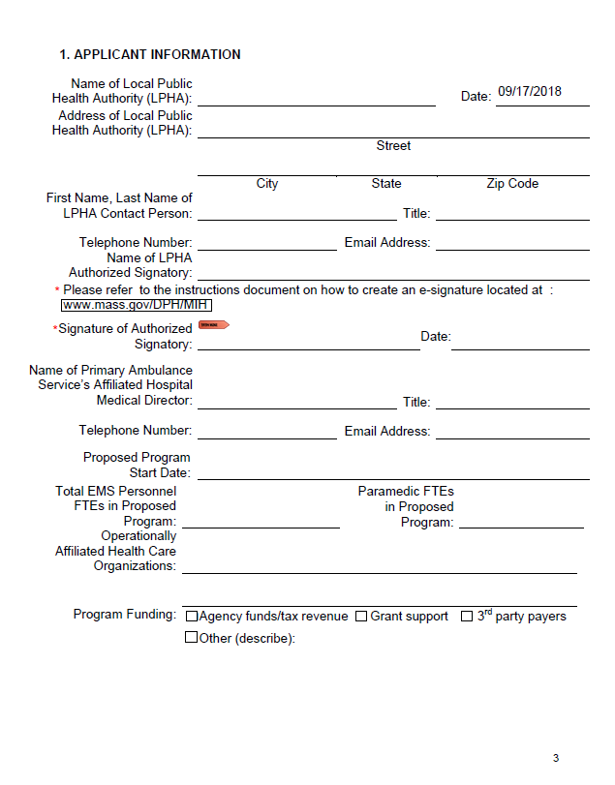
Page 3: Applicant Information
Please ensure that all information is correct: the individual listed will be the primary contact for the application
Digital signature process
Instructions will be available on the MIH website
Wet signatures are not needed
Affiliated health care organizations: what other organizations is the applicant working with to provide the Community EMS Program services
Funding sources

Slide 10
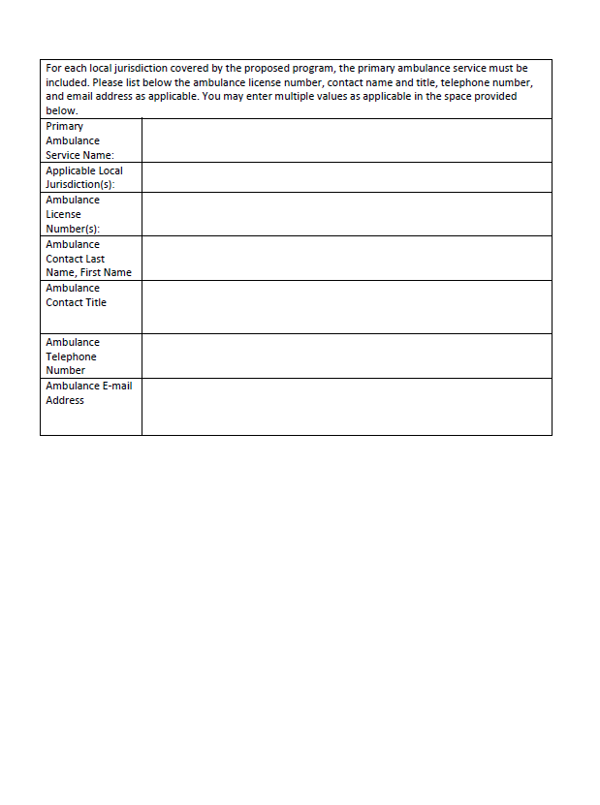
Page 4: Primary Ambulance Service Information
Contact and licensure information for the primary ambulance service
Remember: there is only ONE primary ambulance service in a given jurisdiction

Slide 11
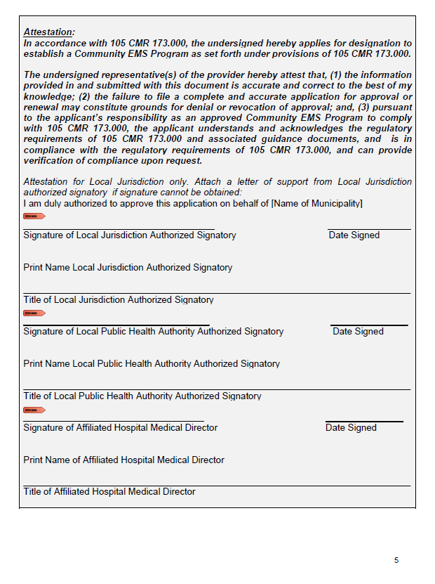
Page 5: Attestations
Attestation that the applicant(s) understand the regulatory requirements of the Community EMS program that they are applying to operate
Signed by a signatory of the Local Jurisdiction, the Local Public Health Authority, and the Affiliate Hospital Medical Director
For the Local Jurisdiction attestation only: applicants may attach a letter of support from the signatory of the Local Jurisdiction
Letter should be on official letterhead
If proposing to operate Community EMS program in more than one municipality, applicant must include required signatures for each

Slide 12
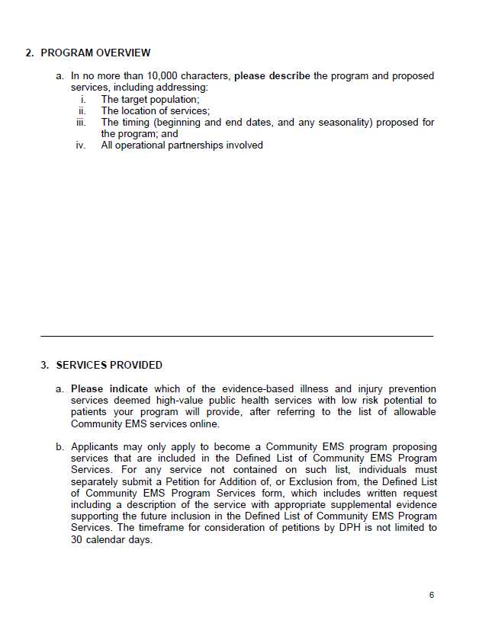
Page 6: Program Overview Narrative and Description of Services
Program overview narrative is provided as an application attachment and should include information for all proposed services:
Target population: who will the program serve - e.g. healthy adult males in need of vaccinations or elderly population
Location: municipality where the ambulance service is the primary ambulance service
Timing: when and how long will services be provided; programs don’t need to run year-round, depending on goals
Operational partnerships: how you plan to work with your operational partners
Services Provided:
List all services that are included in application
If applying to operate a program that is not included on the Defined List of Community EMS Program Services, applicant must submit a Petition with information about the new, proposed services.

Slide 13
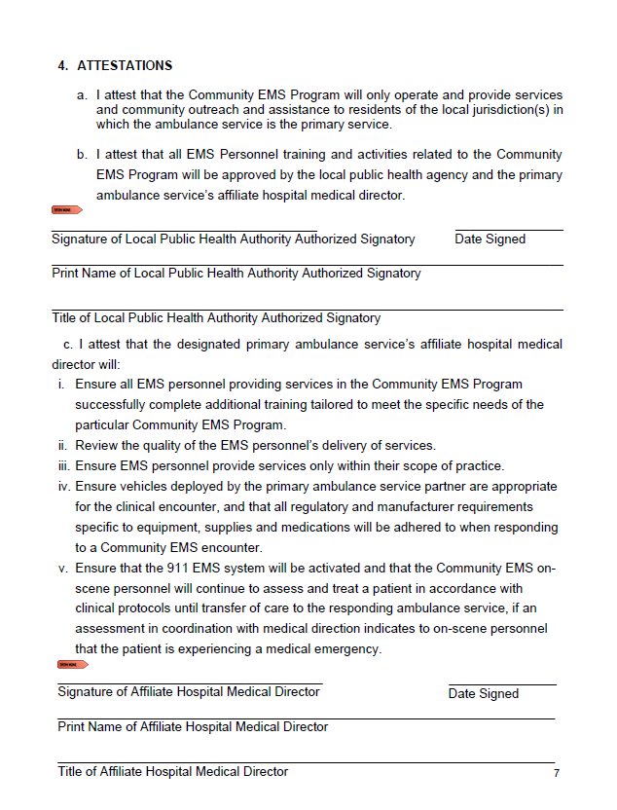
Page 7: Attestations
Attestations by the Local Public Health Authority:
the proposed program will operate only in the community or communities in which the ambulance service is the primary service
The proposed activities are approved by the local public health authority and affiliate hospital medical director
Attestations by the Affiliate Hospital Medical Director (AHMD):
Ensuring training is appropriate and complete
The AHMD does not need to directly provide it to the EMS Personnel
Responsible for monitoring quality of delivered services
EMS personnel only provide services within their scope of practice
Vehicles used by CEMS are appropriate
Emergent conditions will still be treated via the 911 system

Slide 14
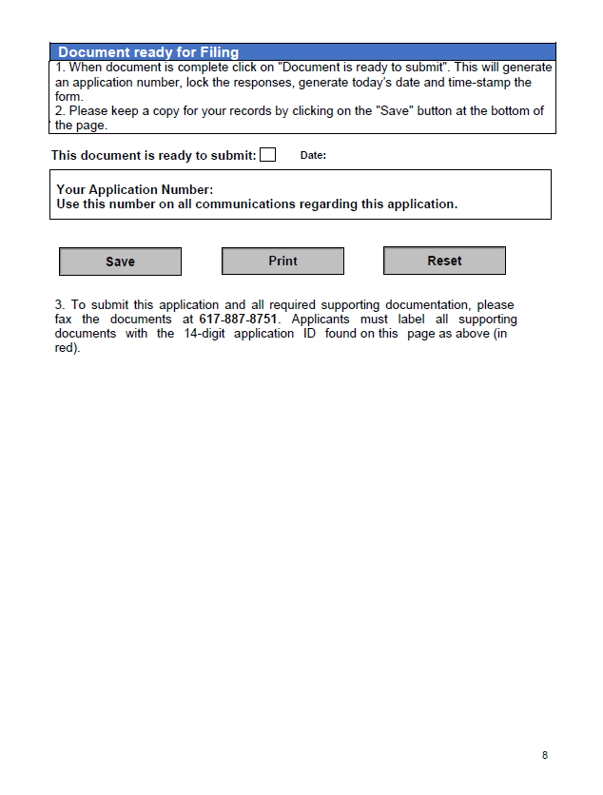
Page 8: Document Submission
Instructions for filing the application
A 14-digit application ID will be auto auto-generated
Please use 14-digit application ID on all communications regarding your application, including any attachments that accompany the application form
Keep a copy of the application for your records

Slide 15
Defined List of Community EMS Program Services

Slide 16
Defined List of Community EMS Program Services
The Defined List of Community EMS Program Services provides information about each of the 24 evidence-based high value public health services that a Community EMS Program applicant may apply to operate
Services should reflect the need of the community or communities where a proposed program will operate
Community EMS applicants may submit a petition to add a new service to the pre-approved service list by submitting a written request with appropriate supporting evidence to DPH
Community EMS Program applicants should align proposals with the EOHHS/DPH priority areas: substance use disorders; housing stability/homelessness; mental illness and mental health; and chronic disease

Slide 17
Community EMS Program Services by Priority Area
Substance Use Disorders | Housing Stability /Homelessness | Mental Illness and Mental Health | Chronic Disease (focus: Cancer, Heart Disease & Diabetes)
Naloxone Information & Training | Assistance with Environmental Lead (Pb) Testing | Behavioral Health Home and Community Referrals | Asthma Evaluation
Sharps Awareness | Assistance with Radon/Air Quality Testing | Depression and Suicide Prevention Resource Lists in the Community | Health Promotion Screening
Substance Use Disorders Education | Child Passenger Safety | Fire arms safety | Provision of Primary Care Resource List & Referral
 | Children with Special Care Needs Evaluation |  | Sharps Awareness
 | Emergency Preparedness Individual Evaluation |  | Vaccinations (by Paramedics ONLY)
 | Fire and Burn Prevention and Education |  | Well-being checks, including home weight check, blood pressure check, blood sugar check, and medication confirmation check (Post-discharge instructions)
 | Home and Community Falls Prevention
 | Home Safety Evaluation
 | Housing instability/ homelessness risk
 | Poison Control Home Evaluation
 | Water Safety
 | Welcome Family (Home Evaluation for New Caregivers)
 | Windows Falls Prevention

Slide 18
Community EMS Program Services
Assistance with Environmental Lead (Pb) Testing
Assisting a community member with environmental lead testing processes (i.e., testing of lead-painted surfaces or soil) will allow for in-home risks to be understood by the community. EMS personnel can help with sample collection, mailing, and interpretation of results as well as providing resources to help with remediation. Neither EMS agencies nor EMS personnel should be responsible for the reporting of results. EMS personnel will not be responsible for the results of testing.
Assistance with Radon/Air Quality Testing
EMS personnel can assist with referral, placement, procedures and interpretation of results to community members who may have difficulty following up on initiating and completing a Radon or Air Quality test. EMS agencies and EMS personnel are not responsible for the reporting of results or for the results of testing but provide services to improve testing rates and completion.

Slide 19
Community EMS Program Services, cont’d
Child Passenger Safety
EMS personnel can make referrals to a local Child Passenger Safety expert as well as make recommendations that improve the safety of children in vehicles. This can include car seats, the dangers of hot cars and seat belt safety education both in the community and in private residences. Referral to a local Child Passenger Safety Seat Technician must be available.
Children with Special Care Needs Evaluation
An in-home visit by EMS personnel to families with children with special care needs can encourage proactive information exchange and minimize misunderstandings should EMS be called to the home in an emergency. A discussion with family members about the types of care needed as well as the technical aspects of any assistive equipment can enable adequate EMS emergency service provision when needed. Documentation should be prepared and shared with dispatch when possible.

Slide 20
Community EMS Program Services, cont’d
Emergency Preparedness Individual Evaluation
EMS personnel can provide individuals or families with an evaluation of their home’s emergency preparedness. Checklists and reviews of current supplies and plans can help families be prepared for emergency situations. Preparation and prevention discussion on home safety, evacuation procedures and required supplies can help families and pets stay safe.
Fire and Burn Prevention and Education
Burns are a significant cause of pain, disfigurement, and infection. EMS personnel can provide education on prevention of burns, potential treatments for burns as well as indications for when to call 911. Prevention can include smoke and carbon monoxide alarms, water heater temperature checks and code evaluation of heat sources in the home.

Slide 21
Community EMS Program Services, cont’d
Home and Community Falls Prevention
Falls Prevention can be accomplished by in-home visits and screenings along with simple improvements: clearing pathways, evaluating toilet and kitchen access, installing grab bars, removing access obstacles, and recommending additional appropriate tools to prevent falls.
Home Safety Evaluation
Home safety impacts residents, families, and the larger community. The Massachusetts Housing website includes resources to address home safety in the community. EMS personnel may be given access to a home when local fire or law enforcement may not and can provide crucial information about safety risks for a particular home.
Homelessness and Housing Instability
Providing support to those experiencing housing instability can prevent future emergencies. EMS personnel can provide referrals to nutrition, shelter, housing, and utility resources. Specifically, providing local resources for veterans, domestic abuse victims, and families in vulnerable situations could improve your community’s well-being. Keeping a verified list of resources available in the local community can keep patients secure and prevent emergency situations. Social work and case management referrals will increase awareness of at-risk community members.

Slide 22
Community EMS Program Services, cont’d
Poison Control Home Evaluation
Household chemical and medication safety education, particularly around preventing overdoses and dosing errors in the home or community, can be a highly effective preventive measure. Education and assistance with this process can reduce unnecessary emergency department visits and provide opportunities to educate families about risks associated with certain types or combinations of medications. Home evaluations should follow Poison Control guidelines.
Additional resource: Regional Center for Poison Control and Prevention
Water Safety
EMS personnel can provide water safety advice that will prevent unnecessary risks in a water environment. This can include education, providing information on flotation devices, drowning prevention tips and improving compliance with the use of flotation devices as well as other water safety tools.

Slide 23
Community EMS Program Services, cont’d
Welcome Family (Home Evaluation for New Caregivers)
Welcome Family is a program of the Massachusetts Home Visiting Initiative. The program offers a universal one-time nurse home visit to all mothers with newborns. Welcome Family assesses mother and newborn health and well-being and provides education, support, and referrals to services as needed. EMS personnel can participate in the program and provide required services after participating in training by the new parent initiative staff or make referrals in conjunction with the new parent initiative staff.
Additional Resource: Welcome Family Information for Providers
Windows Falls Prevention
EMS personnel can provide education to community members on egress and ingress in multi-story homes as well as provide and recommend/install window bars, appropriate window locks, and ladders for egress as needed.

Slide 24
Community EMS Program Services, cont’d
Behavioral Health Home and Community Referrals
EMS personnel can assist with referral and scheduling appointments with behavioral health resources or provide brochures and contact information. Written documentation of the referral is required.
Depression and Suicide Prevention Resource Lists in the Community
EMS personnel can provide referrals, brochures and assist with locating community resources for depression and suicide prevention. EMS can also provide community education on recognizing the signs and symptoms of depression and suicide risks as well as treatment resources in the local community.

Slide 25
Community EMS Program Services, cont’d
Fire Arms Safety
EMS personnel are given access to the home environment that allows for suggestions of safe storage and use of firearms. Providing family members who have a gun in the household with referral tools for local firearm safety classes encourages safe gun ownership. Providing gun locks and suggestions for gun safes and storage can increase pediatric safety and reduce impulse use. Lethal means counseling and education on gun safety have been shown to reduce gun incidents both in accidental and intentional gun deaths.
Additional resource: Suicide Prevention Resource Center Online Courses

Slide 26
Community EMS Program Services, cont’d
Asthma Evaluation
EMS personnel can evaluate the home environment for asthma triggers and provide assistance with initial education on peak flow testing for asthmatics in the home environment. Referrals from the emergency department and an individual’s PCP can help evaluate if asthma is being well controlled in the home. Patients with active shortness of breath must be treated as a medical emergency when applicable.
Health Promotion Screening
EMS personnel can provide community education and health promotion screenings at health promotion screening events. Laboratory testing at Health Promotion Screening events is subject to review and approval by the DPH Clinical Laboratory Program pursuant to 105 CMR 180.030 (D). Further information, including the Health Promotion Screening application, may be found at:
Additional resource: Health Promotion Screen Application information

Slide 27
Community EMS Program Services, cont’d
Vaccinations (by Paramedics ONLY)
Only paramedics may administer flu vaccines and other vaccinations designated by the Department to persons 18 years old and over, as authorized by clinical protocols in a Department-approved MIH or Community EMS Program. See 105 CMR 700.003(A) (4) of the Drug Control Program (DCP) regulations.
The primary ambulance service’s affiliate hospital medical director is responsible for establishing clinical protocols governing such vaccinations by paramedics.
If vaccine responsibility is to be maintained by the primary ambulance service at their base locations, all applicable vaccine storage requirements must be followed, as referenced in DCP regulations. Documentation of immunization must be maintained in accordance with local public health authority processes and comply with federal and DCP regulations. Description of program must include intended population for vaccination and how vaccine acquisition and storage will be handled. Visit the Centers for Disease Control and Prevention website for more information on storage and handling of vaccines.
Eligible healthcare providers who wish to receive vaccine from the Massachusetts Department of Public Health Immunization Program must enroll each year. Find more information on eligibility, enrollment and additional requirements in the Program’s Frequently Asked Questions.

Slide 28
Community EMS Program Services, cont’d
Provision of Primary Care Resource List and Referral
EMS personnel can offer education to individuals who do not have a PCP, are frequent 911 callers or frequent visitors to emergency departments by providing them information about primary care and other health care specialty resources in the community. Assistance and support to help make a PCP connection for an individual is encouraged.
Well-being Checks
An evaluation of a patient for weight, blood pressure, blood pressure and medication confirmation with simple screening tools can occur in the home or community.
Medication Confirmation checks include a review of newly prescribed medications for a recently discharged patient upon arrival at home, ensuring the patient understands discharge instructions; and a review for any duplicate medication prescriptions noted. Referrals to the patient’s pharmacy or primary care provider (PCP) must occur immediately when any issues are noted. Documentation must be completed by EMS personnel and referrals back to discharging provider are required when indicated.

Slide 29
Community EMS Program Services, cont’d
Sharps Awareness
Residential sharps are banned from disposal in the municipal waste stream. A large share of Massachusetts households do not have an option for residential sharps disposal. EMS services can provide sharps disposal drop-off locations (e.g. drop boxes), hold periodic waste collection dates, and provide referrals to resources that will reduce the number of accidental sharps injuries.
Additional resource: Medical waste regulations
Substance Use Disorder Education
EMS personnel can provide education and referral to programs to help reduce tobacco use as well as provide clinical information on the effects of various substances of abuse. Referrals should include notification of the individual’s PCP.
Additional resource: Massachusetts Tobacco Cessation and Prevention Program

Slide 30
Community EMS Program Services, cont’d
Naloxone Information and Training
Providing information about naloxone and its use as well as education on indications and contraindications will catalyze community health improvements. Education will include a demonstration of the procedure as well as the indications for a community member to call 911 to prevent further injury. Training can be provided to patient and family following a 911 call when family requests it but only after full medical evaluation of patient has been completed. Training to police officers and other first responders is encouraged. Additional resource: MassTAPP Technical Assistance

Slide 31
MIH and Community EMS Application Overview Sessions
Topic | Date
Community EMS Application Overview | Friday, September 21
MIH Application Overview | Tuesday, October 16
MIH with ED Avoidance Application Overview | Friday, October 19
Register online at: https://www.mass.gov/service-details/mih-and-community-ems-educational-resources
Materials from this webinar will be shared online early next week

Slide 32
Online Resources
Information, application materials, and resources will be posted online as they become available at:
www.mass.gov/MIH
Applicant Resources:
Application forms and instructions for each program type
MIH Regulations and Guidance
Data submission information and resources for each program type
Application resources, such as best practices for completing a gap in service delivery narrative
Upcoming webinars in-person informational sessions

Slide 33
Questions?
Thank you for participating in today’s webinar!
Questions?
Mobile Integrated Health Care Program
MIH@state.ma.us
617-753-8484

