Slide 1

Mobile Integrated Health Care and
Community EMS Programs
MIH & Community EMS Overview for EMS
September 25, 2018

Slide 2
Objectives
Learn about the Community EMS, Mobile Integrated Health Care (MIH) and MIH with ED Avoidance programs
Understand the role of EMS Personnel in each of the three program types
Review the requirements for each of the applications

Slide 3
Background
Chapter 111O of the General Laws of Massachusetts sets forth standards for the approval and oversight of Community EMS Programs and Mobile Integrated Health Programs, including those with ED Avoidance Components and ensures a high quality of care, and strong consumer protection in alternate health care settings.
The MIH Program regulations, 105 CMR 173.000, Mobile Integrated Health Care and Community EMS Programs, went into effect on September 7, 2018.

Slide 4
Mobile Integrated Health Care: Redefining Care Delivery
Mobile Integrated Health Care (MIH) is an opportunity for enhanced partnerships between healthcare entities and healthcare providers to provide innovative healthcare models that use mobile resources, including EMS personnel, to deliver care and services to patients in an out-of-hospital environment.
Encourages partnerships between various healthcare providers as well as ACOs
Focuses on care coordination and managed care
Expands the setting of practitioners beyond the hospital environment with appropriate training and medical oversight
Programs may differ in goals and services provided based on the needs of the communities where they operate
Examples of services:
  Chronic disease management
  Behavioral health
  Preventative care
  Post-discharge follow-up visits
  Transport or referral to facilities other than hospital EDs
Examples of healthcare facilities and entities:
  Ambulance services
  Hospitals
  Accountable Care Organizations
  Visiting Nurse Associations
  Home Health Agencies
Examples of providers:
  EMS Personnel
  Community Paramedics
  Nurses
  Physician Assistants
  Emergency Service Providers (ESPs)
  Social Workers

Slide 5
Defining the MIH Spectrum
EMS Community EMS MIH MIH with ED Avoidance
Education
Stabilize, treat
and Transport
Scheduled and Acute Treatments, Transport & Refer
(e.g. readmission avoidance, post-discharge follow up)
Treat; Transport to
Alternate Destination within the MIH system
Preventive Services, Low Risk High Impact
(e.g. screenings, falls prevention)
HIGHER RISK

Slide 6
Background Comparison
 | EMS | CEMS | MIH | MIH with EDA
Authority | MGL 111C / 105 CMR 170 | MGL 111O / 105 CMR 173
Goal | Non-/Emergency EMS services | Prevention; high value/ low risk services | Address gaps; prevent over hospitalization | Appropriate Treatment
Staffing | Certified EMTs/ para. | Primary ambulance EMS | EMS/ Community Para. | Primary ambulance EMS
Training | Statewide Treatment Protocols (STP) | STP & Program-specific training | STP & Program-specific training | STP & Advanced EDA training
Operation | Juris. service zone plan | Muni; ambulance AMD | Healthcare partnerships | MIH Program
Oversight | Medical control/direction | Medical control/direction | Medical control/direction | Medical control/direction
Service | Licensed ambulance | Primary ambulance | No preference | Primary ambulance
Vehicle | Min. ambulance standards | Appropriate to encounter | Appropriate to encounter | Min. ambulance standards
Treatment | Assessment, treatment | DPH-approved services | Setting change but within Scope | Assessment, treatment
Transport | To emergency department | N/A | N/A | Alternative destination
911 | Respond to 911; dispatch | Activate 911 in emergency | Activate 911 in emergency | Respond to 911; dispatch
PCP | N/A | PCP Referral | PCP coordination | PCP coordination

Slide 7
What do MIH & Community EMS mean for EMS Personnel?
Community EMS and MIH expand the settings in which EMS personnel provide care, but do not change the scope.
Offers EMS personnel new opportunities to provide education and services to patients in an out-of-hospital environment, with appropriate training and medical oversight.
Encourages partnerships between EMS and local boards of health or other healthcare entities to address the healthcare needs of your communities.

Slide 8
Benefits of Community EMS
Paramedics and EMTs are familiar with their communities and their patients:
Trusted in their community
Mandated reporters
See things in the home setting, that other health care providers may not be aware of:
  Loose rugs
  Piles of mail
  Nutrition issues
  Exercise habits
  Transportation issues
  Lack of hygiene
  Inability to read fine print (medication labels)
  Literacy issues
  Medication compliance
  Prescription Shopping
  Early signs of Dementia
  Timely input from family members

Slide 9
What is Community EMS?
Utilizes a primary ambulance service’s EMS Personnel in partnership with a local public health authority to address illness or injury prevention through high value public health services.
  Operated under the local public health authority
  Developed in coordination with the designated primary ambulance service
  Approved by the local jurisdiction and the ambulance service's affiliate hospital medical director (AHMD)
Community EMS services must fit in the scope of practice of the Emergency Medical Technician (EMT, AEMT or EMT-P) and should be high impact with low risk.
Approved services are defined in a DPH list, and Programs may petition to add new services to this list.

Slide 10
Community EMS Requirements
Applicants for Community EMS must meet the following requirements as part of their application:
Completed application form
Signature or letter of support from the authorized signatory of the local jurisdiction
Description of the program and proposed services from the Defined List of Community EMS Services
Attestation from the local public health authority and the primary ambulance service’s affiliate hospital medical director

Slide 11
Defined List of Community
EMS Program Services
The Defined List of Community EMS Program Services provides information about each of the 24 evidence-based, high value public health services that a Community EMS Program applicant may apply to operate
Services should reflect the need of the community or communities where a proposed program will operate
Community EMS applicants may submit a petition to add a new service to the pre-approved service list by submitting a written request with appropriate supporting evidence to DPH
Community EMS Program applicants should align proposals with the EOHHS/DPH priority areas: substance use disorders; housing stability/homelessness; mental illness and mental health; and chronic disease

Slide 12
Community EMS Program Services by Priority Area
Substance Use Disorders | Housing Stability /Homelessness | Mental Illness and Mental Health | Chronic Disease (focus: Cancer, Heart Disease & Diabetes)
Naloxone Information & Training | Assistance with Environmental Lead (Pb) Testing | Behavioral Health Home and Community Referrals | Asthma Evaluation
Sharps Awareness | Assistance with Radon/Air Quality Testing | Depression and Suicide Prevention Resource Lists in the Community | Health Promotion Screening
Substance Use Disorders Education | Child Passenger Safety | Fire arms safety | Provision of Primary Care Resource List & Referral
 | Children with Special Care Needs Evaluation |  | Sharps Awareness
 | Emergency Preparedness Individual Evaluation |  | Vaccinations (by Paramedics ONLY)
 | Fire and Burn Prevention and Education |  | Well-being checks, including home weight check, blood pressure check, blood sugar check, and medication confirmation check (Post-discharge instructions)
 | Home and Community Falls Prevention
 | Home Safety Evaluation
 | Housing instability/ homelessness risk
 | Poison Control Home Evaluation
 | Water Safety
 | Welcome Family (Home Evaluation for New Caregivers)
 | Windows Falls Prevention

Slide 13
What is MIH?
A system of pre- and post-hospital services that utilizes mobile resources, including EMS Personnel and community paramedics, to deliver a coordinated continuum of care that supports patients’ needs in the community.
Care is planned through collaborative and innovative program development to address gaps in service delivery and prevent unnecessary hospitalizations and other harmful or wasteful resource delivery.
An MIH Program may apply separately to include an ED Avoidance Component.

Slide 14
Examples of MIH Services, Partners & Providers
Services
  Chronic disease management
  Behavioral health
  Preventative care
  Post-discharge follow-up visits
  Transport or referral to facilities other than hospital EDs
Health Care Facilities or Entities
  Ambulance services
  Hospitals
  Accountable Care Organizations
  Visiting Nurse Associations
  Home Health Agencies
Providers
  EMS Personnel
  Community Paramedics
  Nurses
  Physician Assistants
  Emergency Service Providers (ESPs)
  Social Workers

Slide 15
MIH Requirements
Applicants for MIH must meet the following requirements
as part of their application:
Completed application form
Gap in service delivery narrative
Proposed operational partnership documentation , for example:
  Memorandum of Understanding (MOU)
  Memorandum of Agreement (MOA)
  Letter of Intent (LOI)
Organizational chart specific to applicant organization’s management and structure in the field
Designated Medical Director’s biography
Completed MIH Compliance and Capacity Form (if applicable)
Plan for medical oversight, including lines of authority and responsibility, development and review of clinical protocols, training and assessment of skills, communication systems, and continuous quality assurance and improvement

Slide 16
What is ED Avoidance?
A component of an approved MIH Program allowing for management of 911 patients in alternative settings, including outpatient clinics, psychiatric facilities, and the patient’s home.
DPH-approved MIH Programs may apply separately to operate an ED Avoidance Program in addition to the services provided through their MIH Program.
ED Avoidance utilizes the applicable jurisdiction’s designated primary ambulance service and paramedics with advanced training.
By treating at home or transporting the patient to an alternative destination, EDA may prevent crowding of hospital emergency departments as well as more appropriate care.

Slide 17





ED Avoidance Pathway
Transition to ED Avoidance follows a primary ambulance service response (911), patient assessment, consultation with on-line medical direction, and patient consent.
Contact Medical Direction for Permission to Avoid ED Transfer & Initiate Transition
to MIH
Treat in Home
Initiate Patient ED Refusal and Secure Patient Consent to Treat as MIH Patient
Treat and/or Refer or Transport to Appropriate Health Resource
Primary Ambulance Service Dispatch
Behavioral Health
911
Call
On-Scene, is Patient OK
Primary Care Provider
Subject to DPH ED Avoidance Protocol
Social Services
Substance Abuse Treatment

Slide 18
MIH with ED Avoidance Requirements
Applicants for MIH with ED Avoidance must meet the following requirements as part of their application:
Completed MIH with ED Avoidance application form
Either a completed MIH Program Application or a Certificate of Approval for an already approved MIH Program
Gap in service delivery narrative that is specific to the ED Avoidance Program
Contact information for each medical director
Program’s policies and procedures demonstrating the process for obtaining a patient’s informed consent
Clinical and triage protocols
Training curriculum

Slide 19
Required Data Submission
 | Frequency of Submission | Submission Method
Community EMS | Annual (optional) | DPH template with pre-defined fields
MIH | Quarterly | DPH template with pre-defined fields
MIH with ED Avoidance | Real-Time | Massachusetts Ambulance Trip Record Information System (MATRIS)
If an MIH Program also operates an ED Avoidance component, data must be submitted for both the MIH Program and the MIH with ED Avoidance Program.
Data submission instructions, defined data elements, submission templates for Community EMS and MIH will be available online at www.mass.gov/MIH.
Instructions for MATRIS access and use for MIH with ED Avoidance Programs will be available online at www.mass.gov/MIH.

Slide 20
Program Recap
1
2
3
COMMUNITY EMS |  | MIH |  | MIH w/ ED AVOIDANCE
EMS-based programs, in partnership with municipalities.
Focus on advancing illness or injury prevention through needed high value public health services with low risk potential.
Approved services defined by DPH, with option to petition to add new services.
Change to EMS care settings and patient access points, not the scope of care.
Utilizes EMS personnel (and other healthcare personnel) to deliver a coordinated continuum of care.
Addresses gaps in service delivery within a community.
Proactively prevents unnecessary hospitalizations or other harmful and wasteful resource delivery.
Care is provided outside of the hospital environment.
Component of an approved MIH Program that must be applied for separately, with a goal to prevent unnecessary hospitalizations.
Operated by an MIH Program and includes the community’s primary ambulance service.
Follows a primary ambulance service response, patient assessment, consultation with on-line medical direction, and patient consent to treatment at an alternate destination.

Slide 21
Application Submission
All program and application information will be posted on the MIH website: www.mass.gov/MIH.
The Community EMS Program application is now available online
The MIH and MIH with ED Avoidance Program applications will be available online in late fall
Application submission
  Community EMS, MIH, and MIH with ED Avoidance each have a unique application form, which will be available online as a fillable PDF.
  Applicants for all programs will submit completed applications by fax and additional required documents by email or mail to DPH.
  Applications will be reviewed in the order that they are received, and applicants will have the opportunity to provide clarification on the information included in their application throughout the review process, as necessary.
  Once a complete Community EMS application is received, it will be reviewed and applicants will be notified within 30 days of program approval.
  MIH and MIH with ED Avoidance applicants will remit payment for the initial application fee by mail.

Slide 22
Proposed MIH Program Fees
 | Application Fee (Due with Initial Program Application) | Biannual Registration Fee (Due following Program Approval and upon Registration Renewal)
Community EMS | -- | --
MIH | $1,000 | $30,000
MIH with ED Avoidance (EDA) | $2,000 | $40,000
If an applicant applies to operate both an MIH Program and an MIH with EDA Program, they must submit the application fee for each application ($1,000 for MIH; $2,000 for MIH with EDA).
If an applicant receives approval to operate both an MIH Program and an MIH with EDA Program, they must submit the registration fee for each program type ($30,000 for MIH; $40,000 for MIH with EDA).
MIH and MIH with ED Avoidance Programs are approved on a two-year basis, and
Programs may apply to renew their registration.

Slide 23
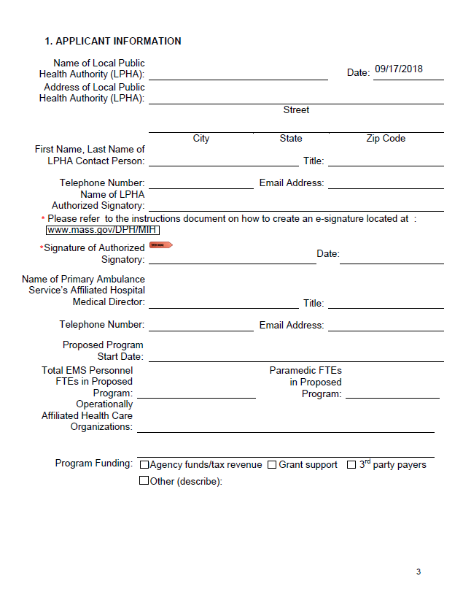
Community EMS Application
Please ensure that all information is correct: the individual listed will be the primary contact for the application
Digital signature process
  Instructions will be available on the MIH website
  Wet signatures are not needed
Affiliated health care organizations: what other organizations is the applicant working with to provide the Community EMS Program services
Funding sources

Slide 24
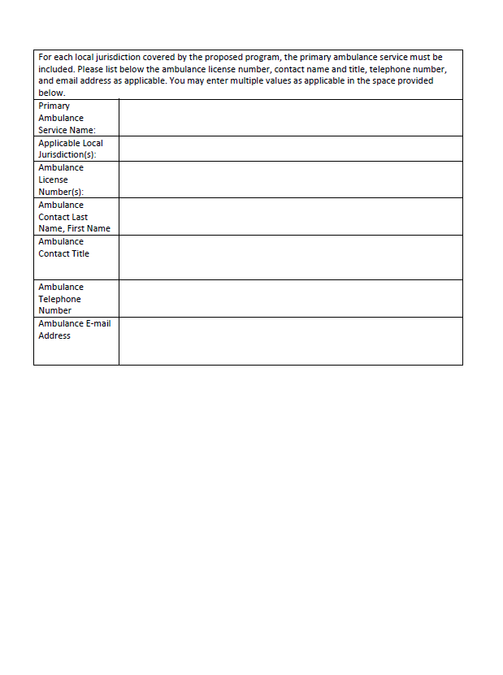
Community EMS
Application, cont’d
Contact and licensure information for the primary ambulance service
Remember: there is only ONE primary ambulance service in a given jurisdiction

Slide 25
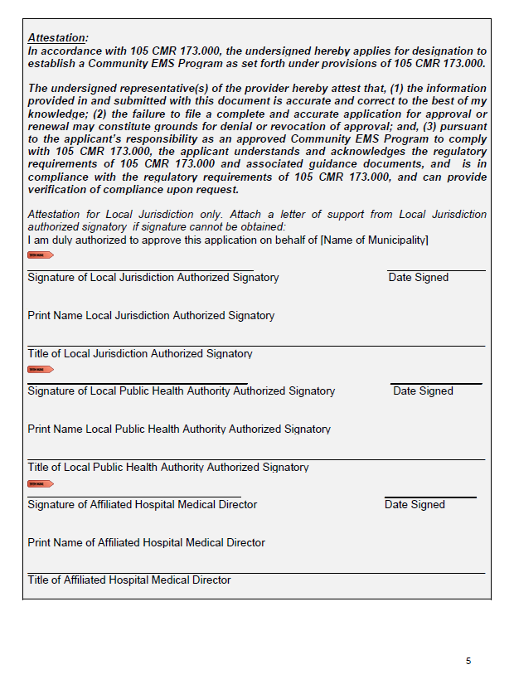
Community EMS
Application, cont’d
Attestation that the applicant(s) understand the regulatory requirements of the Community EMS program that they are applying to operate
Signed by a signatory of the Local Jurisdiction, the Local Public Health Authority, and the Affiliate Hospital Medical Director
For the Local Jurisdiction attestation only: applicants may attach a letter of support from the signatory of the Local Jurisdiction
  Letter should be on official letterhead
If proposing to operate Community EMS program in more than one municipality, applicant must include required signatures for each

Slide 26
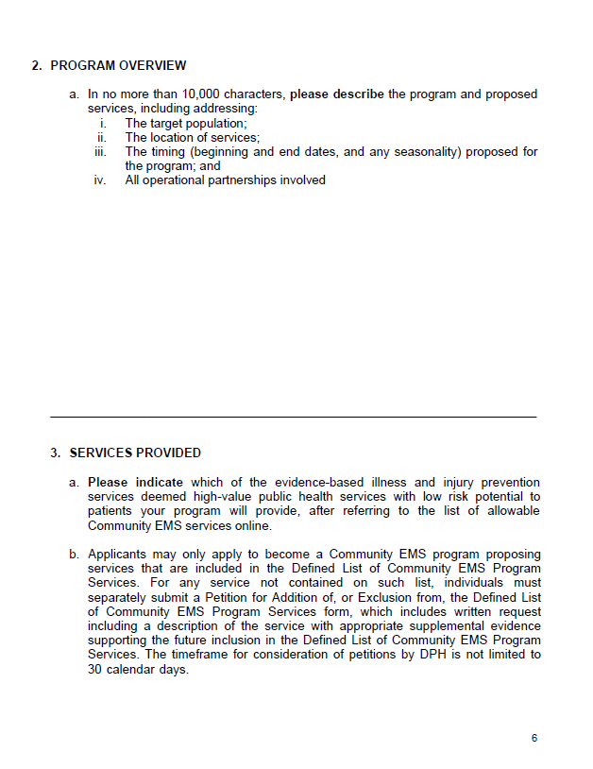
Community EMS
Application, cont’d
Program overview narrative is provided as an application attachment and should include information for all proposed services:
Target population: who will the program serve - e.g. healthy adult males in need of vaccinations or elderly population
Location: municipality where the ambulance service is the primary ambulance service
Timing: when and how long will services be provided; programs don’t need to run year-round, depending on goals
Operational partnerships: how you plan to work with your operational partners
Services Provided:
List all services that are included in application
If applying to operate a program that is not included on the Defined List of Community EMS Program Services, applicant must submit a Petition with information about the new, proposed services.

Slide 27
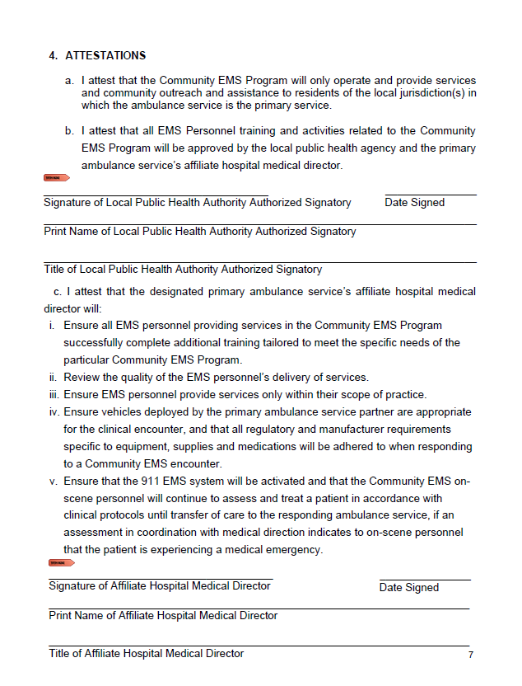
Community EMS
Application, cont’d
Attestations by the Local Public Health Authority:
  the proposed program will operate only in the community or communities in which the ambulance service is the primary service
  The proposed activities are approved by the local public health authority and affiliate hospital medical director
Attestations by the Affiliate Hospital Medical Director (AHMD):
  Ensuring training is appropriate and complete
    The AHMD does not need to directly provide it to the EMS Personnel
  Responsible for monitoring quality of delivered services
  EMS personnel only provide services within their scope of practice
  Vehicles used by CEMS are appropriate
  Emergent conditions will still be treated via the 911 system

Slide 28
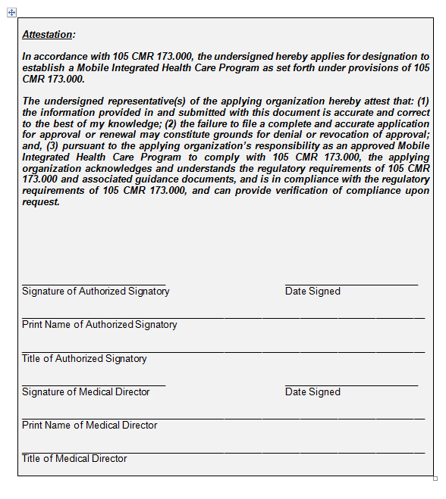
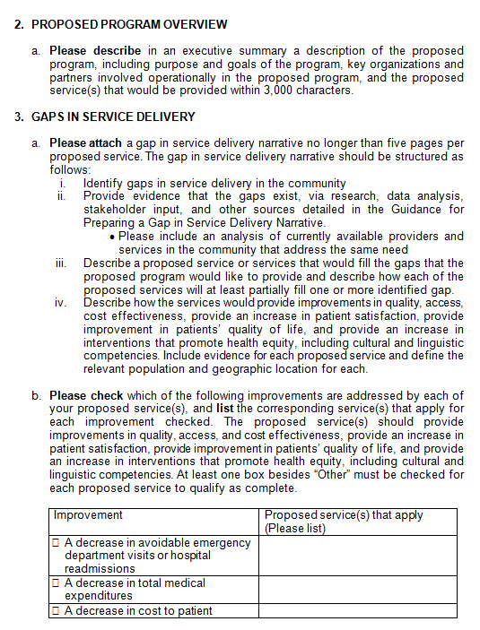
MIH Application
Attestation signatures needed:
Applicant authorized signatory
Program Medical Director
Executive summary of proposed program, including purpose and goals, organizational partners, and services.
Gaps in Service Delivery Narrative

Slide 29
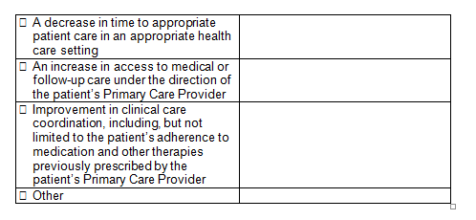
MIH Application, cont’d
Gaps in Service Delivery, cont’d
Identify how proposed services will address the improvements outlined in regulation:
Decrease in avoidable ED visits or hospital readmissions
Decrease in total medical expenditure
Decrease in cost to patient
Decrease in time to appropriate patient care in an appropriate healthcare setting
Increase in access to medical or follow-up care under direction of patient’s PCP
Improvement in clinical care coordination, including patient’s adherence to medication & other therapies previously prescribed by the patient’s PCP.

Slide 30
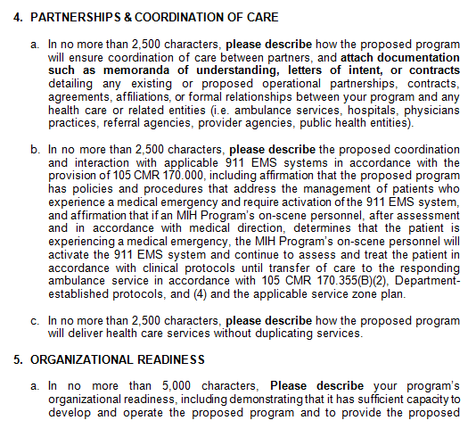
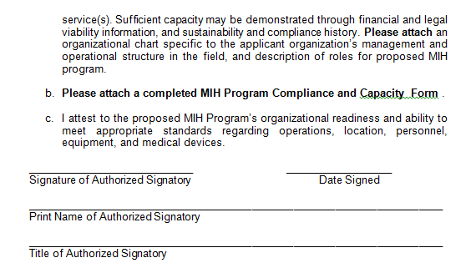
MIH Application, cont’d
Description about coordination of care and interaction with applicable EMS systems
Description of organizational readiness
MIH Program Compliance and Capacity Form

Slide 31
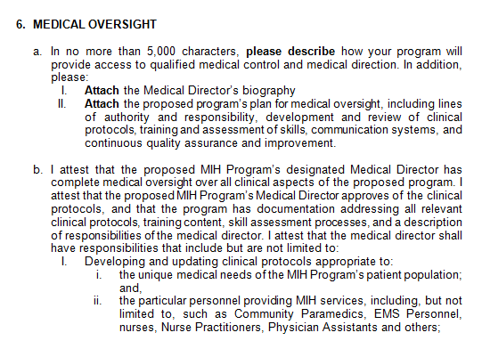
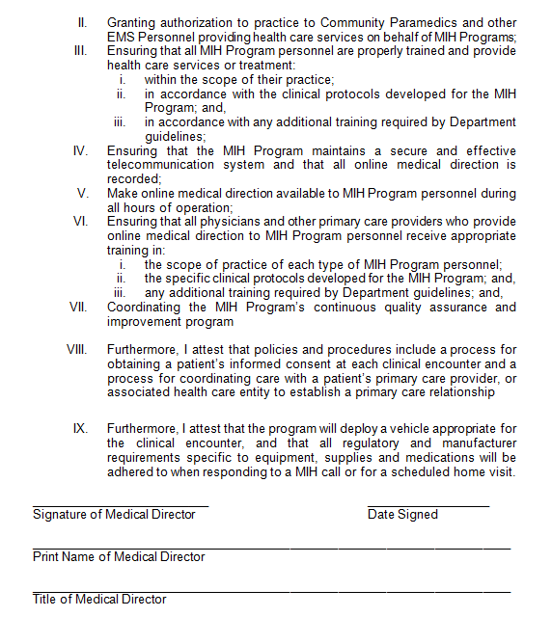
MIH Application, cont’d
Description of Program’s
Medical Oversight
Attestations

Slide 32
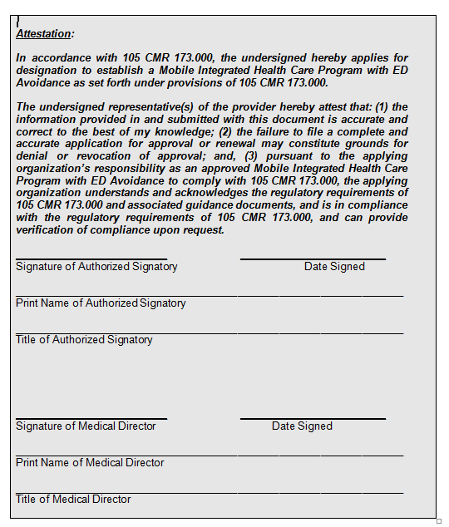
MIH with ED Avoidance Application
Attestation signatures needed:
Authorized Signatory of Program
Affiliated Hospital Medical Director

Slide 33
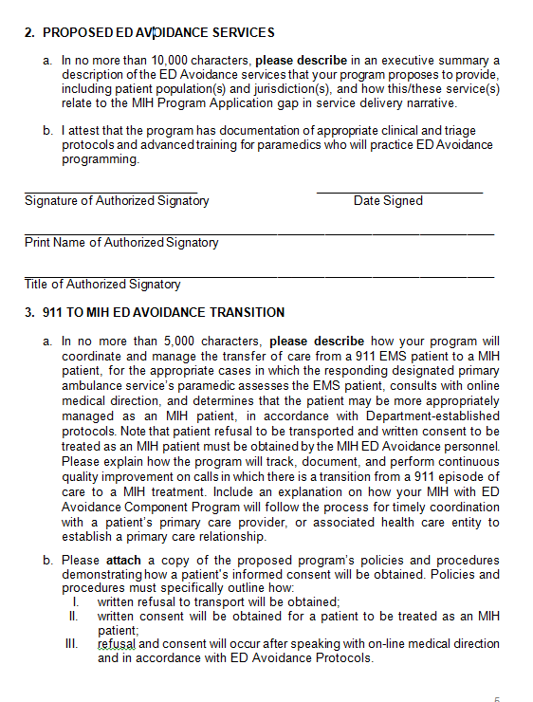
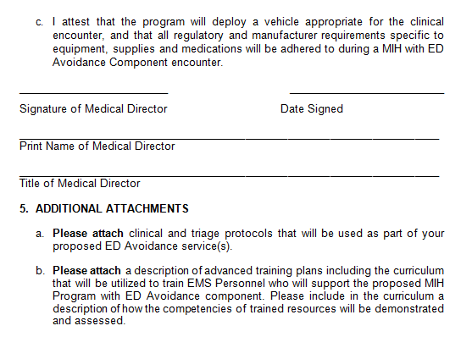
MIH with ED Avoidance Application, cont’d
Executive Summary of proposed ED Avoidance Services
Description of how Program will coordinate & manage transfer of care from a 911 EMS patient to an MIH patient
Policies, procedures, and attestation

Slide 34
Upcoming Educational Sessions
Topic | Date
MIH Overview for Medical Directors, Hospitals, and Healthcare Entities | Tuesday, September 25
MIH Overview for Accountable Care Organizations (ACOs) | Wednesday, September 26
MIH Application Overview | Tuesday, October 16
MIH with ED Avoidance Application Overview | Friday, October 19
Register online at:
https://www.mass.gov/service-details/mih-and-community-ems-educational-resources

Slide 35
Online Resources
Information, application materials, and resources will be posted
online as they become available at:
www.mass.gov/MIH
Applicant Resources:
  Application forms and instructions for each program type
  MIH Regulations and Guidance
  Data submission information and resources for each program type
  Application resources, such as best practices for completing a gap in service delivery narrative
  Upcoming webinars in-person informational sessions
  Recorded DPH webinars and training materials

Slide 36
Questions?
Thank you for participating
in today’s webinar!
Questions?
Mobile Integrated Health Care Program
MIH@state.ma.us
617-753-8484

