Slide 1
Mobile Integrated Health Care and Community EMS Programs
MIH Program Application Overview
October 16, 2018

Slide 2
Objectives
Review the MIH Program application requirements
Understand the process for MIH program application submission to the Department of Public Health (DPH)
Learn more about the gap in service delivery narrative

Slide 3
MIH Background
MIH is a system of pre- and post-hospital services that utilizes mobile resources, including EMS Personnel and community paramedics, to deliver a coordinated continuum of care that supports patients’ needs in the community.
Care is planned through collaborative and innovative program development to address gaps in service delivery and prevent unnecessary hospitalizations and other harmful or wasteful resource delivery.
An MIH Program may apply separately to include an ED Avoidance Component.

Slide 4
MIH Requirements
MIH program applicants must submit the following required information and documentation:
Completed application form
Executive summary of the program
Gap in service delivery narrative
Coordination of care and partnership description and documentation
Organizational readiness description as well as an organizational chart specific to applicant organization’s management and structure in the field
MIH Compliance and Capacity Form
Medical control and medical direction description, Medical Director biography, medical oversight plan

Slide 5
MIH Program Application Submission
DPH will begin to accept MIH program applications in late November 2018
All application forms and materials will be posted at www.mass.gov/MIH
Applications and required documents will be submitted by fax
Applicants must submit a one-time, $1,000 application fee with each application
Approved programs will receive a Certificate of Approval and must submit the $30,000 registration fee to DPH
Program registration is valid for two years; approved programs will be required to apply to renew their approval

Slide 6
MIH Program Application

Slide 7
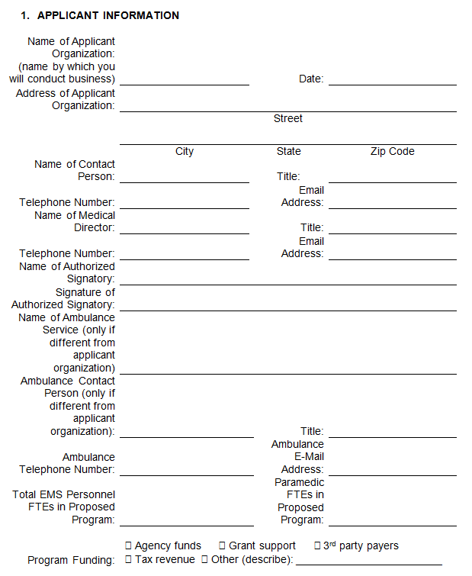
Applicant Information
Ensure that all information is correct
the individual listed will be the primary contact for the application
Digital signature process
Instructions will be available on the MIH website
Wet signatures are not needed
Ambulance service information
Includes total number of EMTs and paramedics that will work with the proposed program
Funding sources

Slide 8
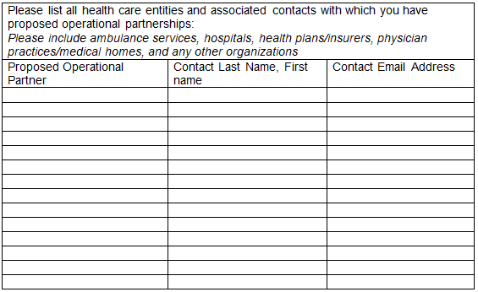
Proposed Operational Partners
If your proposed MIH program will have a primary focus on MassHealth beneficiaries with behavioral health needs, the proposed program must partner or coordinate with an Emergency Services Program (ESP).
This is a requirement is found at 105 CMR 173.040(A)(4).

Slide 9
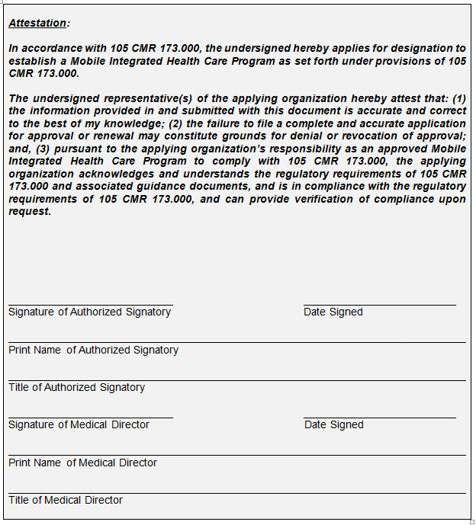
Attestations
Attestation that the applicant understand the regulatory requirements of the MIH program that they are applying to operate
Signed by an authorized signatory of the applicant organization and the proposed program’s Medical Director

Slide 10
Proposed Program Overview
Applicants will attach an executive summary that describes the proposed program
The executive summer must include:
The purpose and goals of the program
Key organizations and partners involved operationally in the proposed program
The proposed service that would be provided as part of the program

Slide 11
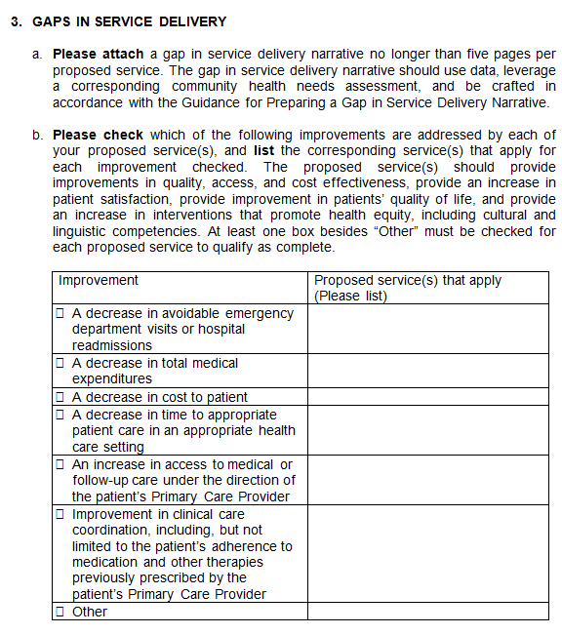
Gaps in Service Delivery Narrative
The gap in service delivery narrative should use data and leverage a corresponding community health needs assessment (CHNA)
Applicants should reference the Guidance for Preparing a Gap in Service Delivery Narrative when preparing their document
Applicants must identify the improvements that their proposed services will address

Slide 12
Gaps in Service Delivery Narrative, cont’d
Proposed services should provide:
improvements in quality, access, and cost effectiveness
an increase in patient satisfaction
improvement in patients’ quality of life
an increase in interventions that promote health equity, including cultural and linguistic competencies

Slide 13
Gap in Service Delivery Narrative Organization
Requirement | Components and Sources of Information
Define the community (population and jurisdiction), and identify relevant gaps in service delivery within the defined community | Use community health needs assessments (required), research, stakeholder and provider input to define the community and identify gaps. Any data should be dis-aggregated (based on community demographics) such that health disparities by race/ethnicity, age, gender, disability status and socio-economic status are captured for the applicable community.
Provide evidence that gaps in service delivery exist | Use appropriate population-based and clinical data sources as evidence that gaps exist. Data should dis-aggregated (based on community demographics) such that health disparities by race/ethnicity, age, gender, disability status and socio-economic status are understood (when available).
 | Use proactive outreach to receive input from local community stakeholders and providers regarding health needs.
Analyze local current service offerings | Complete an analysis of currently available services including proactive outreach to providers for partnering opportunities.
 | Describe the proposed services and their potential clinical and operational effectiveness.
Describe proposed services and their effectiveness at addressing the identified gaps in service delivery | Describe a proposed service or services that would fill the gaps that the proposed program would like to provide and describe how each of the proposed services will at least partially fill one or more identified gap.
 | Identify barriers and resources in the community, resources of the provider, and potential partnerships that could impact the delivery and effectiveness of proposed services.
 | Describe the potential impact of proposed services on providing improvements in quality, access, cost effectiveness, patient satisfaction, patients’ quality of life, and interventions that promote health equity, including cultural and linguistic competencies.

Slide 14
Gap in Service Delivery Narrative: Quantitative Data Source Examples
Quantitative Data
Sources of Data
MA-Specific Sources: Center for Health Information and Analysis data, Massachusetts Ambulance Trip Record Information Systems data, Trauma Registry data, MassGIS, Massachusetts Labor Workforce and Development, MassCHIP Vital statistics Emergency department (ED) data EMS dispatching data Hospital discharge data Centers for Medicare and Medicaid Services data State police or law enforcement agency data (such as Uniform Crime Reporting) Medical examiner data Infectious disease notifications and disability registers US Census data County Health Rankings Community Health Status Indicators (CHSI) Community Need Index Vulnerable Populations Footprint The Commonwealth Fund Health System Data Center Healthy People 2020 National Center for Health Statistics National Center for Education Statistics Common Core of Data (CCD) US Department of Education, No Child Left Behind Bureau of Labor Statistics Behavioral Risk Factor Surveillance System Other public records

Slide 15
Gap in Service Delivery Narrative: Quantitative Data Metric Examples
Quantitative Data
Metrics
Health-Related Mortality Morbidity, prevalence, incidence of diseases Utilization of inpatient, emergency department, outpatient services Communicable disease incidence rates Low birth rates Breastfeeding rates Immunization rates Health behavior indicators (i.e. smoking, drug use, alcohol use, exercise) Demographic, Community Determinant of Health, & Environment-Related Age, Gender, Ethnicity Population size and trends Geographic location and density Education Employment Housing (i.e. home ownership, affordability, homelessness) Economy (i.e. recession, war) Income levels Marginal and high-risk groups (i.e. pediatric, elder, rural, distinct cultural/ethnic groups) Social cohesion: relationships, family and other networks, leisure opportunities Local amenities and resources availability (i.e. health services, healthy food sources, education, parks and open spaces, public services, and other systems of care) Environmental factors (pollution, sanitation, public transportation, crime, natural disasters)

Slide 16
Gap in Service Delivery Narrative: Qualitative Data Source Examples
Qualitative & Stakeholder Information
Sources of Information
Interviews with patients, providers, community groups, health organizations and authorities Public meetings Focus groups Surveys & questionnaires The media or publications | Perceived and actual health needs in the community (incidence, severity, nature of need) Community determinants of health Existing providers of related health services Potential for partnerships between providers Cost of health services

Slide 17
Additional Resources Helpful for Developing Gap in Service Delivery Narratives
Community Tool Box, KU Work Group for Community Health and Development, University of Kansas, http://ctb.ku.edu/en
Community Health Assessment Toolkit, Association for Community Health Improvement, http://www.assesstoolkit.org
Community Health Assessment and Group Evaluation: Building a Foundation of Knowledge to Prioritize Community Needs: An Action Guide, CDC, April 2010, https://www.cdc.gov/nccdphp/dch/programs/healthycommunitiesprogram/tools/change/pdf/changeactionguide.pdf
Principles to Consider for the Implementation of a Community Health Needs Assessment Process, Rosenbaum, JD, George Washington University, June 2013, http://nnphi.org/wp-content/uploads/2015/08/PrinciplesToConsiderForTheImplementationOfACHNAProcess_GWU_20130604.pdf
CDC Community Health Improvement Navigator, https://www.cdc.gov/chinav/index.html
Community Commons Community Health Needs Assessment, https://www.communitycommons.org/chna/

Slide 18
Partnerships and Coordination of Care
Applicants will attach a description on how the proposed program will ensure coordination of care between partners
Include documentation that details existing or proposed partnerships between the proposed program and any health care or related entity.

Slide 19
Partnerships and Coordination of Care, cont’d
Description should include how the proposed program will deliver health care services without duplicating services.
Applicants will attached a description on the proposed coordination and interaction with applicable 911 EMS systems, including confirmation of:
Policies and procedures that address the management of patients who experience a medical emergency and require activation of the 911 EMS system
An MIH Program’s on-scene personnel, after assessment and in accordance with medical direction, determines that the patient is experiencing a medical emergency, the MIH Program’s on-scene personnel will activate the 911 EMS system and continue to assess and treat the patient

Slide 20
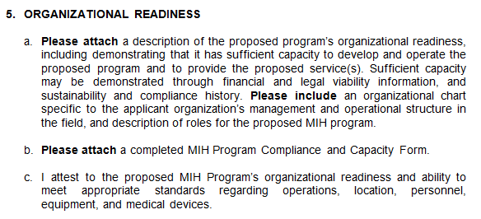
Organizational Readiness
The description of organizational readiness should demonstrate that the applicant organization(s) have sufficient capacity to develop and operate the proposed program.
“Sufficient capacity” can be demonstrated through financial and legal viability information as well as sustainability and compliance history
Applicants must include:
an organizational chart that is specific to the management and operational structure in the field and describe the roles for the proposed MIH program
a completed compliance and capacity form

Slide 21
Medical Oversight
Applicants must attach a description of how the proposed program will provide access to qualified medical control and medical direction.
Include the Medical Director’s biography
Include the plan for medical oversight:
Lines of authority and responsibility
Development and review of clinical protocols
Training and assessment of skills
Communication systems
Continuous quality assurance and improvement

Slide 22
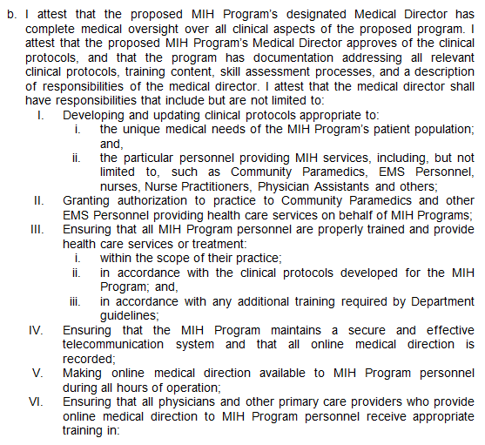
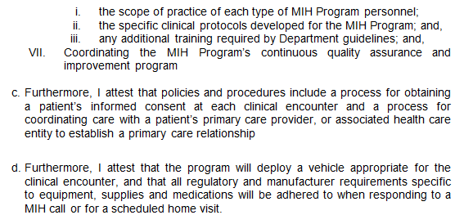
Medical Oversight, cont’d
The proposed program’s Medical Director must attest to complete medical oversight over all clinical aspects of the proposed program.

Slide 23
Document Submission
The application includes instructions for filing the application by fax to DPH
A 14-digit application ID will be auto auto-generated by the fillable PDF
Please use 14-digit application ID on all communications regarding your application, including all attachments that accompany the application form
Keep a copy of the application for your records

Slide 24
Making MIH Work
Discuss partnerships that make sense to solve issues that affect the specific community, and bring together potential partners
Think about care of patients as a system involving your community
Encourage innovative programs and thinking about improvements that matter to patients and staff

Slide 25
Potential Partners for ACOs and Hospitals
Your patient population will determine your partners:
Ambulance Services
Visiting Nurse Associations
Skilled Nursing Facilities
Behavioral Health Providers
Boards of Health
Prisons
Social Service Organizations
Newly created organization (LLC, Inc., etc.)

Slide 26
MIH & MIH with EDA Program Application Overview Sessions
Topic | Date
MIH Program Application Overview | Tuesday, October 16
MIH with ED Avoidance Program Application Overview | Friday, October 19
Register online for the MIH with ED Avoidance program application overview session at: https://www.mass.gov/service-details/mih-and-community-ems-educational-resources
Materials from both webinars will be posted online following each session

Slide 27
Online Resources
Information, application materials, and resources will be posted online as they become available at:
www.mass.gov/MIH
Applicant Resources:
Application forms and instructions for each program type
MIH Regulations, Guidance, and Protocols
Data submission information and resources for each program type
Application resources, such as best practices for completing a gap in service delivery narrative
Instructions to sign up for the MIH and Community EMS Listserv to receive email updates

Slide 28
Questions?
Thank you for participating in today’s webinar!
Questions?
Mobile Integrated Health Care Program
MIH@state.ma.us
617-753-8484

