Slide 1
Trauma Systems Committee
Bureau of Health Care Safety and Quality
Department of Public Health
Wednesday, November 28, 2018

Slide 2
Agenda
Approval of Minutes from August 29, 2018
Approval of Minutes from May 23, 2018
Department Update
Injury Prevention and Surveillance Presentation
Subcommittee Update
Data Presentation
Discussion of future agenda items
Next Steps

Slide 3
Open Meeting Law
G.L. c. 30A, §§18-25
The purpose of open meeting law (OML) is to ensure transparency in the deliberations on which public policy is based.
  This requires that meetings of public bodies be open to the public.
All meetings of a public body must be open to the public.
  A meeting is any deliberation by a public body with respect to any matter within the body’s jurisdiction.
  A deliberation is a communication between members among members of a public body.
A public body is any multi-member board, commission, committee or subcommittee within the executive or legislative branches (except the Legislature) of state government
  This includes any body created to advise or make recommendations
Under OML the public is permitted to attend meetings.
  Individuals in meetings may not address the public body without the permission of the chair.
  Public participation is allowed at the discretion of the chair.
For more information on Open Meeting Law, please visit:
  https://www.mass.gov/the-open-meeting-law

Slide 4
What is a Quorum?
A Quorum is defined as:
  A simple majority of the members of a public body, unless otherwise provided in a general or special law, executive order, or other authorizing provision. G.L. c. 30A, § 18.
  As applied to the Trauma Systems Committee—a quorum equals 10 members (½ of 19 members + 1)
Notes:
4

Slide 5
Meeting Minutes Approval
Approval of Minutes from the August 29, 2018 Meeting

Slide 6
Meeting Minutes Approval
Approval of Minutes from the May 23, 2018 Meeting

Slide 7
Department Updates
Public Health Response to Gas Leak in Andover, Lawrence and North Andover
Competitive Grant Awarded to MA for Disaster Response
Mobile Integrated Health
Prevention Model Framework

Slide 8
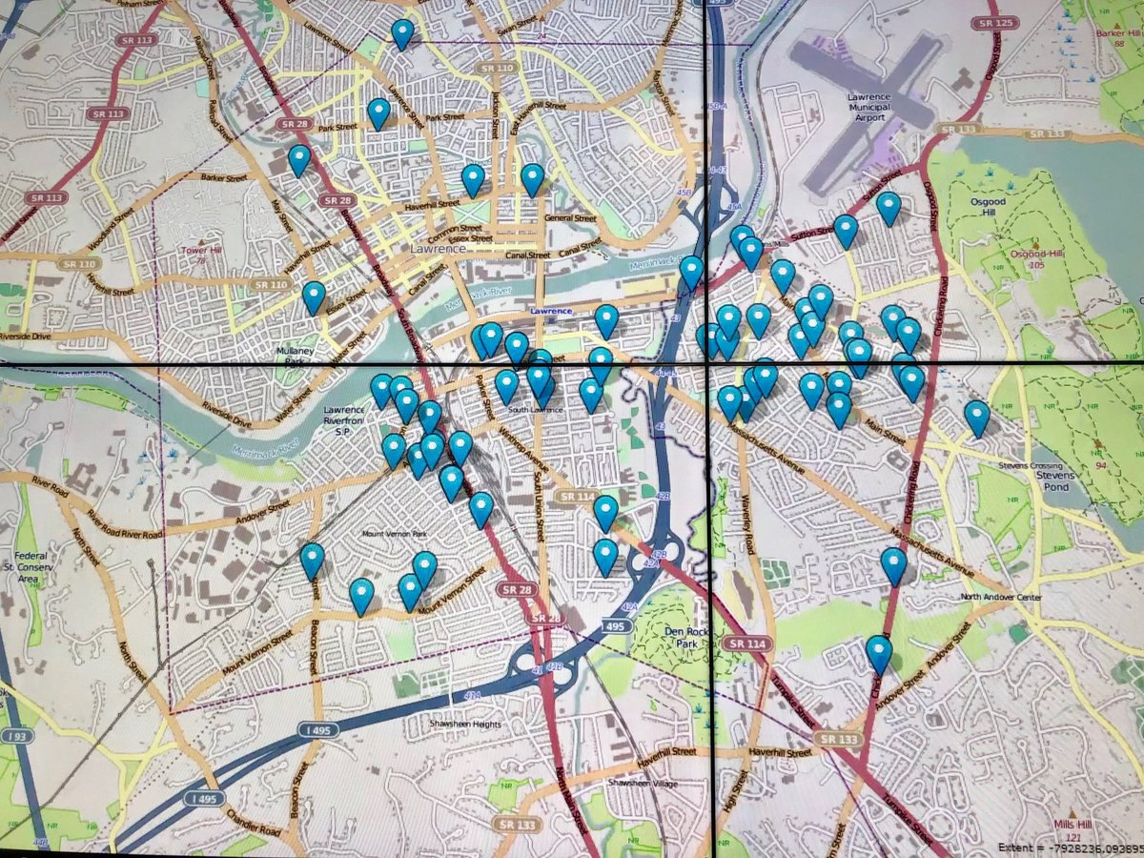
Public Health Response to Gas Leak and Fires in Andover, Lawrence and North Andover

Slide 9
Gas Leak: Response Activities
Data Operations Command Activation
Senior Management HHAN Alert
Monitored Impacts
  EMS transports
  Patient distribution
  Long term care facility status
  Healthcare facility status
  Service delivery programs/group home
Alerts & Notifications
  Long term care facility bed reporting
  Alternate destination waiver
  Hospital pharmacy dispensing
Notes:
9

Slide 10
Gas Leak: Recovery Activities
Establishing an incident management team
  Team is still reporting on recovery
Public health & health care recovery activities
  Gas service interruption
    Monitoring impacted service delivery programs/group homes
    Guidance to local health regarding housing
  Retail food inspections
  Vaccine replacement
Work Groups
  Resource Recovery Centers
  Routine Inspections

Slide 11
Competitive Federal Grant Awarded to MA
The U.S. Department of Health and Human Services’ Office of the Assistant Secretary for Preparedness and Response (ASPR) awarded one of two $3 million grants nationally to Massachusetts General Hospital Center for Disaster Medicine.
  Paul Biddinger, M.D. is serving as the Primary Investigator; and
  DPH leaders, the Director of the Office of Preparedness and Emergency Management and the Director of the Office of Emergency Medical Services, are participating on the executive committee.
The purpose of the grant is to demonstrate how a new Regional Disaster Health Response System can meet the regional needs, including trauma, burn or other specialty care, during a national emergency and leading to more lives saved.
In demonstrating a Regional Disaster Health Response System, each pilot project must:
  build a partnership for disaster health response to support clinical specialty care;
  align plans, policies, and procedures for clinical excellence in disasters;
  increase state-wide and regional medical surge capacity;
  improve state-wide and regional situational awareness, such as the availability of hospital beds; and
  develop metrics and test the regional system’s capabilities.

Slide 12
Mobile Integrated Health
Community Emergency Medical Services
  Program launched on October 1, 2018
  Received applications for innovative programs to meet community needs
    Vaccinations for high risk populations
    Sharps Awareness of safe disposal
Mobile Integrated Health (MIH) and Mobile Integrated Health with ED Avoidance
  Applications posted publicly on Monday, November 26, 2018
  DPH will begin reviewing applications on December 10, 2018

Slide 13
Framework for Public Health Approach to Trauma
Primary Prevention:
Prevent Traumas from Occurring
Education
Built/structured Environment
Secondary Prevention:
Preparedness Once Event Has Occurred
Preparedness and Emergency Management
Emergency Transport
Tertiary Prevention:
Management and Prevention of Negative Sequelae Post Event
Capacity to Address Resulting Chronic Physical and Behavioral Health Conditions
Regulation
Hospitals
Family Reunification
Seeking Trauma Systems Committee Input on its Preferred Role in this Framework
Will explore opportunities for sharing surveillance and programmatic information focusing on Primary Prevention

Slide 14
Injury Prevention
And the Trauma Systems Committee
Injury Prevention and the Trauma Systems Committee
Bekah Thomas, MPA, Director of Injury Prevention and Control
Jeanne Hathaway, MD MPH, Epidemiologist, Injury Surveillance Program

Slide 15
Overview
Introduction to Injury Prevention
Injury Data Sources and Findings
Programs and Partnerships

Slide 16
Introduction to Injury Prevention
Introduction to Injury Prevention:
Definitions, Levels of Prevention, and the Injury Prevention and Control Program

Slide 17
Trauma Vs. Injury
Trauma Versus Injury:
Injury includes poisoning

Slide 18
Prevention Frameworks
The 4 E’s
The Spectrum of Prevention
The Socio-Ecological Model
Levels of Prevention and Promotion

Slide 19
Levels of Prevention
Primary
Intervention before an event occurs
Examples: Education, Roadway Design, Banned substances
Secondary
Screening and treatment before it’s an issue, possible structural changes
Examples: Airbags, Seatbelts
Tertiary
Treatment and Recovery
Examples: Minimize brain damage, Sequelae

Slide 20
Prevention Frameworks:
The Four E’s
Engineering
Modifications to the environment or to products to make things safer.
Example: Seat belts in cars or fencing around a pool
Enforcement
Implementation or development of laws and polices that prevent death
Education
Providing professionals and the public with the information that they need to make safe choices
EMS
Example: Laws requiring seat belt use and school polices requiring students who receive a head injury while playing sports to be pulled from play
Quality trauma management in the field
Example: Training and awareness campaigns about infant safe sleep practices
Example: An ambulance with the proper equipment responds promptly and transports a child who experienced significant trauma to the nearest trauma center
State Highway Safety Plan: https://safety.fhwa.dot.gov/legislationandpolicy/fast/shsp_guidance.cfm

Slide 21
Prevention Frameworks:
The Spectrum of Prevention
Influencing Policy & Legislation
Fostering Coalition and Networks
Educating Providers
Promoting Community Education
Strengthening Individual Knowledge and Skills
Changing Organization Practices

Slide 22
Prevention Frameworks:
Socio-Ecological Model
Institution/Organizations
Relationship
Society
Individual
Community
Dahlberg LL, Krug EG. Violence-a global public health problem. In: Krug E, Dahlberg LL, Mercy JA, Zwi AB, Lozano R, eds. World Report on Violence and Health. Geneva, Switzerland: World Health Organization; 2002:1–56.

Slide 23
Bureau of Community Health and Prevention
Injury Prevention and Control Program
Suicide Prevention Program
Youth Violence Prevention Program
Office of Statistics and Evaluation
Injury Surveillance Program
Division of Violence and Injury Prevention

Slide 24
Key Injury Mechanisms Covered by Injury Prevention and Control Program (IPCP)
Falls
Transportation
Youth Sports Concussion
Sleep-related infant deaths
Poison

Slide 25
Injury Data Sources and Findings
Injury Data Sources and Findings

Slide 26
Injury Data Sources
Primary data sources
  MA Violent Death Reporting System (MAVDRS)
  Hospital Case-mix data
  Vital Records and Statistics (death files)
  State Health Surveys (BRFSS, YRBS, YHS)
Diverse secondary/emerging injury data sources
MA Ambulance Trip Record Information System (MATRIS)
ED Syndromic Surveillance
Linked Crash – Hospital Case-mix data
Trauma Registry
Notes:
MAVDRS – tracks homicides, suicides, unint. firearm deaths, legal intervention deaths and deaths of undetermined intent.
ED Syndromic Surveillance – limited amount of data, but real time
Linked Crash-Hospital Casemix data – exciting, still in early stages
Crash data provides large amount of pre-crash data,
including driver and vehicle factors, non-motorist factors, roadway and environmental factors,
hospital data can be used to identify outcomes, in terms of injury types and severity.
Plan to do regression analysis to identify most important factors contributing to various crash types.

Slide 27
Suicide and Homicide
Suicides, Homicides and Motor Vehicle Fatalities, MA Occurrent, 2005 - 2015
Suicides
Motor Vehicle Fatalities
Homicides
Sources: MA Violent Death Reporting System, MDPH. Fatality Analysis Reporting System (FARS), NHTSA.

Slide 28
Suicide Circumstance
Circumstances Associated with Suicide, Massachusetts, 2015 (n = 631)
Source: MA Violent Death Reporting System, MDPH.

Slide 29
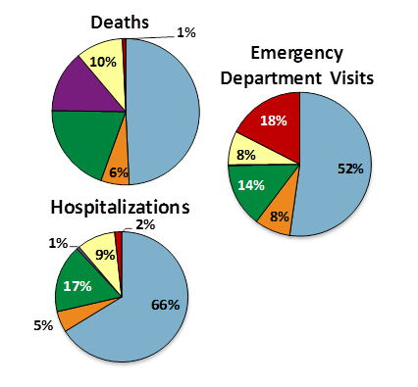
Traumatic Brain Injury
14%
TBI-Related Deaths, Hospitalizations and ED Visits,
by Injury Mechanism,
MA Residents, 2015
N = 820 deaths,
5,062 hospitalizations,
and 68,260 ED visits
49%
20%
Sources: Registry of Vital Statistics and Records, MDPH. Hospital Discharge and Emergency Department Discharge databases, MA Center for Health Information and Analysis.

Slide 30
Falls Among Older Adults
Fall Death Rate by Sex, Ages 65 and Older,
MA Residents, 2006 - 2014
Source: Registry of Vital Records and Statistics, MDPH

Slide 31
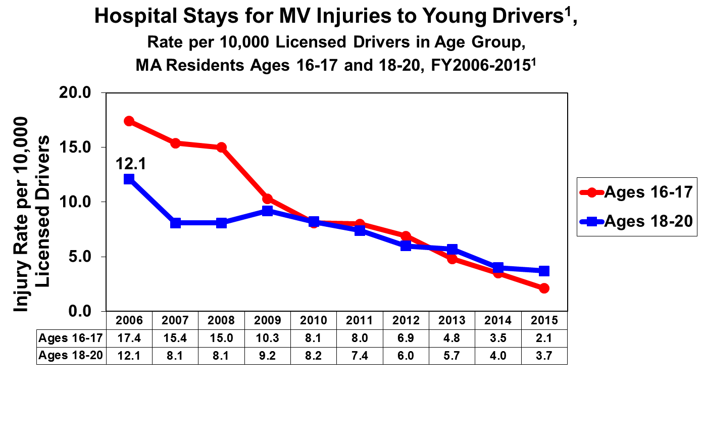
Motor Vehicle Injuries
2007 Jr. Operator Law enacted
2010 Safe Driver Law enacted
Sources: Hospital Discharge and Observation Stay databases, MA Center for Health Information and Analysis. MA Shelley License file, MA Registry of Motor Vehicles.

Slide 32
Motor Vehicle Injuries
Sources: Hospital Discharge and Observation Stay databases, MA Center for Health Information and Analysis. MA Shelley License File, MA Registry of Motor Vehicles.
Notes:
Now comparing these rates to older age groups.
See that in 2015, the rate of hospitalization for MV injuries was lowest among JO’s. Does this surprise anybody?
Hospitalization rates are nearly twice as high for both 18-20 and 21-24 y.o.’s.
Some youth wait until after 18 to get licenses and skip driver’s ED. Then there’s potentially alcohol and other substance issues.
And then there are the those 75+, with hospitalization rates nearly 4x that of JO’s. And this may be underestimate since older adults tend to keep their licenses even if not driving.
So definitely have seen positive improvement for JO’s, but still lots of prevention work to be done.
(Deaths and transfers excluded. Motorcyclist excluded.)

Slide 33
Programs and Partnerships
Programs and Partnerships

Slide 34
Statutes and Statutory Bodies
Falls Prevention Commission
Spinal Cord Injury Cure Research Fund
Child Fatality Review
Executive Traffic Records Collection Committee
Youth Sports Concussions
Off-Highway Vehicle Advisory Committee

Slide 35
Coalitions, Advisory Groups, and Committees
The EMSC Advisory Board
MassPINN
The MassPINN subcommittee for Injury Prevention in Hospitals
Falls Prevention Coalition
Youth Sports Concussion Advisory Group
Youth Sports Concussion Clinical Advisory Group
Interagency Infant Safe Sleep Task Force
Traffic Safety Coalition

Slide 36
Sponsored Programs
Regional Center for Poison Control and Prevention serving Massachusetts and Rhode Island
North East and Caribbean Injury Prevention Network
The Motor Vehicle National Peer Learning Team
http://www.maripoisoncenter.com

Slide 37


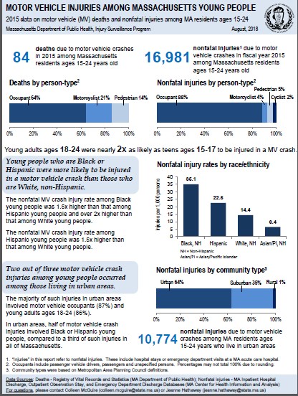

Sample Materials

Slide 38
Exciting New Opportunity
$10 Million budget allocation for a gun and violent crime prevention program addressing out-of-school youth and young adults aged 17-24
Currently gathering input from multi-sector stakeholders
Questions?
Contact Babanina James, Director of Child and Youth Violence Prevention Babanina.James@MassMail.State.MA.US

Slide 39
Trauma Designated and Community Hospital Roles in Prevention
Waiting room education
Hospital-led safety device distribution and installation programs
Hospital-based safe sleep modeling and education
Social worker connections
Screening, Brief Interventions, and Referral to Treatment (SBIRT)
Physician reporting/referrals

Slide 40

Trauma Registry
  Data Presentation
  Katherine T. Fillo, Ph.D., MPH, RN-BC
  Director, Division of Quality Improvement

Slide 41
Trauma Registry
Data Submission Update
Firearms Follow Up from Previous Meeting
Hospital Level All Cause Trauma Rates
Preliminary 2016 Trauma Data

Slide 42
Trauma Data Submissions
Designated Trauma Centers
2016 submissions for designated trauma centers is nearly complete
All programs have submitted a year or more of data from 2017-2018, though the quarters aren’t necessarily consecutive
Ten trauma designated hospitals have completed data entry through FFY Q3-2018
 | Status Date
N = 17 | August 2018 | November 2018
2016 | 16* | 16*
2017 | 9 | 16
2018 | 4 | 14
*At one hospital all adult submissions received and working on pediatric submissions

Slide 43
Trauma Data Submissions
Community Hospitals
Additional outreach continues with community hospitals to increase response rate
Eight community hospitals have complete data through FFYQ3-2018
23 community hospitals have submitted no data between 2016 and 2018
 | Status Date
N = 50 | August 2018 | November 2018
2016 | 25 | 26
2017 | 25 | 25
2018 | 19 | 23

Slide 44
Gun Shot Wound Follow Up Response
At the August 2018 meeting, members had questions about the low count of self-inflicted gunshot wounds in the Massachusetts Trauma Registry
  For 2011-2015 number of incidents reported: 130
Attempted to validate Trauma Registry using MA Ambulance Trip Record Information System (MATRIS) Data
  Like the Trauma Registry, MATRIS doesn’t capture many self-inflicted gunshot wounds
Cases had to meet both requirements:
  Gun Shot Wound (firearm, rifle, shotgun, pistol, handgun included)
  Self Inflicted/Suicidal Intention*
Self Inflicted Intentional GSW | 2015
Obvious Signs of Death | 15
Patient Transported, Death Unconfirmed^ | 6
*Accidental/firearm cleaning injuries were excluded as suicidal ideation was necessary
^6 unconfirmed cases where GSW was likely fatal but death was not called on scene
Data extracted from MATRIS on 6/7/2018

Slide 45
Trauma Rate, 2011-2015
Data Source: MA Trauma Registry
Notes:
New annual populations estimates have been created by the UMASS Donahue Institute for DPH
Introduced across DPH to standardize population denominators across programs
Estimates will be updated annually
Will be used as the denominator for Trauma rates

Slide 46
Trauma Rate and Count,
2011-2015
Data Source: MA Trauma Registry

Slide 47
Trauma Rate by Trauma Hospital Status, 2011-2015
Data Source: MA Trauma Registry

Slide 48
Trauma Rate by Teaching Status, 2011-2015
Data Source: MA Trauma Registry

Slide 49
Trauma Rate by Age,
2011-2015
Data Source: MA Trauma Registry

Slide 50
Unintentional Trauma by Type-Firearm
Data Source: MA Trauma Registry
N= 2,390

Slide 51
Firearm Trauma by Type
Data Source: MA Trauma Registry
N= 2,304

Slide 52
CY2016 Trauma Registry
First Look
2016 submissions are still ongoing, these data are preliminary and subject to change
Additional data collection, review, cleaning, and validation of the data will be completed
43,096 unique traumas with an inpatient observation date in CY2016 have been reported to the registry

Slide 53
CY2016 Trauma Registry
First Look
Median = 604
Data Source: MA Trauma Registry N=43,096
*One facility was removed due to high counts that need to be confirmed

Slide 54
CY2016 Trauma Registry
First Look
Latest year available
Data Source: MA Trauma Registry
2016 N = 43,096

Slide 55
CY2016 Trauma Registry
First Look
Data Source: MA Trauma Registry
N = 1,415
*Includes vehicle occupants

Slide 56
CY2016 Trauma Registry
First Look
Data Source: MA Trauma Registry
N = 43,096

Slide 57
Future Meetings
Meeting Schedule:
Wednesday, February 27, 2019
  All meetings will be held from 10:00am-12:00pm and are expected to be held at MEMA.

Slide 58
Additional Information
For more information, please visit:
https://www.mass.gov/service-details/trauma-systems-committee

