Slide 1
Trauma Systems Committee
Bureau of Health Care Safety and Quality Department of Public Health November 20, 2019

Slide 2
Agenda
Approval of Minutes from August 28, 2019
Department Update
Relocation update
Trauma Systems Committee 2018 and 2019 Recap
Trauma Systems Committee 2020 Plan
Region 4 Discussion
Public Comment on Region 4
2

Slide 3
Open Meeting Law: G.L. c. 30A, §§18-25
The purpose of open meeting law (OML) is to ensure transparency in the deliberations on which public policy is based.
This requires that meetings of public bodies be open to the public.
All meetings of a public body must be open to the public.
A meeting is any deliberation by a public body with respect to any matter within the body’s jurisdiction.
A deliberation is a communication between members among members of a public body.
A public body is any multi-member board, commission, committee or subcommittee within the executive or legislative branches (except the Legislature) of state government
This includes any body created to advise or make recommendations
Under OML the public is permitted to attend meetings.
Individuals in meetings may not address the public body without the permission of the chair.
Public participation is allowed at the discretion of the chair.
For more information on Open Meeting Law, please visit:
https://www.mass.gov/the-open-meeting-law
3
Notes:
These four questions will help determine whether a communication constitutes a meeting subject to the law: 1) is the communication between or among members of a public body; 2) if so, does the communication constitute a deliberation; 3) does the communication involve a matter within the body’s jurisdiction; and 4) if so, does the communication fall within an exception listed in the law?
What is a deliberation:
“an oral or written communication through any medium, including electronic mail, between or among a quorum of a public body on any public business within its jurisdiction.” Distribution of a meeting agenda, scheduling or procedural information, or reports or documents that may be discussed at a meeting is often helpful to public body members when preparing for upcoming meetings. These types of communications generally will not constitute deliberation, provided that, when these materials are distributed, no member of the public body expresses an opinion on matters within the body’s jurisdiction.

Slide 4
What is a Quorum?
A Quorum is defined as:
A simple majority of the members of a public body, unless otherwise provided in a general or special law, executive order, or other authorizing provision. G.L. c. 30A, § 18.
As applied to the Trauma Systems Committee—a quorum equals 10 members (½ of 19 members + 1)
Notes:
4

Slide 5
Meeting Minutes Approval
Approval of Minutes from the August 28, 2019 Meeting

Slide 6
Department Update
BHCSQ Relocation
Anticipate holding May 2020 Trauma System Committee meeting at 67 Forest Street, Marlborough
Recap of Trauma Systems Committee 2018 - 2019 Meetings
Trauma Systems Committee 2020 Plan

Slide 7
Trauma Registry
Trauma Registry Request for Responses (RFR) Update
Hospital Data Submission Update
Intentional Traumatic Self-Injury
Residence City/Town for Trauma Patients in Region 4
Massachusetts Department of Public Health mass.gov/dph

Slide 8
Trauma Data Submissions from Designated Trauma Centers
2016 & 2017 submissions for designated trauma centers are nearly complete
16 trauma designated hospitals have completed data entry through FFY2017
14 trauma designated hospitals have completed data entry through FFY 2018
The Registry is now accepting 2019 submissions
Status Date
N = 17 | August 2018 | November 2018 | February 2019 | May 2019 | August 2019 | November 2019
2016 | 16 | 16 | 16 | 16 | 16 | 16
2017 | 9 | 16 | 16 | 16 | 16 | 17
2018 | 4 | 14 | 15 | 15 | 15 | 17
2019 | -- | -- | -- | -- | 0 | 4

Slide 9
Trauma Data Submissions from Community Hospitals
Ongoing, individual outreach continues with community hospitals to increase response rate
32 community hospitals have complete data through FFY2018
7 community hospitals have submitted no data between 2016 and 2018
Status Date
N = 50 | August 2018 | November 2018 | February 2019 | May 2019 | August 2019 | November 2019
2016 | 25 | 26 | 32 | 38 | 39 | 40
2017 | 25 | 25 | 29 | 28 | 33 | 33
2018 | 19 | 23 | 25 | 30 | 33 | 33
2019 | --- | --- | --- | 3 | 15 | 18

Slide 10
Intentional Traumatic Self-injury in Massachusetts, 2016-2018
179 intentional self-injuries were reported to the registry from 2016 to 2018
Cases were identified using the CDC Injury Coding and Data Systems categories and TR ICD10 primary external cause code
In 2016 there were 636 intentional self-injury deaths in MA*
Data Source: MA Trauma Registry
N=31,879, 2016-2018
8,772 missing ICD=10 primary external cause code
CDC Injury Coding and Data Systems resources: https://www.cdc.gov/injury/wisqars/dataandstats.html
* Massachusetts Deaths 2016 : https://www.mass.gov/files/documents/2019/08/19/DPH-Death-Report-2016-20190815.pdf

Slide 11
Intentional Traumatic Self-injury in Massachusetts, 2016-2018
636 deaths by self-injury, 2016
(2017-2018 deaths not yet available)
Patients admitted to the facility as an in-patient or observation with self-harm injuries
Patients admitted to the facility or completing an observation stay with intentional traumatic self-harm injuries, 2016-2018 (N=179)
Patients presenting to the emergency department with self-harm injuries
Patients presenting the to ED with traumatic self-harm injuries
Data Source: MA Trauma Registry
Massachusetts Deaths 2016 : https://www.mass.gov/files/documents/2019/08/19/DPH-Death-Report-2016-20190815.pdf

Slide 12
Intentional Traumatic Self-injury in Massachusetts, 2016-2018
68.2% of all self-injury traumas were reported in male patients
Women make more suicide attempts than men, but men are known to use more lethal means*
9.5% of all self-injury trauma patients were black or African American
Massachusetts reported self-injury trauma, 2016-2018 (N=179)
 | N | %
Gender
Male | 122 | 68.2%
Female | 57 | 31.8%
Race
White | 146 | 81.6%
Black or African American | 17 | 9.5%
Other | 16 | 8.6%
Data Source: MA Trauma Registry
N= 179
CDC Injury Coding and Data Systems resources: https://www.cdc.gov/injury/wisqars/dataandstats.html
* Turecki G, Brent DA. Suicide and suicidal behavior. Lancet 2016: 387:1227-39.

Slide 13
Reported traumatic intentional self-injury in Massachusetts by age and gender, 2016-2018
Max = 90
Max = 90
Max = 83
Median patient age at time of admission was similar between men and women
Women had more variation in age at trauma when compared to men
Q3 = 51
Q3 = 51
Q3 = 52
Median = 33
Median = 33
Median = 35
Q1 = 27
Q1 = 29
Q1 = 20
Min = 11
Min = 14
Min = 11
Data Source: MA Trauma Registry
N=179
Three cases missing age at admission
CDC Injury Coding and Data Systems resources: https://www.cdc.gov/injury/wisqars/dataandstats.html

Slide 14
Reported traumatic intentional self-injury in Massachusetts by injury type, 2016-2018
Data Source: MA Trauma Registry
N=179
Injury categories with fewer than five reported injuries are suppressed
CDC Injury Coding and Data Systems resources: https://www.cdc.gov/injury/wisqars/dataandstats.html

Slide 15
Specific traumatic intentional self-injury in Massachusetts by injury type and gender, 2016-2018
67% of cutting or piercing related traumatic self-injuries were in men
52% of all motor vehicle related traumatic self-injuries were reported in women, despite women accounting for 31.8% of traumatic self-injury

Slide 16
Reported traumatic intentional self-injury in Massachusetts by cut or piercing external cause, 2016-2018
Data Source: MA Trauma Registry
N=124
CDC Injury Coding and Data Systems resources: https://www.cdc.gov/injury/wisqars/dataandstats.html

Slide 17
Home City/Town of Trauma Patients Treated in Region 4 Facilities, 2011-2015
The majority of patients treated in Region 4 were admitted from the surrounding communities
Some travelled from the Cape and Islands and Northeastern MA
Fewer patients travelled directly from Western MA for treatment
Data Source: MA Trauma Registry
N= 44,597
17,696 reported traumas with no MA resident ZIP, including out of state residents
CDC Injury Coding and Data Systems resources: https://www.cdc.gov/injury/wisqars/dataandstats.html
Includes only reported traumas with a documented patient home address

Slide 18
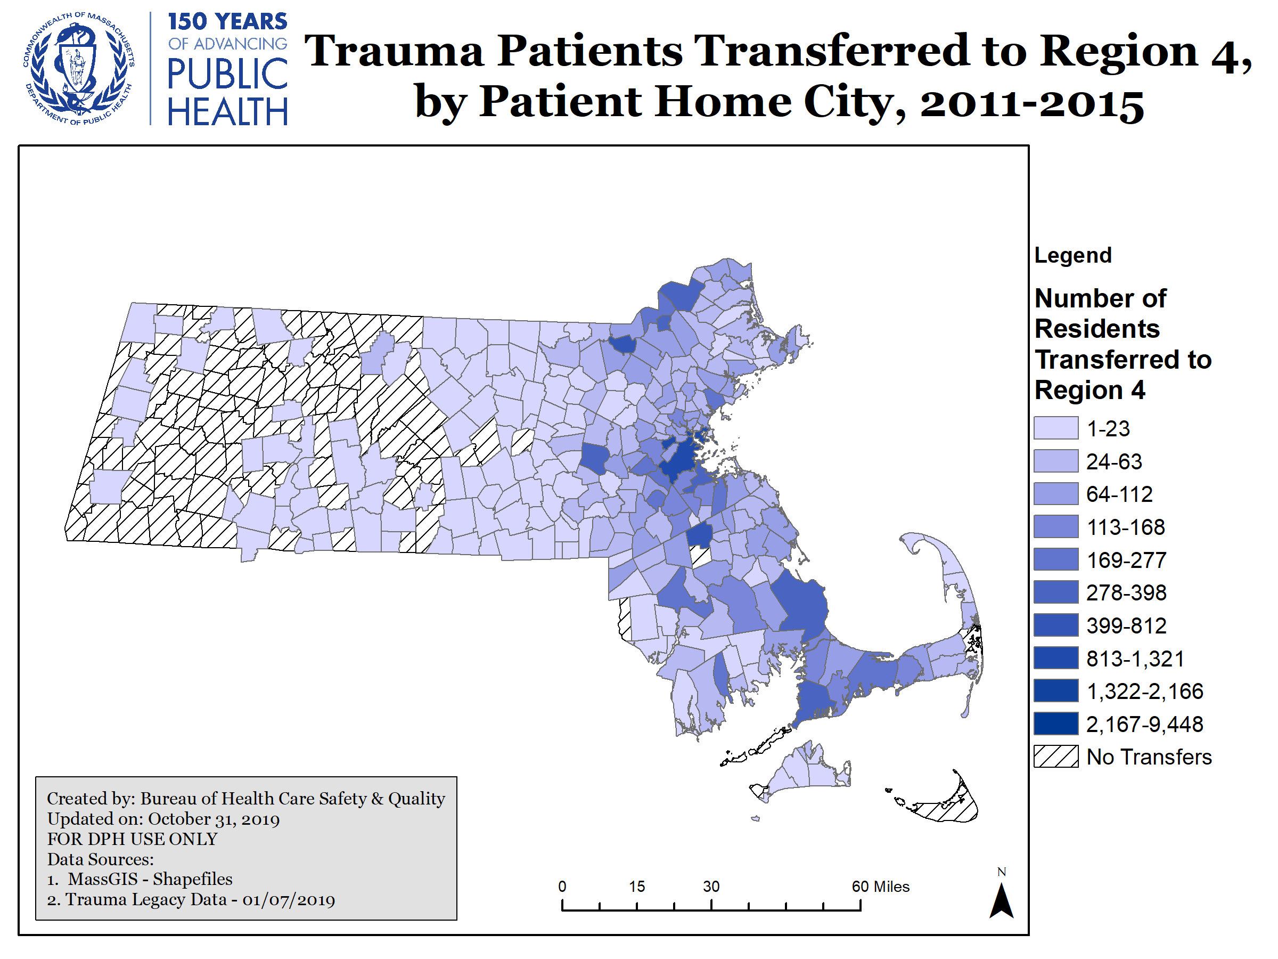
Home City/Town of Trauma Patients Transferred to Region 4 Facilities from another Acute Care Facility, 2011-2015
The majority of patients transferred to Region 4 were from Metro Boston, Southeastern MA, and Northeastern MA
Fewer patients were transferred from Central and Western MA
These counts only include MA residents
Data Source: MA Trauma Registry
N= 14,299
7,781 reported traumas with no MA resident ZIP, including out of state residents
CDC Injury Coding and Data Systems resources: https://www.cdc.gov/injury/wisqars/dataandstats.html
Includes only reported traumas with a documented patient home address

Slide 19
Region 4

Slide 20
Traumas per 10,000 Residents, 2011-2015
Data Source: MA Trauma Registry

Slide 21
EMS Response Time for Trauma Runs
Data Time Frame includes: 1/1/2015 – 12/31/2016
Response time = Unit Notified by Dispatch Date/Time (or Unit En Route Date/Time if the previous is missing) until Unit Arrived on Scene Date/Time (or Arrived at Patient Date/Time if the previous is missing)
Transport time = Unit Left Scene Date/Time until Patient Arrived at Destination Date/Time (if something is missing here, we cannot calculate a transport time)
All runs have a Primary Impression, Secondary Impression or Cause of Injury defining it as a Trauma related incident.
Only includes incident dispositions indicating transport (e.g does not include cancelled, no patient found, standby only, or refusals)
Ambulance services are required to enter data into MATRIS per A/R 5-403 Statewide EMS Minimum Dataset. Data are required to be submitted within 14 days; however, actual submission timeframes vary by ambulance service.

Slide 22
EMS Transport Time for Trauma Runs
Data Time Frame includes: 1/1/2015 – 12/31/2016
Response time = Unit Notified by Dispatch Date/Time (or Unit En Route Date/Time if the previous is missing) until Unit Arrived on Scene Date/Time (or Arrived at Patient Date/Time if the previous is missing)
Transport time = Unit Left Scene Date/Time until Patient Arrived at Destination Date/Time (if something is missing here, we cannot calculate a transport time)
All runs have a Primary Impression, Secondary Impression or Cause of Injury defining it as a Trauma related incident.
Only includes incident dispositions indicating transport (e.g does not include cancelled, no patient found, standby only, or refusals)
Ambulance services are required to enter data into MATRIS per A/R 5-403 Statewide EMS Minimum Dataset. Data are required to be submitted within 14 days; however, actual submission timeframes vary by ambulance service.

Slide 23
Traumas per 10,000 Residents by Age, 2011-2015
Data Source: MA Trauma Registry

Slide 24
Traumas per 10,000 Residents by Gender, 2011-2015
Data Source: MA Trauma Registry

Slide 25
Mode of Transit for Traumas, 2011-2015
Massachusetts, N=149,635
Data Source: MA Trauma Registry
Massachusetts missing = 42,685 missing observations
Region 4 missing = 3,260
25
Notes:
Rates are calculated by location of treating hospital

Slide 26
Transferred Traumas, 2011-2015
Data Source: MA Trauma Registry

Slide 27
Traumas per 10,000 Residents by Fall Type, 2011-2015
Data Source: MA Trauma Registry

Slide 28
Traumas per 10,000 Residents by Fall Type and Gender, 2011-2015
Data Source: MA Trauma Registry

Slide 29
Motor Vehicle Traumas per 10,000 Residents, 2011-2015
Data Source: MA Trauma Registry

Slide 30
Off-Road Vehicle per 10,000 Residents, 2011-2015
Data Source: MA Trauma Registry
Region 4 patients in a snow vehicle accident = 9
Region 4 patients in off road vehicle accident = 135
MA patients in snow vehicle accident = 287
MA patients in off road vehicle accident = 630

Slide 31
Regional Discussion Framework
1. Pre-Hospital:
What is the process used at regional hospitals with designated trauma services for receiving notification from EMS of an incoming trauma?
What follow-up communication or feedback is provided to EMS personnel?
2. In-Hospital:
When do your local hospitals transfer patients to a trauma center?
Are there any specialties that are particularly difficult for you to access for your patients?
3. Post-Trauma:
What post trauma resources are available to your hospitals?
What barriers do you encounter when trying to place patients in an appropriate facility?
4. Prevention and Access:
What role do the hospitals with designated trauma services play in trauma prevention in your region?
Is there equitable access to trauma care in your region, and is current trauma care meeting the needs of the region’s patient population?

Slide 32
Region 4 Public Comment
Public Comment on Region 4

Slide 33
Regional Discussion Framework
1. Pre-Hospital:
What is the process used at regional hospitals with designated trauma services for receiving notification from EMS of an incoming trauma?
What follow-up communication or feedback is provided to EMS personnel?
2. In-Hospital:
When do your local hospitals transfer patients to a trauma center?
Are there any specialties that are particularly difficult for you to access for your patients?
3. Post-Trauma:
What post trauma resources are available to your hospitals?
What barriers do you encounter when trying to place patients in an appropriate facility?
4. Prevention and Access:
What role do the hospitals with designated trauma services play in trauma prevention in your region?
Is there equitable access to trauma care in your region, and is current trauma care meeting the needs of the region’s patient population?

Slide 34
Future Meetings
Meeting Schedule:
Wednesday, May 20, 2020
All meetings will be held from 10:00am-12:00pm at 67 Forest Street, Marlborough.

Slide 35
Additional Information
For more information, please visit:
https://www.mass.gov/service-details/trauma-systems-committee

