Slide 1
Perinatal Advisory Committee Bureau of Health Care Safety and Quality Department of Public Health Wednesday, February 13, 2020

Slide 2
Agenda
Welcome
Overview of Conflict of Interest, Training, and Open Meeting Law Requirements
Special Project Waiver Data Requirements Discussion
Screening Guidelines Discussion

Slide 3
Conflict of Interest, Training, & Open Meeting Law Requirements
Open Meeting Law Kelly Haynes, Deputy General Counsel
Conflict of Interest Kelly Haynes, Deputy General Counsel

Slide 4
Open Meeting Law (OML)
The OML is designed to ensure transparency in the deliberations of public bodies.
A deliberation is:
an oral or written communication, through any medium, including electronic mail,
between or among a quorum of a public body,
on any public business within its jurisdiction.
If a quorum of a public body wants to discuss public business within that body’s jurisdiction, they must do so during a properly posted meeting.

Slide 5
Deliberation
A deliberation does not include:
distribution of a meeting agenda, scheduling or procedural information, or
reports or documents that may be discussed at a meeting, provided that no member of the public body expresses an opinion on matters within the body’s jurisdiction.
NOTE: If a public body member sends an email to a quorum of the public body expressing an opinion on any matter that could come before that body, the communication violates the OML, even if no recipient responds.

Slide 6
What is a Quorum?
A Quorum is defined as:
A simple majority of the members of a public body, unless otherwise provided in a general or special law, executive order, or other authorizing provision. G.L. c. 30A, § 18.
As applied to the Perinatal Advisory Committee quorum equals 8 members (½ of 15 members + 1)
Notes:
6

Slide 7
Avoiding OML Violation-Best Practice Recommendations
Public body members must not engage in “serial deliberations”—a series of separate, independent conversations outside of a meeting among a quorum of the members regarding a topic within its jurisdiction.
In order to avoid even the appearance of a potential OML violation, the Attorney General’s Office advises public body members to refrain from communications over email except for distributing meeting agenda, scheduling meetings and distributing documents created by nonmembers.

Slide 8
Remote Participation
The Attorney General’s Regulations, 940 CMR 29.10, permit members to participate remotely in future public meetings if the public body specifically votes to allow remote participation.
The AGO strongly encourages all members to be physically present at public meetings, when possible.

Slide 9
Reasons/Minimum Requirements for Remote Participation
Public body members may participate remotely in a meeting “only if physical attendance would be unreasonably difficult.”
A quorum of the body, including the chair, must be physically present at the meeting location.
Members of a public body who participate remotely and all persons present must be clearly audible to each other.
All votes taken during a meeting in which a member participates remotely must be by roll call vote.

Slide 10
Procedures for Remote Participation
A member who wishes to participate remotely should notify the chair (or, in the chair’s absence, the person chairing the meeting) of his/her desire to do so, with the reason and factual support for the request.
At the start of the meeting, the chair must announce members participating remotely; the meeting minutes must contain this information as well. (No detail as to the reason is required).
Members participating remotely may vote; roll call vote is required.

Slide 11
Conflict of Interest Law
The Conflict of Interest (COI) law, M.G.L. c. 268A, is meant to prevent conflicts (and appearances of conflict) between a state employee’s private interests and his or her public duties.
As statutory public body members, you are considered to be “special state employees” subject to the COI law.
The COI law is complex; State Ethics Commission attorneys are available, through the “Attorney of the Day” program, to provide confidential advice/guidance on how the COI law applies to you in a particular situation.
Contact Attorney of the Day @ (617) 371-9500

Slide 12
Conflict of Interest Law-Training Requirements
All state employees subject to the COI law are required to:
Certify they received and reviewed the annual Summary of Conflict of Interest Law, and
Complete the biannual online training program through DPH’s PACE (Performance and Care Enhancement Learning Management System).

Slide 13
Training Requirements
Required Conflict of Interest Law PACE Online Trainings
Conflict of Interest Law Online Training Program
Conflict of Interest Law Summary
PACE Contact
Kathy Creed, Kathy.creed@state.ma.us
State Ethics Commission
For information regarding the Education & Training requirements, refer to the State Ethics Commission website: http://www.mass.gov/ethics/revised-implementation-procedures.html
Phone: (617) 371-9500

Slide 14
PACE Trainings
An account will be created for each Committee member in PACE. This will give you access to the trainings.
You will soon receive an automated email from the PACE system with instructions on how to access the system.
If you do not receive an email this week, please email Kathy Creed.
You must complete the training within 30 days.

Slide 15
Additional References
Conflict of Interest Law:
https://www.mass.gov/laws-regulations-rulings-opinions-and-advisories
https://www.mass.gov/learn-more-about-conflicts-of-interest
Office of Attorney General, Open Meeting Law Website and Guide:
https://www.mass.gov/files/documents/2017/09/25/2017%20Guide%20only.pdf
http://www.mass.gov/ago/government-resources/open-meeting-law/

Slide 16
Newton-Wellesley Hospital Short Term Mechanical Ventilation Waiver Update

Slide 17
Short Term Mechanical Ventilation (STMV) Waiver Background
Newton-Wellesley Hospital has a licensed Level II B maternal newborn service
Waiver in place since 2009 for STMV of neonates who have respiratory distress and are intubated at less than 24 hours old for mechanical ventilation anticipated to last for no more than 36 hours
Waiver conditions require neonatologist in house 24/7 while the neonate is on a ventilator, formal collaboration with one Level III maternal newborn service, staff competency, protocols for the assessment of the neonate, policies and procedures on therapy, including inclusion and exclusion criteria, and data reports to the Department of Public Health

Slide 18
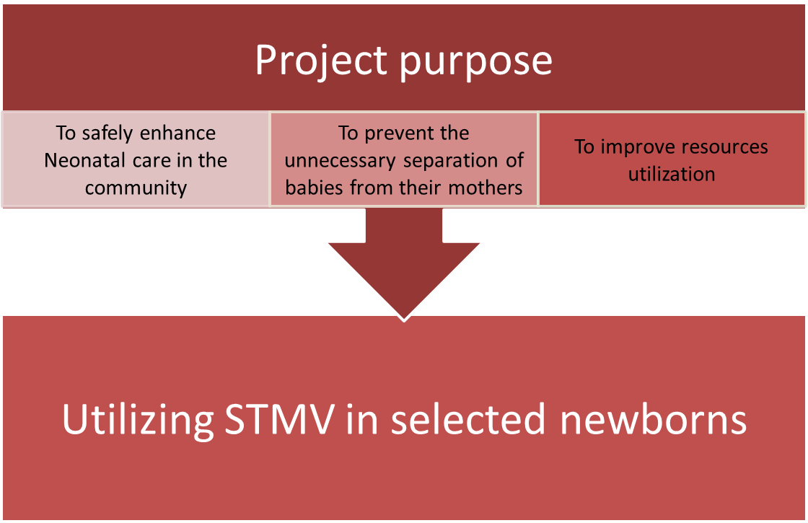
Waiver Justification
Late preterm infants (34-366/7 weeks) have higher incidence of respiratory distress than babies born at 39 weeks gestation or greater (NIH, 2019b)
Straightforward diagnosis of surfactant deficiency in babies that are less than 32 weeks gestation
Difficult diagnosis for late preterm infant, and etiology for respiratory distress (NIH, 2019b)
Lab test, and X-Ray findings are nonspecific (NIH, 2019a)
Nationally increased number of preterm infants (NIH, 2019a)
Increase risk of short and long-term morbidities in these patients (NIH, 2019a)
Concerns about development of pneumothorax in late preterm infant treated with CPAP alone
Massachusetts Department of Public Health mass.gov/dph

Slide 19
NWH Patient Characteristics (2016-2019)
* Total number of neonates born is missing from Jan-June 2019
Notes:
2009-2011 summary: 56 babies have been treated as part of this special project and only one infant required transfer to a Level III unit for additional respiratory care. The babies ranged in gestational age from 32 to 38 4/7 weeks gestation with birth weights of 1620-3400 grams. Approximately two thirds were males. Time of STMV ranged from 1 to 21 hours with an average time of 7 hours. All the infants were extubated within 36 hours of age and there were no deaths or serious complications.

Slide 20
Treatment by Gestational Age
During this time period, NW Hospital reported treating one neonate at 27 weeks.
Data considerations:
Unknown number of total births per specific gestational age. Therefore, treatment averages (%) calculated per ranges from <32 weeks, 32-34 weeks, 35-37 weeks, and >37 weeks.
No data documented for total deliveries from January to June 2019.
Gestational age (Weeks) | 31 | 32 | 33 | 34 | 35 | 36 | 37 | $$≥37$$
# babies born | 1 | 215 | 215 | 215 | 1,663 | 1,663 | 1,663 | 11,145
# treated with STMV | 1 | 6 | 7 | 8 | 9 | 13 | 15 | 17
# treated with CPAP | 1 | 5 | 8 | 8 | 8 | 11 | 19 | 13
Total treated | 1 | 6 | 8 | 8 | 9 | 13 | 19 | 18
% STMV/CPAP | 100% | 2.79% | 3.72% | 3.72% | 0.54% | 0.78% | 1.14% | 0.16%
NWH submitted data from Jan 2016 - Dec 2019

Slide 21
Most Frequently Reported Diagnoses in Neonates Receiving STMV
NWH submitted data from Jan 2016 - Dec 2019
Notes:
Hyaline membrane disease (HMD), aka respiratory distress syndrome (RDS), is a condition that causes babies to need extra oxygen and help breathing
(Didn’t combine HMD and RDS cases because same hospital so need to understand the distinction)

Slide 22
Diagnoses of Neonates Intubated and Transferred to Level III Service
NWH submitted data from Jan 2016 - Dec 2019

Slide 23
Summary Of Observations From NW Hospital
Lower incidence of pneumothoraxes in babies who receive STMV as opposed to CPAP
Benefits of surfactant in STMV over CPAP
Concerns about development of pneumothoraces in the late preterm infants who are treated with CPAP alone

Slide 24
Discussion
Currently biannual hospital reporting to the Department using the STMV template form which captures:
GA
BW
Neonatal diagnoses
Antenatal steroids: Full course/partial course/none/ within 7 days of birth (yes/no).
Intubation age
Total time CPAP before STMV (hrs)
Total time on STMV (hrs)
Total time on CPAP after STMV (hrs)
Total time on CPAP (hrs)
Surfactant replacement (yes, no, ·doses, age at first dose (hours).
Extubate within 36 hours (yes/no)
Re-intubated
Neonatal complications (yes/no)
Disposition (transfer level III, DC home, death
Reason to transfer (if applicable)
Retro-transfer
Readmission (if within 30 days)
Notes:
From the literature review we found some factors that may influence quality of care for the neonate requiring CPAP and STMV;
Method of delivery (Glover et al., 2017; Haviv, Saild & Mol, 2018; Sweet et al., 2017)
Delay cord clamping (Yigit et al., 2019)
Initiation time of CPAP (in labor room?)
What’s your antenatal Dexamethasone policy?
During the STMV special project duration, have NW Hospital performed any changes on their policies and guidelines for neonates in the project?
If so, did they identify any significant results from that change?
Any significant observations from neonates who were administered antenatal Dexamethasone?
Consider Special Project report to be once a year?

Slide 25
Alcohol and Substance Use Screening in Pregnant Women

Slide 26
NAS/SEN Validation Findings Across 15 Selected Hospitals: Preliminary Results
We reviewed 1,124 mother-baby dyads
ICD code information was provided by hospitals
Substance use or exposure was assigned based on chart review and included the following drugs:
methadone, buprenorphine, heroin, other opioids, methamphetamine, amphetamines, benzodiazepines, barbiturate, cocaine, hallucinogens, or cannabis
The following findings are not representative of all births in MA
The majority of NAS is due to opioid use
Ongoing debate around NOWS v NAS
We defined NAS as confirmed substance exposure and either Finnegan of 8 or higher OR diagnosis noted in the chart
Notes:
NOWS is a new construct/terminology, cannot retrofit to our data but this is the next step and we are exploring
ICD codes were provided for the ICD codes outlined in the circular letter
F11.20 – Opioid Dependence (uncomplicated)
F13.20 – sedative/hypnotic or anxiolytic dependence (uncomplicated)
Substance use or exposure included the following drugs: exposure at any time during pregnancy to OR lab toxicology screen positive for at least 1 of the following: methadone, buprenorphine, heroin, other opioids, methamphetamine, benzodiazepines, barbiturate, cocaine, hallucinogens, or cannabis
NOT REPRESENTATIVE OF ALL BIRTHS IN MA

Slide 27
Substance Use Screening
Findings
Gaps and Opportunities
Less than 0.1% of the mother’s had evidence of a standardized screening tool in their electronic health records
100% of mothers that had evidence of substance use screening using a tool were white
Birth hospitals had similar rates of documented substance use screening
Action: Universally select an appropriate and validated substance use screening tool for use in prenatal and L&D settings and implement them
DPH recommended screening tools (“Guidelines for Community Standard for Maternal/Newborn Screening for Alcohol/Substance Use ”)
AIM OUD bundle
Action: Document screening in prenatal charts and send to intended birth hospital
Note: Not representative of all births. Findings are based on review of 1,123 mother-infant dyads selected from infants born in 2017 at 15 hospitals across the Commonwealth.
Notes:
We also touched on that we did not see a lot of evidence of substance use screening. Our weighted estimate shows that <0.1% of mothers at the 15 selected hospitals had documentation of screening.
It is critical that mothers with substance use disorder are identified in prenatal care so that they can be appropriately referred and linked to appropriate clinical care and resources.
Unweighted:
For mom’s with documented opioid use, evidence for use was found in:
Progress notes documenting maternal self-report of opioid use (85.55%)
Maternal toxicology laboratory testing during pregnancy (actual results available in record) (74.04%)
Progress notes documenting maternal toxicology laboratory test results (40.71%)
Medication history documented outside of progress notes (26.55)
Progress notes documenting opioid use without clear source of information (19.17%)
Pharmacy records (9.73%)
Standardized screening questionnaire (3.83%)
Other (0.29%)

Slide 28
Guidelines for Community Standard for Maternal/Newborn Screening for Alcohol/Substance Use
Purpose for issuing guidelines was to create a community standard and consensus approach to the screening and testing of pregnant women and their newborns for exposure to substances or alcohol during pregnancy.
DPH issued these guidelines in 2013
Recommended three screening opportunities of pregnant woman:
First prenatal visit
Repeated at 28 weeks
Upon admission to Labor and Delivery

Slide 29
2013 Guidelines Recommended Screening Tools
Substance Use Risk Profile Pregnancy Tool for Labor and Delivery
5 P’s Screen for Alcohol/Substance Use: Prenatal and Postpartum visits
Notes:
*Adapted from the Substance Use Risk Profile-Pregnancy scale published in the October 2010 issue of Obstetrics & Gynecology.

Slide 30
2013 Guidelines Recommended Testing
Maternal Urine Toxicology
Recommended standardizing testing panel
Basic urine panel example : cocaine, TCH, amphetamines, benzodiazepines, opiates
Newborn Toxicology
Urine
Meconium

Slide 31
Discussion
Updates to screening tools
Updates to screening frequency
Updates to testing recommendations

