Slide 1
Trauma Systems Committee
Bureau of Health Care Safety and Quality
Department of Public Health
Wednesday, May 23, 2018

Slide 2
Agenda
Welcome
Approval of Minutes from February 28, 2018
Trauma Registry Structure
Traumas Reported by City or Town Service Area
Legacy Data (FFY 2008-FFY 2015) Findings
Transition Year (FFY 2016) Submission Updates
Current Data (FFY 2017-2018) Submissions Updates
Public Comment
Next Steps

Slide 3
Open Meeting Law (OML)
The OML is designed to ensure transparency in the deliberations of public bodies.
A deliberation is:
  an oral or written communication, through any medium, including electronic mail,
  between or among a quorum of a public body,
  on any public business within its jurisdiction.
If a quorum of a public body wants to discuss public business within that body’s jurisdiction, they must do so during a properly posted meeting.

Slide 4
What is a Quorum?
A Quorum is defined as:
  A simple majority of the members of a public body, unless otherwise provided in a general or special law, executive order, or other authorizing provision. G.L. c. 30A, § 18.
  As applied to the Trauma Systems Committee—a quorum equals 10 members (½ of 19 members + 1)
Notes:
4

Slide 5
Meeting Minutes Approval
Approval of Minutes from the February 28, 2018 Meeting

Slide 6
Trauma Registry Structure-Current Submission Process
  Data submission is uploaded through a system (SENDS/INET) that the Center of Health Information and Analysis (CHIA) developed for claims reporting.
  Chloen Systems maintains this system as the Department’s vendor.
  The Trauma Registry is housed on a server within another agency.
  Data files are created by Chloen Systems.
  Data is abstracted to DPH server by DPH Information Technology.

Slide 7
Trauma Registry Structure Request for Responses
The Department is issuing a Request for Responses (RFR) to seek a vendor to implement and support a second generation of the Trauma Registry system.
The Department uses a transparent procurement process to solicit responses from bidders.
  Bidders must submit a complete response via COMMBUYS, the Commonwealth’s public procurement record system.
  Once posted, all information about the RFR may be found on: www.commbuys.com
Review of responses includes:
  Business
  Technical
  Cost
The Department secured funding for this work through a competitive grant from the National Highway Traffic Safety Administration.

Slide 8
  Trauma Registry

Slide 9
Trauma Registry Background
The Trauma Registry data system (Trauma Registry) is comprised of reported hospital data, as submitted by hospital trauma registrars.
The Trauma Registry collects information in accordance with the National Trauma Data Bank as well as some minimal state specific data points that allow linkages with other State systems.
The data element categories are organization and personal identifiers, demographics, clinical information, injury information, pre-hospital information, emergency department information, diagnosis information, injury severity information, and quality assurance information.

Slide 10
Trauma Registry Reporting Requirements
As required by 105 CMR 130.851 (C): a hospital providing trauma services as a designated trauma center must provide:
to the Center for Health Information Analysis (CHIA) the designated trauma center data set specified in Department guidelines;
As required by 105 CMR 130.852 (A), a hospital that is not a designated trauma center may be licensed to provide Emergency Services only if the hospital provides to CHIA the trauma service hospital data set to be specified in 105 CMR 130.851(C).

Slide 11
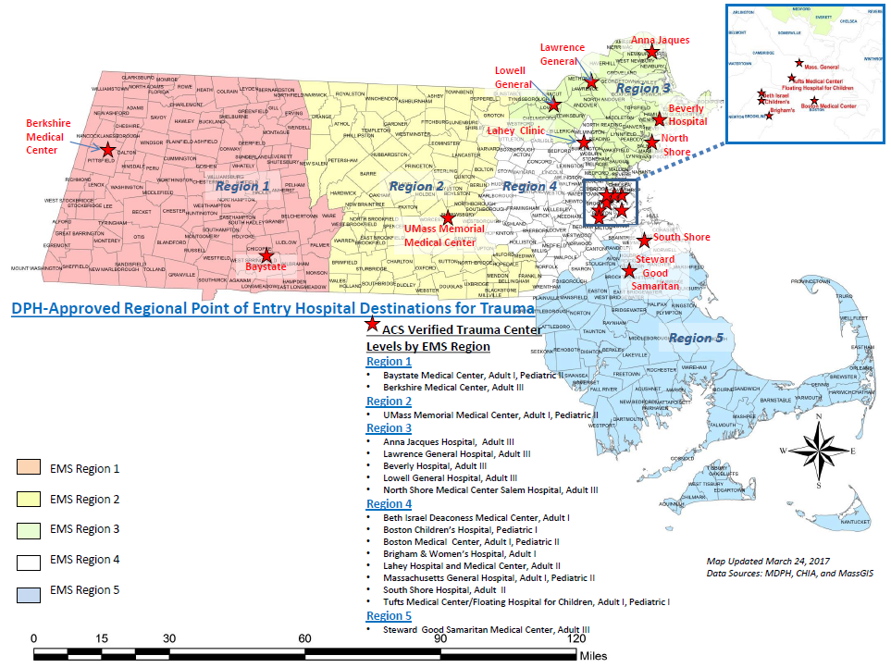
Massachusetts Emergency Medical Service Regions (EMS) and American College of Surgeons (ACS) Verified Trauma Centers

Slide 12
February 28, 2018 Follow-up Requests
Request | Action Taken
How are transfers out of state captured? | -Out of state transfers are not captured in the Trauma Registry -Exploring MATRIS data to identify event estimates
What is the outcome of patients who are captured in the trauma registry? | Submitted legacy database to CHIA for matching to administrative data to determine discharge disposition
What type of individual experiences a fall? | Age example included in later slide.
What are the traumas by community versus trauma hospital? | Age examples included in later slides.
What are the ages of individuals who experience a trauma? | Age examples included in later slides.

Slide 13
Trauma Observations by Incident Location
In order to be responsive to multiple requests for information the Department is sharing today and posting shortly on its website:
Reported Trauma Incident Count by Incident Cities/Towns for FFY 2014 and FFY 2015:
INCIDENT CITY/TOWN | 2014 | 2015
ABINGTON | 96 | 83
ACTON | 97 | 99
ACUSHNET | * | *
ADAMS | 37 | 47
AGAWAM | 40 | 45
ALFORD | * | 10
AMESBURY | 145 | 112
AMHERST | 75 | 56
* Any incident count less than 5 will be suppressed in accordance with Department of Public Health Confidentiality Procedure 7

Slide 14
Trauma Registry Data
There are three categories of Trauma Registry Data:
Legacy Data (Federal Fiscal Year (FFY)2008-FFY2015):
  Starting in 2008, Massachusetts collected 41 data elements.
  Includes traumas reported with Admission dates of October 1, 2007-September 30, 2015.
  Uses International Classification of Diseases 9th edition (ICD-9-CM) for inclusion criteria, diagnosis and injury codes.
Transition Data (FFY2016):
  Transition to ICD-10-CM from ICD-9-CM.
Current Data (FFY2017-present):
  In alignment with the National Trauma Data Bank, there are now 96 data elements.

Slide 15
Legacy Data: All Cause Trauma Incidents by Age
Data Source: MA Trauma Registry

Slide 16
Legacy Data: Trauma Incidents by Age and Gender
Data Source: MA Trauma Registry

Slide 17
Legacy Data: Diving Accidents by Age
Data Source: MA Trauma Registry

Slide 18
Legacy Data: Dog Bites by Age
Data Source: MA Trauma Registry

Slide 19
Legacy Data: Suicide and Self-Injury by Age
Data Source: MA Trauma Registry

Slide 20
Legacy Data: Suicide and Self-Injury by Age and Gender
Data Source: MA Trauma Registry

Slide 21
Legacy Data: Trauma Incidents by Region and Age
Data Source: MA Trauma Registry

Slide 22
Legacy Data: Pediatric Trauma Incidents by Region
Data Source: MA Trauma Registry
N= 55,319

Slide 23
Legacy Data: Trauma Incidents by Region
Data Source: MA Trauma Registry
N= 297,725

Slide 24
FFY 2016 Data Submission Update for Verified Trauma Hospitals
 | Number | Percentage
Quarter 1 | 8 | 47%
Quarter 2 | 7 | 41%
Quarter 3 | 6 | 35%
Quarter 4 | 7 | 41%
Overall Completeness | 28 | 41%
Five hospitals have successfully submitted for all 2016 quarters
One hospital has three quarters of 2016 data submitted
Five hospitals have successfully submitted one quarter of 2016 data
Five hospitals have not passed any submissions
One hospital has passed all adult but not pediatric 2016 submissions
Data abstracted from the Trauma Registry on May 6, 2018

Slide 25
FFY 2017 & 2018 Data Submission Update for All Hospitals
 | Number of Quarters | Number of Hospitals
FFY 2017 | 26 | 10
FFY 2018 | 3 | 3
Data abstracted from the Trauma Registry on May 6, 2018

Slide 26
Public Comment Period

Slide 27
Anticipated Next Meeting Deliverables
Overview of out-of-state transfers.
Overview of fall-related traumas by age and region.
Discussion of state-specific data elements of the Trauma Data Collection File Specification Guide for FFY 2019.
Summary of Trauma Registry data for FFY2016 reported.

Slide 28
Future Meetings
Meeting Schedule:
  Wednesday, August 29, 2018
  Wednesday, November 28, 2018
  All meetings will be held from 10:00am-12:00pm and are expected to be held at MEMA.

Slide 29
Additional Information
For more information, please visit:
https://www.mass.gov/service-details/trauma-systems-committee

