Slide 1
CHARGING UP
The Role of States, Utilities, and the Auto Industry in Dramatically Accelerating Electric Vehicle Adoption in Northeast and Mid-Atlantic States
Presentation to the Massachusetts Zero Emission Vehicle Commission Meeting
November 18, 2015

Slide 2
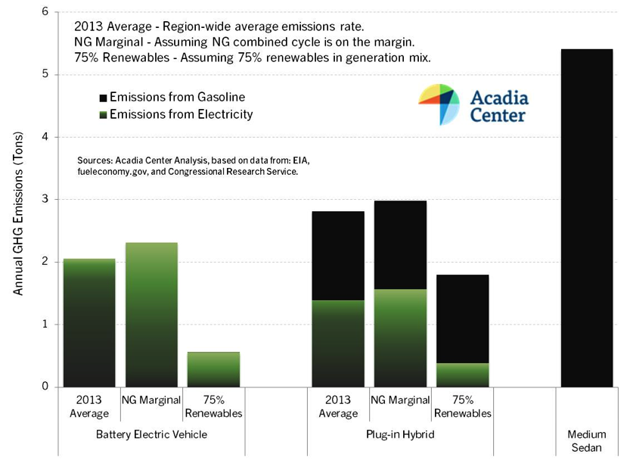
EVs Present Clear Pathway to Climate Goals
Massachusetts has
GHG reduction targets of:
25% below 1990 levels by 2020
80% below 1990 levels by 2050

Slide 3
Massachusetts EV Numbers Are Growing, but Not Fast Enough
 | Reported Total EVs (mid-2015) | EVs Needed in 2017 to Meet 2025 Goal | EVs Needed in 2020 to Meet 2025 Goal | 2025 Goal
Total Cumulative | 5,475 | 18,829 | 81,944 | 303,814

Slide 4
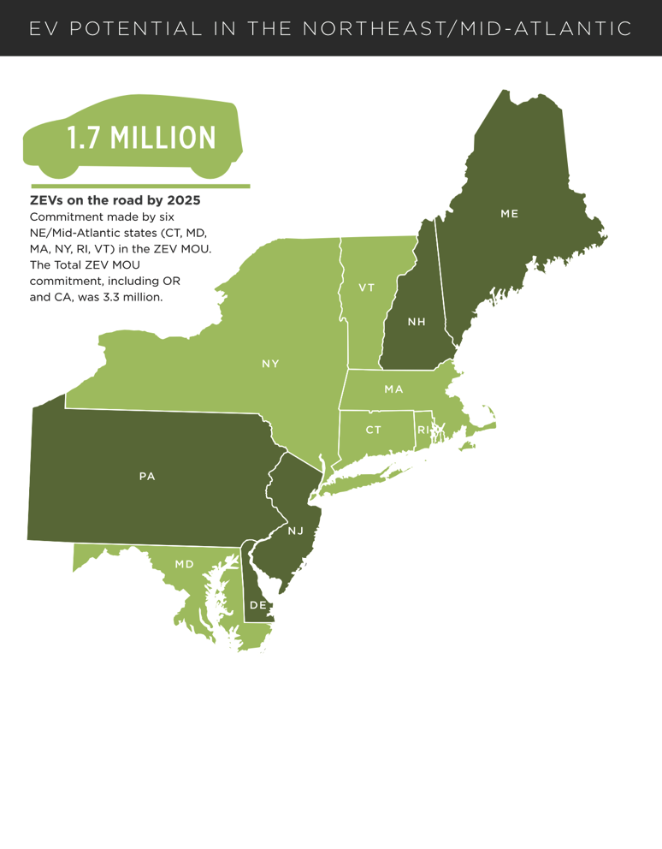
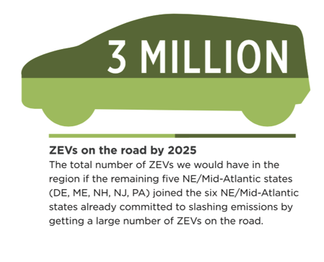
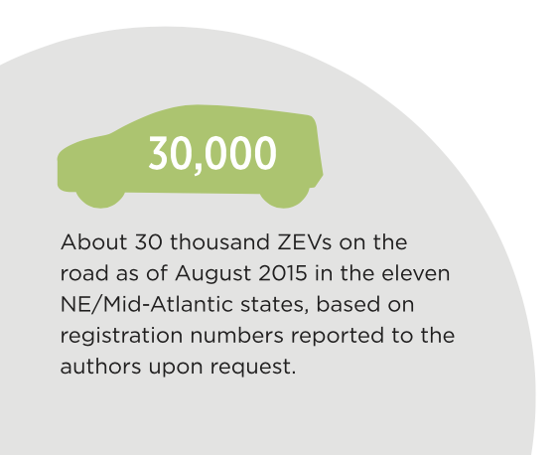
EV Potential in the Northeast/Mid-Atlantic

Slide 5
Nine Vital Steps for Success
High-level state task force or commission
Consumer incentives
Programs to make EVs more accessible to low-income residents
Utility programs and investments
Widespread consumer-friendly charging stations
State and local governments leading by example
Increased efforts by automakers
Auto dealership programs
Public education and outreach

Slide 6
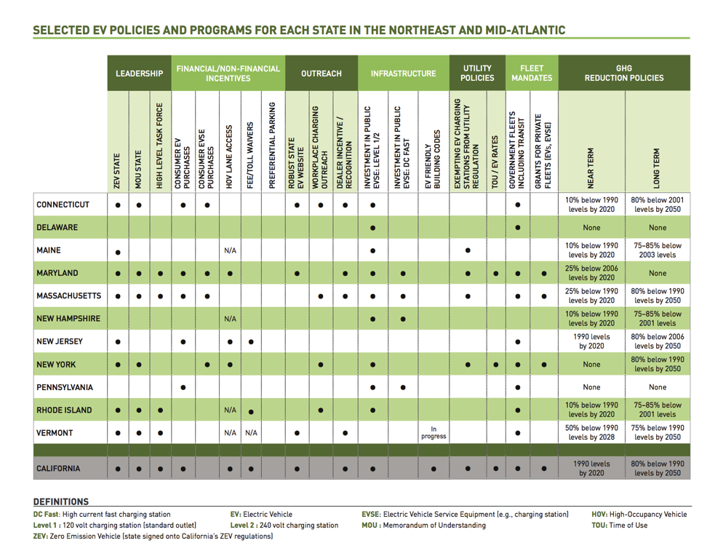
Selected State EV Policies & Programs for the Northeast & Mid-Atlantic

Slide 7
Consumer Incentives Increase Sales
States with the largest EV incentives had EV sales 2–4 times national average
MOR-EV is a great program but should continue to be improved
Funding should be continuous and sustained for increased predictability
Price cap will stretch funds for consumers that need rebates most
Dealer incentive

Slide 8
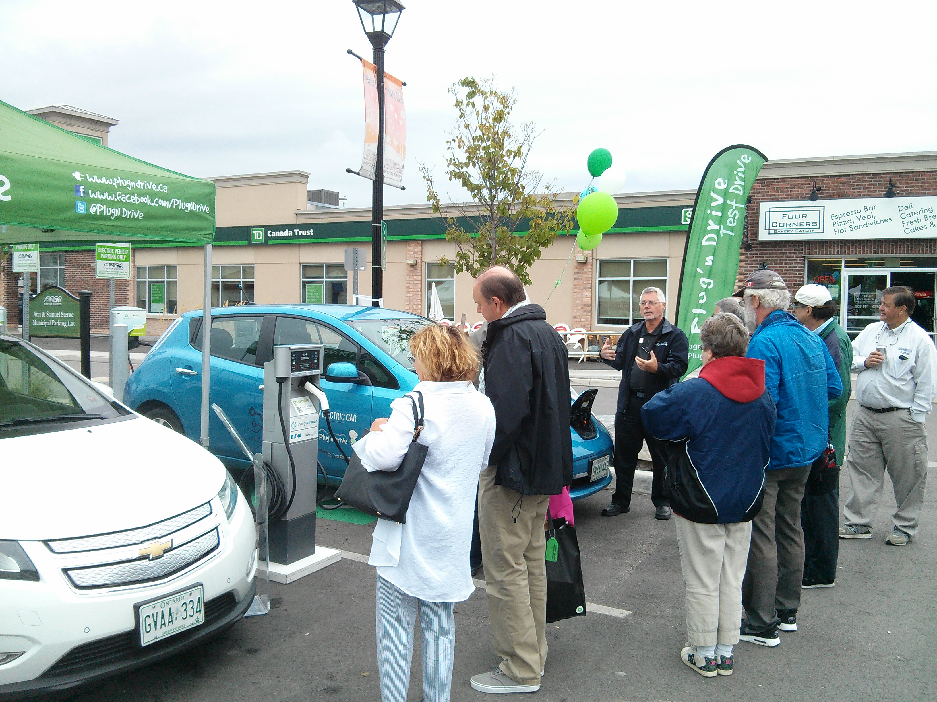
Equitable Distribution of EV Benefits
Low-income communities stand to benefit most from reduced air pollution from increased EV market
CA model: Charge Ahead Law
Low-income residents scrap older cars get a clean vehicle like new or used EVs.
Car-sharing programs & EVSE in low-income neighborhoods.
MA should adopt Income Based Tiered EV Rebate Pilot Program
MA should add trade-in and car-sharing

Slide 9
Electric Utilities Can Promote EVs and Utilize As a Resource to Optimize System
Utility investments and planning
Time-varying rates, managed charging & other vehicle-grid integration programs
General TVR framework and Grid Mod Plans
Studies and pilots set up for future action
Reform rates/demand charges that inhibit public fast charging

Slide 10
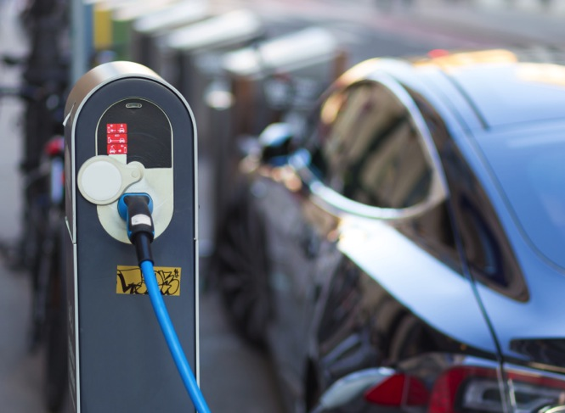
Widespread Consumer-friendly Charging Stations
Consumer-friendly regulation should replace burdensome utility regulation
Weights and measures
Signage
Interoperability
Open access requirements
Building codes and permitting policies
Base code and stretch code
Targeted incentives and programs for high priority categories and hard-to-reach market segments

Slide 11
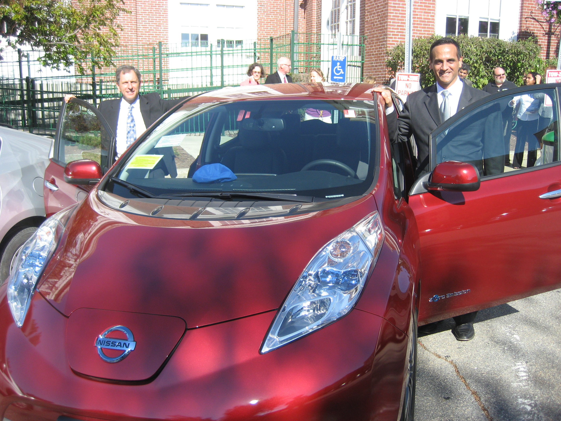
State and Local Governments Should Lead by Example
Fleet owners
EV-specific incentives and requirements
Fleet fuel economy standards
Workplaces
Employee and visitor charging stations
Parking managers
Charging and other benefits for EV drivers in government-owned lots or curbside parking

Slide 12
Widespread Education Builds Public Awareness & Enthusiasm
More public ‘ride n drive’ events
More workplace charging and events
Events with VIPs
Strong consumer web site
Compelling ads by OEMs, dealers, government & utilities

Slide 13
CHARGING UP Primary Authors:
Jennifer Rushlow jrushlow@clf.org
Gina Coplon-Newfield gina.coplon-newfield@sierraclub.org
Mark LeBel mlebel@acadiacenter.org
Emily Norton emily.norton@sierraclub.org

