Slide 1
Charles River Dam Road (Craigie Bridge)
MassDOT Highway Division
Department of Conservation and Recreation
December 18, 2018

Slide 2
Commitments –
Other Charles River Crossings
Longfellow Bridge
Winter commitments
Design Spring pilot
Massachusetts Avenue Bridge
Install speed feedback radar signs (Spring 2019)
Boston University Bridge
Install flex-posts at the intersections (Spring 2019)

Slide 3
Path to Providing Bike Facilities
Improvements on Charles River Dam Road (Craigie Bridge) will be done in Spring 2019
These changes will have impacts to the cross section
We need to hear from you.
What do you like?
What do you want to see and experience?
What don’t you like?

Slide 4
Additional Safety Improvements
Change speed limit signs to 25 MPH (Dec 2018)
Install speed feedback radar signs (Jan 2019)
Conduct Road Safety Audit (Winter 2018/2019)
Install pavement marking changes (Spring 2019)
Install flexposts if possible (Spring 2019)

Slide 5
Next Steps
Gather feedback from you tonight
Conduct Road Safety Audit
Develop final design
Host meeting Winter 2019 to present design
Implement new striping plan in Spring 2019
Gather data on effectiveness

Slide 6
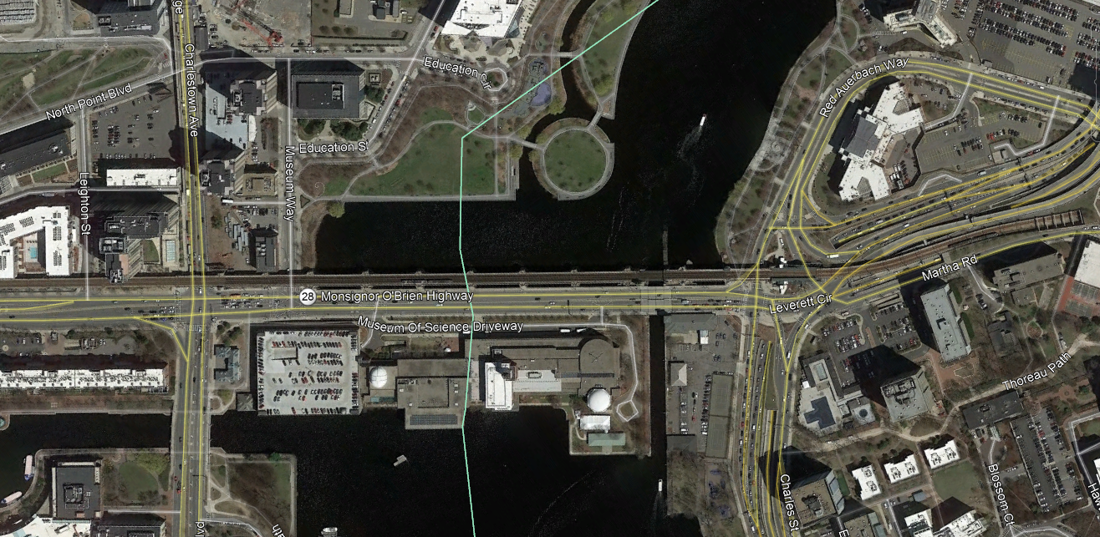
Project Area

Slide 7
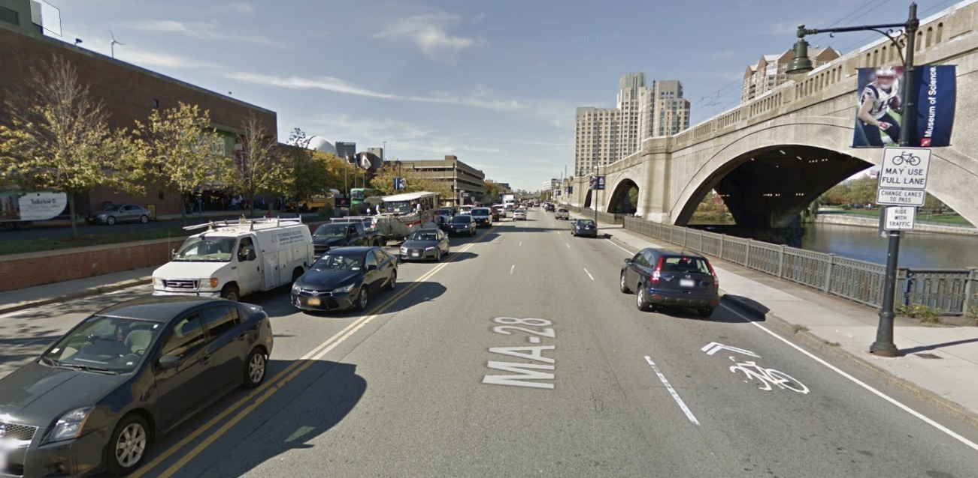
Current Conditions
Segment between Land Boulevard and Leverett Circle
Posted speed limit: 25 MPH
Pavement width: 64 feet
AADT: 37,500 (September 2018)
Two bridges:
Craigie Drawbridge
Craigie Dam
Buses to Museum of Science

Slide 8
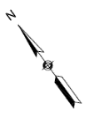
Current Conditions
No dedicated bike facilities
People are biking in travel lanes and on the sidewalks
Sidewalks on both sides
6 vehicular travel lanes
No defined turn lane into Museum of Science

Slide 9
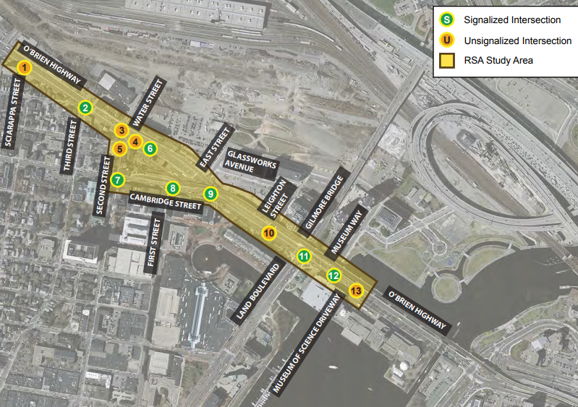
Current Conditions
Conducted Road Safety Audits* nearby:
Leverett Circle (October 2015)
Monsignor O’Brien Highway (June 2014)
Charles River Dam Road (Winter 2019)
*Road Safety Audit examines existing conditions regarding safety by an independent, multi-disciplinary team

Slide 10
Constraints
Curb to curb width: 64 feet
Two fixed bridges
Provide 5 travel lanes

Slide 11
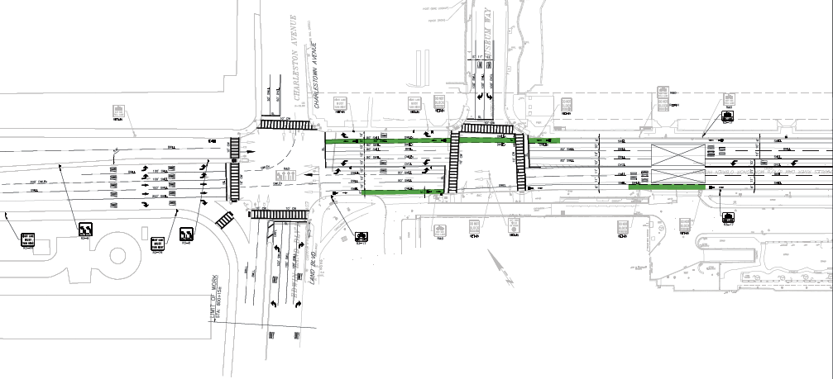
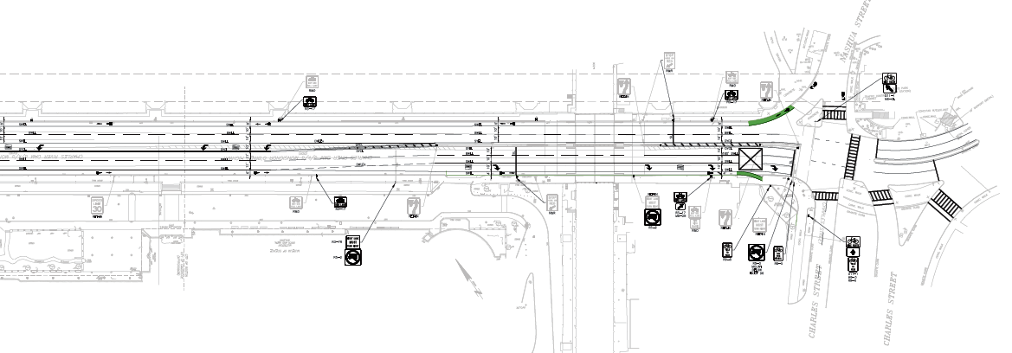
Option A (developed in 2008)
Adds continuous on-road bike lanes
Maintains existing sidewalks
Removes 1 travel lane (5 total vehicle travel lanes)
Provides 2 travel lanes in each direction
Adds a left turn lane into Museum of Science

Slide 12
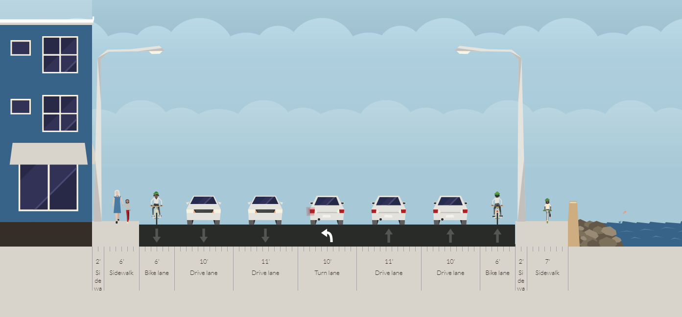
Option A

Slide 13
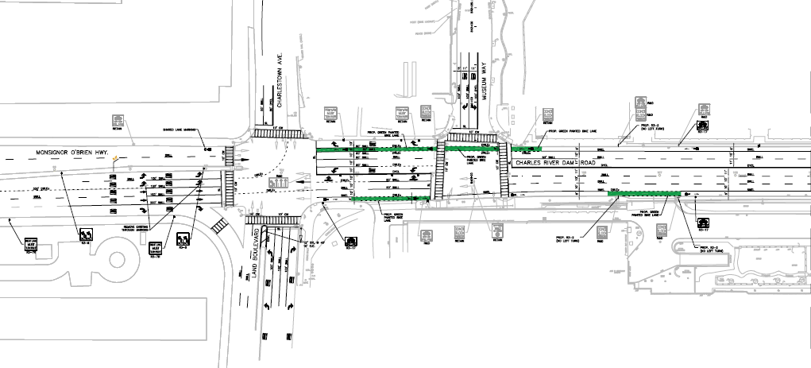
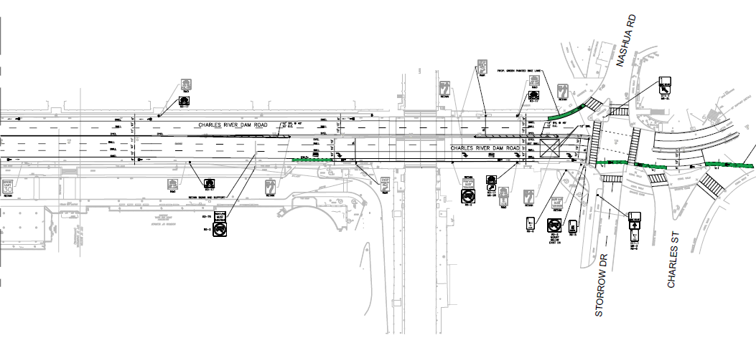
Option B
Same as Option A except:
Provides 3 travel lanes to Leverett Circle
Restricts left turns into Museum of Science

Slide 14
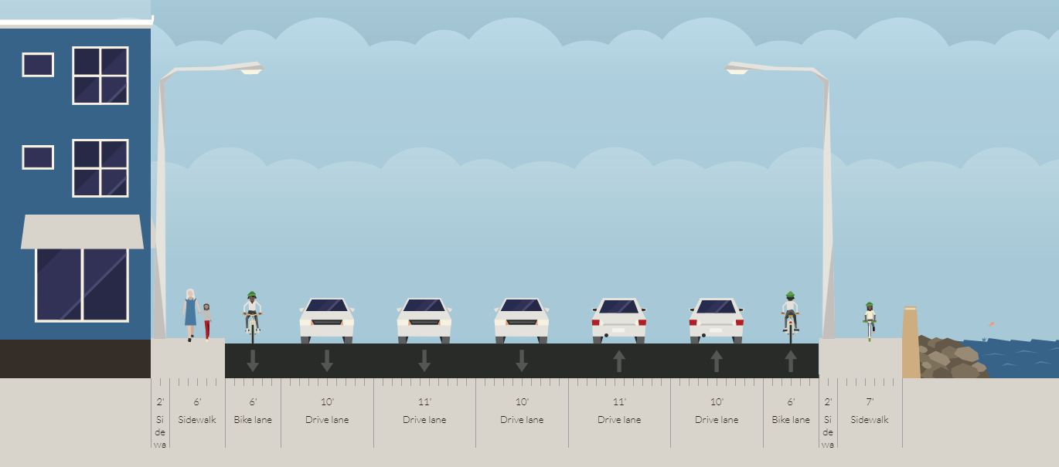
Option B

Slide 15
Potential Short-term Option

Slide 16
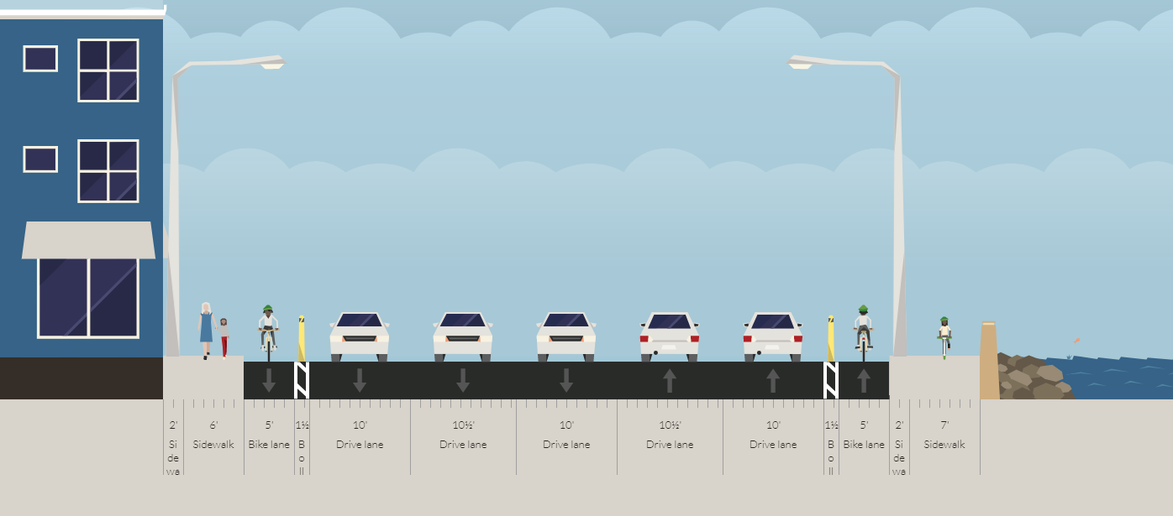
Potential Short-term Option

Slide 17
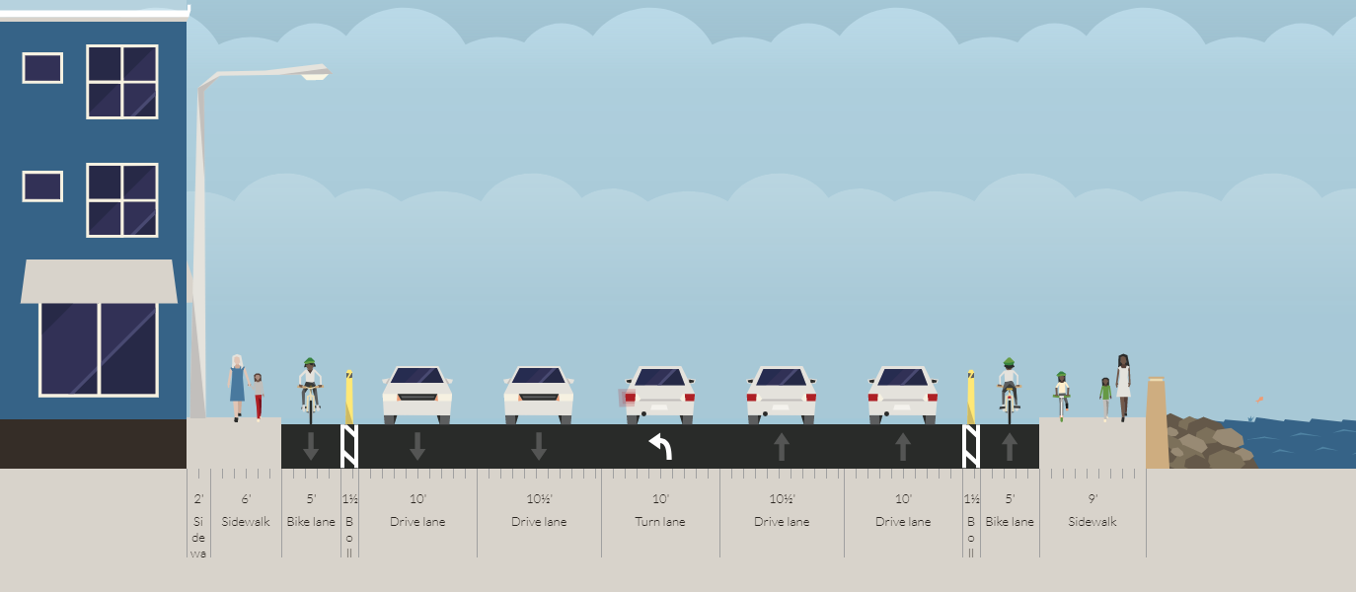
Potential Long-term Option

Slide 18
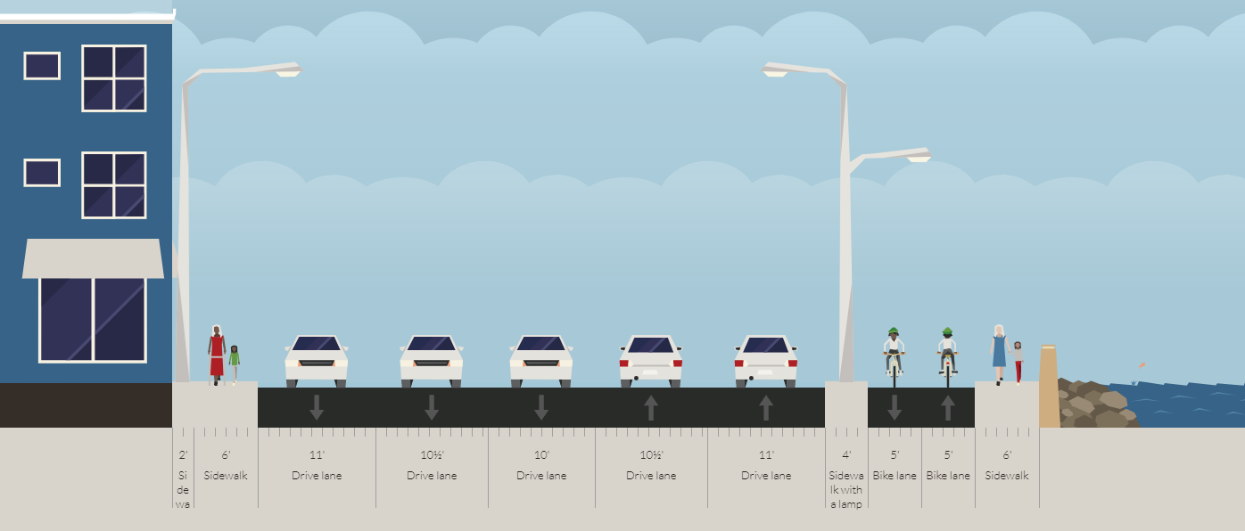
Potential Long-term Option

Slide 19
Open House
What would you like to see on Charles River Dam Road?
Provide your ideas and comments
The presentation made will be viewable after the public meeting on DCR’s website at www.mass.gov/dcr/past-public-meetings. The public will be invited to submit comments after the meeting, with a deadline for receipt by DCR of January 22, 2019. Comments may be sent to Jeff Dietrich at jdietrich@hshassoc.com or by phone at 617-482-7080 x220

