Slide 1
BURLINGTON’s Proposal to Join the MWRA under the Interbasin Transfer Act
Request for Additional Information
MA Water Resources Commission
January 9, 2020

Slide 2
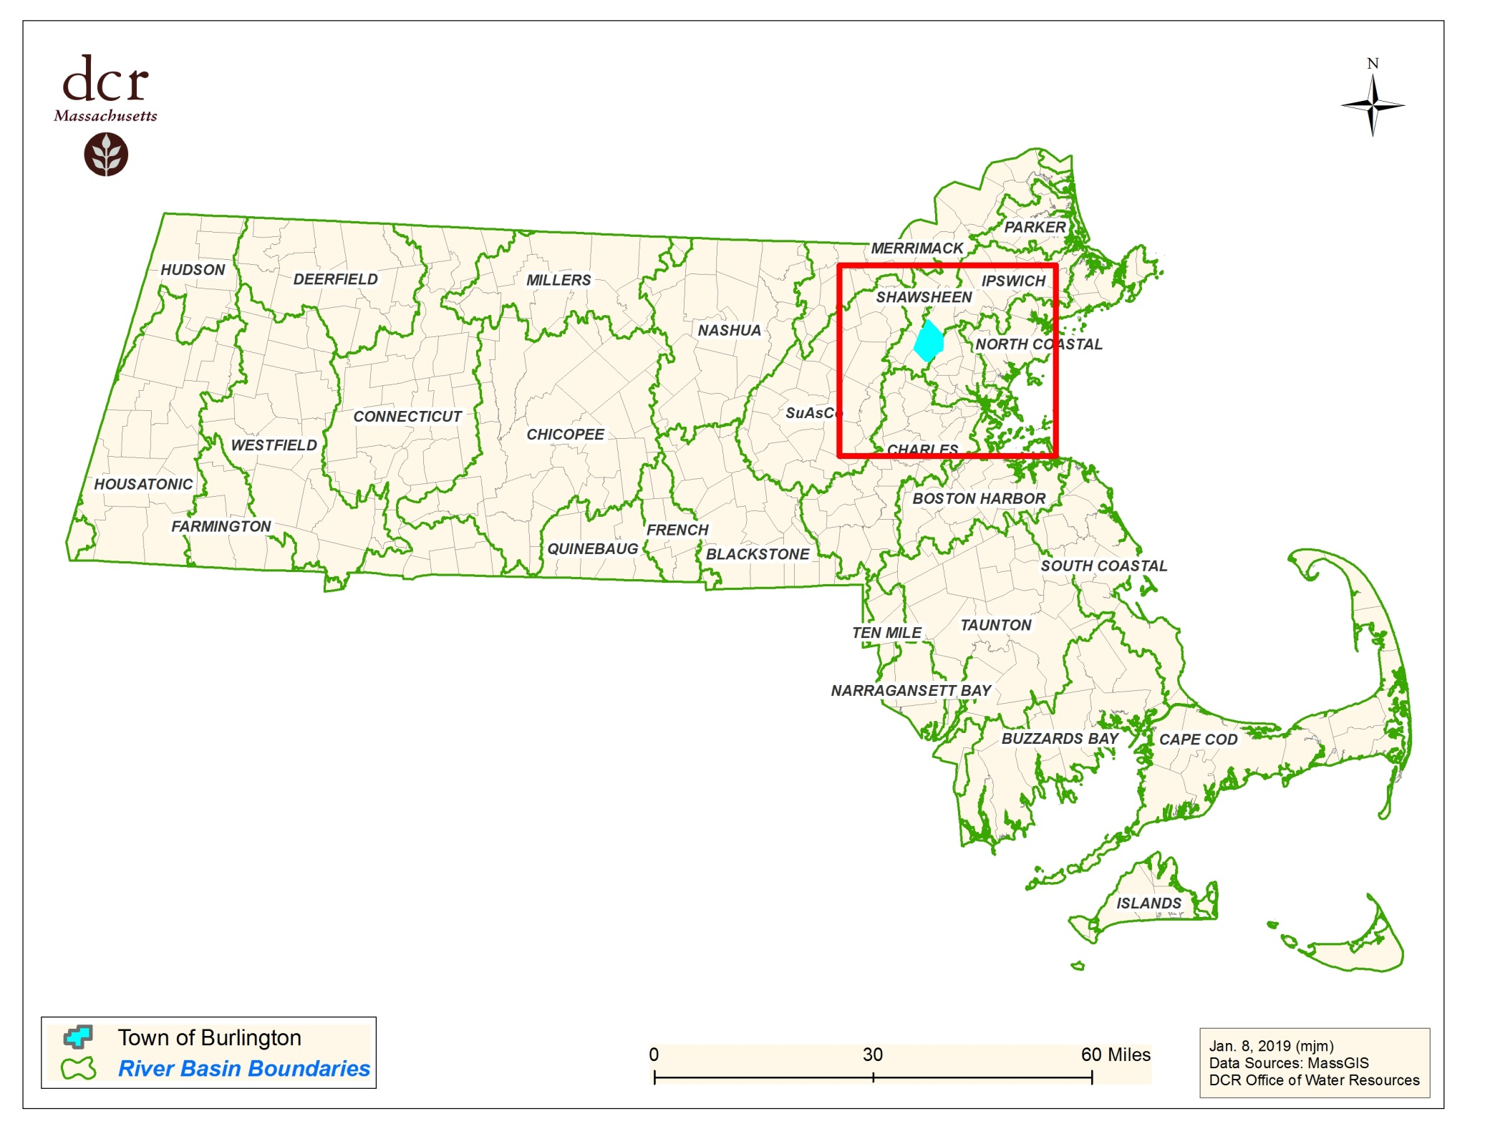

Slide 3
Facts Pertaining to the Application
Burlington has land area in the Shawsheen, Ipswich, and Boston Harbor basins
7 groundwater wells and 1 surface water source:
  3 wells offline due to 1, 4-dioxane contamination
  Mill Pond Reservoir primarily fed from Shawsheen River via 4 mile pipe
  Mill Pond WTP (2.5-3 MGD) lacks redundancy (offline 2-3x/year to clean)
Proposing to purchase up to 6.5 MGD (max day) to supplement its existing water supply sources and provide redundancy
MWRA Waterworks System has sources in the Chicopee River and Nashua River basins

Slide 4
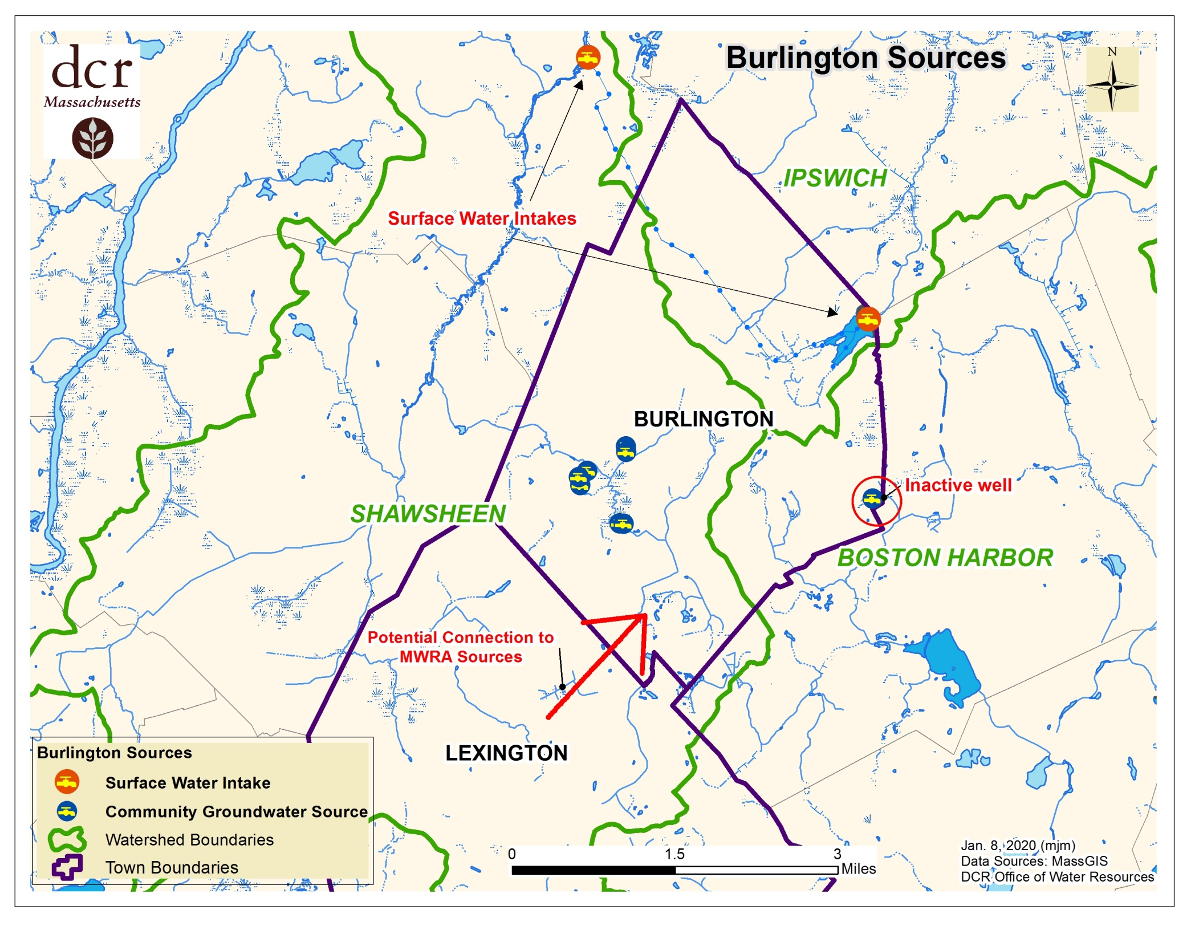

Slide 5
Brief Timeline
2011 1,4-Dioxane MCL reduced from 3ppb to 0.3
Wells 3, 4 & 5 taken offline at Vine Brook TP, reducing capacity by 1.95 to 1MGD
Town implemented a Drought Plan including outdoor watering restrictions tied to elevations at Mill Pond
2016 Alternatives Analysis- reviewed existing sources, new sources, purchase from MWRA and/or neighboring towns
Recommended Alternative: Vine Brook offline, keep Mill Pond, estimated need from MWRA= 3.5 ADD, 6.5 MDD with Mill Pond offline

Slide 6
Information to be Requested
Comments on the DEIR are due to MEPA on January 10, 2020
MEPA decision expected on January 17, 2020
WRC staff will be requesting additional information pertaining to these criteria:
  3. Water Conservation (water rates, overall program)
  4. Forestry Management Program
Agency reviewers are also requesting more information on Reasonable Instream Flow

