Slide 1
Massachusetts PEV and Recharging
Infrastructure Case Study (Draft, Work in Progress)
ZEV Commission Meeting
Boston, Massachusetts
Commissioned and Funded by DOE
EV Everywhere Grand Challenge and Clean Cities Program
Fred Wagner (Energetics)
Jim Francfort and Sera White (Idaho National Laboratory)
July 28, 2016

Slide 2
Background: DOE Everywhere
Grand Challenge (Draft, Work in Progress)
Most PEV sales have been in highly conducive urbanized areas, not broadly across the country
DOE’s EV Everywhere Grand Challenge is looking at barriers and opportunities for cities and states to more actively partake in the PEV market
Massachusetts has been chosen as a success story to execute a case study. Objectives include:
  Determining activities that are most effective at encouraging the acquisition of PEVs and deployment of infrastructure
  Prioritizing and sequencing their implementation
  Identifying means to extrapolate and apply this understanding across
  the country
Lessons learned will be used to inform a national pilot program to enable communities to implement PEV growth plans

Slide 3
Massachusetts Case Study:
Scope and Approach (Draft, Work in Progress)
With State of Massachusetts review actions to prepare for further PEV penetration
  Answer series of comprehensive questions that may support increased market penetration of PEVs
  Frame charging infrastructure analysis requirements
  Identify comprehensive listing of stakeholders (government agencies, communities, utilities, auto dealerships, nonprofits, workplaces,…)
  Conduct Massachusetts stakeholder meeting (April 13th)
Conduct PEV registration and charging infrastructure analyses
Conduct stakeholder phone interviews and web research
Evaluate critical factors
Frame extrapolation of lessons learned for other states
Prepare draft and final reports

Slide 4
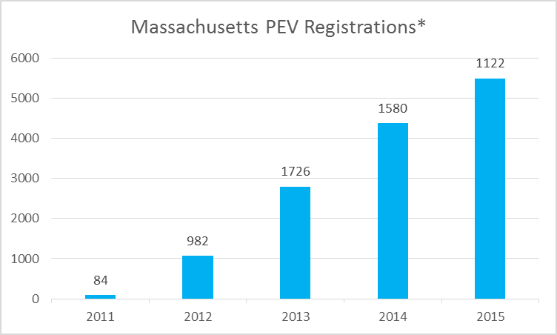
Massachusetts PEV and Recharging Infrastructure Program (Draft, Work in Progress)
Massachusetts activities initiated in 2010
Goal: Increase the use of electrified transportation in Massachusetts
Five major components
  Strategic planning/leadership
  Stakeholder/partnership development
  Policy development
  Education and outreach
  Incentives
Massachusetts PEV registrations have
shown steady growth
* Numbers above the bars indicate annual data,
while bars indicate cumulative ownership
statistics over time

Slide 5
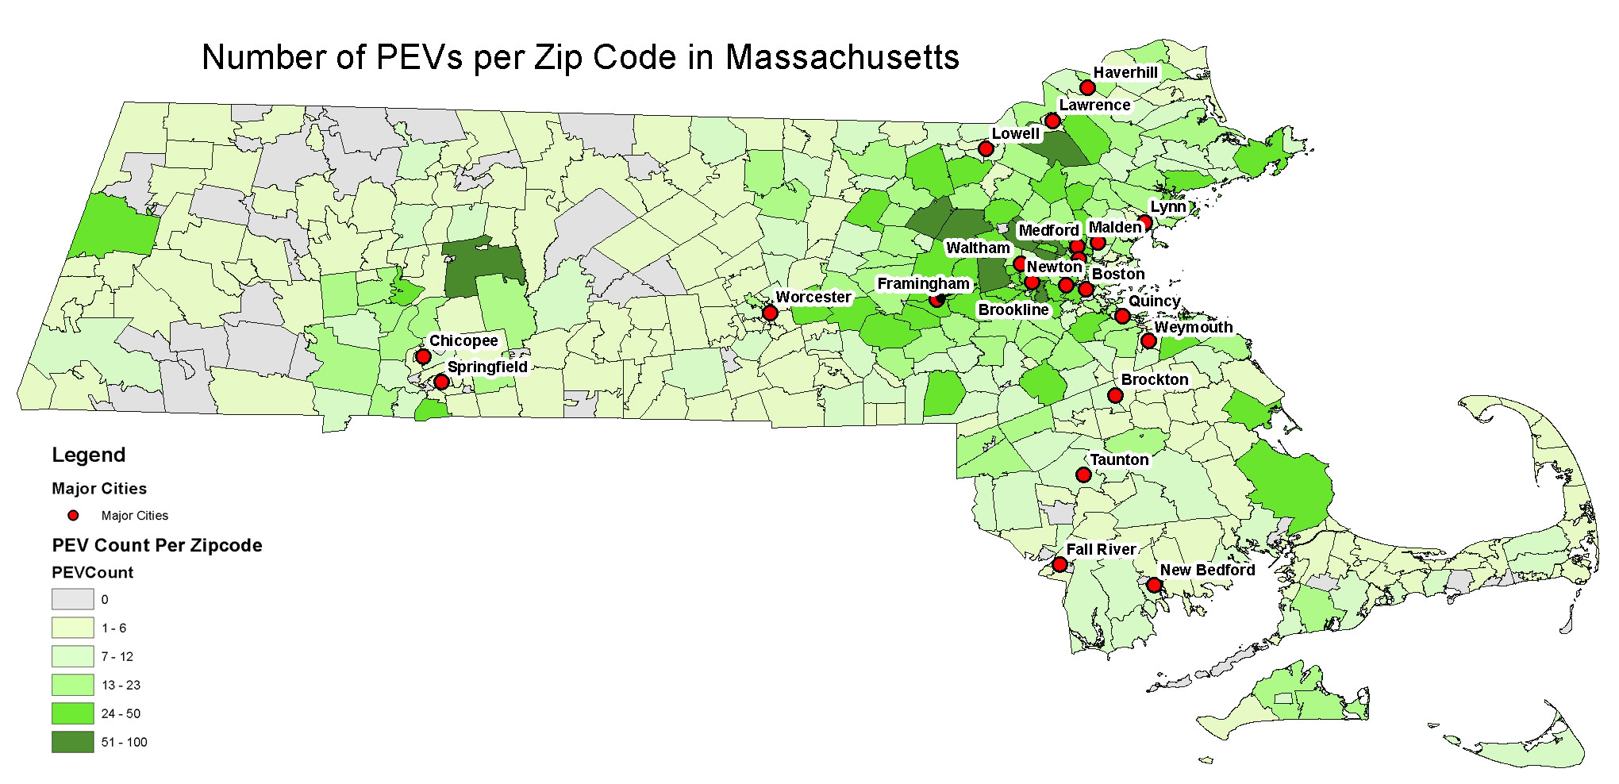
Massachusetts: PEV Analysis
(Draft, Work in Progress)
Most PEVs are clustered in ring communities of major metropolitan areas
Toyota Prius, Chevy Volt, Tesla Model S, and Nissan Leaf are bulk of market (64%); with Ford Cmax Energi and Fusion Energi, Smart ForTwo, and BMW i3 counting for an additional 20%
Over 70% of Massachusetts’ PEV owners are in communities < 50,000 people
Smaller communities tend to have a higher PEV penetration per capita

Slide 6
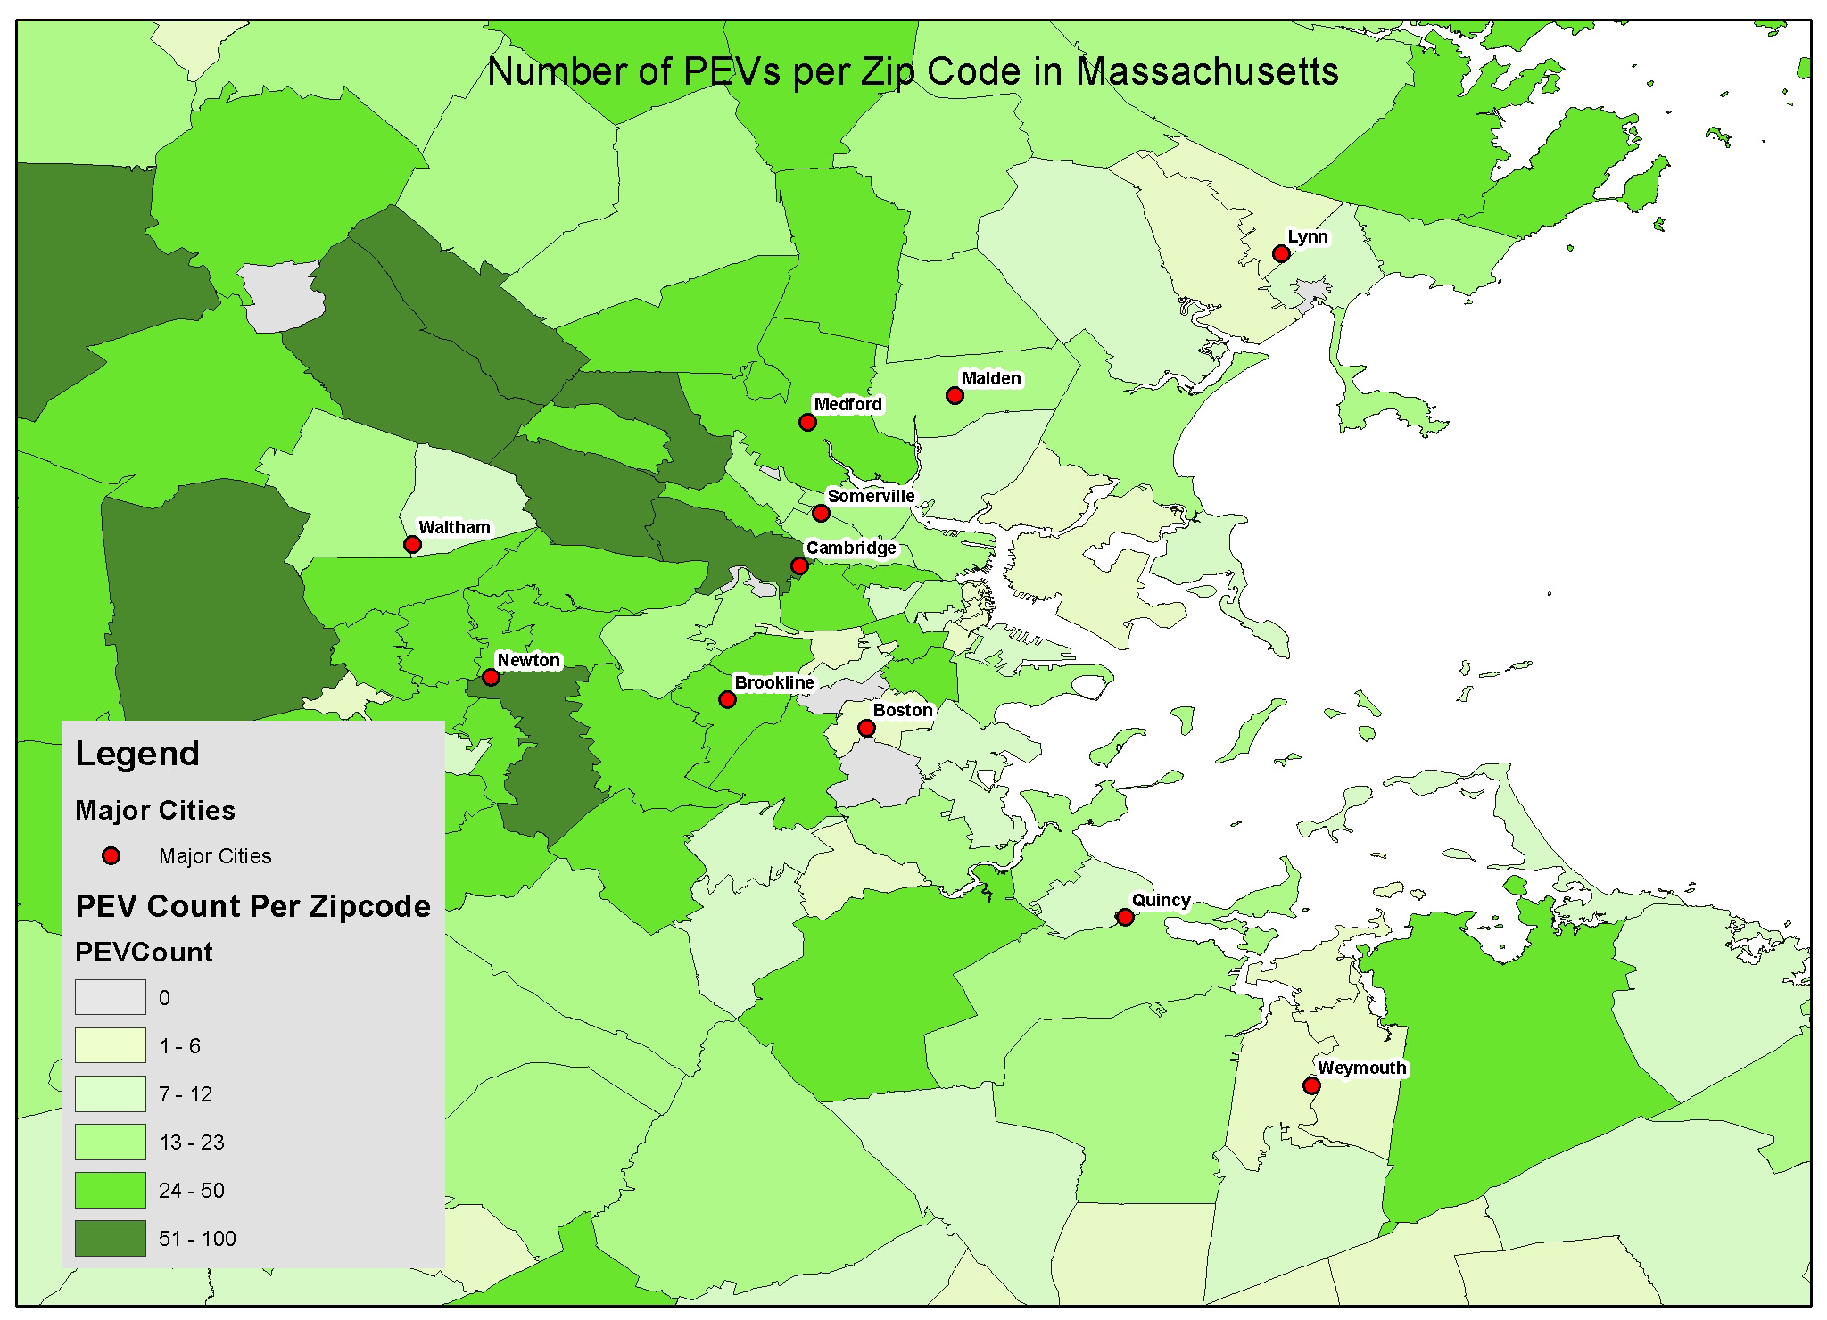
Number of PEVs per Zip Code in Areas Surrounding Boston (Draft, Work in Progress)

Slide 7
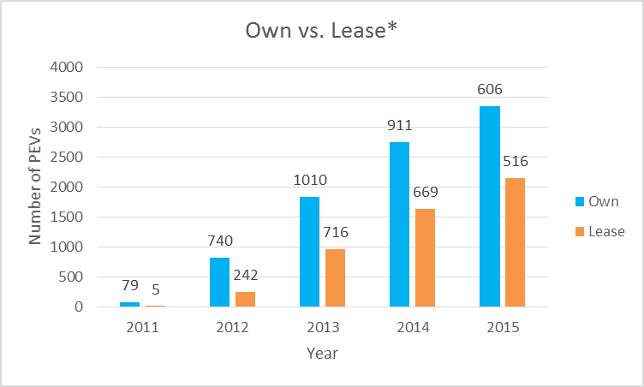
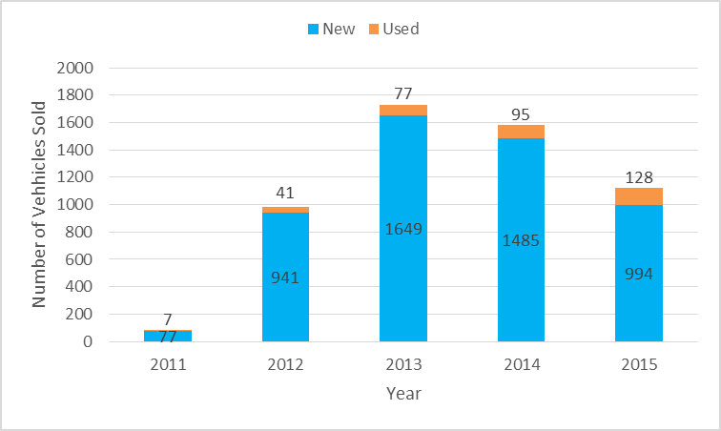
PEV Ownership Versus Leasing and Used Vehicle Sales in Massachusetts (Draft, Work in Progress)
Leasing has slowly grown as a percentage of total PEV sales; outright ownership still majority
Used PEV sales have slowly increased and expected to grow as market develops
* Numbers above the bars indicate annual data,
while bars indicate cumulative ownership
statistics over time

Slide 8
Massachusetts: EVSE Charging Levels and Communities (Draft, Work in Progress)
Vast majority of EVSE locations contain L2 chargers solely or combined with L1 or DCFC
A majority of EVSE are located in communities between 5,000-50,000 people, but there is not a general trend by community size

Slide 9
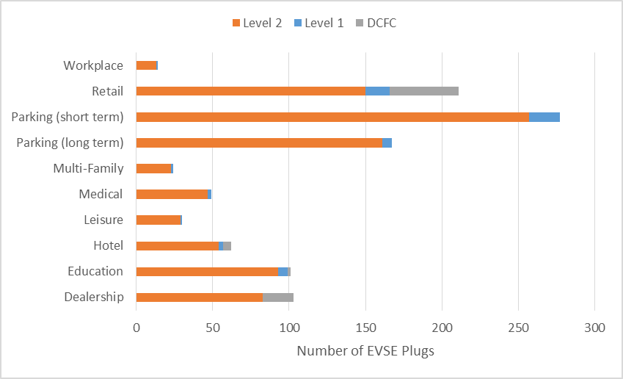
Massachusetts: EVSE Venue Analysis (Draft, Work in Progress)
Most EVSE are in short and long term parking and retail
A number of EVSE plugs identified under categories such as short term parking, retail, medical, or education could also be classified as workplace
State of Massachusetts has funded 206 workplace EVSE locations including 408 stations most being data networked
Over 60% of stations are on ChargePoint network, with eVgo, Tesla, SemaConnect, others accounting for remaining share
EVSE Venues and Charging Levels*
* DOE Alternative Fuels Data Center, ChargePoint, and PlugShare.com: Accessed May 2016

Slide 10
Massachusetts: Free EVSE Charging (Draft, Work in Progress)
Over 70% of EVSE locations offer free charging
Free charging is heavily dependent upon charging network provider
The percentage of free charging shows little variation across community size

Slide 11
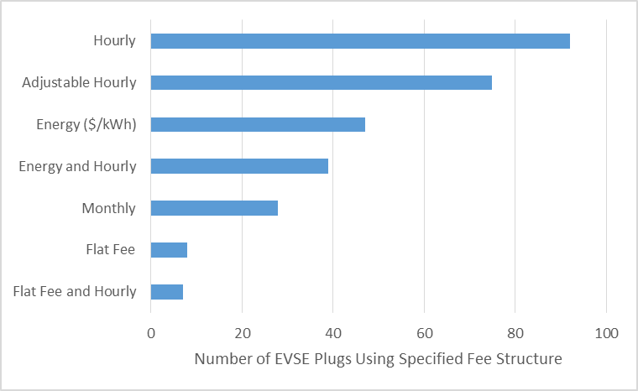
Massachusetts: EVSE Pricing Structure (Draft, Work in Progress)
For EVSE that do charge, the most popular is hourly with rates between $0.50/hr and $6.00/hr
Followed by adjustable hourly and energy (rates between $0.10/kWh and $0.50/kWh)
Monthly fee structures only used by eVgo
EVSE plugs (number of outlets) by pricing structure

Slide 12
Massachusetts: Critical factors Evaluation (Draft, Work-in-Progress)
Legislation and Policy: High level political support provides sturdy foundation, raises visibility, and gains stakeholder buy-in
Incentives: State incentives in place and working well. Base recommended to be deeper, more diversified, and institutionalized
Car Dealerships: Strong engagement is essential especially with early adopter dealerships; motivation/incentives critical for dealerships/sales people, as well as awareness
Utilities: Significant infrastructure can be purchased, coordinated, and promoted through utilities; additional Department of Public Utilities clarity and utility involvement needed
Outreach and Education: Consistent, centralized PEV/EVSE messaging; one-stop technical support; and increased public promotion
Workplace Charging: For EVSE, biggest bang for the buck. Workplaces utilize incentives, larger entities more conducive, parking policy important, and plan for future
Communities: Heavily dependent upon incentives; important to make business case to community leaders
Non Governmental Organizations: Broad base and outreach: Policy, advocacy, technical expertise, coalition building, lobbying
Clean Cities: Force multiplier for technical assistance, education and outreach, and incentives
Cultural and Climatic Factors: Receptive PEV culture contrasts with challenging climate
INL is conducting geographical EVSE analyses to help inform placement of
future EVSE in Massachusetts

Slide 13


Acknowledgements
(Draft, Work in Progress)
Utilities/Installers
National Grid
Eversource
Massachusetts Municipal Wholesale Electric Company
Voltrek
Auto Dealers
Massachusetts Auto Dealers Association
Boch Toyota
Dube Hyundai
State of Massachusetts
Executive Office of Energy and Environmental Affairs
Department of Energy Resources
Department of Environmental Protection
Clean Cities
Office of Representative, 15th Norfolk
City of Boston Environment Department, Metropolitan Area Planning Council, and Public Works Fleet Management
Communities of New Bedford, Plymouth, Melrose, and Boston
Workplace Charging
Tufts Health
EMD Serono
Dunkin Brands
NG0s
Sierra Club
Acadia Center
Conservation Law Foundation
Special thanks is given to ChargePoint and eVgo for suppling EVSE
usage data to analyze recharging patterns in Massachusetts

