Slide 1
Strengthening Resident and Family Councils Maximizing Resident Engagement Part II - Accommodations and Adaptation
Notes:
Welcome to this educational program, “ Maximizing Resident Engagement through Accommodations and Adaptation”, part of an initiative on Strengthening Resident and Family Councils.
I’m Paula Griswold, the Executive Director of the Massachusetts Coalition for the Prevention of Medical Errors.
Our Coalition was contracted by the Massachusetts Department of Public Health, sponsor of this initiative to increase resident and family engagement in Massachusetts nursing homes, and improve the quality of life for residents.
The project is funded through the federal government Center for Medicare and Medicaid Services.

Slide 2
Introduction
Goals
Engage residents and families
Partner with nursing homes on improvement
Improve quality of life for residents

Slide 3
Maximizing Engagement through Accommodations and Adaptation Kate Waldo, CTRS, ACC National Director of Recreation and Guest Services

Slide 4
Objectives
Discuss cognitive, visual, auditory, physical/mobility and group design accommodations and adaptations for engagement.

Slide 5
The Story of Madame President

Slide 6
Skills of Active Listening Defined
What is body language?
The way people communicate through facial expressions, postures, and gestures.
What is tone of voice?
The way people speak to each other including pitch, volume and intonations.
What is paraphrase?
Repeating back in one’s own words what the speaker has said to ensure understanding of the facts, feelings or both.
What is inquiry?
Using open or closed questions to clarify or gather additional information.

Slide 7
Listening Deeply to Understand
How might using the skills of Active Listening as an accommodation for cognitive or hearing impairments?

Slide 8
Active Listening as an Accommodation
Body Language
As people lose other senses and abilities the capacity to read body language often increases.
Tone of Voice
A person may not understand the words you are saying but they can often grasp emotion through tone of voice.
Paraphrasing
Allows for validation and understanding of a person who is having a hard time expressing herself.
Allows for others to hear the ideas of someone who speaks at a low volume.
Inquiry
You can gage the level and complexity of your question to match a person’s cognitive abilities.

Slide 9
Engaging Others in Improvement
Strength and ability based accommodations and adaptations

Slide 10
Cognitive Accommodations and Adaptations
What do you need?
What have you tried?
Suggestions:
Active Listening
Representative objects
Small groups
Flip charts

Slide 11
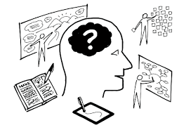
Visual Accommodations and Adaptations
What do you need?
What have you tried?
Suggestions:
White boards
Written and distributed agendas (Large Print)
Reading test for universal font size
Flip charts
Pass items around the group

Slide 12
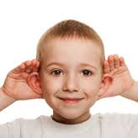
Auditory Accommodations and Adaptations
What do you need?
What have you tried?
Suggestions:
Use of microphones
Use of pocket talkers
A quiet location with no distractions
Karaoke machines
Seating arrangements

Slide 13
Physical/Mobility Accommodations and Adaptations
What do you need?
What have you tried?
Suggestions:
On unit/neighborhood meetings
Small gatherings in a resident’s room
Use larger spaces
Wide doorways
Card holders

Slide 14
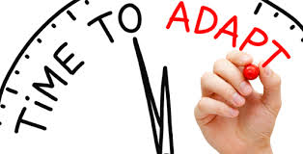
Group Design Accommodations and Adaptations
What do you need?
What have you tried?
Suggestions:
Use of committees
Recreation Planning, Social, Welcome Wagon, Food Advisory, Fundraising, Charity and Community Outreach, Education, etc.
Use of individual meetings
Neighborhood meetings
Parallel programs
Variety of frequency and duration

Slide 15
Part I- Maximizing Engagement through Appreciation
Part II-Maximizing Engagement through
Accommodations and Adaptation Kate Waldo, CTRS, ACC National Director of Recreation and
Guest Services

Slide 16
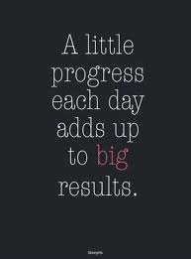
Commitments for Next Steps
What is the positive image you are moving towards?
Visualize the positive change.
Choose one or two things to implement starting today.
Include the Residents in the process and decision making; seek their input and involvement.
Do this “with” the Residents not “to” the Residents.

