Slide 1
MOR-EV Program Update
July 2016

Slide 2
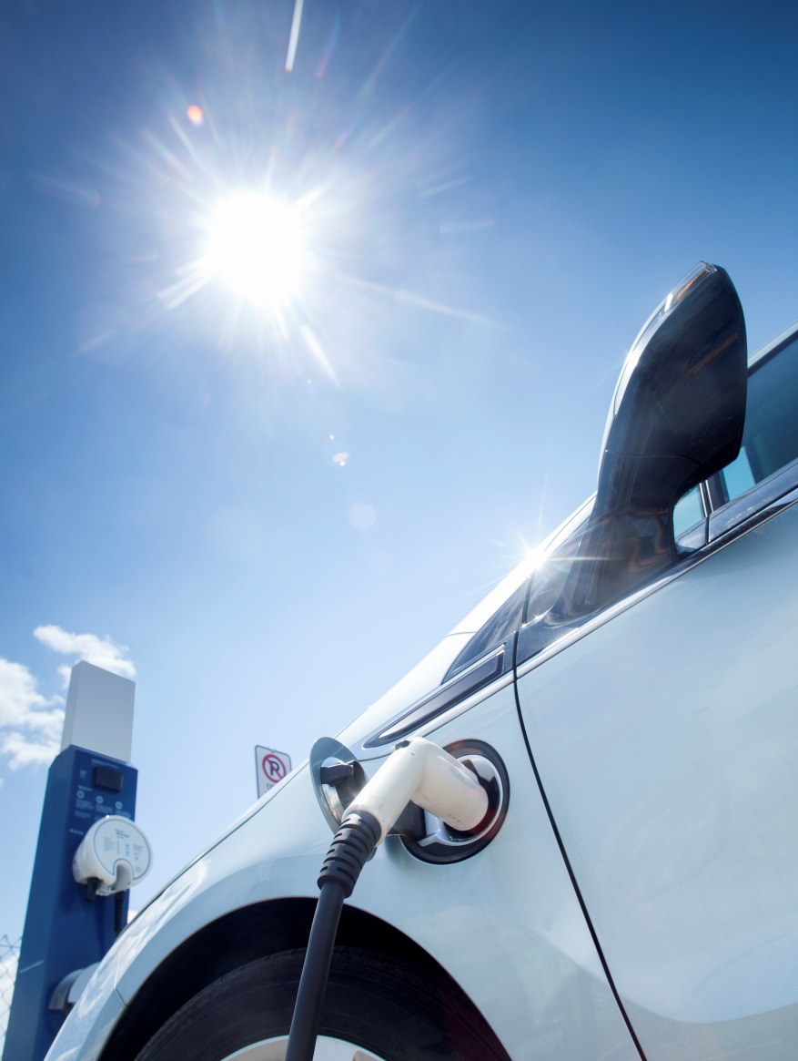
Program Update
Funding Status
Program Statistics
Greenhouse gas reductions

Slide 3
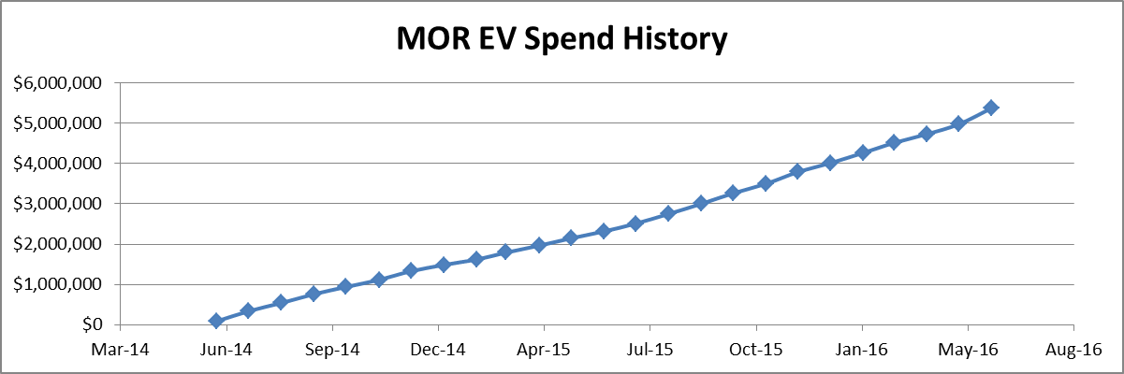
Funding Status
Funding To-Date | $6M
Rebate Funds Issued | $5.5M (2,345 rebates)
Remaining Funds | $420k (190 rebates remain)
Projected Fund Depletion | Sept 2016
Additional Funds Required by Sept 2016
Original contract 06/2014 $2M
Amendment 3/19/2015 $2M
Amendment 2/22/2016 $2M
6,700 ZEVs expected registered in Massachusetts by September 2016

Slide 4
Program Statistics

Slide 5
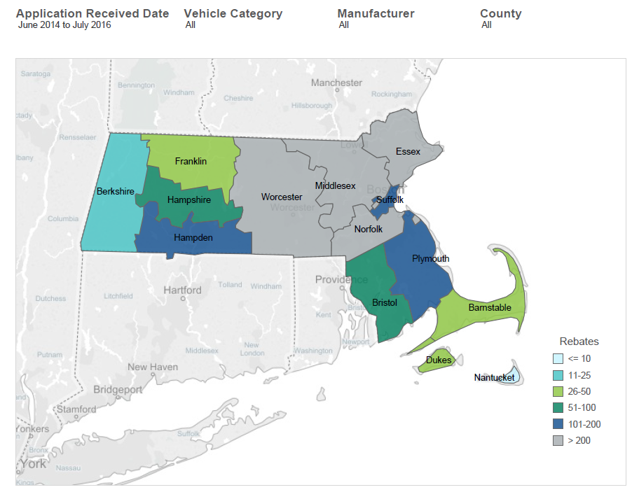
Rebate Geography
Berkshire 17
Franklin 27
Hampshire 94
Hamden 107
Plymouth 108
Bristol 63
Barnstable 46
Dukes 30
Nantucket 5
Worcester 205
Middlesex 951
Essex 256
Norfolk 315
Suffolk 121

Slide 6
Program Statistics
BEV: 61%
PHEV+: 22%
PHEV: 16%
ZEM: <1%
Vehicle Types | Definition
BEV | Battery Electric Vehicle
PHEV+ | Plug-in Hybrid Electric Vehicle with battery capacity > 10kWh
PHEV | Plug-in Hybrid Electric Vehicle with battery capacity < 10kWh
ZEM | Zero Emission Motorcycle

Slide 7
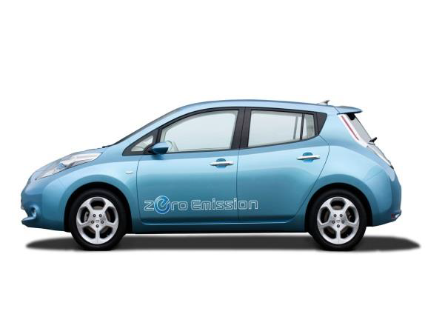
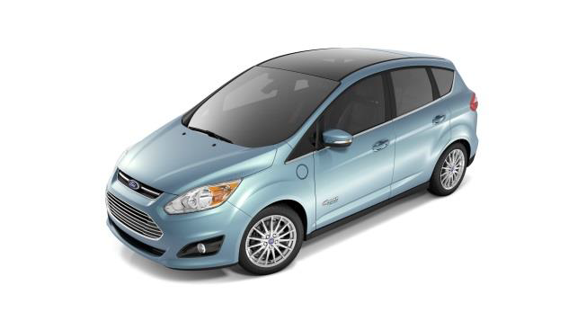
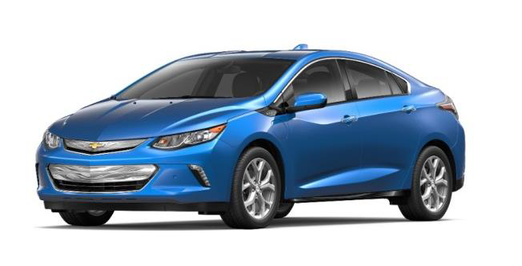
Rebates by Vehicle Category
Battery Electric 62% 1446
PHEVs 16% 382
PHEV + 22% 510
ZEM > 1% 7

Slide 8
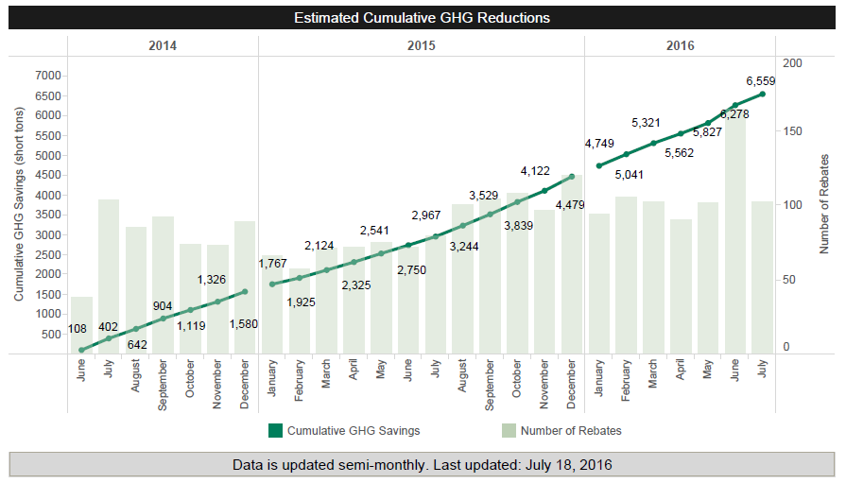
GHG Reductions

