Slide 1
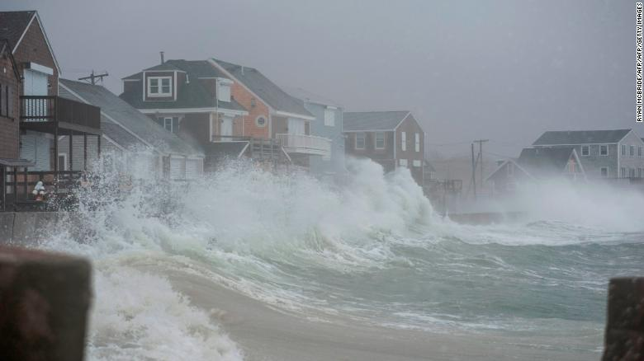
The National Flood Insurance Program in Massachusetts
DCR’s Flood Hazard Management Program
Scituate, March 2, 2018.
Photo credit: Ryan McBride/ AFP/ Getty Images

Slide 2
The Exchange agreement
Flood insurance for
floodplain enforcement
Title 44 CFR (Code of Federal Regulations), Parts 59 through 80,
especially Part 60.3
In Massachusetts:
Statewide building code, 9th Edition, flood-resistant standards 780 CMR
Wetlands Protection Act 310 CMR
Sewer & Septic 310 CMR 15, Title 5
Local Bylaws

Slide 3
Massachusetts NFIP stats
341 out of 351 communities are in the National Flood Insurance Program
As of 9-30-19, there were 60,229 active policies, with an average annual premium of $1,280. This insurance covers more than $15.8 billion in property value.
The coastal counties have 49,385 policies (82% of state total)
Property covered by flood insurance in the these coastal counties= $13.1 billion (83% of state total)
1,405 properties on MA coasts are in the very high risk flood zone (V zone)
On 2-28-19 there were 3,451 structures designated as “repetitive loss structures” in MA, and 284 of these are “severe repetitive loss structures.”

Slide 4
Repetitive Loss Structures in MA
Repetitive Loss is defined by FEMA as “any insurable building for which two or more claims of more then $1,000 were paid by the NFIP within any 10-year rolling period since 1978.”
Top 10 MA communities with RL structures (as of 2-28-19)
Scituate 554 6. Winthrop 148
Revere 296 7. Nantucket 75
Hull 253 8. Duxbury 64
Marshfield 206 9. Billerica 51
Quincy 202 10. Tied: Nahant, Peabody
& Swampscott 47 each
Since 1978, the NFIP has paid out over $416 million
for 34,014 in claims in MA

Slide 5
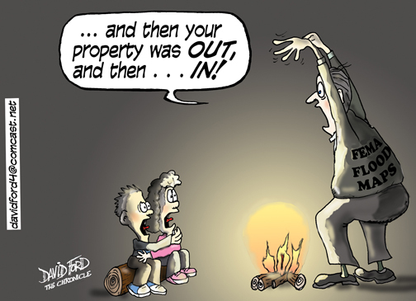
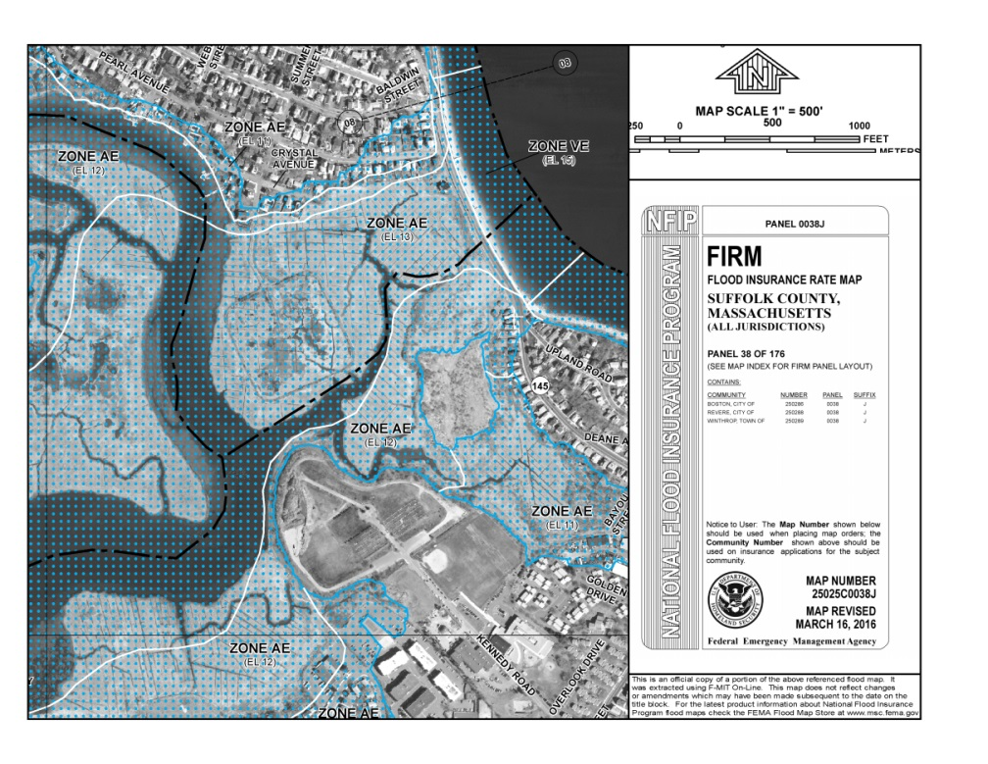
FEMA Maps Update

Slide 6
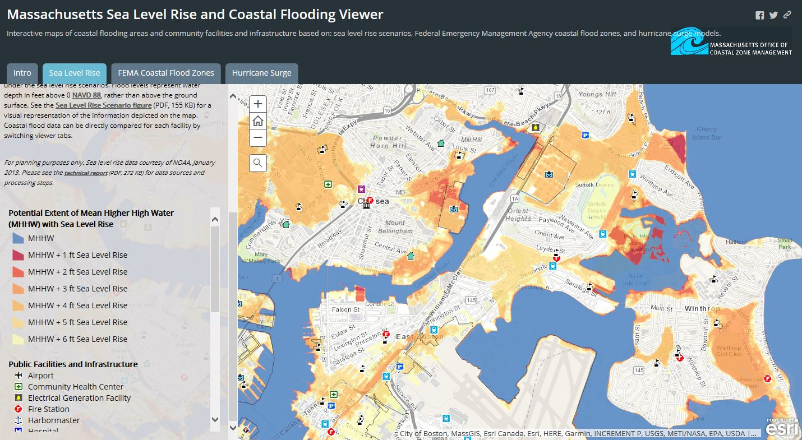
MA CZM SLR & Coastal Flooding Viewer
Massachusetts Climate Change Clearinghouse at http://resilientma.org

Slide 7
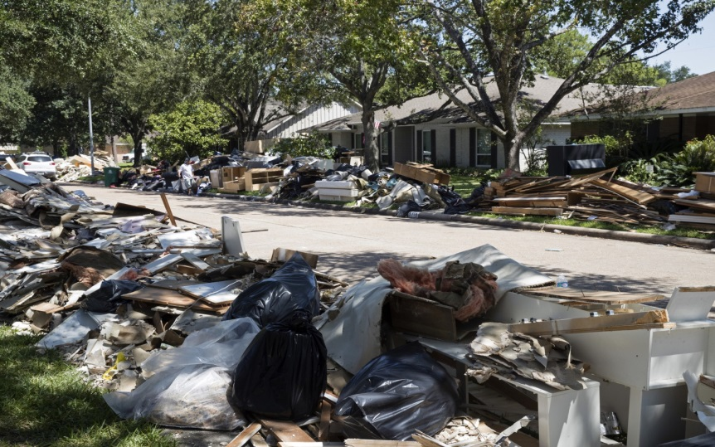
Flood Insurance Inadequacies in MA
$45.69 billion dollars in general building stock in coastal MA
(MassGIS, FEMA HAZUS loss estimation; 2018 state plan, p.4-118)
Only $13.1 billion is covered by an NFIP policy (FEMA CIS Data on 10/4/19)
In very simplistic terms, this means that possibly
More than $32.5 billion dollars
worth of coastal property in MA is
not covered for flood damages.
Total residential damage in Houston from Hurricane Harvey
was more than $2.3 billion.
70% of damages from Harvey were not insured.
(CoreLogic August 22, 2018)
One month after Hurricane Harvey. Source: Chicago Tribune ©

Slide 8
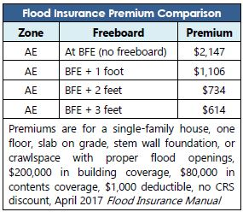
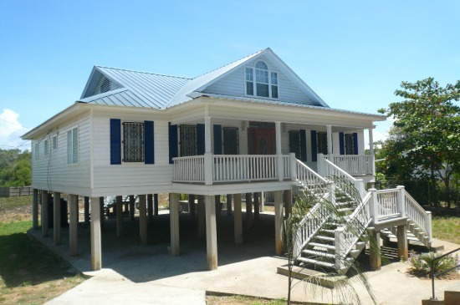
Flood Mitigation Makes a Difference
Benefit-Cost Ratio
by Hazard Mitigation Type
National Institute of Building Sciences, “Natural Hazard Mitigation Saves 2017 Interim Report”

Slide 9
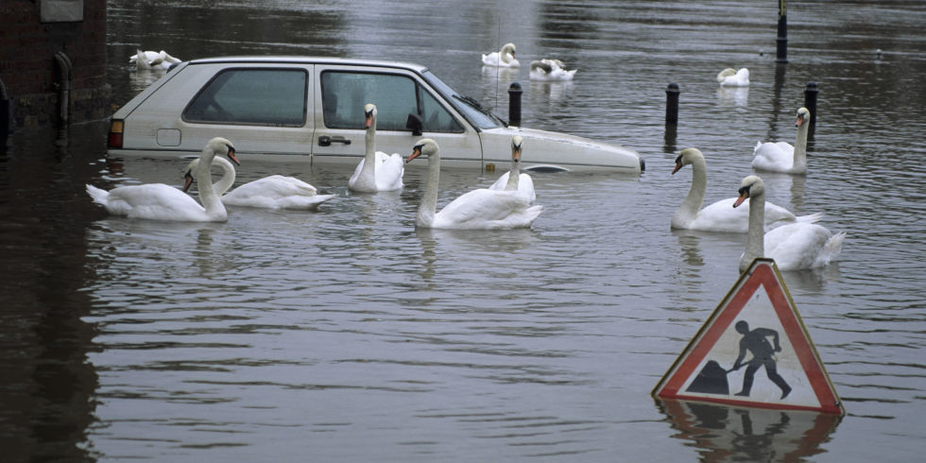
Getty photo:
John Cancalosi
Joy Duperault, CFM
State NFIP Coordinator & Deputy Hazard Mitigation Officer
Flood Hazard Management Program, DCR
(617) 626-1406 or joy.duperault@mass.gov

Slide 10
Report to FEMA: Assessment of Floodplain Management Regulations for State-Owned Properties

Slide 11
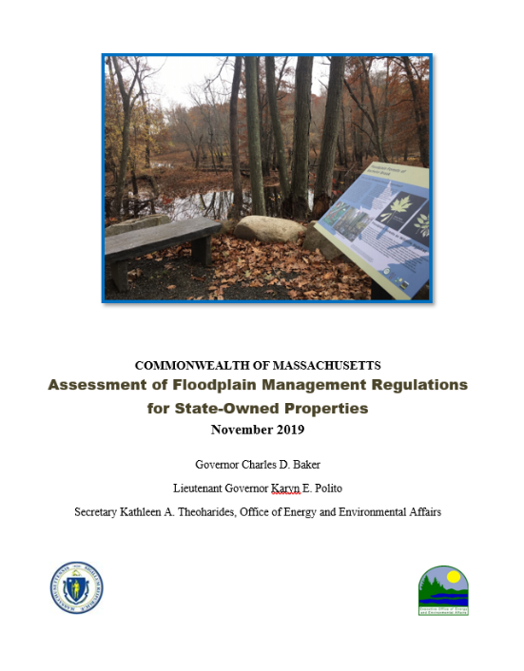
A Snapshot of the Ask by FEMA
Overview of state’s efforts at managing development in state-owned & state-managed properties in Special Flood Hazard Areas
List and brief description of state statutes and regulations that authorize/regulate land use
List of agencies with development oversight
Process that state uses to demonstrate compliance
Description of permitting process
How compliance is tracked

Slide 12
MA meets the NFIP through…….
State Building Code
MA Wetlands Protection Act
MA 401 Water Quality Certification
MA Waterways Program
MA Title V Regulations
MA Dam Safety Regulations
at various agencies……
EEA, WRC – Executive Order 149
MassDEP
DCR
CZM

Slide 13
State Project Oversight…..
Division of Capital Asset Management and Maintenance (DCAMM)
MassDOT
MEPA
Compliance & Violations……
Board of Building Regulations and Standards (BBRS) – state building inspectors
State agencies issuing permits & licenses
CZM
DEP tracks wetlands violations

Slide 14
Contact Information
Vandana Rao, EOEEA,
Director of Water Policy
Executive Director, Water Resources Commission
vandana.rao@mass.gov
617-626-1248

