Slide 1


Strengthening Resident and Family Councils
Person-Centered Care in Nursing Homes

Slide 2
Introduction
Goals
  Engage residents and families
  Partner with nursing homes on improvement
  Improve quality of life for residents
This session: Person-centered Care

Slide 3

Person-centered Care:
How can we strengthen our commitment?
    Lori Todd, RN, LNHA
    Executive Director

Slide 4
What is person-centered care?
The importance of keeping the resident (person) at the center of care planning and decision-making is honored.
Promotes choice, purpose, and meaning in daily life
There are many dimensions of care and person-centered values
Let’s review some of the values, and imagine how they could change care practices if we think a bit differently.

Slide 5
Relationships
Person-centered care is the bond between the person who is receiving the care and the person who is giving the care or providing support services.
When ongoing relationships flourish,
then values, preferences, choices and desires
are known, acknowledged, and met.
Knowing the person is key!

Slide 6

Individuality
What would make your bedroom feel more like home?
Examples: Are you surrounded by pictures and items that were once important to you at home?
Do you have enough lighting, lamps ?
Can you have a refrigerator in your room if you want to?
What would make the facility feel more like home?
Examples: Are there comfortable areas to visit with friends or family?
How could you make your beliefs and choices understood better?
Examples: Is there a way to have employees understand and know you better?

Slide 7

Independence
What small changes in your day would make you feel more independent and in control of your day?
Examples: Can you decide what to wear? When you bathe?
During your day, does anything make you feel dependent on the nursing home team members?
Examples: Is there an outdoor space you can access?

Slide 8

Privacy
Is there some small change that would make you feel that your privacy is respected more?
Examples: Can you shut your door, close your curtain, ask to have undisturbed time?
Can you have private time with loved ones?

Slide 9

Partnership
Is there any way that you could feel closer to your caregivers and the support staff that would strengthen your relationship with them?
Examples: Do you have the same people take care of you most of the time?
Is there a way to be involved in the employee hiring process?

Slide 10

Choice
Are there things that make you feel that you have no say in matters?
Can you think of some choices you would like to make that are currently being made for you?
Examples: Can you choose your bedtime/wake time? When you take your medications?

Slide 11
Dignity
Think about what makes you feel dignified….
While living in the nursing home, does anything compromise your dignity?
Examples: Are you made to wear clothing protectors?
When you shower, do you change clothes in the bathing suite when you arrive, so as not to be transported in a blanket?

Slide 12

Respect
Are there issues around respect?
Examples: Are you attending your care plan meetings? Does your opinion count?
Do your caregivers know about the person you are and your life history before you came to live in the nursing home?

Slide 13

Rights
Do you know you rights as a resident of the nursing home?
Do you ever feel they are compromised?
If so can you describe those circumstances?
What would you change?

Slide 14
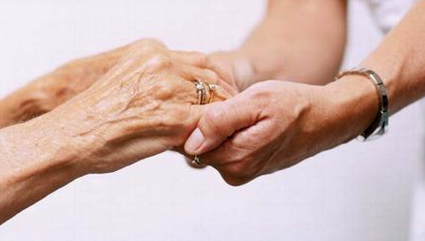
Food for thought:
There are many ways to improve life in a nursing home.
Looking at some of the institutional practices is a way to begin a journey to person-centered care.
Resident and family councils are a way to work together and start to prioritize ways to make changes, whether small or large.
When we work together and try small changes -
eventually when we look back,
we will see how far we’ve come.

Slide 15

Reviewing values and care practices will help improve life for residents and team members
Working together can increase bonds, strengthen relationships and make life a better place for all involved
Remember:
One small step at a time and celebrate successes!

