Slide 1
Plug-in Vehicles from the Utility, Ratepayer and Grid Perspective
Massachusetts ZEV Commission
November 18, 2015
Nancy E. Ryan, Ph.D.
Senior Director, Policy and Strategy

Slide 2
Presentation Overview
Background and context
  Policy context
  Threshold questions for regulators
Case studies
  California
  Seattle, WA
Policy implications for regulators

Slide 3

About E3
  E3 is an electricity consulting firm founded in 1989 in San Francisco
  Clients span local, state and federal government, small and large public and investor-owned electric utilities, and energy technology companies
  Research and practice area in long term CO2 pathways and utility impact of clean transportation (electric and gas)
  Approximately 40 staff in energy economics, distributed resources, policy implementation, and resource planning

Slide 4
Background and context

Slide 5
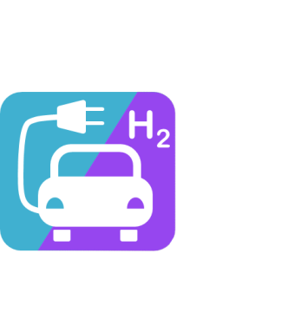



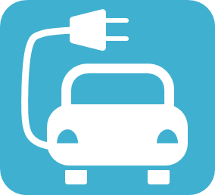




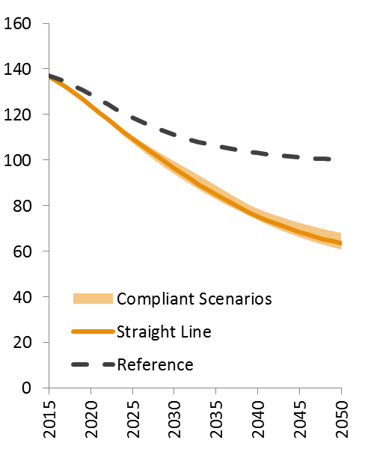
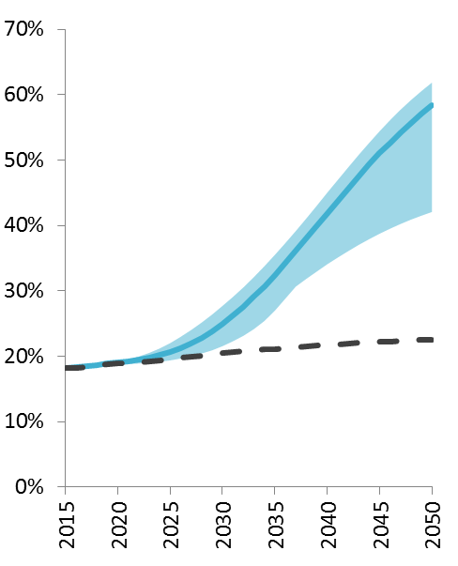
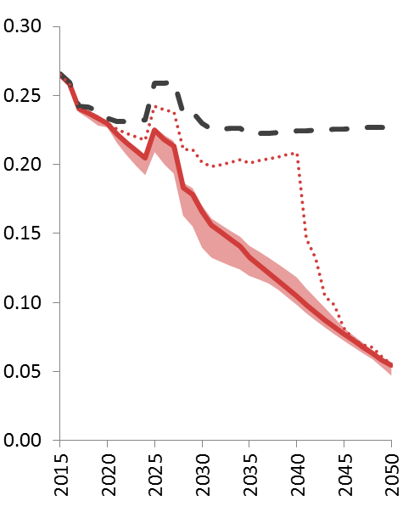
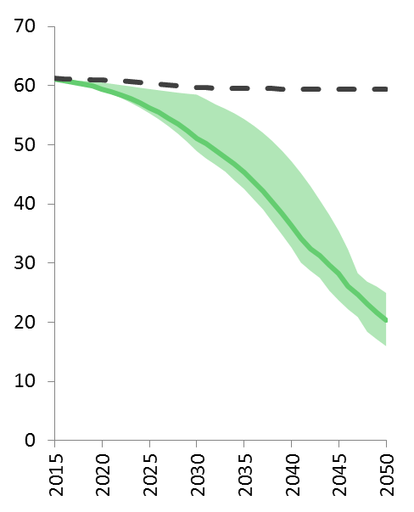
Deep decarbonization depends on four energy transitions
1. Efficiency and Conservation
2. Fuel
Switching
3. Decarbonize electricity
4. Decarbonize fuels (liquid & gas)
Energy use per capita (MMBtu/person)
Share of electricity & H₂ in total final energy (%)
Emissions intensity (tCO2e/MWh)
Emissions intensity (tCO2/EJ)
CCS

Slide 6
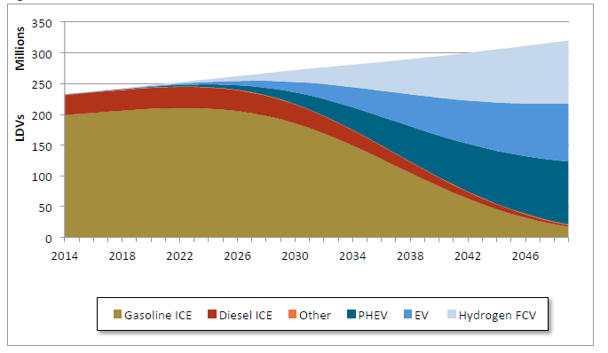

Decarbonizing the US economy will require significant growth in ZEVs
  E3’s US PATHWAYS model lays out technologically-feasible pathways consistent with a 2-degrees Celsius warming limit
  ZEVs account for over 65% of new vehicle sales in 2030
Annual Light-Duty Vehicle Stock (Mixed Case)
http://deepdecarbonization.org/wp-content/uploads/2015/09/US_DDPP_Report_Final.pdf
Notes:
that in 2030, about 2/3 of new vehicle sales are from ZEVs

Slide 7
ZEV requirements are ramping up
2012 ZEV Amendments: Likely Compliance Scenario
Annual Vehicle Sales (000’s)
ZEVs
Current Sales
ZEV+PHEV
PHEVs
PHEV
Courtesy of California Air Resources Board

Slide 8
Threshold questions for regulators
Is promoting EV adoption in the public interest?
Is public funding needed to promote EV adoption?
What is best done by utilities vs. left to the competitive market?
What is the appropriate level of utility ratepayer funding?
How to maximize flexibility and minimize grid and customer costs?

Slide 9
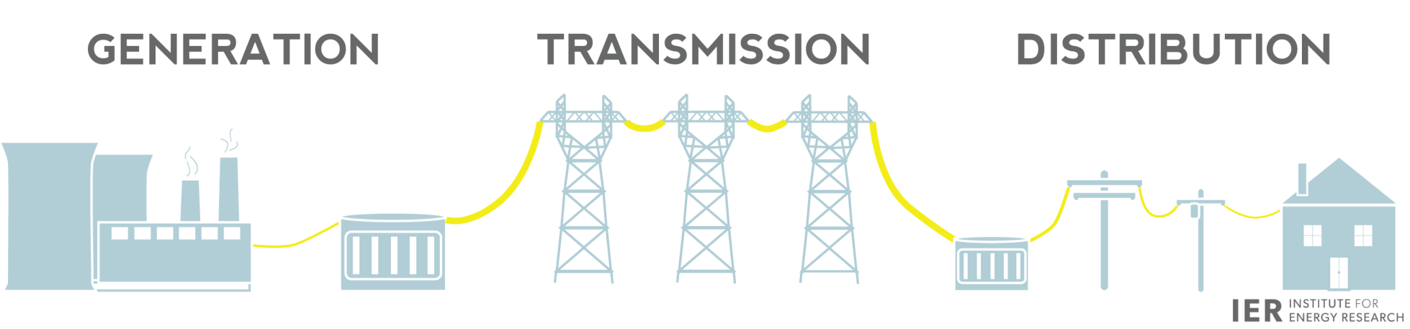
PEV Grid Integration: Issues
Do we need new power plants or transmission lines to support PEV charging?
What are the opportunities to exploit the latent flexibility in PEV charging load to balance out fluctuations in renewable energy generation?
Will EV charging overload local distribution circuits?
  New upgrades needed?
  Safety/Reliability affected?
Can PEV charging be timed to coincide with rooftop solar generation?

Slide 10
California Electric transportation coalition: transportation Electrification assessment

Slide 11
About the TEA Study
Sponsors:
  Pacific Gas & Electric
  Southern California Edison
  San Diego Gas & Electric
  Sacrmamento Municipal Utility District
Study conducted in multiple phases:
  Phase 1: Environmental benefits and barriers to adoption
  Phase 2: LDV grid impacts, costs and benefits
  Phase 3: Goods and people movement grid impacts, costs and benefits
http://www.caletc.com/wp-content/uploads/2014/09/CalETC_TEA_Phase_1-FINAL_Updated_092014.pdf
http://www.caletc.com/wp-content/uploads/2014/10/CalETC_TEA_Phase_2_Final_10-23-14.pdf

Slide 12
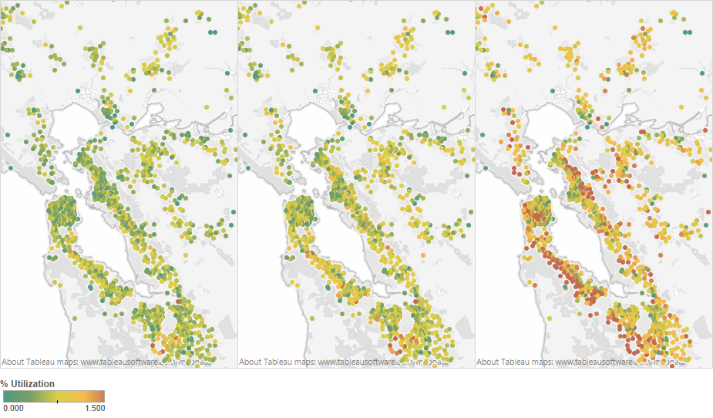
Distribution grid impacts from PEV charging are modest in the near term
Feeder and substation utilization
“ZEV most likely” vehicle adoption and TOU rates
2010
2020
2030
Notes:
E3/ICF TEA study found minimal upgrade costs even at higher penetration scenarios
15 year NPV for PEV driven distribution system upgrades is less than 1% of Annual Distribution RRQ
Smart charging helps keep costs down and capture value of PEV’s to the grid.
TOU or dynamic rates and/or
Direct load control

Slide 13
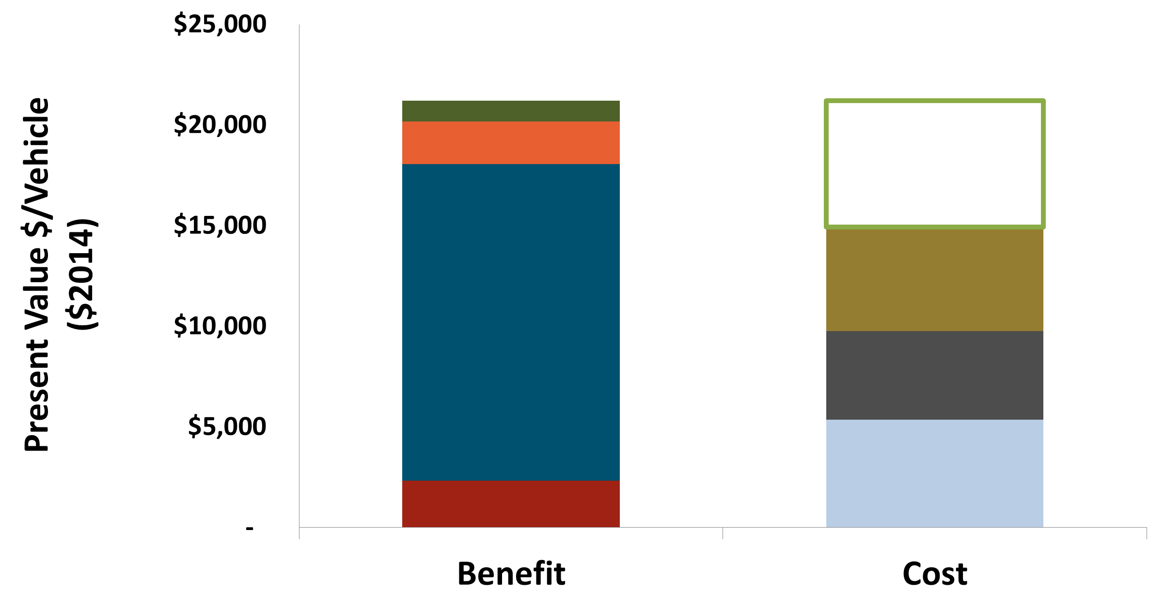
Transportation electrification is fundamentally energy efficiency
Net Societal Benefits from PEV Charging Load
Illustrative results for California Utilities
Petrol. Reliance
Carbon & Health
Net Benefit
$6,267
Energy & Capacity
Costs
Gas Savings
Charger
Cost
Incremental Vehicle Cost
Fed. Tax Credits
PEVs use primary energy more efficiently than conventional vehicles
Costs and benefits span the power and transportation sectors, complicating policy
Notes:
Under TOU rates

Slide 14
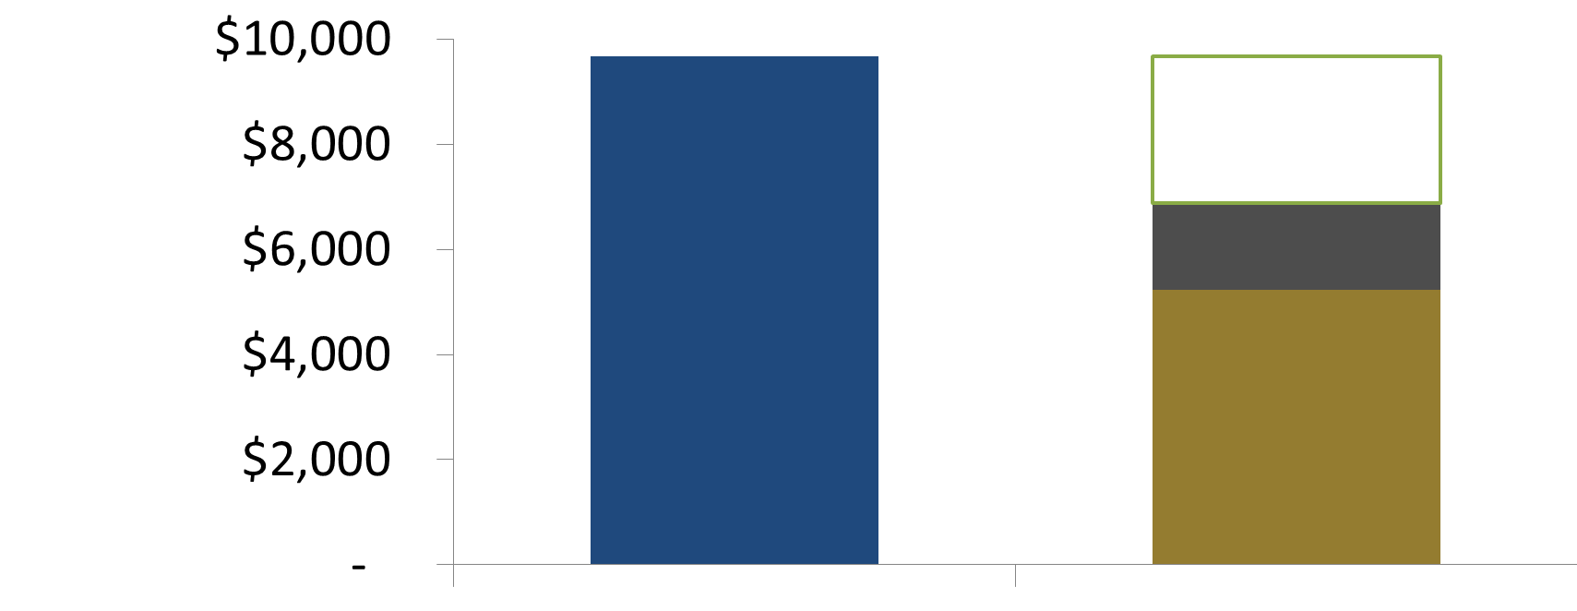
PEV load benefits ALL utility ratepayers
Net Revenues from PEV Charging Load
Illustrative results for California Utilities
Net Revenue
$2,778
Utility
Bills
Infrastructure
Energy & Capacity Cost
Revenue
Cost
Utility rates are higher than the marginal cost of delivered energy in most hours
PEVs are unique in providing environmental and customer benefits while putting downward pressure on rates
Notes:
Under TOU rates

Slide 15

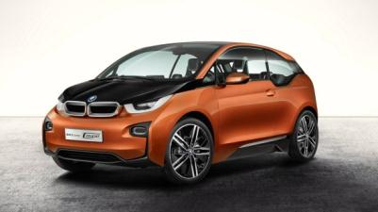

Utility and Ratepayer Perspective:
PEVs are the opposite of PV and EE
GHG & Emissions
Total Energy Consumption
Utility Infrastructure
Retail Rates
PV and EE shift costs to other ratepayers
EVs increase utility asset utilization → lower rates

Slide 16
Seattle city light: assessment of electrification options

Slide 17
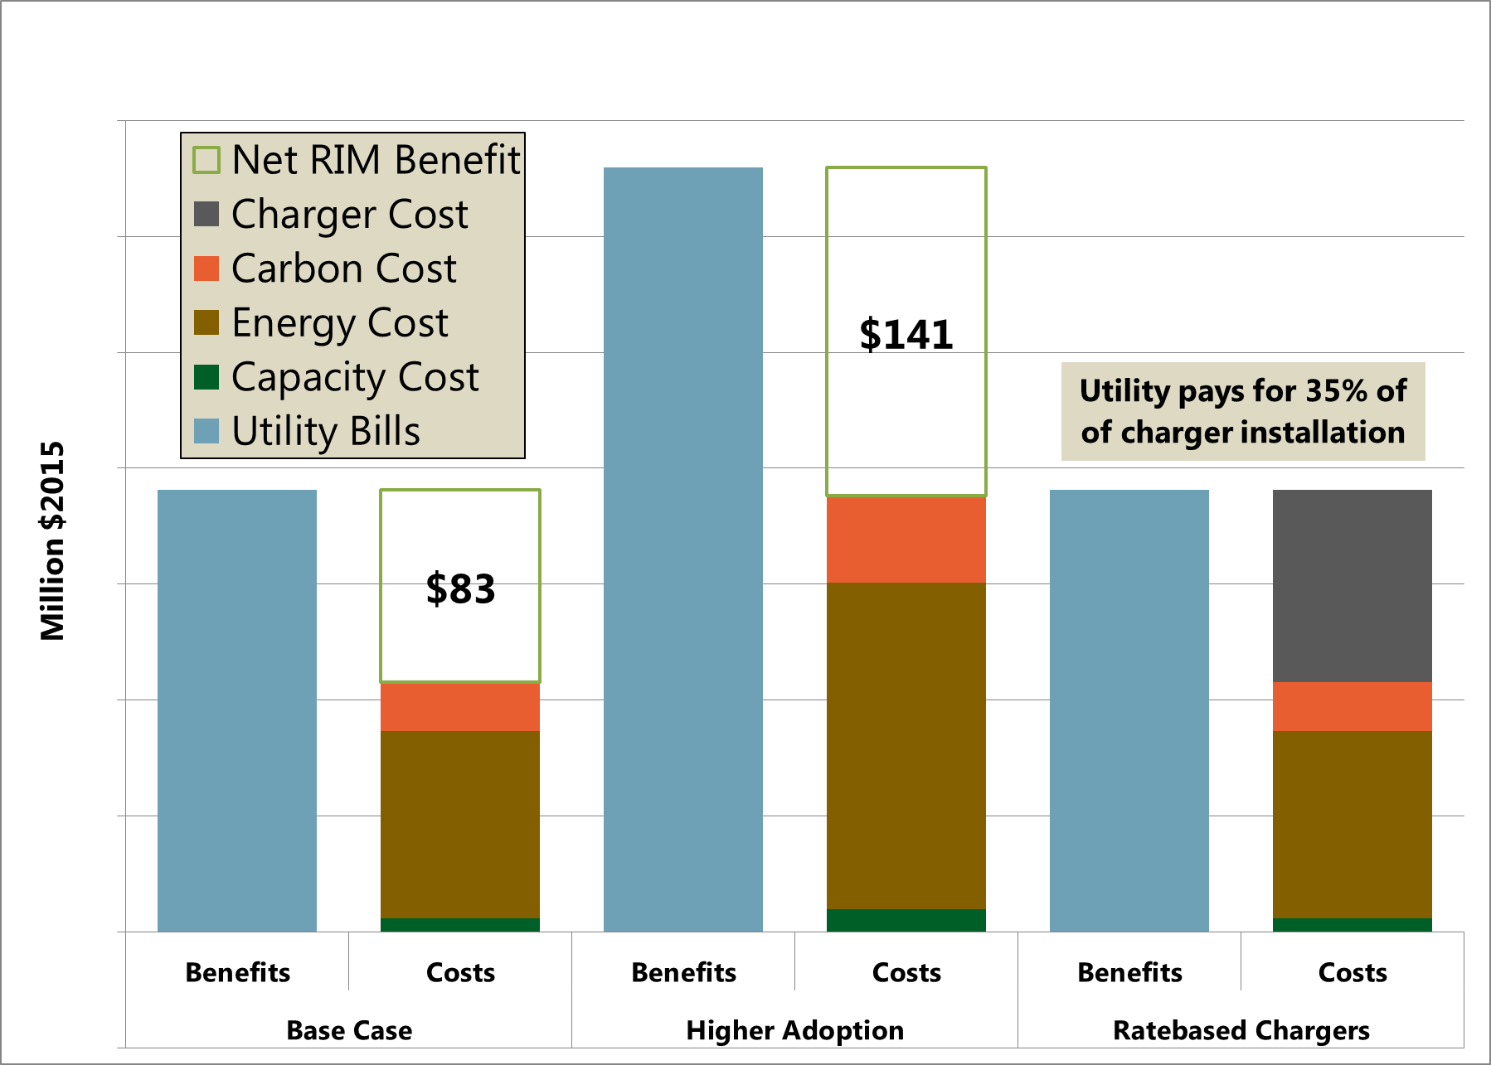
Seattle City Light:
Net ratepayer benefits of LDVs
Net Ratepayer Benefits of LDVs

Slide 18
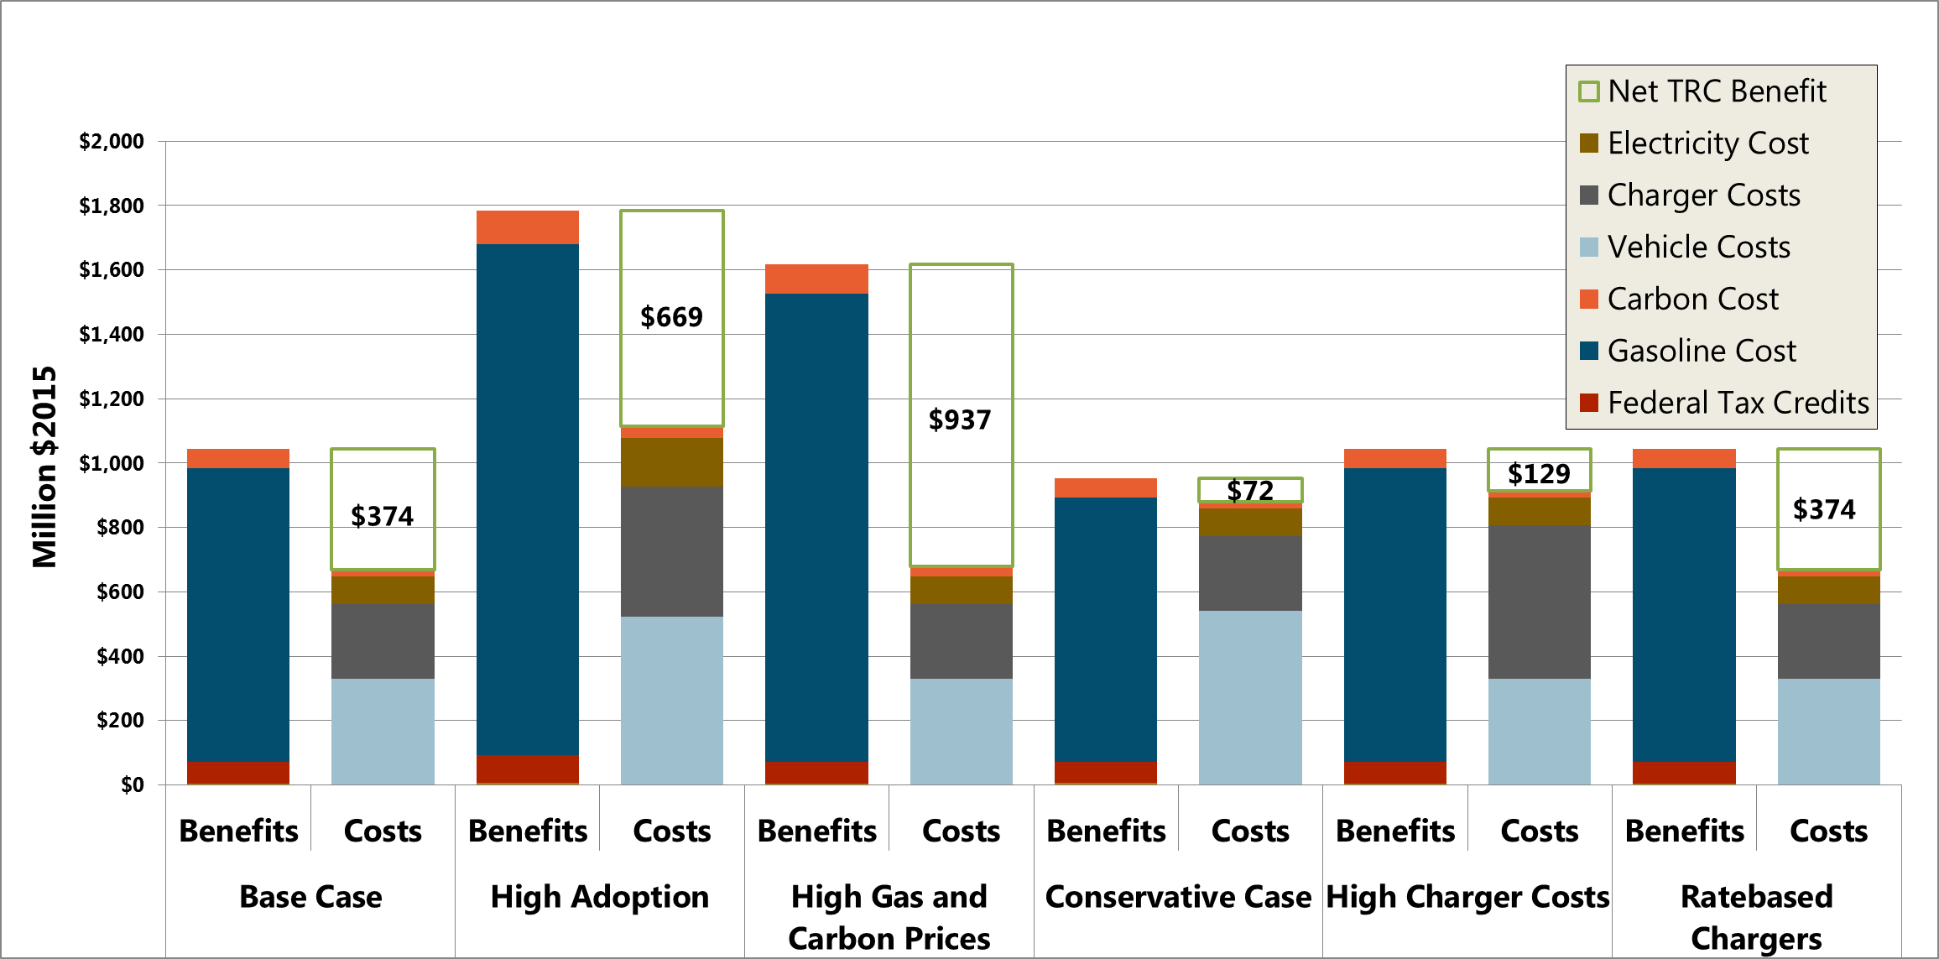
Seattle City Light:
Net regional benefits of LDVs
Net Regional Benefits of LDVs

Slide 19
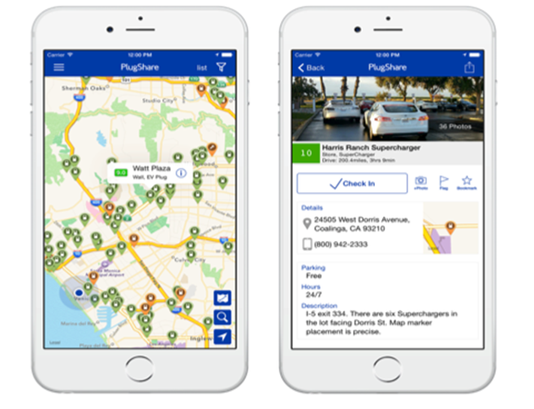
Crowd-sourced PlugShare data on chargers identifies gaps
Most complete data base of charger locations: all providers
Drivers rate and review their experience
Highlights maintenance problems
Identifies sites with unmet charging demand

Slide 20
Policy implications for regulators

Slide 21
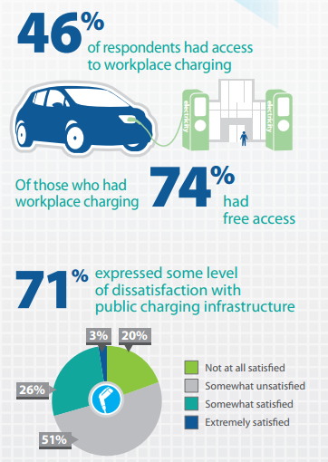
Widespread EV adoption requires extensive charging infrastructure
CA’s ZEV Mandate requires 1.5 million zero-emissions vehicles on the road by 2025
Historically, most EV adopters
  Own their homes
  Charge their EVs primarily at home
Meeting the ZEV Mandate will require reliable, well-placed public charging infrastructure
  Reduce range anxiety
  Accommodate EV drivers who do not have access to home charging
Graphic is part of the February 2014 PEV Owner Survey by the Center for Sustainable Energy

Slide 22
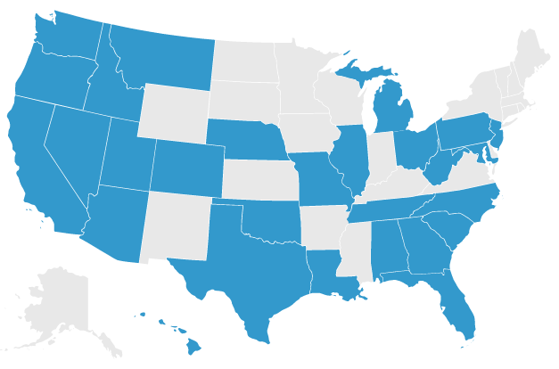
Public incentives and funding
STATES:
27 states offer incentives for PEVs or charging
  Upfront rebates or subsidies
  HOV lane access
  Tax exemptions & credits
  Parking meter & insurance exemptions
  WA, OR & CA govts have joined forces on the West Coast Electric Highway
  DC fast chargers every 25 – 50 miles along Interstate 5 and other roadways
  CITIES:
Cities have emerged as a significant player in promoting EVs, by:
  Financing charging infrastructure and reducing permitting hurdles
  Purchasing EV fleets
  Providing educational outreach, and
  Granting HOV access
Map from Plug In America: http://www.pluginamerica.org/incentives
Notes:
NB: all number on this slide are stations (versus charge points/outlets – there can be more than one charge point/outlet on each station)
Sources:
DOE
http://www.teslamotors.com/supercharger
http://www.greentechmedia.com/articles/read/bmw-vw-partner-with-chargepoint-to-build-out-100-fast-chargers

Slide 23
Utility and private sector funding
UTILITIES:
As of June 2015, 28 utilities in 15 states offer EV-specific rate schedules
  In May 2015, Minnesota became the first state to require all IOUs to offer EV-specific rate schedules
Kansas City Power & Light is developing a network of over 1,000 public chargers
  Through partnerships with Nissan and site hosts, charging will be free for the first 2 years
  California’s investor-owned utilities have applied to state regulators to rate-base significant investments in charging infrastructure
  Georgia power has begun installing 60 DC fast chargers throughout the state
PRIVATE CHARGING NETWORKS:
  Chargepoint, AeroVironment, EVgo, Greenlots and other private networks provide >7,000 public level 2 stations and > 750 DC fast chargers
  Tesla offers 553 public DC charging stations at no cost to drivers
  BMW & Volkswagen are partnering with Chargepoint to build 100 DC fast chargers on the East and West Coasts
Notes:
KCP&L network is 1,100 total chargers: 15 DCFC and the remainder at Level 2
Sources:
JEA: https://www.jea.com/uploadedFiles/jea.com/JEA_and_the_Environment/Emerging_Technologies/Plug-In_Electric_Vehicles/jea_plug-in_rebate_final.INTERACTIVE.pdf
Kansas City: http://www.kcpl.com/about-kcpl/media-center/2015/january/kcpl-becomes-electric-vehicle-infrastructure-leader
Georgia power: http://www.fleetsandfuels.com/fuels/evs/2015/10/georgia-power-adds-plans-ev-charging/

Slide 24
California utilities envision different roles to support electrification
SDG&E
Duplicates functions built into the car
Smartphone app controls charging
PG&E
Competes directly with EVSPs
Utility owns chargers
SCE
Enables competitive EVSP market
Utility does make-readies & provides rebate for chargers
Source of diagram: PG&E application (A15-02-009), p. 4.
Notes:
Arguments for Utility-Owned Chargers

Slide 25
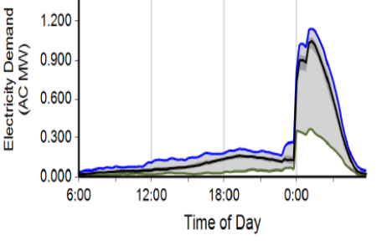
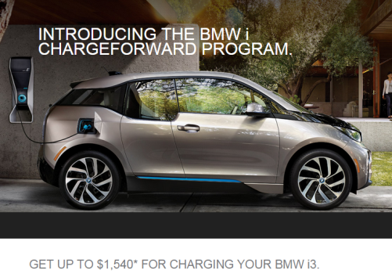
Smart charging lowers costs of PEV grid integration: Pilots needed!
Rate design:
  Time of use rates
  Dynamic rates (SDG&E’s proposed VGI pilot)
  Demand charges
Demand response:
  The utility or a third party directly controls when a vehicle charges: (PG&E/BMW pilot)
  Designed to test extent of driver cooperation
  Customer is paid for performance and can over-ride if necessary
Charging behavior responds to rates!
Washington DC
(No Time Varying Rates)
San Diego
(TOU Rates)

Slide 26
Thank You
Nancy E. Ryan,
Senior Director for Policy & Strategy
415-391-5100
nancy@ethree.com

