Slide 1
Trauma Systems Committee
Bureau of Health Care Safety and Quality
Department of Public Health
August 28, 2019

Slide 2
Agenda
Approval of Minutes from May 29, 2019
Department Update
Region 3 Discussion
  Public Comment on Region 3
Region 5 Discussion
  Public Comment on Region 5
2

Slide 3
Open Meeting Law: G.L. c. 30A, §§18-25
The purpose of open meeting law (OML) is to ensure transparency in the deliberations on which public policy is based.
  This requires that meetings of public bodies be open to the public.
All meetings of a public body must be open to the public.
  A meeting is any deliberation by a public body with respect to any matter within the body’s jurisdiction.
  A deliberation is a communication between members among members of a public body.
A public body is any multi-member board, commission, committee or subcommittee within the executive or legislative branches (except the Legislature) of state government
  This includes any body created to advise or make recommendations
Under OML the public is permitted to attend meetings.
  Individuals in meetings may not address the public body without the permission of the chair.
  Public participation is allowed at the discretion of the chair.
For more information on Open Meeting Law, please visit:
  https://www.mass.gov/the-open-meeting-law
3
Notes:
These four questions will help determine whether a communication constitutes a meeting subject to the law: 1) is the communication between or among members of a public body; 2) if so, does the communication constitute a deliberation; 3) does the communication involve a matter within the body’s jurisdiction; and 4) if so, does the communication fall within an exception listed in the law?
What is a deliberation:
“an oral or written communication through any medium, including electronic mail, between or among a quorum of a public body on any public business within its jurisdiction.” Distribution of a meeting agenda, scheduling or procedural information, or reports or documents that may be discussed at a meeting is often helpful to public body members when preparing for upcoming meetings. These types of communications generally will not constitute deliberation, provided that, when these materials are distributed, no member of the public body expresses an opinion on matters within the body’s jurisdiction.

Slide 4
What is a Quorum?
A Quorum is defined as:
  A simple majority of the members of a public body, unless otherwise provided in a general or special law, executive order, or other authorizing provision. G.L. c. 30A, § 18.
  As applied to the Trauma Systems Committee—a quorum equals 10 members (½ of 19 members + 1)
Notes:
4

Slide 5
Meeting Minutes Approval
Approval of Minutes from the May 29, 2019 Meeting

Slide 6
Department Update
New Office of Emergency Medical Services Director
Bureau of Health Care Safety and Quality relocation
  67 Forest Street, Marlborough, MA 01752
  Future meetings
July 4th Events Update
Lahey Hospital and Medical Center achieved Level 1 Trauma Designation

Slide 7
Trauma Registry
Trauma Registry Request for Responses (RFR) Update
Hospital Data Submission Update
Trauma Registry 2016-2018 Injury Severity Findings
Trauma Transfer Analysis
Ambulance Response and Transport Times
Trauma Rates by Region
Massachusetts Department of Public Health mass.gov/dph

Slide 8
Trauma Data Submissions from Designated Trauma Centers
2016 & 2017 submissions for designated trauma centers are nearly complete
15 trauma designated hospitals have completed data entry through FFY2017
14 trauma designated hospitals have completed data entry through FFY 2018
The Registry is now accepting 2019 submissions
Status Date
N = 17 | August 2018 | November 2018 | February 2019 | May 2019 | August 2019
2016 | 16* | 16* | 16* | 16* | 16
2017 | 9 | 16 | 16 | 16 | 16
2018 | 4 | 14 | 15 | 15 | 15
2019 | -- | -- | -- | -- | 0
*At one hospital all adult submissions received and pediatric submissions are in progress.

Slide 9
Trauma Data Submissions from Community Hospitals
Ongoing, individual outreach continues with community hospitals to increase response rate
30 community hospitals have complete data through FFY2018
9 community hospitals have submitted no data between 2016 and 2018
4 community hospitals have completed their first submission since the last committee meeting
Status Date
N = 50 | August 2018 | November 2018 | February 2019 | May 2019 | August 2019
2016 | 25 | 26 | 32 | 38 | 39
2017 | 25 | 25 | 29 | 28 | 33
2018 | 19 | 23 | 25 | 30 | 33
2019 | --- | --- | --- | 3 | 15

Slide 10
Calendar Years 2016-2018 Preliminary Data
Initial trauma counts mirror hospital data submission trends
31,879 traumas have been reported for this period; this will increase as submissions continue
  30,381 patients were admitted from the community; 77% of these patients were admitted to community hospitals
  1,498 patients were transferred from other facilities; 97% of these patients were transferred to trauma hospitals
  The initial admission for transferred patients may be included in the 30,381 community admits
 | 2016 | 2017 | 2018 | Total
Traumas | 16,056 | 10,284 | 5,538 | 31,879
Trauma Center | 2,979 | 3,347 | 2,190 | 8,516
Community Hospital | 13,077 | 6,937 | 3,348 | 23,363
Data Source: MA Trauma Registry
Preliminary data, will change as submissions continue
Time period: Jan 1, 2016-December 30, 2018

Slide 11
Duration of Hospital Admission, 2016-2018
Duration of Admission, in days
Data Source: MA Trauma Registry
Preliminary data, will change as submissions continue
Figures limited to duration <20 days, 3.5% of transferred patients and 3.7% of admitted from community patients not visualized
*Community Hospital transfer data suppressed due to low counts, 44 (2.9%) transferred patients suppressed
Time period: Jan 1, 2016-December 30, 2018

Slide 12
Trauma Patient Abbreviated Injury Scale (AIS), 2016-2018
Only trauma hospitals submit AIS data elements to the Massachusetts Trauma Registry
Trauma patients may be given a 7-digit unique numerical identifier with a decimal between the 6th and 7th digit
  Pre-Dot
    6 digit code representing the body, anatomical structure and location, and level of the specific injury
    A patient with multiple injuries may have multiple AIS codes
  Post-Dot Code
    AIS severity number-1 digit number representing the severity of the injury
    Ranked 1 to 6
      1 = Minor
      6 = Maximum
Can be used to identify classes of injuries
  i.e. Head injuries
Injuries reported for Trauma Hospital Patients (N=8,516)
Injuries Reported | Populated | Not Populated
1 or more | 7,595 | 921
2 or more | 4,543 | 3,973
3 or more | 2,812 | 5,704
Data Source: Massachusetts Trauma Registry
Includes all patients treated at trauma hospitals
Number of patients treated at trauma hospitals in the time period = 8,516

Slide 13
5 Most Common AIS pre-codes for 1st Reported Injury, 2016-2018*
Skeletal lower extremity injury
Thorax skeletal injury
Head organ level injury
Whole area head injury
Patient Count
Data Source: MA Trauma Registry
*from first AIS code
Figure may double count patients transferred from a trauma facility to another trauma facility

Slide 14
Median Duration of Trauma Hospital Patient Stay by Injury Severity Score (ISS), 2016-2018
 | ISS | Patient Count | Median (in days) | Min | Max | Standard Deviation
Transfers (N=1,394)
 | 0-9 | 905 | 4 | 0 | 48 | 4.6
 | 10-15 | 168 | 5 | 0 | 44 | 6.6
 | 16-24 | 205 | 5 | 0 | 58 | 8.1
 | 25+ | 116 | 8 | 0 | 163 | 18.4
Direct Admits (N=5,755)
 | 0-9 | 4517 | 3 | 0 | 111 | 4.0
 | 10-15 | 614 | 4 | 0 | 62 | 5.5
 | 16-24 | 410 | 5 | 0 | 71 | 8.1
 | 25+ | 214 | 6 | 0 | 145 | 16.0
Injury Severity Score
Data Source: MA Trauma Registry
Preliminary data, will change as submissions continue
AIS score is only a required variable for hospitals with trauma services
Direct admits missing duration of stay or ISS = 1,307, transferred traumas missing duration of stay or ISS = 60

Slide 15
Transfer Status of Head Injury Patients, 2016-2018
Data Source: Massachusetts Trauma Registry
Includes patients with any ISS code starting with 1, maximum submitted head injury severity
Total patients with head injuries = 2,172
Transfer patients with head injuries = 439, Direct admit patients with head injuries = 1733
Notes:
NQF Trauma Outcomes Report: Inter-hospital transfer rate to level I/II trauma center among seriously injured patients (e.g., ISS >= 16, head AIS >= 3) in a region (undertriage)
Percentage of transfers by ISS group:
ISS=1 8.8%
ISS=2 17.7%
ISS=3 27.0%
ISS=4 29.9%
ISS=5 34.4%

Slide 16
Region 3

Slide 17
Traumas per 10,000 Residents, 2011-2015
Data Source: MA Trauma Registry

Slide 18
EMS Response Time for Trauma Runs
Data Time Frame includes: 1/1/2015 – 12/31/2016
Response time = Unit Notified by Dispatch Date/Time (or Unit En Route Date/Time if the previous is missing) until Unit Arrived on Scene Date/Time (or Arrived at Patient Date/Time if the previous is missing)
Transport time = Unit Left Scene Date/Time until Patient Arrived at Destination Date/Time (if something is missing here, we cannot calculate a transport time)
All runs have a Primary Impression, Secondary Impression or Cause of Injury defining it as a Trauma related incident.
Only includes incident dispositions indicating transport (e.g does not include cancelled, no patient found, standby only, or refusals)
Ambulance services are required to enter data into MATRIS per A/R 5-403 Statewide EMS Minimum Dataset. Data are required to be submitted within 14 days; however, actual submission timeframes vary by ambulance service.

Slide 19
EMS Transport Time for Trauma Runs
Data Time Frame includes: 1/1/2015 – 12/31/2016
Response time = Unit Notified by Dispatch Date/Time (or Unit En Route Date/Time if the previous is missing) until Unit Arrived on Scene Date/Time (or Arrived at Patient Date/Time if the previous is missing)
Transport time = Unit Left Scene Date/Time until Patient Arrived at Destination Date/Time (if something is missing here, we cannot calculate a transport time)
All runs have a Primary Impression, Secondary Impression or Cause of Injury defining it as a Trauma related incident.
Only includes incident dispositions indicating transport (e.g does not include cancelled, no patient found, standby only, or refusals)
Ambulance services are required to enter data into MATRIS per A/R 5-403 Statewide EMS Minimum Dataset. Data are required to be submitted within 14 days; however, actual submission timeframes vary by ambulance service.

Slide 20
Traumas per 10,000 Residents by Age, 2011-2015
Data Source: MA Trauma Registry

Slide 21
Traumas per 10,000 Residents by Gender, 2011-2015
Data Source: MA Trauma Registry

Slide 22
Mode of Transit for Traumas, 2011-2015
Massachusetts, N=149,635
Data Source: MA Trauma Registry
Massachusetts missing = 42,685 missing observations
Region 3 missing = 1,598
22
Notes:
Rates are calculated by location of treating hospital

Slide 23
Transferred Traumas, 2011-2015
Data Source: MA Trauma Registry

Slide 24
Traumas per 10,000 Residents by Fall Type, 2011-2015
Data Source: MA Trauma Registry

Slide 25
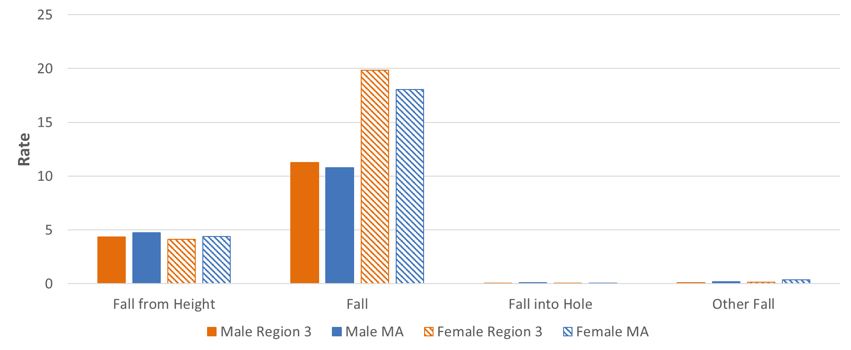
Traumas per 10,000 Residents by Fall Type and Gender, 2011-2015
Data Source: MA Trauma Registry

Slide 26
Motor Vehicle Traumas per 10,000 Residents, 2011-2015
Data Source: MA Trauma Registry

Slide 27
Off-Road Vehicle per 10,000 Residents, 2011-2015
Data Source: MA Trauma Registry
Region 3 patients in a snow vehicle accident = 15
Region 3 patients in off road vehicle accident = 70
MA patients in snow vehicle accident = 287
MA patients in off road vehicle accident = 630

Slide 28
Regional Discussion Framework
1. Pre-Hospital:
  What is the process used at regional hospitals with designated trauma services for receiving notification from EMS of an incoming trauma?
  What follow-up communication or feedback is provided to EMS personnel?
2. In-Hospital:
  When do your local hospitals transfer patients to a trauma center?
  Are there any specialties that are particularly difficult for you to access for your patients?
3. Post-Trauma:
  What post trauma resources are available to your hospitals?
  What barriers do you encounter when trying to place patients in an appropriate facility?
4. Prevention and Access:
  What role do the hospitals with designated trauma services play in trauma prevention in your region?
  Is there equitable access to trauma care in your region, and is current trauma care meeting the needs of the region’s patient population?

Slide 29
Region 3 Public Comment
Public Comment on Region 3

Slide 30
Region 5

Slide 31
Traumas per 10,000 Residents, 2011-2015
Data Source: MA Trauma Registry

Slide 32
EMS Response Time for Trauma Run
Data Time Frame includes: 1/1/2015 – 12/31/2016
Response time = Unit Notified by Dispatch Date/Time (or Unit En Route Date/Time if the previous is missing) until Unit Arrived on Scene Date/Time (or Arrived at Patient Date/Time if the previous is missing)
Transport time = Unit Left Scene Date/Time until Patient Arrived at Destination Date/Time (if something is missing here, we cannot calculate a transport time)
All runs have a Primary Impression, Secondary Impression or Cause of Injury defining it as a Trauma related incident.
Only includes incident dispositions indicating transport (e.g does not include cancelled, no patient found, standby only, or refusals)
Ambulance services are required to enter data into MATRIS per A/R 5-403 Statewide EMS Minimum Dataset. Data are required to be submitted within 14 days; however, actual submission timeframes vary by ambulance service.

Slide 33
EMS Transport Time for Trauma Run
Data Time Frame includes: 1/1/2015 – 12/31/2016
Response time = Unit Notified by Dispatch Date/Time (or Unit En Route Date/Time if the previous is missing) until Unit Arrived on Scene Date/Time (or Arrived at Patient Date/Time if the previous is missing)
Transport time = Unit Left Scene Date/Time until Patient Arrived at Destination Date/Time (if something is missing here, we cannot calculate a transport time)
All runs have a Primary Impression, Secondary Impression or Cause of Injury defining it as a Trauma related incident.
Only includes incident dispositions indicating transport (e.g does not include cancelled, no patient found, standby only, or refusals)
Ambulance services are required to enter data into MATRIS per A/R 5-403 Statewide EMS Minimum Dataset. Data are required to be submitted within 14 days; however, actual submission timeframes vary by ambulance service.

Slide 34
Traumas per 10,000 Residents by Age, 2011-2015
Data Source: MA Trauma Registry

Slide 35
Traumas per 10,000 Residents by Gender, 2011-2015
Data Source: MA Trauma Registry

Slide 36
Mode of Transit for Traumas, 2011-2015
Massachusetts, N= 149,635
Data Source: MA Trauma Registry
Massachusetts missing = 42,685 missing observations
Region 5 missing = 28,902
36
Notes:
Rates are calculated by location of treating hospital

Slide 37
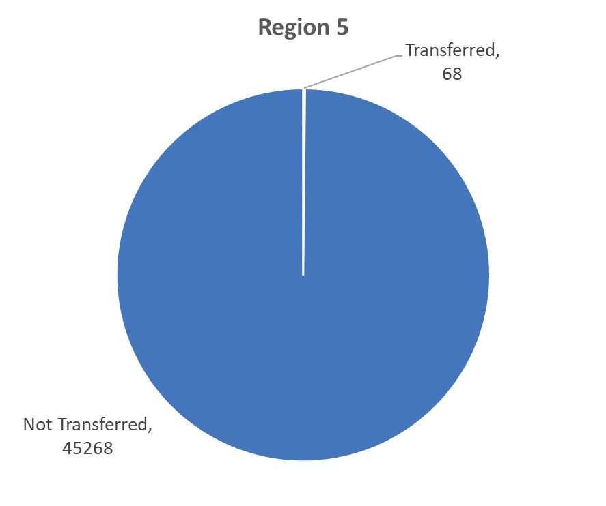
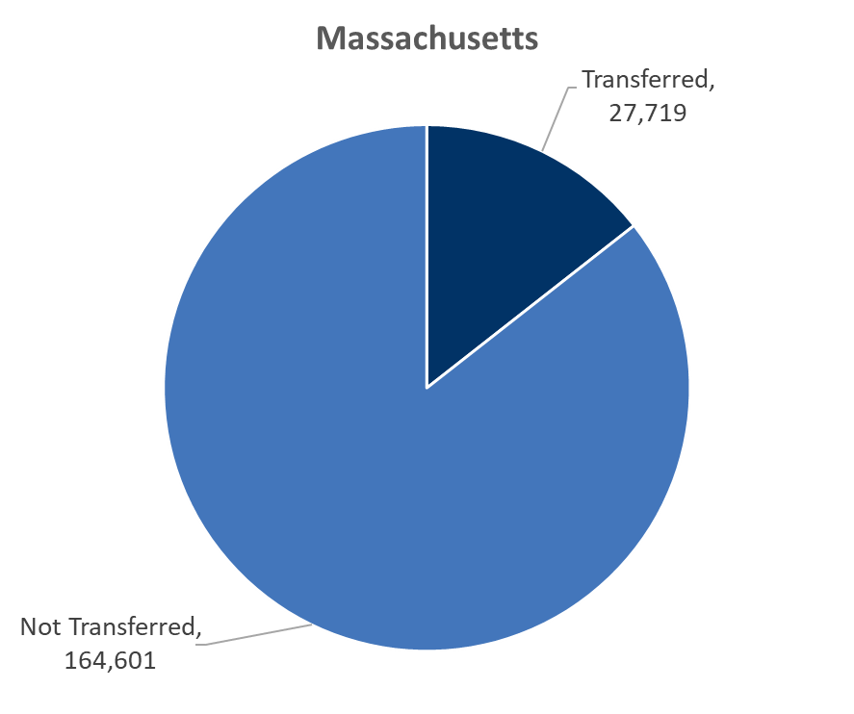
Transferred Traumas, 2011-2015
Data Source: MA Trauma Registry

Slide 38
Traumas per 10,000 residents by fall Type, 2011-2015
Data Source: MA Trauma Registry

Slide 39
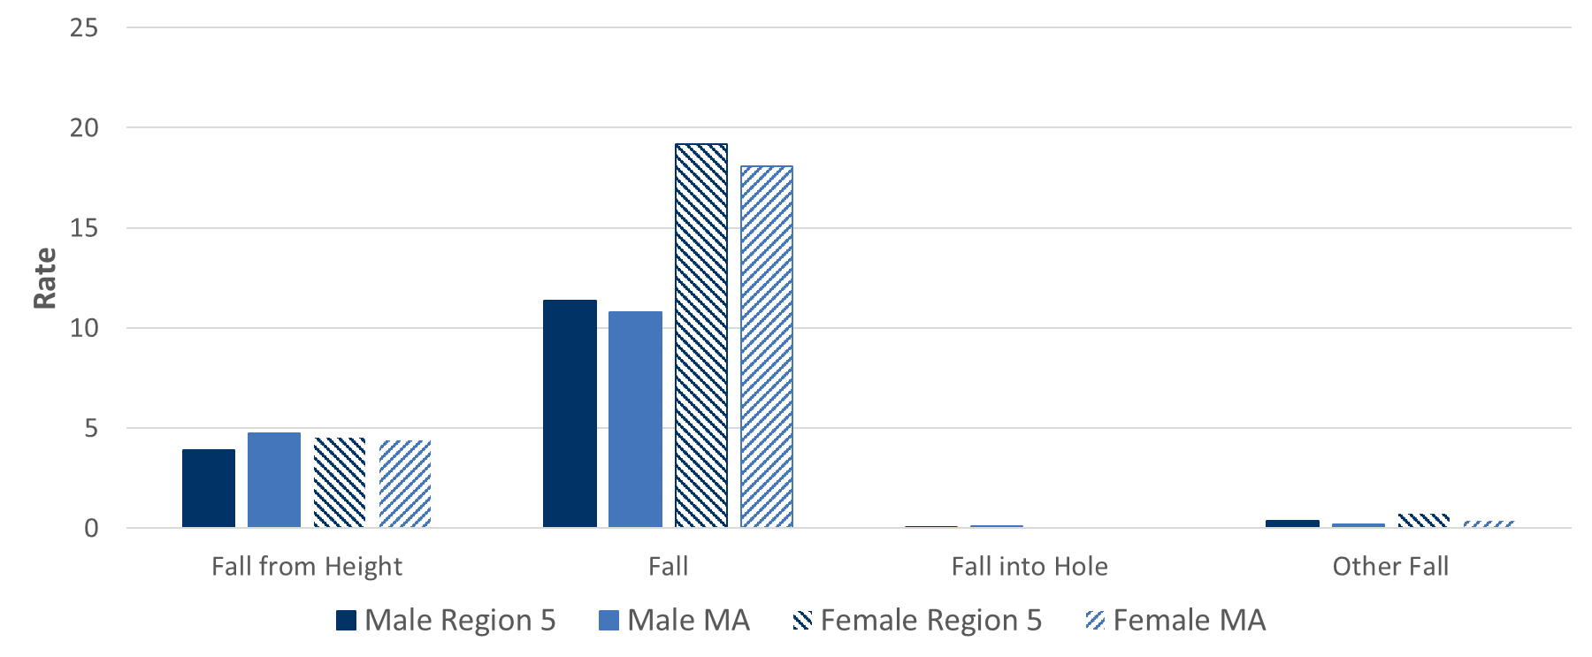
Traumas per 10,000 Residents by Fall Type and Gender, 2011-2015
Data Source: MA Trauma Registry

Slide 40
Motor Vehicle Traumas per 10,000 Residents, 2011-2015
Data Source: MA Trauma Registry

Slide 41
Off-Road Vehicle per 10,000 Residents, 2011-2015
Data Source: MA Trauma Registry
Region 5 treated patients in a snow vehicle accident = 224
Region 5 treated patients in an off road vehicle accident = 183
MA treated patients in snow vehicle accident = 287
MA treated patients in an off road vehicle accident = 630

Slide 42
Regional Discussion Framework
1. Pre-Hospital:
  What is the process used at regional hospitals with designated trauma services for receiving notification from EMS of an incoming trauma?
  What follow-up communication or feedback is provided to EMS personnel?
2. In-Hospital:
  When do your local hospitals transfer patients to a trauma center?
  Are there any specialties that are particularly difficult for you to access for your patients?
3. Post-Trauma:
  What post trauma resources are available to your hospitals?
  What barriers do you encounter when trying to place patients in an appropriate facility?
4. Prevention and Access:
  What role do the hospitals with designated trauma services play in trauma prevention in your region?
  Is there equitable access to trauma care in your region, and is current trauma care meeting the needs of the region’s patient population?

Slide 43
Region 5 Public Comment
Public Comment on Region 5

Slide 44
Future Meetings
Meeting Schedule:
Wednesday, November 20, 2019
  All meetings will be held from 10:00am-12:00pm.

Slide 45
Additional Information
For more information, please visit:
https://www.mass.gov/service-details/trauma-systems-committee

