Slide 1
Trauma Systems Committee
Bureau of Health Care Safety and Quality Department of Public Health Wednesday, May 29, 2019

Slide 2
Agenda
Approval of Minutes from November 28, 2018 and February 27, 2019
Department Update
Region 2 Discussion
Public Comment on Region 2
Region 3 Discussion
Public Comment on Region 3
2

Slide 3
Open Meeting Law: G.L. c. 30A, §§18-25
The purpose of open meeting law (OML) is to ensure transparency in the deliberations on which public policy is based.
This requires that meetings of public bodies be open to the public.
All meetings of a public body must be open to the public.
A meeting is any deliberation by a public body with respect to any matter within the body’s jurisdiction.
A deliberation is a communication between members among members of a public body.
A public body is any multi-member board, commission, committee or subcommittee within the executive or legislative branches (except the Legislature) of state government
This includes any body created to advise or make recommendations
Under OML the public is permitted to attend meetings.
Individuals in meetings may not address the public body without the permission of the chair.
Public participation is allowed at the discretion of the chair.
For more information on Open Meeting Law, please visit:
https://www.mass.gov/the-open-meeting-law
3

Slide 4
What is a Quorum?
A Quorum is defined as:
A simple majority of the members of a public body, unless otherwise provided in a general or special law, executive order, or other authorizing provision. G.L. c. 30A, § 18.
As applied to the Trauma Systems Committee—a quorum equals 10 members (½ of 19 members + 1)
Notes:
4

Slide 5
Meeting Minutes Approval
Approval of Minutes from the November 28, 2018 Meeting
Approval of Minutes from the February 27, 2019 Meeting

Slide 6
Department Updates
New Trauma Systems Committee Chair
Boston Marathon Recap

Slide 7
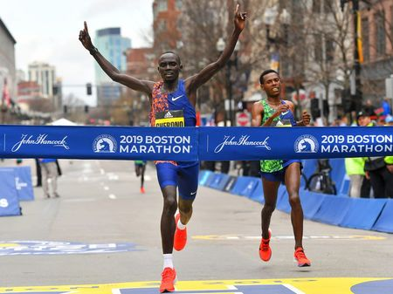
2019 Boston Marathon Overview
30,000 runners
10,000 volunteers
1,900 medical personnel

Slide 8
2019 Boston Marathon: Public Health Priorities
Situational Awareness
Coordination with Hospitals
Ambulance Strike Teams
MCI Patient Tracking & Family Reunification
Notes:
, ARC and US HHS.

Slide 9
2019 Boston Marathon
Medical Stations provided care to 853 runners
Many cases of heat-related illness
53 transports to hospitals

Slide 10
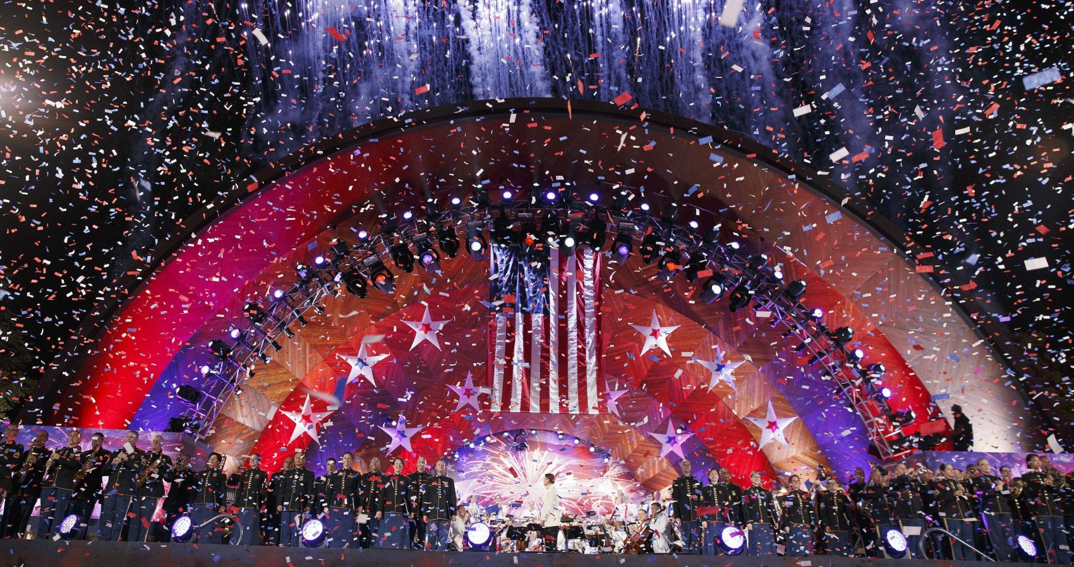
Boston Fireworks and July 4th Pops Concert
500,000 spectators
Public safety planning
Medical concerns

Slide 11
Trauma Registry: Framing the Regional Conversation
Framing the Regional Conversation
Katherine T. Fillo, Ph.D., MPH, RN-BC
Director, Division of Quality Improvement

Slide 12
Trauma Registry
Data Submission Update
Ambulance Response and Transport Times
Trauma Rates by Region
Massachusetts Department of Public Health mass.gov/dph
12

Slide 13
Trauma Data Submissions from Designated Trauma Centers
2016 submissions for designated trauma centers is nearly complete
All programs have submitted a year or more of data from 2017-2018, though the quarters aren’t necessarily consecutive
12 trauma designated hospitals have completed data entry through FFY 2018
Status Date
N = 17 | August 2018 | November 2018 | February 2019 | May 2019
2016 | 16* | 16* | 16* | 16*
2017 | 9 | 16 | 16 | 16
2018 | 4 | 14 | 15 | 15
*At one hospital all adult submissions received and working on pediatric submissions

Slide 14
Trauma Data Submissions from Community Hospitals
Ongoing, individual outreach continues with community hospitals to increase response rate
22 community hospitals have complete data through FFY-2018
13 community hospitals have submitted no data between 2016 and 2018
5 community hospital have completed their first submission since the last committee meeting
Status Date
N = 50 | August 2018 | November 2018 | February 2019 | May 2019
2016 | 25 | 26 | 32 | 38
2017 | 25 | 25 | 29 | 28
2018 | 19 | 23 | 25 | 30
2019 | --- | --- | --- | 3

Slide 15
Traumas per 10,000 Residents, 2011-2015
Data Source: MA Trauma Registry

Slide 16
EMS Response Time for Trauma Runs
Data Time Frame includes: 1/1/2015 – 12/31/2016
Response time = Unit Notified by Dispatch Date/Time (or Unit En Route Date/Time if the previous is missing) until Unit Arrived on Scene Date/Time (or Arrived at Patient Date/Time if the previous is missing)
Transport time = Unit Left Scene Date/Time until Patient Arrived at Destination Date/Time (if something is missing here, we cannot calculate a transport time)
All runs have a Primary Impression, Secondary Impression or Cause of Injury defining it as a Trauma related incident.
Only includes incident dispositions indicating transport (e.g does not include cancelled, no patient found, standby only, or refusals)
Ambulance services are required to enter data into MATRIS per A/R 5-403 Statewide EMS Minimum Dataset. Data are required to be submitted within 14 days; however, actual submission timeframes vary by ambulance service.

Slide 17
EMS Transport Time for Trauma Runs
Data Time Frame includes: 1/1/2015 – 12/31/2016
Response time = Unit Notified by Dispatch Date/Time (or Unit En Route Date/Time if the previous is missing) until Unit Arrived on Scene Date/Time (or Arrived at Patient Date/Time if the previous is missing)
Transport time = Unit Left Scene Date/Time until Patient Arrived at Destination Date/Time (if something is missing here, we cannot calculate a transport time)
All runs have a Primary Impression, Secondary Impression or Cause of Injury defining it as a Trauma related incident.
Only includes incident dispositions indicating transport (e.g does not include cancelled, no patient found, standby only, or refusals)
Ambulance services are required to enter data into MATRIS per A/R 5-403 Statewide EMS Minimum Dataset. Data are required to be submitted within 14 days; however, actual submission timeframes vary by ambulance service.

Slide 18
Traumas per 10,000 Residents by Age, 2011-2015
Data Source: MA Trauma Registry

Slide 19
Traumas per 10,000 Residents by Gender, 2011-2015
Data Source: MA Trauma Registry

Slide 20
Mode of Transit for Traumas, 2011-2015
Data Source: MA Trauma Registry
There are 42,685 missing observations.
Region 2 N: 18,003 MA N: 149,635
Notes:
Rates are calculated by location of treating hospital

Slide 21
Transferred Traumas, 2011-2015
Data Source: MA Trauma Registry
Notes:
Rates are calculated by location of treating hospital

Slide 22
Traumas per 10,000 Residents by Fall Type, 2011-2015
Data Source: MA Trauma Registry

Slide 23
Traumas per 10,000 Residents by Fall Type and Gender, 2011-2015
Data Source: MA Trauma Registry

Slide 24
Motor Vehicle Traumas per 10,000 Residents, 2011-2015
Data Source: MA Trauma Registry
Notes:
Rates are calculated by location of treating hospital

Slide 25
Off-Road Vehicle Traumas per 10,000 Residents, 2011-2015
Data Source: MA Trauma Registry

Slide 26
Regional Discussion Framework
1. Pre-Hospital:
What is the process used at regional hospitals with designated trauma services for receiving notification from EMS of an incoming trauma?
What follow-up communication or feedback is provided to EMS personnel?
2. In-Hospital:
When do your local hospitals transfer patients to a trauma center?
Are there any specialties that are particularly difficult for you to access for your patients?
3. Post-Trauma:
What post trauma resources are available to your hospitals?
What barriers do you encounter when trying to place patients in an appropriate facility?
4. Prevention and Access:
What role do the hospitals with designated trauma services play in trauma prevention in your region?
Is there equitable access to trauma care in your region, and is current trauma care meeting the needs of the region’s patient population?

Slide 27
Region 2 Public Comment
Public Comment on Region 2

Slide 28
Future Meetings
Meeting Schedule:
Wednesday, August 28, 2019
Wednesday, November 20, 2019
All meetings will be held from 10:00am-12:00pm.

Slide 29
Additional Information
For more information, please visit:
https://www.mass.gov/service-details/trauma-systems-committee

