Slide 1
RAA RAFT Office Hours
RAFT Policy Clarifications, Processing Reminders, and 4-23-26 HHH Build
EOHLC Office Hours
04.23.2026

Slide 2
Welcome

Slide 3
Engagement Best Practices
Asking Questions
We will be monitoring the chat for questions
If at any point throughout today’s session you have any questions, please send those in the chat. We will also have two questions breaks during today's session as well.
You can also raise your hand during our question break if you would prefer to come off mute and share your question verbally
We will make sure to share today’s presentation and with everyone after the session

Slide 4
Agenda
RAFT Benefit Cap
Denial Reasons Refresher
Question break 1
Notice to Quit Clarifications under RAFT
Requesting Missing Documents
Question break 2
4-23-26 HHH Build
Final Question Break

Slide 5
RAFT Benefit Cap
The RAFT benefit cap is $7,000 in a rolling 12-month period.
When reviewing prior payment history, refer to the payment date.
  For re-issued payments, refer to the original payment date, not the re-issue date.
Follow up with landlords, utility companies, etc. regarding any outstanding balances not able to be covered by RAFT to ensure the crisis will be resolved.
Applicants might re-apply before the 12th month, but become eligible while awaiting assignment for processing.
  Example: an applicant received $7,000 with a payment date of 2/10/2025. The applicant then re-applied for RAFT on 2/5/2026, slightly before the 12-month period reset, but their case was not assigned and worked until 2/12/2026. Therefore, they are potentially eligible for the full $7,000 benefit again.

Slide 6
RAFT Benefit Cap, continued
Case Number | Payment Reason | Status | Verified or Actual Payment | Happy Payment Date | Paid to Rental | Paid to Provider
00112233 | ARR | Payment Successful | $5,153 | 3/13/2026 | John Smith
01234567 | ARR | Payment Successful | $7,000 | 2/10/2025 | John Smith

Slide 7
Denial Reminders & Refresher
RAAs are encouraged to use their best judgment in making a denial decision, and the tenant may submit an administrative review.
Always select the most accurate and specific denial reason when determining a household is not eligible for RAFT.
A case cannot be denied for a reason that is not listed, specified, or required in the RAFT admin plan.
If you are requesting additional information due to concerns of potential suspicious activity, please ensure you case comment in HHH and explain why you are asking for it outside of the RAFT admin plan.
An application should only be denied if the household is found to be ineligible for RAFT based on one of the ineligibility reasons from the admin plan.
Key Reminders
Denials vs Timeouts
Denials
Ineligible for RAFT
Appeal option
Timeouts
Missing Documentation
No appeal option

Slide 8
Denial Reminders & Refresher, continued
Example #1:
Chaser/CM identifies that the tenant only has $400 remaining in RAFT dollars currently and has a shut off notice for $750.
What is the Chaser/CM next step in this situation?
Example #2:
Chaser/CM is requesting the tenant’s most recent proof of residency due to concerns about whether the housing crisis is within Massachusetts.
What is the Chaser/CM next step in this situation?
Incorrect
Correct
Incorrect
Correct
Deny for “No eligible housing crisis” because remaining assistance will not resolve the crisis.
Check with utility company if remaining RAFT prevents shut-off.
If it does not, upload confirmation to HHH. Deny for "RAFT unable solve your housing crisis"
Deny for “Other” crisis, as the tenant did not provide information requested to support an eligible crisis.
Tenant Document Timeout as the requested information was not provided by the stated deadline
*Timeout or Deny
Deny for “No Eligible Housing Crisis” if, after RAA due diligence, the documentation provided does not support an eligible housing crisis in Massachusetts.

Slide 9
Question Break 1

Slide 10
Notice to Quit Clarifications
Applicants applying under the Notice to Quit housing crisis must provide a document that meets the RAFT Admin Plan guidelines:
  Written statement from the landlord to the tenant (usually with the title “Notice to Quit” or “Notice Terminating Tenancy”) that states that the tenancy is being terminated;
  Includes the date of the notice;
  Includes the date that the tenancy will be terminated;
  Includes the name of the leaseholder;
  Includes the rental address;
  Includes the amount due, or, if for something other than nonpayment, includes the reason for the termination;
  Dated within 90 days of the RAFT application.
Documents that do not meet the above criteria should not be accepted.

Slide 11
Notice to Quit Clarifications, continued
Not acceptable:
Notice to Quit
4/1/2026
To: John Smith
Your tenancy is terminated. You must surrender possession of the premises and remove your personal belongings. If you do not vacate, I will file in eviction court.
From: Jane Lee
Acceptable:
30-day Notice to Quit
4/1/2026
To: John Smith
123 Apple Way, Boston, MA 02135
You are hereby notified of my intent to terminate your tenancy for nonpayment of rent totaling $6,800, effective 5/1/2026. You must surrender possession of the premises and remove your personal belongings by that date. If you do not vacate by then, I will file in eviction court.
From: Jane Lee

Slide 12
Requesting Missing Documents
If documentation is missing during the initial review, staff can request it.
Cases can be returned to “Draft Stage” multiple times for missing documentation within the same 14-day period.
Applicants have 14 days to upload the documents while in "Draft Stage" before the application will automatically time out
RAAs should not coach applicants on acceptable crisis documentation but may ask if additional documentation has been obtained since the initial submission.

Slide 13
Requesting Missing Documents - Examples
Coaching, providing too much detail and direction
Non-Coaching, but still helpful and points to which document is not sufficent
Thank you for submitting your documentation. The notice to quit you provided does not meet program criteria.
Your NTQ is missing the amount of arrears you currently owe. You should ask your landlord to update the NTQ to include this information so it meets program requirements. Once you obtain this updated document, please upload it to your application so we can proceed.
Thank you for submitting your documentation. At this time, the Notice to Quit provided does not meet program criteria.
If you have received any additional or updated documentation related to your housing crisis since your initial submission, please upload.
All requested information must be submitted by [deadline]. If documentation is not received by this date, your application may be denied or timed out.

Slide 14
Question Break 2

Slide 15
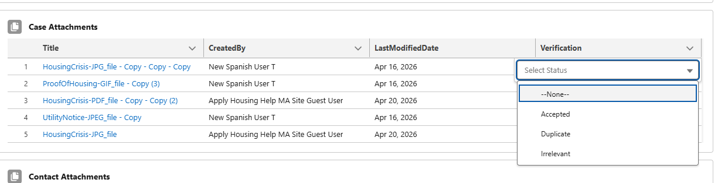
Case Attachment Verification
The Case Attachment verification field will change from a checkbox to a dropdown menu
Staff may select from the following options
  Accepted
  Duplicate
  Irrelevant
Once saved, the Case Attachment section will sort docs with Accepted on top
HLC is still exploring the options to limit the number of documents uploaded on a case

Slide 16
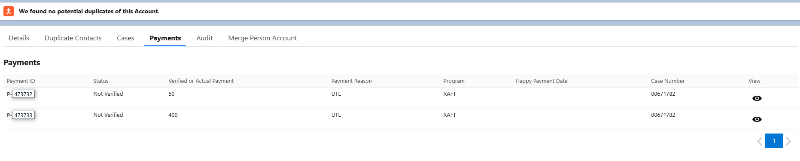
Person Account Updates
Duplicates view has been added to the Person Account case layout
Case numbers now appears in the Payments tab on Person Account
Deloitte has not been able to solve the issue around the ‘view’ eyeball refreshing the page
  To keep the page from refreshing
    Search using case number that now appears
    Right click on the eyeball and select ‘open in new tab’ (this will open a new browser tab)

Slide 17
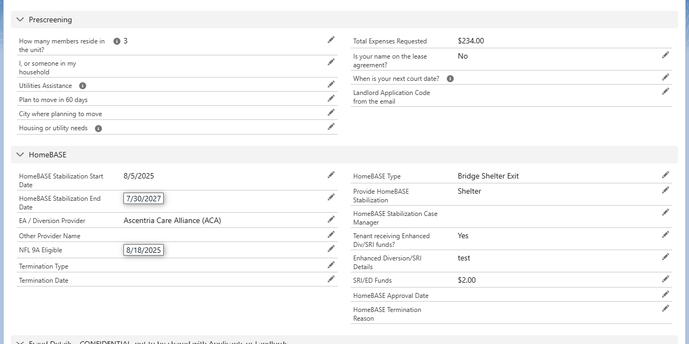
Case Layout Changes
HomeBASE fields have been pulled out of the Prescreening section and added to a distinct HomeBASE section
If you work on RAFT files only, feel free to collapse this section so that it does not appear in your case view
This section is case specific, so it does not mean the applicant doesn’t have a HomeBASE case – still do a duplicate review to check

Slide 18
Other 4/23 Updates
Document Checklist Archiving
Archiving Policy: Beginning 4/23, document checklists on cases closed for more than 12 months will be archived to optimize system performance
Impact on Older Cases: When viewing these older paid cases, the Doc Checklist will appear empty
Recovery: If access is required for a specific case, the checklist can be unarchived by submitting a Zendesk ticket
Translation Fixes & Assessment
RAFT Denials: Historically untranslated RAFT Denial Reasons will be fully corrected in the 4/23 build
Chinese Language Fix: A defect causing Chinese RAFT/LOI/LL applications to display partially in English has been resolved
System-Wide Audit: HLC and Deloitte will be doing a comprehensive translation assessment over the coming months to ensure all applications and notifications are translated correctly
Pallium & Fraud Section Layout Changes
Untrusted List Updates: Upcoming changes to how HLC and Deloitte handle the Untrusted List will introduce two new fields in the Pallium List item view
Current Action: Please continue processing as normal; specialized training and a formal rollout for these fields are coming in the next few weeks
UI Improvement: The Recommended Actions field is being reformatted to improve readability and ease of use for staff.

Slide 19
Final Question Break

Slide 20
RAA Resources
Resources
  RAA Resource Portal
  Only for RAA staff, this resource provides key updates, training and learning opportunities, and helpful information to support programs including FAQs.
  Zendesk Training Materials
  Only for RAA staff, this resource offers helpful info on processing within HHH/Salesforce
  RAFT Public Resource and Training Portal
  Resources are available for public community-based organizations and other partners with information about the RAFT program.

Slide 21












Thank You!
+

