Slide 1
Rare Disease Advisory Council FULL COUNCIL MEETING November 17, 2022 9:00 am – 11:00 am

Slide 2
AGENDA
Welcome: Dr. Dylan Tierney, Council Chair
Roll Call
VOTE Minutes from the last full council meeting on 9/15/22
Rare Disease Speaker – Jenn McNary
Discussion on RDAC priorities, goals and subcommittee workgroups
Guest Speaker – Rare NE Data Mapping Project
Guest Speaker – HPC Telehealth Report
Adjourn

Slide 3
Council Priorities
Improving healthcare access and quality of care for people with rare diseases.
Advocate for and improve access to social supports and services for people impacted by a rare disease.
Foster communication and collaboration to empower the rare disease community in Massachusetts.

Slide 4
Developing Goals for each Priority (example)
PRIORITY 1
Improve healthcare access and quality of care for people with rare diseases in Massachusetts
GOAL: Determine the prevalence of rare diseases in MA
OUTCOME: Report that defines the prevalence of rare diseases in MA
* Legislative charge (ii)
ACTIVITIES (example of possible activities)
Identify records, datasets, and other information needed for report
List information in each record or dataset and contact person for each
Develop a methodology for analyzing the data
Develop a report template
Analyze the data and populate the report template

Slide 5
Developing Goal for Priority 2
PRIORITY 2
Advocate for and improve access to social supports and services for people impacted by rare diseases.
GOAL: Develop a profile of existing rare disease social supports and services in MA
OUTCOME:
*Legislative charge (v and vi)

Slide 6
Developing Goal for Priority 3
PRIORITY 3
Foster communication and collaboration to empower the rare disease community in Massachusetts.
GOAL: Develop a profile of rare disease expert individuals, community-based organizations, voluntary organizations, healthcare providers, and any other public or private organizations with an interest in rare diseases in Massachusetts.
OUTCOME:
*Legislative charge (I and iii)

Slide 7
NOMINATIONS for Subcommittees
FULL COUNCIL
Steering Committee
Workgroup 1
Workgroup 2
Workgroup 3

Slide 8
Subcommittee Workgroups
STEERING COMMITTEE RECOMMENDATION
Every council member should be on at least ONE sub-committee workgroup.

Slide 9
Guest Speaker – Julie Gortze

Slide 10
RNE Data Mapping Project
Putting Rare Diseases on the Map
MA RDAC
November 17, 2022
Julie Gortze, President
Rare New England

Slide 11
Have you ever been asked...
How many people have your disease in this area?
How many people in our district or state have a rare disease?
Why should we spend so much time and money on diseases that we know are rare?
Notes:
A big challenge when advocating on behalf of the rare disease community is that many people do not see the whole problem.
Patients and caregivers are focused on the disorder that affects them.
Others hear “Rare” and assume that means few.
The overall data we have is too broad - nationwide, generalized, too non-specific
7000 diseases - now over 10,000 acording to Rare-X
30 million people How do we know?
1 in 10 Americans? Really? But does that rule of thumb hold in Massachusetts? Is it different in Boston than in North Adams?

Slide 12
There is very little geographic data on WHERE rare disease patients live.
Data are fragmented across different sources
HIPAA protections make it harder to aggregate
Notes:
After years of asking, we came to the conclusion that there is no accessible source of LOCAL data on the prevalence and incidence of rare diseases.
There are many sources of data that could answer these questions - too many.
And many of these sources are not accessible because it is connected to personally identifiable information.
We need a way to locate the diseases without violating people’s privacy.

Slide 13
The Rare New England Solution
ASK THE PATIENTS!
What do you have?
Where do you live?
Notes:
Our Solution: ASK THEM

Slide 14
Data Model
ZIP CODE | DIAGNOSIS | MUTATION
Notes:
We are asking people to respond anonymously. No name, no email, no phone number.
The only data we want are zip code and diagnosis. If people know their mutation, they can provide that too.
With just these three pieces of data, there is no way to identify an unknown individual. Obviously, if you know someone in your zip code with a diagnosis, you might be able to make the connection. But wait, you already know them and their diagnosis - nothing new is revealed.

Slide 15
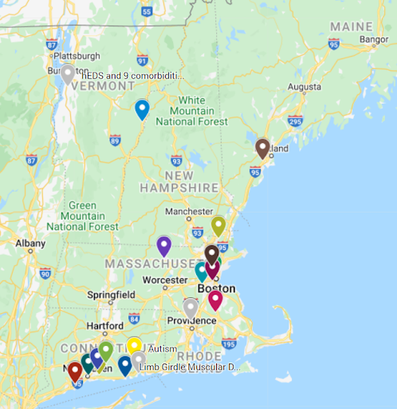
Our Vision
Notes:
If we can put rare diseases on the map:
We can answer the questions we posed earlier
We can connect patients to resources
We can inform researchers where they should do their studies
Can you think of any other benefits?

Slide 16
Our Plan
2022 - Pilot Project Developed - Simple proof of concept
Begin collecting data
Learn
2023 - Improve the survey as needed
Increase recruitment
Translate into other languages TBD
Build the map
Notes:
Our plan is pretty simple.
We spent 2022 designing the project. While it ended up very simple, we had many more complicated approaches that we discarded.
2023 will be about going from a prototype to a more robust model from what we learn from version 1.

Slide 17
Thank you!
Julie Gortze, President
Rare New England

Slide 18
Telehealth Utilization in the Massachusetts Commercial Market
November 17, 2022

Slide 19
Background: Telehealth Policy in the Commonwealth
March 2020: Emergency Order
In response to a state of emergency, Governor Charlie Baker issued an executive order mandating the coverage of clinically appropriate and medically necessary telehealth services. The order also established that telehealth services be reimbursed at the same rates as in-person services.¹
January 2021: Chapter 260 of the Acts of 2020
Chapter 260 mandated that all services that can be appropriately delivered via telehealth will continue to be covered permanently. In addition:
It required that behavioral health services delivered via telehealth be reimbursed on par with in-person services in perpetuity.
It mandated reimbursement parity for primary care and chronic disease management provided via telehealth until January 1, 2023.
The requirement to reimburse all other services delivered via telehealth at parity would no longer be statutorily mandated as of September 13, 2021 (90 days after the end of the governor’s state of emergency).
1. Commonwealth of Massachusetts, order expanding access to telehealth services and to protect health care providers, March 10, 2020. https://www.mass.gov/doc/march-15-2020-telehealth-order/download

Slide 20
Legislatively Mandated Report on Telehealth Use in the Commonwealth
Chapter 260 also directs the HPC in consultation with CHIA to issue a report on the use of telehealth services and their impact on healthcare access and costs.
The HPC is charged with:
Analyzing utilization and spending trends: such as telehealth use by type of service, provider organization, payer, patient demographics, and geographic region and total healthcare expenditures on telehealth services and impact on total healthcare spending;
Assessing patient access: including impact of payer coverage and payment rates and cost of care, barriers to increased telehealth use, such as provider technology infrastructure and patient broadband and cellular access, and equity in access for low-income patients;
Providing policy recommendations on reimbursement levels, including facility fees; the appropriateness of pre-authorization and other utilization management tools on telehealth, and ways to expand the use of and services provided through telehealth

Slide 21
Methods for Quantitative Analysis
Data
source
Massachusetts All-Payer Claims Database (APCD), V10.0, five large commercial payers
Includes both professional and facility claims; claims on the same day for the same patient were combined
Sample restricted to commercial members under 65
Identify telehealth
Telehealth identified by:
Place of service code 02
Procedure modifiers
Telehealth specific procedure codes
Remote patient monitoring and chronic care management codes were excluded

Slide 22
Over half of commercial members had some telehealth use in 2020 with telehealth accounting for nearly 1/3 of all ambulatory visits.
Share of commercial members who had any telehealth use:
2018: 0.3%
2019: 0.6%
2020: 53.5%
Share of ambulatory visits by site, 2018-2020
Notes: Ambulatory visits for all diagnoses are included, including for mental health. Analysis by ambulatory sites includes members with partial year coverage; share of members by telehealth use include members with full year coverage only.
Sources: HPC analysis of Center for Health Information and Analysis All-Payer Claims Database, 2018-2020, V 10.0.

Slide 23
Telehealth enabled ambulatory visit volume to return toward baseline levels later in 2020.
Number of in-person and telehealth ambulatory visits by month, 2020
Sources: HPC analysis of Center for Health Information and Analysis All-Payer Claims Database, 2020, V 10.0.
Notes:
Break out BH vs non-BH

Slide 24
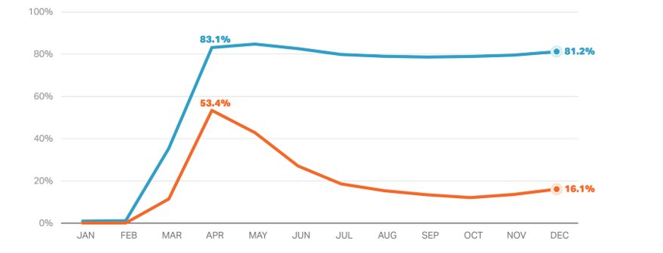
High telehealth use for mental health conditions continued through the end of 2020.
Percent of ambulatory visits that were telehealth by month and type of condition, 2020
Sources: HPC analysis of Center for Health Information and Analysis All-Payer Claims Database, 2020, V 10.0.

Slide 25
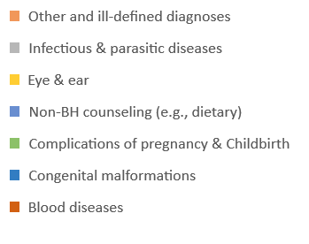
63% of all telehealth visits in 2020 were for mental health conditions.
Telehealth visits by clinical areas, 2020
Notes: clinical areas adapted from Clinical Classification System (CCS).
Sources: HPC analysis of Center for Health Information and Analysis All-Payer Claims Database, 2020, V 10.0.

Slide 26
Telehealth use was similar across commercial health plans in 2020.
Percent of ambulatory visits that were telehealth by payer and quarter, 2020
Sources: HPC analysis of Center for Health Information and Analysis All-Payer Claims Database, 2020, V 10.0.

Slide 27
Payers waived virtually all cost-sharing for telehealth in the first 6 months of the COVID-19 pandemic.
Percent of telehealth visits with any cost-sharing by month and payer, 2020
Sources: HPC analysis of Center for Health Information and Analysis All-Payer Claims Database, 2020, V 10.0.

Slide 28
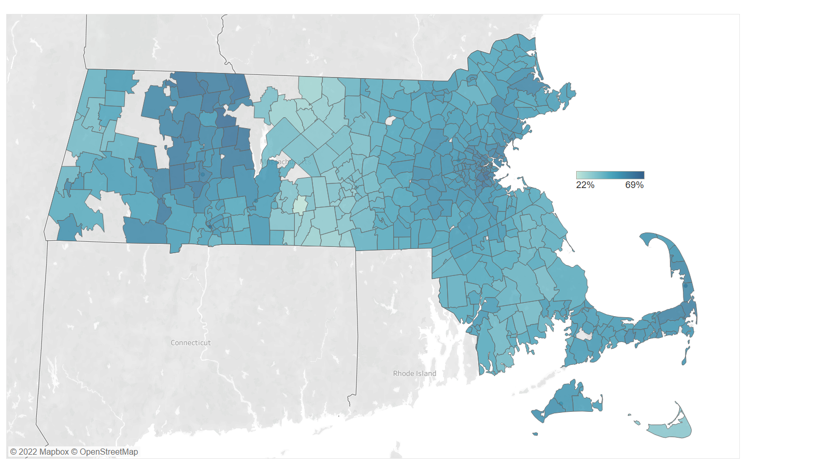
Telehealth use for non-mental health services was higher for residents in Metro Boston and the Pioneer Valley/Franklin region.
Among members with at least one visit for a non-mental health condition, percent with any telehealth use for such conditions by zip code, March 15-December 31, 2020
Notes: Analysis includes members who had health care utilization for non-mental health conditions between March 15-December 31, 2020. Zip codes for which the number of telehealth users or non-telehealth users was less than 11 were omitted.
Sources: HPC analysis of Center for Health Information and Analysis All-Payer Claims Database, 2020, V 10.0.

Slide 29
Telehealth use for non-mental health services by provider organization ranged from 37% to 60%.
Among members with at least one visit for a non-mental health condition, percent with any telehealth use for such conditions by provider organization, March 15-December 31, 2020
Notes: Analysis restricted to members who had at least a visit for non-mental health conditions between March 15-December 31, 2020. Results for members attributed to other provider organizations are not shown.
Sources: HPC analysis of Center for Health Information and Analysis All-Payer Claims Database, 2020, V 10.0.

Slide 30
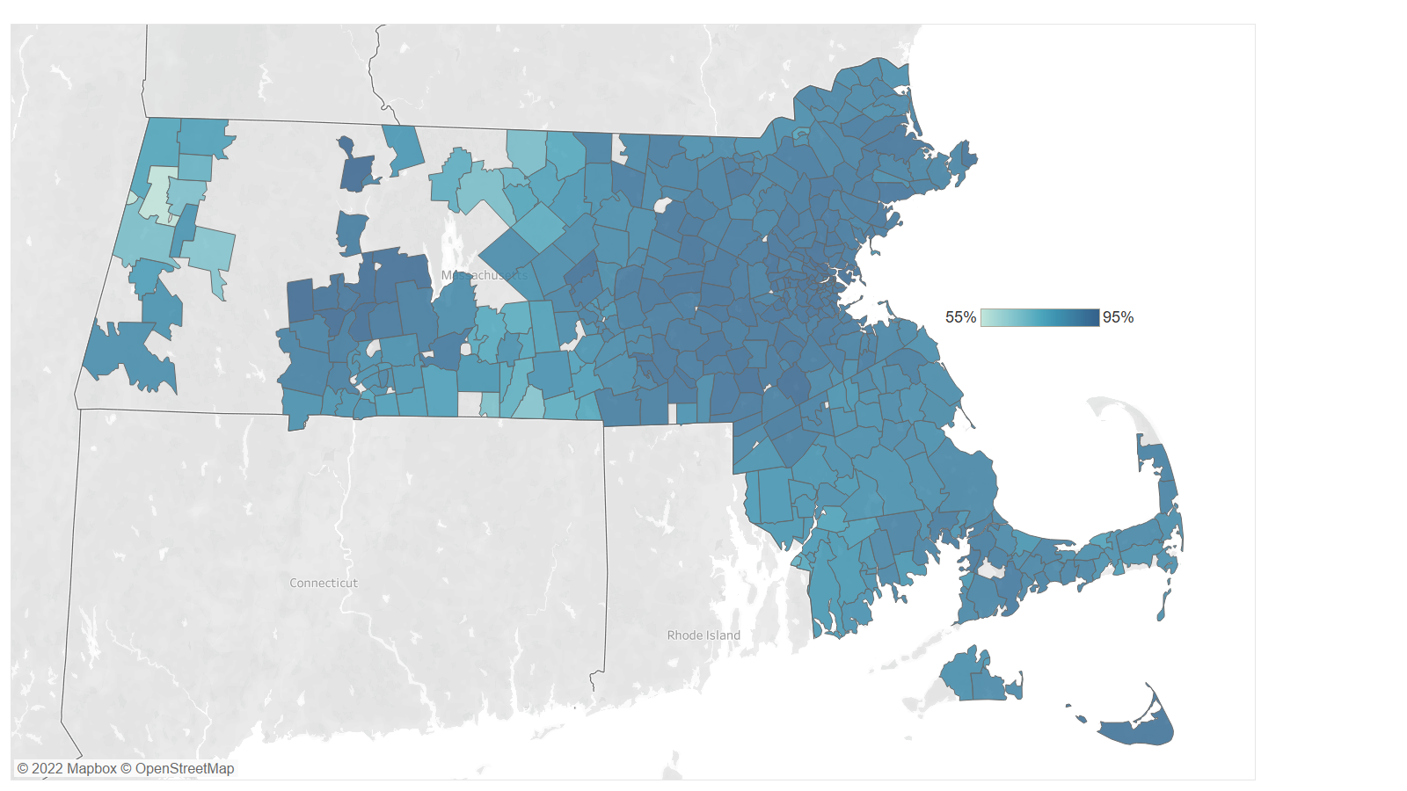
Telehealth use for mental health conditions was higher overall, but also varied by zip code.
Among members with at least one visit for a mental health condition, percent with any telehealth use for such conditions by zip code, March 15-December 31, 2020
Notes: Analysis includes members who had health care utilization for mental health conditions between March 15-December 31, 2020. Zip codes for which the number of telehealth users or non-telehealth users was less than 11 were omitted.
Sources: HPC analysis of Center for Health Information and Analysis All-Payer Claims Database, 2020, V 10.0.

Slide 31
Telehealth use for mental health conditions varied less by provider organization compared to other conditions.
Among members with at least one visit for a mental health condition, percent with any telehealth use for such conditions by provider organization, March 15-December 31, 2020
Notes: Analysis restricted to members who had at least one visit for mental health conditions between March 15-December 31, 2020. Results for members attributed to other provider organizations are not shown.
Sources: HPC analysis of Center for Health Information and Analysis All-Payer Claims Database, 2020, V 10.0.

Slide 32
Telehealth use was higher for those in communities that were more urban and had a high level of internet access; there were minimal differences by community income.
Percentage point difference in likelihood (and 95% CI’s) of any telehealth use relative to the omitted group, from March 15-December 31, 2020
Age (ref: 0-17)
Gender (ref: male)
Risk score (ref: <1)
Community income quintile (ref: 1; lowest)
Geography (ref: urban)
Notes: Analysis excludes members without any health care utilization between March 15 – December 31, 2020. Community internet access measured by percent of households with an internet subscription, which includes cellular data plans (American Community Survey 5-year estimates, 2020). Regression also adjusted for provider organization, payer and total number of visits (coefficients not shown).
Sources: HPC analysis of Center for Health Information and Analysis All-Payer Claims Database, 2020, V 10.0.

Slide 33
Policy Considerations
Reimbursement
Is payment parity for telehealth vs in-office visits appropriate (non-mental health services)? For all services, or for primary care and chronic disease management services? Other services?
When are differential payments for telehealth vs. in-office services appropriate?
Telehealth in global payment models to improve access/transparency
Policies To Expand Access And Ensure Quality Of Care
Clinical guidelines for when a telehealth vs in-person visit is appropriate vs. coverage/utilization management requirements
Policies to support equitable access to telehealth services
Policies to address the provision of telehealth when providers are out of state and when patients travel out of state
Policies that incorporate telehealth consideration in network adequacy requirements
Virtual Visits Provided Through Video Vs. Audio Only
Should coverage or payment policies differ by modality?
Facility Fees
The HPC has previously recommended prohibiting facility fees for E&M visits, which would include most telehealth services
Role of third-party companies providing telehealth services such as Teledoc and alternative models of care such as TalkSpace

Slide 34
Discussion Questions
How has the availability of telehealth changed care for patients with rare diseases? What worked and what didn’t work?
Do you have any concerns about the future access of telehealth for patients with rare diseases? What resources would patients need from the state to address any access challenges?
Are there any recent lessons learned from telehealth that could inform and improve the overall approach to care for patients with rare diseases?

Slide 35
THANK YOU!
Yue Huang
Senior Research Analyst at
Massachusetts Health Policy Commission

Slide 36
ANNOUNCEMENTS

Slide 37
Adjourn
Next Full Council Meeting
January 19, 2023
9:00 am – 11:00 am

Slide 38
Adjourn
Thank you
Dr. Dylan Tierney, RDAC Chair
Dylan.Tierney@mass.gov
Mary Lou Woodford, RN, BSN, MBA, CCM
Massachusetts Rare Disease Advisory Council Coordinator
Marylou.Woodford@mass.gov

