Slide 1
Inclusive Emergency Management
Co-facilitated by:
Dawn Brantley, Director of MEMA
Abby Shneyder, Program Coordinator for Emergency Preparedness at MOD

Slide 2
Organizational Roles
Massachusetts Emergency Management Agency (MEMA)
Massachusetts Office on Disability (MOD)
Ensures the state is prepared to withstand, respond to and recover from all types of emergencies and disasters.
Supports and assists cities and towns in preparedness, response, recovery, and mitigation.
Provides information and guidance on issues related to disability rights and physical access.
Informs people with disabilities and their loved ones on their rights and opportunities to improve access.
Assists municipalities, state agencies, businesses, nonprofits, and other places that serve the public to understand their disability-related rights and obligations.

Slide 3
There are two primary choices in life: to accept conditions as they exist or accept responsibility for changing them. - Denis Waitley

Slide 4
Let's start with why
Why inclusive emergency management?
Legal framework - ADA applies to public shelters, public communications
"Disasters are a disability issue" - Politico, 1/06/23
"People with disabilities are much more likely than others to be forced to leave home during a disaster. Evacuation often leads to people being permanently institutionalized and facing a cascade of other problems."

Slide 5
Let's start with why
Why you?
As municipal officials and coordinators, you know the needs of your community best
Disability community members are personal subject matter experts
“Nothing about us without us”

Slide 6
Let's start with why
Why now?
MOD offers Municipal ADA Improvement Grant which you can use to fund updating emergency plans
Emergency plans are continuously being updated

Slide 7
What do we mean by inclusive?
For this workshop, we define inclusion as:
Accessibility for individuals with disabilities
Accessibility for individuals with access & functional needs
Accessibility and equity for individuals who do not speak English well
Equity for historically marginalized and underserved communities including, but not limited to, racial equity, low resourced communities and households, and the LGBTQ+ community.

Slide 8
Today’s presentation focus
Inclusion and accessibility for people with…
Disabilities
Access needs
Functional needs

Slide 9
Defining AFN
Access and functional needs has a specific origin and meaning
The concept of AFN is to "understand the range of function-based needs within the population" to develop a "common framework that can relate functional supports to functional needs." Source: Moving Beyond Special Needs, June Kailes & Alexandra Enders

Slide 10
Agenda
1-3pm
Part 1: How emergency management happens in Massachusetts
Ten minute break
Part 2: Practical steps to make emergency management inclusive

Slide 11
Part 1:
How Emergency Management works in Massachusetts

Slide 12
The Emergency Management Enterprise
EM is diverse and structured
Begins and ends locally
Local mission: Direct response and recovery for their community
State mission: Support local response and recovery; coordinate state's response and recovery
Federal mission: Support states with resources, personnel, money; coordinate the federal response

Slide 13
The Emergency Management Enterprise
EM is diverse and structured
Political subdivisions and jurisdictions
State and federal agencies
Utilities
Hospitals
Higher Ed
Private companies
EM consultants

Slide 14
You should become very good friends with your local EMD.
Who are they and how do you find them?
What do they actually do?

Slide 15
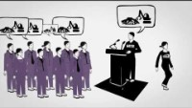
The Essential Emergency Manager

Slide 16
In addition to response
Your EMD wears 10,000 hats!
Planning
Training
Exercises
Public education and information
Mitigation
Recovery (can take years)
And may also be literally putting out fires every day!

Slide 17
Municipal Emergency Plans
Most plans are...
Already written
Extensively R&D'd
Updated on a cycle

Slide 19
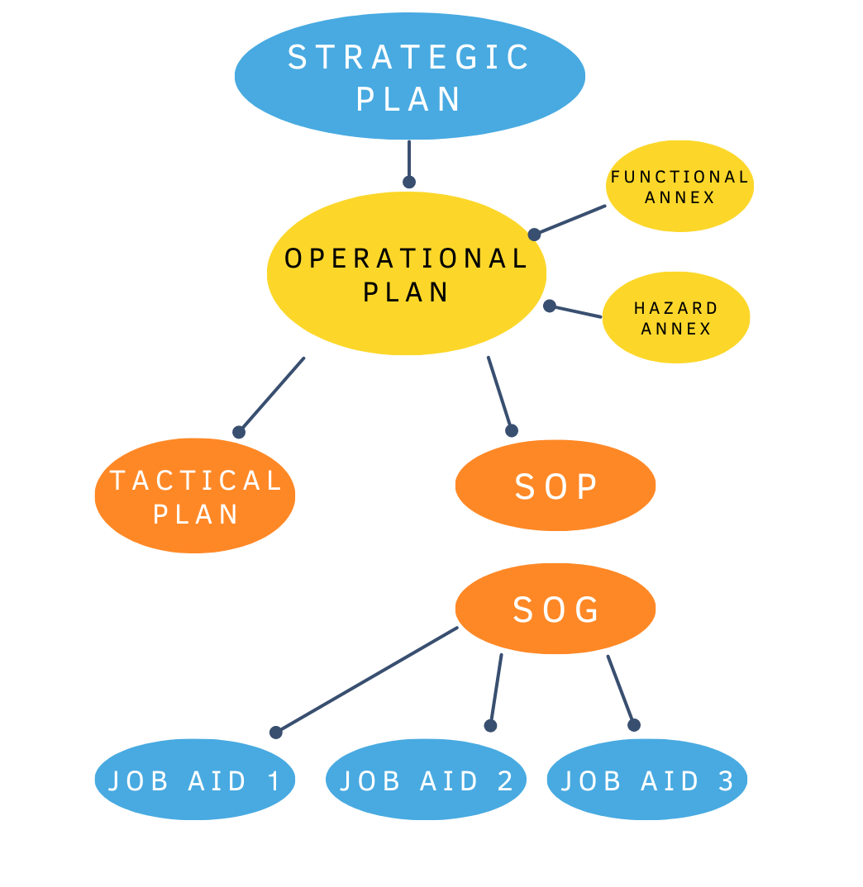

Slide 20
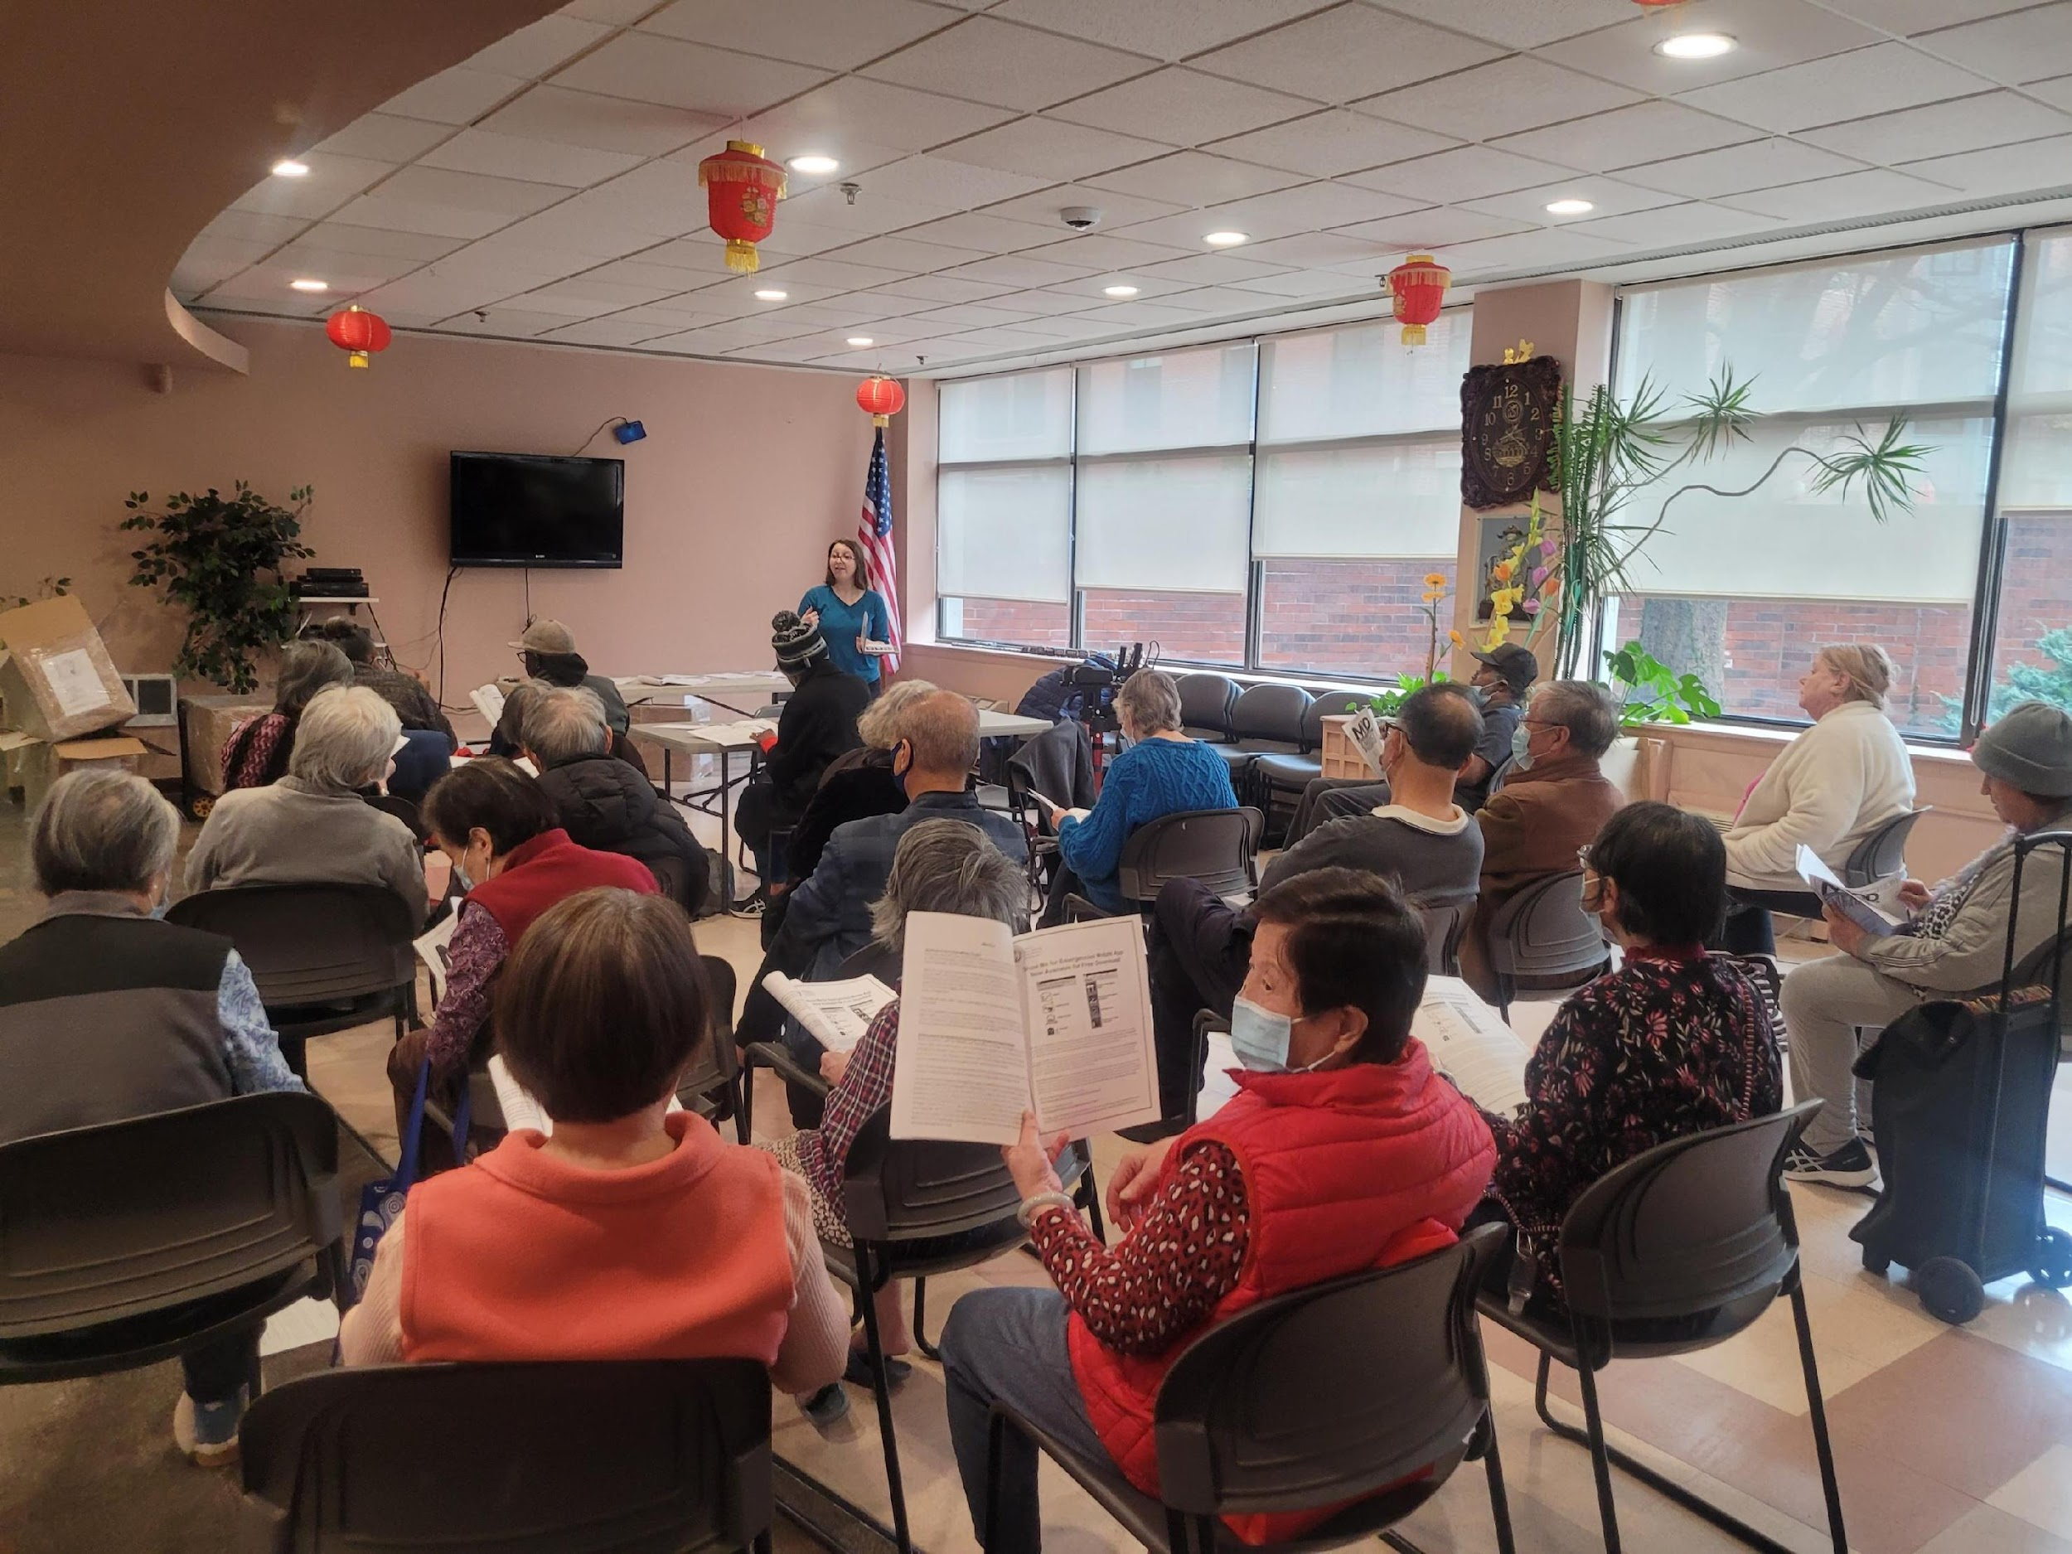
Individual Emergency Preparedness
MOD coordinates community trainings on individual emergency preparedness for people with disabilities

Slide 21
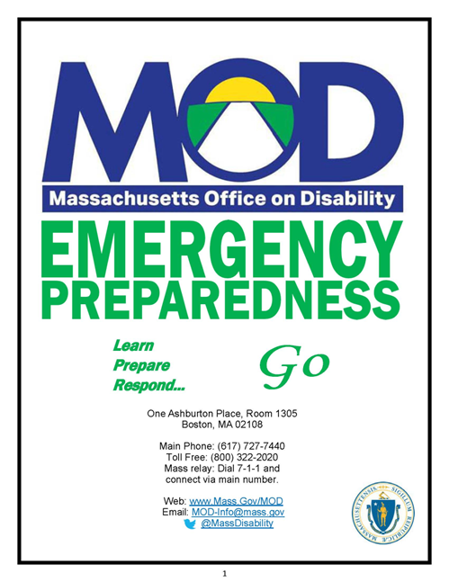
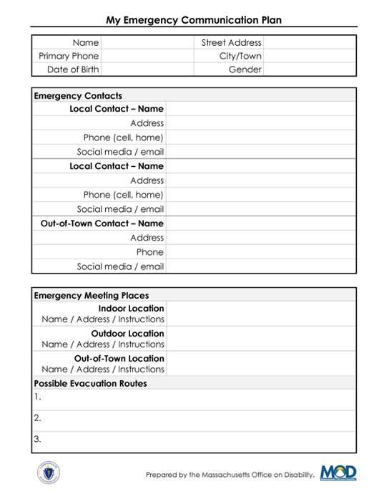
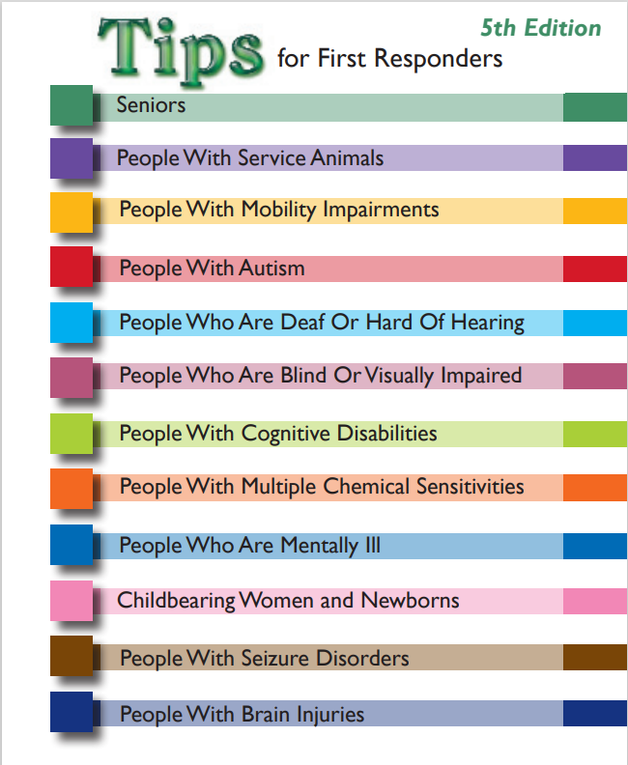
Individual Emergency Preparedness
Key resources from MOD's presentation
Supplemental Information Packet
Individual emergency communication plan worksheet
Tips for First Responders

Slide 22
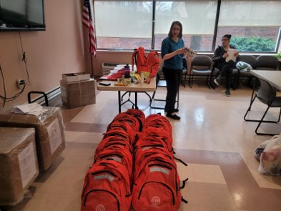
Individual Emergency Preparedness
Bring a community training to your municipality
Get in touch with Abby to schedule a training in your town or city!
Email: Abigail.Shneyder@mass.gov

Slide 23
10 minute break

Slide 24
Part 2:
Practical steps to make emergency
management inclusive

Slide 26
EMDs are not SMEs in everything
I know, I don't like to admit that either.

Slide 27
Recruit people with disabilities
Look for people who…
Have personal experience with disability / identify as a person with a disability
Have experience as a disability advocate
Can discuss cross-disability issues
Can act as a liaison to communities they work with

Slide 28
Where to recruit people from the disability community?
Town agencies / boards
Commissions on Disability
Councils on Aging
DEIA Committees
Institutional partners
Community healthcare facilities
Community Behavioral Health Centers (CBHCs)
3. Advocacy organizations
Independent Living Centers
Local disability-focused organizations

Slide 29
Let's talk about this nonsense...
"They don't know emergency management."
"We have to educate them before they can participate."
"They're the public and our plan is sensitive information."

Slide 30
Common challenges
Sometimes we get in our own way.
Grenade-dropping
Bat swinging
Impenetrable walls

Slide 31
unless

Slide 32
Let's transform those interactions into:
Same team, same mission
Keeping it respectful
Keeping it professional
Solutions-oriented discussion
Understanding each of our challenges and realities

Slide 34
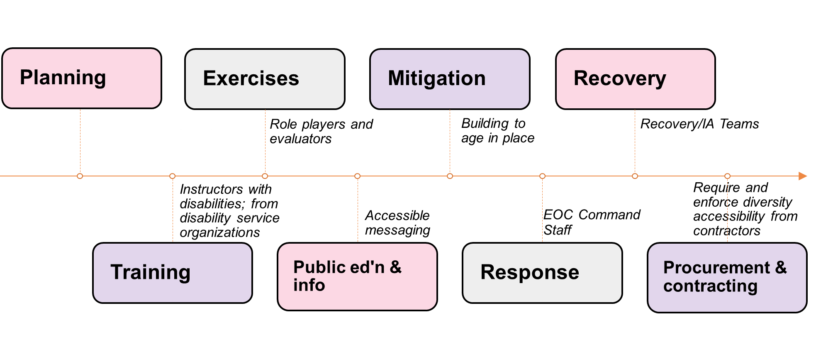
Touch Points for Inclusion in Emergency Management

Slide 35
Incorporate CMIST Framework
Use the CMIST framework to identify gaps or concerns in planning and propose solutions
C = Communication
M = Maintaining Health
I = Independence
S = Services and Support
T= Transportation

Slide 36
Incorporate CMIST Framework
Communication
Outreach to community networks that support at-risk individuals
Communication paths to people who have limited English proficiency, are Deaf/HOH, are Blind, or have low-vision
Multiple delivery methods: TV, radio, social media, internet pages, ethnic media sources
Adapted from DPH’s Public Health Planning Toolkit for
At-Risk Individuals with Access and Functional Needs

Slide 37
Incorporate CMIST Framework
Maintaining Health
Considerations for those who need assistance with daily living activities (toileting, eating, dressing)
Supplies for supporting daily living of individuals who might not be able to bring with them (feeding tubes, diapers, bandages)
Resources for determining availability of pharmacies for those who require daily medication
Adapted from DPH’s Public Health Planning Toolkit for
At-Risk Individuals with Access and Functional Needs

Slide 38
Incorporate CMIST Framework
Independence
Support / access for people with service animals
Support / access for people with mobility devices and/or assistive technology (wheelchairs, communications aids, etc)
Adapted from DPH’s Public Health Planning Toolkit for
At-Risk Individuals with Access and Functional Needs

Slide 39
Incorporate CMIST Framework
Service and Support
Resources for meeting behavioral health needs – including for needs that result of an emergency
Resources for meeting needs of those who are pregnant or nursing as well as infants and children
Adapted from DPH’s Public Health Planning Toolkit for
At-Risk Individuals with Access and Functional Needs

Slide 40
Incorporate CMIST Framework
Transportation
Mass transit needs and alternate transportation resources
Contracts and/or MOUs for transportation resources
Adapted from DPH’s Public Health Planning Toolkit for
At-Risk Individuals with Access and Functional Needs

Slide 41
Takeaways and supplemental resources

Slide 43
Key Takeaways
Be solution partners
Every person matters and is worth the effort
Think in touchpoints

Slide 44
Supplemental Resources
MOD will follow up via email
Recording of this presentation
MEMA Access & Functional Needs Resource Guide
Inclusive Emergency Management Community: free, online, resources, and more
Join 650+ others working to transform emergency management at InclusiveEM.community
DPH's Planning Toolkit for At-Risk Individuals with Access and Functional Needs
Resources from June Kailes, including checklists for inclusion
MOD's Individual Emergency Preparedness Resources

Slide 45
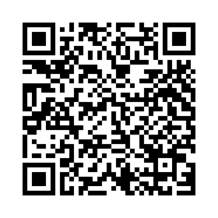
Our very own Google Drive
Notes:
MOD/MEMA Inclusive EM Resources - Google Drive

Slide 46
Get in touch!
Dawn's contact information
Abby's contact information
Dawn.Brantley@mass.gov
508-309-0619
DM me on the Inclusive EM Community!
Abigail.Shneyder@mass.gov
857-275-4655

