Slide 1
Municipal ADA Improvement Grant Program
May 19, 2025
Presented by:
Evan George, Grant Compliance Coordinator

Slide 2
Massachusetts Office on Disability
The Massachusetts Office on Disability (MOD) provides information, guidance, and training on disability-related civil rights and architectural access.
We help people understand their disability rights and obligations, how regulations apply to the specifics of their situation, and practical steps they can take to assert their rights and comply with the law.
Notes:
Focus on legal rights/obligations

Slide 3
Agenda
Grant Overview
Planning grants
Project grants
Tips to improve your score
Q&A

Slide 4
Overview
Municipal ADA Improvement Grant Program

Slide 5
What is the ADA Improvement Grant?
Founded in 2017
Reimbursement funding to municipalities for:
City-wide accessibility planning (ADA Self-Evaluation and/or Transition Plans) or
Individual projects to remove architectural or communication barriers

Slide 6
Types of grants
Planning grants
Project grants
These grants are for updating or creating a Self-Evaluation and/or Transition Plan as required under the Administrative Requirements of Title II of the ADA
These grants are for removal of architectural or communication barriers or physical/communication access improvements
Only municipal properties or municipally owned facilities are eligible

Slide 7
Eligibility
Eligible:
Massachusetts municipalities
Municipally owned properties
School districts and housing authorities
Not eligible:
Private businesses, private property, non-profit organizations, private homes, or other non-municipal properties

Slide 8
MBTA Communities Act
The receipt of grant funds is contingent upon the grantee being able to certify that it will comply with the Massachusetts General Laws, including G.L. c. 40A, § 3A, the MBTA Communities Act.
Compliance with the MBTA Communities Act is determined by the Executive Office of Housing and Livable Communities.

Slide 9
Program overview
Maximum Grant Award: $250,000
Grants can (but do not have to be) matching
Can be applied by any employee
Invoices must be dated after contract is signed and before June 30th, 2026

Slide 10
Important dates: FY26 grant
May 1 – June 13, 2025
Fall 2025
Executive Office of Administration and Finance announces awardees
Online application open
July - August 2025
Late Fall 2025
Review process begins:
Grant Selection Committee
FY25 Grant contracts issued to awarded communities

Slide 11
FY25 Grant metrics
Applications Received: 140
Applications Approved: 55
Total Amount Requested: $15 million
Total Amount Rewarded: $4.9 million

Slide 12
Required Documentation for All Grants
Designation of a Responsible Employee (ADA Coordinator)
Notice of Non-Discrimination and proof of posting
An ADA Grievance Procedure

Slide 13
1) Designation of a Responsible Employee (ADA Coordinator)
Submit via MOD’s Municipal ADA Coordinator Contact Information Form
Include this information in your application by uploading:
A screen shot of your municipality’s listing on MOD’s public listing of municipal ADA Coordinators, or
A screen shot of the confirmation email you received when you submitted the Municipal ADA Coordinator contact information form

Slide 14
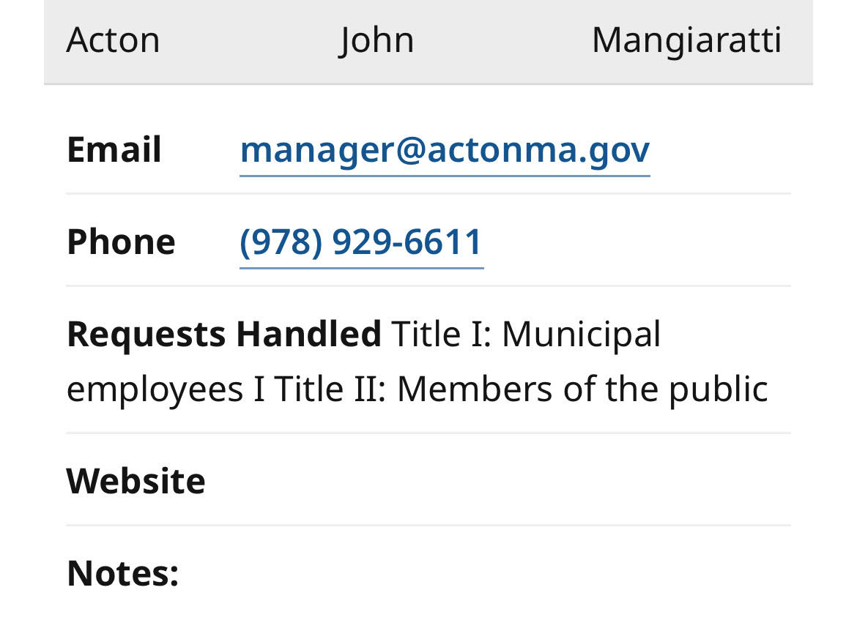
Sample Designation Posting

Slide 15
2) Notice of Non-Discrimination
Include this information in your application by uploading:
A screen shot of the non-discrimination notice posted on your municipality’s website, or
A Word of PDF file with the non-discrimination notice (see the New England ADA Center’s Sample ADA Public Notice for a template)

Slide 16
Sample Notice of Non-Discrimination

Slide 17
3) Grievance Procedure
Include this information in your application by uploading:
A screen shot of your grievance procedure from your municipality’s website, or
A Word or PDF file of the grievance procedure (see the New England ADA Center’s Sample ADA Grievance Procedure for a template)

Slide 18
Sample Grievance Procedure

Slide 19
Resources: Title II compliance
ADAActionGuide.org
Documents, forms, how to create a grievance procedure, etc.
mass.gov/MOD
Architectural Access Board (AAB) rules and regulations

Slide 20
Planning grants
Creating or updating ADA Self-Evaluation or Transition Plans

Slide 21
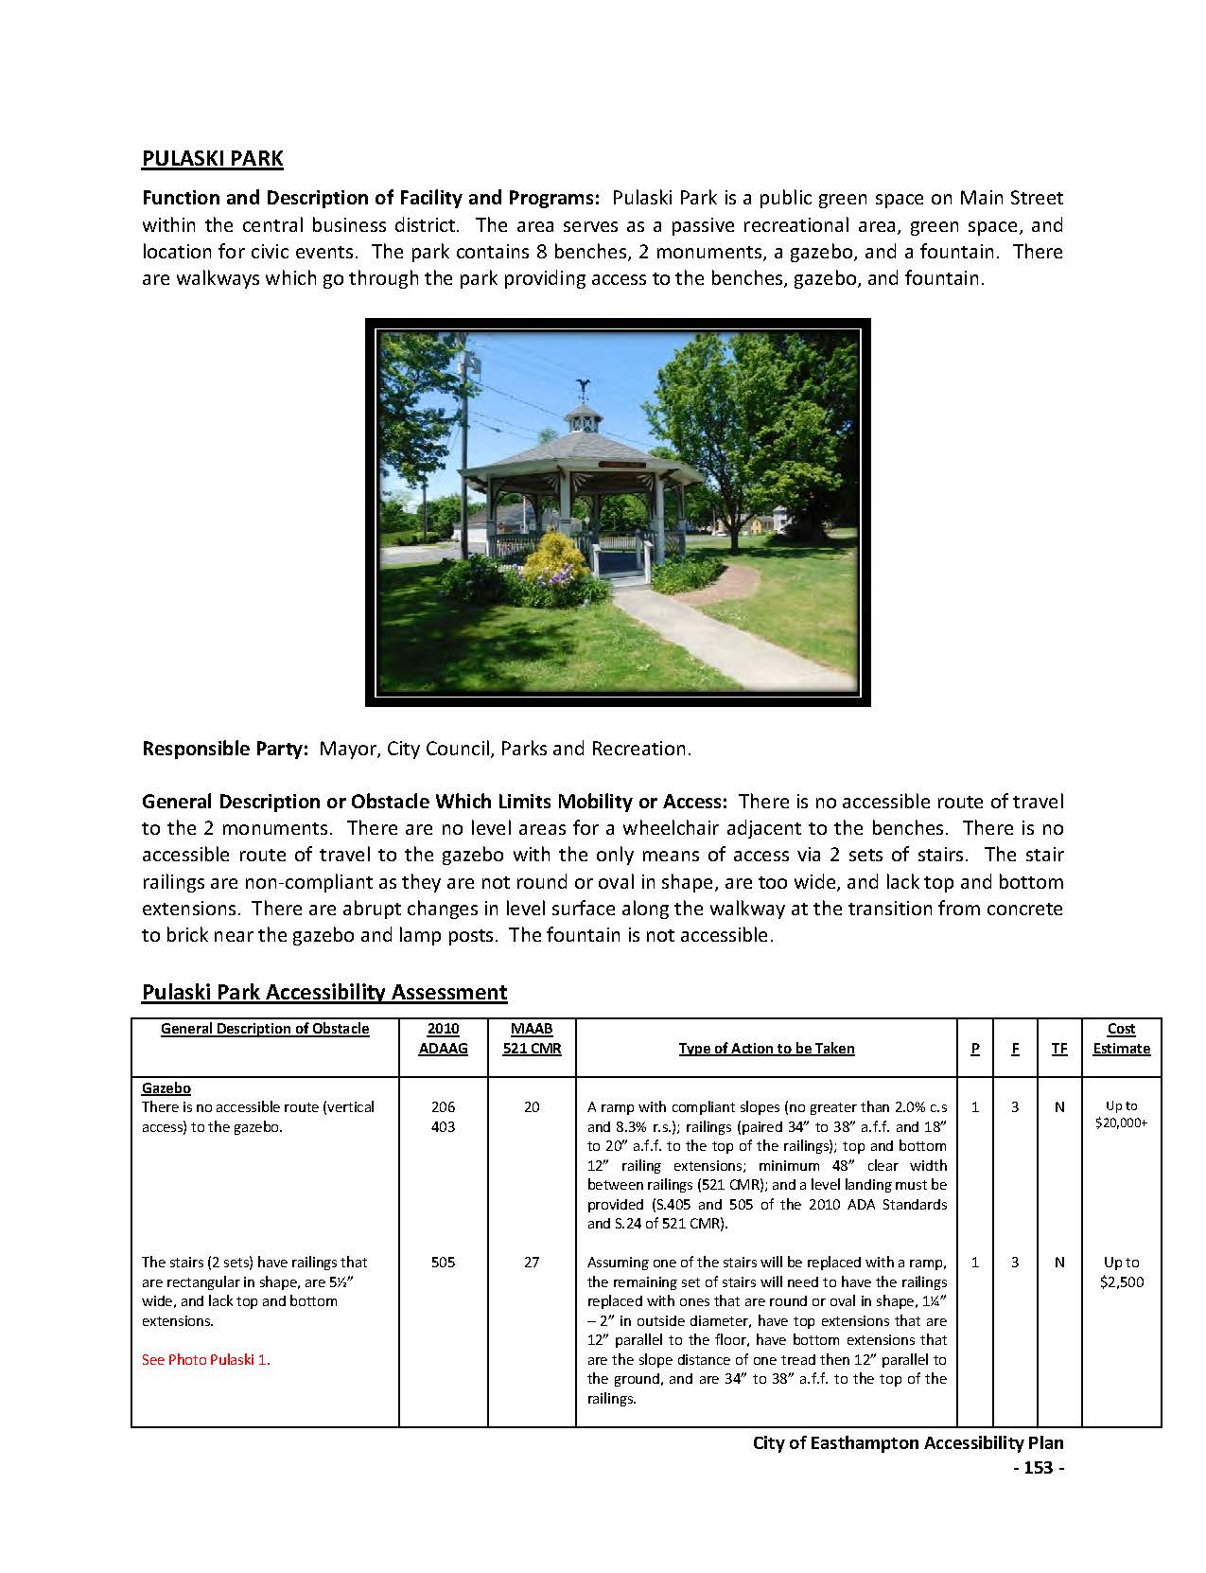
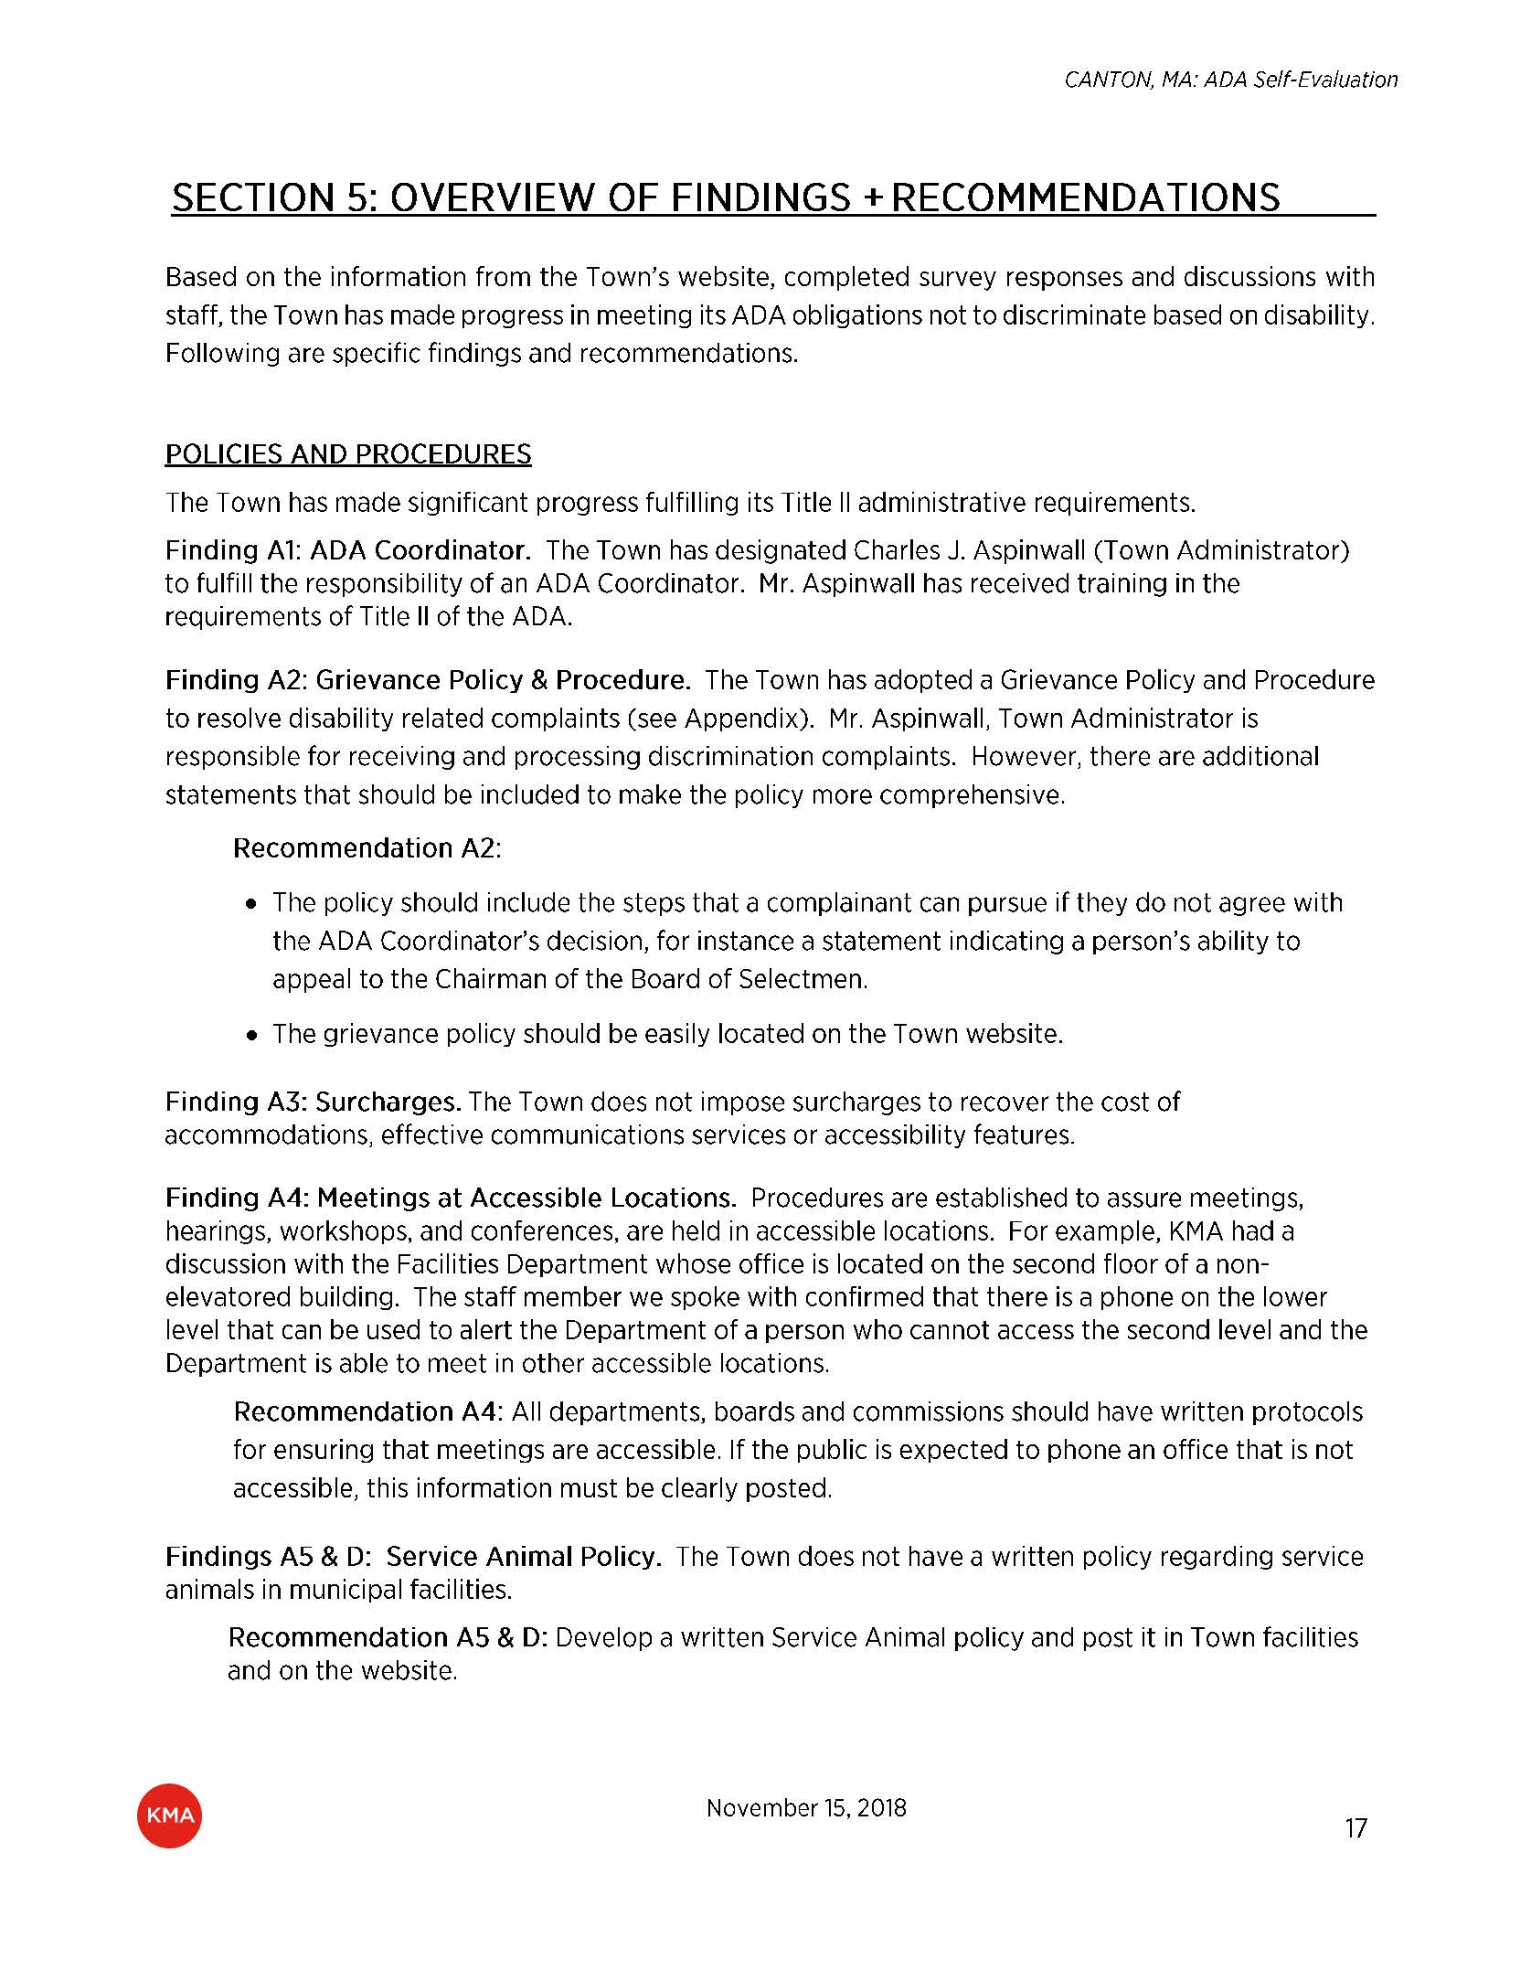
Former planning grants

Slide 22
Planning grant application

Slide 23
Grant application (zoomed in)

Slide 24
Project grants
Removing architectural and communication barriers at municipal facilities

Slide 25
Project grants: Required documentation
Same as planning grant, plus:
Self-Evaluation Plan
Transition Plan

Slide 26
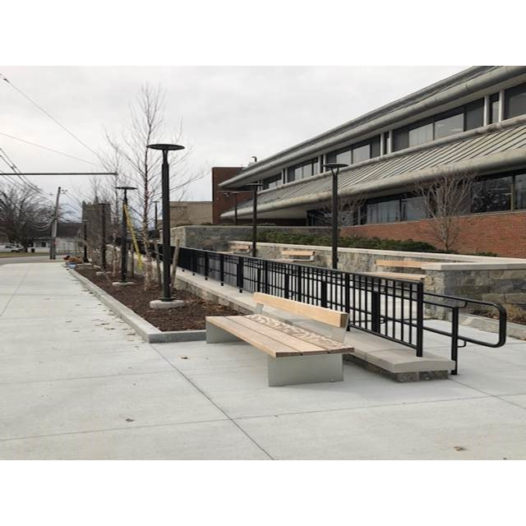
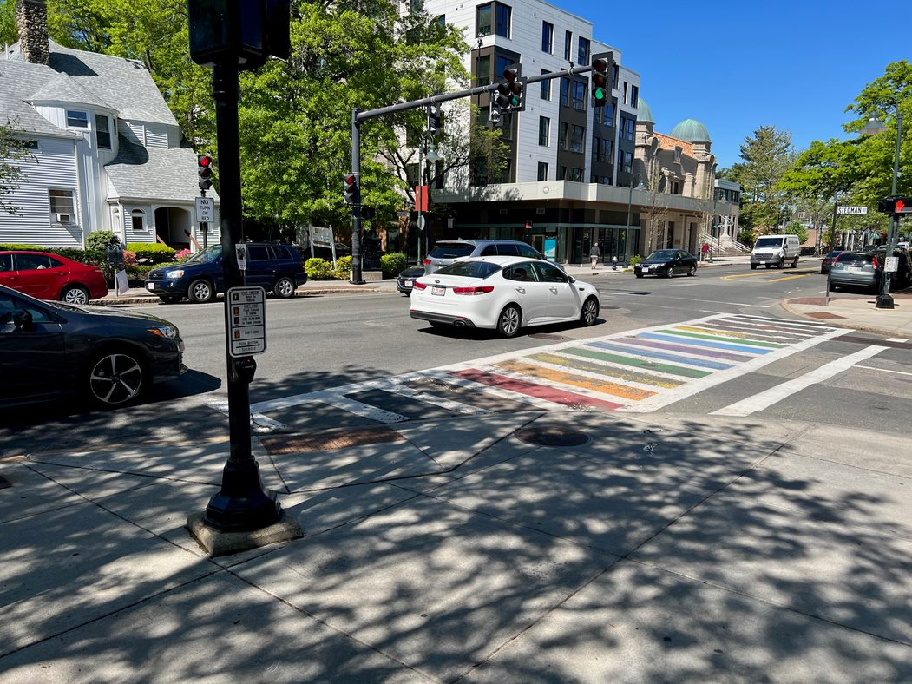
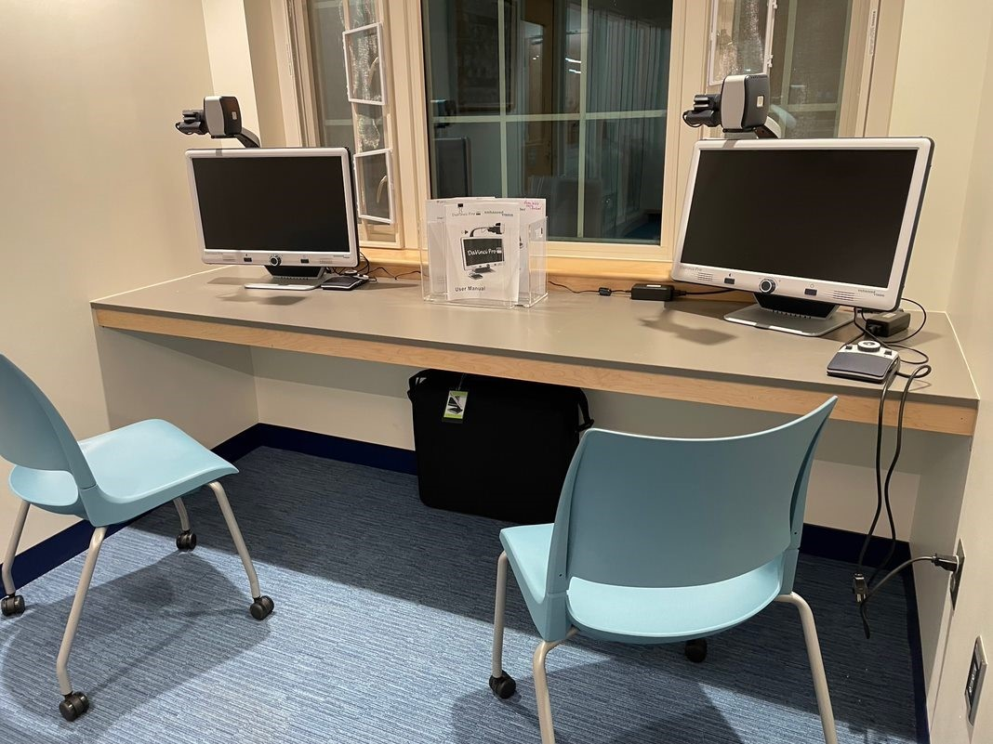
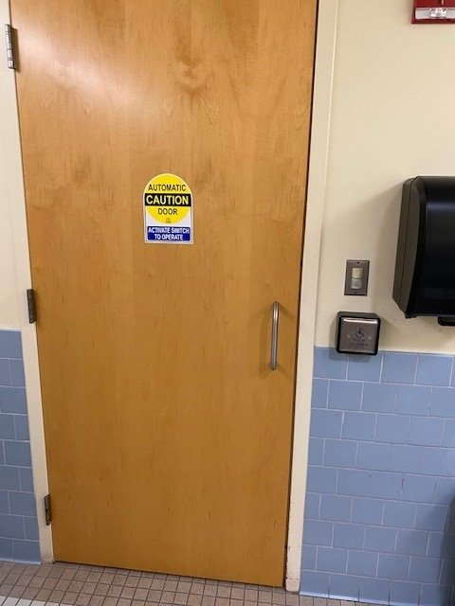
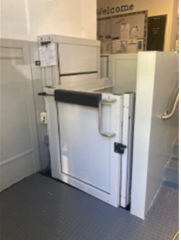
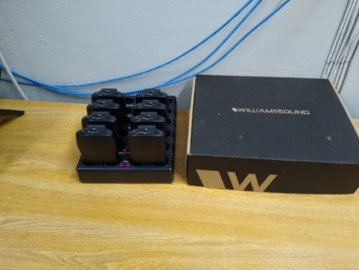
Former project grants

Slide 27
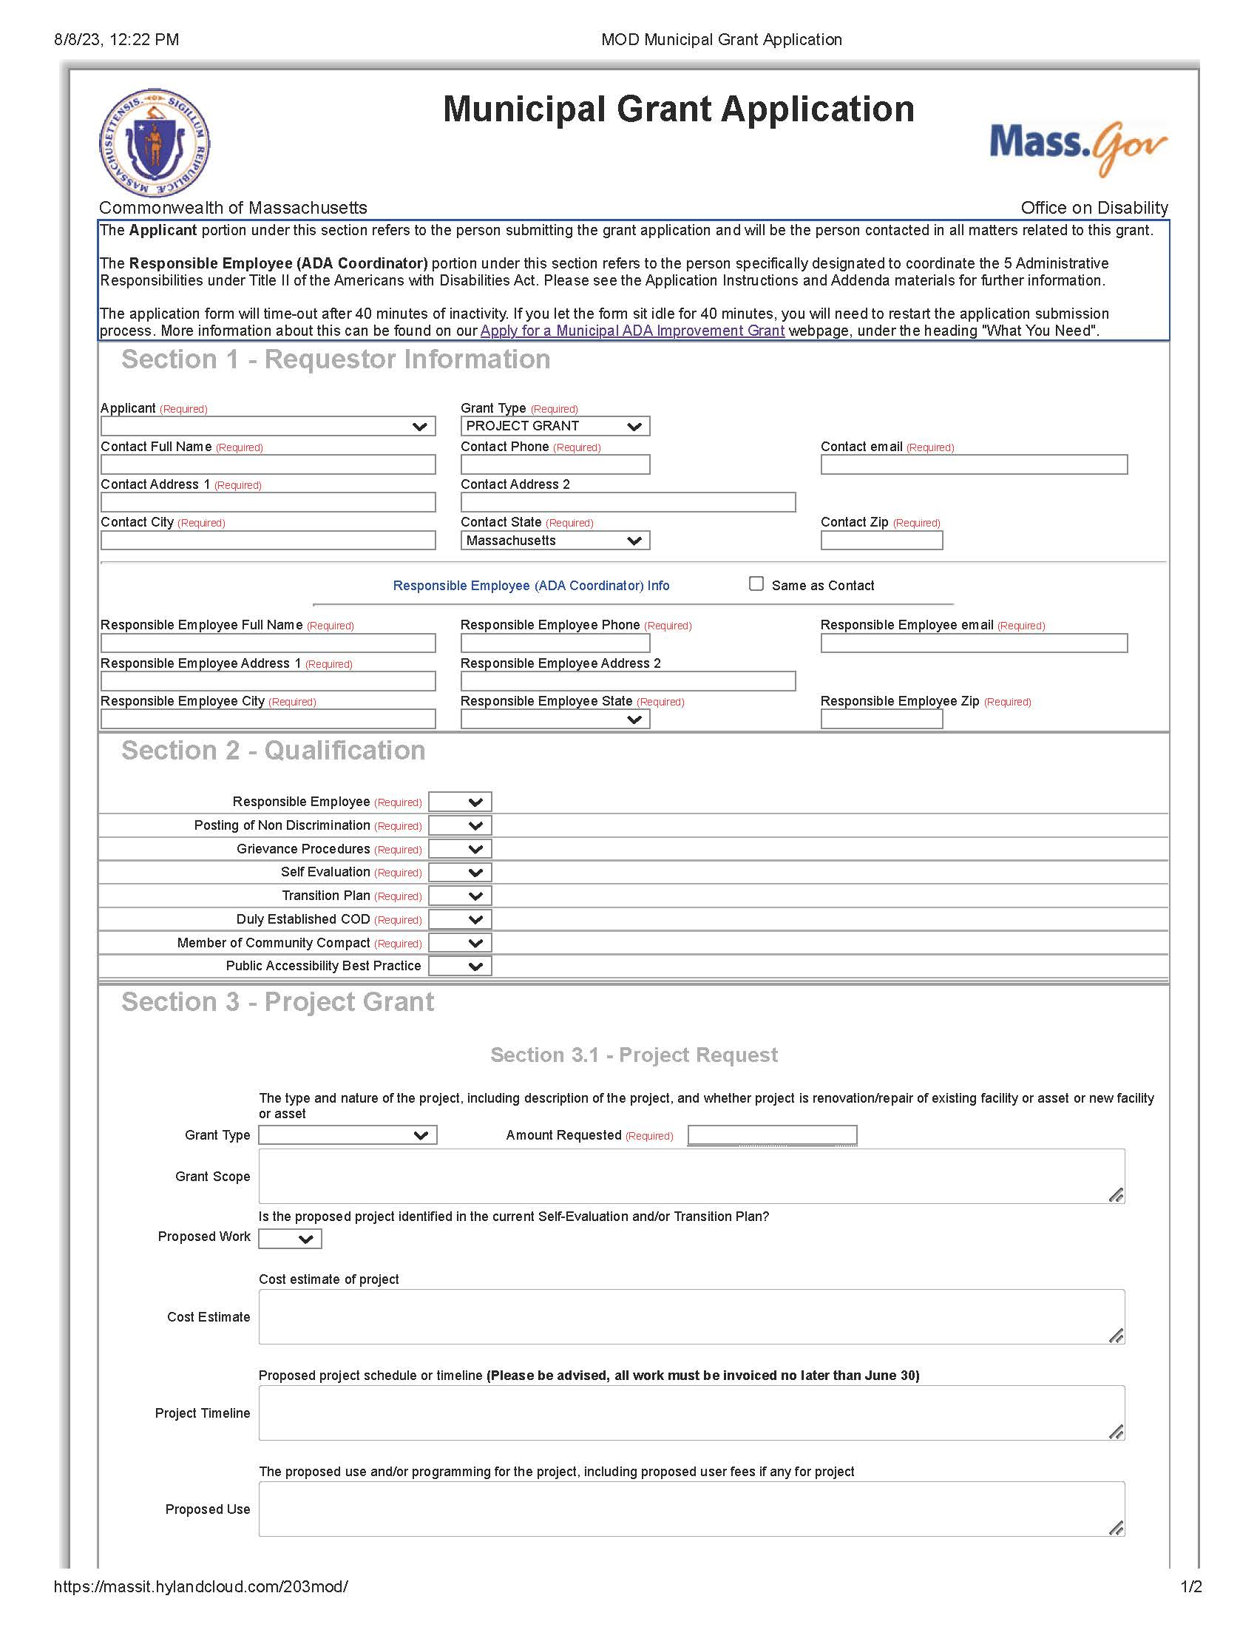
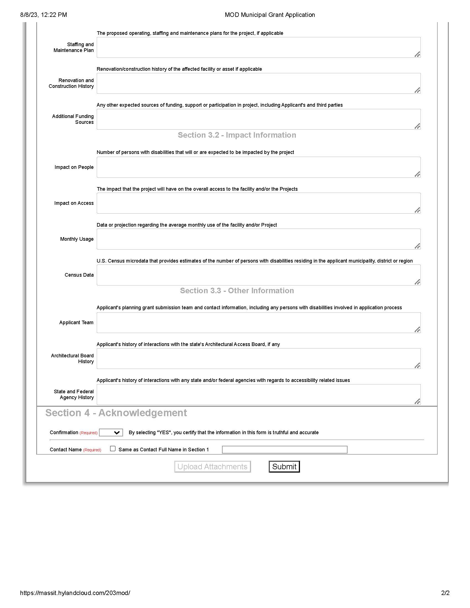
Project grant application

Slide 28
Submission tips
Once you click “Submit”, do not exit the page prior to receiving the application submission confirmation pop-up.
You will receive an email within 15 minutes confirming your application submission was received. Do not reply to the email. If you received both the confirmation screen and email, your application was successfully completed.
If you did NOT receive a confirmation email or see the appropriate screens mentioned above, your submission was unsuccessful, and you will need to resubmit.

Slide 29
Tips to improve your score

Slide 30
Scoring System
Primary Considerations:
Realistic Timeline
Outlined Cost Estimate
Project from Updated SETP
Adequate Detail Outline
Age of SETP
Secondary Considerations:
Grant History
Municipality
Innovation

Slide 31
Top 3 tips to improve your score
1
2
3
Submit multiple project grants
CCC: Public accessibility best practice
Establish a Commission on Disability

Slide 32
Community Compact Cabinet (CCC)
mass.gov/best-practices-program
Voluntary, mutual agreement entered into between the Healey-Driscoll Administration and individual cities and towns of the Commonwealth
Option to select Public Accessibility Best Practice

Slide 33
Resources for Commissions on Disability (CODs)
mass.gov/MOD/COD
Complete the COD Contact Information Form to update your contact information with MOD

Slide 34
Required Documentation for All Grants (again)
Designation of a Responsible Employee (ADA Coordinator)
Notice of Non-Discrimination and proof of posting
An ADA Grievance Procedure

Slide 35
Important dates: FY26 grant (again)
May 1 – June 13, 2025
Fall 2025
Executive Office of Administration and Finance announces awardees
Online application open
July - August 2025
Late Fall 2025
Review process begins:
Grant Selection Committee
FY25 Grant contracts issued to awarded communities

Slide 36
Contact MOD
Evan George​
Grant Compliance Coordinator​
Office: 617-727-7440 ext. 27313
Cell: 857-248-7924​
Email: Evan.George@mass.gov​
Website: mass.gov/MOD

Slide 37
Q&A

