Slide 1
Public health council
September 17, 2020
Today’s presentations are available on the mass.gov/dph website under “Upcoming Events” by clicking on the September 17 Public Health Council listing

Slide 2
Massachusetts
wIC Nutrition Program UPDATE
September 17, 2020
Rachel Colchamiro, MPH, RD, LDN, CLC
Director, Nutrition Division

Slide 3
What Does WIC Offer Families?
Nutrition and health screening and assessment
Nutrition and breastfeeding education and counseling, including breastfeeding peer counseling
Referrals to related health and social services
Monthly benefits to purchase specific nutrient-dense foods ($50 - $80 per month per participant)
Checks to spend at farmers’ markets

Slide 4
WIC Reach
Nationally, approximately 6.3 million women, infants and children receive WIC services each month
Approximately half of all babies born in the US participate in WIC during the first year of life; about 43% of babies born in Massachusetts accessed the program in 2018
In FY20, nearly 185,000 unique individuals accessed WIC in MA
31 local programs operate over 114 sites statewide

Slide 5
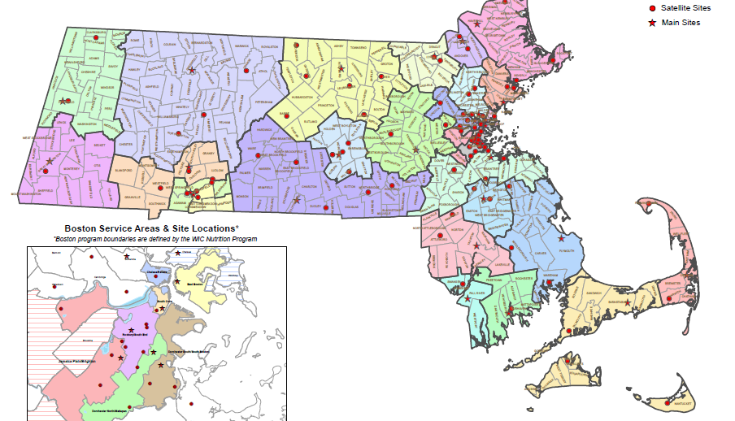
WIC Clinic Locations

Slide 6
What Happens at a WIC Certification Appointment?
Eligibility Determination
Food Security Screening
Weight and Height Evaluation
Blood Test for Iron (Hgb/Hct)
Immunization Screening
Health Screening
Nutrition/Breastfeeding Assessment and Counseling
Explanation and Issuance of Benefits
Referrals

Slide 7
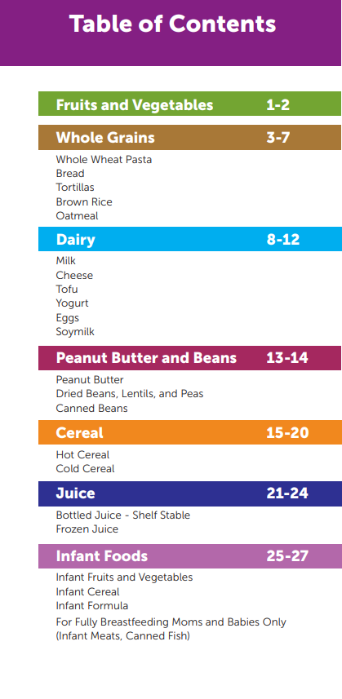
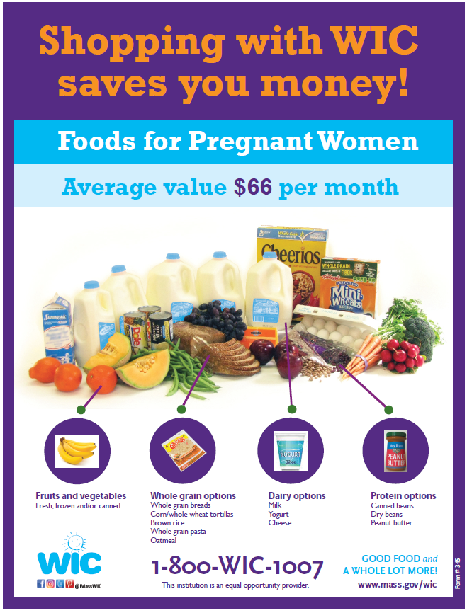
WIC Food Benefits

Slide 8
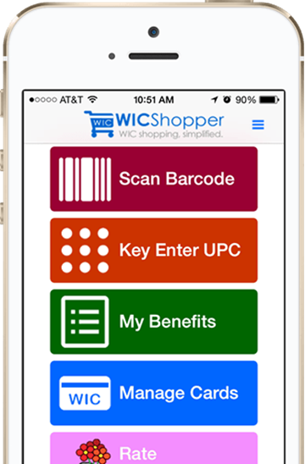
WIC Technology

Slide 9
COVID-19 Waivers Granted by USDA – 3/2020
Physical presence at certification – allows all WIC certification/recertification appointments to be conducted by phone
Remote benefits issuance – allows staff to issue foods to participants’ WIC Card accounts remotely
Medical documentation – allows staff to issue special formula to existing participants without renewal documentation and allows staff to collect medical approval from providers by phone
Separation of duties – allows a single staff person to conduct all components of the WIC certification and benefit issuance without requiring reporting or additional quality assurance activities

Slide 10
COVID-19 Waivers Granted by USDA – 3/2020, cont.
Whole grains/whole wheat bread – allows MA WIC to issue loaves of bread larger (20 ounce loaves) than the amount allowed in WIC regulations (16 ounce loaves)
Mandatory minimum requirements – allows MA WIC to relax mandatory minimum requirements at the retailer to deal with potential food shortages; not implementing this as we did not see any single WIC food categories with consistent shortages. We did stop our inventory audits because of social distancing and are instead monitoring redemptions and dealing with individual store issues as they arise
Local agency monitoring – allows MA WIC to conduct all required audits of local programs remotely

Slide 11
Additional MA WIC Flexibilities/Strategies
Expanded WIC food package with changes allowed by current regulations - added additional sizes of eggs to minimize challenges with stocking shortages and additional breakfast cereals and yogurt to maximize options for participants
Authorized self-checkout lanes at Walmart, Shaw’s, Star Market, and Price Rite
Increased nutrition education material availability on website and WICShopper app
Expansion of WICSmart online education
Update of data sharing agreement with DTA/SNAP

Slide 12
WIC Participation Trends 2012 - 2020

Slide 13
MA WIC Digital Marketing Campaigns
https://www.youtube.com/watch?v=O4nnmXBu6is

Slide 14
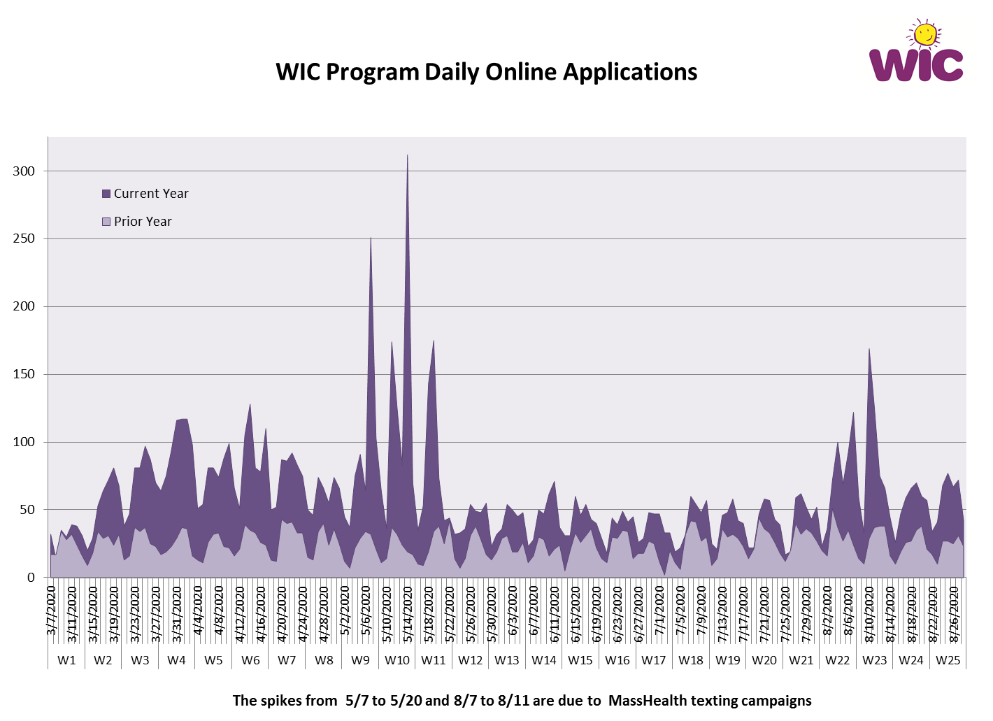

Slide 16
MA WIC Caseload and Participation Trends

Slide 17
Participant Satisfaction Survey – July 2020

Slide 18
Participant Satisfaction Survey – July 2020

Slide 19
Participant Satisfaction Survey – July 2020

Slide 20
Participant Satisfaction Survey – July 2020

Slide 21
Thank You!

Slide 22
Influenza Immunization
Update
Public Health Council
September 17, 2020
Pejman Talebian, Director
Immunization Division

Slide 23
Massachusetts leads the nation
Childhood Flu Vaccination Rates
2018-19 Influenza Season
Source: 2018-19 National Immunization Survey (NIS) – Flu

Slide 24
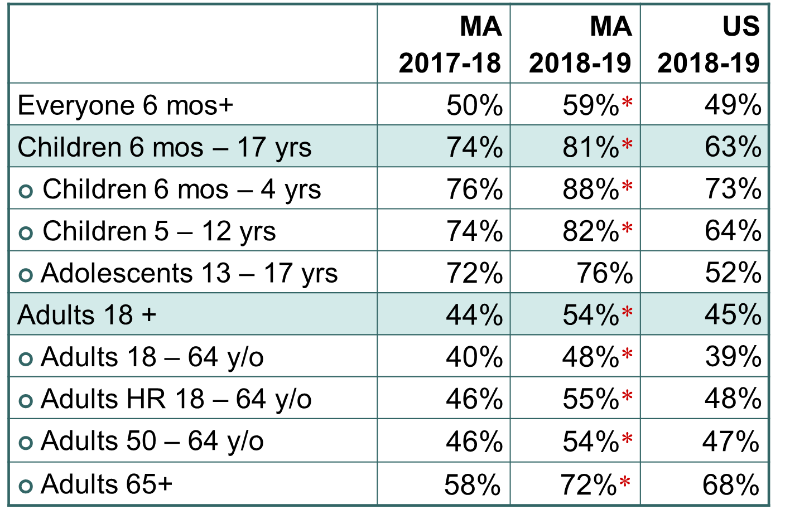
Flu Vaccination Rates
*Statistically significant change
Source: 2017-18 and 2018-19 National Immunization Survey (NIS) – Flu, and BRFSS

Slide 25
Flu Vaccination Rates - race and ethnicity
Seasonal Influenza Vaccination Rates in MA in >6 months, by Race/Ethnicity, 2018-2019 Season
 | MA | US | Ranking
White | 59% | 51% | 4
Black | 58% | 45% | 6
Hispanic | 62% | 46% | 4
Other | 58% | 47% | 3
Source: NIS-Flu and BRFSS

Slide 26
Flu vaccination rates - health care workers
The current Healthy People 2020 goal for influenza vaccination among healthcare personnel is 90%.
Vaccination rates in acute care hospitals, nationally and in MA have surpassed 90% and should be congratulated.
We continue to work closely with healthcare facilities to encourage health care worker vaccination.

Slide 27
Flu season
2019-2020 flu season:
40,698 laboratory-confirmed cases reported to DPH
55,000-60,000 emergency department visits for flu
7,000-8,000 hospitalizations

Slide 28
Flu vaccine supply in Massachusetts
DPH has purchased approximately 900,000 doses annually
This year we will receive 1.156M doses
A 28% increase this season
Notes:
we are confident there will be plenty of flu vaccine universally available for all pediatric practices to handle the potential increase in demand from the new requirement.

Slide 29
Flu vaccination during COVID-19
Flu vaccine is even more important now:
Flu and COVID-19 have overlapping symptoms and signs
Flu and COVID-19 are managed differently in terms of treatment and isolation
Patients with ILI must be seen, evaluated and tested for both
Some patients can be infected by both flu and SARS-CoV2
High levels of flu vaccination will prevent illness AND reduce impact on healthcare facilities, resources, and staff

Slide 30
New Student Flu Immunization Requirement
All students
Childcare attendees ≥6 months of age
Kindergarten – Grade 12
Post-secondary Institutions
Receipt of 1 dose of influenza vaccine for the current flu season by December 31st
Those entering between January 1 – March 31st must have received a dose of flu vaccine for school entry
Exemptions – medical or religious

Slide 31
Support from Massachusetts Pediatricians

Slide 32
Support from Massachusetts Medical Society Office of Health Equity
32

Slide 33
Editorial support

Slide 34
Other required vaccines
2019-20 MA School Requirements
Childcare (≥2 years):
1-4 Hib
4 DTaP
3 Polio
3 HepB
1 MMR
1 Varicella
Kindergarten – Grade 6:
5 DTaP
4 Polio
3 HepB
2 MMR
2 Varicella
Post-Secondary:
1 Tdap
3 HepB
2 MMR
2 Varicella
1 MenACWY (full-time students ≤21 years)
Grade 7 – Grade 12:
1 Tdap
4 Polio
3 HepB
2 MMR
2 Varicella

Slide 35
2019-20 MA School Requirements
For Kindergarten – Grade 6
DTaP | 5 doses
Polio | 4 doses
Hepatitis B | 3 doses; laboratory evidence of immunity acceptable
MMR | 2 doses; laboratory evidence of immunity acceptable
Varicella | 2 doses; a reliable history of chickenpox* or laboratory evidence of immunity acceptable

Slide 36
2019-20 MA Immunization Surveys
Kindergarten Imm Survey Results
5 DTaP/ DTP | 97.2%
4 Polio | 97.3%
2 MMR | 97.3%
3 Hep B | 98.0%
2 Varicella | 96.8%
History of chickenpox disease | 0.2%
Immunity to chickenpox | 97.0%
Series Complete | 95.9%
Medical Exemptions | 0.23%
Religious exemptions | 1.10%
Survey childcare, Kindergarten, Grade 7 and college
1144/1369 Kindergartens surveyed responded
Imm rates for childcare, Kindergarten and Grade 7 are similar, with most rates consistently >95%
College rates are lower, approximately 85-90%, with Men ACWY rates lower
Exemptions rates are slightly lower for childcare and Grade 7

Slide 38
Next Meeting:
October 14, 2020

