Slide 1
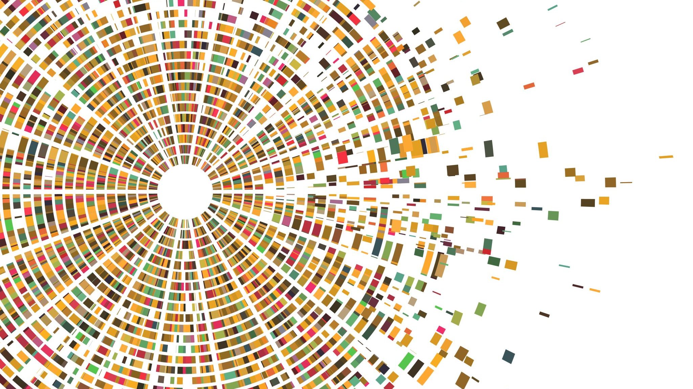
Restrictive Housing and Prison Order
RHOC Subcommittee – Effects of Rh on Prison Order and Control

Slide 2
Restrictive Housing Research
Existing Research on Restrictive Housing and Institutional Order
Existing Research on Restrictive Housing and Mental Health

Slide 3
Prior Research
Administrative segregation may affect prison order through three mechanisms (Mears & Reisig, 2006).
First, it may incapacitate inmates by removing them from the general prison population, thereby reducing their opportunity to engage in serious misconduct.
Lack of research in the area of incapacitation and reduced opportunity and prison safety
Second, administrative segregation may deter inmates from serious misconduct because of its promise for swift, certain, and severe punishment.
Third, segregation may normalize facilities by removing troublesome inmates from the general prison population”.
Prior Research Indicates the use of restrictive housing to improve prison safety are inconsistent:
sometimes improving order (Sundt, Castellano, & Briggs, 2008)
sometimes making it worse (Briggs, Sundt, & Castellano, 2003; Labracque, 2015, Wooldredge & Steiner, 2015),
bust mostly having no effect (Briggs et al, 2003;, Huebner, 2003, Sundt, et al., 2008,; also Lebrecque, 2015; Morris, 2015).
Steiner and Cain did a review of 16 studies of the effects of segregation on offenders’ behavior and found the lack of research on this topic prevents any determination of whether segregation deters, amplifies, or has no effect on offenders’ subsequent misbehavior (Steiner & Cain, 2016)
…there is a notable lack of research on the impact of restrictive housing on behavioral outcomes in
Prison
Sundt, J. (2016). The Effect of Administrative Segregation on Prison Order and Organizational Culture. Restrictive Housing in the U.S.: Issues, Challenges, and Future Directions. Washington, DC:, National Institute of Justice, U.S. Department of Justice
Lebrecque & Smith (2019) Criminal Justice and Behavior, Vol.46, No. 10, pg. 1445

Slide 4
Competing Perspectives
Deterrence Theory
Restrictive Housing is an unpleasant experience that should deter inmates from reoffending increasing safety, order and control. The expectation that non-compliance with institutional rules resulting in placement in RH should deter behavior
Deprivation Theory, Social Bonds Theory, Labeling Theory, Strain Theory, Social Learning Theory, and Defiance Theory
Harsh conditions of Restrictive Housing increases criminal behavior and causes mental health issues through weakened social bonds, negative labels, few rehabilitative opportunities...from this perspective RH leads to more violation of institutional rules
Behavior Deep Freeze Theory
Restrictive Housing has no effect on inmate behavior. Their behavior is based on previously held values and motivations
Lebrecque & Smith (2019) Criminal Justice and Behavior, Vol.46, No. 10, pg. 1447

Slide 5
MA DOC Data– RH Admissions – 2019 Biannual
Restrictive Housing Single Versus Multiple Admissions
 | January - June 2019 Based on 1,395 Inmates |  | July - December 2019 Based on 1,373 Inmates
Admission Types | RHU Count | Percent | RHU Count | Percent
Multiple Admissions | 1,176 | 55% | 1,272 | 59%
Single Admissions | 944 | 45% | 887 | 41%
Total Admissions | 2,120 | 100% | 2,159 | 100%
Data is based on inmates who had one or more admission date(s) within the reporting time frame regardless of their release date. These counts include inmates with a single admission as well as inmates with multiple admissions, who were admitted and discharged during the reporting time frame and then re-admitted during the reporting period.

Slide 6
Restrictive Housing and Managing Gangs
A survey by the Urban Institute of 600 prison wardens showed that 83 percent of respondents endorse the use of RH for gang affiliates and gang leaders.
Removing gang members from the general population controls both violent and nonviolent misconduct, ‘soothes tensions’
Reduction in violations (Arizona), reduction in homicide and assault (Texas)
Gang leader segregation/transfer not effective (Texas); gang affiliates leaving RH ‘fared worse’ than non-affiliates by engaging in misconduct upon return to gen pop (Ohio)
Some aggregate-level studies –
Indicate using Restrictive Housing units to manage gang inmates reduces violence and other disobedience outcomes within state prison systems
Other studies have had mixed results
Pyrooz D.C. (2018). Using Restrictive Housing to Manage Gangs in U.S. Prisons. Washington, DC:, National Institute of Justice, U.S. Department of Justice
Lebrecque&Smith (2019) Criminal Justice and Behavior, Vol.46, No. 10, pg. 1447

Slide 7
Restrictive Housing Reform
There is cross-national evidence that supports reforming the use of RH
Colorado DOC:
Reassigned those in long term segregation to step-down
Developed a sanction matrix narrowing list of violations punishable by segregation
Eliminated indeterminate sentences to administrative segregation
Reports no increase of assaults on staff by inmates since these reforms have been implemented
Washington State DOC:
reduce restrictive housing population and created productive activities for those who remain
Modified sanction guidelines
Expanded cognitive behavioral and skill-building programs
Report less violence and fewer staff uses of force at the prisons with intensive management units
U.S Department of Justice, Report and Recommendations Concerning the Use of Restrictive Housing (January, 2016), 80 - 81

Slide 8
Restrictive Housing Reform
Virginia DOC: Red Onion State Prison
Cultural Change
Cognitive Treatment Officers
Segregation Step-Down Program
Reports that there has been a 68 percent reduction in the number of security S (maximum security administrative segregation level inmates, a 78 percent reduction in incident reports, a 91 percent decrease in inmate grievances, and an 86 percent reduction in informal complaints”
Hampden County HOC
Increased use of alternatives to using disciplinary segregation
New programming and positive reinforcement in restrictive housing
Step-Down Units
No reported increase in assaults in either segregation unit or the general population
U.S Department of Justice, Report and Recommendations Concerning the Use of Restrictive Housing (January, 2016), 82 - 83

Slide 9
Competing perspectives on the expected effects restrictive housing has on inmate behavior and prison order
Lack of research with different definitions, methodologies and findings
Some positive outcomes regarding RH reform noted in the DOJ report.

Slide 10
Restrictive Housing and Mental Health
RHOC Subcommittee – Prison Order and Control

Slide 11
Variation Among RH Experiences
To be sure, each person experiences RH differently.
Preexisting disabilities and other conditions, the length of the confinement, and the amount of control the prisoner perceives that they have over whether and how they can end it all effecting their overall experience.
Personal differences between individual in RH also account for how they manifest the strain caused by restrictive housing, if at all, and the duration of those external manifestations.
Moreover, there is variation in how different correctional systems utilize restrictive housing.

Slide 12
Inherent Risks of RH Conditions
Despite the variation in individual experiences, it is well understood that isolation from socially and psychologically meaningful contact and perceptual stimulation – static characteristics of restrictive housing settings – may have foreseeable deleterious effects on an individual’s mental health and overall wellbeing.
See, e.g., Craig Haney, Restricting the Use of Solitary Confinement, 1 Ann. Rev. Criminology 285 (2018) (collecting studies); Dana G. Smith, Neuroscientists Make a Case Against Solitary Confinement, Sci. Am. (Nov. 9, 2018); Carol Schaeffer, “Isolation Devastates the Brain”: The Neuroscience of Solitary Confinement, Solitary Watch (May 11, 2016); See Terry Kupers, Isolated Confinement: Effective Method for Behavior Change or Punishment for Punishments Sake?, Routledge Handbook of Int'l Crime & Just. Stud., 5-6 (2013); Stuart Grassian, Psychiatric Effects of Solitary Confinement, 22 Wash. U. J.L. & Pol’y 325 (2006); Peter Scharff Smith, The Effects of Solitary Confinement on Prison Inmates: A Brief History and Review of the Literature, 34 Crime & Just. 441 (2006).

Slide 13
Recorded Psychological Disturbances Experienced by People in RH Conditions
Studies going back many years have catalogued a broad range of psychological disturbances among people in RH, including individuals without a prior history of mental illness: anxiety, panic, depression, post traumatic stress, cognitive dysfunction, confusion, memory loss, paranoia, psychosis, auditory and visual hallucinations, stimuli hypersensitivity, irritability, aggression, suicidal ideation, self harm.
See, e.g., Position Statement: Solitary Confinement (Isolation), National Commission on Correctional Health Care (April 2016); Prisons and Health, World Health Organization (2014); Stuart Grassian, Psychiatric Effects of Solitary Confinement, 22 Wash. U. J.L. & Pol’y 325 (2006); Peter Scharff Smith, The Effects of Solitary Confinement on Prison Inmates: A Brief History and Review of the Literature, 34 Crime & Just. 441 (2006); Craig Haney, Mental Health Issues in Long Term Solitary and “Supermax” Confinement, 49 Crime & Delinq. 124 (2003).

Slide 14
Study of Isolated Prisoners at MCI-Cedar Junction:
This 1983 study of isolated inmates at MCI-Cedar Junction (“Walpole”) provides a record from within the Commonwealth of the prevalence of psychopathology in solitary confinement. In the study, Dr. Grassian found:
Two-thirds of the prisoners interviewed exhibited “hyperresponsivity to external stimuli.”
Two-thirds suffered from “massive free-floating anxiety,” while nearly half experienced obsessive thoughts like “primitive aggressive fantasies” and “persecutory fears.”
Half of the interviewed inmates suffered from “difficulties with thinking, concentration, and memory,” with a quarter reporting “acute confusional states.”
Half had experienced “hallucinations,” such as “hearing voices,” and “perceptual distortions,” like seeing “[t]he cell walls start wavering.”
Stuart Grassian, Psychopathological Effects of Solitary Confinement, 140 Am. J. Psychiatry 1450, 1453 (1983).

Slide 15
Recorded Physiological Effects Experienced by People in RH Conditions
Physiological symptoms associated with living in isolative conditions of RH, even for a short period of time, include insomnia, headaches, lethargy, dizziness, heart palpitations, appetite loss, weight loss, severe digestive problems, diaphoresis, back pain, joint pain, deteriorated vision, shaking, chills, and aggravation of preexisting medical problems.
Neuroscientists posit that stress of RH conditions can create changes in the brain, particularly an area of the brain important for emotion regulation and memory.
See, e.g., Dana G. Smith, Neuroscientists Make a Case Against Solitary Confinement, Sci. Am. (Nov. 9, 2018); Carol Schaeffer, “Isolation Devastates the Brain”: The Neuroscience of Solitary Confinement, Solitary Watch (May 11, 2016); Position Statement: Solitary Confinement (Isolation), National Commission on Correctional Health Care (April 2016); Prisons and Health, World Health Organization (2014); Carnagie Fujio et al., Buried Alive: Solitary Confinement in the U.S. Detention System, Physicians for Human Rights (April 2013); Stuart Grassian, Psychiatric Effects of Solitary Confinement, 22 Wash. U. J.L. & Pol’y 325 (2006); Peter Scharff Smith, The Effects of Solitary Confinement on Prison Inmates: A Brief History and Review of the Literature, 34 Crime & Just. 441 (2006); Craig Haney, Mental Health Issues in Long Term Solitary and “Supermax” Confinement, 49 Crime & Delinq. 124 (2003).

Slide 16
Recent Studies Have Shown a Correlation between RH Conditions and…
Development and exacerbations of mental health conditions
Based on a cohort of 119 participants, placement in RH conditions was significantly associated with positive screenings for PTSD symptoms. B.O. Hagan, et al., History of Solitary Confinement Is Associated with Post-Traumatic Stress Disorder among Individuals Recently Release from Prison, J. Urban Health 95 (2018)
Hypertension
California prisoners between the ages of 27 and 45 in RH conditions experienced a 31% higher hypertension prevalence when compared to males housed in supermax prison facilities, where out of cell time is already limited to about 2 hours per day. As a result, study authors cited a $155 million increase in future healthcare costs for people placed in RH settings and drastically worse quality of life. B.B. Williams, et al., The Cardiovascular Health Burdens of Solitary Confinement, JGEN INTERN MED (2019).
Increased rates of morbidity and reincarceration after release
With a cohort of nearly 300,000 of South Carolina prisoners from 2000 to 2015, showed that, in the first year post-release, individuals held in RH conditions were more likely to die post-release, primarily by suicide and homicide. Within two weeks of release, data showed that those housed in solitary confinement were more likely to die of an opioid overdose or be incarcerated again. Lauren Brinkley-Rubenstein, et al., Association of Restrictive Housing During Incarceration with Mortality After Release, JAMA Network Open (2019).

Slide 17
Recognition by Additional International Sources:
Examples of international sources recognizing the link between RH conditions poor health outcomes include:
Istanbul Statement on the Use & Effects of Solitary Confinement, prepared by the International Psychological Trauma Symposium comprised of experts from around Europe:
It has been convincingly documented on numerous occasions that solitary confinement may cause serious psychological and sometimes physiological ill effects.3 Research suggests that between one third and as many as 90 per cent of prisoners experience adverse symptoms in solitary confinement. A long list of symptoms ranging from insomnia and confusion to hallucinations and psychosis has been documented. Negative health effects can occur after only a few days in solitary confinement, and the health risks rise with each additional day spent in such conditions. Individuals may react to solitary confinement differently. Still, a significant number of individuals will experience serious health problems regardless of the specific conditions, regardless of time and place, and regardless of pre-existing personal factors.
Istanbul Statement at 2. Int'l Psychol. Trauma Symp., Istanbul Statement on the Use & Effects of Solitary Confinement, 2 (Dec. 9, 2007).
U.N. Special Rapporteur on torture and other cruel, inhuman or degrading treatment or punishment Nils Melzer reported in 2020 regarding the restrictive housing practices routinely used in US correctional facilities:
"These practices trigger and exacerbate psychological suffering, in particular in inmates who may have experienced previous trauma or have mental health conditions or psychosocial disabilities or psychosocial disabilities…The severe and often irreparable psychological and physical consequences of solitary confinement and social exclusion are well documented and can range from progressively severe forms of anxiety, stress, and depression to cognitive impairment and suicidal tendencies…This deliberate infliction of severe mental pain or suffering may well amount to psychological torture.
See United States: prolonged solitary confinement amounts to psychological torture, says UN expert, UNHCHR (February 28, 2020).
Time in RH Conditions Is Linked to Psychological Disturbances and Physiological Harm

